Slide 1
March 1, 2023

Slide 2

Massively parallel computing with MPI in Python
A Reproducible Research Workshop
Simon Stone
Research Data Services
Dartmouth College

Slide 3
About the Reproducible Research Group
Joint venture of Research Computing @ ITC and Research Data Services @ Library
Consult with experts on
research data management,
data visualization,
biomedical research support,
spatial data and GIS,
high performance and research computing,
statistical analysis,
economics and social sciences data
Meet the people on campus that support your reproducible research lifecycle
Engage in community discussions to learn from other researchers on campus
Attend a workshop to learn practical tools and tips

Slide 4
About Research Data Services
Research Data Management
Data Management Plans (DMPs) for sponsored projects
Finding and using 3rd party data
Collection and cleaning of data
Organization and documentation
Publishing and Repositories
Data Analysis/Visualization
Textual, numeric, spatial data
Reproducible research workflows
Scripting in R: tidyverse core package (i.e. ggplot, dplyr, tydr, tibble, etc.)
Scripting in Python: NumPy, SciPy, Pandas, Scikit-learn, Matplotlib, Seaborn, (OpenCV, PyTorch, TensorFlow, Tesseract, NLTK, etc.)
Computational Scholarship
Computational project planning
Collections as Data
Storytelling with data and visualizations
Text and data mining
Digital Humanities support
Computational Pedagogy

Slide 5
Work with us
ResearchDataHelp@groups.dartmouth.edu
Jeremy Mikecz Research Data Science Specialist jeremy.m.mikecz@dartmouth.edu dartgo.org/jeremyappts | Simon Stone Research Data Science Specialist simon.stone@dartmouth.edu dartgo.org/meetwithsimon
Lora Leligdon Head of Research Data Services lora.c.leligdon@dartmouth.edu dartgo.org/lora

Slide 6
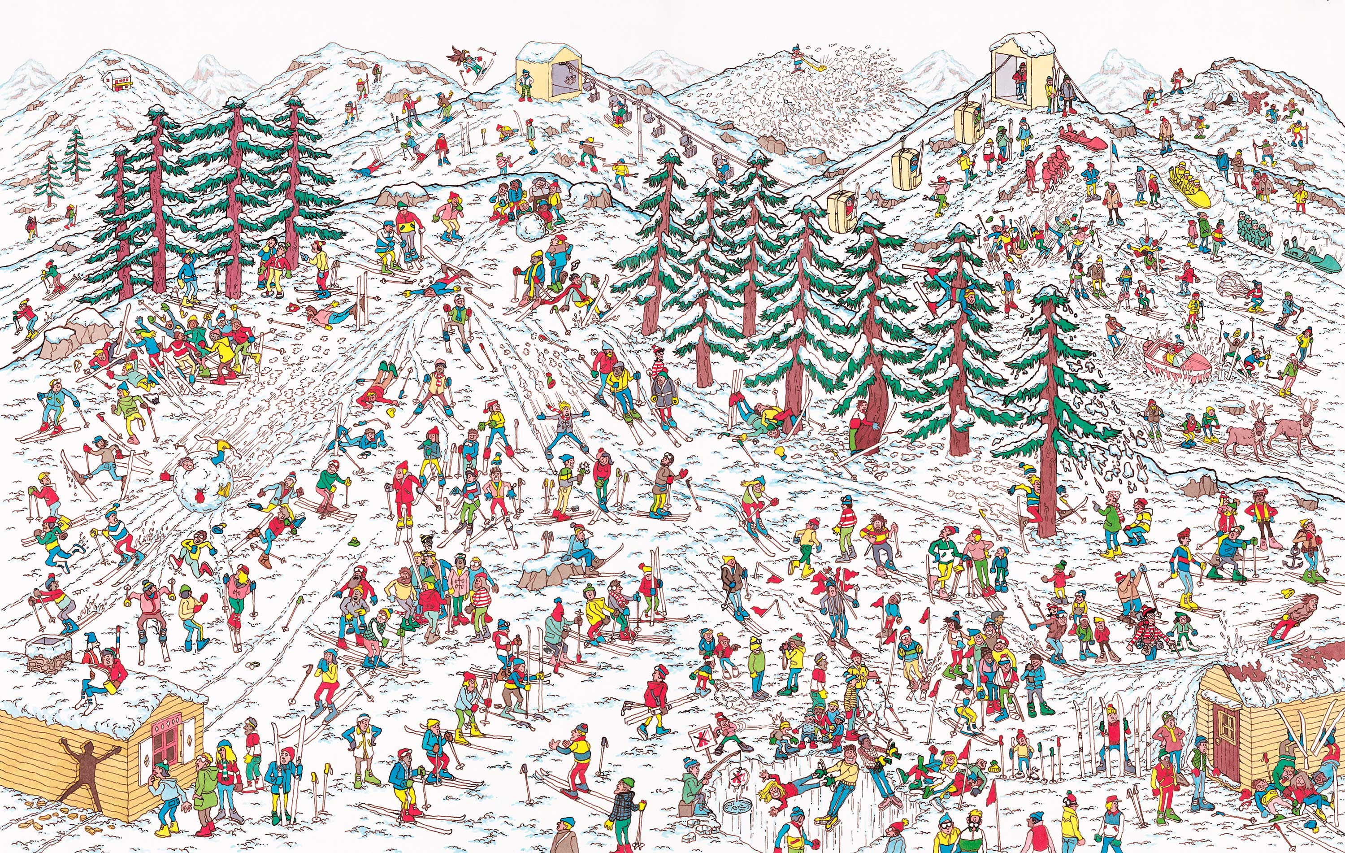
Thought experiment I
Task:
Find Waldo as fast as possible!
Resources:
8 people in the same room
1 laptop
What would be a good strategy to perform this task?
Have each person focus on one section of the image
P0 | P1 | P2 | P3
P4 | P5 | P6 | P7

Slide 7
Thought experiment II
Task:
Find Waldo as fast as possible!
Resources:
64 people in 64 different places
64 laptops
What would be a good strategy to perform this task?
Send each person a section of the image
Have each person search through their section
Wait for the results to come back
Crowdsource edition!!!

Slide 8
Comparison
Comparison
of shared-memory and distributed-memory parallelism
CPUs,
node
CPUs,
nodes
Version I: Multiple workers, single room
Pros:
Simple implementation
Low overhead
Cons:
Limited by finite local resources
Version II: Multiple workers, multiple rooms
Pros:
Virtually unlimited scaling
Cons:
More complex implementation
Communication between workers causes overhead
OpenMP, C++11 threads, joblib, …
MPI

Slide 9
What is MPI?
MPI: Standard for a Message Passing Interface
Defines:
Ways for exchanging messages between computing units
Messages can contain flow control signals, data, and additional info
Implemented by various C/C++/Fortran libraries
MVAPICH2, OpenMPI, MPICH, Intel MPI, …
CPUs, cores, threads, processes, HPC nodes

Slide 10
What you will learn in this workshop
Basic concepts of MPI
Core communication paradigms:
One-to-one, one-to-many, many-to-one
How to run MPI-powered programs on Discovery
Some Pitfalls and good practices

Slide 11



What we will work with in this workshop
We will use the Python wrapper mpi4py (around OpenMPI)
Run on Dartmouth’s Discovery cluster
Focus on concepts over implementation details

Slide 12
Let’s get started…

