Slide 1
April 12, 2023

Slide 2

Gentle Introduction to Machine Learning: Statistics
A Reproducible Research Workshop
Simon Stone
Research Data Services
Dartmouth College

Slide 3
About the Reproducible Research Group
Joint venture of Research Computing @ ITC and Research Data Services @ Library
Consult with experts on
research data management,
data visualization,
biomedical research support,
spatial data and GIS,
high performance and research computing,
statistical analysis,
economics and social sciences data
Meet the people on campus that support your reproducible research lifecycle
Engage in community discussions to learn from other researchers on campus
Attend a workshop to learn practical tools and tips

Slide 4
About Research Data Services
Research Data Management
Data Management Plans (DMPs) for sponsored projects
Finding and using 3rd party data
Collection and cleaning of data
Organization and documentation
Publishing and Repositories
Data Analysis/Visualization
Textual, numeric, spatial data
Reproducible research workflows
Scripting in R: tidyverse core package (i.e. ggplot, dplyr, tydr, tibble, etc.)
Scripting in Python: NumPy, SciPy, Pandas, Scikit-learn, Matplotlib, Seaborn, (OpenCV, PyTorch, TensorFlow, Tesseract, NLTK, etc.)
Computational Scholarship
Computational project planning
Collections as Data
Storytelling with data and visualizations
Text and data mining
Digital Humanities support
Computational Pedagogy

Slide 5
Work with us
ResearchDataHelp@groups.dartmouth.edu
Jeremy Mikecz Research Data Science Specialist jeremy.m.mikecz@dartmouth.edu dartgo.org/jeremyappts | Simon Stone Research Data Science Specialist simon.stone@dartmouth.edu dartgo.org/meetwithsimon
Lora Leligdon Head of Research Data Services lora.c.leligdon@dartmouth.edu dartgo.org/lora

Slide 6
Gentle Introduction to Machine Learning
Machine Learning is ”the field of study that gives computers the ability to learn without explicitly being programmed.”
- Arthur Samuel, 1959 (paraphrased)
Machine Learning
Deep Learning
Artificial General Intelligence
Machine Learning is what we should call (the current) Artificial Intelligence!

Slide 7
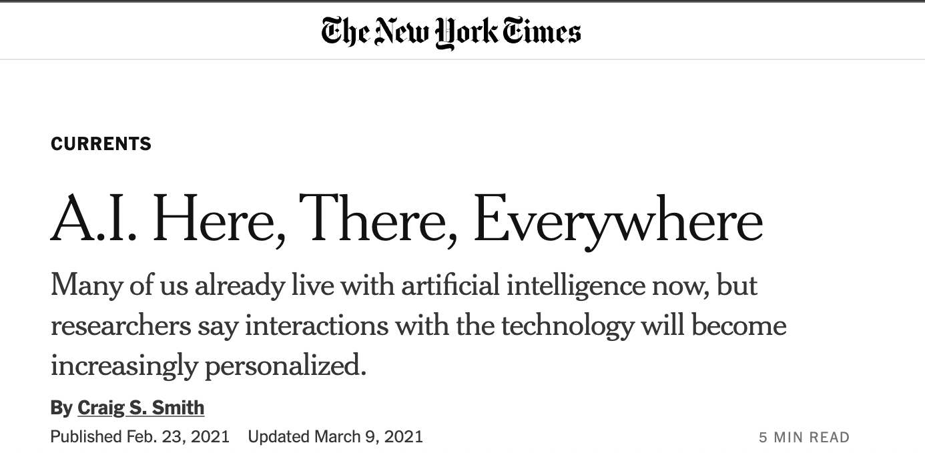
Gentle Introduction to Machine Learning
Machine Learning is everywhere
We are interacting with it every day
But how much do most of us know about our new algorithmic overlords?

Slide 8
Gentle Introduction to Machine Learning
Aim of this series:
Demystify the field a bit and give context to the buzzwords
A working mental model how machine learning algorithms think operate
To provide enough knowledge to think critically about “A.I.”
To inspire you to go use machine learning in your work and personal life

Slide 9
Gentle Introduction to Machine Learning
Statistics
A brief survey of the fundamentals for Machine Learning
Regression (April 25)
How can an algorithm find relationships between two variables?
Classification (May 9)
How can an algorithm put a label on a real-world object?

Slide 10
Basics Intro
Activity:
Define “Statistics”
One definition (Upton & Cook, 2008):
“The science of collecting, displaying, and analysing data.”
In Machine Learning:
“The way that algorithms perceive the world”

Slide 11
Basics Intro
Two sides of the (fair) coin:
Descriptive Statistics
Describing an apparent mess
Inferential Statistics
Making predictions based on the mess

Slide 12
Basics Intro
Descriptive Statistics
Inferential Statistics
Every machine learning model, ever:
Descriptive Statistics
Inferential Statistics
Mystery Box
Descriptive Statistics
Inferential Statistics
Input data
Output data

Slide 13
Descriptive Statistics Types of data
Activity:
We want to statistically describe the population of people at Dartmouth to a machine learning model.
Pair up and identify some variables that might help us do that

Slide 14
Descriptive Statistics Types of data
Categorical data
Numerical data

Slide 15
Descriptive Statistics Summarizing data
Percentile
Measures of Central Tendency
Measures of Variability

Slide 17
References
Upton, G., & Cook, I. (2008). A dictionary of statistics. Oxford University Press. DOI: 10.1093/acref/9780199541454.001.000

