Slide 1
September 21, 2023

Slide 2

Jupyter Notebooks 101
A Reproducible Research Workshop
Simon Stone
Research Data Services
Dartmouth College

Slide 3
About the Reproducible Research Group
Joint venture of Research Computing @ ITC and Research Data Services @ Library
Consult with experts on
research data management,
data visualization,
biomedical research support,
spatial data and GIS,
high performance and research computing,
statistical analysis,
economics and social sciences data
Meet the people on campus that support your reproducible research lifecycle
Engage in community discussions to learn from other researchers on campus
Attend a workshop to learn practical tools and tips

Slide 4
About Research Data Services
Research Data Management
Data Management Plans (DMPs) for sponsored projects
Finding and using 3rd party data
Collection and cleaning of data
Organization and documentation
Publishing and Repositories
Data Analysis/Visualization
Textual, numeric, spatial data
Reproducible research workflows
Scripting in R: tidyverse core package (i.e. ggplot, dplyr, tydr, tibble, etc.)
Scripting in Python: NumPy, SciPy, Pandas, Scikit-learn, Matplotlib, Seaborn, (OpenCV, PyTorch, TensorFlow, Tesseract, NLTK, etc.)
Computational Scholarship
Computational project planning
Collections as Data
Storytelling with data and visualizations
Text and data mining
Digital Humanities support
Computational Pedagogy

Slide 5
Work with us
ResearchDataHelp@groups.dartmouth.edu
Jeremy Mikecz Research Data Science Specialist jeremy.m.mikecz@dartmouth.edu dartgo.org/jeremyappts | Simon Stone Research Data Science Specialist simon.stone@dartmouth.edu dartgo.org/meetwithsimon
Lora Leligdon Head of Research Data Services lora.c.leligdon@dartmouth.edu dartgo.org/lora

Slide 6
Why talk about Jupyter Notebooks?
Jupyter Notebooks are an important tool in computational research and education
Many beginner courses use them, but only gloss over how they work
With only a superficial grasp of them, Jupyter Notebooks can get in the way of learning and understanding
Some bad practices may be unwittingly adopted because of them

Slide 7
What you will learn in this workshop
What are Jupyter Notebooks
How do you use Jupyter Notebooks
What to look out for when working with Jupyter Notebooks
When to use Jupyter Notebooks

Slide 8

What we will work with in this workshop
Jupyter Notebooks 🎉
We will use a smattering of Python for illustrative code examples
Materials: www.dartgo.org/rr-notebooks101

Slide 9
Let’s get started…

Slide 10
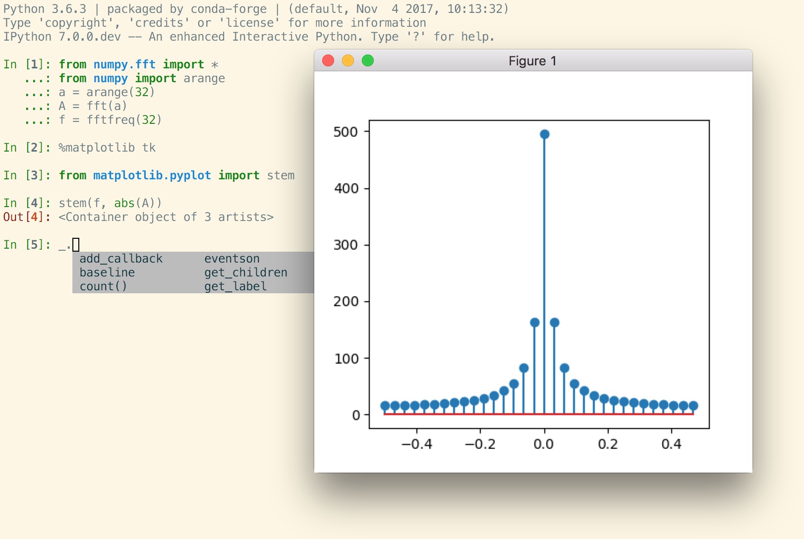
A brief history of Jupyter
In 2001, Fernando Pérez wanted a better Python shell
He created IPython:
Syntax highlighting
Autocompletion
Interactive visualizations
Mbussonn, CC BY-SA 4.0, via Wikimedia Commons

Slide 11
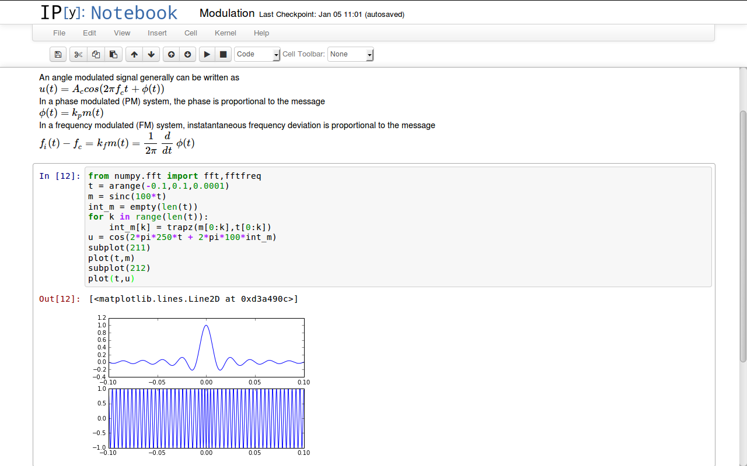
A brief history of Jupyter
In 2001, Fernando Pérez wanted a better Python shell
He created IPython:
Syntax highlighting
Autocompletion
Interactive visualizations
A rich editor view mixing text, code, and visualizations

Slide 12

A brief history of Jupyter
In 2014, Pérez and his team realized that their editor functionality in IPython was actually independent of the programming language used
Project Jupyter was spun off from IPython
Jupyter: Julia, Python, R (the originally supported languages)
Today, Jupyter Notebooks are used by all major cloud providers (Amazon Sagemaker, Google Colaboratory, Microsoft Azure Notebook)
Jupyter Notebooks are virtually everywhere in research and education
The Atlantic: “The Scientific Paper is Obsolete”
Cameron Oelsen, BSD, via Wikimedia Commons

Slide 13
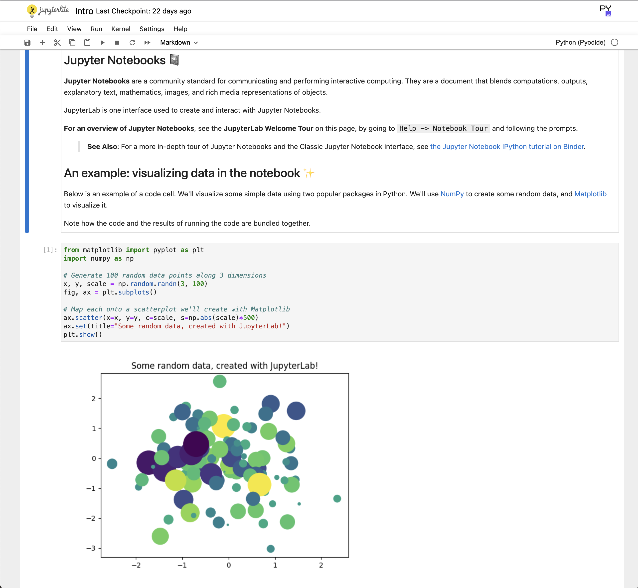
What is a Jupyter Notebook?
Source: https://jupyter-notebook-beginner-guide.readthedocs.io/en/latest/what_is_jupyter.html
Notebooks are files produced by the Jupyter Notebook application, which contain both computer code (e.g., python) and rich text elements (paragraph, equations, figures, links, etc…).
The Jupyter Notebook App is a server-client application that allows editing and running notebook files via a web browser.
The Jupyter Notebook App can be executed on a local desktop requiring no internet access or can be installed on a remote server and accessed through the internet.
Source: https://jupyter.org/try

Slide 14
What is a Jupyter Notebook?
Source: https://jupyter-notebook-beginner-guide.readthedocs.io/en/latest/what_is_jupyter.html
The code cells are executed by the kernel, a computational engine associated with the notebook
There are many different kernels, each one offering a different programming language:
IPython, IRKernel, IJulia, Xeus (C++), many more
Think of a kernel as a service that your notebook uses to run the code
The kernel can run on your local machine or remotely (e.g., in the cloud or on an HPC cluster)
Source: https://jupyter.org/try

Slide 15
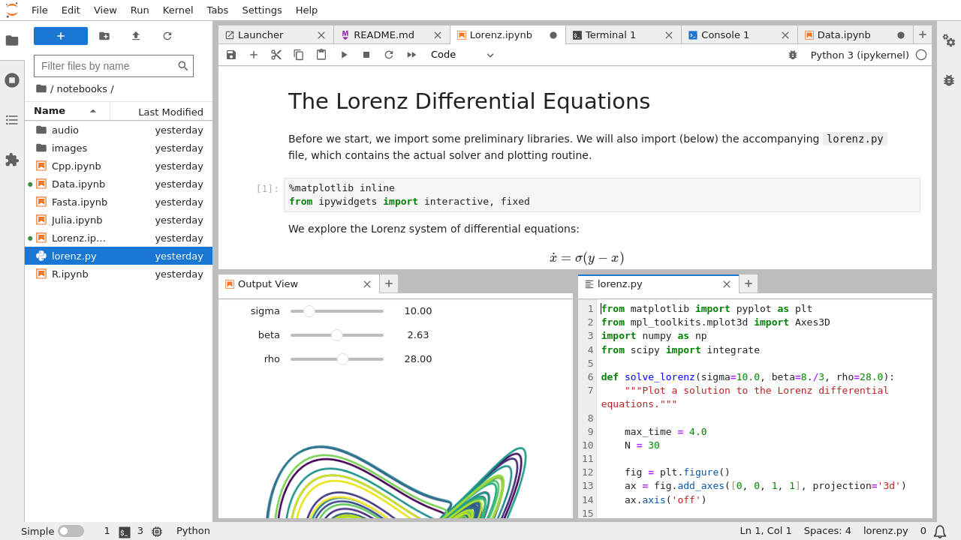
How can you run Jupyter Notebooks?
Many ways lead to Jupyter, e.g.:
The official website (www.jupyter.org/install)
The original Jupyter Notebook App
The face-lifted, latest version JupyterLab
Source: https://jupyterlab.readthedocs.io/en/latest/

Slide 16
How can you run Jupyter Notebooks?
Many ways lead to Jupyter, e.g.:
The official website (www.jupyter.org/install)
The original Jupyter Notebook App
The face-lifted, latest version JupyterLab
Using a Code Editor/IDE
E.g., PyCharm or Visual Studio Code
Source: https://towardsdatascience.com/jupyter-notebook-in-visual-studio-code-3fc21a36fe43

Slide 17
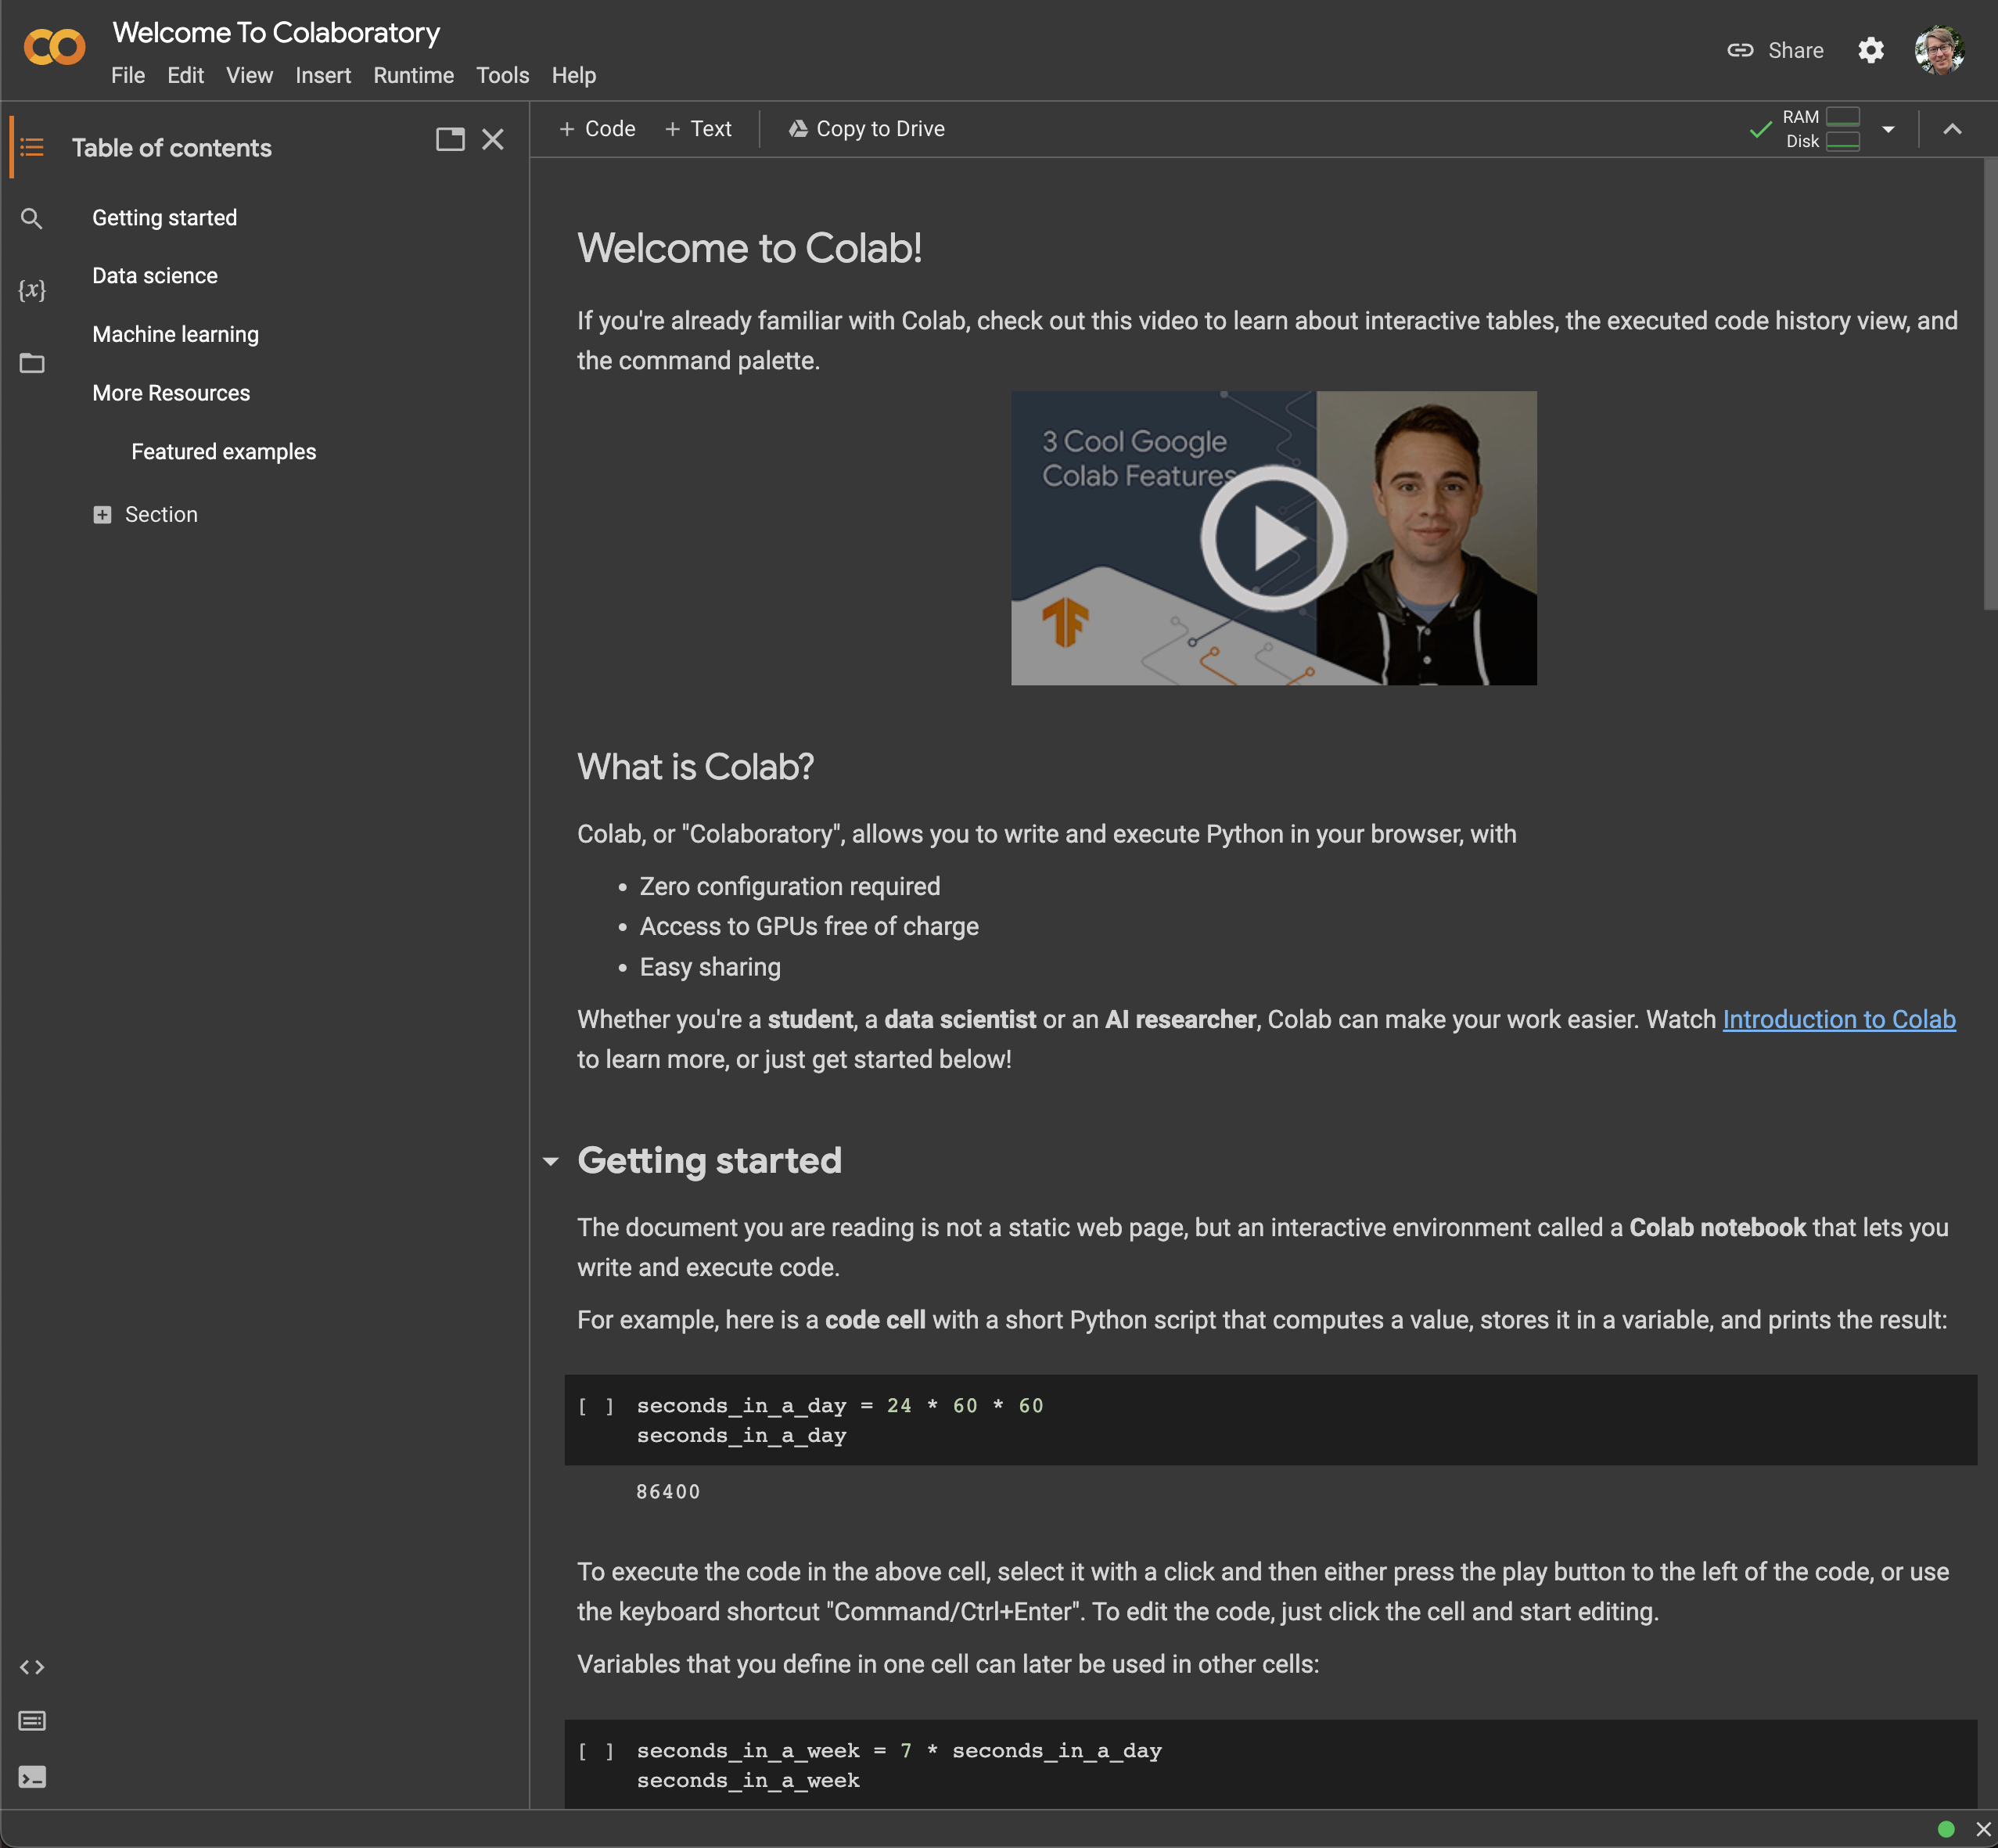
How can you run Jupyter Notebooks?
Many ways lead to Jupyter, e.g.:
The official website (www.jupyter.org/install)
The original Jupyter Notebook App
The face-lifted, latest version JupyterLab
Using a Code Editor/IDE
E.g., PyCharm or Visual Studio Code
Cloud service
Google Colab, Amazon Sagemaker
JupyterHub (e.g., jhub.dartmouth.edu)
Source: https://colab.research.google.com/

Slide 18
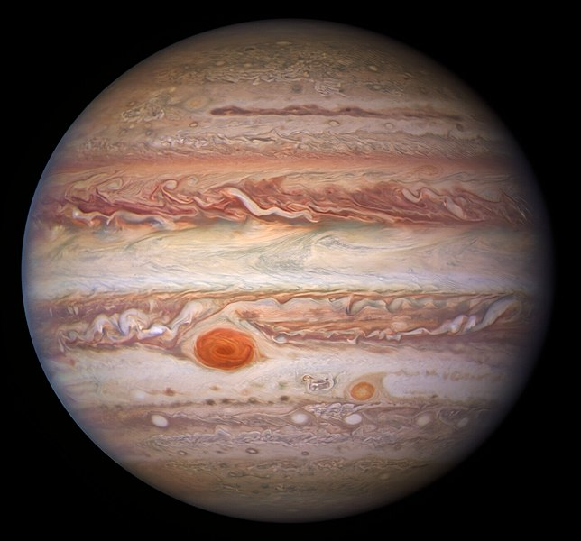
A Walk around Jupyter: Hands-on
Itinerary
General layout and interface elements
Markdown cells
Code cells
Producing figures
Magic commands
NASA/ESA/NOIRLab/NSF/AURA/M.H. Wong and I. de Pater (UC Berkeley) et al.Acknowledgments: M. Zamani, CC BY 4.0, via Wikimedia Commons

Slide 19

What to look out for
Running code out of order
“God notebooks”
Discouraging modularity
Difficulty to test and debug code
Version control can be challenging
Reproducibility may be an illusion:
Only 3 % of notebooks from scientific publications truly reproducible
NASA/ESA/NOIRLab/NSF/AURA/M.H. Wong and I. de Pater (UC Berkeley) et al.Acknowledgments: M. Zamani, CC BY 4.0, via Wikimedia Commons
Samuel, S., & Mietchen, D. (2023). Computational reproducibility of Jupyter notebooks from biomedical publications. arXiv preprint arXiv:2308.07333.

Slide 20
When to use Jupyter Notebooks
Drafting, rapid prototyping
Creating visualizations
Reporting
Education and Teaching
Stand-alone tasks that are not part of a bigger pipeline
When reusability of code is not a concern

Slide 21
Next steps
Widgets:
Graphical user interface controls (sliders, checkboxes, text inputs, …)
Nbconvert
Convert your notebook into a static format (PDF, HTML, LaTeX, Markdown, …)
Voilà
Turn your notebook into a dashboard or web app

Slide 22
Questions

Slide 23
Thank you.

