Slide 1
April 17, 2023

Slide 2
R Boot Camp for EARS
Simon Stone
Research Data Services
Dartmouth College

Slide 3
About the Reproducible Research Group
Joint venture of Research Computing @ ITC and Research Data Services @ Library
Consult with experts on
research data management,
data visualization,
biomedical research support,
spatial data and GIS,
high performance and research computing,
statistical analysis,
economics and social sciences data
Meet the people on campus that support your reproducible research lifecycle
Engage in community discussions to learn from other researchers on campus
Attend a workshop to learn practical tools and tips

Slide 4
About Research Data Services
Research Data Management
Data Management Plans (DMPs) for sponsored projects
Finding and using 3rd party data
Collection and cleaning of data
Organization and documentation
Publishing and Repositories
Data Analysis/Visualization
Textual, numeric, spatial data
Reproducible research workflows
Scripting in R: tidyverse core package (i.e., ggplot, dplyr, tydr, tibble, etc.)
Scripting in Python: NumPy, SciPy, Pandas, Scikit-learn, Matplotlib, Seaborn, (OpenCV, PyTorch, TensorFlow, Tesseract, NLTK, etc.)
Computational Scholarship
Computational project planning
Collections as Data
Storytelling with data and visualizations
Text and data mining
Digital Humanities support
Computational Pedagogy

Slide 5
Work with us
ResearchDataHelp@groups.dartmouth.edu
Jeremy Mikecz Research Data Science Specialist jeremy.m.mikecz@dartmouth.edu dartgo.org/jeremyappts | Simon Stone Research Data Science Specialist simon.stone@dartmouth.edu dartgo.org/meetwithsimon
Lora Leligdon Head of Research Data Services lora.c.leligdon@dartmouth.edu dartgo.org/lora

Slide 6
Agenda
Intro
R and RStudio
Tour of RStudio
Swirl
Reading and writing data frames
Basic data frame manipulation
Lunch break + visit by your librarian Tricia
Tidyverse
Data frame manipulation in the tidyverse
Basic graphing with ggplot2
Project time!

Slide 7
R
https://www.r-project.org/
R is a language and environment for statistical computing and graphics
Many best practices are easily implemented
Common workflows need little code and are easy to read and understand
Less common operations and/or non-statistics stuff can be challenging

Slide 8
RStudio
An Integrated Development Environment (IDE) to create and manage R projects
It includes:
Console
Syntax-highlighting editor
Tools for plotting, history, debugging, and workspace management

Slide 9
RStudio
Tour

Slide 10
Swirl
Hands-on

Slide 11
Tidy data
“Tidy data“ means following good practice
“Tidiness” begins with your project folder structure
r-boot-camp-for-ears
└── data
├── original
│ ├── my_excel_data.xlsx
│ └── my_csv_data.csv
└── working
├── my_excel_data.xlsx
└── my_csv_data.csv

Slide 12
Tidy data
In tidy data:
Every column is a variable.
Every row is an observation.
Every cell is a single value.
Hadley, W. (2014). Tidy data. The Journal of Statistical Software, 59(1).

Slide 13
Tidy data
Not Tidy
Tidy
person | treatment_a | treatment_b
John Smith |  | 2
Jane Doe | 16 | 11
Mary Johnson | 3 | 1
person | treatment | result
John Smith | a
Jane Doe | a | 16
Mary Johnson | a | 3
John Smith | b | 2
Jane Doe | b | 11
Mary Johnson | b | 1
treatment | John_Smith | Jane_Doe | Mary_Johnson
a |  | 16 | 3
b | 2 | 11 | 1

Slide 14
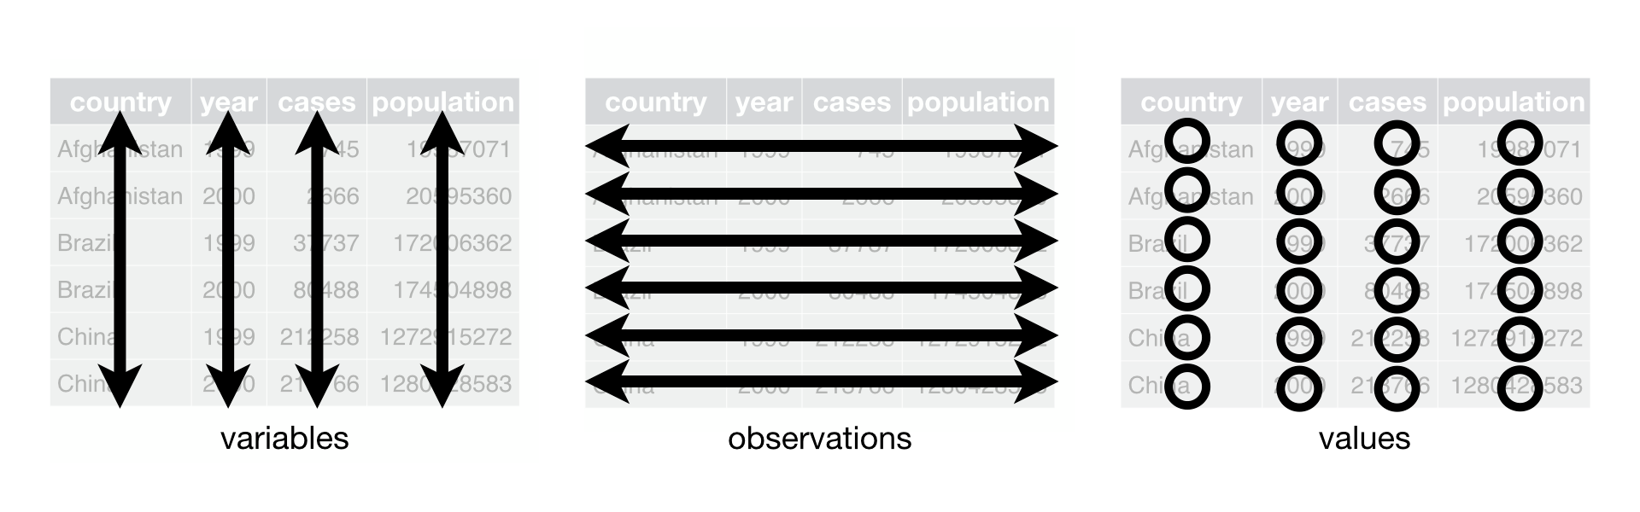
Tidy data

Slide 15
Reading and writing data frames
Hands-on

Slide 16
Basic data frame manipulation
Hands-on

Slide 17
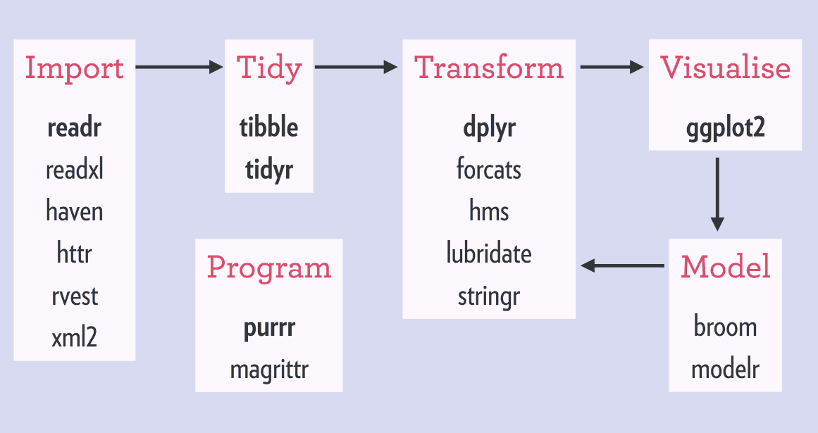
Tidyverse
“The tidyverse is a coherent system of packages for data manipulation, exploration and visualization that share a common design philosophy. […] Tidyverse packages are intended to […] facilitate communication, and result in reproducible work products. Fundamentally, the tidyverse is about the connections between the tools that make the workflow possible.”
- Joseph Rickert, “What is the tidyverse?”
https://www.tidyverse.org/

Slide 18
Manipulating data frames in the tidyverse
Hands-on

Slide 19
Basic graphing in ggplot2
Hands-on

Slide 20
Project time!
Hands-on

Slide 21
Resources
More cheat sheets:
https://github.com/rstudio/cheatsheets
Tidyverse documentation and help:
https://www.tidyverse.org/
Additional content around today’s lessons:
https://swcarpentry.github.io/r-novice-gapminder/
More tutorial content in the tidyverse:
https://r4ds.had.co.nz/index.html

