Slide 1
RESEARCH QUESTIONS & PROJECT DESIGN
Emily Myers, PhD
Research Facilitation
September 2, 2026

Slide 2
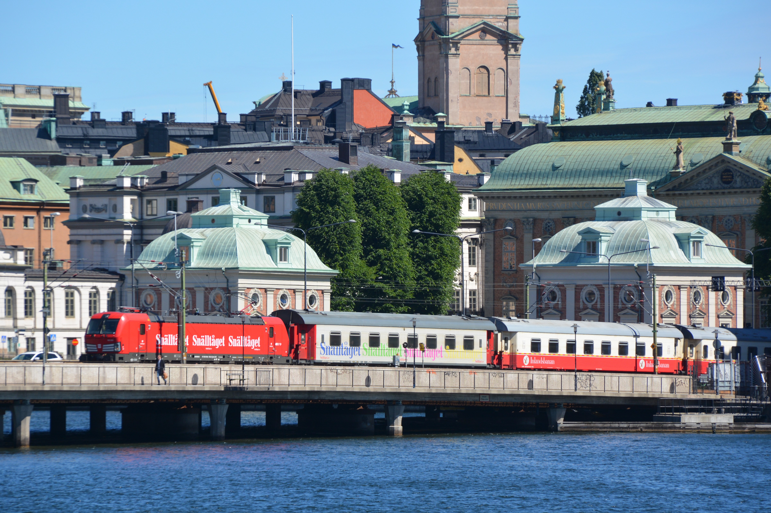
Photo by Bengt Oberger, Creative Commons Attribution-Share Alike 4.0 International License
Notes:
In your tables, please come up with one to two research questions about train routes around the world

Slide 3
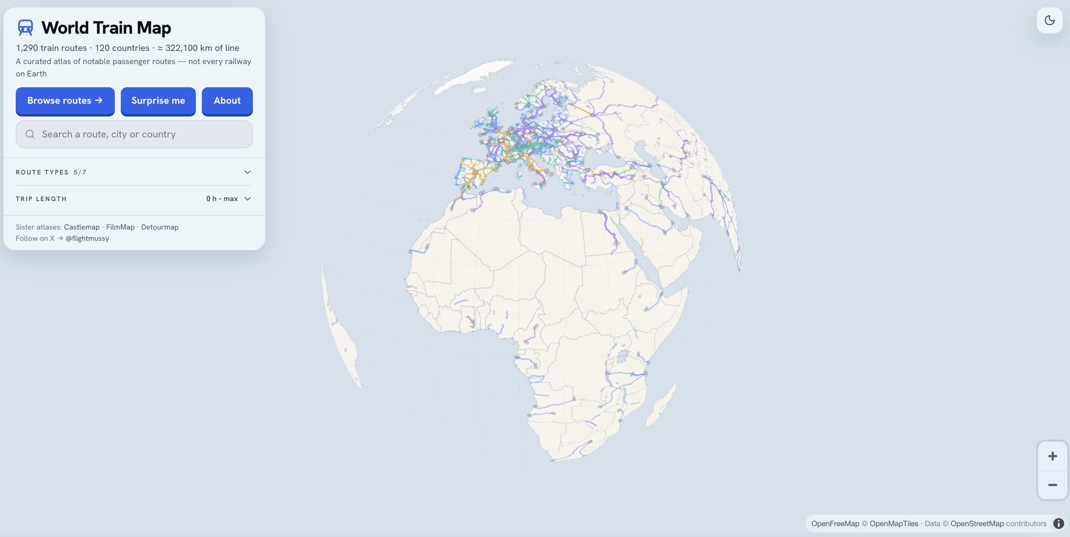
Now, go to: https://worldtrainmap.com/
Notes:
Think about your research questions. Can you answer your original questions with this data? What new, interesting questions might you answer?

Slide 4
How did your research questions change when you looked at the World Train Map data?
What are some interesting questions you might answer with this data?
Notes:
Group discussion

Slide 5

Research process
Research question
Research design
Data collection
Analysis & output
Notes:
We’re often told the research process goes like this; but often it’s much more iterative than that!

Slide 6

GUIDING PRINCIPLES FOR RESEARCH QUESTIONS
Notes:
Regardless of the relationship between project design and research question, there are some general principles that help us form good research questions

Slide 7
A good research question is:
Clear and specific
Unresolved, with room for debate
Researchable
Interesting to you and to an external audience

Slide 8
Examples
What is the effect of eating breakfast on productivity?
Is it good to eat breakfast?
What is the capital of New Hampshire?
(How) does topography shape the selection of state capitals in New England?
What would happen if nothing were illegal for one day?*
*The plot of The Purge, I think??
To what extent are people’s actions constrained by fear of sanction?*
*Still hard to research, but more do-able (behavioral game?)

Slide 9
Caveats
Can depend on your discipline
Can depend on your research goal (descriptive vs. analytical vs. causal; inductive vs. deductive; etc.)

Slide 10
STRATEGIES TO FORMULATE RESEARCH QUESTIONS

Slide 11
Turn to academic literature
Create a research question practice! After every article/group of articles you read, think of three research questions that spring from your reading.
Guiding questions:
What remains unanswered by the article(s)?
Do any tensions arise in the arguments and/or findings? What might explain those tensions?
Do the findings run counter to something you’ve read/observed/know to be true? Why might that be?

Slide 12
Mine news & real-world observation
Ask “why” and “how” questions about the world around you and about information you consume.
Read widely on your topic of interest and related topics– policy papers/evaluations, news articles, histories, etc.
Guiding questions:
How does this information relate to academic literature/convention on this topic?
Does existing research give us tools to understand this? Why or why not?
What am I curious about after reading/seeing this?
Does this story/information fit into a broader pattern I’ve observed? How? Why?

Slide 13
Think about measurement & data
Brainstorming measures can help you get more specific about what you’re interested in.
Guiding questions:
How might you measure the concepts in your question?
What type of data might be available/could you collect on these measures?
If you don’t have the time or resources for original data collection, are there reasonable sources of data out there?

Slide 14
Imagine potential arguments
The answer to a good research question requires an explanation, not just a yes or a no.
Guiding questions:
What might your answer to your question be?
What’s the reasoning behind that answer? What evidence could you draw on to back up your reasoning?
Can you think of counter-arguments/alternative explanations?

Slide 15
BACK TO TRAINS!
Notes:
How can we improve the research questions we brainstormed? Introduce our research question

Slide 16
QUESTIONS?

