Slide 1

Session 2a:
INTRODUCTION TO EXPLORING YOUR DATA

Slide 2
Exploratory Data Analysis aka EDA
By the end of this session, you will
Understand why it is important to explore a dataset before analyzing it.
Learn high-level dataset features to consider for suitability to the research question.
Be able to effectively explore a dataset’s contents and identify issues
After the break, we’ll apply this learning to our train data.

Slide 3
Discussion Questions
What does exploratory data analysis mean to you?
You have just been given a dataset to analyze. How confident are you in your next steps?
Not at all confident - I don't really know where to start.
A little confident
Somewhat confident - I have some ideas and can start playing around with the data.
Pretty confident
Highly confident - I have a plan and know what my next steps are.
Notes:
What does exploratory data analysis mean to you?
2) You have just been given a dataset to analyze. How confident are you in your next steps?
1- Not at all confident - I don't really know where to start.
2 - A little confident
3 - Somewhat confident - I have some ideas and can start playing around with the data.
4 - Pretty confident
5 - Highly confident - I have a plan and know what my next steps are.

Slide 4
The research process from a data perspective

Slide 5
The research process from a data perspective*
*Note this flow is specific to the data aspects of a research project and does not include critical steps like literature review and sharing your findings.
Get Raw Data
Exploratory Data Analysis
Analysis Planning
Data Cleaning
Data Analysis
Learn what your data contains and how it is formatted
Notes:
Note this flow is specific to the data aspects of a project and does not include critical steps like literature review and hypothesis formulation.

Slide 6
Why do we explore our data?

Slide 7
Why explore the data?
Determine whether it is suitable for your analysis.
Identify features to keep in mind as you conduct the rest of your project.
Analysis planning
Data cleaning
Data analysis
It’s important to think critically about the dataset before
you start analyzing it.
Notes:
You need to know several things before you start working with a dataset.
If you don’t know these things, you don’t know if or how to use the data to answer your question(s)

Slide 8
Do I have to do this step?
What if I’ve been given a dataset and told exactly how to analyze it?
What if I have been told this is the dataset we’re analyzing, and I just need to pick a question?
What if I generated the dataset?
Yes! You should do EDA for every research project.
Notes:
You need to know several things before you start working with a dataset.
If you don’t know these things, you don’t know if or how to use the data to answer your question(s)

Slide 9
What exactly is EDA?

Slide 10
What does it mean to explore our data?
Investigating the dataset’s contents and format via summaries, figures, tables, and other methods.
Note that EDA shares some tools with data analysis.
However, the goal of the EDA phase is to become familiar with the data, not generate results.

Slide 11
EDA: Art and science
It is good to have a plan to structure EDA, and this session will give you that framework.
However, there is no complete checklist for EDA, because each dataset is unique.
EDA usually leads to discoveries about your dataset that require further exploration.
Think of it as a plan that you can expect to deviate from.
Notes:
not everything I talk about will apply to all datasets

Slide 12
Main EDA phases
Read about the dataset
Examine its structure and contents (high level)
Dive into the data
Notes:
You need to know several things before you start working with a dataset.
If you don’t know these things, you don’t know if or how to use the data to answer your question(s)

Slide 13
Best practices for working with data
Document your findings.
What you find as you explore your data will inform your next steps.
Do this as you go – don’t leave it until the end.
Do not explore in your original (“raw”) data files!
Yes, even if you’re just sorting and filtering it in Excel.
Save a “working” copy and leave the original file untouched in case anything goes wrong.
R is good for this because it only reads files, not modifies them, unless you tell it to save a new version.

Slide 14
How do we explore our data?
Phase 1: Read

Slide 15
What is the source of the data?
Who generated this data?
Do you trust it to be
Accurate?
Free of bias?
These questions are best evaluated by someone with domain expertise

Slide 16
What methods were used to generate it?
Are they appropriate?
Technically
Ethically
Culturally
What are the caveats of these methods?
Are those acceptable?
If so, how do they impact your analysis?
These questions are best evaluated by someone with domain expertise

Slide 17
Is there enough documentation to understand the data?
“Documentation”: a description of the dataset
Also known as metadata, codebook,…
Range of format and formality
Key information about the variables, such as
Name
Units
Coding, e.g.
1 = Yes
2 = No
Notes on other dataset features
ID | Var1 | Var2 | Var3
1 | 5/1/1956 | 60 | 97.3
2 | 6/25/1967 | 63 | 98.5
3 | 4/29/2003 | 69 | 97.4
… | … | … | …
ID | Date of Birth | Height (inches) | Temperature (F)
1 | 5/1/1956 | 60 | 97.3
2 | 6/25/1967 | 63 | 98.5
3 | 4/29/2003 | 69 | 97.4
… | … | … | …

Slide 18
What is the dataset’s format?
A single file of data? Multiple files?
A database? Something else?
What is the file format?
Something common, like a CSV file?
Something specific to a software?
Free, e.g. Rdata files
Paid, e.g. SAS files

Slide 19
Suitability checkpoint:
Now that you’ve read about the dataset’s source, methods, and documentation, is it suitable for your analysis?
If so, let’s start looking at the data!

Slide 20
How do we explore our data?
Phase 2: Examine structure and contents

Slide 21
Our dataset
ID | Date of Birth | Age (years) | Body Temperature (F) | Height (inches) | Veggies (servings)* | Consumes meat
1 | 5/1/1956 | 69 | 97.3 | 60 | 3 | Yes
2 | June 25, 1967 | 58 |  | 63 | 1 | No
3 | 04/29/03 | 22 | 97.4 | 69 | 0 | yes
4 | 27170 | 51 | 97.0 | 70 | 1 or 2 | Y
5 | 1/30/1998 | 27 | 99.3 | 61 | 2 | Ys
6 | 6/21/1988 | 37 | 99.3 | 66 | 5 | No
7 | 3/29/2002 | 23 | 37.0 | 72 | 1 | Yes
8 | 11/16/2007 | 17 | 97.1 | 66 | 3 | yes
9 | 4/24/1992 | 33 | 98.6 | 66 | Unknown | YES
10 | 6/10/2026 | 12 | 97.9 | 22 | 1 | No
*From the documentation: The number of servings of vegetables consumed, on average, each day.

Slide 22
Dataset size
ID | Date of Birth | Age (years) | Body Temperature (F) | Height (inches) | Veggies (servings) | Consumes meat
1 | 5/1/1956 | 69 | 97.3 | 60 | 3 | Yes
2 | June 25, 1967 | 58 |  | 63 | 1 | No
3 | 04/29/03 | 22 | 97.4 | 69 | 0 | yes
4 | 27170 | 51 | 97.0 | 70 | 1 or 2 | Y
5 | 1/30/1998 | 27 | 99.3 | 61 | 2 | Ys
6 | 6/21/1988 | 37 | 99.3 | 66 | 5 | No
7 | 3/29/2002 | 23 | 37.0 | 72 | 1 | Yes
8 | 11/16/2007 | 17 | 97.1 | 66 | 3 | yes
9 | 4/24/1992 | 33 | 98.6 | 66 | Unknown | YES
10 | 6/10/2026 | 12 | 97.9 | 22 | 1 | No
Number of rows – data points
Number of columns – variables

Slide 23
Data arrangement: long or wide
Wide: Default
One row per subject
Data in columns
Long: Often used for time series.
Multiple rows per subject
Data spread across columns and rows
ID | Date of Birth | Age (years) | Body Temperature (F) | Height (inches) | Veggies (servings)
1 | 5/1/1956 | 69 | 97.3 | 60 | 3
2 | 6/25/1967 | 58 |  | 63 | 1
3 | 4/29/2003 | 22 | 97.4 | 69 | 0
4 | 5/21/1974 | 51 | 97.0 | 70 | 1 or 2
5 | 1/30/1998 | 27 | 99.3 | 61 | 2
ID | Time Point | Height
1 | 1 | 63
1 | 2 | 64
2 | 1 | 59
2 | 2 | 60
2 | 3 | 60

Slide 24
Variables
ID | Date of Birth | Age (years) | Body Temperature (F) | Height (inches) | Veggies (servings) | Consumes meat
1 | 5/1/1956 | 69 | 97.3 | 60 | 3 | Yes
2 | June 25, 1967 | 58 |  | 63 | 1 | No
3 | 04/29/03 | 22 | 97.4 | 69 | 0 | yes
4 | 27170 | 51 | 97.0 | 70 | 1 or 2 | Y
5 | 1/30/1998 | 27 | 99.3 | 61 | 2 | Ys
6 | 6/21/1988 | 37 | 99.3 | 66 | 5 | No
7 | 3/29/2002 | 23 | 37.0 | 72 | 1 | Yes
8 | 11/16/2007 | 17 | 97.1 | 66 | 3 | yes
9 | 4/24/1992 | 33 | 98.6 | 66 | Unknown | YES
10 | 6/10/2026 | 12 | 97.9 | 22 | 1 | No
Name
What it measures
Units
Type of variable

Slide 25
Variable types
ID | Date of Birth | Age (years) | Body Temperature (F) | Height (inches) | Veggies (servings) | Consumes meat
1 | 5/1/1956 | 69 | 97.3 | 60 | 3 | Yes
2 | June 25, 1967 | 58 |  | 63 | 1 | No
3 | 04/29/03 | 22 | 97.4 | 69 | 0 | yes
4 | 27170 | 51 | 97.0 | 70 | 1 or 2 | Y
5 | 1/30/1998 | 27 | 99.3 | 61 | 2 | Ys
6 | 6/21/1988 | 37 | 99.3 | 66 | 5 | No
7 | 3/29/2002 | 23 | 37.0 | 72 | 1 | Yes
8 | 11/16/2007 | 17 | 97.1 | 66 | 3 | yes
9 | 4/24/1992 | 33 | 98.6 | 66 | Unknown | YES
10 | 6/10/2026 | 12 | 97.9 | 22 | 1 | No
Numeric
Date
Categorical
Text

Slide 26
Suitability checkpoint 2:
Given the dataset’s structure and contents, is it still suitable for your analysis?
If so, let’s dig into the data!
Notes:
Are any important variables missing entirely? Does the arrangement of the data work (i.e. do you have a timeseries kind of question and the data aren’t there?)

Slide 27
How do we explore our data?
Phase 3: Dive into the data

Slide 28
Summarize numeric & date variables
Characteristics of interest
Central tendency
Mean
Median
Range
Distribution
Methods
Numeric
Visual
ID | Date of Birth | Age (years) | Body Temperature (F) | Height (inches) | Veggies (servings) | Consumes meat
1 | 5/1/1956 | 69 | 97.3 | 60 | 3 | Yes
2 | June 25, 1967 | 58 |  | 63 | 1 | No
3 | 04/29/03 | 22 | 97.4 | 69 | 0 | yes
4 | 27170 | 51 | 97.0 | 70 | 1 or 2 | Y
5 | 1/30/1998 | 27 | 99.3 | 61 | 2 | Ys
6 | 6/21/1988 | 37 | 99.3 | 66 | 5 | No
7 | 3/29/2002 | 23 | 37.0 | 72 | 1 | Yes
8 | 11/16/2007 | 17 | 97.1 | 66 | 3 | yes
9 | 4/24/1992 | 33 | 98.6 | 66 | Unknown | YES
10 | 6/10/2026 | 12 | 97.9 | 22 | 1 | No

Slide 29
Numeric summaries
Summary statistics for Age:
Minimum = 12
25th percentile = 22.25
Median = 30
Mean = 34.9
75th percentile = 47.5
Maximum = 69
ID | Date of Birth | Age (years) | Body Temperature (F) | Height (inches) | Veggies (servings) | Consumes meat
1 | 5/1/1956 | 69 | 97.3 | 60 | 3 | Yes
2 | June 25, 1967 | 58 |  | 63 | 1 | No
3 | 04/29/03 | 22 | 97.4 | 69 | 0 | yes
4 | 27170 | 51 | 97.0 | 70 | 1 or 2 | Y
5 | 1/30/1998 | 27 | 99.3 | 61 | 2 | Ys
6 | 6/21/1988 | 37 | 99.3 | 66 | 5 | No
7 | 3/29/2002 | 23 | 37.0 | 72 | 1 | Yes
8 | 11/16/2007 | 17 | 97.1 | 66 | 3 | yes
9 | 4/24/1992 | 33 | 98.6 | 66 | Unknown | YES
10 | 6/10/2026 | 12 | 97.9 | 22 | 1 | No

Slide 30
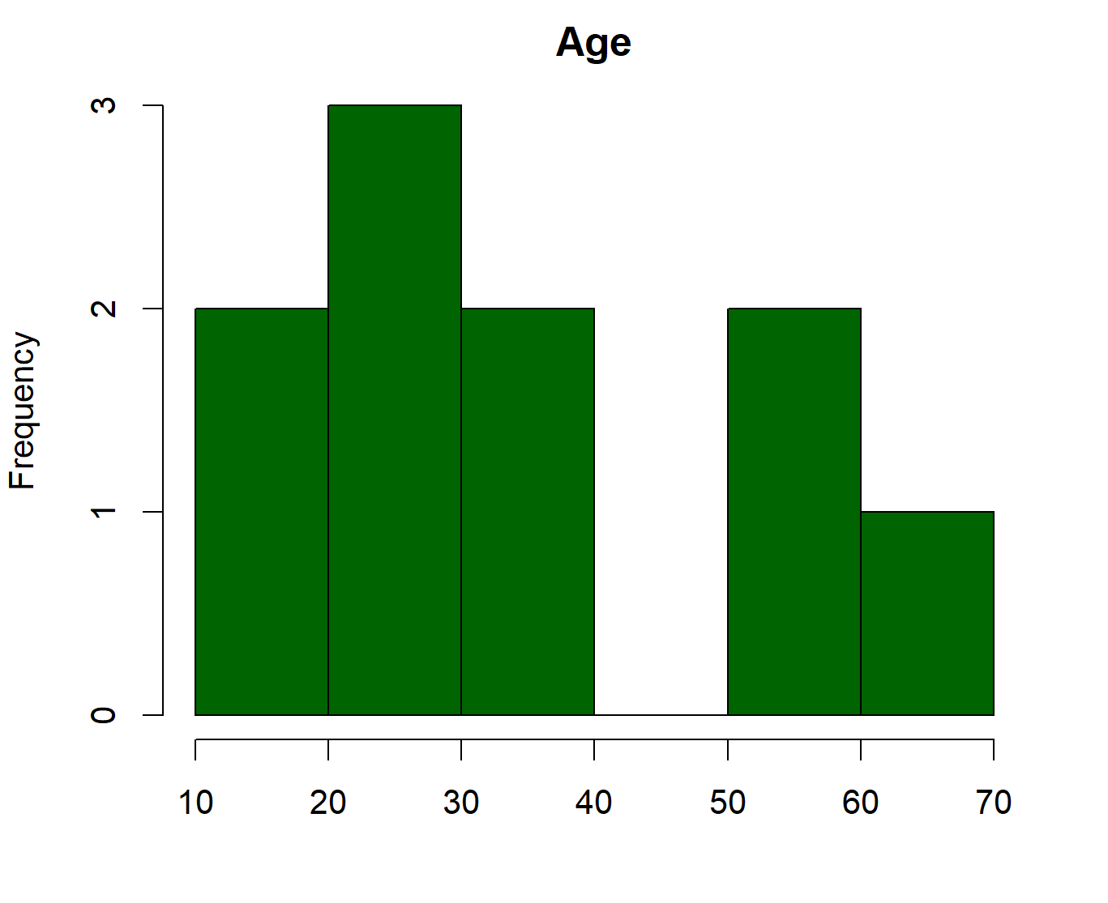
Visual summaries: Histograms
ID | Date of Birth | Age (years) | Body Temperature (F) | Height (inches) | Veggies (servings) | Consumes meat
1 | 5/1/1956 | 69 | 97.3 | 60 | 3 | Yes
2 | June 25, 1967 | 58 |  | 63 | 1 | No
3 | 04/29/03 | 22 | 97.4 | 69 | 0 | yes
4 | 27170 | 51 | 97.0 | 70 | 1 or 2 | Y
5 | 1/30/1998 | 27 | 99.3 | 61 | 2 | Ys
6 | 6/21/1988 | 37 | 99.3 | 66 | 5 | No
7 | 3/29/2002 | 23 | 37.0 | 72 | 1 | Yes
8 | 11/16/2007 | 17 | 97.1 | 66 | 3 | yes
9 | 4/24/1992 | 33 | 98.6 | 66 | Unknown | YES
10 | 6/10/2026 | 12 | 97.9 | 22 | 1 | No

Slide 31
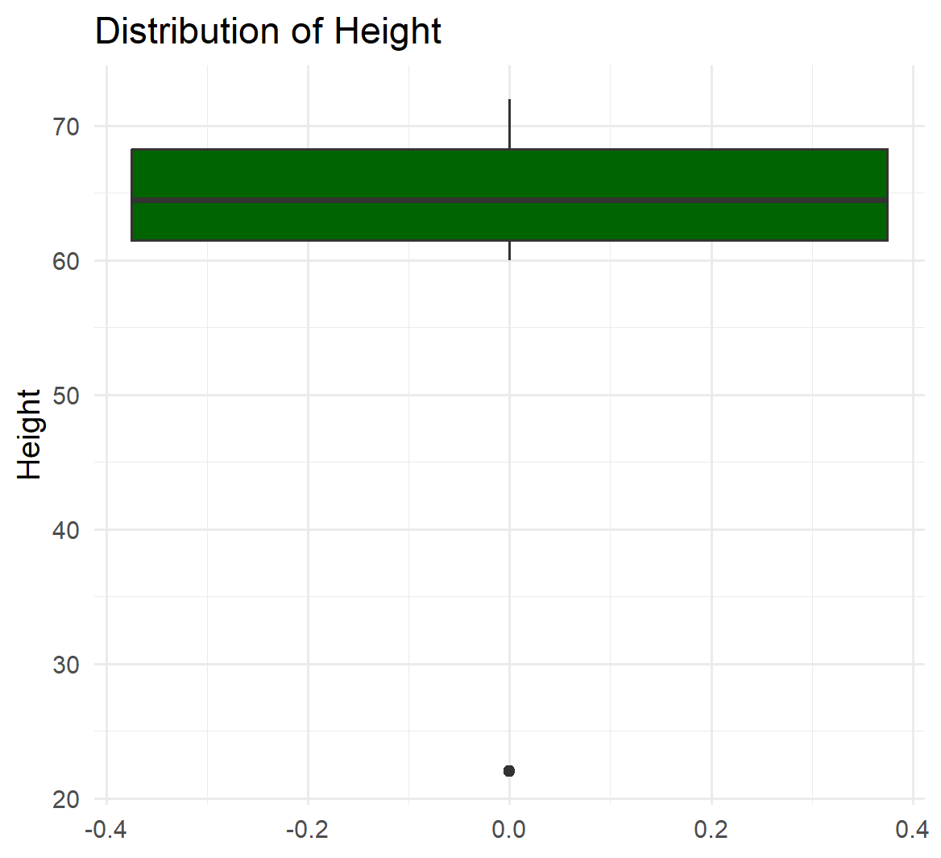
Visual summaries: Boxplots
ID | Date of Birth | Age (years) | Body Temperature (F) | Height (inches) | Veggies (servings) | Consumes meat
1 | 5/1/1956 | 69 | 97.3 | 60 | 3 | Yes
2 | June 25, 1967 | 58 |  | 63 | 1 | No
3 | 04/29/03 | 22 | 97.4 | 69 | 0 | yes
4 | 27170 | 51 | 97.0 | 70 | 1 or 2 | Y
5 | 1/30/1998 | 27 | 99.3 | 61 | 2 | Ys
6 | 6/21/1988 | 37 | 99.3 | 66 | 5 | No
7 | 3/29/2002 | 23 | 37.0 | 72 | 1 | Yes
8 | 11/16/2007 | 17 | 97.1 | 66 | 3 | yes
9 | 4/24/1992 | 33 | 98.6 | 66 | Unknown | YES
10 | 6/10/2026 | 12 | 97.9 | 22 | 1 | No
Outlier!

Slide 32
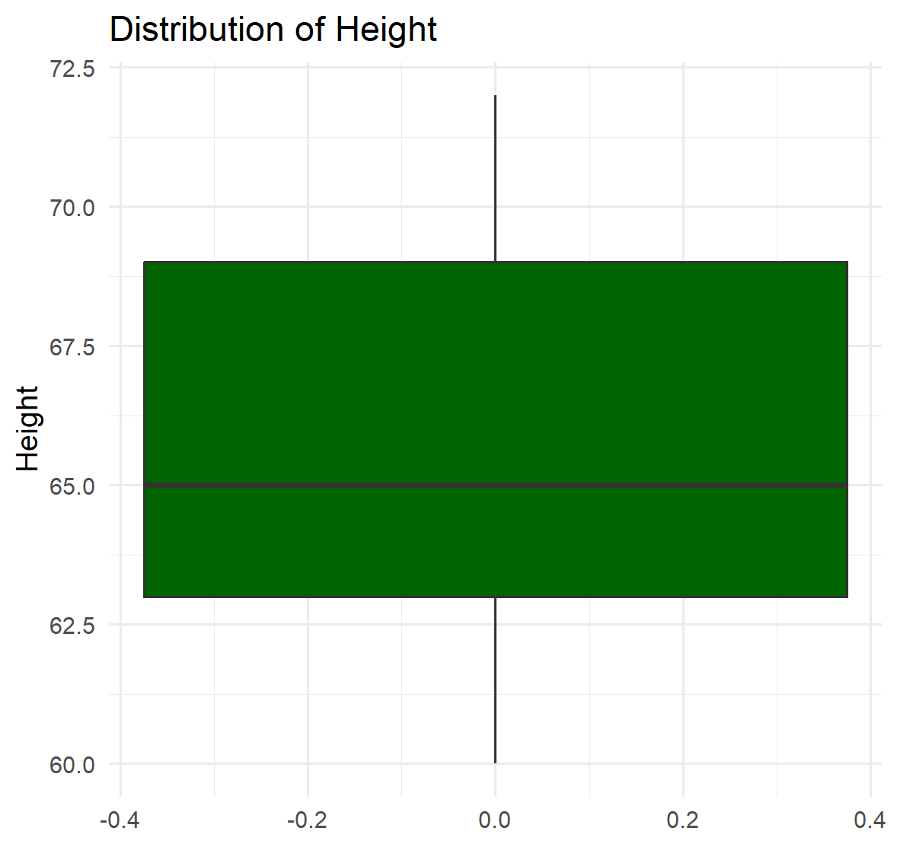
Visual summaries: Boxplots
ID | Date of Birth | Age (years) | Body Temperature (F) | Height (inches) | Veggies (servings) | Consumes meat
1 | 5/1/1956 | 69 | 97.3 | 60 | 3 | Yes
2 | June 25, 1967 | 58 |  | 63 | 1 | No
3 | 04/29/03 | 22 | 97.4 | 69 | 0 | yes
4 | 27170 | 51 | 97.0 | 70 | 1 or 2 | Y
5 | 1/30/1998 | 27 | 99.3 | 61 | 2 | Ys
6 | 6/21/1988 | 37 | 99.3 | 66 | 5 | No
7 | 3/29/2002 | 23 | 37.0 | 72 | 1 | Yes
8 | 11/16/2007 | 17 | 97.1 | 66 | 3 | yes
9 | 4/24/1992 | 33 | 98.6 | 66 | Unknown | YES
10 | 6/10/2026 | 12 | 97.9 | 22 | 1 | No

Slide 33
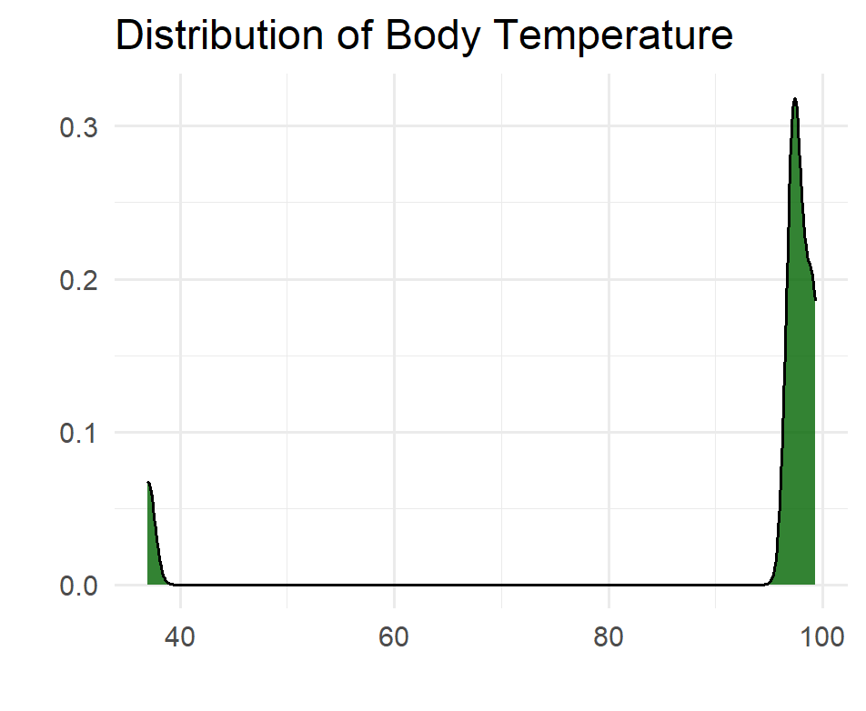
Visual summaries: Density Plot
ID | Date of Birth | Age (years) | Body Temperature (F) | Height (inches) | Veggies (servings) | Consumes meat
1 | 5/1/1956 | 69 | 97.3 | 60 | 3 | Yes
2 | June 25, 1967 | 58 |  | 63 | 1 | No
3 | 04/29/03 | 22 | 97.4 | 69 | 0 | yes
4 | 27170 | 51 | 97.0 | 70 | 1 or 2 | Y
5 | 1/30/1998 | 27 | 99.3 | 61 | 2 | Ys
6 | 6/21/1988 | 37 | 99.3 | 66 | 5 | No
7 | 3/29/2002 | 23 | 37.0 | 72 | 1 | Yes
8 | 11/16/2007 | 17 | 97.1 | 66 | 3 | yes
9 | 4/24/1992 | 33 | 98.6 | 66 | Unknown | YES
10 | 6/10/2026 | 12 | 97.9 | 22 | 1 | No
Outlier!

Slide 34
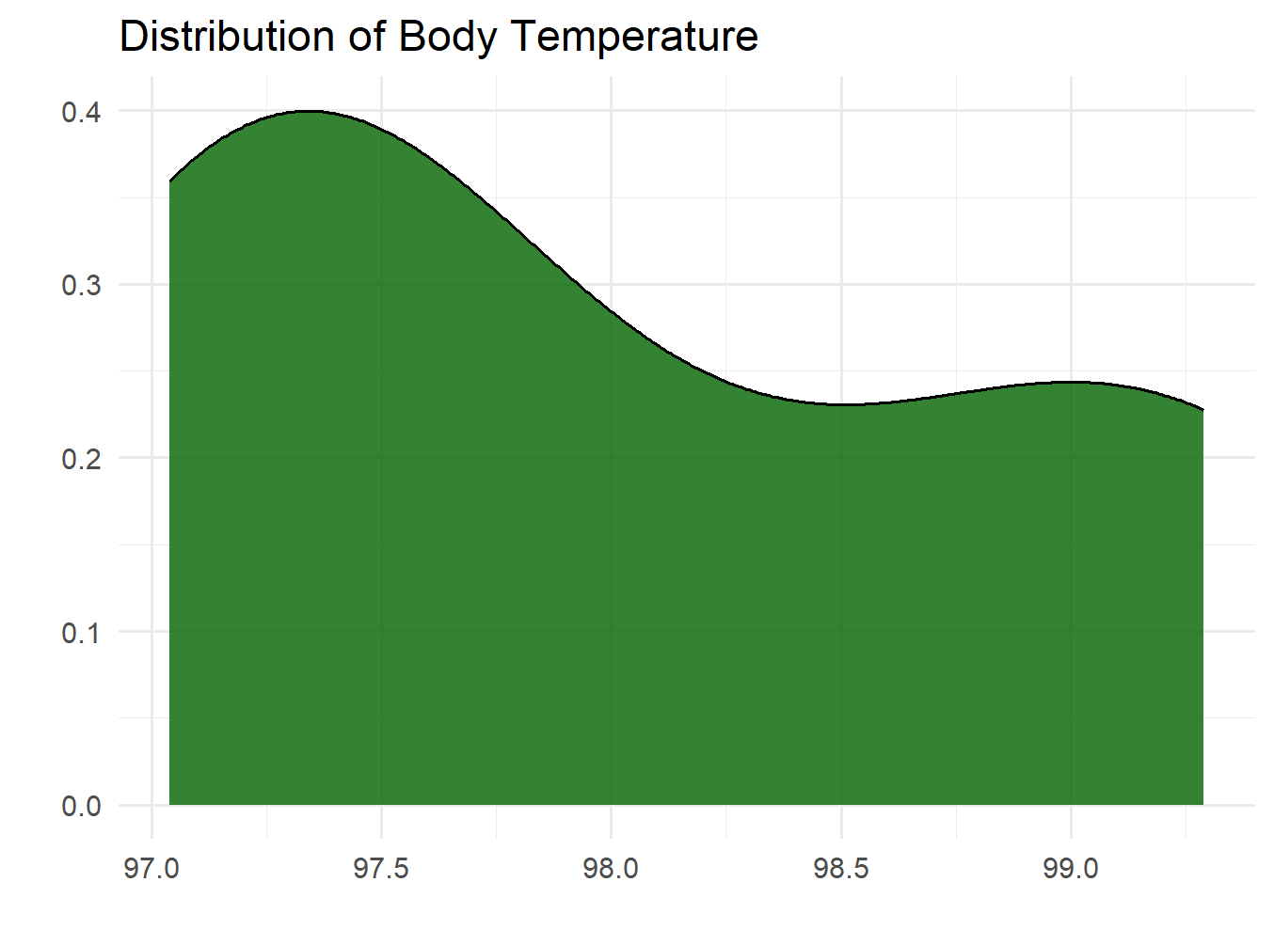
Visual summaries: Density Plot
ID | Date of Birth | Age (years) | Body Temperature (F) | Height (inches) | Veggies (servings) | Consumes meat
1 | 5/1/1956 | 69 | 97.3 | 60 | 3 | Yes
2 | June 25, 1967 | 58 |  | 63 | 1 | No
3 | 04/29/03 | 22 | 97.4 | 69 | 0 | yes
4 | 27170 | 51 | 97.0 | 70 | 1 or 2 | Y
5 | 1/30/1998 | 27 | 99.3 | 61 | 2 | Ys
6 | 6/21/1988 | 37 | 99.3 | 66 | 5 | No
7 | 3/29/2002 | 23 | 37.0 | 72 | 1 | Yes
8 | 11/16/2007 | 17 | 97.1 | 66 | 3 | yes
9 | 4/24/1992 | 33 | 98.6 | 66 | Unknown | YES
10 | 6/10/2026 | 12 | 97.9 | 22 | 1 | No

Slide 35
Visual summaries
There are many useful figure types for exploring data!
You may need to try several before you find one that works for any individual variable.
R Graph Gallery (https://r-graph-gallery.com ) is a great resource for R.
It has examples of a huge range of figures, split out by their type (distribution, correlations, ranking, etc.)
It includes the code to generate them!

Slide 36
Summarize categorical variables
Characteristics of interest
Distribution across categories
Methods
Numeric
Visual

Slide 37
Numeric Summaries: Frequency Tables
ID | Date of Birth | Age (years) | Body Temperature (F) | Height (inches) | Veggies (servings) | Consumes meat
1 | 5/1/1956 | 69 | 97.3 | 60 | 3 | Yes
2 | June 25, 1967 | 58 |  | 63 | 1 | No
3 | 04/29/03 | 22 | 97.4 | 69 | 0 | yes
4 | 27170 | 51 | 97.0 | 70 | 1 or 2 | Y
5 | 1/30/1998 | 27 | 99.3 | 61 | 2 | Ys
6 | 6/21/1988 | 37 | 99.3 | 66 | 5 | No
7 | 3/29/2002 | 23 | 37.0 | 72 | 1 | Yes
8 | 11/16/2007 | 17 | 97.1 | 66 | 3 | yes
9 | 4/24/1992 | 33 | 98.6 | 66 | Unknown | YES
10 | 6/10/2026 | 12 | 97.9 | 22 | 1 | No
Response to “Consumes meat” | Count
No | 3
Y | 1
Yes | 2
yes | 2
YES | 1
Ys | 1

Slide 38
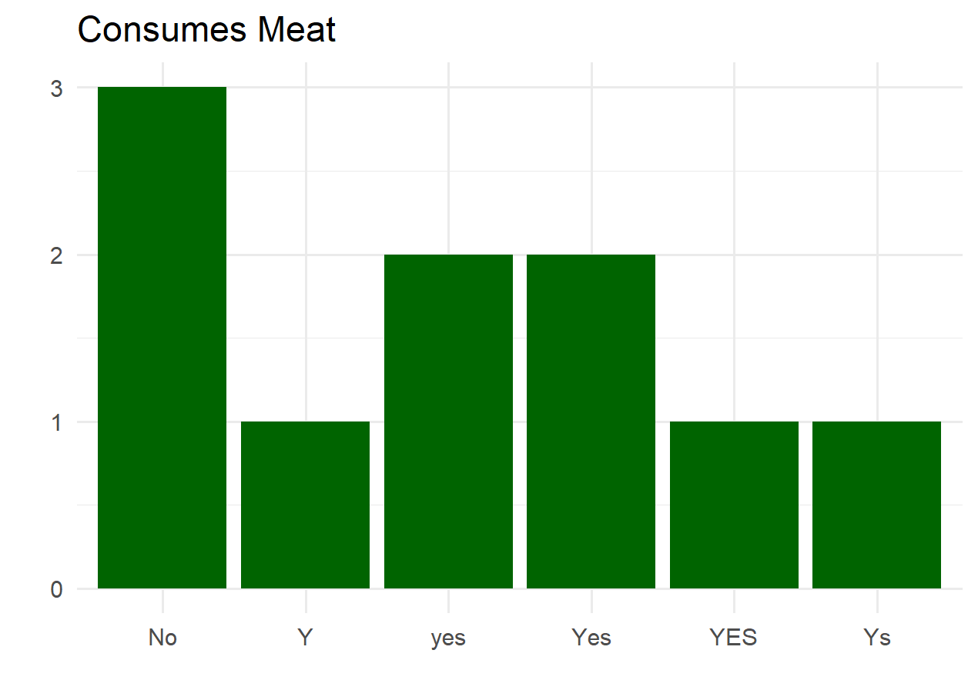
Visual Summaries: Barplot
ID | Consumes meat
1 | Yes
2 | No
3 | yes
4 | Y
5 | Ys
6 | No
7 | Yes
8 | yes
9 | YES
10 | No

Slide 39
Variables & the relationships between them
Up until now we’ve been examining one variable at a time, which is called univariate analysis.
It’s also important to look at the relationships between variables, which is called multivariate analysis.
Input and output variables
Multiple input variables

Slide 40
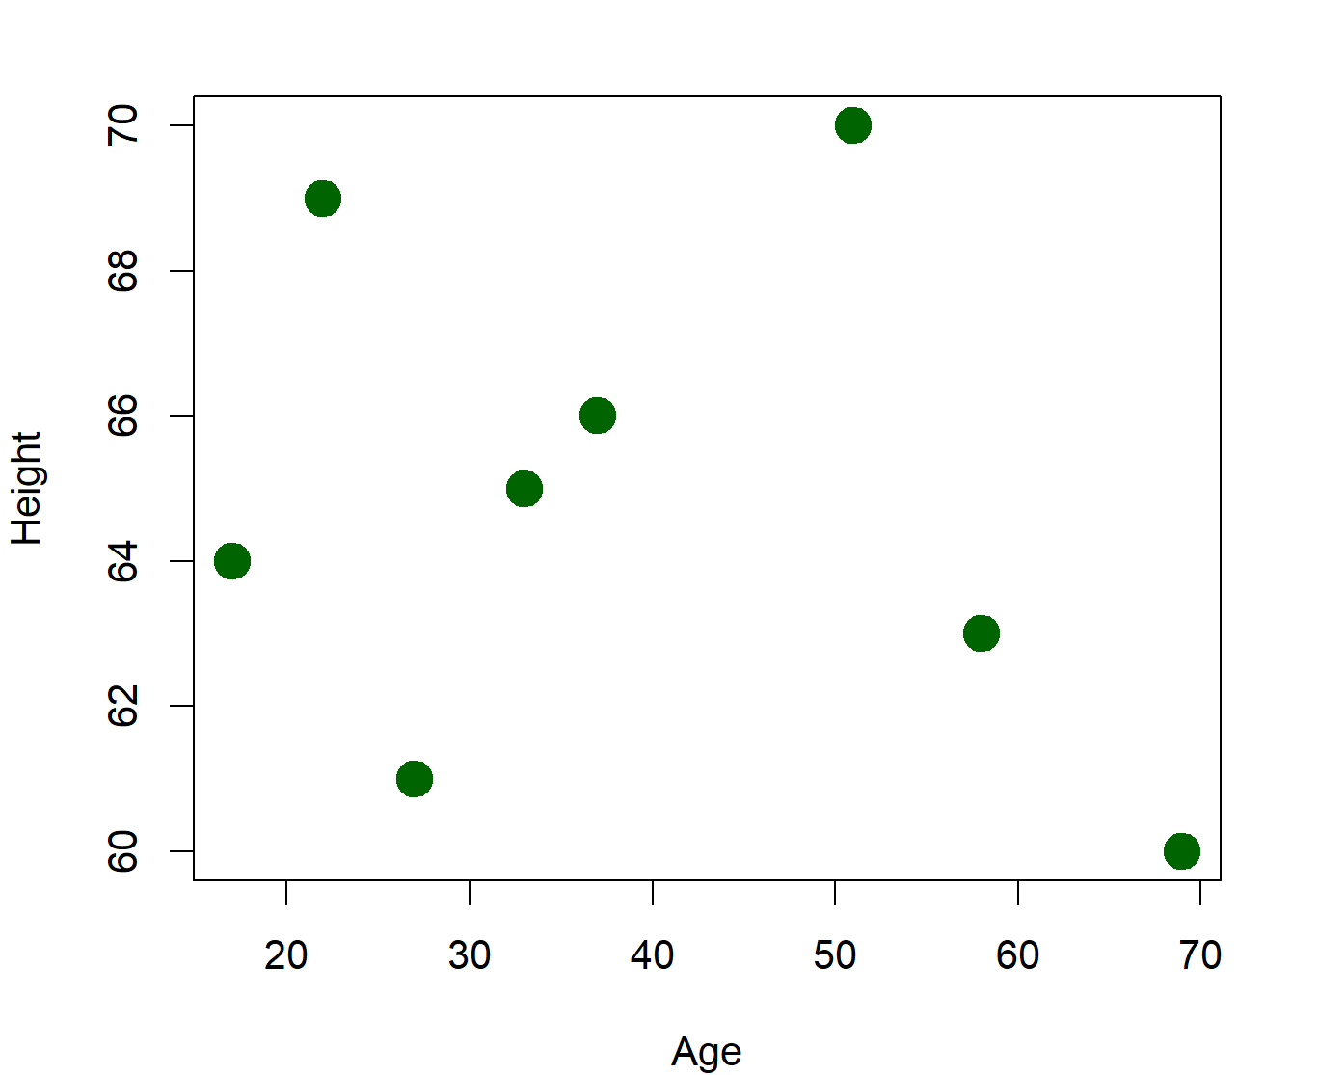
Pairwise (bivariate) relationships
Visual, e.g. scatterplot, line graphs
Numeric values, e.g. correlation = 0.4

Slide 41
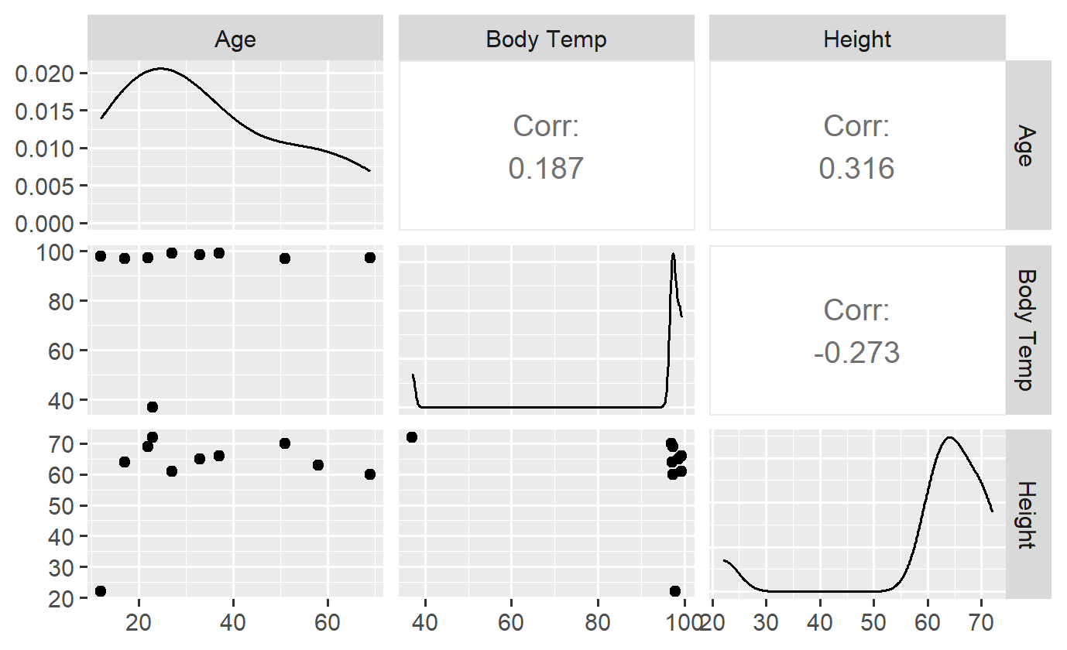
Multivariate relationships: Correlation matrix
Numeric
Visual

Slide 42
Non-linear relationships
Consider the scatterplot on the right. Would you say these variables are correlated?
A traditional numeric measure of this correlation would be very low, but there is clearly a strong relationship between the variables.

Slide 43
Variable distributions and relationships affect analysis plans!
Statistical analyses often have specific requirements around variable distributions and relationships
Linear relationships
Normal distributions
Independent (i.e. not correlated) explanatory variables

Slide 44
Common issues: Missing data
Labels
Blank
“Unknown”
NA/Null
A specific number like 999 or -1
Quantity
ID | Date of Birth | Age (years) | Body Temperature (F) | Height (inches) | Veggies (servings) | Consumes meat
1 | 5/1/1956 | 69 | 97.3 | 60 | 3 | Yes
2 | June 25, 1967 | 58 |  | 63 | 1 | No
3 | 04/29/03 | 22 | 97.4 | 69 | 0 | yes
4 | 27170 | 51 | 97.0 | 70 | 1 or 2 | Y
5 | 1/30/1998 | 27 | 99.3 | 61 | 2 | Ys
6 | 6/21/1988 | 37 | 99.3 | 66 | 5 | No
7 | 3/29/2002 | 23 | 37.0 | 72 | 1 | Yes
8 | 11/16/2007 | 17 | 97.1 | 66 | 3 | yes
9 | 4/24/1992 | 33 | 98.6 | 66 | Unknown | YES
10 | 6/10/2026 | 12 | 97.9 | 22 | 1 | No

Slide 45
Common issues: Missing data, cont.
An important characteristic of missing data is the pattern of missingness
Random: all values have an equal chance of being missing
Lost samples
Instrument error
Non-random: certain values are more likely to be missing
Physical
Social

Slide 46
Common issues: Formatting & typos
Typos –e.g., “ys” instead of “yes”
Text formatting – e.g., “Yes”, “YES”, and “yes”
Dates
ID | Date of Birth | Age (years) | Body Temperature (F) | Height (inches) | Veggies (servings) | Consumes meat
1 | 5/1/1956 | 69 | 97.3 | 60 | 3 | Yes
2 | June 25, 1967 | 58 |  | 63 | 1 | No
3 | 04/29/03 | 22 | 97.4 | 69 | 0 | yes
4 | 27170 | 51 | 97.0 | 70 | 1 or 2 | Y
5 | 1/30/1998 | 27 | 99.3 | 61 | 2 | Ys
6 | 6/21/1988 | 37 | 99.3 | 66 | 5 | No
7 | 3/29/2002 | 23 | 37.0 | 72 | 1 | Yes
8 | 11/16/2007 | 17 | 97.1 | 66 | 3 | yes
9 | 4/24/1992 | 33 | 98.6 | 66 | Unknown | YES
10 | 6/10/2026 | 12 | 97.9 | 22 | 1 | No

Slide 47
Common issues: Variable type
That’s not a date! Or is it…?
Mix of text and numbers
Numbers stored as text
ID | Date of Birth | Age (years) | Body Temperature (F) | Height (inches) | Veggies (servings) | Consumes meat
1 | 5/1/1956 | 69 | 97.3 | 60 | 3 | Yes
2 | June 25, 1967 | 58 |  | 63 | 1 | No
3 | 04/29/03 | 22 | 97.4 | 69 | 0 | yes
4 | 27170 | 51 | 97.0 | 70 | 1 or 2 | Y
5 | 1/30/1998 | 27 | 99.3 | 61 | 2 | Ys
6 | 6/21/1988 | 37 | 99.3 | 66 | 5 | No
7 | 3/29/2002 | 23 | 37.0 | 72 | 1 | Yes
8 | 11/16/2007 | 17 | 97.1 | 66 | 3 | yes
9 | 4/24/1992 | 33 | 98.6 | 66 | Unknown | YES
10 | 6/10/2026 | 12 | 97.9 | 22 | 1 | No

Slide 48
Common Issues: Duplicates
How are you defining duplicates?
Single variable – beware of typos
Combinations of variables
Duplicates may not be exact.
Different missing data
Conflicting values
ID | Name | DOB | Zip code
1 | John Smith | 04/29/03 | 03755
2 | John Smiths | 04/29/03 | 03755
3 | John Smith | 04/30/03 | 03755
4 | John Smith | 04/29/03 | 03756
5 | John Smith |  | 03756

Slide 49
EDA Conceptual wrap-up

Slide 50
Recap
We explored a framework for EDA and some common dataset features to examine.
Your exploration will almost certainly lead to discoveries unique to your dataset that require further exploration.
EDA is an ongoing process – you may discover things later in the process that require you to investigate further.

Slide 51
Discussion Questions
What does exploratory data analysis mean to you now?
You have just been given a dataset to analyze. How confident are you in your next steps?
Not at all confident - I don't really know where to start.
A little confident
Somewhat confident - I have some ideas and can start playing around with the data.
Pretty confident
Highly confident - I have a plan and know what my next steps are.
Notes:
What does exploratory data analysis mean to you?
2) You have just been given a dataset to analyze. How confident are you in your next steps?
1- Not at all confident - I don't really know where to start.
2 - A little confident
3 - Somewhat confident - I have some ideas and can start playing around with the data.
4 - Pretty confident
5 - Highly confident - I have a plan and know what my next steps are.

Slide 52
What questions do you still have about EDA?

