Slide 1

Introduction to Data Cleaning for Analysis and Reproducible Research

Slide 2
Objectives
By the end of this session, you will
Be able to explain what data cleaning means and why it is such an important step in the research process.
Have a list of tasks to consider including in your data cleaning plan.
Be able to develop a data cleaning plan to implement in R (or your analysis software of choice).

Slide 3
Discussion Questions
What does data cleaning mean to you?
You have just been given a dataset to clean. How confident are you in your next steps?
Not at all confident - I don't really know where to start.
A little confident
Somewhat confident - I have some ideas and can start adjusting the data.
Pretty confident
Highly confident - I have a plan and know what my next steps are.

Slide 4
The research process from a data perspective

Slide 5
The Research Process from a Data Perspective*
*Note this flow is specific to the data aspects of a research project and does not include critical steps like literature review and sharing your findings.
Get Raw Data
Exploratory Data Analysis
Analysis Planning
Data Cleaning
Data Analysis
Determine data format requirements for your analysis
Make it happen!
Learn what your data contains and how it’s formatted
Notes:
Note this flow is specific to the data aspects of a project and does not include critical steps like literature review and hypothesis formulation.

Slide 6
What is data cleaning and why is it important?

Slide 7
What does it mean to clean the data?
“Fix and format”
Motivation
Exploratory data analysis (EDA) findings
Analysis plan
Questions
Methods
Goal: A dataset ready for you to analyze according to your chosen methods

Slide 8
Data cleaning has important implications!
Data cleaning changes your data.
Any time you change your data, you can change the outcome of your study.

Slide 9
Changes made during data cleaning must be
Documented – What change(s) did you make and how?
Justifiable – Why was each change necessary? Why did you change it the way you did?
Reproducible – Given your documentation, could someone else recreate what you did?

Slide 10
Reproducibility
Data cleaning is one of the best arguments for using a code-based analytical process.
What if you get an updated version of your dataset? Or another dataset to repeat your analysis on?
If you did your cleaning manually, you have to repeat the whole process, which is inefficient, error-prone, and hard to reproduce (by you or others!).
If you are using code, you simply re-run it on the new data, saving time and ensuring the same process is followed.

Slide 11
The data cleaning process

Slide 12
Step 0: Save a copy of your data to work with
Do not clean your original (“raw”) data file(s)!
Save a “working” copy and leave the original file untouched in case anything goes wrong.
Remember that reading the data into R does not modify the original file, so that’s ok!

Slide 13
The data cleaning process
Have a plan
Implement the plan
Make sure the plan worked correctly

Slide 14
1. Have a plan
Problem
What have you identified that needs to be cleaned?
How did you identify it?
Why does each item need to be cleaned?
Solution
How are you fixing it?
Why did you choose that method?

Slide 15
1. Have a plan, cont.
Format
The plan should be accessible to a non-technical audience
Ideally, something generic like a Word document
Think of this as a draft of the methods section of your paper

Slide 16
2. Implement the plan
Follow the plan!
If you notice an issue as you complete a step, update the plan to describe and account for it.
Check that the fix for each problem worked as expected and did not have unintended consequences.

Slide 17
3. Make sure the plan worked correctly
While implementing your plan, you checked that each individual fix worked as expected.
Now give the dataset as a whole the same treatment. Make sure that there aren’t any unintended consequences or interactions between your cleaning steps.

Slide 18
Elements to consider for your data cleaning plan
Phase 1: Re-formatting

Slide 19
Our dataset
ID | Date of Birth | Age (years) | Body Temperature (F) | Height (inches) | Veggies (servings)* | Consumes meat
1 | 5/1/1956 | 69 | 97.3 | 60 | 3 | Yes
2 | June 25, 1967 | 58 |  | 63 | 1 | No
3 | 04/29/03 | 22 | 97.4 | 69 | 0 | yes
4 | 5/21/1974 | 51 | 97.0 | 70 | 1 or 2 | Y
5 | 1/30/1998 | 27 | 99.3 | 61 | 2 | Ys
6 | 6/21/1988 | 37 | 99.3 | 66 | 5 | No
7 | 3/29/2002 | 23 | 37.0 | 72 | 1 | Yes
8 | 11/16/2007 | 17 | 97.1 | 66 | 3 | yes
9 | 4/24/1992 | 33 | 98.6 | 66 | Unknown | YES
10 | 1/25/2026 | 12 | 97.9 | 22 | 1 | No
*From the documentation: The number of servings of vegetables consumed, on average, each day.

Slide 20
Consider first: Subset
Select only the observations that you will analyze. If your study:
Does not need Height, exclude that variable.
Includes only people aged ≥20 years, exclude anyone younger.
Doing this first = less data to clean!
Note: Subset first only if you are using the same subset of data for all analyses.
If you’ll use the dataset again for different analyses, subset last once the whole dataset is clean.
ID | Date of Birth | Age (years) | Body Temperature (F) | Height (inches) | Veggies (servings)* | Consumes meat
1 | 5/1/1956 | 69 | 97.3 | 60 | 3 | Yes
2 | June 25, 1967 | 58 |  | 63 | 1 | No
3 | 04/29/03 | 22 | 97.4 | 69 | 0 | yes
4 | 5/21/1974 | 51 | 97.0 | 70 | 1 or 2 | Y
5 | 1/30/1998 | 27 | 99.3 | 61 | 2 | Ys
6 | 6/21/1988 | 37 | 99.3 | 66 | 5 | No
7 | 3/29/2002 | 23 | 37.0 | 72 | 1 | Yes
8 | 11/16/2007 | 17 | 97.1 | 66 | 3 | yes
9 | 4/24/1992 | 33 | 98.6 | 66 | Unknown | YES
10 | 1/25/2026 | 12 | 97.9 | 22 | 1 | No

Slide 21
Change variable names
Long variable names are a pain to type repeatedly
“How old are you, in years?” -> Age
“What is your date of birth?” -> DOB
Be sure to
Keep the name meaningful
Record your changes
ID | Date of Birth | Age (years) | Body Temperature (F) | Veggies (servings)* | Consumes meat
1 | 5/1/1956 | 69 | 97.3 | 3 | Yes
… | … | … | … | … | …
versus
ID | DOB | Age | BodyTemp | Veggies | Meat
1 | 5/1/1956 | 69 | 97.3 | 3 | Yes
… | … | … | … | … | …

Slide 22
Fix typos
Address simple, clear issues like “Ys” instead of “Yes”
ID | DOB | Age | BodyTemp | Veggies | Meat
1 | 5/1/1956 | 69 | 97.3 | 3 | Yes
2 | June 25, 1967 | 58 |  | 1 | No
3 | 04/29/03 | 22 | 97.4 | 0 | yes
4 | 5/21/1974 | 51 | 97.0 | 1 or 2 | Y
5 | 1/30/1998 | 27 | 99.3 | 2 | Ys
6 | 6/21/1988 | 37 | 99.3 | 5 | No
7 | 3/29/2002 | 23 | 37.0 | 1 | Yes
9 | 4/24/1992 | 33 | 98.6 | Unknown | YES

Slide 23
Standardize formatting
Ensure consistent formatting within and between columns
Dates – MM/DD/YYYY, DD-MM-YY
Units – temperature, age
ID | DOB | Age | BodyTemp | Veggies | Meat
1 | 5/1/1956 | 69 | 97.3 | 3 | Yes
2 | June 25, 1967 | 58 |  | 1 | No
3 | 04/29/03 | 22 | 97.4 | 0 | yes
4 | 5/21/1974 | 51 | 97.0 | 1 or 2 | Y
5 | 1/30/1998 | 27 | 99.3 | 2 | Yes
6 | 6/21/1988 | 37 | 99.3 | 5 | No
7 | 3/29/2002 | 23 | 37.0 | 1 | Yes
9 | 4/24/1992 | 33 | 98.6 | Unknown | YES

Slide 24
Standardize, cont.
Missing data format
Blank
“Unknown”
NA/NaN/NULL
A specific number, e.g. 999 or -1
Text entries
Yes/yes/YES -> Yes
ID | DOB | Age | BodyTemp | Veggies | Meat
1 | 5/1/1956 | 69 | 97.3 | 3 | Yes
2 | 6/25/1967 | 58 |  | 1 | No
3 | 4/29/2003 | 22 | 97.4 | 0 | yes
4 | 5/21/1974 | 51 | 97.0 | 1 or 2 | Y
5 | 1/30/1998 | 27 | 99.3 | 2 | Yes
6 | 6/21/1988 | 37 | 99.3 | 5 | No
7 | 3/29/2002 | 23 | 98.6 | 1 | Yes
9 | 4/24/1992 | 33 | 98.6 | Unknown | YES

Slide 25
Fix data types
Ensure data are stored as the intended type (numeric, date, etc.)
Always check dates!
Text in the Veggies column will result in that column being treated as text
We’ll review the data types again after we clean the data
ID | DOB | Age | BodyTemp | Veggies | Meat
1 | 5/1/1956 | 69 | 97.3 | 3 | Yes
2 | 6/25/1967 | 58 |  | 1 | No
3 | 4/29/2003 | 22 | 97.4 | 0 | Yes
4 | 5/21/1974 | 51 | 97.0 | 1 or 2 | Yes
5 | 1/30/1998 | 27 | 99.3 | 2 | Yes
6 | 6/21/1988 | 37 | 99.3 | 5 | No
7 | 3/29/2002 | 23 | 98.6 | 1 | Yes
9 | 4/24/1992 | 33 | 98.6 | Unknown | Yes

Slide 26
Elements to consider for your data cleaning plan
Phase 2: Clean the data itself

Slide 27
*EDA = Exploratory Data Analysis
Fixes based on your EDA* findings
Example: “1 or 2” in the Veggies column
Numeric – treat as 1.5?
Categorical – treat as 1 or 2?
Exclude?
Consider what you know about
Data collection methods
Context of the study and/or variable
Analysis plan
May need to check data type after fixes
ID | DOB | Age | BodyTemp | Veggies | Meat
1 | 5/1/1956 | 69 | 97.3 | 3 | Yes
2 | 6/25/1967 | 58 |  | 1 | No
3 | 4/29/2003 | 22 | 97.4 | 0 | Yes
4 | 5/21/1974 | 51 | 97.0 | 1 or 2 | Yes
5 | 1/30/1998 | 27 | 99.3 | 2 | Yes
6 | 6/21/1988 | 37 | 99.3 | 5 | No
7 | 3/29/2002 | 23 | 98.6 | 1 | Yes
9 | 4/24/1992 | 33 | 98.6 |  | Yes

Slide 28
Duplicates
How are you defining duplicates?
Single variable vs combination of variables
Exact vs “fuzzy” matching - duplicates may not be exact
Different missing data
Conflicting values
How are you handling duplicates?
Delete one?
Combine them? How and why?
ID | Name | DOB | Zip code
1 | John Smith | 04/29/03 | 03755
2 | John Smiths | 04/29/03 | 03755
3 | John Smith | 04/30/03 | 03755
4 | John Smith | 04/29/03 | 03756
5 | John Smith |  | 03756

Slide 29
Missing data
Before you do anything about missing data, you need to understand if there is a pattern to the missingness.
Random: all values have an equal chance of being missing
Non-random: certain values are more likely to be missing
ID | DOB | Age | BodyTemp | Veggies | Meat
1 | 5/1/1956 | 69 | 97.3 | 3 | Yes
2 | 6/25/1967 | 58 |  | 1 | No
3 | 4/29/2003 | 22 | 97.4 | 0 | Yes
4 | 5/21/1974 | 51 | 97.0 | 1 | Yes
5 | 1/30/1998 | 27 | 99.3 | 2 | Yes
6 | 6/21/1988 | 37 | 99.3 | 5 | No
7 | 3/29/2002 | 23 | 98.6 | 1 | Yes
9 | 4/24/1992 | 33 | 98.6 |  | Yes

Slide 30
Handling missing data
Delete – most common
Two ways to apply this method
Across all rows for any subject with missing data
For analyses of missing variable only
Suitability depends on how much data is missing
Use other values in the dataset to estimate missing values
Impute
Interpolate
ID | DOB | Age | BodyTemp | Veggies | Meat
1 | 5/1/1956 | 69 | 97.3 | 3 | Yes
2 | 6/25/1967 | 58 |  | 1 | No
3 | 4/29/2003 | 22 | 97.4 | 0 | Yes
4 | 5/21/1974 | 51 | 97.0 | 1 | Yes
5 | 1/30/1998 | 27 | 99.3 | 2 | Yes
6 | 6/21/1988 | 37 | 99.3 | 5 | No
7 | 3/29/2002 | 23 | 98.6 | 1 | Yes
9 | 4/24/1992 | 33 | 98.6 |  | Yes

Slide 31
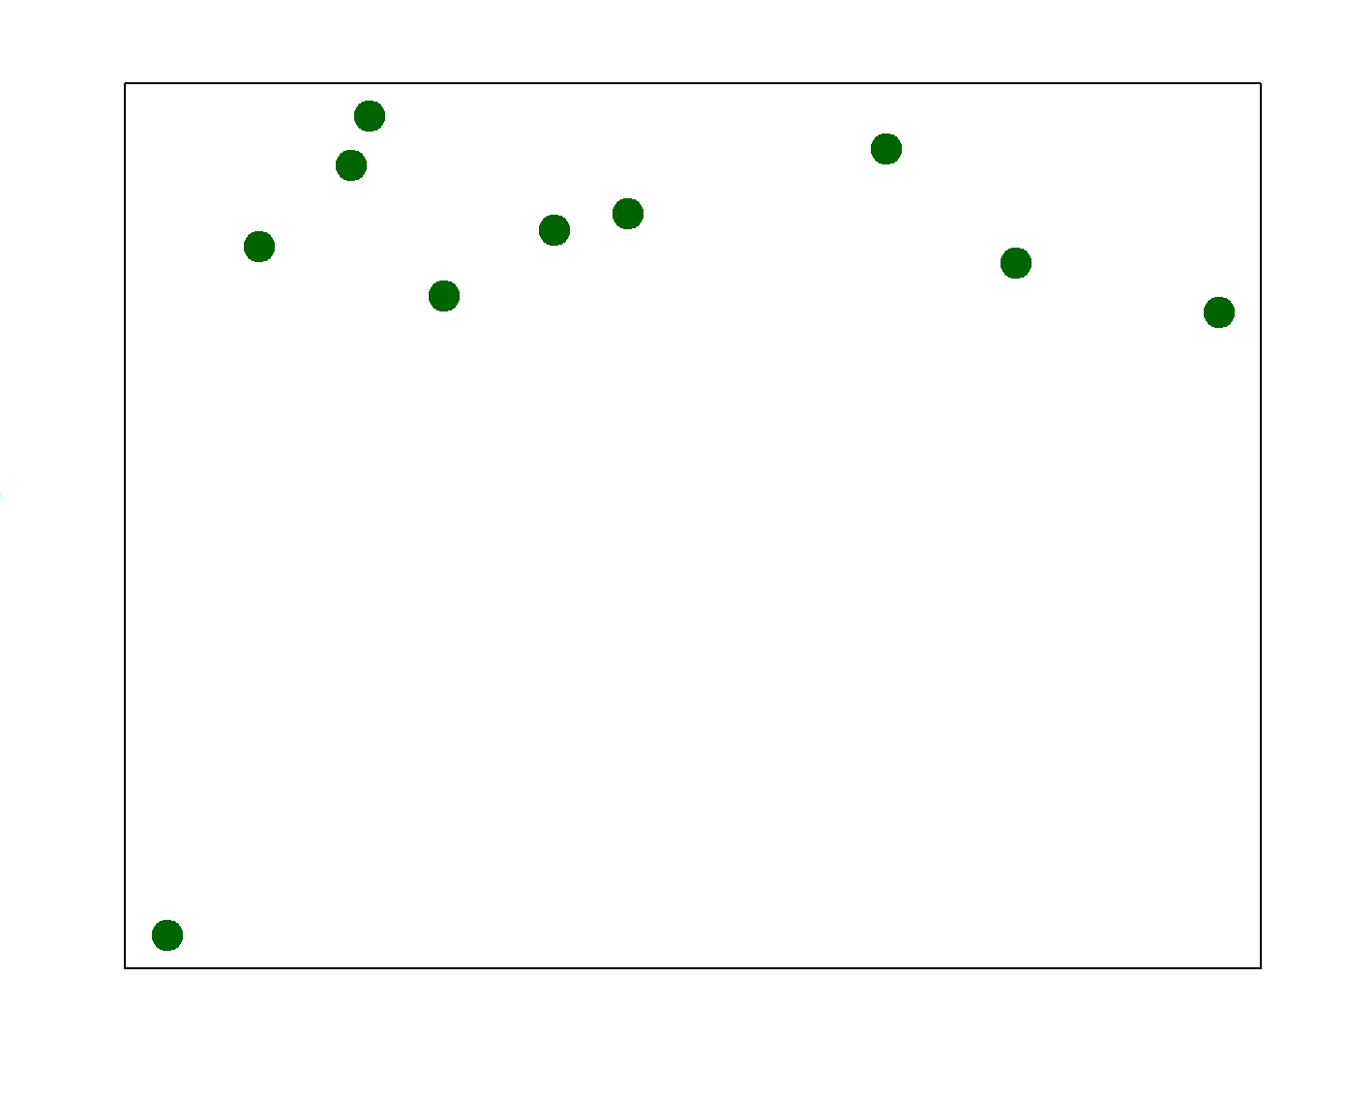
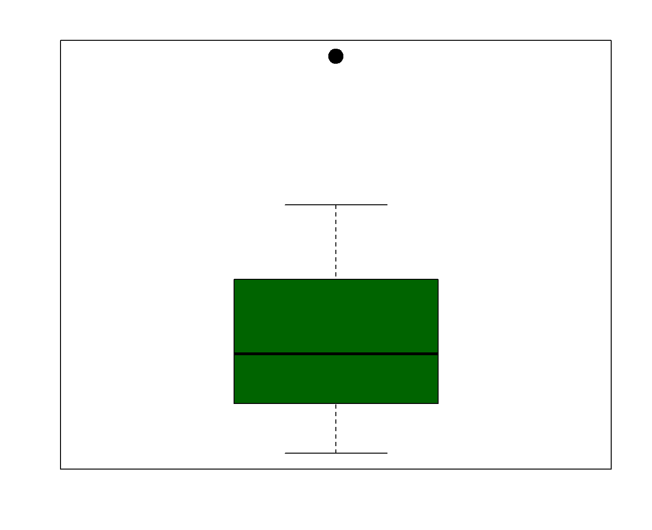
Outliers
Identify outliers
Visual, e.g., a boxplot or scatterplot
Statistical methods, e.g., a value >2 standard deviations from the mean
Evaluate outliers
Is the data point invalid, e.g., caused by a measurement error?
Or is it a valid but unusual number?
Determine how to handle outliers
Delete
Include in analyses

Slide 32
Transformations
Creating new variables, e.g., age groups from numeric ages
Change the format, e.g., from long to wide
Statistical test requirements, e.g., normally distributed data
ID | Date of Birth | Age (years) | Body Temperature (F) | Height (inches) | Veggies (servings)
1 | 5/1/1956 | 69 | 97.3 | 60 | 3
2 | 6/25/1967 | 58 |  | 63 | 1
3 | 4/29/2003 | 22 | 97.4 | 69 | 0
4 | 27170 | 51 | 97.0 | 70 | 1 or 2
5 | 1/30/1998 | 27 | 99.3 | 61 | 2
ID | Time Point | Height
1 | 1 | 63
1 | 2 | 64
2 | 1 | 59
2 | 2 | 60
2 | 3 | 60
Notes:
Framing - transformations are really a kind of reformatting, but you do them after cleaning once the data themselves are clean and it’s time to do final formatting.

Slide 33
The process, revisited

Slide 34
The data cleaning process
Have a plan
Implement the plan
Make sure the plan worked correctly

Slide 35
The importance of order in your cleaning steps
Example: Standardizing different ways of entering “yes”
using a command like “change ‘YES’ or ‘yes’ or ‘Y’ or ‘Yes’ → ‘Yes’”
…when one of the entries has a typo.
Example: Entries in incorrect units (e.g., temperature in Fahrenheit versus Celsius)
… which could otherwise seem like outliers.
Answer
YES
yes
Y
Yes
Answer
Yes
Yes
Yes
Yes
Answer
YES
ys
Y
Yes
Answer
Yes
ys
Yes
Yes
versus

Slide 36
The 80/20 rule of data science
80%
Get Raw Data
Exploratory Data Analysis
Analysis Planning
Data Cleaning
Data Analysis
20%

Slide 37
Data cleaning conceptual wrap-up

Slide 38
Final points
We discussed what data cleaning is and that it is an important step in the research process.
During this stage you make decisions with major implications for your analysis.
These decisions and related methods need to be justifiable, documented, and reproducible.
We discussed how to approach data cleaning – with a plan!
We went through a list of common data cleaning tasks to consider including in your plan.

Slide 39
Discussion Questions
What does data cleaning mean to you?
You have just been given a dataset to clean. How confident are you in your next steps?
Not at all confident - I don't really know where to start.
A little confident
Somewhat confident - I have some ideas and can start adjusting the data.
Pretty confident
Highly confident - I have a plan and know what my next steps are.

Slide 40
What questions do you still have about data cleaning?

