Slide 1

Computational / Reproducible Research Best Practices

Slide 2
Objectives
By the end of this session, you will
Identify some general reproducible research best practices that apply widely and…
Contrast to discipline-specific best practices
Examine ways to apply these best practices to your own research
Be familiar with some common strategies for getting help with the implementation of these best practices (generally) and with writing reproducible code and documentation.

Slide 3
Open and (or?) Reproducible Research

Slide 4
Reproducible Research (RR)
Goal: conduct and document your research in a way that allows others (including future you!) to understand, verify, and rerun the analysis using the same data and methods.
Note: depending on the discipline, this may or may not mean replicating results
Open Scholarship (OS)
Goal: make the products of our research as accessible and reusable as possible. Products may include publications, data, code, documentation, descriptions of methods, and other materials. Open Scholarship looks different across disciplines and must balance accessibility with privacy, safety, community needs, and cultural protocols. But all open scholarship shares a common principle: reducing barriers to allowing others to engage with and benefit from your research (especially those who could be most positively affected).

Slide 5
Academic Crises Galore

Slide 6
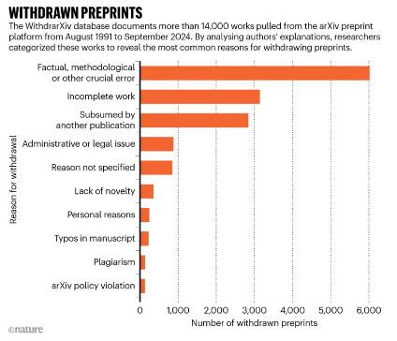
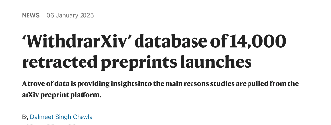
Why should we care about RR / OS? and why now?
https://www.nature.com/articles/d41586-025-00011-8?utm_source=Live+Audience&utm_campaign=721ef416a7-nature-briefing-weekly-20250110&utm_medium=email&utm_term=0_b27a691814-721ef416a7-51739536

Slide 7
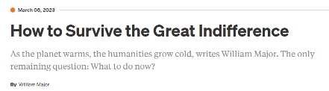
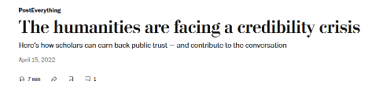
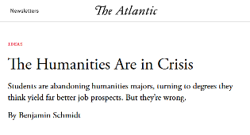
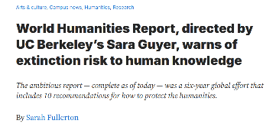
https://www.washingtonpost.com/outlook/2022/04/15/humanities-sciences-credibility-crisis-public-trust/
https://www.insidehighered.com/advice/2023/03/09/thoughts-dealing-despair-over-state-humanities-opinion
https://news.berkeley.edu/2024/10/14/world-humanities-report-directed-by-uc-berkeleys-sara-guyer-warns-of-extinction-risk-to-human-knowledge/
https://www.theatlantic.com/ideas/archive/2018/08/the-humanities-face-a-crisisof-confidence/567565/

Slide 8
What does good open / reproducible research look like in your discipline?
In what ways are researchers in your discipline failing to achieve this?

Slide 9
Different Disciplines, different needs

Slide 10
Open Scholarship Movement
“The open scholarship movement seeks to make knowledge of all kinds, openly shared, transparent, rigorously researched, and inclusive.”
(Azevedo, et al. “Towards a Culture of Open Scholarship” in BMC Res Notes, 2022)
“Open scholarship is an umbrella term that refers to the endeavour to improve openness, integrity, social justice, diversity, equity, inclusivity and accessibility in all areas of scholarly activities. Open scholarship extends the more widely used terms open science and open research to include academic fields beyond the sciences and activities beyond academic research.”
(Parson, et al. “A community-sourced glossary of open scholarship terms” in Nature Human Behavior, 2022)

Slide 11
Open…
Access
Code / software
Data
Education Resources
Methods
Peer Review

Slide 12
DATA Principles
F.A.I.R.
C.A.R.E.
F.A.I.R.E.S.T.

Slide 13
FAIREST + CARE
BRAINSTORM
Collective Benefit
Authority to Control
Responsibility
Ethics
e a few minutes to map these data principles to your research workflow diagram. Jot down specific and feasible ways you could better accomplish these objectives.
Findable
Accessible
Interoperable
Reusable
Ethics
Source
Trust

Slide 14

Dartmouth OSCARRs (Feb/Mar ‘27)
Annual awards recognizing Open Scholarship & Reproducible Research on campus
Learn more at the Dartmouth OSCARRs website, including more explanation of the FAIR(EST) / CARE principles.

Slide 15
From Principles to Best Practices

Slide 16
Computation Research Best Practices
Organization
Documentation
Data Management
Coding Practices
Workflow Automation
Sharing & Openness
Version Control

Slide 17
Organization
One project / one folder
Consistent project structure (i.e. folders: code, data, docs)
Descriptive but interoperable file names
No white space; avoid special characters besides “_” and “-”; lowercase often easier:
“Research Plan.docx” → “research_plan_2026-09.docx”
Think about sorting when naming files
Think about where to place your project files: local hard drive? Cloud drive?

Slide 18
Documentation
Include a README file in each project folder. This should include: a project overview, principal team members, an overview of project files, an explanation of what your code does, an explanation of your data’s provenance, a data dictionary (what each variable means and how each was recorded / measured / modified), license, etc.
Purpose: your project is interpretable by others without you present
Create (or borrow) templates to create consistent documentation structure across projects.
Notes:
Disciplinary variation: Quantitative fields often lean on data dictionaries and codebooks; qualitative researchers may need to document coding schemes and interpretive decisions; lab sciences may need protocols and instrument settings documented alongside code.

Slide 19
Data Management
Non-destructive workflows
Never edit “raw” or “original” data; place copies to be edited in a “processed” folder
Clearly document data provenance: where it came from, every transformation applied, etc.
Notes:
Disciplinary variation: Clinical/human subjects research may need to document consent and de-identification steps; computational social science may need to document API pulls or web-scraping parameters and dates (since online data changes).

Slide 20
Coding Best Practices
Create readable, well-documented, well-organized code
Clear structure
Meaningful variable names, i.e. “post45_books_df” to indicate a dataframe built from Post45 books data.
Modular, reusable code
Store reusable chunks of code in functions
Managing dependencies & local environments
Minimal: record software, packages, and versions used; store in README or other documentation (in R, can retrieve this with sessionInfo()).
Recommended: set up separate virtual environments in each project folder; for R use renv (Python: uv).
Notes:
Disciplinary variation: Especially valuable wherever similar analyses are repeated across many units — many samples in a lab, many survey waves, many texts in a corpus.

Slide 21
Automating Workflows
Create readable, well-documented, well-organized code
Write scripts to automate complex workflows so they can be replicated for new data or other projects
For modular coding: store code for each step in a separate script
Notes:
Disciplinary variation: The "final output" varies widely — a manuscript, a policy brief, a map, a digital exhibit — but scripting the path to any of them improves reproducibility.

Slide 22
Sharing & Openness
Clearly state what uses are permitted through explicit licenses
store and share your code and relevant documentation in a code repository (i.e. GitHub)
Store your data in a data repository for preservation and use by others
Provide persistent identifiers or links to your data (repository) and code (i.e. GitHub) with your publications
Notes:
Making clear what others are permitted to do with your code and data through explicit licenses, and depositing materials in appropriate repositories. Disciplinary variation: Norms and infrastructure differ substantially — genomics has established repositories (GenBank), social sciences often use ICPSR, some humanities fields are still developing shared norms; sensitive data (human subjects, Indigenous data sovereignty contexts) may require restricted or tiered access rather than full openness.of them improves reproducibility.

Slide 23
Version Control
Track changes over time to your code (and other documentation) using git and store copy of project folder online via GitHub.
For other project information, use cloud backup to protect against data loss and allow you to revert to earlier versions of a file.
Notes:
Disciplinary variation: Some fields (bioinformatics, CS-adjacent fields) have widely adopted Git/GitHub norms; others are only beginning to, and may use version control more informally (dated file names, tracked changes in Word) — this workshop is a chance to introduce Git as a more robust alternative.

Slide 24
How can you adapt the lessons of this workshop to your own field & research?

Slide 25
Computational Research Help

Slide 26
Where to get help
Errors will happen! Even once-working code will break!
Steps to minimize these errors:
modular, well-documented code
Beg, borrow, steal (code): don’t reinvent the wheel
Error handling
Kinds of issues: errors, warnings, unintended output
Notes:
Disciplinary variation: Some fields (bioinformatics, CS-adjacent fields) have widely adopted Git/GitHub norms; others are only beginning to, and may use version control more informally (dated file names, tracked changes in Word) — this workshop is a chance to introduce Git as a more robust alternative.

Slide 27
How to handle errors when the inevitably occur
Read the error message carefully (especially the 1st and last lines)
Search for the error message online or in an LLM
Run / click traceback()
Try passing in different inputs (does the error re-occur always? Or only with certain inputs?)
Identify, isolate, and re-run the minimal chunk of code that reproduces the problem
Run your code one step at a time, outputting each intermediate result for review
Look for common bugs: data type mismatches, syntax errors (unclosed “” or []), name mismatches, NA / null values, etc.
Search for / ask for help: online, LLMs, humans
Fix one problem at a time and test it

