Slide 1



Python Graph Gallery
A part of the Reproducible Research Workshop Series
www.dartgo.org/RRADworkshops
Steve Gaughan
https://dartgo.org/steve
Research Computing & Data @ ITC
rc.dartmouth.edu
Notes:
dartgo.org/RRADworkshops for more in the series
Data Science & Reproducible Research
visualization

Slide 2
About the Reproducible Research Group
Joint venture of Research Computing @ ITC and Research Data Services @ Library
Consult with us on
Research data management
Data visualization
Biomedical research support
Spatial data and GIS
High performance and research computing
Statistical software and tools
Economics and social sciences data
Meet the people on campus that support your reproducible research lifecycle
Engage in community discussions to learn from other researchers on campus
Attend our workshops to learn practical tools and tips

Slide 3
About Research Computing and Data
High Performance Computing
Linux Cluster and High Performance Network Storage
Secure systems for medical and protected data
Data Science, Data Analysis, Data Visualization
Textual, numerical, spatial data
Assistance with building reproducible workflows
Scripting in R and Python
Consulting
Computational project planning
Storytelling with data and visualizations
Digital Humanities support

Slide 4
A roadmap for this workshop
Why Python for Graphs & Plots?
Python Jupyter Notebooks
Tidy Data
Live-coding using Python with a reproducible plotting and graphing techniques
Feel free to contact us anytime! research.computing -at- dartmouth.edu
Research Computing homepage https://rc.dartmouth.edu/
ITC homepage https://services.dartmouth.edu/
Notes:
Key Python Libraries for Visualization
Data Types and Structures
Data Visualization Techniques
Matplotlib: A Comprehensive Introduction
Seaborn: Statistical Data Visualization
Live Coding Examples

Slide 5
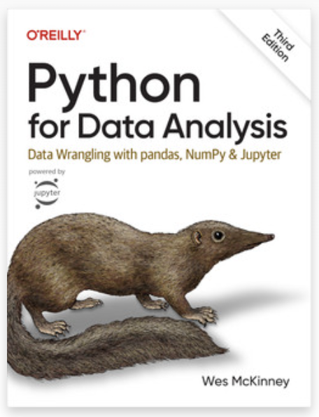
Why Python?
Python can help us make our research reproducible
Python is open source, with many libraries built specifically for data science
Python is a free and easy to download
Standard libraries like Matplotlib and Seaborn for professional quality graphs and plots
Python's importable libraries make it a useful language for data science and data analysis
Python can import and export common data formats such as CSV files
References: Python Graph Gallery, Python for Data Analysis, by Wes McKinney, O'Reilly Publishing https://www.w3schools.com/datascience/ds_python.asp

Slide 6
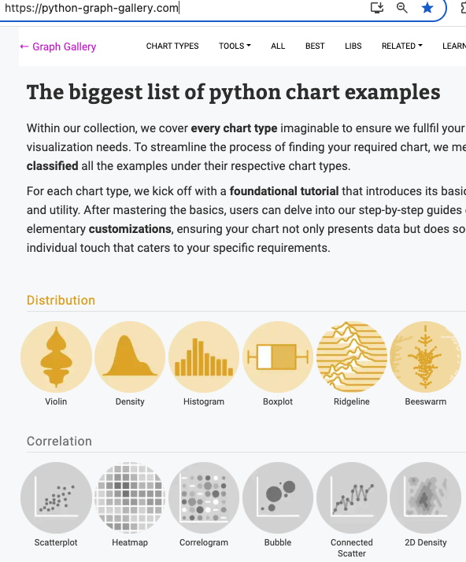
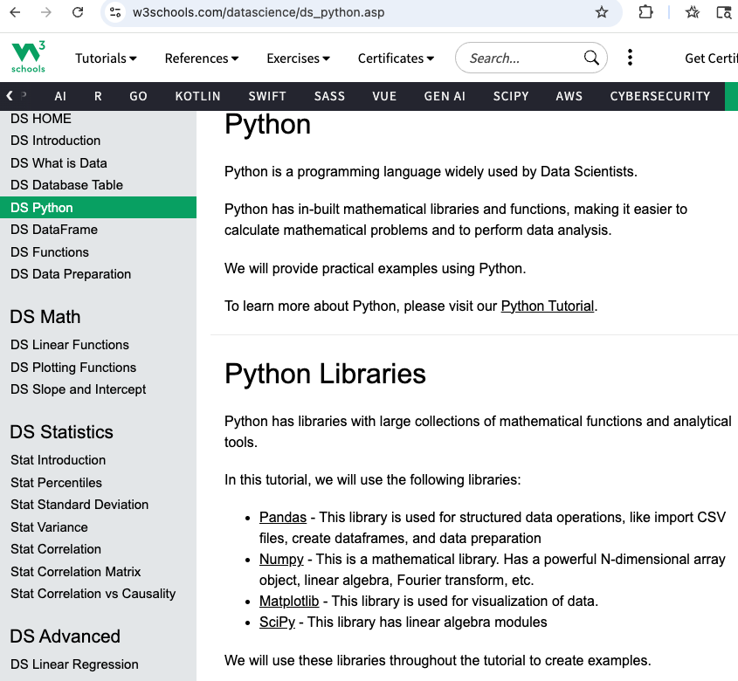
Python Graph Gallery and Python for Data Science

Slide 7
Python Graphs & Plots - Libraries
Python can help us make our research reproducible with libraries that extend capabilities
Some data science libraries include:
NumPy & SciPy - For numerical & scientific computations and linear algebra
Pandas (data frames) - Handling and manipulating data structures / data frames
Matplotlib - Data visualization
Seaborn - Statistical graphics, which build on matplotlib's foundation
Plotly - Interactive and dynamic data visualizations
Scipy Stats and Statsmodels - Econometric and statistical modeling
Note: R & RStudio are a great option also, many similarities (data frames, ggplot, stats)
More books and resources:
Python for Data Analysis, Wes McKinney, O'Reilly Publishing
Data Science from Scratch: First Principles with Python 2nd Edition, Joel Grus
Python for Data Science: A Hands-On Introduction, Yuli Vasiliev

Slide 8
Python Graphs & Plots - Libraries
Python can help us make our research reproducible with libraries that extend capabilities
Some data science libraries include:
NumPy & SciPy - For numerical & scientific computations and linear algebra
Available through Dartmouth College Library
Online edition of “Foundational Python for Data Science” https://learning.oreilly.com/library/view/foundational-python-for/9780136624417/
Python Graph Gallery https://python-graph-gallery.com/
Matplotlib https://matplotlib.org/3.5.3/gallery/index.html
Seaborn https://seaborn.pydata.org/
Python for Data Science https://www.w3schools.com/datascience/ds_python.asp

Slide 9
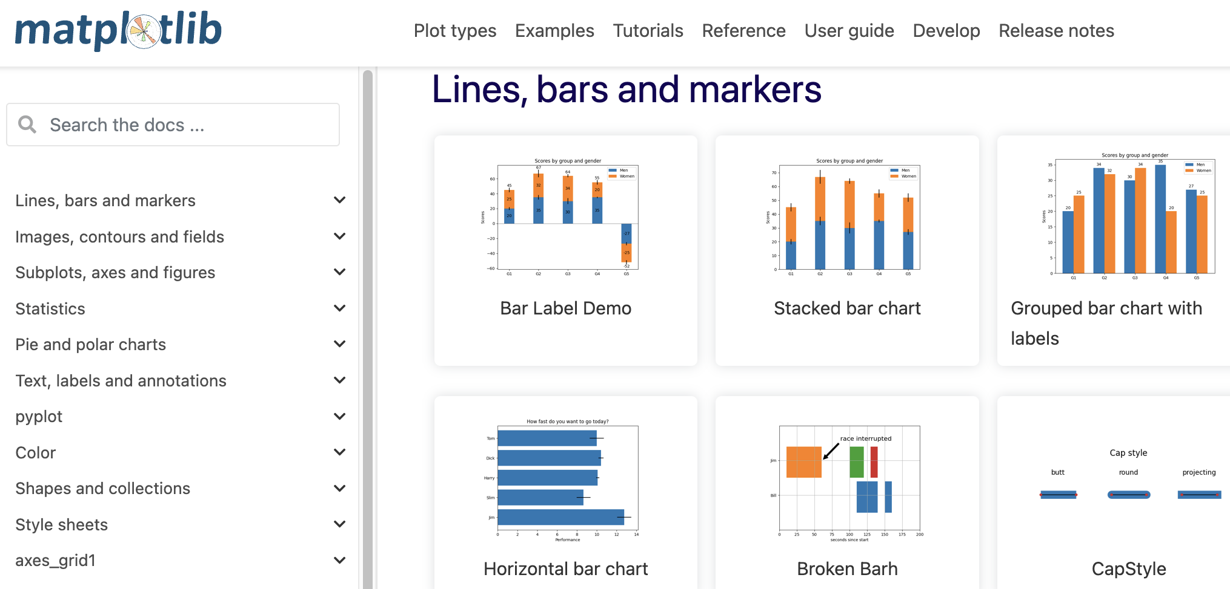
Matplotlib library for Data Visualization
Matplotlib pyplot
Notes:
https://matplotlib.org/3.5.3/gallery/index.html

Slide 10
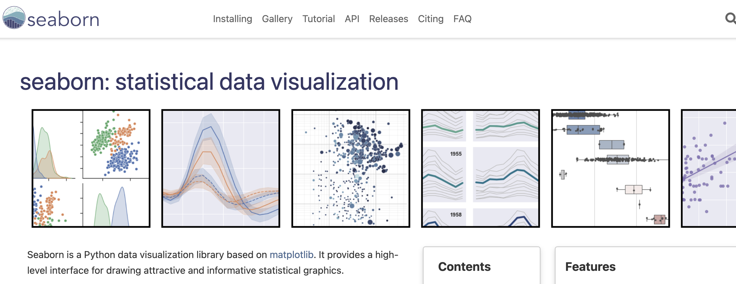
Seaborn library for Data Visualization
Seaborn
Seaborn

Slide 11
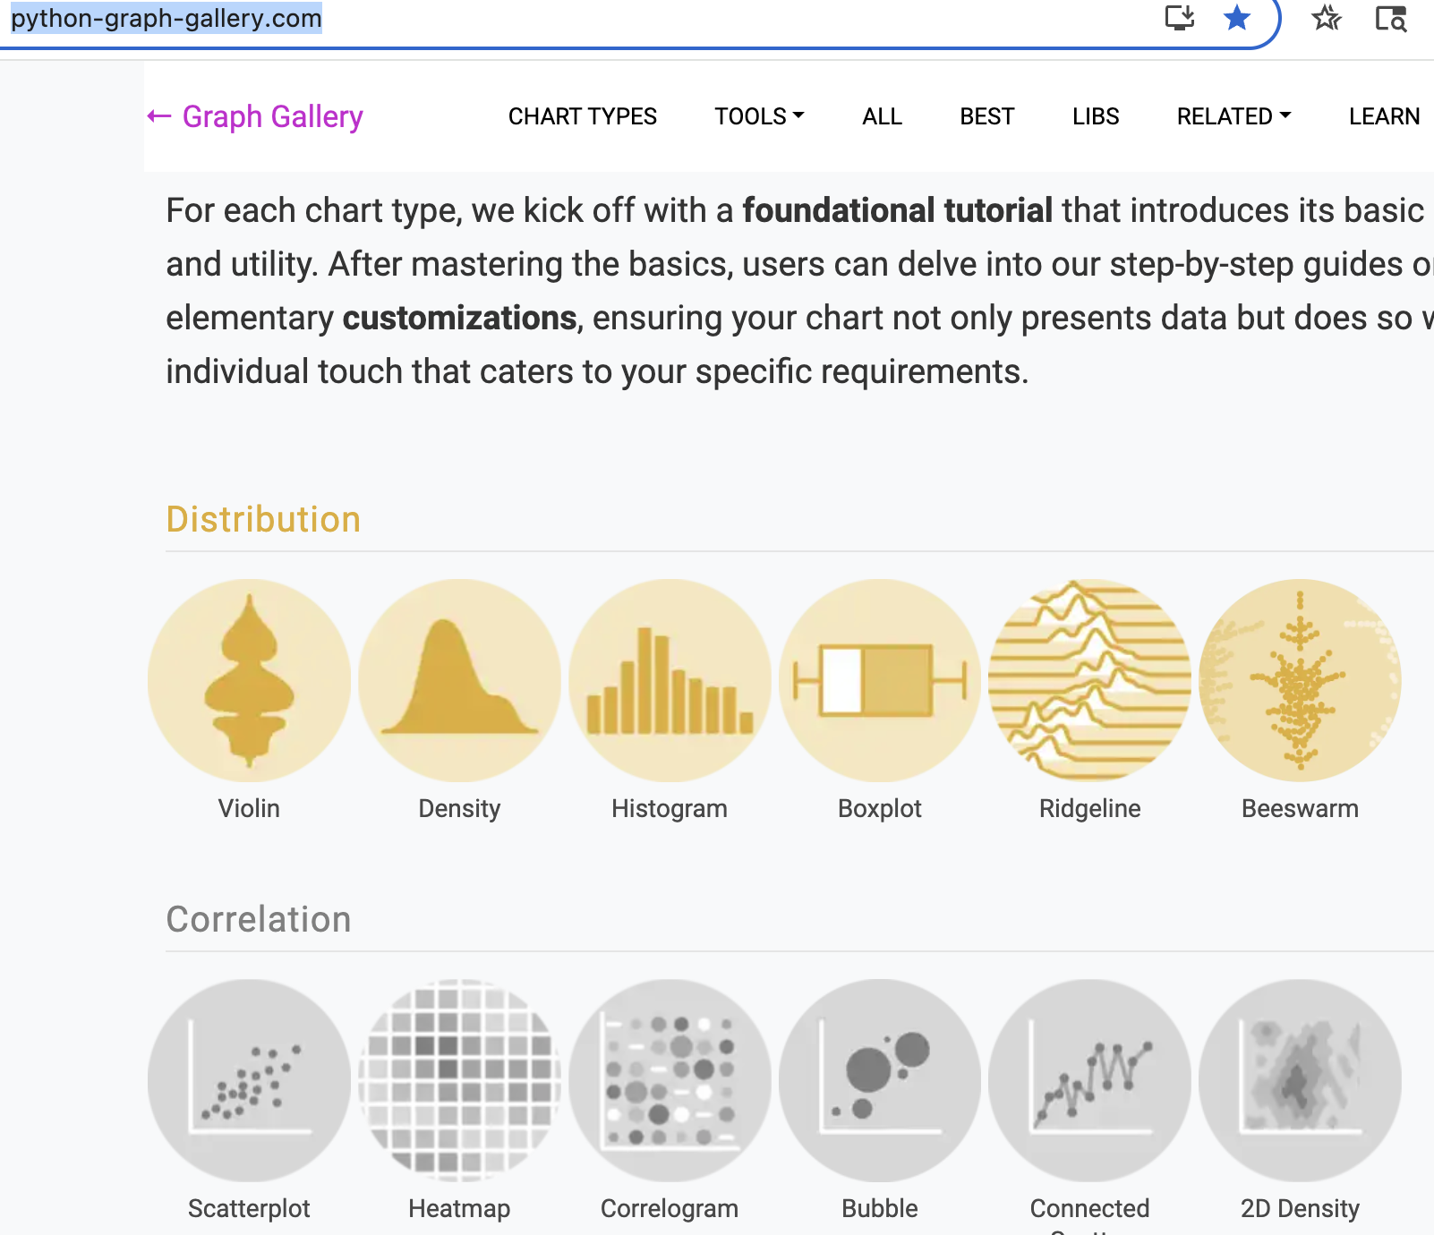
Python Graph Gallery
Python Graph Gallery site
Graph Gallery

Slide 12
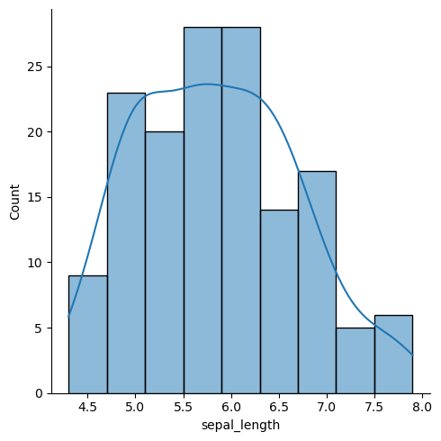
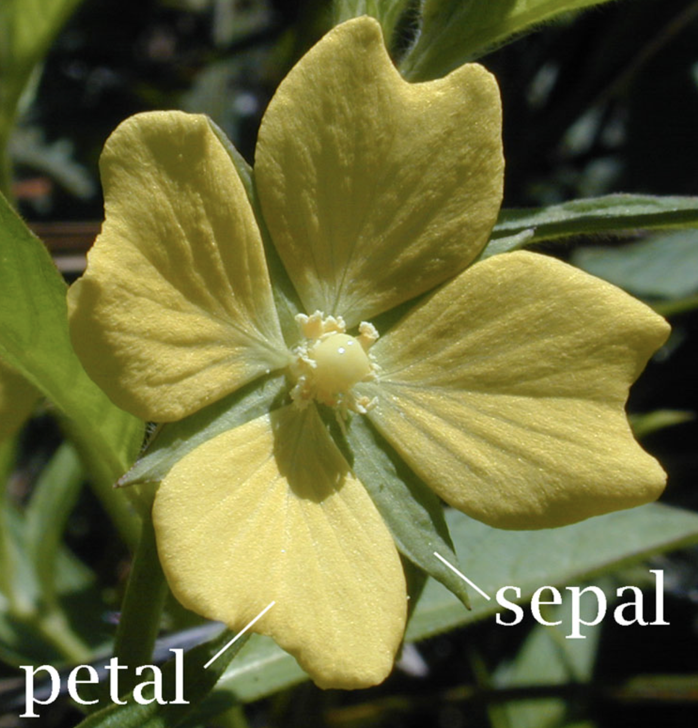
Live code with built in datasets
# library & dataset
import seaborn as sns
df = sns.load_dataset('iris')
# Plot the histogram thanks to the displot function
sns.displot( data=df["sepal_length"], kde=True )

Slide 13
Basics of Reproducible Research for Data Science
To make our research reproducible:
Provide data, with metadata, and the code and software or software version used to run the analysis
Emphasize transparency throughout the research lifecycle
Test that you can generate the same result more than once
Enable other researchers to be able to generate the same result, given the data and the scripts or programs that capture the methodology of the analysis, and then build on that with new data
Run the same analysis steps, given new data with an identical data structure. For example, the data is updated with new observations(rows) and the analysis is re-run.

Slide 14
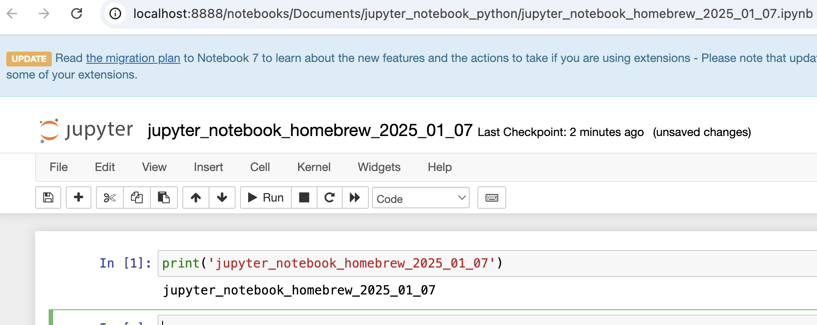
What is a Jupyter Notebook?
Jupyter Notebooks store code, and also show things like plots, visualizations, maps and explanations generated by the Python code and 'markdown' text
Types:
Anaconda Jupyter notebook
VS Code
Google Colab

Slide 15
Jupyter Notebooks, Anaconda, VS Code, Google Colab…
Python = programming language
Anaconda = downloadable software for Mac, PC, Linux that contains a Python Jupyter Notebook system within it
VS Code = downloadable software for Mac, PC, Linux that can (with the right plugins) be used as a Python Jupyter notebook
Google Colab = browser-based Google product (must have a Google account of some sort) that mimics a Python Jupyter notebook
Jhub = ”JupyterHub” and is a web or server-based Jupyter Notebook. Jhub.Dartmouth.edu jhub.dartmouth.edu is TEACHING & LEARNING platform, not designed for research purposes

Slide 16
Notebooks & Code for Python
Anaconda Navigator or Visual Studio Code with Python can help us make our research reproducible
See these notebooks for more: https://github.com/Dartmouth-Libraries/Intro-to-Python and https://github.com/Dartmouth-Libraries/data-viz-matplotlib
Anaconda navigator: https://www.anaconda.com/download/success
Download and install VS Code(Mac or PC) https://code.visualstudio.com/download
See https://code.visualstudio.com/docs/python/python-tutorial
Set up Python in VS Code (Getting Started with Python in VS Code): https://www.youtube.com/watch?v=D2cwvpJSBX4
More Youtube videos on the Visual Studio Code youtube channel at https://www.youtube.com/@code

Slide 17
Conda, Pip, Homebrew
What is does “pip install seaborn” mean?
Conda environments, Anaconda website environments, Conda environments on Dartmouth systems and , Conda website
Pip is a Python package installer system
Homebrew is a Mac-only installer system Homebrew and Python

Slide 18
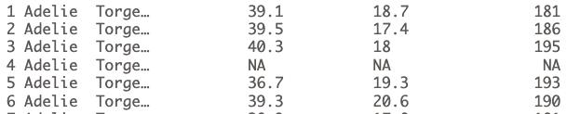
File extensions: .py, .R, .ipynb, csv, xls, jpg, png
Code (.py, .R)
Notebook (code + text(markdown) + images) (.ipynb)
Data (.csv, .xls)
Tidy data – rows and columns, one row per observation, one data type per column, column headings with no spaces no special characters
Images (.jpg, .png, .svg)
Code + data + jupyter md = results, stats, plots

Slide 19
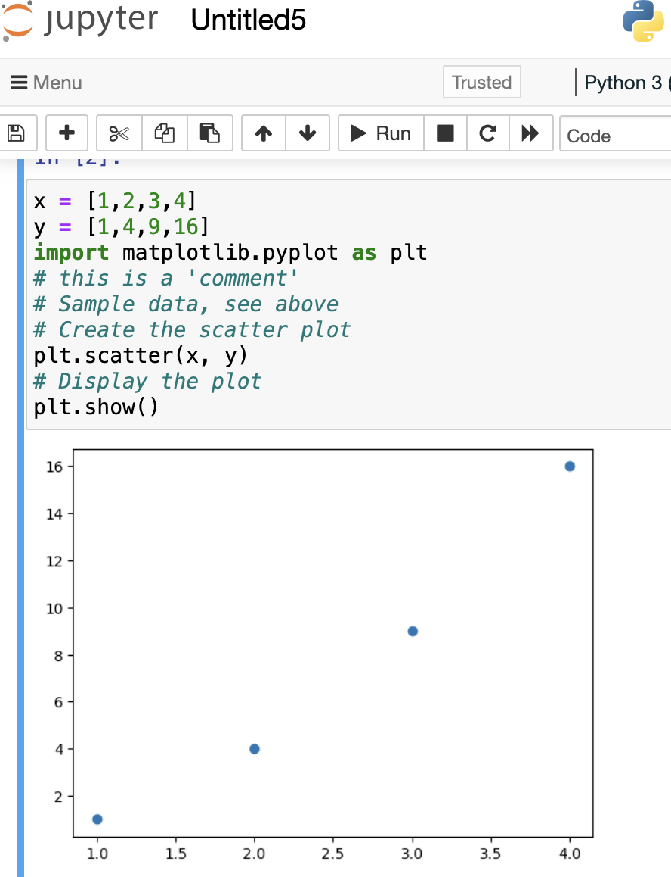
With just a few lines of code, here's a very basic example of how Python and Jupyter notebooks can be used to create reproducible code and a visualization, both of which are essential to data science:
x = [1,2,3,4]
y = [1,4,9,16]
import matplotlib.pyplot as plt
# this is a 'comment'
# Sample datasets x and y, see above
# Create the scatter plot
plt.scatter(x, y)
# Display the plot
plt.show()

Slide 20
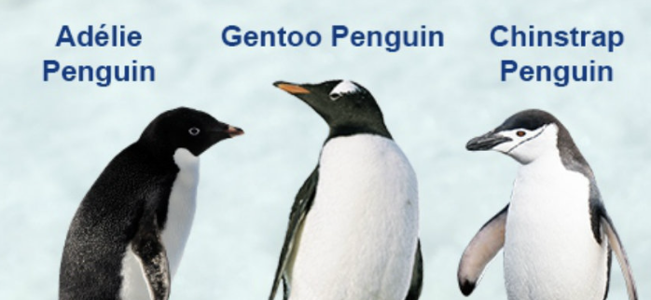
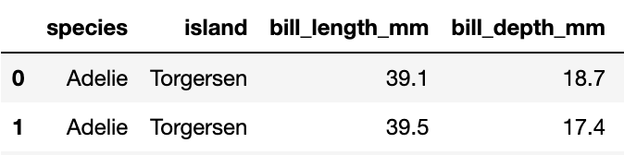
More code to run:
import seaborn as sns
# biology/ornithology/zoology example
penguins = sns.load_dataset('penguins')
# first five rows of data
penguins.head(5)
# shift run to run and create new cell
# built-in dataset - penguins
Source: https://www.kaggle.com/code/sunaysawant/penguin-in-antarctica-eda
Notes:
import seaborn as sns
# shift run to run and create new cell
# built-in datasets, penguins, iris
# biology/ornithology/zoology (penguins)
penguins = sns.load_dataset('penguins')
# first five rows of data
penguins.head(5)
# penguins.tail(5)

Slide 21
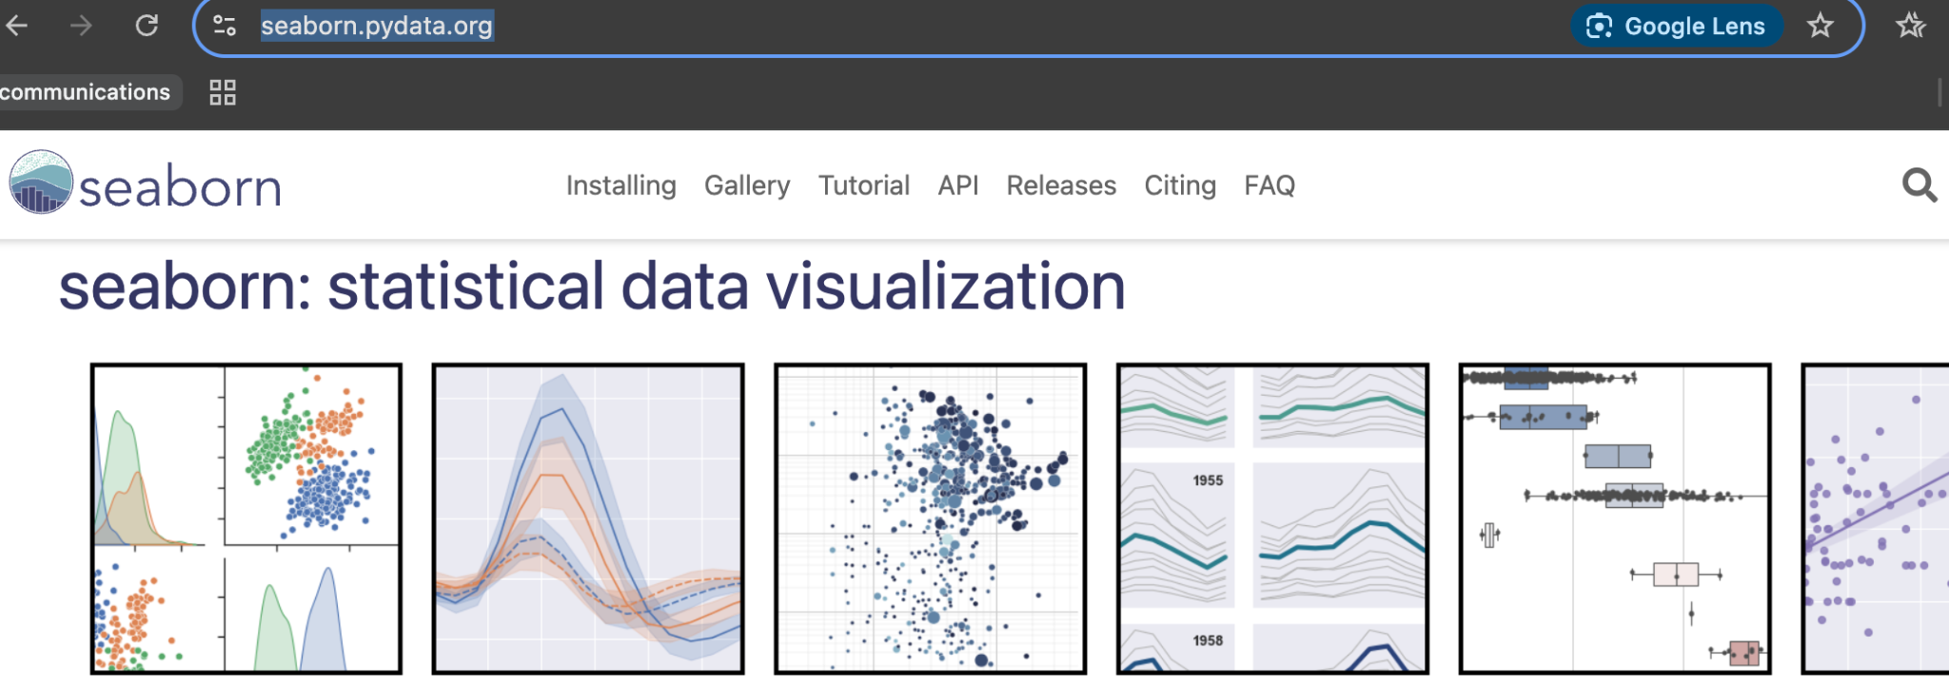
Import seaborn as sns
import seaborn as sns
penguins = sns.load_dataset('penguins')

Slide 22
Loading external data from Excel or CSV, and exporting data to CSV or Excel
import pandas as pd
# pandas is an acronym for python data analysis / panel data attributed to Wes McKinney
# Export the dataframe to a CSV file
penguins.to_csv('penguins.csv')
# Import the 'penguins' dataset from a csv file into a new pandas 'data frame'
penguins_data_frame = pd.read_csv('penguins.csv')
Or you can download the penguin data and then see if you can import it:
https://dartgo.org/penguin_data_csv

Slide 23
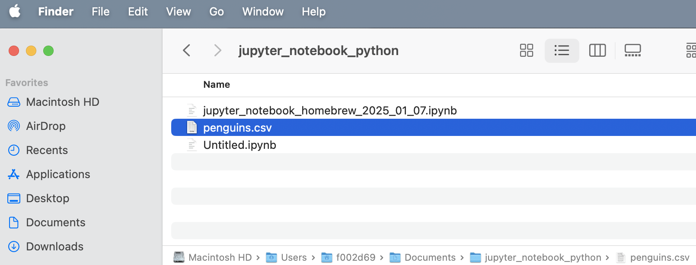
Export to CSV / Excel, import to CSV / Excel:
The Jupyter notebook, in this case, was in the user's "Documents" folder, so the exported CSV file was placed there

Slide 24
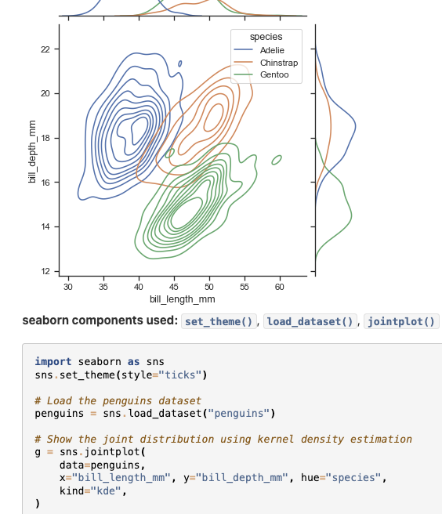
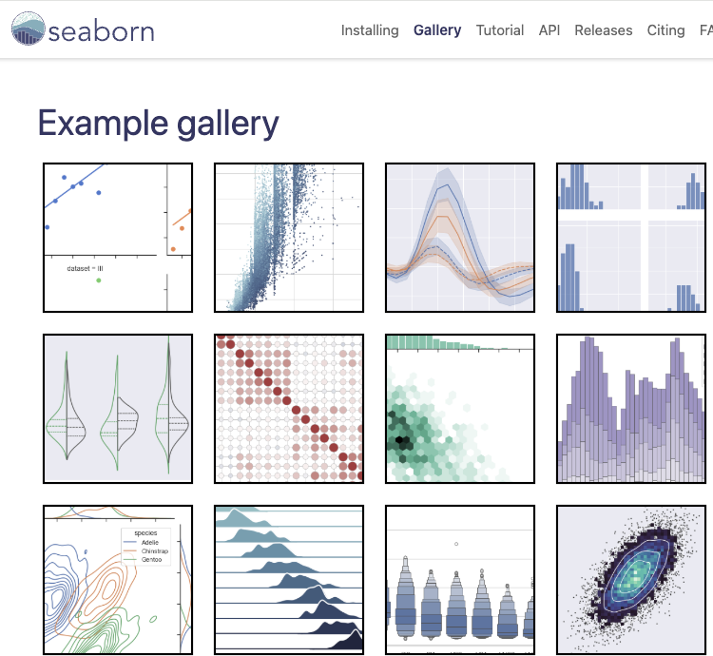
Seaborn plots…and code!
https://seaborn.pydata.org/examples/index.html

Slide 25
'Tidy' Data - a concept for all data, borrowed from R
Tidy Data refers to a structure for arranging data where:
Each variable has its own column, making it easier to compare across observations.
Each observation (or case) has its own row, allowing for easy handling and aggregation of the data.
There is one table (not multiple tables) per subject area or concept.
There are no hidden values, and the number of rows is equal to the total count of observational units.
Following these principles allows for much easier data analysis, and it promotes an intuitive understanding and exploration of the data.
Note: it is ok to have multiple tables and relational database tables, but for data analysis and visualization, it is beneficial to focus on extracting data from those entities into a tidy-format data structure as described above. (source: https://r4ds.had.co.nz/tidy-data.html

Slide 26
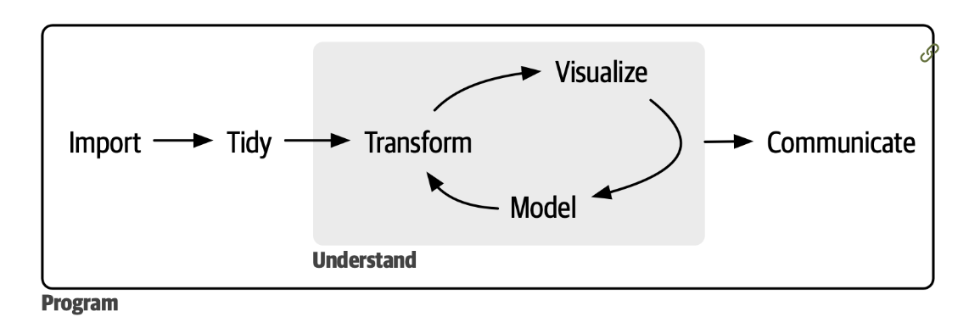
A typical data science process:
Good practice: make a copy of raw dataset, store securely if necessary, do not modify the raw data
With the copy, import & tidy or tidy & import
Transform/model/analyze/visualize
Review results with colleagues, iterate process for new methods & discovery
Communicate the results to general audience in a visual, human-readable and understandable fashion
Source: R for Data Science, Wickham et al

Slide 27
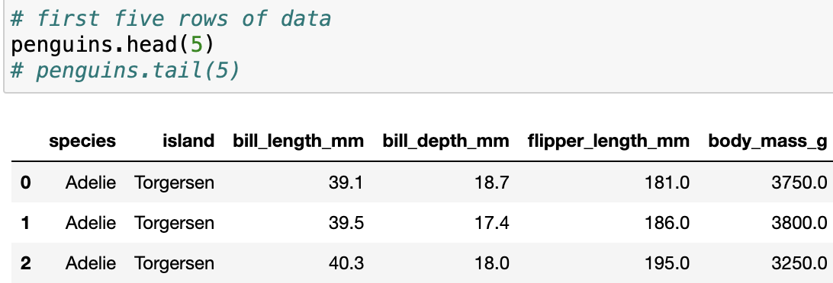
Tidy data example, observations
Observations per penguin
Rows are individuals, columns are attributes/measurements, species, location where penguin was measured, length of the bill length, flipper length, body mass

Slide 28
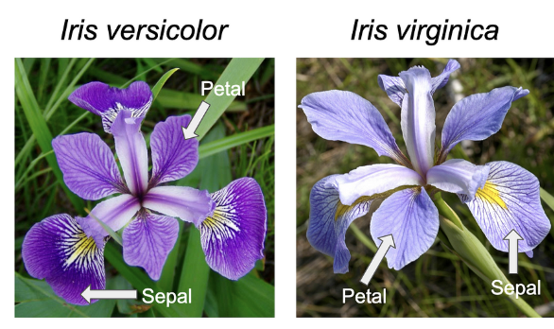
Built-in datasets
Python's Seaborn library has very useful built-in datasets, specifically for learning data science and data visualization concepts
'Iris' dataset
Penguins dataset
Sources: https://en.wikipedia.org/wiki/Iris_flower_data_set#/media/File:Iris_virginica.jpg
https://en.wikipedia.org/wiki/Iris_flower_data_set#/media/File:Iris_versicolor_3.jpg
Source: https://www.kaggle.com/code/sunaysawant/penguin-in-antarctica-eda

Slide 29
More resources
Pandas
https://pandas.pydata.org/docs/getting_started/intro_tutorials/index.html
Seaborn https://seaborn.pydata.org/
Matplotlib, https://www.w3schools.com/python/matplotlib_intro.asp
Numpy statistics routines
https://docs.scipy.org/doc/numpy/reference/routines.statistics.html
SciPy stats
https://docs.scipy.org/doc/scipy-1.15.0/reference/stats.html
Notes:
https://www.w3schools.com/python/matplotlib_scatter.asp

Slide 30
Next steps
Learning data science with Python takes time! Good to see it as a journey, not a destination
Contact us anytime!
Many tutorials available to learn, relatively quickly, how to do the basics in Python
Data types (integers, float/decimal, strings, lists, arrays)
Control flow, programming if-then-else statements, for loops, while loops, conditionals
Writing functions
Data wrangling
Loading data from CSV, Excel, databases
Handling missing values
Filtering data, sorting data, grouping data
Matplotlib and Seaborn visualizations for Exploratory Data Analysis and final publication graphics

Slide 31
Next steps
Work on a small subset of your data first, or work with a built-in dataset to begin to understand the basics
Take it a step at a time
Get to know your data
Don't try to learn everything at once
Establish reasonable goals
Use built-in data and small subsets of larger datasets first
Follow tutorials, documentation, books and programming resources
https://seaborn.pydata.org/tutorial.html
https://www.w3schools.com/python/pandas/default.asp
https://pandas.pydata.org/docs/user_guide/10min.html
https://stackoverflow.com/
Software Carpentry https://swcarpentry.github.io/python-novice-gapminder/
More at https://github.com/Dartmouth-Libraries/reproducible-research

Slide 32
Resources & Links
Contact us: https://rc.Dartmouth.edu
Upcoming workshops: dartgo.org/rradworkshops
Materials will be sent out
Slides
Code and sample datasets to experiment with
Notes:
https://swcarpentry.github.io/python-novice-gapminder/01-run-quit.html
Key Python Libraries for Visualization
Matplotlib: Basic plotting library
Seaborn: Based on Matplotlib; enhances statistical visualizations

Slide 33
Live Code with built-in dataset
Visit https://dartgo.org/python-data for external data
pip install statsmodels
import pandas as pd
from statsmodels.api import datasets
# Load the mtcars dataset
mtcars = datasets.get_rdataset("mtcars").data
print(mtcars.head())

Slide 34
Live Code with built in dataset
# Check for missing values
print(mtcars.isnull().sum())
# For this dataset, we can check for and fill missing values as needed
# As an example, let's replace missing values in 'hp' with the mean of the column
mtcars['hp'].fillna(mtcars['hp'].mean(), inplace=True)
print(mtcars['hp'].describe())

Slide 35
Live Code with built in dataset
import matplotlib.pyplot as plt
# Create a scatter plot of 'mpg' vs 'wt' (miles per gallon vs weight)
plt.scatter(mtcars['wt'], mtcars['mpg'], color='blue')
plt.xlabel('Weight (1000 lbs)')
plt.ylabel('Miles per Gallon (mpg)')
plt.title('Scatter plot of mpg vs. wt')
plt.grid()
plt.show()

Slide 36
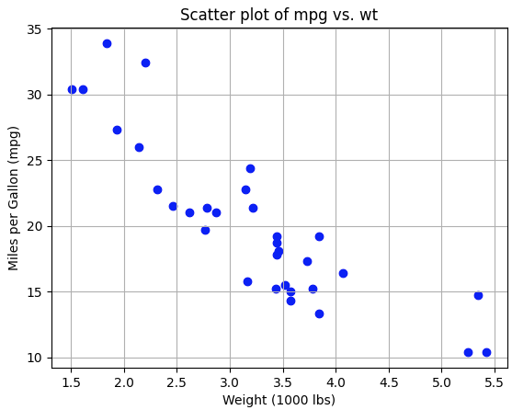
Result
import matplotlib.pyplot as plt
# Create a scatter plot of 'mpg' vs 'wt' (miles per gallon vs weight)
plt.scatter(mtcars['wt'], mtcars['mpg'], color='blue')
plt.xlabel('Weight (1000 lbs)')
plt.ylabel('Miles per Gallon (mpg)')
plt.title('Scatter plot of mpg vs. wt')
plt.grid()
plt.show()

Slide 37
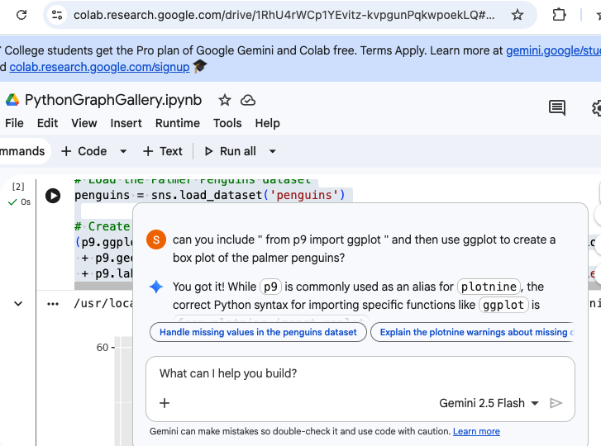
ggplot / R
Know R or GGPlot syntax??
import plotnine as p9
import pandas as pd
import seaborn as sns # Load the Palmer Penguins dataset
penguins = sns.load_dataset('penguins')
# Create a ggplot scatter plot
(p9.ggplot(penguins, p9.aes(x='flipper_length_mm', y='bill_length_mm', color='species’))
+ p9.geom_point()
+ p9.labs(title='Flipper Length vs. Bill Length by Species', x='Flipper Length (mm)', y='Bill Length (mm)'))
Also shown: Google Gemini AI coding

Slide 38
Feedback
Thanks for coming to our workshop!
We want to now learn from you about how we continue to present relevant workshops in the best way we can.
Please take a minute or so to fill out our form with your constructive feedback, we can't wait to hear from you!
dartgo.org/feedback

Slide 39

Questions?
As always, feel free to reach out anytime.
https://rc.dartmouth.edu/
https://services.dartmouth.edu/
Thanks for attending our workshop!

