Slide 1
Terminology
1
Data Value

Slide 2
Terminology
1
0
21
T
lg
1.
13
Data Point

Slide 3
Terminology
1
0
21
T
lg
1.
13
0
1
33
F
m
2.
-1
Dataset
1
0
24
F
s
3.
7
1
1
28
T
lg
1.
0

Slide 4
Terminology
Column C
Column F
Column E
Column B
Column G
Column A
Column D
1
0
21
T
lg
1.
13
0
1
33
F
m
2.
-1
Data frame
1
0
24
F
s
3.
7
1
1
28
T
lg
1.
0
Notes:
Data itself can also be all of these things, as well as visualizations, results, quantitative facts, etc.
Ex. Google ‘airbnb data’ click the Airbnb DNA link, type in a city, show all the things it gives me as ‘data’.

Slide 5
Logical
Character
Integer
Monetary
Numeric
Date
Complex
Data Values
Notes:
Individual data values

Slide 6
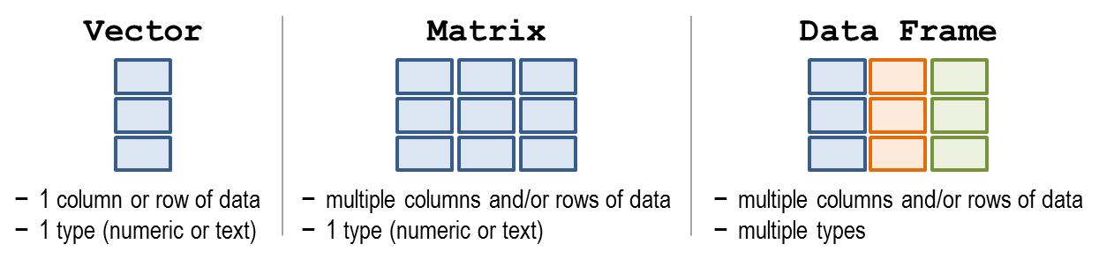

Slide 7
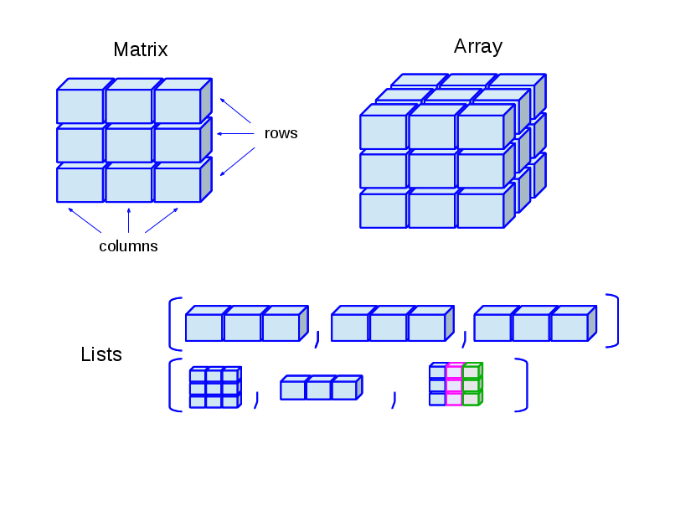

Slide 8
Dimensions
Vectors and (simple) lists typically only have 1D -> length!
Matrices and Data frames have 2D -> rows and columns
Notes:
Rows always come first.
Data frames have the inherited format that you have observations in rows, and variables/features/stuff being measured/described in columns
Most people assume this structure for matrices, although it is not necessarily true. In many cases it can be advantageous to transpose a matrix.

Slide 9
Dimensions
 | 1D | 2D | Multi-D
Homogeneous | Vector | Matrix | Array
Heterogeneous | List | Dataframe | Lists of dimensional object
Heterogeneity

Slide 10
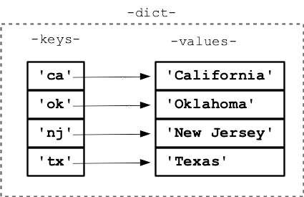
Special python objects

