Slide 1
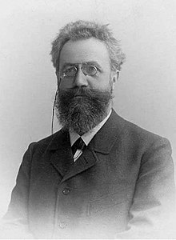
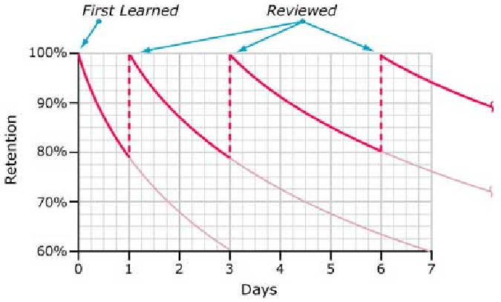
Important People
Hermann Ebbinghaus
Studied memory
Discovered the forgetting curve

Slide 2
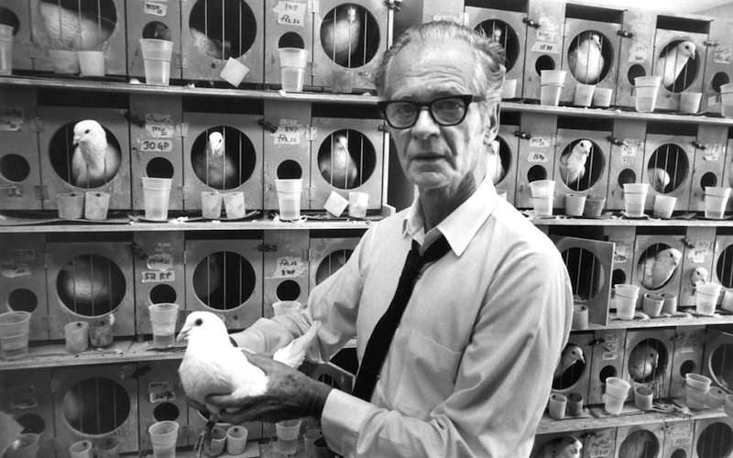
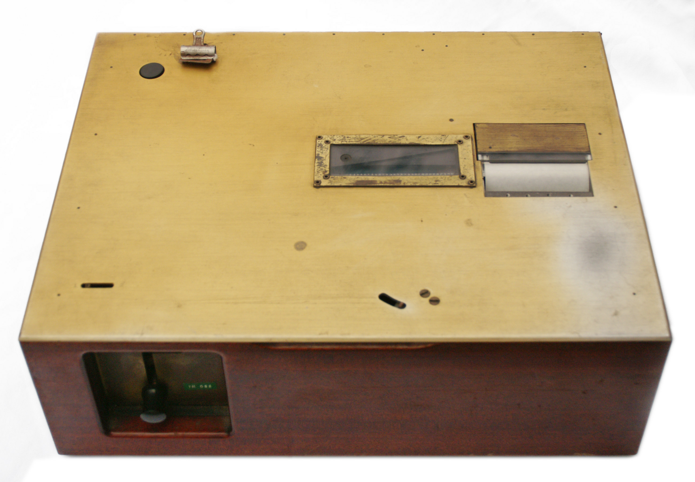
Important People
B. F. Skinner
Pioneered radical behaviorism
Invented “GLIDER”

Slide 3
GLIDER
Implemented:
Automatic, immediate and regular reinforcement without the use of aversive control
Adjustable spacing of repetitions to suite the individuals learning speed.

Slide 4
GLIDER
GLIDER could not automatically adjust the spacing of repetitions, this was done manually, and based on “intuition,” not a mathematical model.
It was mechanical.
It was very expensive.

Slide 5
My Program

Slide 6
My Program
Uses same operant conditioning principles as “GLIDER.”
Automatically calculates spacing of repetitions. This makes it more precise than GLIDER, and allows learning to occur at the maximum rate that an individual is capable of.
Calculates the forgetting curve of each set of information. This is so that users can look at pictures of a graph of the forgetting curves, (in a future update).

Slide 7

Spacing
Spacing of repetitions is implemented by this formula:
It just means:
The length of time for the new interval to the next repetition, is equal to that of the previous interval, multiplied by difficulty.
Or;
newInterval = previousInterval * difficulty;

Slide 8

Difficulty
Difficulty, as seen in the previous slide, determines the length of the interval between repetitions.
Difficulty is implemented by this formula:
This is known as the “slope-intercept” formula.

Slide 9
y = mx + b
What is y = mx + b doing here?
Difficulty is calculated as the point of a line that intercepts the y-axis of a cartesian co-ordinate graph.
The line must not intersect the y-axis outside of the values 1.3, and 2.5.
Otherwise, the study sessions can occur too often, and slow progress down, or not often enough, and cause the ability to retrieve information to decay to much.

Slide 10
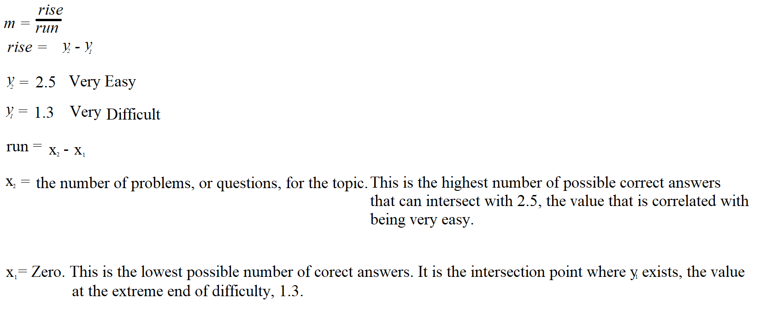
y = mx + b
m is the slope. This provides the constraints

Slide 11
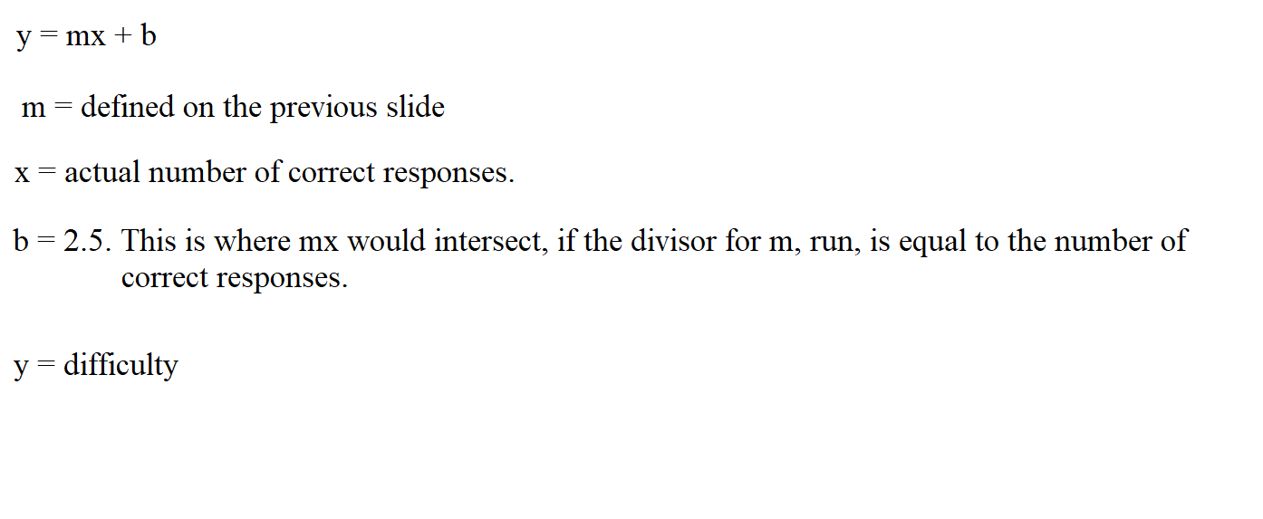
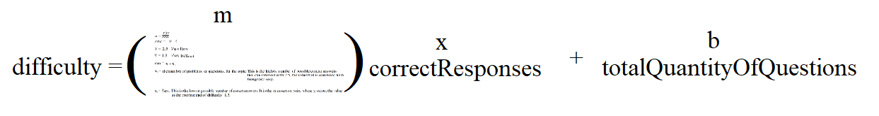
y = mx + b
y = mx + b, or:

Slide 12
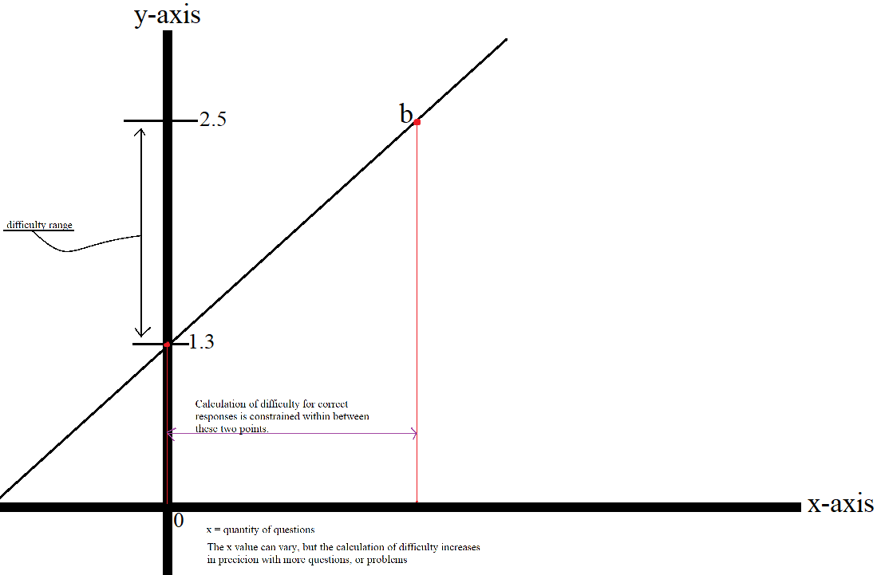
y = mx + b

Slide 13
Prepare the course.

Slide 14
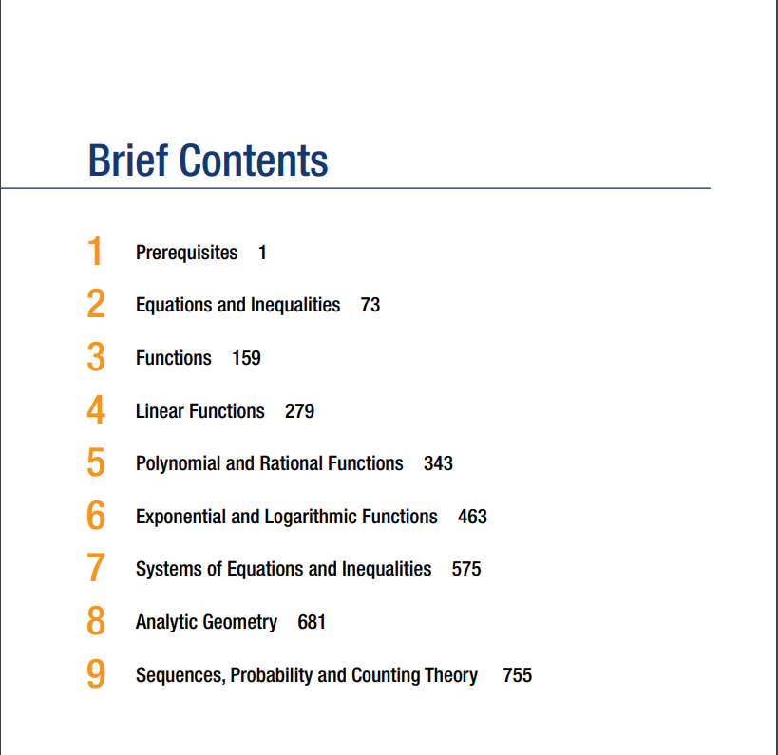
It’s easy to use!
The program is easy to use.
Step 1: Note the number of chapters.

Slide 15
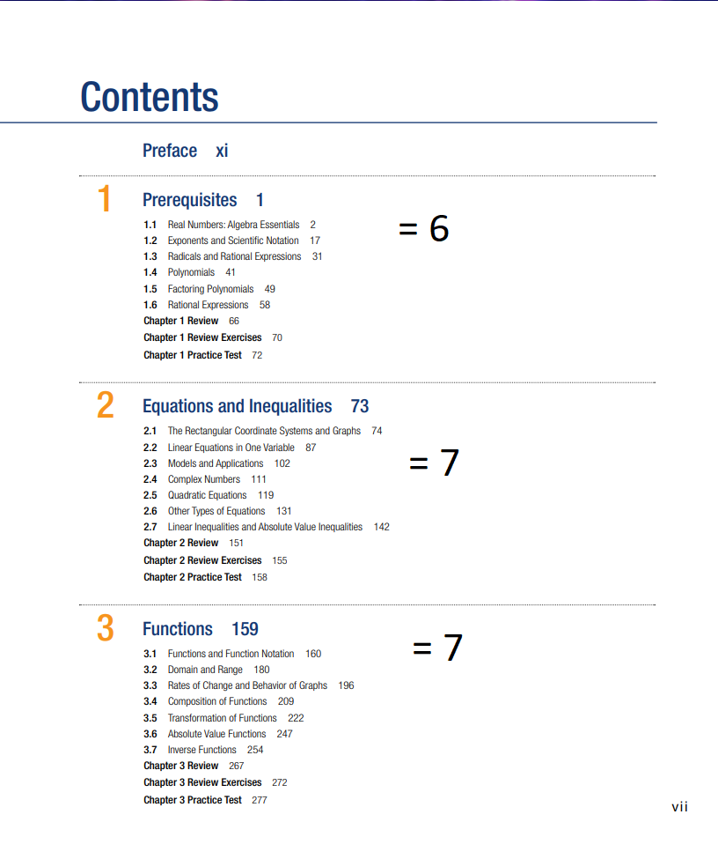
It’s easy to use!
The program is easy to use.
Step 2: Note the number of topics, for each chapter.

Slide 16
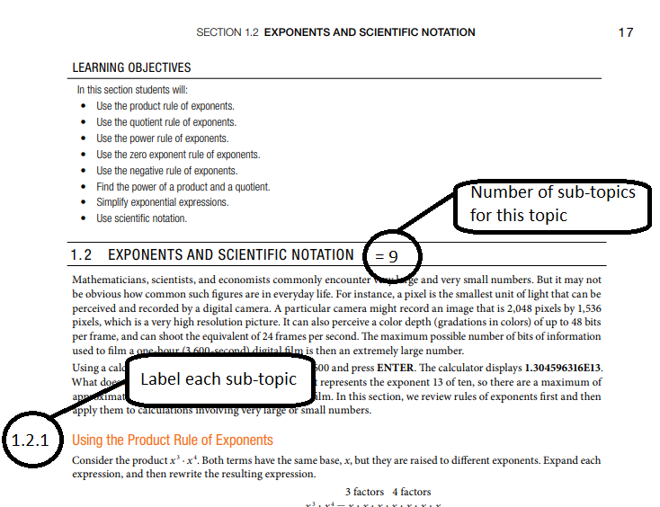
Step 3: Note the number of sub-topics, for each topic. Also, label each one, (or write it down in a notebook).
It’s easy to use!

Slide 17
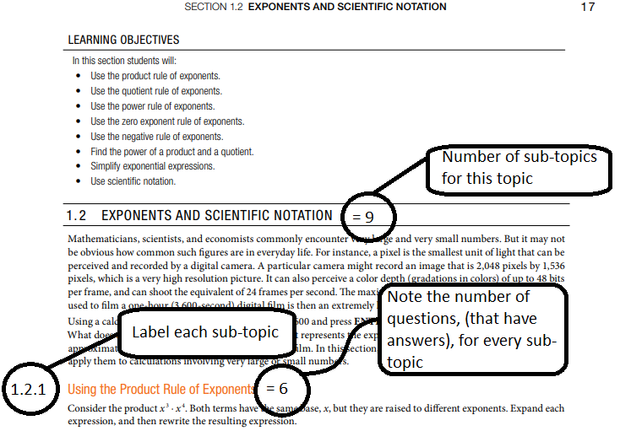
Step 4: Not the number of questions, or problems (only ones with answers provided!), for each sub-topic.
It’s easy to use!

Slide 18
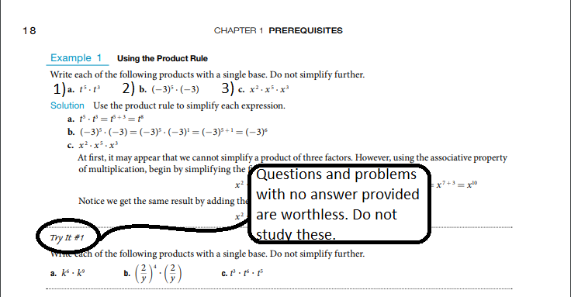
Note about Step 4:
It’s easy to use!
This is true for mathematical subjects, not for programming languages.

Slide 19
Upload the course

Slide 20
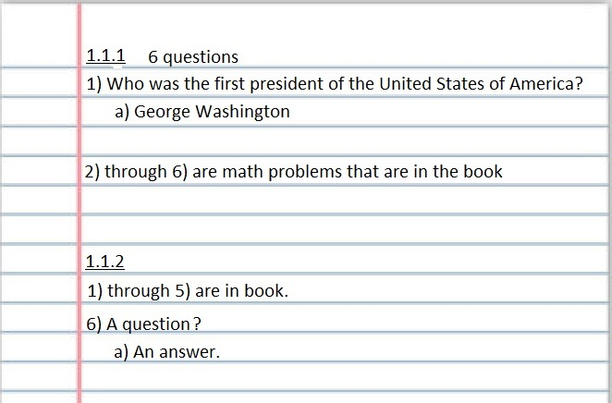
Uploading
Step 1: Write down the questions and answers.
Using pen & paper is quicker than making images for a digital flashcard system.

Slide 21
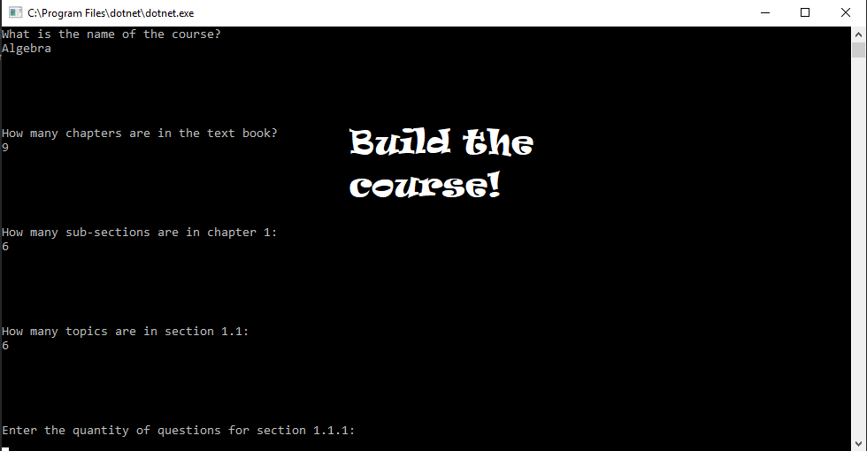
Uploading
Step 2: Upload all of the information.
A future update will allow one chapter at a time.

Slide 22
Use the program!

Slide 23
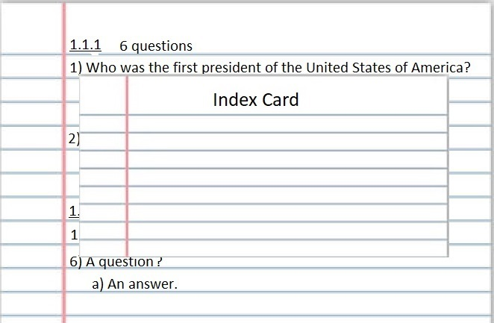
Use it!
Use an index card.
Hide the answer while you respond to the question, or problem.

Slide 24
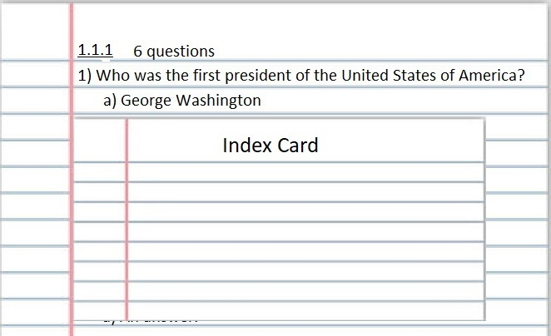
Use it!
Reinforce desired responses.
If you get the right answer, then you just reinforced, and strengthened, the engram’s stability.

Slide 25
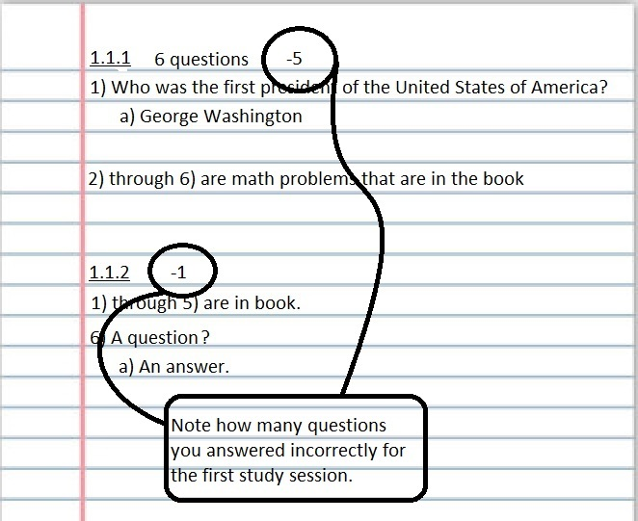
Use it!
Note the quantity of incorrect responses in your notebook. Only do this on the first study session.
This is needed to calculate the difficulty

Slide 26
Use it!
After the first study session of a topic:
Check the program every day. Some days will have no practiced material to rehearse.
(A future update will pop a notification up in your taskbar, and schedule the rehearsals in your calendar. There will also be a GUI)
Do not let too much time pass from a scheduled repetition! The memory of that information will decay, and you will have to relearn the information.

Slide 27
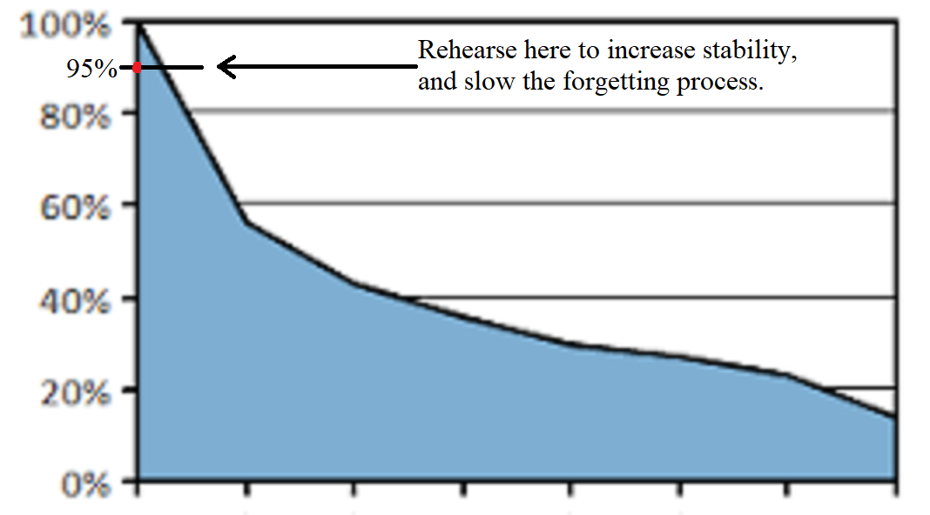
Use it!
The rehearsals are scheduled on days that retrieval decays to 95%
Example of 1st repetition forgetting curve:

