Slide 1

The Future Of Ai Will Be About Less Data Not More
Presented By
Abouhane Zahra
Bazgour Yassine
M’kouka Btissam
Zahedi Chaimaa
Bouamir Assia
El Akil Hakima
Evaluated By
El Hassan Abdelouahd

Slide 2



Core Focus of the Article

Slide 3
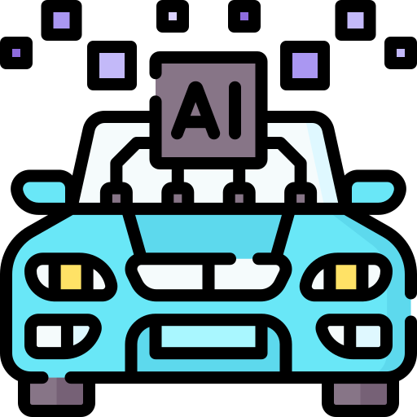

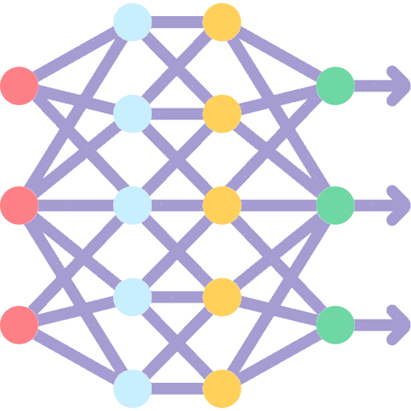
Limitations Of Current AI

Slide 4

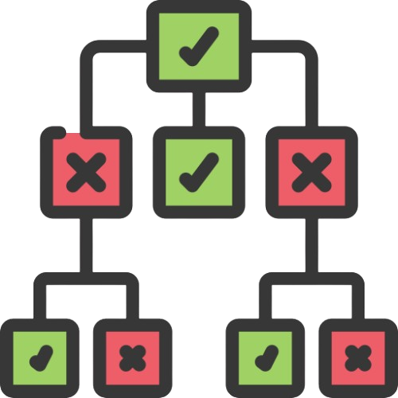
Top-Down Reasoning in AI

Slide 5




Broader Application

Slide 6
Title of slide

Slide 7
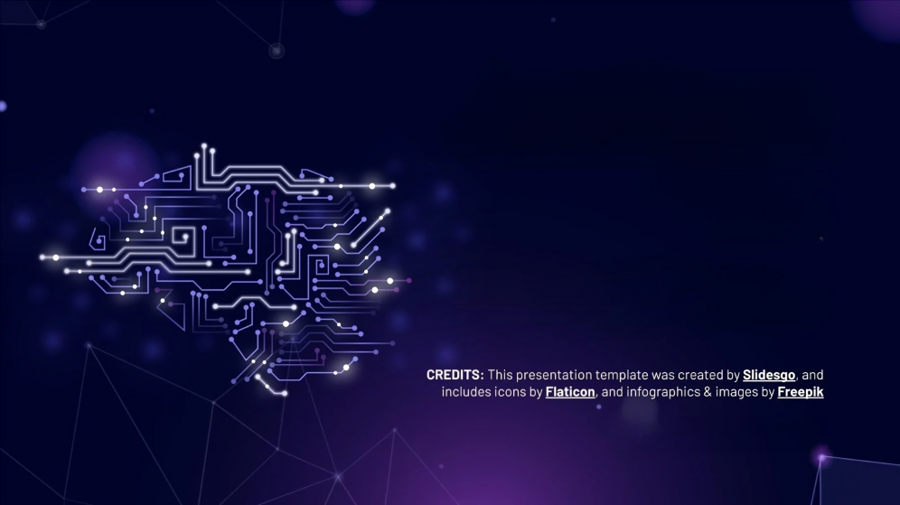
THANKS

