Slide 1
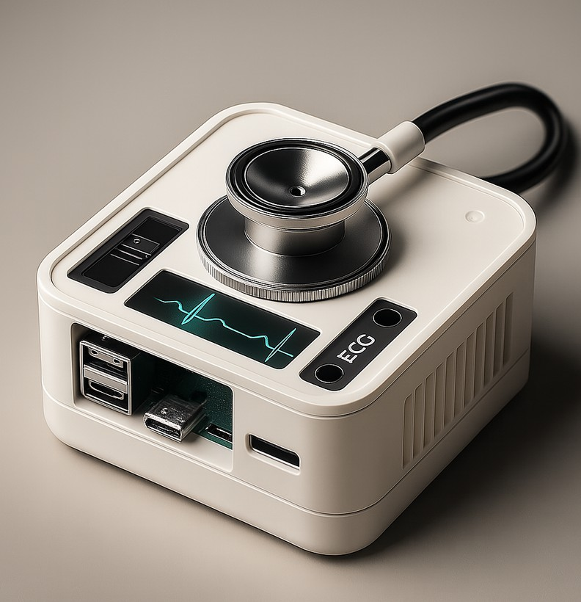
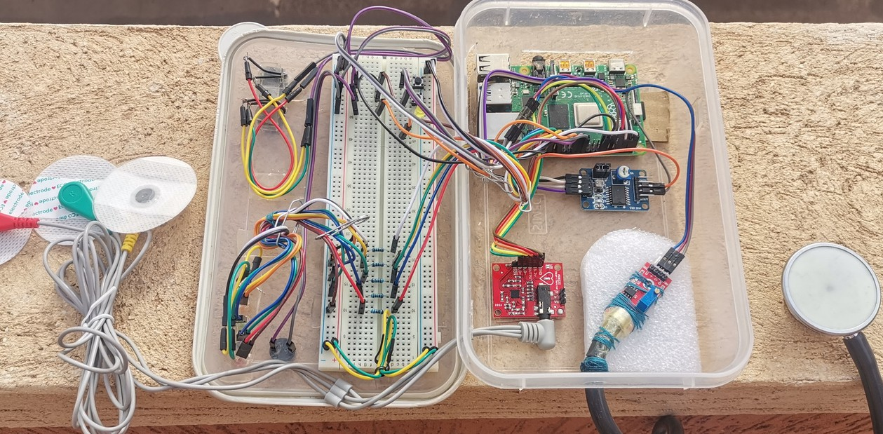
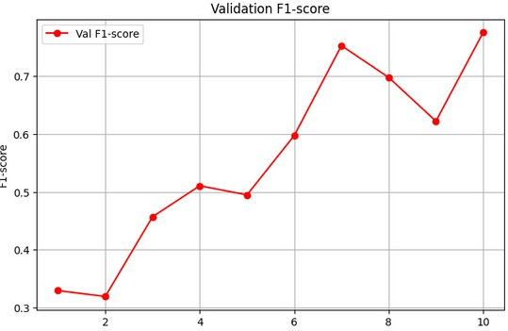
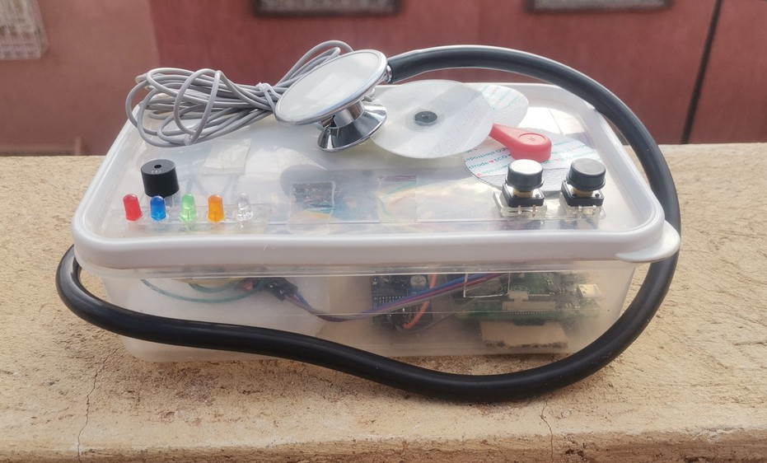
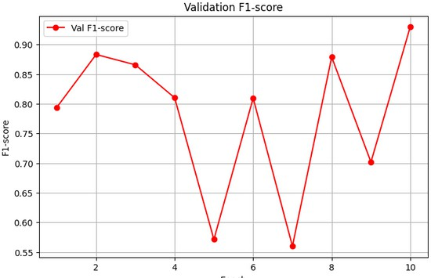
PulseX: Deep Learning- Enhanced Heartbeat Audio Analysis for Early Cardiovascular Anomaly
Detection
Mr. Yassine BAZGOUR, Dr. Mohammed AMEKSA Dr. Mohamed-Amine CHADI
Heart diseases causes over 20 million deaths yearly, often due to late or inaccessible diagnostics. PulseX offers a portable, AI- powered system for early detection, combining stethoscope- based heart sound analysis and ECG recording on Raspberry Pi.
Trained on 800+ labeled recordings, it classifies abnormal heartbeats with 92% accuracy. The PulseTrack interface manages patient data and displays results, enabling non-specialists to screen for cardiac issues and advancing scalable, low-cost care.
1
Problem
20M die yearly from heart disease, 640M live with it. In Morocco, it’s 38% of deaths. Early, automated detection is critical.
2
Objective
AI-based stethoscope and ECG system with demographics for automated cardiac analysis on Raspberry Pi, low-cost, real-world use.
3
Methodology
PulseX uses a dataset of over 800 normal and abnormal heart sounds with demographics (age, gender, smoking status, region). Audio is converted to Mel-spectrograms and combined with metadata, then classified by a ResNet-18 model on a Raspberry Pi. An AD8232 ECG module records heart signals for additional monitoring, supporting telemedicine on embedded devices.
4
Results
The PulseX binary model achieved 92.65% accuracy, 92.96% F1-score, 89.19% precision, and 97.06% recall, showing strong detection of abnormal heart sounds. The multi-label model reached 80.62% accuracy, 77.57% F1-score, 81.13% precision, and 80.33% recall. Combining Mel- spectrograms with demographic data enabled accurate heart sound analysis on Raspberry Pi, supporting telemedicine use.
References
https://world-heart-federation.org/news/deaths-from-cardiovascular-disease-surged-60-globally https://www.bhf.org.uk/-/media/files/for-professionals/research/heart-statistics/bhf-cvd-statistics-global-factsheet.pdf
https://www.researchgate.net/publication/355082014_Epidemiology _of_Cardiovascular_Diseases_in_Morocco_A_Systematic_Review

