Slide 1

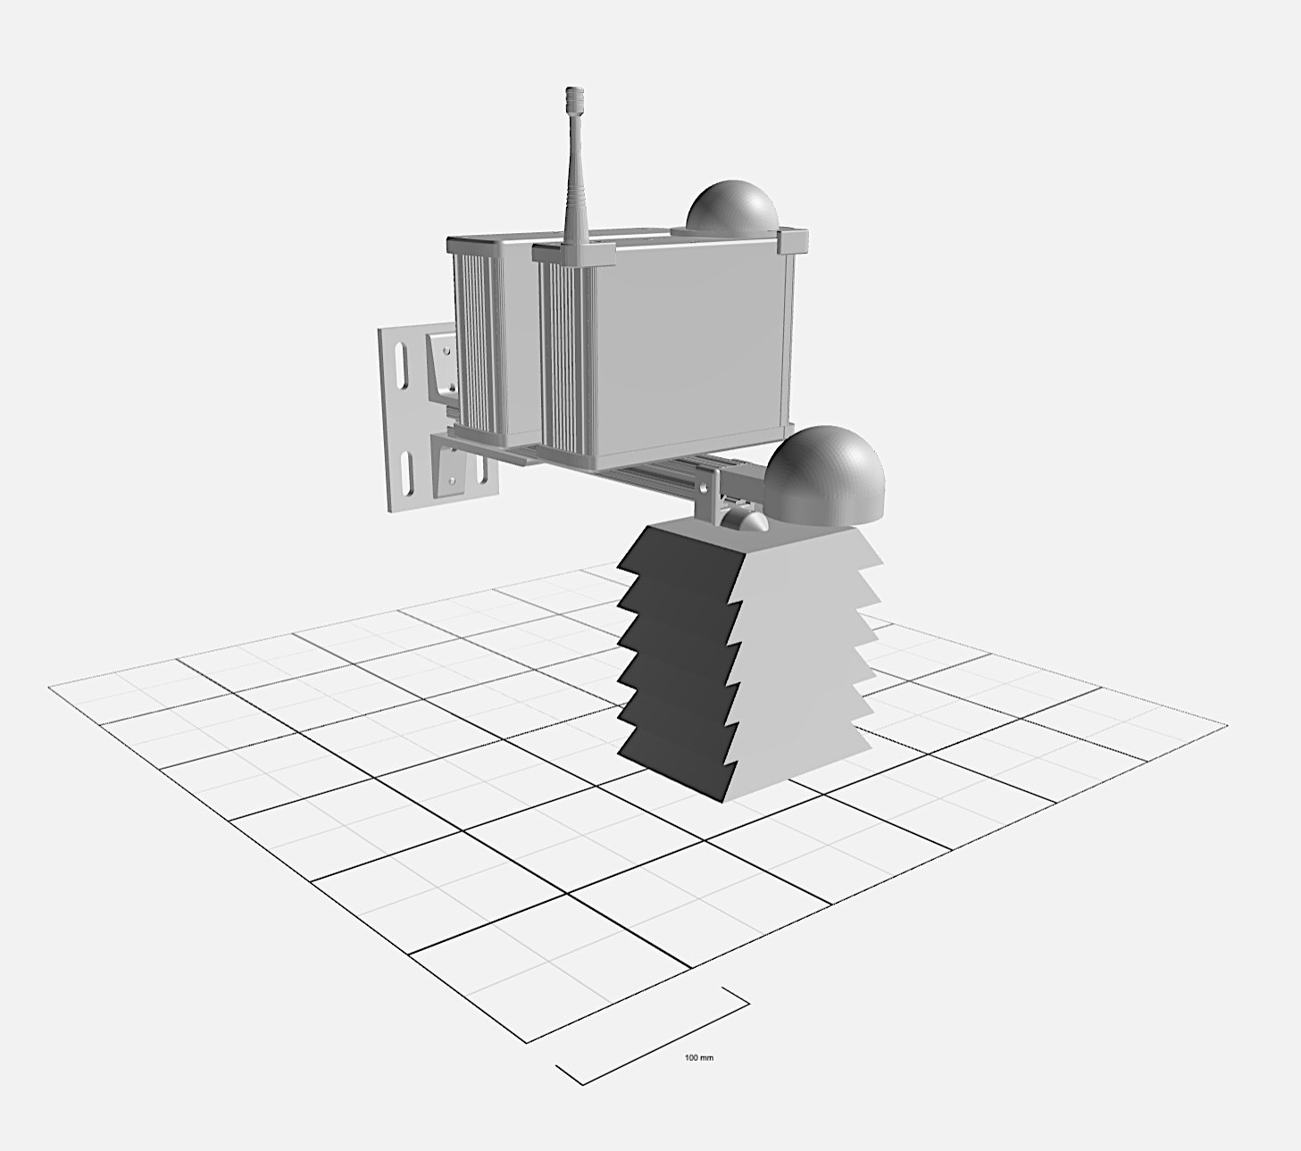
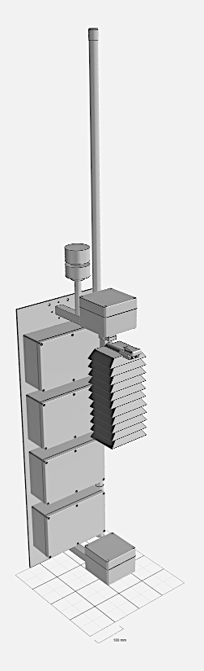
Multi-scale Integrated Sensing and Simulation (MINTS)
https://github.com/mi3nts
http://utdmints.info/
Primary Sensing Suite:
IPS7100: Provides data on specific-sized particulate matter concentrations and corresponding particle counts.
BME280: Offers meteorological insights, including temperature, pressure, and humidity readings.
SCD30: Supplies information on CO₂ levels, temperature, and humidity.
GPS: Every unit is equipped with GPS for location tracking.
Secondary Sensing Suite:
RG15: Provides precipitation information.
Airmar, BME680, RG15: Offers additional meteorological data, including rainfall, windspeed, and wind direction.
Geiger-Müller Tube: Measures Beta and Gamma particle levels.
TL108L: Measures Ozone concentrations.
Light Sensors (AS7265X, APDS9002, AS7262, GLOO1, GUV001, SI114X, TSL3993, VEML6075, AS3935): Collection of light sensors measuring light intensities from UV to IR.
Microphone and Sound Level Monitor: Measures acoustic data, including bird call information from the surroundings.
Skycam: An upward-looking camera collecting data on cloud cover and sky color.
https://github.com/mi3nts
http://utdmints.info/

