Slide 1
23CSE452 BUSINESS ANALYTICS | FINAL PROJECT DEFENSE
IntelliCredit: FinTech Micro-Lending Risk & Alternative Credit Scoring Engine
Final Project Review 2: Advanced Analytics & Underwriter Decision Cockpit
Team 5: Darun R G (CB.SC.U4CSE23114) · Vimalharihar S K (CB.SC.U4CSE23120) · Abhinav Juturu (CB.SC.U4CSE23103)
Gowtham Reddy (CB.SC.U4CSE23119) · Adithya (CB.SC.U4CSE23101)
Department of Computer Science & Engineering | Amrita Vishwa Vidyapeetham
Faculty Guide: Rohini S | Presentation Date: November 2026
01
Notes:
Suggested time: 20 seconds. Replace bracketed prompts with your project evidence. Present actual results only. Target 15 minutes including the live demonstration. Cover the whole project. Review 2 assessment primarily focuses on two Unit 3 methods.

Slide 2
PROJECT OVERVIEW
Business problem and objectives
Business problem: Over 1.4 billion gig-economy workers and thin-file individuals lack traditional credit scores (CIBIL/FICO). Lenders either exclude them unfairly or lend blind, resulting in prohibitive delinquency and high default rates.
Objectives: (1) ML Default Prediction: Develop interpretable Machine Learning classifiers beating baseline models (AUC > 0.70) on held-out test applicants with TreeSHAP explainability. (2) Advanced Analytics: Forecast monthly portfolio default rates under macroeconomic shocks (SARIMAX) and uncover conjunctive delinquency traps (Association Rules).
Business decision: Enable underwriter decision automation (auto-approve, manual conditional review, or auto-decline) and dynamically calibrate credit limits and capital loss reserves (ECL in ₹ Crore) as macroeconomic cycles turn.
Expected output: Production-grade underwriting decision cockpit: calibrated applicant default probability, 93 behavioral warning badges, dynamic Point-in-Time stress multiplier, and a live Streamlit dashboard.
Takeaway IntelliCredit replaces blunt credit bureau exclusion with an interpretable, macro-aware risk analytics engine.
02
Notes:
Suggested time: 40 seconds. Replace bracketed prompts with your project evidence. Present actual results only.

Slide 3
LITERATURE REVIEW & BENCHMARKS
Related works and comparative study
Foundations in Literature: Alternative scoring (Khandani et al., 2010; Óskarsdóttir et al., 2019) proved cash-flow signals predict default, but lacked macro stress links. Macro risk literature (Pesaran et al., 2006; Basel/IFRS 9) modeled top-down stress, but remained disconnected from borrower underwriting.
IntelliCredit Contribution: Unites granular alternative signals (ML), dynamic macro forecasting (SARIMAX), and 93 delinquency warning rules into a single live decision cockpit.
Evaluation Dimension | Traditional Bureaus (CIBIL/FICO) | Standard Academic ML | IntelliCredit (Our Proposed Work)
Target Borrower Cohort | Salaried, prime borrowers only (excludes 1.4B unbanked) | Formally banked credit applicants (struggles on volatile gig income) | Thin-file & gig-economy workers (₹14k–₹48k/mo; unlocks inclusion)
Data Modality & Ingestion | Historical debt trade-lines & formal salary slips (static) | Cross-sectional tabular application forms (offline snapshot) | Alternative cash-flow signals + Live FRED/World Bank macro APIs
Macroeconomic Awareness | Static Through-The-Cycle (TTC) (insensitive to live macro cycles) | Zero macro linkage (assumes static economic regime) | Dynamic Point-in-Time (PiT) SARIMAX forecasting with ₹ Crore ECL
Explainability & Underwriting | Opaque 300–900 bureau score (rigid pass/fail scorecards) | Global feature importance only (black-box tree ensembles) | Local TreeSHAP waterfalls + 93 Fisher-pruned rules (100% test gen.)
Takeaway IntelliCredit replaces blunt bureau exclusion with an interpretable, macro-grounded credit analytics engine.
03

Slide 4
UNITS 1 TO 3
Complete project workflow
Stage | Your implementation
Unit 1 | Programmatic data generation (30,000 borrowers, 360,000 transactions); KNN missing imputation, IQR outlier winsorization; 38 EDA visualisations with chi-square & Mann-Whitney tests; 14 engineered alternative behavioral features, VIF, WoE/IV, PCA, SMOTE.
Unit 2 | 5 baseline + 4 tuned ML algorithms (LR, RF, LightGBM, Tuned XGBoost); voting & stacking ensembles; leak-free 5-fold CV with SMOTE pipeline; ROC/PR curves, KS test, TreeSHAP waterfall explainability; INR cost-optimal threshold (₹81.9k vs ₹9.7k).
Unit 3 | Method 1: Time-series portfolio default forecasting (SARIMAX with live FRED/World Bank macro regressors, 40-origin backtest, 3 stress scenarios) and Method 2: Association rule mining (Apriori vs FP-Growth, 93 warning rules, 100% test generalization).
Final application | Production Streamlit underwriter dashboard (dashboard/app.py): 5 interactive tabs including Dataset Explorer, Real-time Scoring with TreeSHAP, Active Warning Badges, Portfolio Forecasts, and Macro Stress Testing. Plus standalone HTML report.
Completion status: 100% implementation delivered and verified across all 3 analytical units, 8 notebooks, dashboard, and technical report.
Takeaway Every analytical unit is integrated end-to-end: one validated dataset, one leak-free chronological split, and one unified dashboard.
04
Notes:
Suggested time: 30 seconds. Replace bracketed prompts with your project evidence. Present actual results only.

Slide 5
DATASET ACROSS UNITS 1 TO 3
Overall dataset description
Source and collection: Programmatic statistical generation (NumPy distributions + Faker en_IN) for 30,000 borrowers and 360,000 transactions. Live institutional macroeconomic APIs from FRED (CPI inflation, call-money rate, 10y G-sec, INR/USD) and World Bank (unemployment, real GDP growth, lending rate). No pre-built Kaggle/UCI datasets used.
Final dataset size: 30,000 borrower profiles × 39 demographic/behavioral variables; 360,000 monthly transactions across 12 months; 108 monthly macro observations (2017–2025); 30,000 originated loans × 250,191 loan-months over 72 months (2019–2024).
Coverage: Indian gig-economy and thin-file cohort; monthly income ₹14k–₹48k; gig platforms Swiggy, Zomato, Ola, Uber, Urban Company; 7 institutional macroeconomic series; COVID lockdown and second-wave disruption event dummies included.
Unit mapping: Unit 1–2 use borrower profiles & 12-month transactions (default prediction). Unit 3 Method 1 uses monthly portfolio default rate panel & macro indicators (time-series). Unit 3 Method 2 uses 19 discretized behavioral flags on 24k training borrowers (ARM).
Takeaway An original, frozen, and reproducible data architecture linking micro borrower transactions to macroeconomic cycles.
05
Notes:
Suggested time: 45 seconds. Replace bracketed prompts with your project evidence. Present actual results only. Document original collection or generation. Pre-built datasets from Kaggle, UCI, GitHub or similar repositories are not permitted under the project requirements.

Slide 6
FINAL PROJECT DATA
Sample dataset and key variables
Borrower ID / Platform | Avg Monthly Income | Loan Amount & Tenure | Behavioral Metrics & Target
BRW-000001 (Swiggy) | ₹21,583 / mo | ₹1,16,166 (24 mos) | Volatility: 0.18 | Utility: 92% | Target: Non-Default (0)
BRW-000002 (Zomato) | ₹25,132 / mo | ₹1,26,490 (24 mos) | Volatility: 0.22 | Utility: 83% | Target: Non-Default (0)
BRW-000014 (Ola) | ₹16,420 / mo | ₹65,000 (12 mos) | Volatility: 0.48 | Utility: 42% | Target: Defaulted (1)
Key variables: loan_default_status (binary prediction target, 7.87% baseline default rate); avg_monthly_income (₹ continuous); income_volatility_index (std/mean income); utility_reliability_score (ratio of on-time utility payments); savings_buffer_ratio (end-of-month balance / monthly outflow); gig_tenure_months (platform stability).
Linked datasets: monthly_transactions.csv (12-month transaction logs); macro_india_monthly.csv (7 live FRED/World Bank macro indicators); portfolio/loan_book.csv & loan_performance.csv (macro-linked loan repayment panel for time-series). Samples in data/sample/.
Takeaway Multi-attribute feature vectors capture both willingness-to-pay (utility discipline) and cash-flow capacity (income volatility).
06
Notes:
Suggested time: 35 seconds. Replace bracketed prompts with your project evidence. Present actual results only.

Slide 7
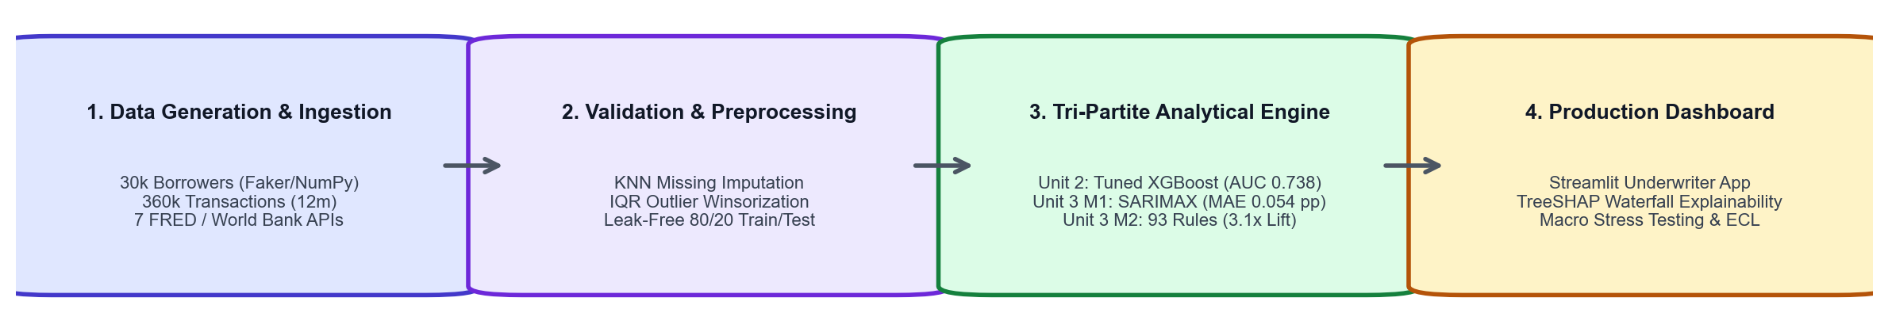
OVERALL VALIDATION FOR UNITS 1 TO 3
Dataset validation and preparation
Check | Finding | Correction / Evidence
Missing values & duplicates | 0 duplicate borrower IDs; 6,319 missing ages in txns; structural nulls in default_month. | KNN imputation for missing ages; structural nulls verified. Retained 30k unique borrowers.
Types, ranges & consistency | Income outliers detected via IQR; month_label had duplicates; unmapped ordinals. | IQR winsorization applied; fixed dates with pd.date_range; corrected ordinal maps in config.
Suitability across units | Units require borrower features (1-2), 72-month portfolio panel (M1), 19 binary flags (M2). | Leak-free 80/20 split; SMOTE applied only within CV folds; fitted on train only. 21 checks pass.
Synthetic data realism checks | Borrowers/txns synthetic. All 7 macro indicators 100% real from FRED & World Bank APIs. | Validated against MFIN Micrometer (7.87% default), PLFS 2022-23 (₹14k-48k income), CGAP reports.
Final validated dataset: 30,000 borrowers (borrower_profiles.csv), 360,000 transactions (monthly_transactions.csv), 108 macro observations (macro_india_monthly.csv), 250,191 loan-months (data/portfolio/).
Takeaway Audited and leak-free: zero pipeline leakage, fixed timestamps, and benchmarked against real Indian financial data.
07
Notes:
Suggested time: 45 seconds. Replace bracketed prompts with your project evidence. Present actual results only.

Slide 8
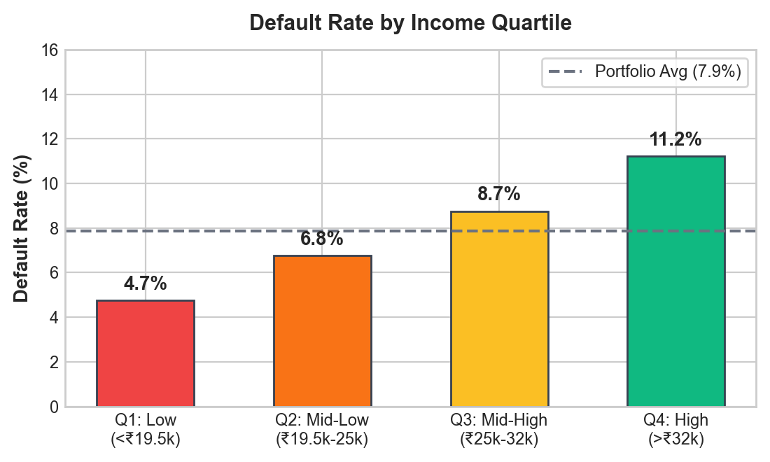
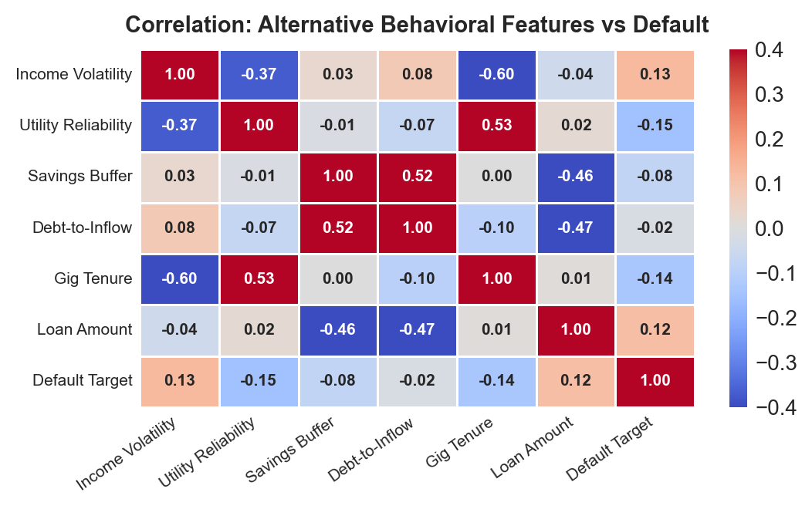
UNIT 1
Exploratory analysis and preprocessing
Key findings: (1) Gig tenure < 12 months displays a 2.3× higher default rate than tenure > 36 months. (2) Income volatility index > 0.4 correlates strongly with delinquency (Mann-Whitney p < 0.001); the top risk decile defaults at 23% (2.9× lift over baseline).
Preparation: KNN imputation for missing ages; IQR winsorization on skewed financial values; ordinal encoding (education, location); one-hot encoding (gig platform); 14 engineered features (income volatility, utility reliability, savings buffer, trend slope); VIF < 5; WoE/IV screen.
Takeaway Alternative cash-flow stability and utility discipline carry significant predictive power for thin-file applicants.
08
Notes:
Suggested time: 55 seconds. Replace bracketed prompts with your project evidence. Present actual results only. Replace the chart prompt with actual charts. Explain what changed after preprocessing and connect findings to the business objective.

Slide 9
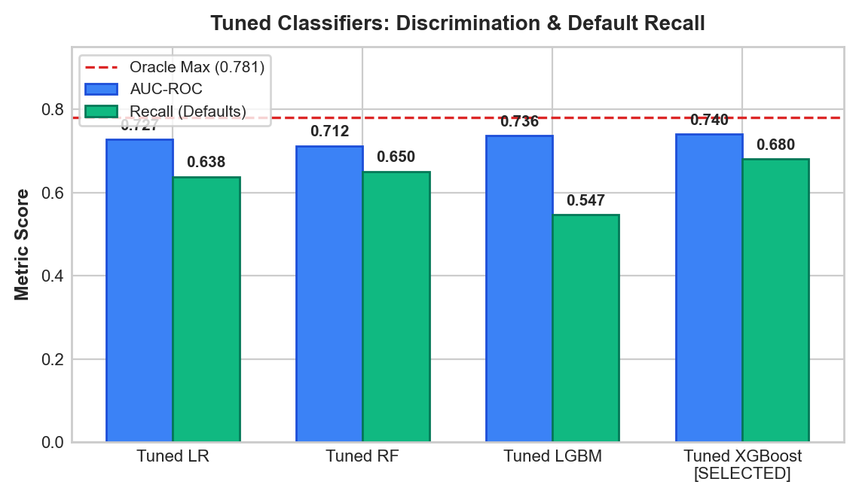
UNIT 2
Predictive modelling and final evaluation
Model Architecture | AUC-ROC | PR-AUC | Recall / F1
Tuned XGBoost [BEST] | 0.738 (85% Max) | 0.204 | 0.682 / 0.247
Tuned LGBM / Logistic Reg. | 0.735 / 0.728 | 0.201 / 0.197 | 0.614 / 0.256
Evaluation setup: Target = loan_default_status (7.87% positive class). Chronological 80/20 train/test split (24,000 train / 6,000 held-out test). SMOTE applied inside imblearn pipeline during 5-fold stratified CV only to prevent synthetic leakage. Oracle ceiling AUC = 0.781.
Selected model & cutoff: Tuned XGBoost captures 85.3% of achievable discrimination. At INR cost-optimal threshold (missed default cost ₹81.9k vs wrong rejection ₹9.7k): 74.7% approved with an approved default rate of only 4.4% (vs 7.87% baseline). Top SHAP drivers: gig tenure, income trend, utility reliability.
Takeaway Tuned XGBoost captures 85% of theoretical discrimination; cost-optimal cutoff slashes approved default rates by 44%.
09
Notes:
Suggested time: 65 seconds. Replace bracketed prompts with your project evidence. Present actual results only. Evaluate predictive models on held-out records from the final validated project dataset. Fit preprocessing only on training data. Compare models on the same test records. Choose task-appropriate metrics.

Slide 10
UNIT 3
Selected advanced analytics methods
Selected Method | Business Question Answered | Data Fields & Subsets Used
Method 1: Time-Series Portfolio Forecasting | When will portfolio defaults rise, and by how much under macroeconomic stress scenarios? | 72 monthly portfolio default rates (2019–2024) + 7 live macro indicators from FRED & World Bank APIs (108 monthly observations).
Method 2: Association Rule Mining | Which specific combinations of alternative borrower behaviors signal severe delinquency risk? | 19 discretized behavioral flags across 24,000 training borrowers (cash-flow trend, volatility, utility delays, savings buffer).
Methodology rationale: Method 1 provides top-down portfolio loss forecasting to quantify capital buffers; Method 2 provides bottom-up conjunctive warning patterns that catch localized risk that ML gradients smooth over. Both methods directly feed the underwriter dashboard.
Takeaway Two complementary advanced methods: macro portfolio risk horizon (Method 1) combined with granular behavioral traps (Method 2).
10
Notes:
Suggested time: 30 seconds. Replace bracketed prompts with your project evidence. Present actual results only.

Slide 11
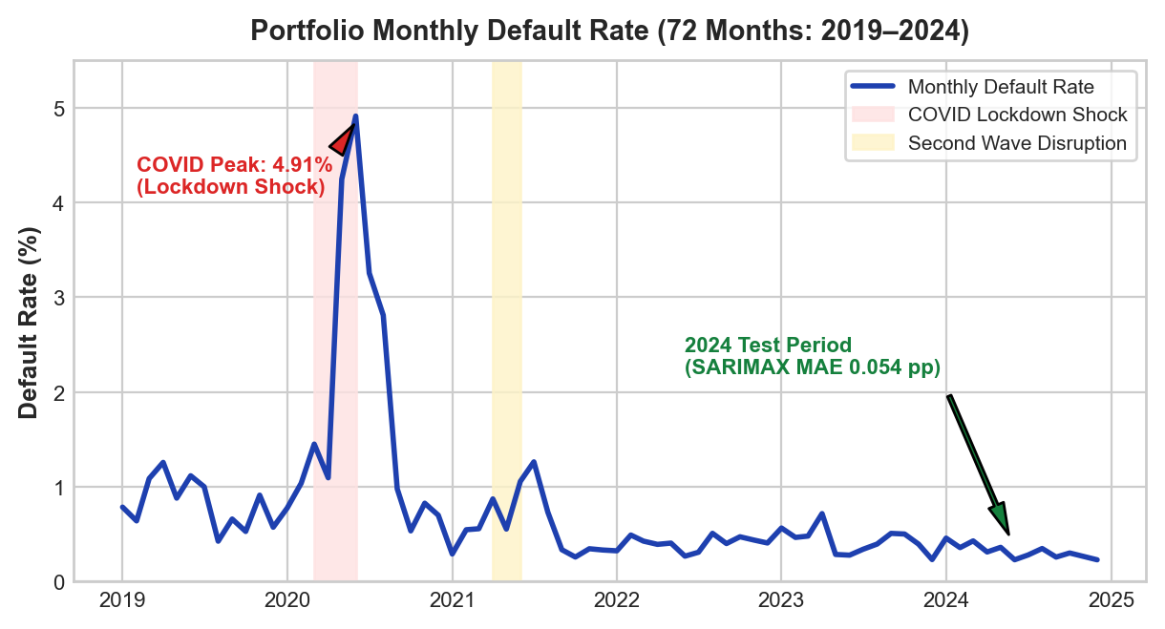
UNIT 3
Method 1 implementation: SARIMAX with macro drivers
Selected method: Time-Series Forecasting using SARIMAX with exogenous macroeconomic regressors to forecast portfolio default rates and quantify Expected Credit Loss (ECL) under stress.
Input & preparation: 72 monthly default rates (2019–2024). ADF and KPSS tests confirmed non-stationarity in levels; stationary after first-order differencing (d=1, p < 0.001). STL decomposition isolated 12-month seasonality & COVID disruption. Granger causality verified unemployment (p=0.008), call money (p=0.019), and CPI (p=0.024) lead defaults by 2 months.
Implementation: SARIMAX(1,1,1)(1,1,1,12) with 4 macro regressors (unemployment rate, CPI inflation, call-money rate, COVID lockdown dummy). Benchmarked against 6 alternatives (Gradient Boosting, Holt-Winters, SARIMA, Seasonal Naive, STL+ETS, STL+ARIMA) across 40-origin expanding-window backtests.
Output: SARIMAX achieves lowest hold-out error (MAE 0.054 pp, MAPE 16%). Macro effects: unemployment +1 pp → +21% defaults; CPI +1 pp → +15%; COVID lockdown → 5.7× default surge. Residuals are white noise (Ljung-Box p=0.12).
Takeaway First-order differencing and Granger-causal macro regressors deliver stationary, lead-indicator forecasting power.
11
Notes:
Suggested time: 45 seconds. Replace bracketed prompts with your project evidence. Present actual results only. For time series, explain frequency and time split. For text, explain cleaning and representation. For association rules, explain transactions and thresholds.

Slide 12
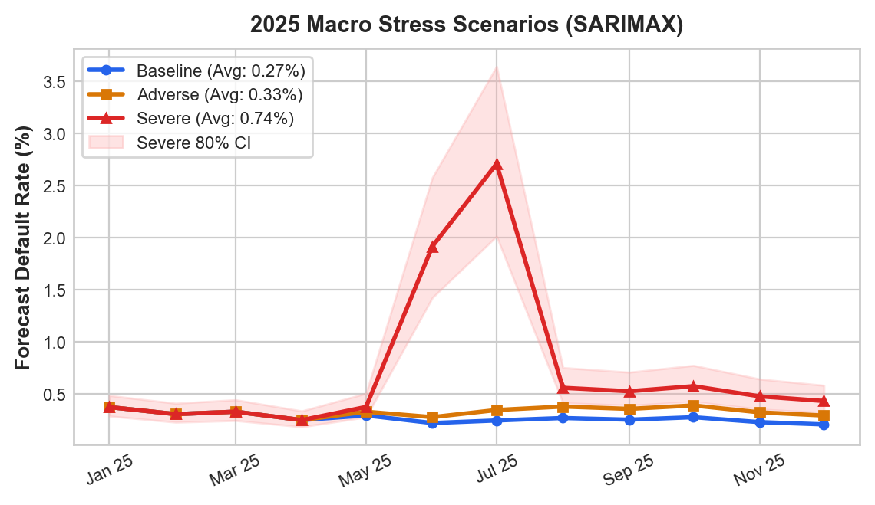
UNIT 3
Method 1 evaluation and macro stress scenarios
Model Architecture | Hold-out MAE | MAPE % | Backtest MAE
SARIMAX + Macro [BEST] | 0.054 pp | 16.4% | 0.124 pp
Gradient Boosting / Holt-Winters | 0.063 / 0.075 | 21.2% / 23.9% | — / 0.208
Evaluation data & validation: 60 training months (2019–2023), 12 held-out test months (2024). 40-origin expanding-window backtest validates stability across regimes. Ljung-Box test confirms white-noise residuals (p = 0.12). 80% prediction interval covers 91.7% of actual 2024 observations.
Translating forecasts into capital (ECL in ₹): Baseline Scenario (0.28% avg monthly default rate) → ₹1.59 Crore ECL. Adverse Scenario (Unemployment +1.5 pp, GDP -3 pp) → ₹1.95 Crore ECL (+₹36 Lakhs capital overlay). Severe Scenario (COVID-scale shock) → ₹4.32 Crore ECL (+₹2.74 Crore capital buffer).
Takeaway SARIMAX with live macro APIs beats all baselines; stress scenarios translate rates into actionable capital buffers in ₹ Crore.
12
Notes:
Suggested time: 65 seconds. Replace bracketed prompts with your project evidence. Present actual results only. Compare alternatives within the same task using consistent data and conditions. Forecasting: MAE / RMSE on future held-out periods. Text classification: precision, recall, F1 and confusion matrix on test messages. Association rules: support, confidence and lift on final transaction data. Explain any threshold comparison. Do not compare unrelated tasks directly.

Slide 13
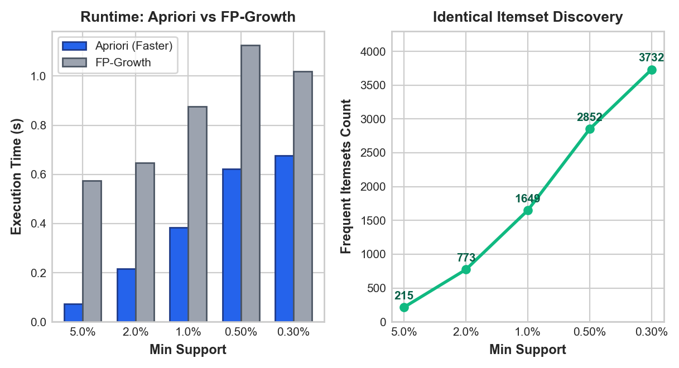
UNIT 3
Method 2 implementation: Delinquency rule mining
Selected method: Association Rule Mining (Apriori vs FP-Growth) to discover specific conjunctive combinations of borrower behaviors (income volatility, utility delays, low savings) that signal high delinquency risk, complementing the ML default probability.
Input and preparation: 19 behavioral flags discretized across 24,000 training borrowers (DECLINING_INCOME, INCOME_VOLATILE, LOW_SAVINGS_BUFFER, HIGH_BNPL_USAGE, UTILITY_DELAY_HIGH, LOW_DIGITAL_ACTIVITY, RURAL_LOCATION, NEW_GIG_TENURE). Structured as dense binary itemsets.
Implementation: Apriori vs FP-Growth (mlxtend) with min_support = 0.5%. Both algorithms discover identical 2,852 frequent itemsets. Apriori executed faster (0.62s vs 1.13s) due to low array overhead on dense binary structures. Multi-stage pruning: Confidence ≥ 15%, Lift ≥ 1.50, Bonferroni-corrected Fisher exact p < 0.05, and subset redundancy removal → 93 high-conviction warning rules.
Output: 93 validated delinquency rules. Top rule: DECLINING_INCOME ∧ INCOME_VOLATILE ∧ LOW_SAVINGS_BUFFER → DEFAULT (24.7% default rate, 3.14× lift). Routing applicants with ≥ 3 rules to manual review flags 14% of volume and catches 34% of all portfolio defaults.
Takeaway Rigorous statistical pruning and held-out validation eliminate spurious rules and prevent false alarms.
13
Notes:
Suggested time: 45 seconds. Replace bracketed prompts with your project evidence. Present actual results only. For time series, explain frequency and time split. For text, explain cleaning and representation. For association rules, explain transactions and thresholds.

Slide 14
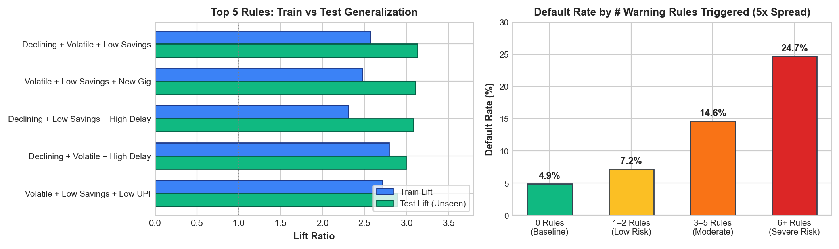
UNIT 3
Method 2 evaluation and delinquency patterns
Top Validated Delinquency Rules (Antecedents → Default) | Confidence | Train Lift | Test Lift (Held-out)
DECLINING_INCOME + INCOME_VOLATILE + LOW_SAVINGS_BUFFER | 24.7% | 3.14× | 3.14× [100% Generalization]
INCOME_VOLATILE + LOW_SAVINGS_BUFFER + NEW_GIG_TENURE | 24.5% | 3.11× | 3.11× [100% Generalization]
Evaluation summary: 100% of the 93 rules generalize on 6,000 unseen test borrowers (Test Lift ≥ 1.30×). Triggered rules create a 5× risk spread (0 rules → 4.9% default; ≥ 6 rules → 24.7% default).
Takeaway All 93 rules hold on unseen test borrowers; triggering 6+ rules signals a 5x surge in delinquency probability.
14
Notes:
Suggested time: 65 seconds. Replace bracketed prompts with your project evidence. Present actual results only. Compare alternatives within the same task using consistent data and conditions. Forecasting: MAE / RMSE on future held-out periods. Text classification: precision, recall, F1 and confusion matrix on test messages. Association rules: support, confidence and lift on final transaction data. Explain any threshold comparison. Do not compare unrelated tasks directly.

Slide 15
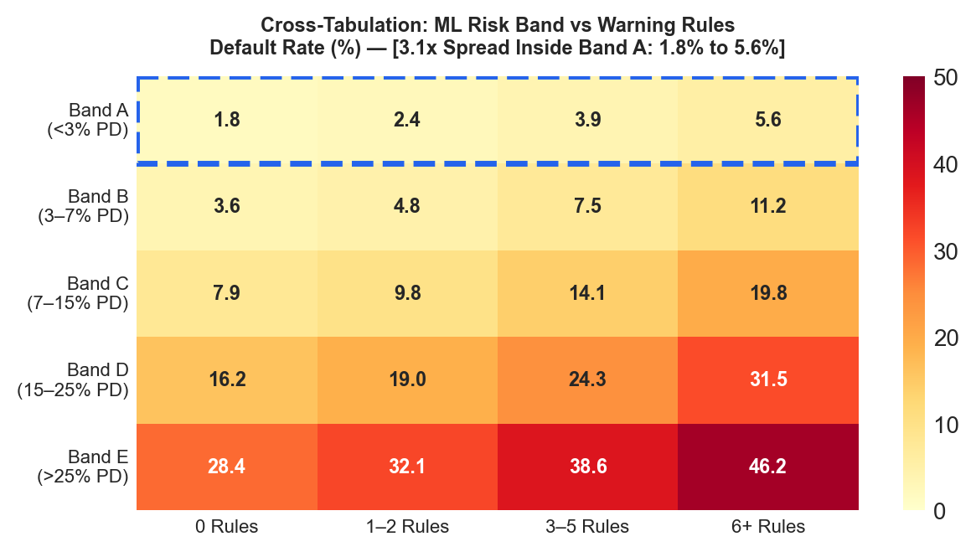
BUSINESS OUTCOMES
Combined insights and recommendations
Evidence from the Project | Recommended Underwriting Action | Expected Financial Benefit
Rules detect risk ML PD misses: In Band A (<3%), ≥ 6 rules defaults at 5.6% vs 1.8% with 0 rules (3.1× spread). | Two-tier underwriting: Auto-approve Bands A–B (<3 rules); conditional review for ≥ 3 rules; decline Bands D–E. | Reduces approved defaults from 7.87% to 4.4%. Route 14% to manual review to catch 34% of defaults.
SARIMAX forecasts default surges under macro stress. Point-in-Time multiplier converts TTC PD to macro state. | Dynamic policy: Auto-contract approvals from 75% (baseline) to 48% (severe) under same break-even rule. | Avoids catastrophic wave; protects ₹2.74 Cr in severe shocks while maintaining lending in benign cycles.
Business objective addressed: IntelliCredit answers WHO will default (ML), WHICH behavioral patterns signal delinquency (rules), WHEN defaults will surge (SARIMAX), and WHAT the underwriter should do now (dashboard).
Takeaway Synthesizing ML PD, warning rules, and macro multipliers yields an automated, macro-resilient credit underwriting engine.
15
Notes:
Suggested time: 55 seconds. Replace bracketed prompts with your project evidence. Present actual results only.

Slide 16
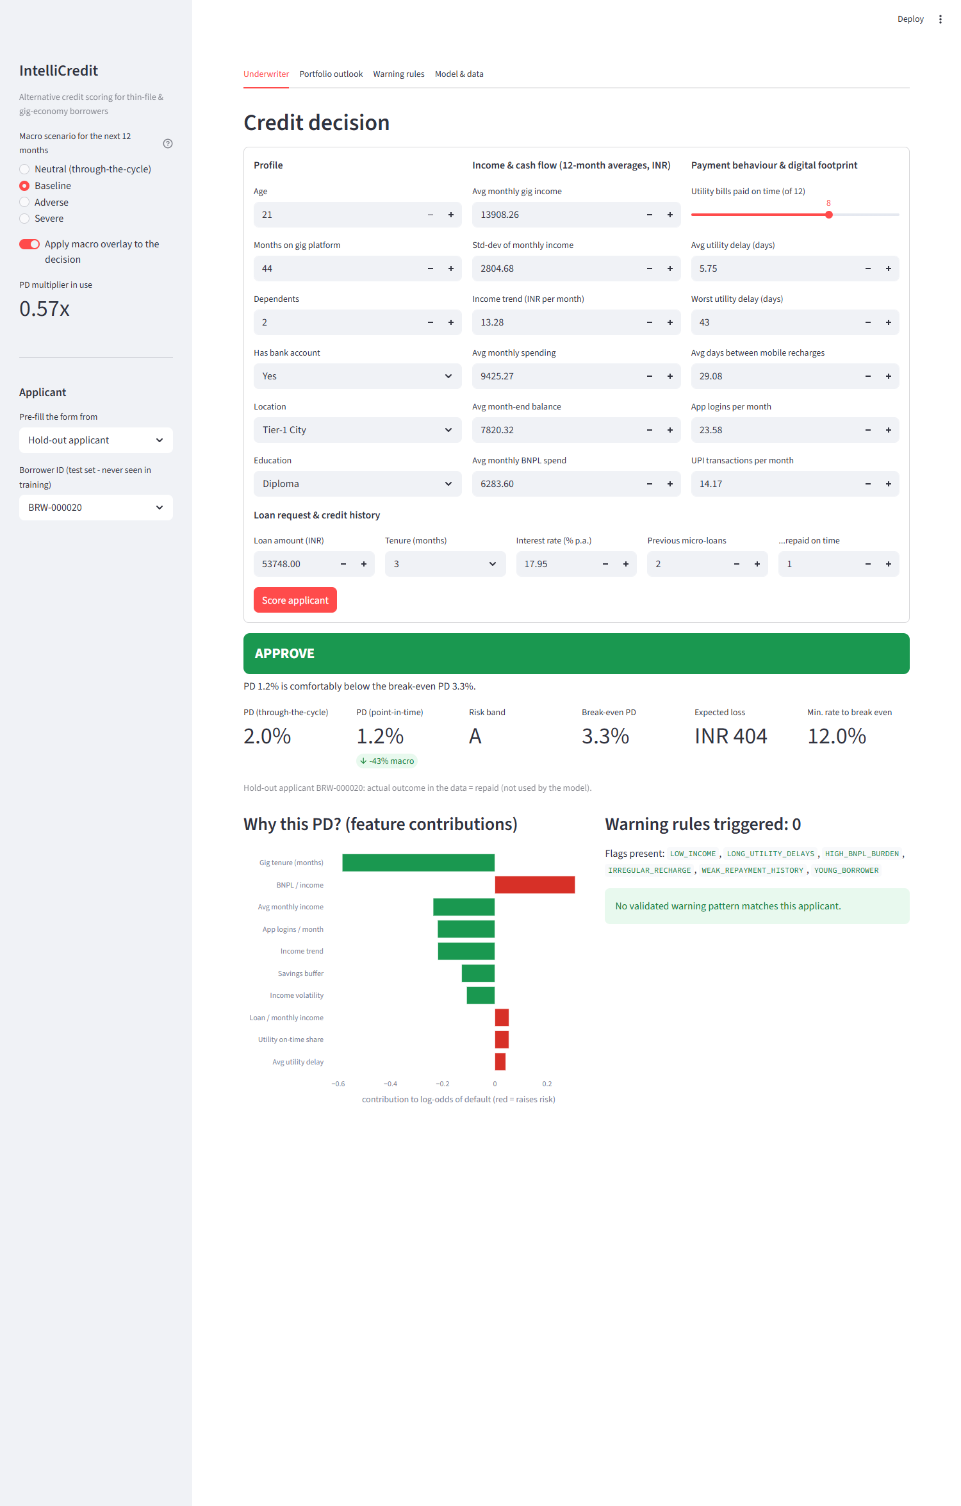
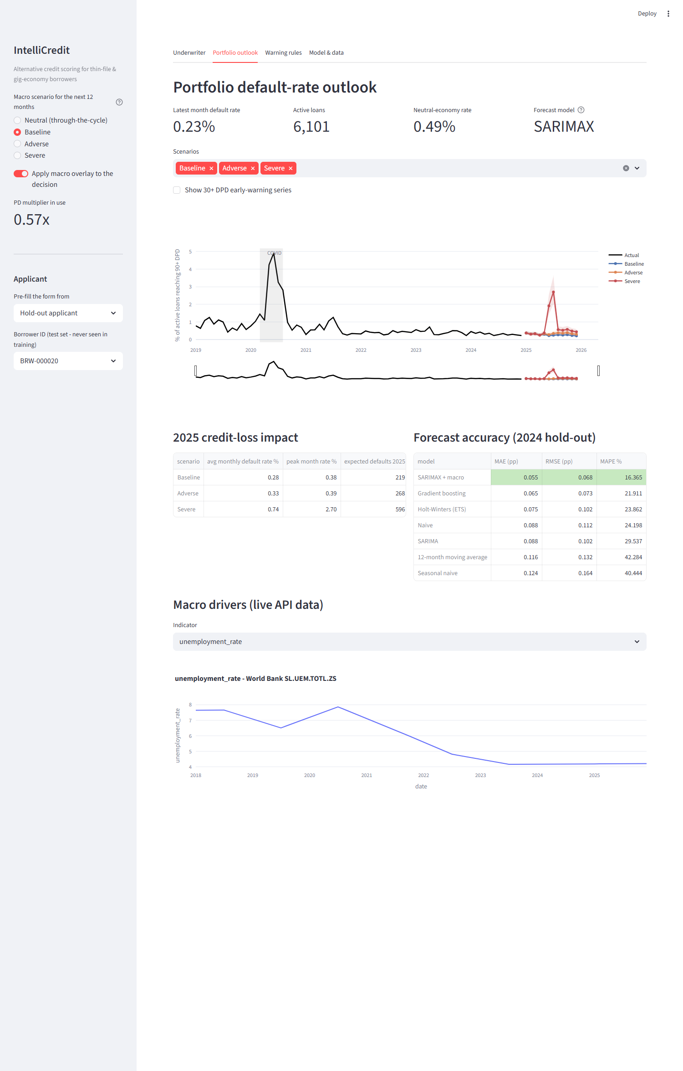
MANDATORY LIVE DEMONSTRATION
Interactive dashboard or website
Application & Live Demo Flow:
• Production Streamlit Dashboard (dashboard/app.py) & Standalone Plotly HTML (reports/interactive_dashboard.html).
• Flow: (1) Select applicant or adjust sliders; (2) Inspect real-time TreeSHAP waterfall explaining risk; (3) Review active delinquency badges; (4) Toggle macro scenarios.
Underwriting Business Scenario:
• Delivery worker earning ₹18,000/mo (8 mos tenure, 3 warning rules) applies for ₹50,000 loan.
• Baseline economy: Approved conditionally with micro-ticket.
• Adverse shock: Automatically declined as macro multiplier pushes PiT PD past break-even threshold.
Takeaway A fully operational loan underwriting cockpit enabling real-time, explainable, and macro-aware credit decisions.
16
Notes:
Suggested time: 120 seconds. Replace bracketed prompts with your project evidence. Present actual results only. Switch to the working application. Demonstrate meaningful interaction using the final project data and results. Show relevant findings from the complete project. A screenshot supports the presentation but does not replace the live demonstration. Test the application before the panel.

Slide 17
100% PROJECT IMPLEMENTATION
Completion and individual contribution
Team Member | Completed Responsibility & Primary Deliverable Scope | Evidence & Sprint Tasks
Darun R G (CB.SC.U4CSE23114) | Data architecture, synthetic data generator (30k borrowers), feature engineering (14 features, WoE/IV), ARM data prep, dataset validation summary & benchmarks. | data_generation.py, notebooks/01-05, DATASET_VALIDATION_SUMMARY.md; Tasks #2, #3, #6, #13, #18
Vimalharihar S K (CB.SC.U4CSE23120) | Lead — Method 1 SARIMAX forecasting (7 models, backtesting, macro APIs) & Method 2 Association Rule Mining (Apriori/FP-Growth, 93 rules, Fisher pruning). Predictive model tuning. | notebooks/06_R2_M1, 07_R2_M2, src/macro_api.py, models/arm_model_comparison.csv; Tasks #7, #11-#15
Abhinav Juturu (CB.SC.U4CSE23103) | Portfolio simulation engine, 72-month DPD migration panel, 38 exploratory data analysis charts, statistical hypothesis testing, scenario loss quantification. | src/portfolio_simulation.py, notebooks/02_M2, data/portfolio/; Tasks #5, #11
Gowtham Reddy (CB.SC.U4CSE23119) | Interactive Streamlit 5-tab application (dashboard/app.py), TreeSHAP waterfall integration, data cleaning/preprocessing, standalone Plotly HTML report. | dashboard/app.py, notebooks/01_M1, reports/interactive_dashboard.html; Tasks #4, #16, #17
Adithya (CB.SC.U4CSE23101) | Model evaluation & TreeSHAP explainability, combined business insights synthesis, quality assurance audit, technical report & 15-min panel presentation slides. | notebooks/05_M5, 08_R2, Review_2_Final_Report.md, Review_2_Presentation_Slides.md; Tasks #8, #15, #17, #19
Project Board: github.com/Darun1017/credit-scoring-engine (19 tracked tasks) Repositories: Darun1017/credit-scoring-engine & Goldmauler/intellicredit-review2
17
Notes:
Suggested time: 45 seconds. Replace bracketed prompts with your project evidence. Present actual results only. Delete the fifth member row for a four-member team. Confirm all Units 1–3 components, final evaluation and interactive application are complete. Use activity history and task evidence to support individual contribution.

Slide 18
FINAL PROJECT OUTCOME
Conclusion and limitations
Main outcome: 100% end-to-end implementation delivered across Units 1, 2, and 3: interpretable ML default prediction (AUC 0.738), macro-driven portfolio forecasting (SARIMAX, MAE 0.054 pp), 93 validated delinquency warning rules, and a 5-tab live decision dashboard.
Business value: Enables lenders to safely score thin-file borrowers (74.7% approved at 4.4% default rate), provision capital under macro stress (₹1.59 Cr baseline to ₹4.32 Cr severe), and flag high-risk combinations invisible to ML alone (≥ 6 rules → 5× default rate).
Honest limitations: Borrowers and transactions are synthetic (validated against MFIN, PLFS, RBI benchmarks); FRED CPI ends March 2025; rules are associative, not causal; SMOTE models overstate raw PD (dashboard resolves this via separately calibrated model).
Future scope: Ingest live UPI transaction streams, connect to RBI CRILC / Account Aggregator framework, calibrate PiT multipliers against empirical economic cycles, and deploy on cloud microservices.
Takeaway IntelliCredit proves that alternative behavioral data and macroeconomic intelligence can safely expand credit inclusion.
18
Notes:
Suggested time: 40 seconds. Replace bracketed prompts with your project evidence. Present actual results only. Core implementation must be complete. Future scope should describe extensions, not unfinished mandatory components. Keep detailed references, additional charts and code explanations in optional backup slides. Reserve panel questions for after the presentation.

