Slide 1
23CSE452 BUSINESS ANALYTICS
IndieGuard: Indie Game Launch Analytics
Final Project Presentation
Group 1: Thotakura Srihitha (CB.SC.U4CSE23450), Gayas Sheik (CB.SC.U4CSE23118), Shantharam P (CB.SC.U4CSE23146), Pradeep Sasidharan (CB.SC.U4CSE23232), Valikala Tejaswini (CB.SC.U4CSE23752)
Review 2: Unit 3 advanced analytics (text mining and association rules) and the interactive dashboard
Guide: Rohini S
Date: 18 October 2026
01
Notes:
Suggested speaker: Shantharam. 0:20.
Introduce the project in one sentence: IndieGuard tells a small indie studio what to fix before Steam's 2-hour refund window closes, which feature combinations to back and when to patch.

Slide 2
PROJECT OVERVIEW
Business problem and objectives
Business problem: A small indie studio cannot tell what drives negative Steam reviews. A negative review written inside the 2-hour refund window costs the rating and often the sale.
Objectives: (1) Beat the guessing baselines on unseen games: PR-AUC for negative reviews, macro-F1 for game success tiers. (2) Find which complaint themes and tag combinations go with weak or strong reception, tested on held-out games.
Business decision: What to fix before launch, which feature combinations and price to back, and when a patch is worth the effort.
Expected output: Review and game predictions, complaint themes, tag rules, a patch-impact result, a launch-risk scorer and a dashboard with recommendations.
02
Notes:
Suggested speaker: Tejaswini. 0:40.
Who: small indie studios. Problem: negative reviews in the first two hours cost both rating and sale. Two measurable objectives, both evaluated on games the models never saw.

Slide 3
UNITS 1 TO 3
Complete project workflow
Stage | Your implementation
Unit 1 | Own scrapers: 1,861 games and 1.65M reviews; 32 logged cleaning rules; EDA; features (tag PCA, TF-IDF with SVD)
Unit 2 | Dummy, Logistic Regression, Random Forest, LightGBM and XGBoost at review and game level; shared split by game; grid-search tuning
Unit 3 | Text mining (topic model and sentiment classification) and association rule mining; patch impact as an extra
Final application | Streamlit dashboard (market explorer, rules and complaints, patch impact, launch-risk scorer) and recommendations
Completion status: Units 1 to 3, evaluation, report and dashboard are implemented and integrated; the dashboard is deployed at indieguard.streamlit.app.
Takeaway Every unit is implemented end to end and linked: one dataset, one split by game, one dashboard.
03
Notes:
Suggested speaker: Shantharam. 0:30.
One row per unit. The pipeline is reproducible: python -m src.features rebuilds the features and runs 21 checks.

Slide 4
DATASET ACROSS UNITS 1 TO 3
Overall dataset description
Source and collection: Our own throttled, resumable scrapers on public Steam sources (store search, store details, SteamSpy, news, reviews), 1 to 2 October 2026. No pre-built dataset.
Final dataset size: 1,861 games x 58 variables; 1,648,387 reviews x 34 variables; 29,918 patch and sale events.
Coverage: Indie roguelike and roguelite games released 2022 to 2025; 31 languages; 99.95% of the reviews Steam reports were collected (five very large games are capped at their newest 15,000).
Unit mapping: Unit 2: 1,573,436 reviews with features and 1,490 games with a success tier. Unit 3: 557,202 English reviews (text); 1,490 games with 137 tag, price and Early Access items (rules); 29,918 events (patch impact).
Takeaway Our own, documented, frozen dataset: 1,861 games and 1.65M reviews, ready for all three units.
04
Notes:
Suggested speaker: Shantharam. 0:45.
All data was collected by us. Documentation: docs/data_documentation.md; raw data frozen with row counts and SHA256 hashes.

Slide 5
FINAL PROJECT DATA
Sample dataset and key variables
Review text (excerpt) | Playtime at review | Language | Target: review is
If you're reading comments right now to decide if you should buy it - ... | 23.9 h | english | positive
Why Nerf a coop hades ripoff? It's a PvE game lmao | 13 h | english | negative
Hardness for the sake of hardness. Game has several situations where y... | 11.6 h | english | negative
Game | Released | Price (USD) | Reviews and target: success tier
Cross The World | 2025 | $19.99 | 23 reviews, 0% negative; tier Strong
Bloody Heaven 2 | 2024 | $4.99 | 138 reviews, 15% negative; tier Solid
Firework War | 2025 | $0.00 | 55 reviews, 4% negative; tier Strong
Key variables: voted_up (target: negative review), playtime at review (hours), language, review text; per game: price (USD), launch year, DLC, achievements, tags (text), review totals, success tier.
Takeaway Reviews join games on appid; the success tier uses games with at least 20 reviews. Full samples: data/sample/.
05
Notes:
Suggested speaker: Shantharam. 0:35.
Actual rows from the cleaned data (data/sample/). The target at review level is whether the review is negative; at game level it is the tier (Struggling 30%+ negative, Strong 10% or less).

Slide 6
OVERALL VALIDATION FOR UNITS 1 TO 3
Dataset validation and preparation
Check | Finding | Correction / evidence
Missing values and duplicates | 4,612 empty reviews; no duplicate review or game IDs; some game columns mostly empty (Metacritic, about 98%) | Empty reviews dropped (1,652,999 to 1,648,387); empty columns unused; free games priced 0; unknown playtime flagged
Types, ranges and consistency | Playtime outliers (8,242 above 363 h); 318 wrong launch dates; 30,018 reviews before launch; spam and copy-paste reviews | Timestamps in UTC; playtime winsorised in a copy; dates corrected; the rest flagged and kept (32 logged rules)
Suitability across all units | Each unit has the fields it needs: tiers (1,490 games), English text (557,202), tag items (137), events (29,918) | One split by game; 21 feature checks and 21 Review 2 checks pass
Synthetic data | None: every record comes from public Steam endpoints | Not applicable
Takeaway Final validated dataset: 1,861 games and 1,648,387 reviews (data/processed/games_clean.parquet, reviews_clean/).
06
Notes:
Suggested speaker: Shantharam. 0:35.
Details in docs/validation_summary.md and docs/cleaning_log.md. Almost nothing is deleted: suspicious rows are flagged so each analysis chooses its own rule.

Slide 7
UNIT 1
Exploratory analysis and preprocessing
Key findings: 21.2% of reviews under 2 hours of play are negative against 8.8% later, and they are 29% of all negatives; inside that window negativity climbs from 11% (under $5) to 32% ($20 or more).
Preparation: empty reviews dropped, suspicious ones flagged; 439 tag columns reduced to 68 PCA components; review text to TF-IDF and 78 SVD components; all fitted on training games only.
Takeaway The first two hours and the price inside them show where to act before the refund window closes.
07
Notes:
Suggested speaker: Srihitha. 0:55.
Two patterns relevant to the objectives: the refund window and the price gradient inside it. 29 EDA figures are in notebooks/02_EDA_Visualizations.ipynb.

Slide 8
UNIT 2
Predictive modelling and final evaluation
Model | Review PR-AUC | Review ROC-AUC | Game macro-F1
Dummy (prior) | 0.106 | 0.500 | 0.220
Logistic Regression | 0.194 | 0.663 | 0.423
Random Forest | 0.280 | 0.726 | 0.371
LightGBM | 0.254 | 0.724 | 0.372
XGBoost | 0.275 | 0.729 | 0.437
Evaluation setup: review is negative (1,257,095 train and 316,341 test reviews); game tier (1,191 train and 299 test games). Split by game, 5 folds inside train, preprocessing fitted on train, tuned by grid search, test scored once.
Selected model and interpretation: the three tree models tie at review level (PR-AUC about 0.28 against 0.11 for guessing) and at game level tuned XGBoost (0.44) and Logistic Regression (0.42) lead, while Random Forest and LightGBM fall to 0.37 on test after tuning (intervals overlap, no winner); store metadata says little about how good a game is.
Takeaway Metadata alone says little about reception; reading the review text is where the large gain is (next slides).
08
Notes:
Suggested speaker: Gayas. 0:55.
Same test records for every model. Guessing baselines: PR-AUC 0.106, macro-F1 0.22. Every model was tuned by grid search on the shared folds. Review-level gains were within one standard deviation; at game level the cross-validation gains for Random Forest and LightGBM did not carry to test, so quote the test intervals.

Slide 9
UNIT 2
Model comparison at a glance
How to read it: guessing scores PR-AUC 0.106, ROC-AUC 0.500 and macro-F1 0.220. The three tree models tie at review level; at game level tuned XGBoost and Logistic Regression lead, and the intervals overlap (299 test games). Settings were tuned by grid search; the test set was scored once.
Takeaway Every model beats guessing, but store metadata alone reaches only ROC-AUC 0.73 and macro-F1 0.44; the next slides add the review text.
09
Notes:
Suggested speaker: Gayas. 0:25.
Same numbers as the table, drawn as bars. Compare each bar with the guessing baseline, not with 1.0.

Slide 10
UNIT 3
Selected advanced analytics methods
Selected method | Business question | Data used
Method 1: Text mining | What do players complain about, and can the review text flag a negative review? | 557,202 English reviews: text, playtime, price tier, target
Method 2: Association rule mining | Which tag, price and Early Access combinations go with Strong reception? | 1,490 games: 137 items (tags, price band, Early Access) and tiers
Selected: Text Mining and Association Rule Mining. Patch impact and the launch-risk scorer are extra analyses.
Takeaway Two Unit 3 methods, each evaluated on held-out games and compared with fair alternatives.
10
Notes:
Suggested speaker: Gayas. 0:40.
Two of the three allowed methods: text mining and association rules. Time series was not selected.

Slide 11
UNIT 3
Method 1 implementation
Selected method: Text mining, to find complaint themes and to flag negative reviews from their own words.
1 Select reviews
2 Prepare text
3 Detect
4 Find themes
• English reviews only
• Script and language filters
• Split by game: 436,715 train, 120,487 test
• Negation binding (not_fun, too_hard)
• Stopwords removed
• TF-IDF, 1 to 2 words, 100,000 terms
• Logistic Regression on text and metadata
• 30-setting grid on 5 shared folds
• Threshold from out-of-fold predictions
• NMF, 8 topics, on 40,000 negative training reviews
• LDA as the baseline
• Compare early and later complaints
OUTPUT 557,202 reviews
OUTPUT sparse text matrix
OUTPUT negative-review detector
OUTPUT 8 complaint themes
Output: a negative-review detector (PR-AUC 0.84, ROC-AUC 0.97, accuracy 94.6%) and 8 complaint themes: crashes and multiplayer bugs lead early (29%), boss and balance later (34%); “boring” is in 9.1% of negative reviews against 0.8% of positive ones.
Takeaway Text mining gives a detector and complaint themes from the same cleaned reviews.
11
Notes:
Suggested speaker: Tejaswini. 0:45.
Cleaning and representation: negation binding and TF-IDF. Two uses of text: supervised detection of negative reviews and unsupervised themes.

Slide 12
UNIT 3
Method 1 results at a glance
How to read it: left, adding the text lifts ROC-AUC from 0.76 to 0.97 on the same test reviews. Right, crashes and multiplayer bugs lead early negatives (29% against 24%), boss and balance later (34% against 25%); the themes are exploratory (blind check 35.5%).
Takeaway The words of a review carry the signal: a text model flags negative reviews far better than metadata, and the complaints change with playtime.
12
Notes:
Suggested speaker: Tejaswini. 0:20.
Left: same test reviews, four approaches. Right: the topic model's dominant theme among negative reviews, early against later; treat the themes as exploratory.

Slide 13
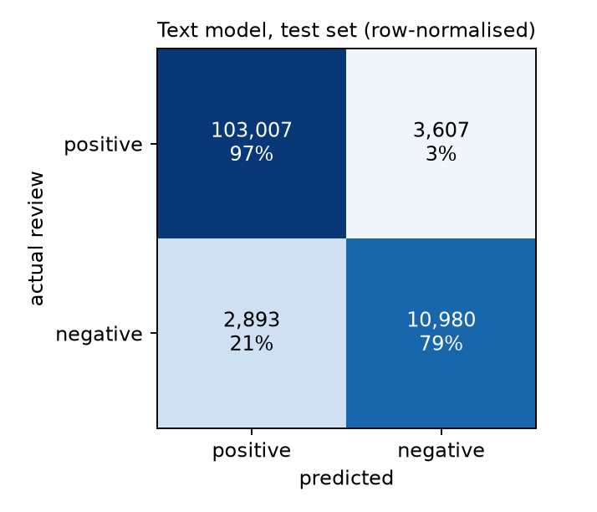
UNIT 3
Method 1 evaluation and comparison
Approach | PR-AUC / ROC-AUC (test) | Precision / recall | F1
Dummy (prior) | 0.115 / 0.500 | 0.12 / 1.00 | 0.21
LightGBM, metadata only | 0.360 / 0.758 | 0.32 / 0.49 | 0.39
LightGBM, metadata + text components | 0.593 / 0.895 | 0.52 / 0.62 | 0.56
Logistic Regression, full text + metadata | 0.838 / 0.971 | 0.75 / 0.79 | 0.77
Test set: 120,487 English reviews from games never seen in training. Caught 10,980 negatives, missed 2,893, 3,607 false alarms, 103,007 correct positives.
Accuracy 94.6% against 88.5% for always guessing positive; balanced accuracy 87.9%; specificity 96.6%; MCC 0.74.
How to read it: the 90%-plus accuracy is partly the easy positive class, so the honest evidence is ROC-AUC 0.971 (per-game 0.976) and the 0.75 precision and 0.79 recall on negatives.
Topics: NMF diversity 90.0% against 86.25% for LDA, coherence -2.380 against -1.732 (LDA better), stability 0.745. A blind check of 200 reviews (AI-labelled) agrees on 35.5%: only Early Access, repetition and crash topics are reliable.
Takeaway Reading a review's own text separates negative from positive very well (ROC-AUC 0.97), but it detects a complaint, it does not forecast one.
13
Notes:
Suggested speaker: Tejaswini. 1:00.
Same test reviews for every row. Be upfront: LDA scores better on UMass coherence; NMF was chosen for interpretability. The blind topic check was labelled by an AI assistant, in one pass, and the earlier 96% figure was withdrawn.

Slide 14
UNIT 3
Method 2 implementation
Selected method: Association rule mining with FP-Growth, to find tag, price and Early Access combinations that go with the Strong tier.
1 Build transactions
2 Mine itemsets
3 Filter
4 Check on unseen games
• 1,191 training games
• User tags (no after-play opinion tags), price band, Early Access
• FP-Growth (mlxtend)
• Support at least 25 games, up to 3 items
• At least 10 Strong hits, lift at least 1.2
• Benjamini-Hochberg q below 0.10
• 299 test games, scored once
• A rule counts if 10 or more test games match
OUTPUT 137 items
OUTPUT 4,715 candidate rules
OUTPUT 95 Strong rules
OUTPUT 68% of 66 hold
Output: 4,715 candidate rules, 95 Strong rules pass, 0 Struggling rules. Top rule: Pixel Graphics + Retro + Shooter, 25 games, 80% Strong (lift 2.26), 3 of 4 test games Strong.
Takeaway Rules are mined on training games only, corrected for multiple testing, then checked once on held-out games.
14
Notes:
Suggested speaker: Pradeep. 0:45.
Transactions, thresholds and the train-then-test protocol. Support, confidence and lift are defined on slide 16's table and in notebooks/review2/association_rules.ipynb.

Slide 15
UNIT 3
Method 2 rules at a glance
How to read it: each pair of bars is one rule: the share of training games with that tag combination that reached the Strong tier, then the same share on unseen test games (4 to 14 games per rule, so noisy). About two-thirds of rules hold in every configuration.
Takeaway Strong combinations mostly hold up on unseen games, but test shares are lower than training shares and the groups are small: treat each rule as a hypothesis.
15
Notes:
Suggested speaker: Pradeep. 0:25.
Training bars come from the 1,191 training games, test bars from the 299 test games. Lower test bars are expected after picking the best rules on training data.

Slide 16
UNIT 3
Method 2 evaluation and comparison
Configuration | Strong rules (FDR) | Mean confidence / lift | Hold on test games
FP-Growth, support 25, up to 3 items (chosen) | 95 | 0.59 / 1.68 | 68% of 66
Apriori, same thresholds | 95 | 0.59 / 1.68 | 68% of 66
FP-Growth, support 15 (looser) | 107 | 0.65 / 1.85 | 66% of 56
FP-Growth, support 40 (stricter) | 69 | 0.57 / 1.60 | 69% of 59
FP-Growth, pairs only | 41 | 0.56 / 1.59 | 83% of 30
FP-Growth, keeping after-play tags | 131 | 0.60 / 1.69 | 69% of 88
Evaluation data: same 1,191 training and 299 test games for every row; support, confidence and lift on training games, then a held-out check of whether each rule still holds.
Interpretation: FP-Growth and Apriori return the same 95 rules. Lower support finds more rules with higher lift that hold less often on test games; keeping after-play tags adds circular rules. No configuration finds a Struggling rule. Supports are small (30 to 60 games): hypotheses, not recipes.
Takeaway Rules hold on unseen games about two-thirds of the time, so they are hypotheses to test, not recipes.
16
Notes:
Suggested speaker: Pradeep. 0:55.
Support = share of games with the combination and the tier; confidence = share of games with the combination that have the tier; lift = confidence divided by the tier's overall rate. The comparison varies support, rule length, algorithm and the after-play tags.

Slide 17
BUSINESS OUTCOMES
Combined insights and recommendations
Evidence from the project | Recommended action | Expected benefit / limitation
Refund window: 21.2% negative under 2 h against 8.8% later (Unit 2); crashes, multiplayer bugs and controls lead early negatives (text mining) | Blind-test the first 30 minutes; fix crashes and controls before launch; monitor early reviews | Targets the 29% of negatives written in the window; association, not cause
Early negativity rises with price (11% to 32%); 2D, pixel, retro and procedural combinations are Strong about two-thirds of the time; no rule predicts Struggling (rules) | Prefer focused scope; price below about $15 unless depth is verified; complete the store page | Small supports (30 to 60 games); treat as hypotheses to test
Patches: no clear effect against matched controls (+0.27 points, interval includes zero); themes show what to patch (patch impact, text mining) | Patch for specific problems (crashes, controls, balance), not to lift ratings in general | Controls cover 164 of 617 games
Takeaway Business objective addressed: evidence for what to fix before the refund window closes, which combinations and price to back, and when to patch.
17
Notes:
Suggested speaker: Gayas. 0:45.
Each recommendation combines a Unit 2 or Unit 3 finding with its limit. Full list in docs/final_report.md section 12.

Slide 18
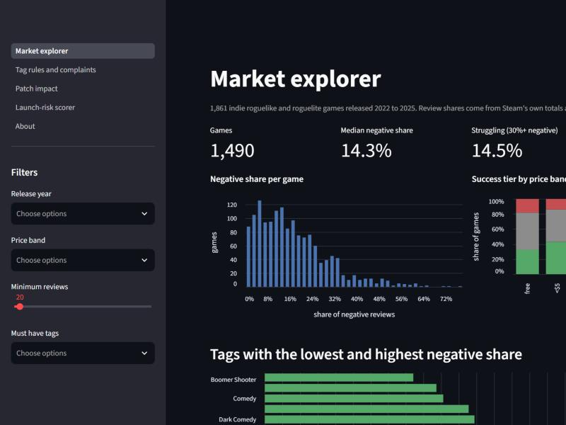
MANDATORY LIVE DEMONSTRATION
Interactive dashboard or website
Application: IndieGuard dashboard (Streamlit), live at https://indieguard.streamlit.app. Local launch: streamlit run src/dashboard/app.py; steps in docs/dashboard.md.
Live demo: Market explorer: tick the tag Pixel Graphics and the tier mix and risky tags update; Tag rules: set lift 1.8 and stability stable; Scorer: describe a game and read its tier.
Business scenario: a studio planning a $9.99 pixel-art roguelike checks tag risk, the rules that apply, the patch evidence and a launch-risk score.
18
Notes:
Suggested speaker: Srihitha. 1:50.
Switch to the running app (streamlit run src/dashboard/app.py before the session). Demo order: market explorer filter by tag; tag rules by lift; patch impact; scorer with a described game. The screenshot is a fallback.

Slide 19
100% PROJECT IMPLEMENTATION
Completion and individual contribution
Team member | Completed responsibility | Evidence / project-board task
Thotakura Srihitha (CB.SC.U4CSE23450) | Exploratory analysis: 29 figures, association tests, tag combinations; dashboard wireframe and CSV downloads | PRs #1, #101, notebooks/02_EDA_Visualizations.ipynb; cards #20, #21, #37, #40, #41
Gayas Sheik (CB.SC.U4CSE23118) | Features and tag PCA; patch impact with controls; launch-risk scorer; reproducibility | PRs #2, #49, #50, #69, #71, #80; cards #4, #18, #19, #38, #39, #42
Shantharam P (CB.SC.U4CSE23146) | Data collection and cleaning; split and targets; models and tuning; dashboard; final report | src/collect, src/clean, src/models; PRs #56, #57, #95-#97; cards #5-#17, #23-#27, #43, #45, #83-#94
Pradeep Sasidharan (CB.SC.U4CSE23232) | XGBoost models with SHAP; association rules | PRs #55, #70; cards #34, #35, #36
Valikala Tejaswini (CB.SC.U4CSE23752) | Text mining and topic modelling; combined insights | PRs #66, #81; cards #31, #32, #44
Board: github.com/users/Shan713/projects/1 Repository: github.com/Shan713/IndieGuard
19
Notes:
Suggested speakers: all five, about 9 seconds each. 0:45.
Board history and pull requests show who did what; the board has 39 Review 2 cards with owners, due dates and evidence.

Slide 20
FINAL PROJECT OUTCOME
Conclusion and limitations
Main outcome: Units 1 to 3 are implemented end to end: own data, cleaning, models with held-out evaluation, text mining and association rules, and a working dashboard.
Business value: the first two hours decide a lot (21% against 9% negative); crashes, controls and price matter early; focused 2D and pixel-style combinations go with strong reception; patches do not lift sentiment on their own.
Limitations: associations, not causes; store data are October 2026 snapshots; only 51 Struggling test games; five large games capped; about 60% of reviews are not English; the AI-labelled topic check is weak for boss and balance topics.
Future scope: re-label a sample by hand, add discount-impact analysis, calibrate the scorer, and extend to more genres.
20
Notes:
Suggested speaker: Pradeep. 0:40.
Close with the main finding and the honest limits. Questions follow.

