Slide 2
Decision-Making and Strategic Communication in Health
Communication Skills, Listening and Nonverbal Communication
Health Psychology
The Healthcare Communication Process

Slide 3
Decision-Making and Strategic Communication in Health
1. Definition of Communication Skills
Effective communication is the ability to convey information clearly and efficiently.
Communication skills allow us to express our ideas and receive those of others so that both parties clearly understand the message.

Slide 4
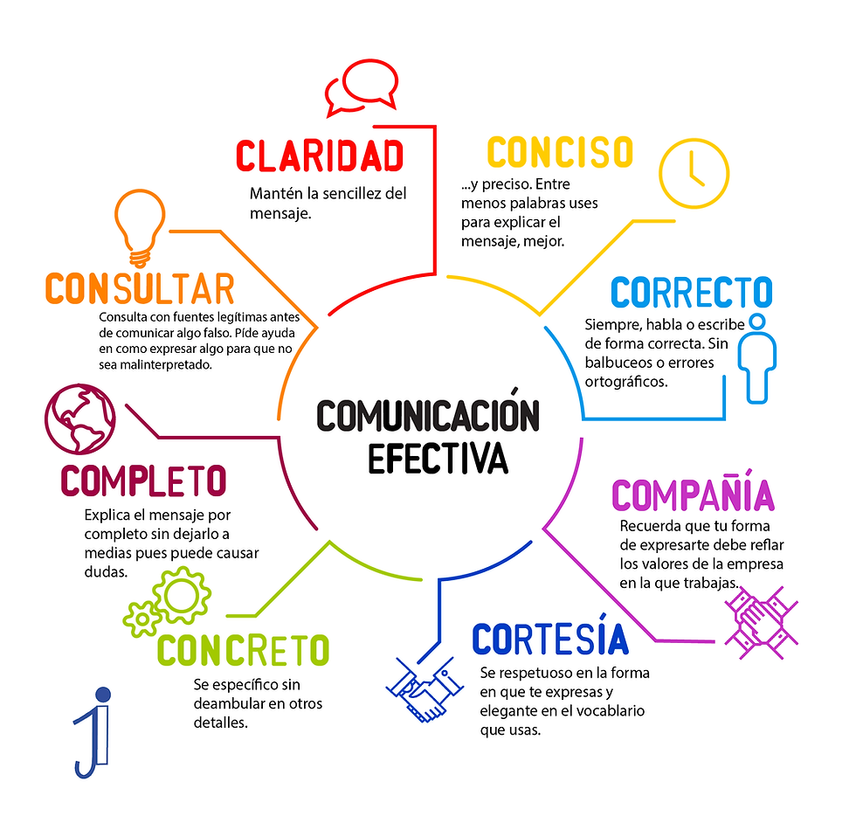
Decision-Making and Strategic Communication in Health
Key Elements of Effective Communication
CLARITY
CONCISE
Keep your message simple.
...and precise. The fewer words you use to explain, the better.
Clarity
Concise
Inquisitive
Correct
Complete
Empathetic
Concrete
Coherence
CONSULT
CORRECT
Check legitimate sources before sharing anything false. Ask for help phrasing things so they are not misread.
Always speak and write correctly. No stammering or spelling mistakes.
EFFECTIVE
COMMUNICATION
COMPLETE
COMPANY
Explain the whole message; leaving it half-finished causes doubts.
Your way of expressing yourself should reflect your company's values.
CONCRETE
COURTESY
Be specific without drifting into other details.
Be respectful in how you express yourself and elegant in the vocabulary you use.

Slide 5
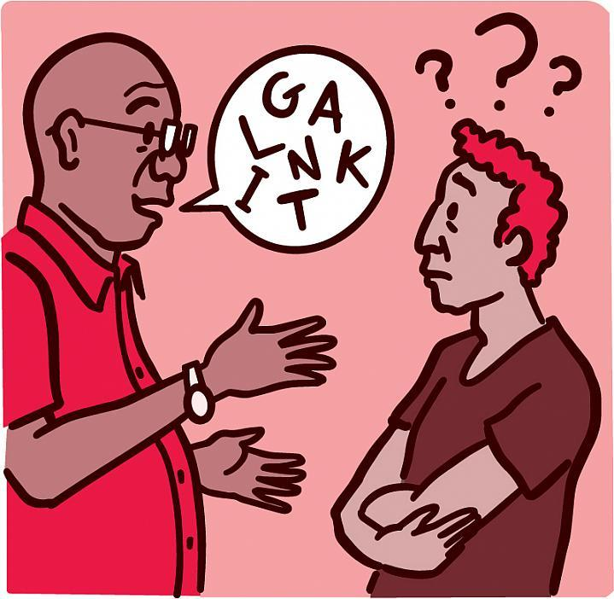
Decision-Making and Strategic Communication in Health
Importance of Communication in Health Management
Effective communication in health management is crucial. It enables better coordination between teams, improves relationships with patients and increases operational efficiency. Poor communication can lead to medical errors, patient dissatisfaction and coordination problems.

Slide 6

Decision-Making and Strategic Communication in Health
Active Listening
  Active listening is a fundamental part of effective communication. Listening actively means paying full attention and showing genuine interest in what the other person is saying.
  This not only improves our understanding of the message, but also strengthens our interpersonal relationships.
  Active listening involves listening not only to the words, but also to the speaker's tone, emotion and body language.

Slide 7

Decision-Making and Strategic Communication in Health
Active Listening Techniques
Paraphrasing: Repeating what the other person has said in our own words to confirm our understanding.
Asking open-ended questions: Encouraging the conversation to go deeper.
Showing nonverbal cues: Nodding, maintaining eye contact.
Avoiding interruptions: Letting the other person finish their ideas.
These techniques help us show that we are paying attention and allow us to better grasp the other person's message.

Slide 8

Decision-Making and Strategic Communication in Health
Benefits of Active Listening
Improves understanding and retention of information
Strengthens interpersonal relationships
Fosters an environment of respect and trust.
In health management, active listening can improve communication with patients and among members of the healthcare team, leading to better health outcomes.

Slide 9

Decision-Making and Strategic Communication in Health
Nonverbal Communication
Nonverbal communication is the transmission of messages without the use of words. It includes gestures, facial expressions, posture, eye contact and proxemics, which is the use of personal space and distance.
Nonverbal communication can complement, emphasize or even replace verbal communication, and it is a crucial part of effective communication.

Slide 10

Decision-Making and Strategic Communication in Health
Components of Nonverbal Communication
Gestures: Hand and arm movements that can emphasize or replace words.
Facial expressions: Reflect our emotions and can influence how our message is perceived.
Posture: The way we position ourselves can convey attitudes and emotions.
Eye contact: Maintaining or avoiding eye contact can affect perceptions of trust and sincerity.
Proxemics: The use of personal space and distance can influence comfort and receptiveness to the message.

Slide 11

Decision-Making and Strategic Communication in Health
Importance of Nonverbal Communication
Nonverbal communication is essential because it complements and reinforces our verbal message.
Inconsistent nonverbal communication can lead to misunderstandings and confusion.
Example: If we say we are open to ideas, but cross our arms and avoid eye contact, the nonverbal message can contradict our words.

Slide 12

Decision-Making and Strategic Communication in Health
Examples of Nonverbal Communication in Health Management
Affirmation gestures: Nodding to show agreement or understanding.
Eye contact: Maintaining eye contact to show interest and attention.

Slide 13
Decision-Making and Strategic Communication in Health
Categories of Gestures
Adaptor gestures: They are the least effective gestures in communication. They tend to convey an image of insecurity inconsistent with the composure desirable in a leader. Their impact on the audience's unconscious mind is considerable, because the limbic system of our brain is genetically programmed to automatically process this type of nonverbal behavior.

Slide 14

Decision-Making and Strategic Communication in Health
Adaptor Gestures
Nail biting is perhaps one of the most popular and easily recognizable adaptors, but the variety is almost endless: scratching, touching, rubbing,
fiddling with, squeezing or manipulating in any way any part of the body or an object: these are adaptor gestures that usually express nervousness, anxiety and insecurity.

Slide 15

Decision-Making and Strategic Communication in Health
Relaxation Gestures
Relaxation gestures appear mainly in an environment of intimacy or when we believe no one is watching us. In this case, the gestures are usually linked to certain physiological needs, such as tiredness

Slide 16

Decision-Making and Strategic Communication in Health
Watch What We Touch
Adaptor gestures that involve the sensory organs tend to be very revealing. Just as young children do spontaneously, covering the mouth, nose, eyes or ears can unconsciously express discomfort or rejection toward a stimulus processed by that sensory channel, even when done very subtly.

Slide 17

Decision-Making and Strategic Communication in Health
Pressed Lips
Pressed lips can also speak, as Donald Trump has accustomed us to.
This way of pressing and thinning the lips, so characteristic of him, is not only a facial expression, but at the same time an adaptor gesture linked to emotional repression, and to the attempt to hide a basic emotion with negative valence, such as anger.
Curiously, Donald Trump has internalized this gesture so deeply that it appears systematically even when he tries to put on a social smile.

Slide 18





Examples

Slide 19

Decision-Making and Strategic Communication in Health
Integration of Communication Skills
Applying these skills in team meetings, patient interactions, conflict management and communication with other organizations and stakeholders is essential.
Let us always remember that good communication not only conveys information, but also builds relationships and facilitates collaboration

Slide 20

Decision-Making and Strategic Communication in Health
Strategies to Improve Communication
Continuous training: Taking part in communication courses and workshops.
Regular practice: Practicing communication and active listening techniques in daily life.
Feedback: Requesting and offering feedback to improve our skills.
Self-assessment: Reflecting on our interactions and looking for areas for improvement.

Slide 21

Decision-Making and Strategic Communication in Health
Impact of Effective Communication in Health Management
Improved quality of service: Clear and effective communication can reduce errors and improve patient care.
Increased patient satisfaction: Patients feel more valued and understood when communicated with effectively.
Operational efficiency: Good communication facilitates coordination and collaboration among team members, improving operational efficiency.

