Slide 1
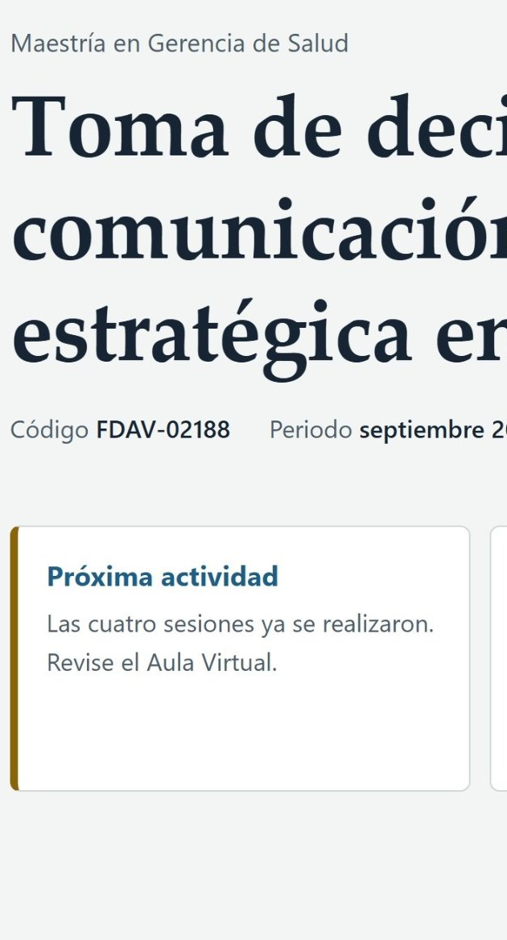
GUIDE 21
Interactive Syllabus
Decision Making and Strategic Communication in Health
From PDF to phone
Daniel Rodríguez Villalba · UTE
Juan Pablo Arrobo · UTPL
Narration generated with an AI voice (ElevenLabs) and reviewed by the authors
1 / 10
Notes:
We present the Interactive Syllabus for Decision Making and Strategic Communication in Health. It was built by Daniel Rodríguez and Juan Pablo Arrobo. It turns the course syllabus into a website that students can explore from their phones.

Slide 2


Readings did not connect
The articles were in the syllabus, but students did not know when or why to read them.
Syllabus as PDF
2 / 10
Notes:
Our course is part of the Master's program in Health Management. Until now the syllabus reached students only as a P D F file. Everything was there, but in a long and static document that was hard to navigate. The clearest problem appeared with the readings. The reference articles were listed in the syllabus. Even so students did not see how they connected to the development of the course. A list of references does not explain when or why to read each article.

Slide 3



The tool
Who uses it
What they get
What they find
Students of the course
One bilingual link
Schedule, grading, resources, contact, tasks
Guide 21
3 / 10
Notes:
The users are the students of the course. They receive a single link. When they open it they find the schedule of the four sessions and the grading scheme. They also see the resources, the bibliography and the instructors' contact details. In addition they can keep simple track of their weekly tasks. Everything is available in Spanish and in English. The site is based on guide twenty one of our course.

Slide 4






Four steps, human decision
1
2
3
4
Approved syllabus
Claude builds the site
Instructors review: 5 versions
Published: GitHub Pages
A person always decides
4 / 10
Notes:
The process has four steps. First we started from the approved syllabus and the list of resources. Then Claude generated the website from that material. Each section comes from a specific part of the syllabus. Next we as instructors reviewed every version against the syllabus and asked for corrections. Claude never published anything on its own. That is how we reached five versions. Finally we published the site on GitHub Pages. The A I proposes the content and the design. People always decide what gets published, which dates are valid and which resources are included.

Slide 5


What we verified
4
3 of 3
5
different phones
colleagues: simple navigation
reviewed versions
Dates match the approved syllabus
Pending: testing with students
5 / 10
Notes:
We verified four things. The content and the dates of the four sessions match the approved syllabus. In our last review we found a mismatch in the course period and corrected it. The site works on four different phones. Three out of three colleagues found the navigation simple. Our review as instructors added the English version and more resources in each version. We have not yet tested the site with our students. For now that remains a proposal for the next term.

Slide 6



Limits and responsible use
Does not replace
Live classes or Moodle
Data
No names or emails
Next step
Moodle and testing with students
6 / 10
Notes:
The site does not replace the live online classes. It does not replace Moodle either. Moodle remains the official channel for submitting assignments and taking exams. The site does not ask for names or email addresses. Task checkmarks stay only in each student's browser. Our next step is to link the site from Moodle. Then we will test it with students next term.

Slide 7
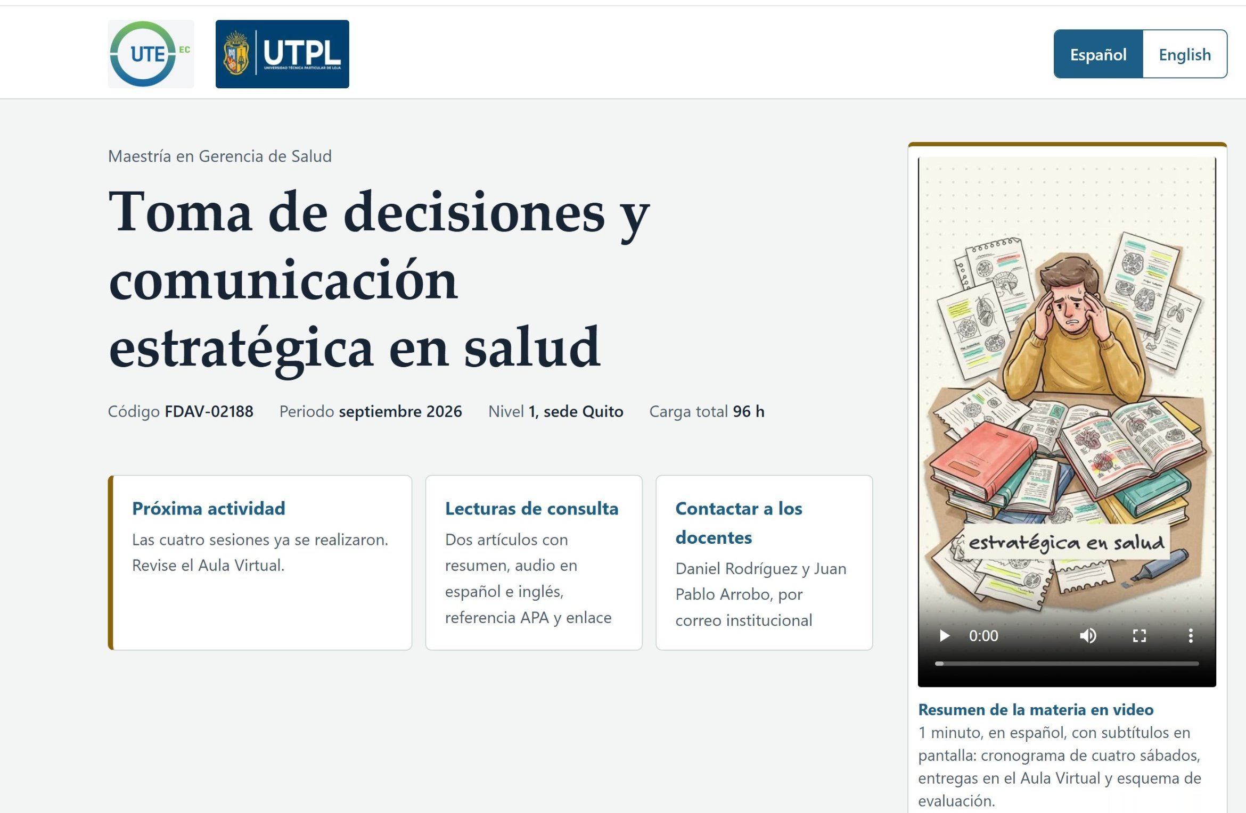
Input: the student's home page
Three main tasks from the home page
7 / 10
Notes:
Let's look at the site. This is the screen students see when they open the link. Our screenshots show the Spanish version, and the site also has an English version. At the top they choose the language. Below the title are the three most common tasks. See the next activity, find the readings and contact the instructors. On the right there is a one minute video that summarizes the course.

Slide 8
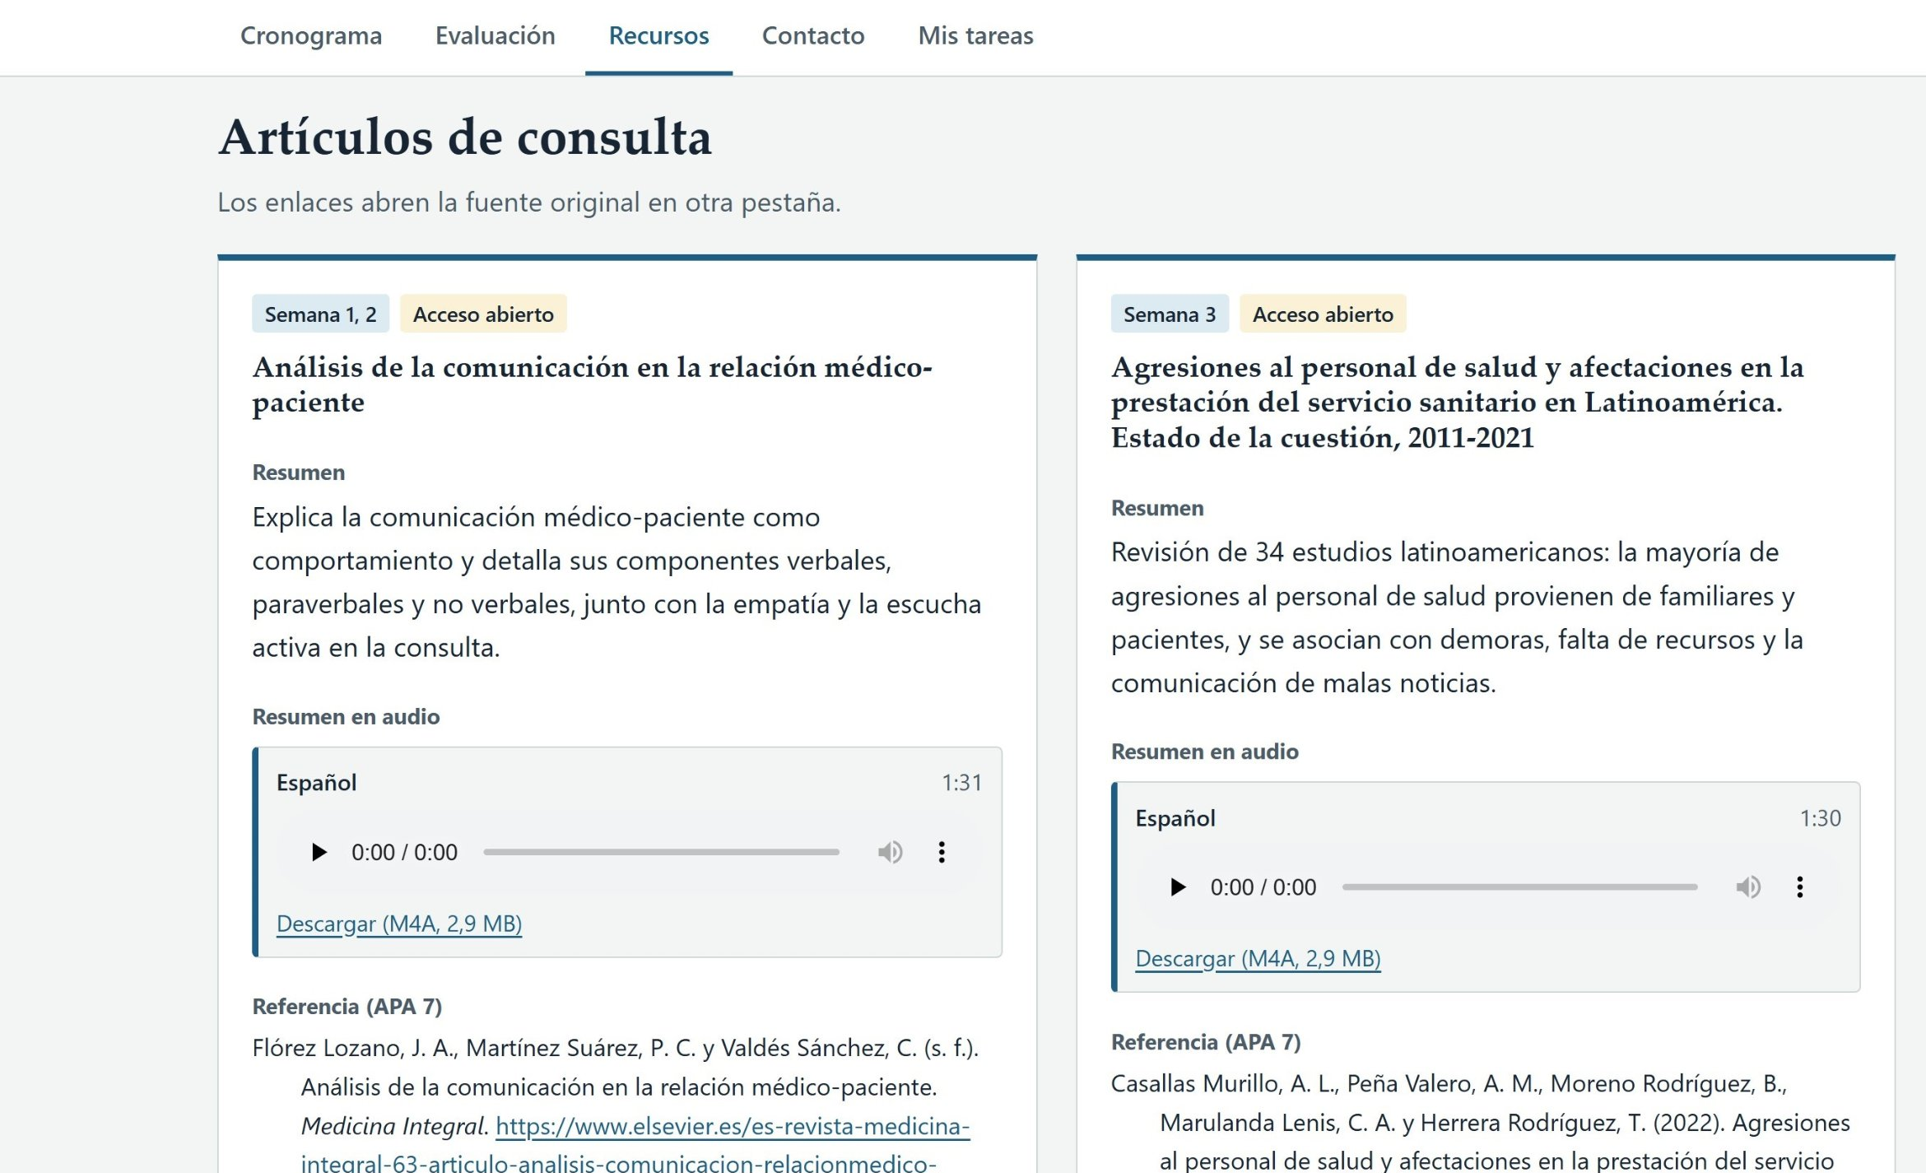
Result: each reading with its week
Week, summary, audio, reference and link
8 / 10
Notes:
This is the reference articles section. Here is the answer to our problem. Each article is labeled with the week when it is used in class. The audio summaries are recorded in Spanish and in English. It also includes a short summary and an audio summary. It gives the A P A reference and a link to the original source. That way students know what to read and when to read it before they even open it. Both articles are open access.

Slide 9
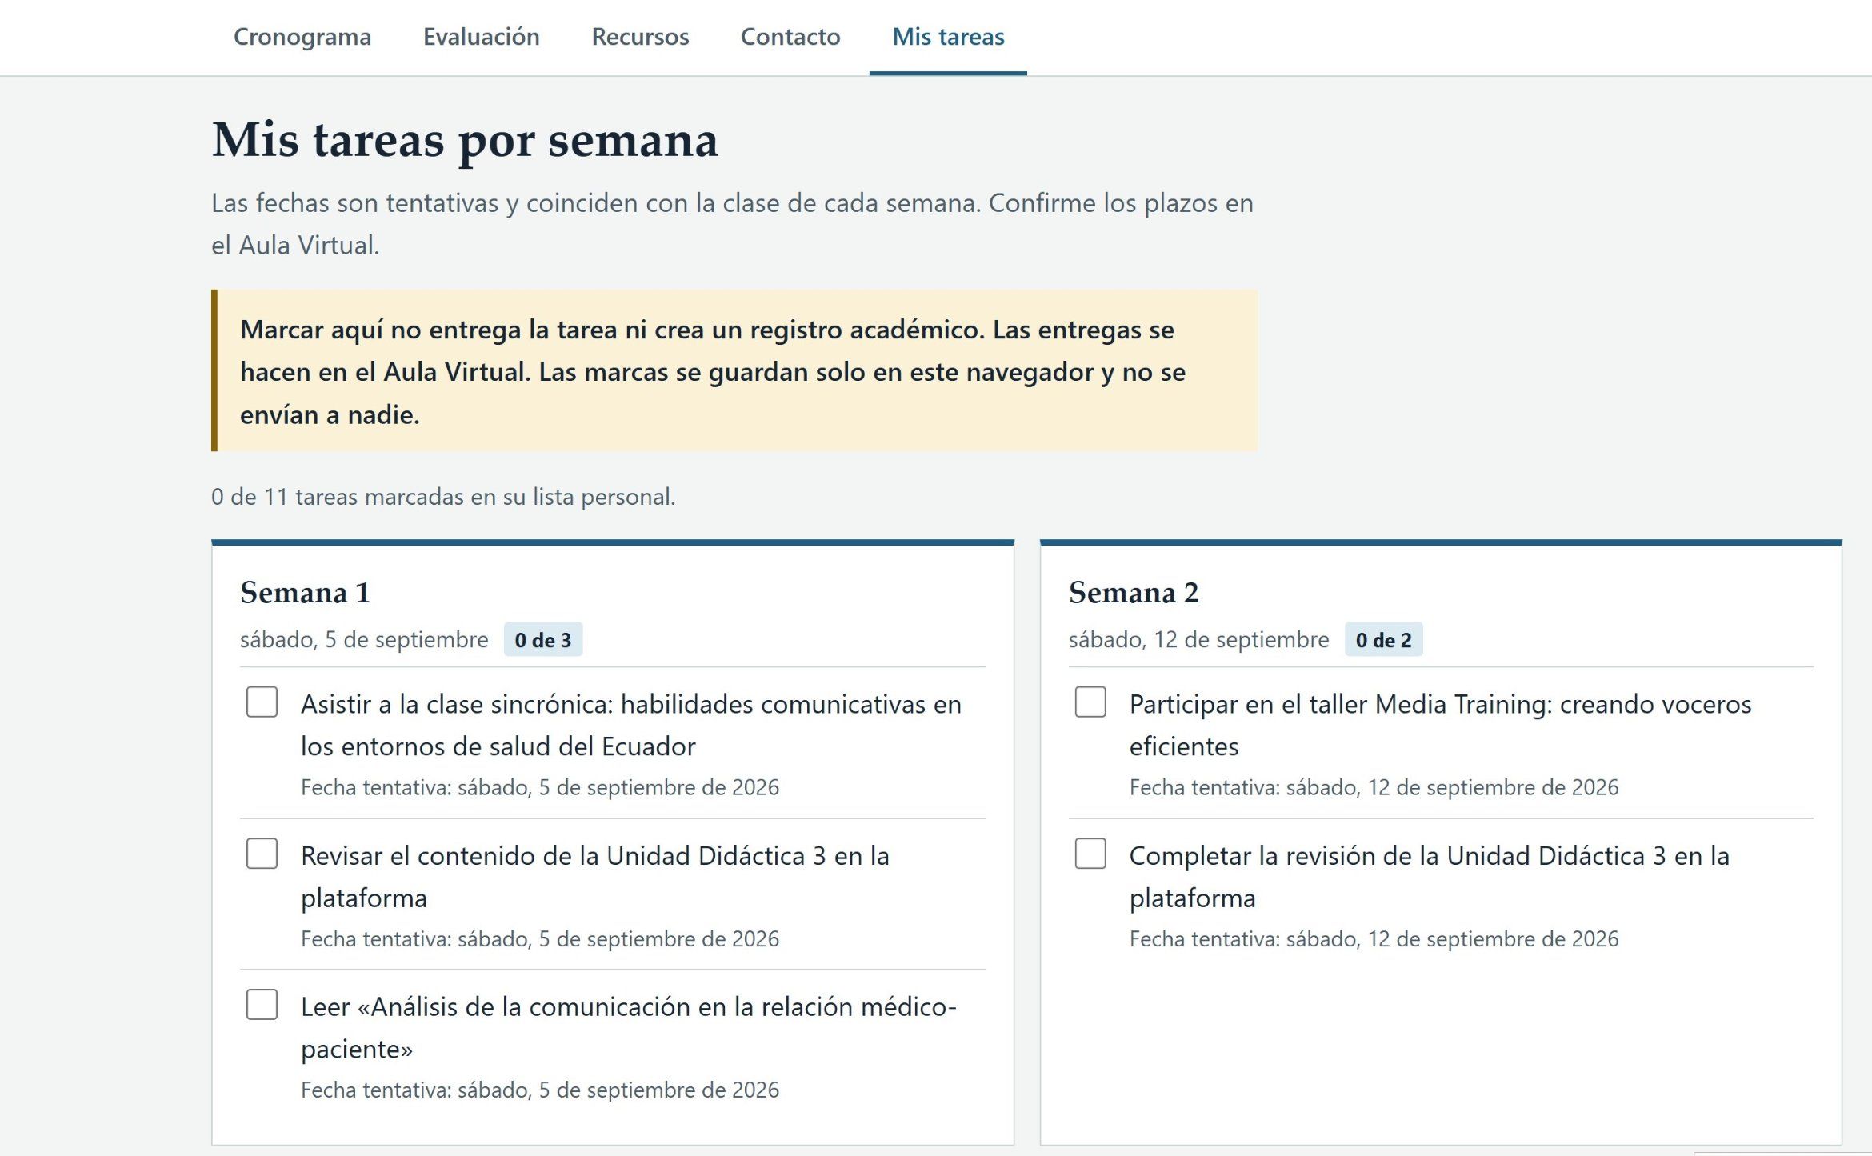
Tracking: my tasks by week
Checking a task does not submit it: submit in the virtual classroom
9 / 10
Notes:
This is the weekly task list, called My tasks by week. Readings and activities appear next to the date of each class. Students check off what they have done and see their own progress. The notice is clear and always visible. Checking a task here does not submit it. Assignments are submitted in the virtual classroom. The checkmarks are saved only in the student's browser and are never sent to anyone.

Slide 10
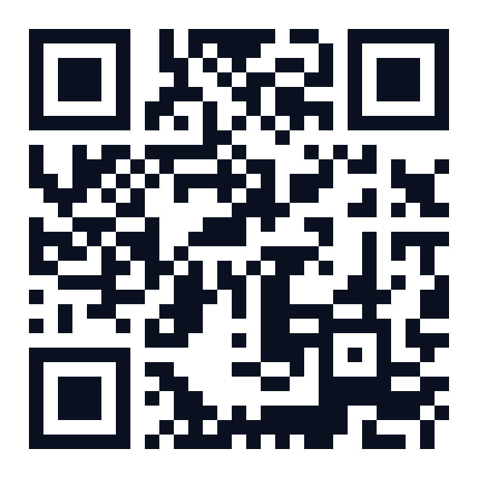

A syllabus for every week
darv1970.github.io/Silabo-V5
Next step: Moodle and students
Daniel Rodríguez Villalba · UTE
Juan Pablo Arrobo · UTPL
Open the site
Thank you
10 / 10
Notes:
With this site the syllabus is no longer a static document. It becomes a guide for every week of the course. We hope to spend less time repeating dates and more time on conversation in class. Our next step is to test it with students through Moodle. We invite you to open the link and adapt the idea to your own course. Thank you.

