Slide 1
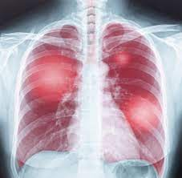
Pneumonia Detection on X-ray Images Using Deep Learning
Presentation By : Team 5
Group Members: Darvin (Team Leader); Mary; Shadrack & Marvin
Date: June 2023

Slide 2
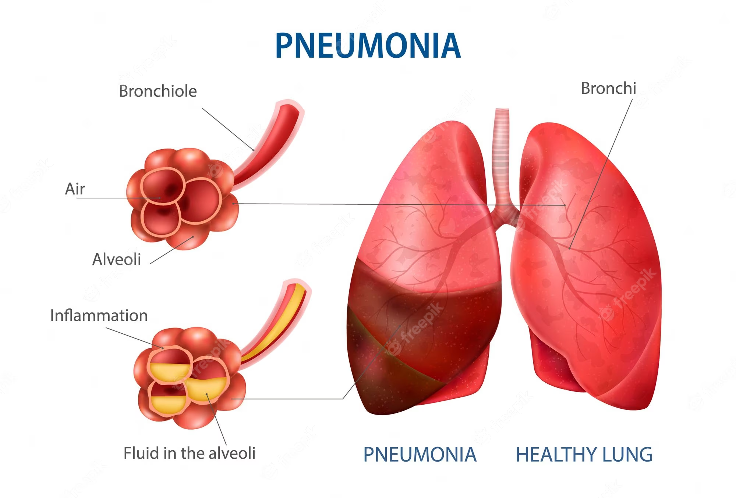
IMPORTANT FACTS ABOUT PNEUMONIA
WHAT IS PNEUMONIA?
Pneumonia is an infection that affects one or both lungs. It causes the air sacs, or alveoli, of the lungs to fill up with fluid or pus. Bacteria, viruses, or fungi may cause pneumonia.
WHAT ARE RED FLAGS FOR PNEUMONIA?
Fever, sweating and shaking chills. Lower than normal body temperature (in adults older than age 65 and people with weak immune systems). Nausea, vomiting or diarrhea. Shortness of breath.

Slide 3
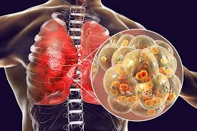
PROJECT OVERVIEW
Pneumonia is a leading cause of death worldwide, and early detection is crucial for effective treatment.
Manual interpretation of chest X-ray images by radiologists is time-consuming and prone to human error, leading to delayed diagnosis and treatment.
Application of Machine Learning, Deep Learning, Artificial Intelligence has increased tremendously in the field of medicine over the past few years.
Modern Day Applications: X-ray Images Analysis, ECGs (Electrocardiogram) and other technologies to diagnose diseases or ailments in patients.

Slide 4
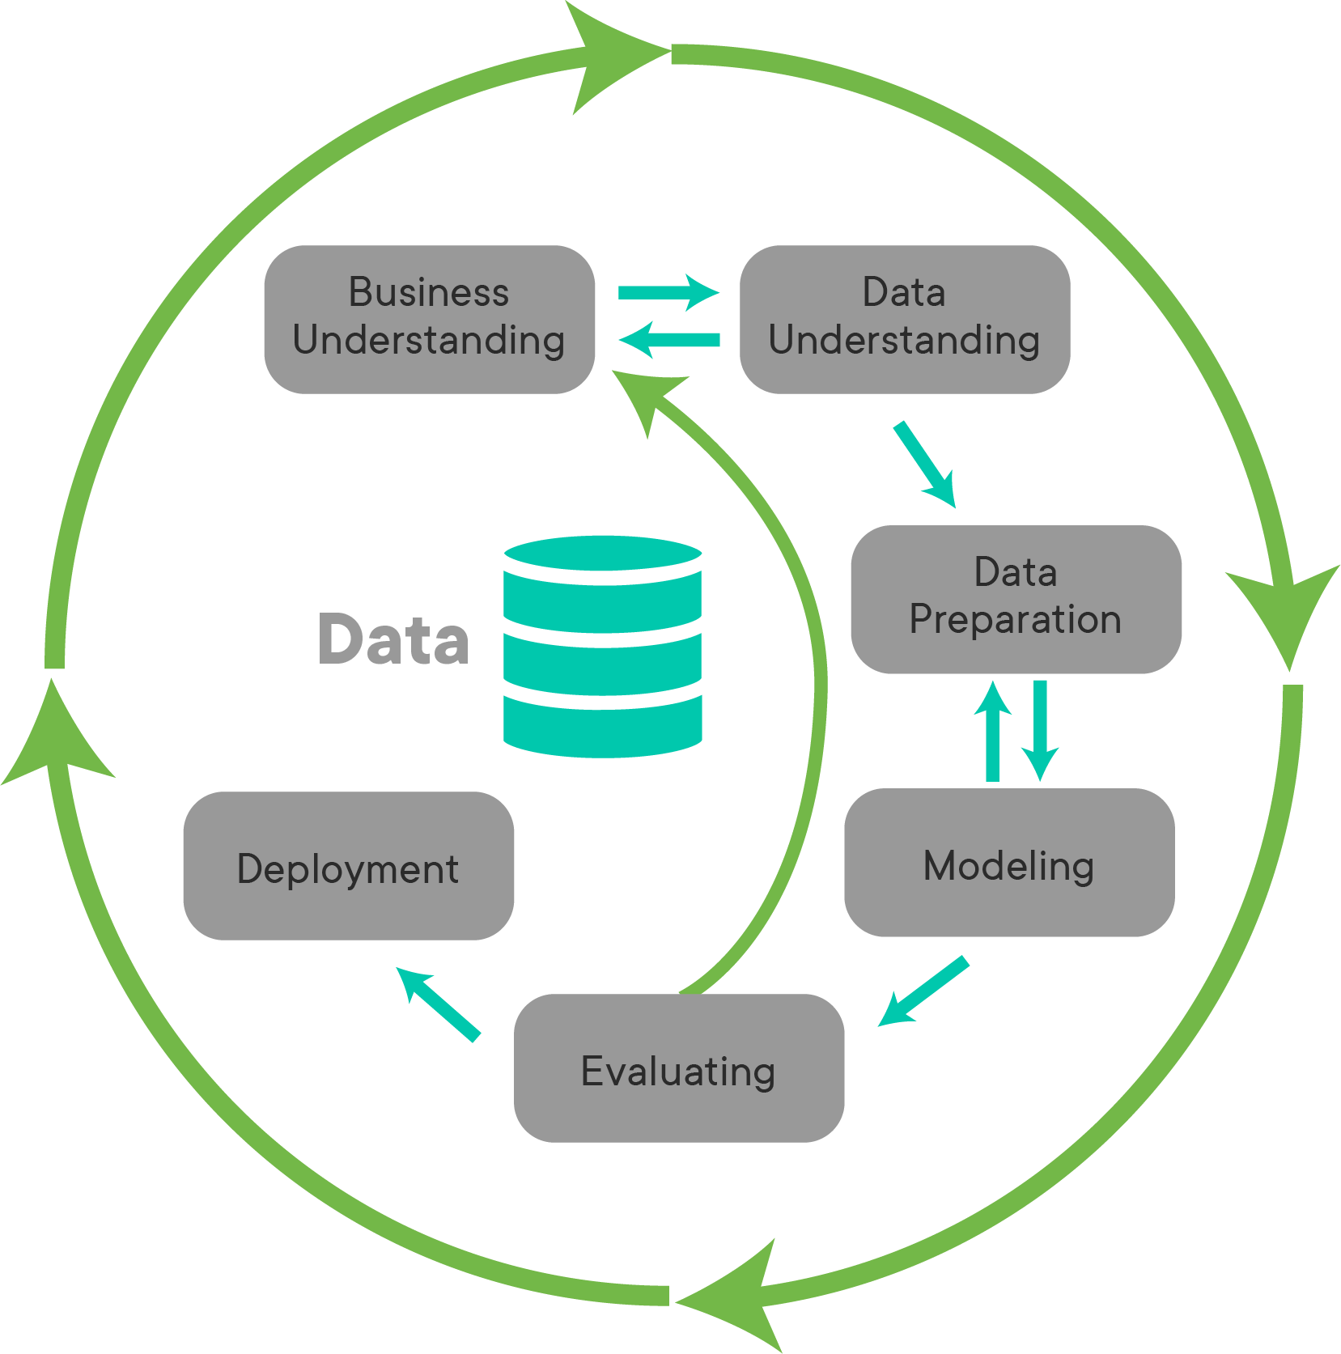
DATA SCIENCE PROCESS/FRAMEWORK
CRSIP-DM
CRoss-Industry Standard Process for Data Mining

Slide 5

BUSINESS UNDERSTANDING
Our Goal
To develop a deep learning model to automate the process of pneumonia detection from chest X-ray images, enabling faster and more accurate diagnosis.

Slide 6
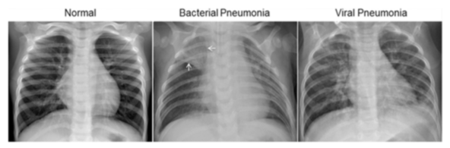
CHEST X-RAY IMAGES
Clear Lungs Without Any Abnormal Opacification in the Image
Focal lobar Consolidation in the right upper lobe (Depicted by White Arrow)
More Diffuse ‘Interstitial’ pattern in both lungs

Slide 7
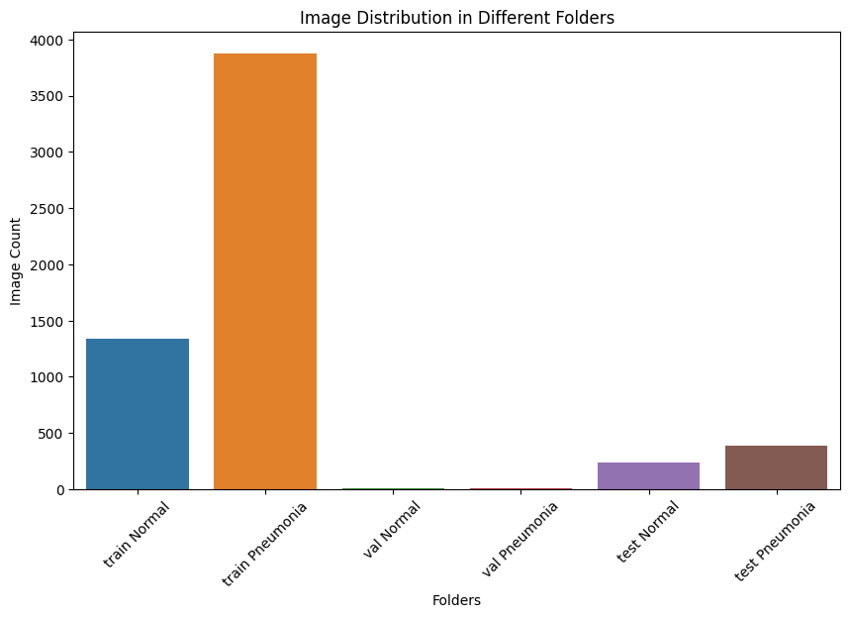
LABELS DISTRIBUTION IN TRAIN, TEST & VALIDATION FOLDERS
Training images are class imbalanced with more images labelled ‘Pneumonia’ than ‘Normal’. Few Examples in Validation folder

Slide 8
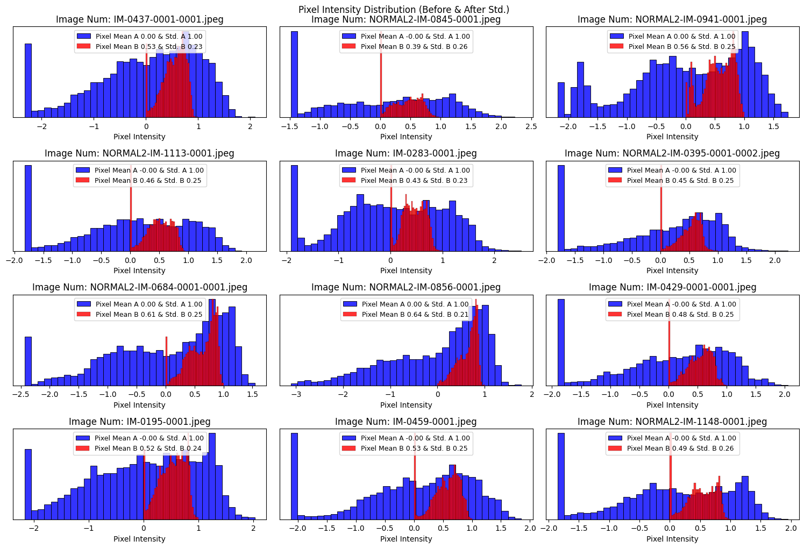
PIXEL INTENSITY DISTRIBUTION (BEFORE & AFTER STANDARDIZATION)
Image Data adjusted to a new mean of zero (0) & standard deviation of one (1)

Slide 9
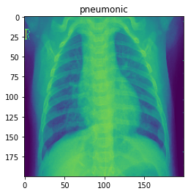
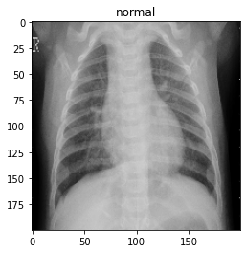
EFFECTS OF ILLUMINATION
Grayscale Normalization Done to Reduce the Effects of illuminations.

Slide 10
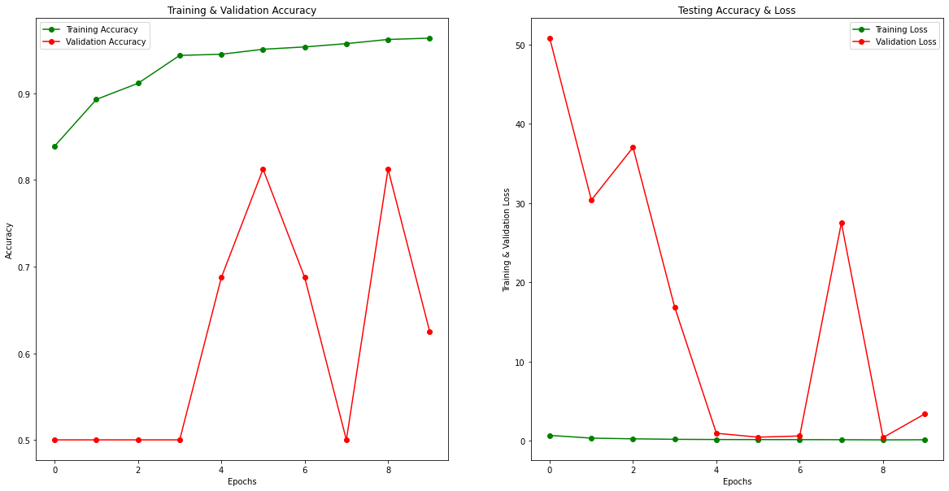
MODEL LOSS & ACCURACY PLOTS
Training accuracy increases as we increase epochs while validation accuracy irregular due to data variations.
Training loss remains relatively low & constant which is a good story

Slide 11
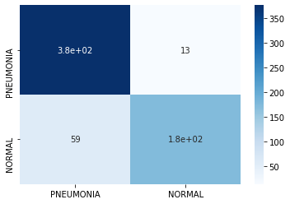
PREFFERED MODEL
CNN WITH 4 HIDDEN LAYERS
Overall Accuracy: 88%
Recall for Pneumonia: 97%
Precision for Pneumonia: 86%

Slide 12
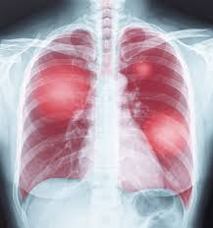
RECOMENDATION
This model can be used in Healthcare sector in the radiological department to assist predict chest Xray images easily and accurately.
Similar model likewise can be improved on and deployed to assist with detection of any infectious lung diseases.

Slide 13
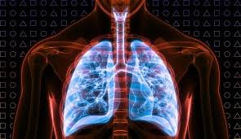
THANK YOU

