Slide 1
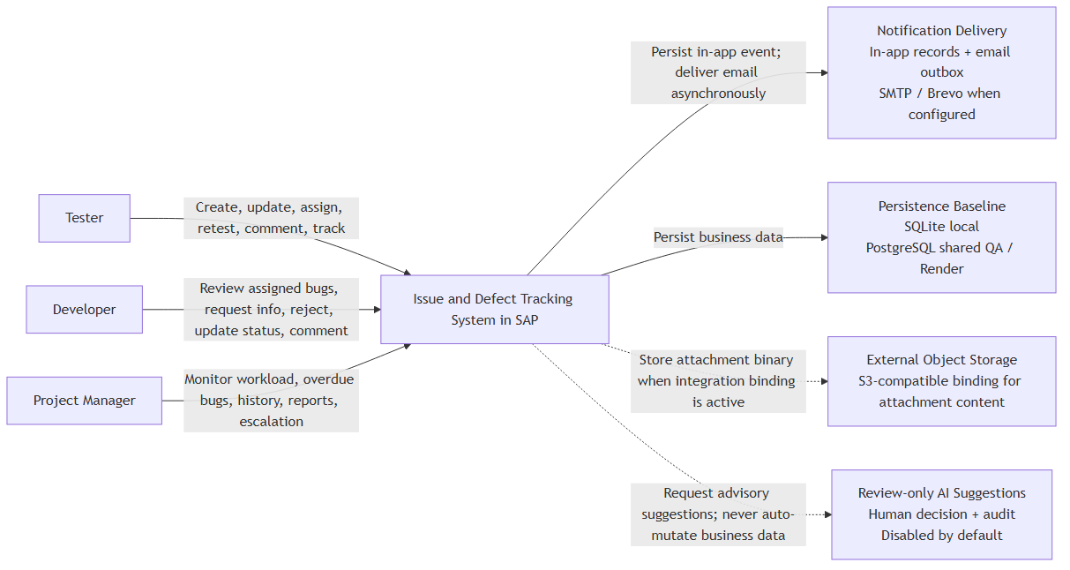
01. System Context — Overview
IDTS SAP01 | Source asset: 01-system-context.png | Slide 1
Notes:
Mentor review summary: 01. System Context — Overview. Use this diagram to explain the actors/components, the direction of the flow, the CAP/backend control boundary, and the observable data or side effect. Canonical source asset: 01-system-context.png; editable source and manifest are kept in docs/diagrams/rendered.

Slide 2
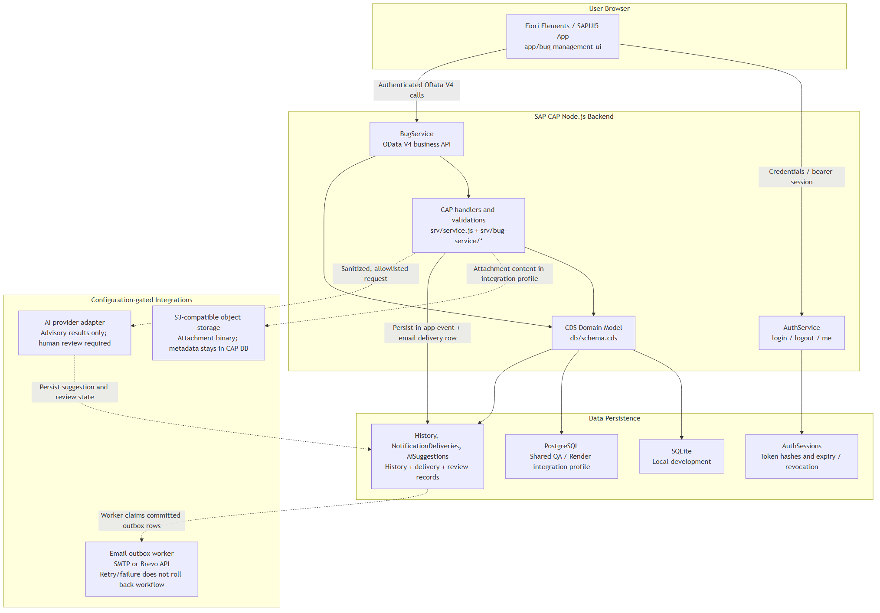
02. SAP CAP/Fiori Architecture — Overview
IDTS SAP01 | Source asset: 02-cap-fiori-architecture.png | Slide 2
Notes:
Mentor review summary: 02. SAP CAP/Fiori Architecture — Overview. Use this diagram to explain the actors/components, the direction of the flow, the CAP/backend control boundary, and the observable data or side effect. Canonical source asset: 02-cap-fiori-architecture.png; editable source and manifest are kept in docs/diagrams/rendered.

Slide 3
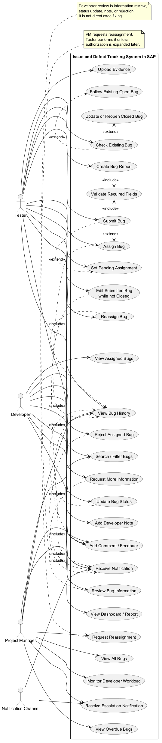
03. Use Case Diagram — Overview
IDTS SAP01 | Source asset: 03-use-case.png | Slide 3
Notes:
Mentor review summary: 03. Use Case Diagram — Overview. Use this diagram to explain the actors/components, the direction of the flow, the CAP/backend control boundary, and the observable data or side effect. Canonical source asset: 03-use-case.png; editable source and manifest are kept in docs/diagrams/rendered.

Slide 4
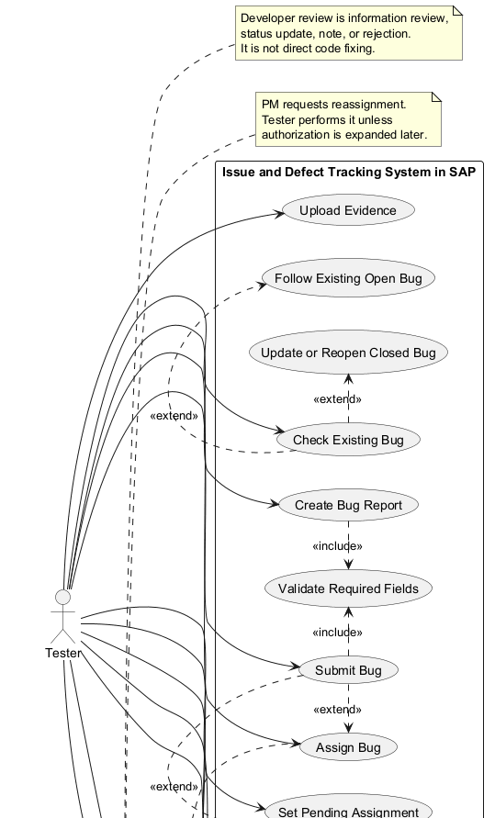
03. Use Case Diagram — Detail 1/3
IDTS SAP01 | Source asset: 03-use-case.png | Slide 4
Notes:
Mentor review summary: 03. Use Case Diagram — Detail 1/3. Use this diagram to explain the actors/components, the direction of the flow, the CAP/backend control boundary, and the observable data or side effect. Canonical source asset: 03-use-case.png; editable source and manifest are kept in docs/diagrams/rendered.

Slide 5
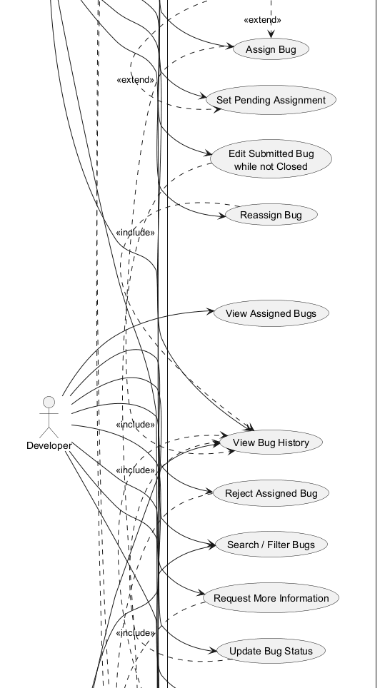
03. Use Case Diagram — Detail 2/3
IDTS SAP01 | Source asset: 03-use-case.png | Slide 5
Notes:
Mentor review summary: 03. Use Case Diagram — Detail 2/3. Use this diagram to explain the actors/components, the direction of the flow, the CAP/backend control boundary, and the observable data or side effect. Canonical source asset: 03-use-case.png; editable source and manifest are kept in docs/diagrams/rendered.

Slide 6
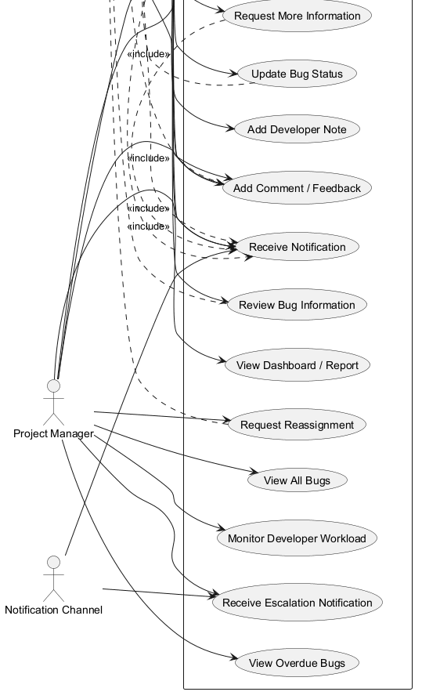
03. Use Case Diagram — Detail 3/3
IDTS SAP01 | Source asset: 03-use-case.png | Slide 6
Notes:
Mentor review summary: 03. Use Case Diagram — Detail 3/3. Use this diagram to explain the actors/components, the direction of the flow, the CAP/backend control boundary, and the observable data or side effect. Canonical source asset: 03-use-case.png; editable source and manifest are kept in docs/diagrams/rendered.

Slide 7
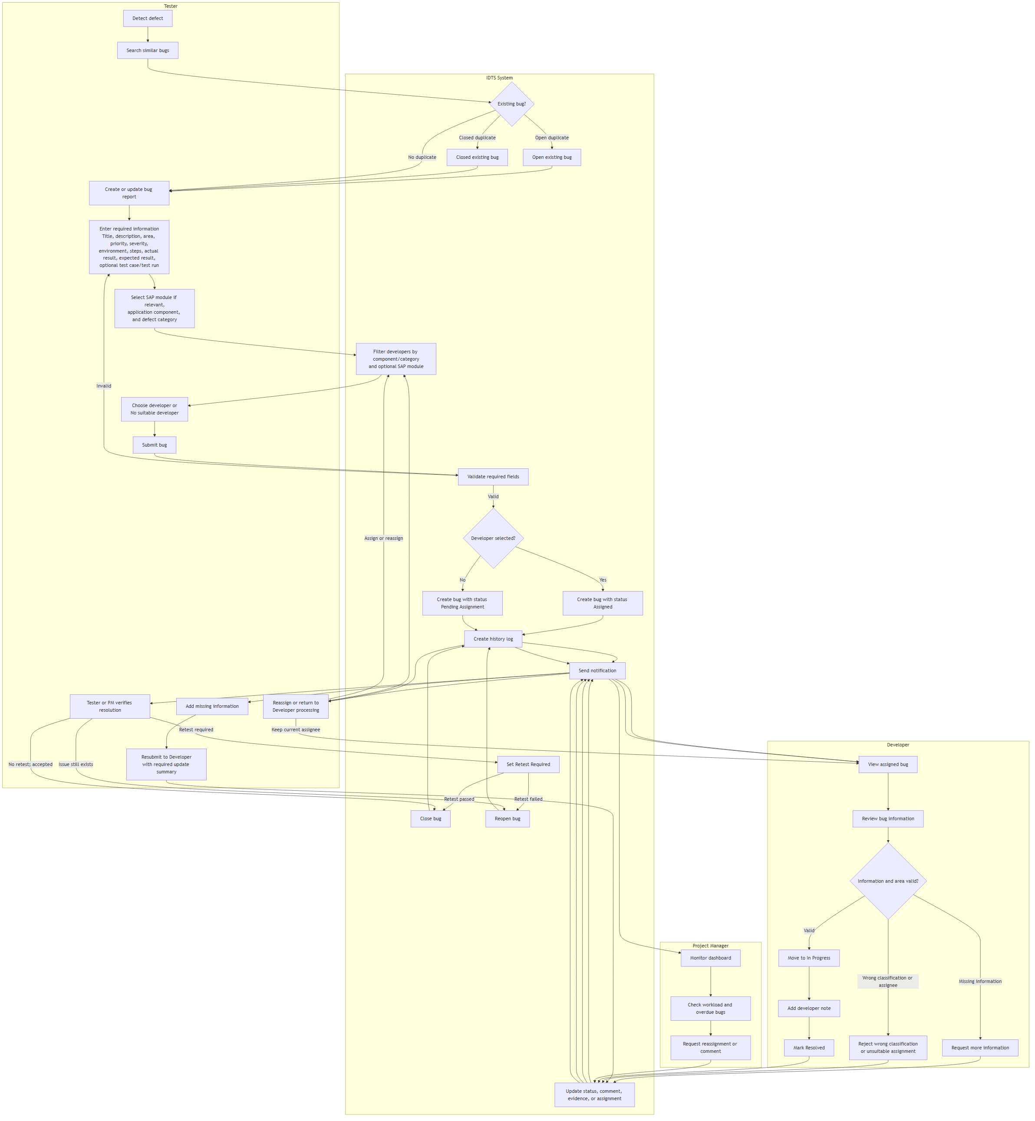
04. End-to-End Defect Tracking Flow — Overview
IDTS SAP01 | Source asset: 04-end-to-end-defect-flow.png | Slide 7
Notes:
Mentor review summary: 04. End-to-End Defect Tracking Flow — Overview. Use this diagram to explain the actors/components, the direction of the flow, the CAP/backend control boundary, and the observable data or side effect. Canonical source asset: 04-end-to-end-defect-flow.png; editable source and manifest are kept in docs/diagrams/rendered.

Slide 8
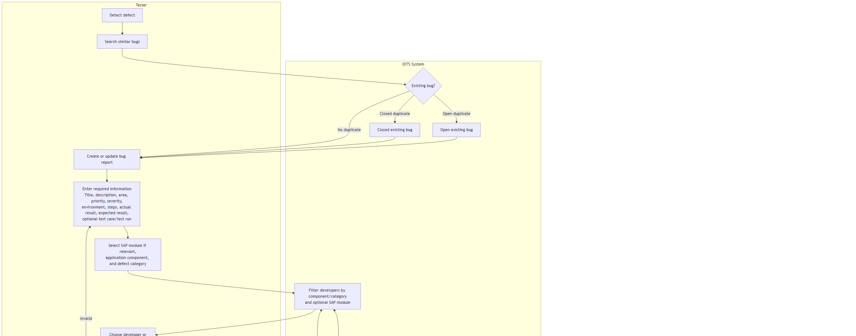
04. End-to-End Defect Tracking Flow — Detail 1/3
IDTS SAP01 | Source asset: 04-end-to-end-defect-flow.png | Slide 8
Notes:
Mentor review summary: 04. End-to-End Defect Tracking Flow — Detail 1/3. Use this diagram to explain the actors/components, the direction of the flow, the CAP/backend control boundary, and the observable data or side effect. Canonical source asset: 04-end-to-end-defect-flow.png; editable source and manifest are kept in docs/diagrams/rendered.

Slide 9
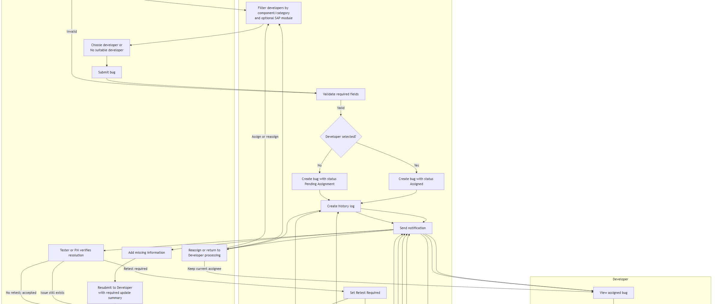
04. End-to-End Defect Tracking Flow — Detail 2/3
IDTS SAP01 | Source asset: 04-end-to-end-defect-flow.png | Slide 9
Notes:
Mentor review summary: 04. End-to-End Defect Tracking Flow — Detail 2/3. Use this diagram to explain the actors/components, the direction of the flow, the CAP/backend control boundary, and the observable data or side effect. Canonical source asset: 04-end-to-end-defect-flow.png; editable source and manifest are kept in docs/diagrams/rendered.

Slide 10
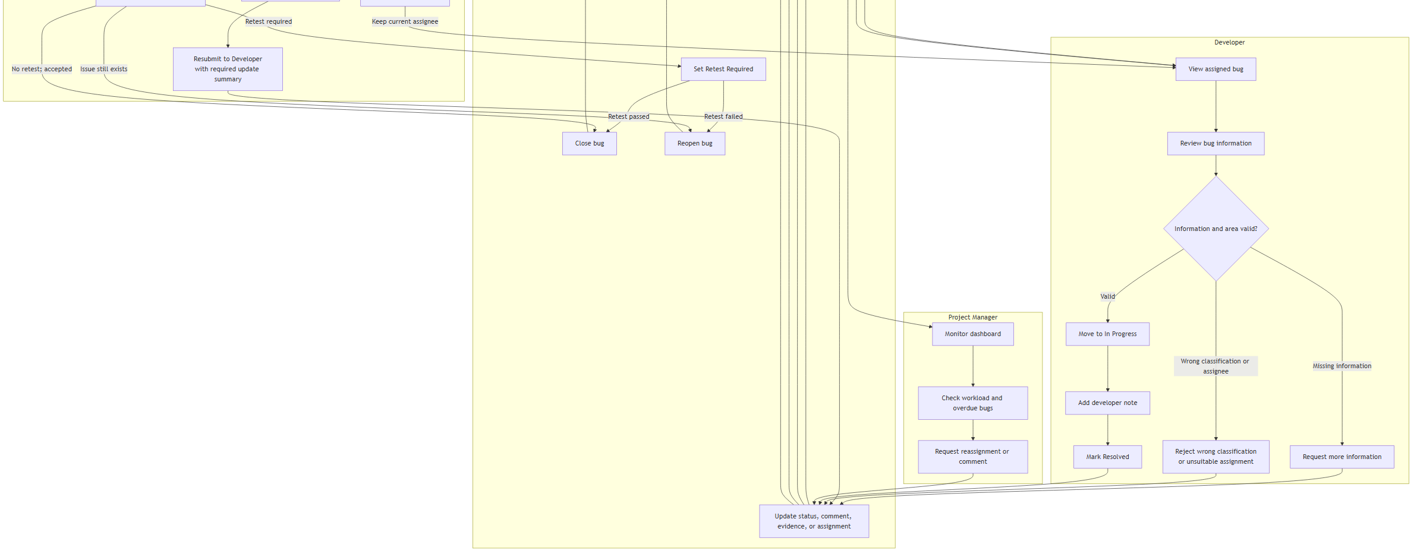
04. End-to-End Defect Tracking Flow — Detail 3/3
IDTS SAP01 | Source asset: 04-end-to-end-defect-flow.png | Slide 10
Notes:
Mentor review summary: 04. End-to-End Defect Tracking Flow — Detail 3/3. Use this diagram to explain the actors/components, the direction of the flow, the CAP/backend control boundary, and the observable data or side effect. Canonical source asset: 04-end-to-end-defect-flow.png; editable source and manifest are kept in docs/diagrams/rendered.

Slide 11
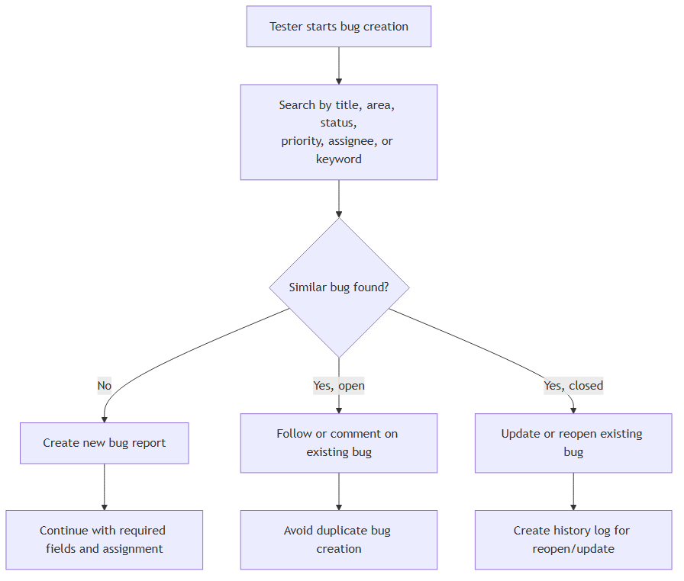
05. Duplicate Checking Flow — Overview
IDTS SAP01 | Source asset: 05-duplicate-checking.png | Slide 11
Notes:
Mentor review summary: 05. Duplicate Checking Flow — Overview. Use this diagram to explain the actors/components, the direction of the flow, the CAP/backend control boundary, and the observable data or side effect. Canonical source asset: 05-duplicate-checking.png; editable source and manifest are kept in docs/diagrams/rendered.

Slide 12
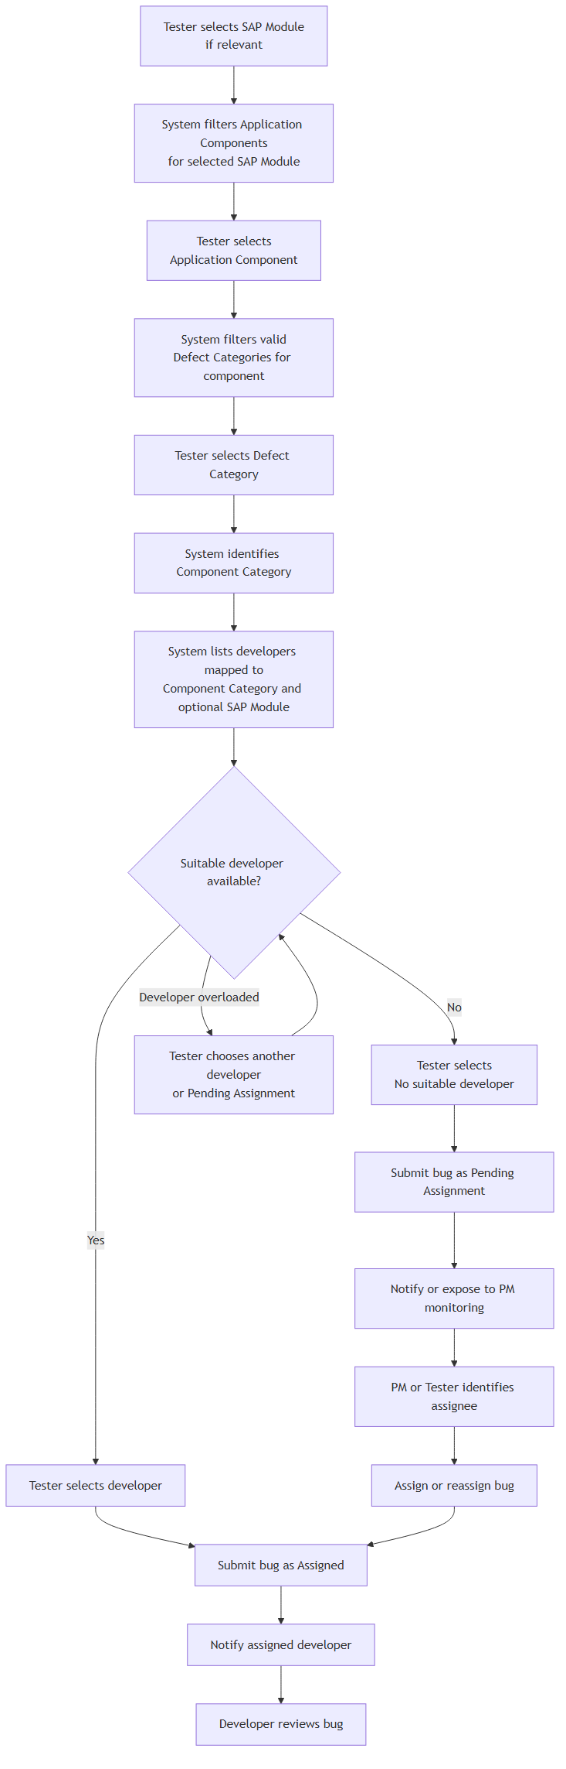
06. Assignment Decision Flow — Overview
IDTS SAP01 | Source asset: 06-assignment-decision.png | Slide 12
Notes:
Mentor review summary: 06. Assignment Decision Flow — Overview. Use this diagram to explain the actors/components, the direction of the flow, the CAP/backend control boundary, and the observable data or side effect. Canonical source asset: 06-assignment-decision.png; editable source and manifest are kept in docs/diagrams/rendered.

Slide 13
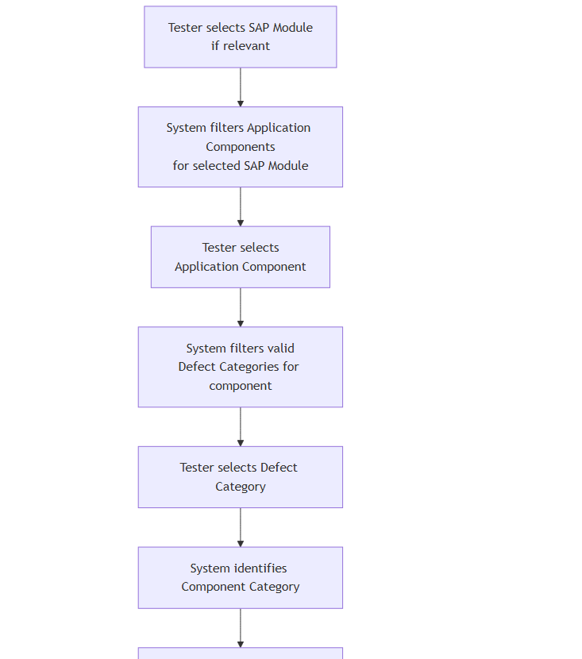
06. Assignment Decision Flow — Detail 1/3
IDTS SAP01 | Source asset: 06-assignment-decision.png | Slide 13
Notes:
Mentor review summary: 06. Assignment Decision Flow — Detail 1/3. Use this diagram to explain the actors/components, the direction of the flow, the CAP/backend control boundary, and the observable data or side effect. Canonical source asset: 06-assignment-decision.png; editable source and manifest are kept in docs/diagrams/rendered.

Slide 14
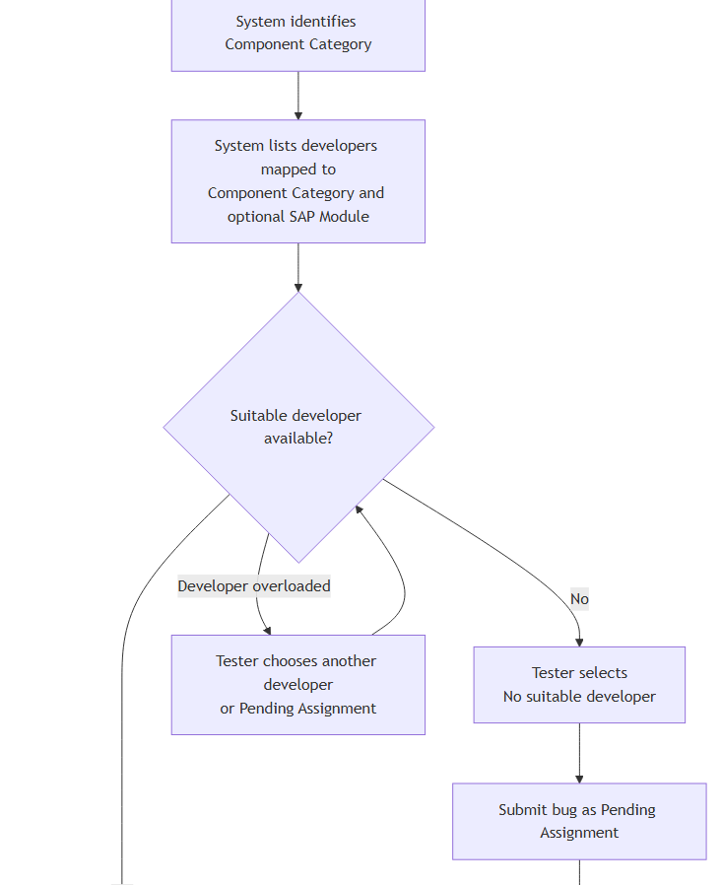
06. Assignment Decision Flow — Detail 2/3
IDTS SAP01 | Source asset: 06-assignment-decision.png | Slide 14
Notes:
Mentor review summary: 06. Assignment Decision Flow — Detail 2/3. Use this diagram to explain the actors/components, the direction of the flow, the CAP/backend control boundary, and the observable data or side effect. Canonical source asset: 06-assignment-decision.png; editable source and manifest are kept in docs/diagrams/rendered.

Slide 15
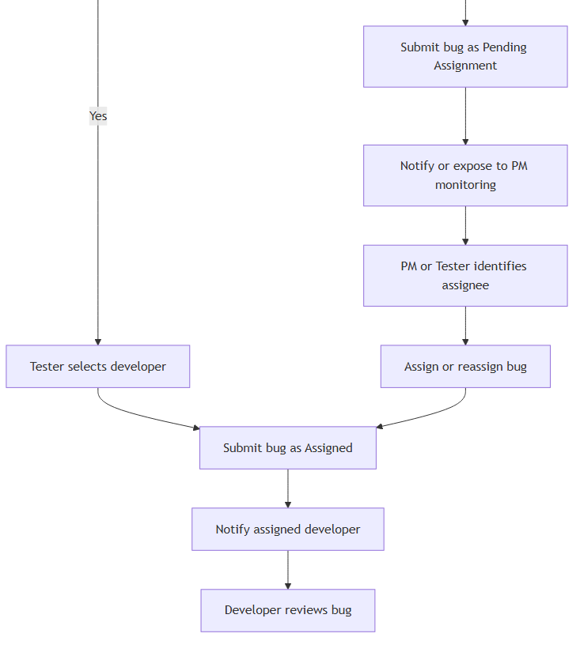
06. Assignment Decision Flow — Detail 3/3
IDTS SAP01 | Source asset: 06-assignment-decision.png | Slide 15
Notes:
Mentor review summary: 06. Assignment Decision Flow — Detail 3/3. Use this diagram to explain the actors/components, the direction of the flow, the CAP/backend control boundary, and the observable data or side effect. Canonical source asset: 06-assignment-decision.png; editable source and manifest are kept in docs/diagrams/rendered.

Slide 16
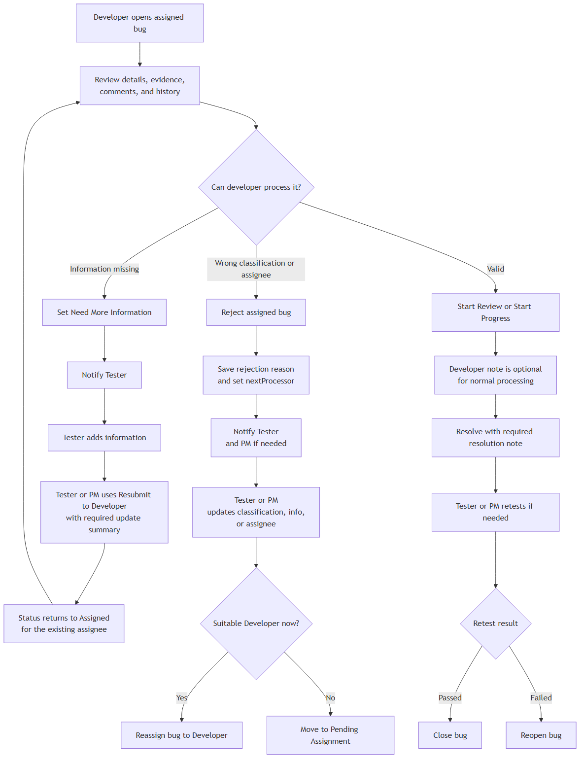
07. Developer Review Flow — Overview
IDTS SAP01 | Source asset: 07-developer-review.png | Slide 16
Notes:
Mentor review summary: 07. Developer Review Flow — Overview. Use this diagram to explain the actors/components, the direction of the flow, the CAP/backend control boundary, and the observable data or side effect. Canonical source asset: 07-developer-review.png; editable source and manifest are kept in docs/diagrams/rendered.

Slide 17
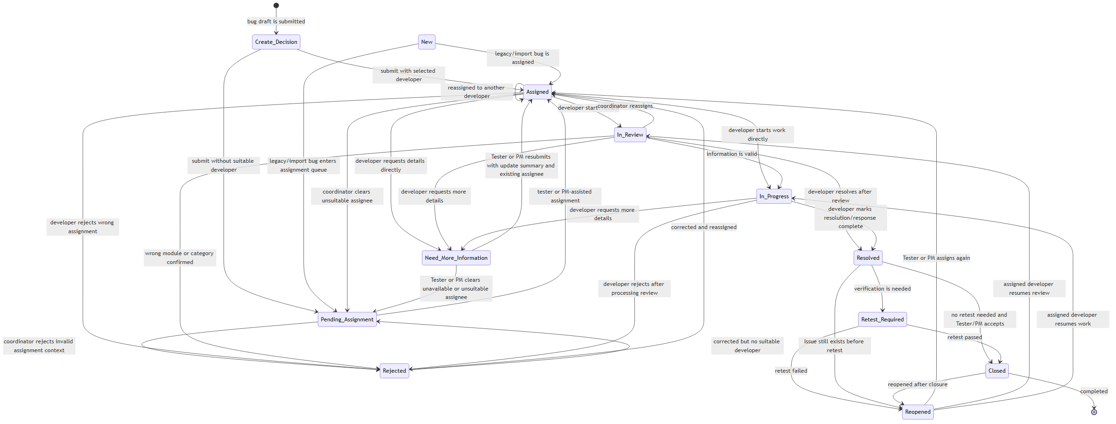
08. Bug Status Lifecycle — Overview
IDTS SAP01 | Source asset: 08-status-lifecycle.png | Slide 17
Notes:
Mentor review summary: 08. Bug Status Lifecycle — Overview. Use this diagram to explain the actors/components, the direction of the flow, the CAP/backend control boundary, and the observable data or side effect. Canonical source asset: 08-status-lifecycle.png; editable source and manifest are kept in docs/diagrams/rendered.

Slide 18
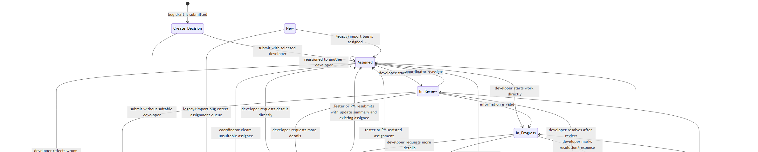
08. Bug Status Lifecycle — Detail 1/2
IDTS SAP01 | Source asset: 08-status-lifecycle.png | Slide 18
Notes:
Mentor review summary: 08. Bug Status Lifecycle — Detail 1/2. Use this diagram to explain the actors/components, the direction of the flow, the CAP/backend control boundary, and the observable data or side effect. Canonical source asset: 08-status-lifecycle.png; editable source and manifest are kept in docs/diagrams/rendered.

Slide 19
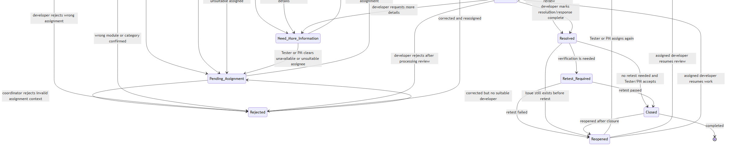
08. Bug Status Lifecycle — Detail 2/2
IDTS SAP01 | Source asset: 08-status-lifecycle.png | Slide 19
Notes:
Mentor review summary: 08. Bug Status Lifecycle — Detail 2/2. Use this diagram to explain the actors/components, the direction of the flow, the CAP/backend control boundary, and the observable data or side effect. Canonical source asset: 08-status-lifecycle.png; editable source and manifest are kept in docs/diagrams/rendered.

Slide 20
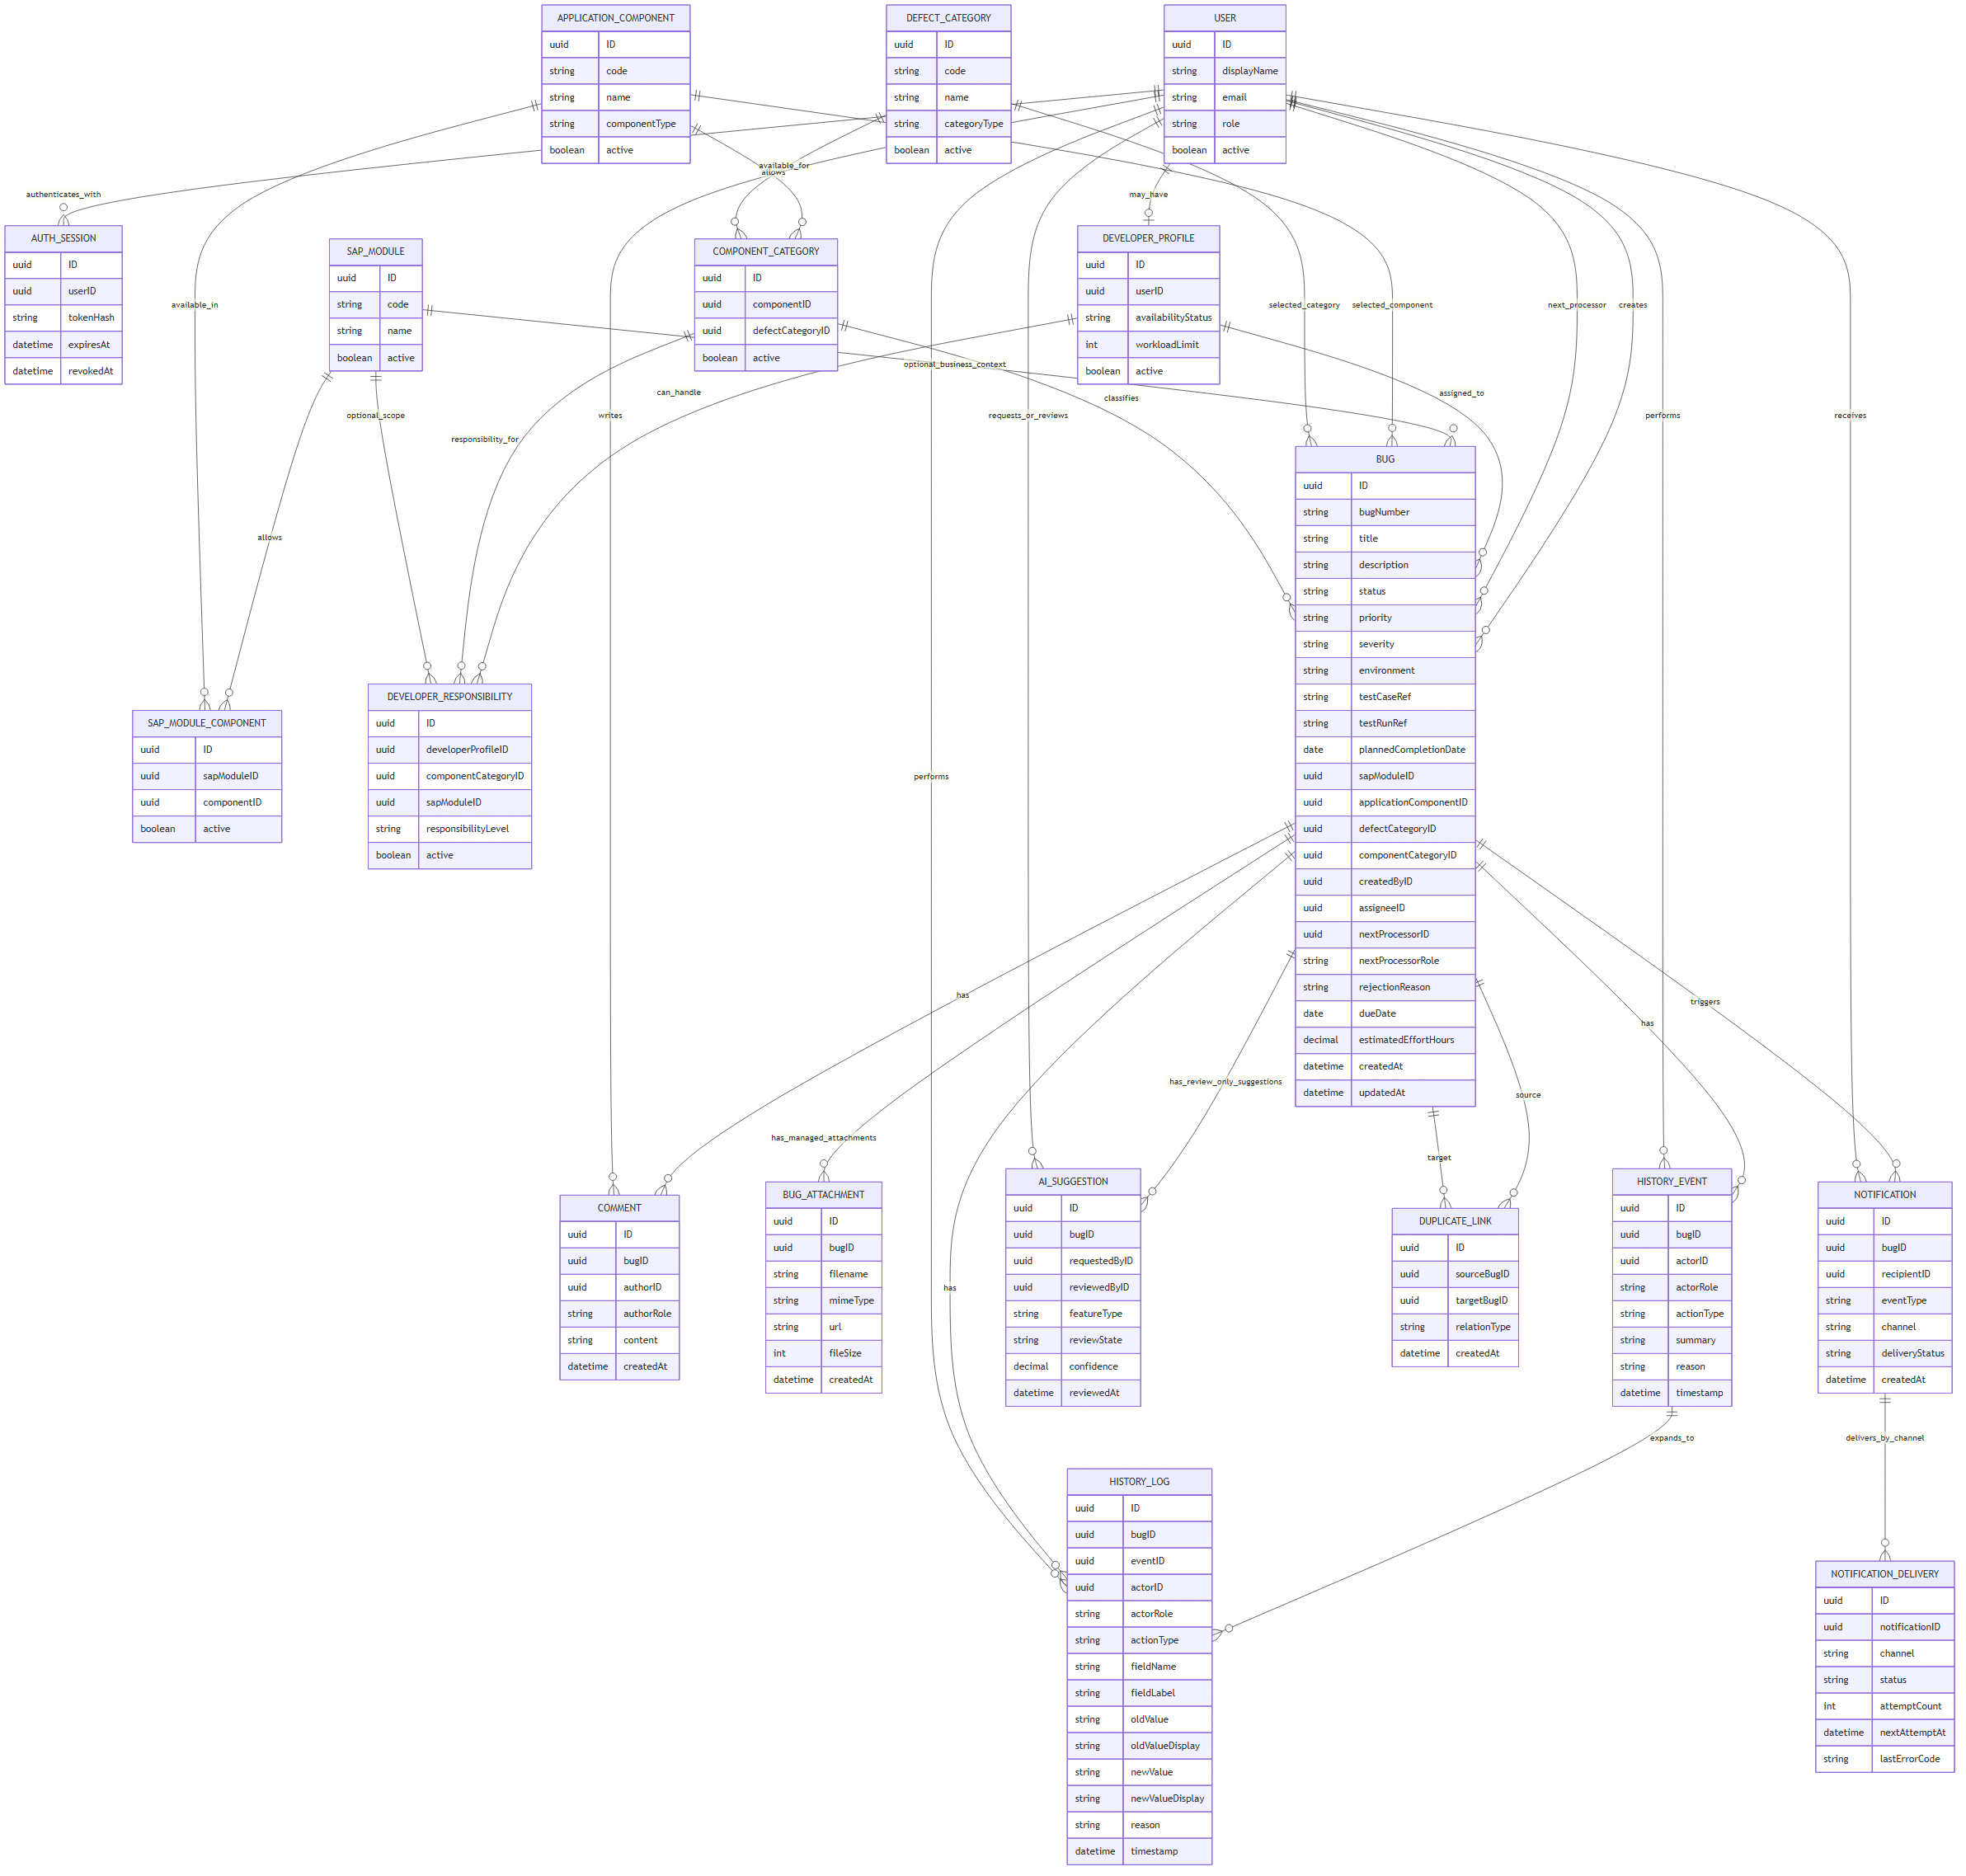
09. Conceptual Data Model — Overview
IDTS SAP01 | Source asset: 09-conceptual-data-model.png | Slide 20
Notes:
Mentor review summary: 09. Conceptual Data Model — Overview. Use this diagram to explain the actors/components, the direction of the flow, the CAP/backend control boundary, and the observable data or side effect. Canonical source asset: 09-conceptual-data-model.png; editable source and manifest are kept in docs/diagrams/rendered.

Slide 21
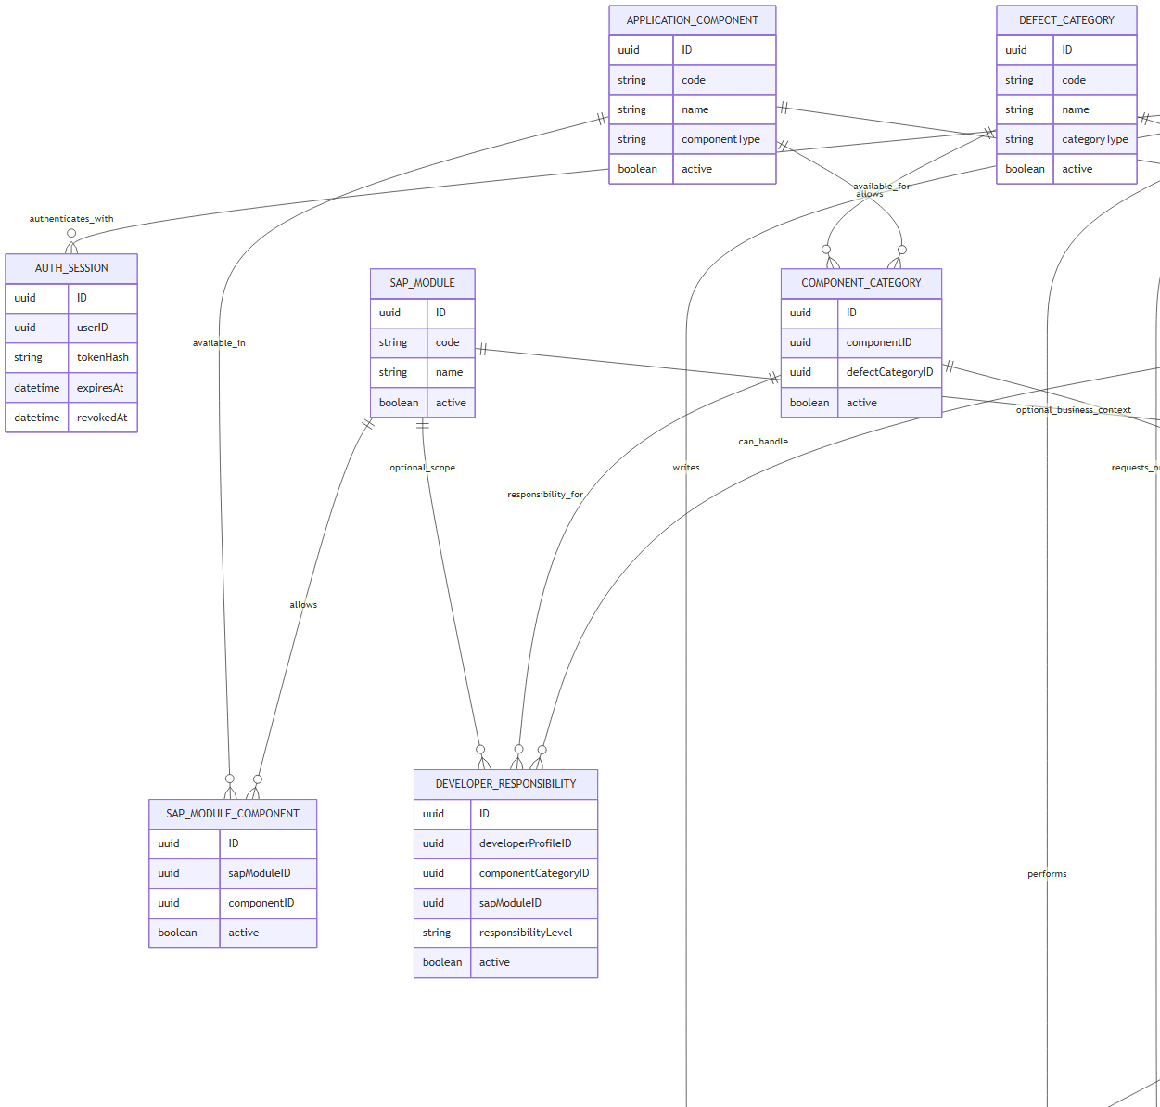
09. Conceptual Data Model — Detail 1/4
IDTS SAP01 | Source asset: 09-conceptual-data-model.png | Slide 21
Notes:
Mentor review summary: 09. Conceptual Data Model — Detail 1/4. Use this diagram to explain the actors/components, the direction of the flow, the CAP/backend control boundary, and the observable data or side effect. Canonical source asset: 09-conceptual-data-model.png; editable source and manifest are kept in docs/diagrams/rendered.

Slide 22
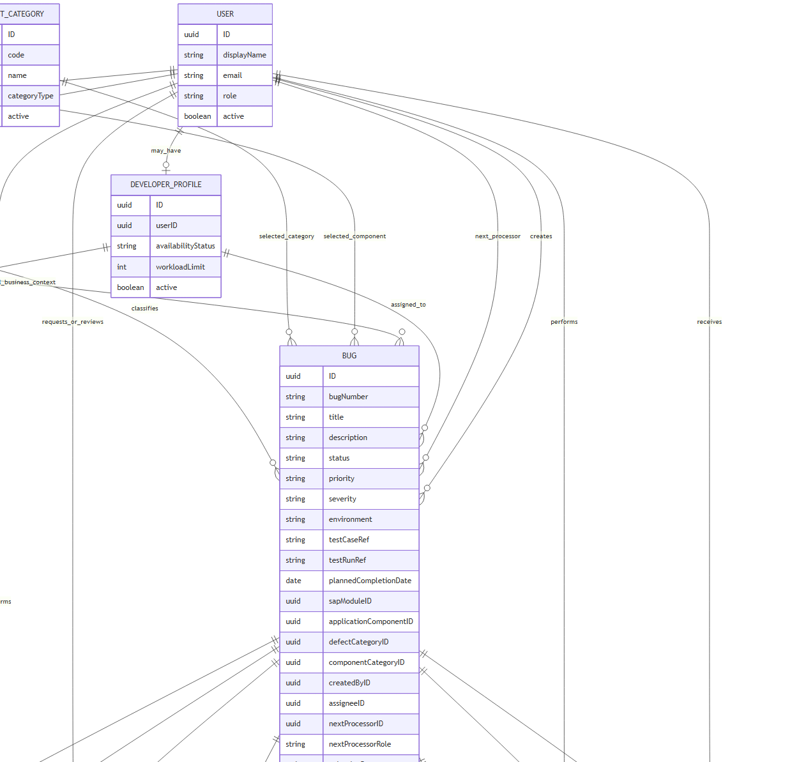
09. Conceptual Data Model — Detail 2/4
IDTS SAP01 | Source asset: 09-conceptual-data-model.png | Slide 22
Notes:
Mentor review summary: 09. Conceptual Data Model — Detail 2/4. Use this diagram to explain the actors/components, the direction of the flow, the CAP/backend control boundary, and the observable data or side effect. Canonical source asset: 09-conceptual-data-model.png; editable source and manifest are kept in docs/diagrams/rendered.

Slide 23
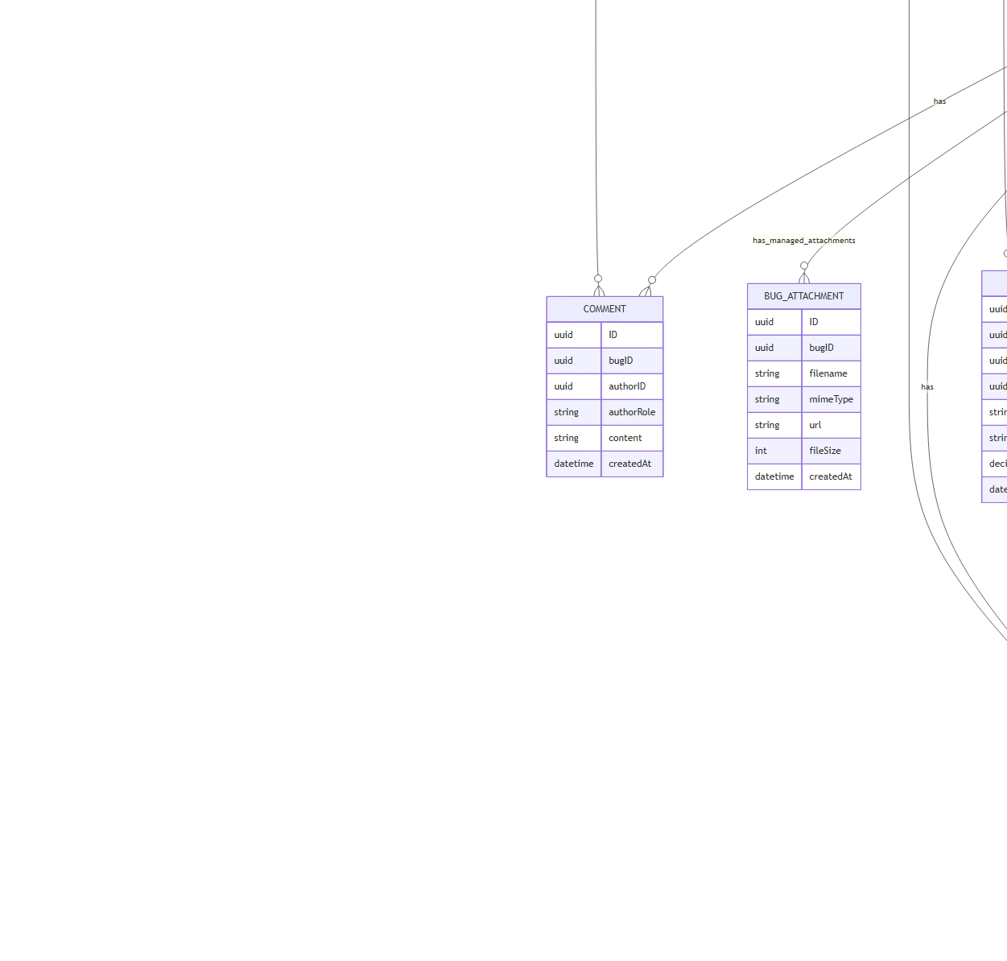
09. Conceptual Data Model — Detail 3/4
IDTS SAP01 | Source asset: 09-conceptual-data-model.png | Slide 23
Notes:
Mentor review summary: 09. Conceptual Data Model — Detail 3/4. Use this diagram to explain the actors/components, the direction of the flow, the CAP/backend control boundary, and the observable data or side effect. Canonical source asset: 09-conceptual-data-model.png; editable source and manifest are kept in docs/diagrams/rendered.

Slide 24
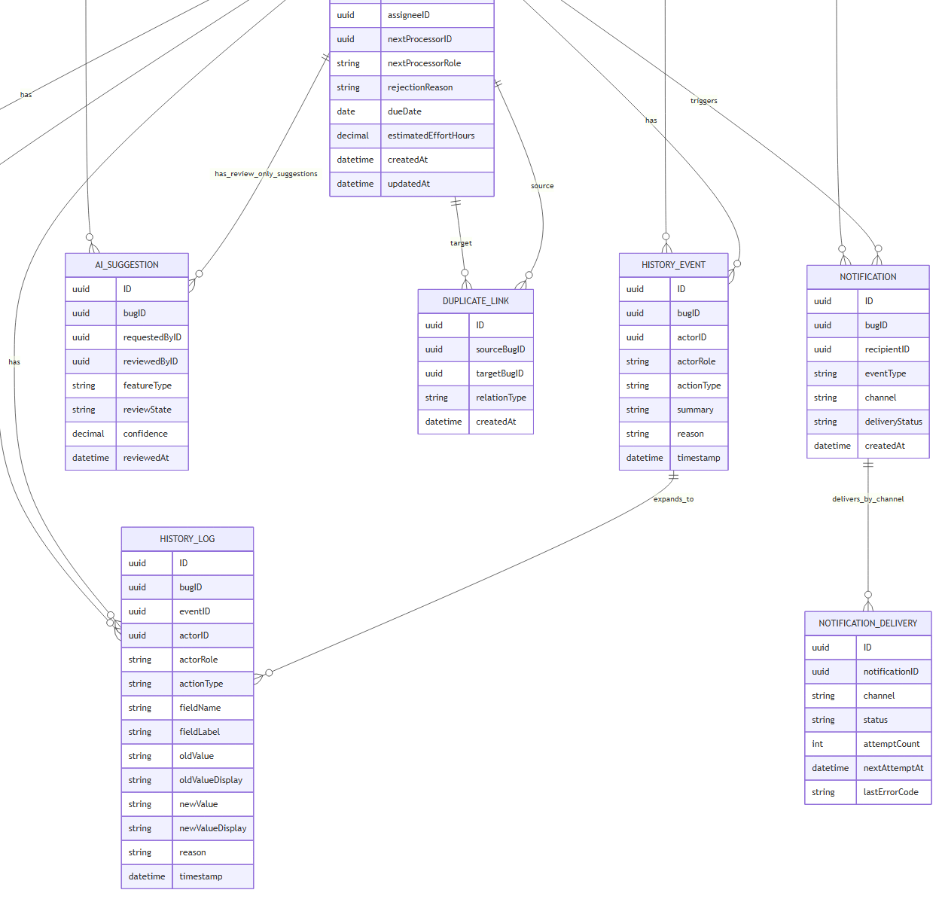
09. Conceptual Data Model — Detail 4/4
IDTS SAP01 | Source asset: 09-conceptual-data-model.png | Slide 24
Notes:
Mentor review summary: 09. Conceptual Data Model — Detail 4/4. Use this diagram to explain the actors/components, the direction of the flow, the CAP/backend control boundary, and the observable data or side effect. Canonical source asset: 09-conceptual-data-model.png; editable source and manifest are kept in docs/diagrams/rendered.

Slide 25
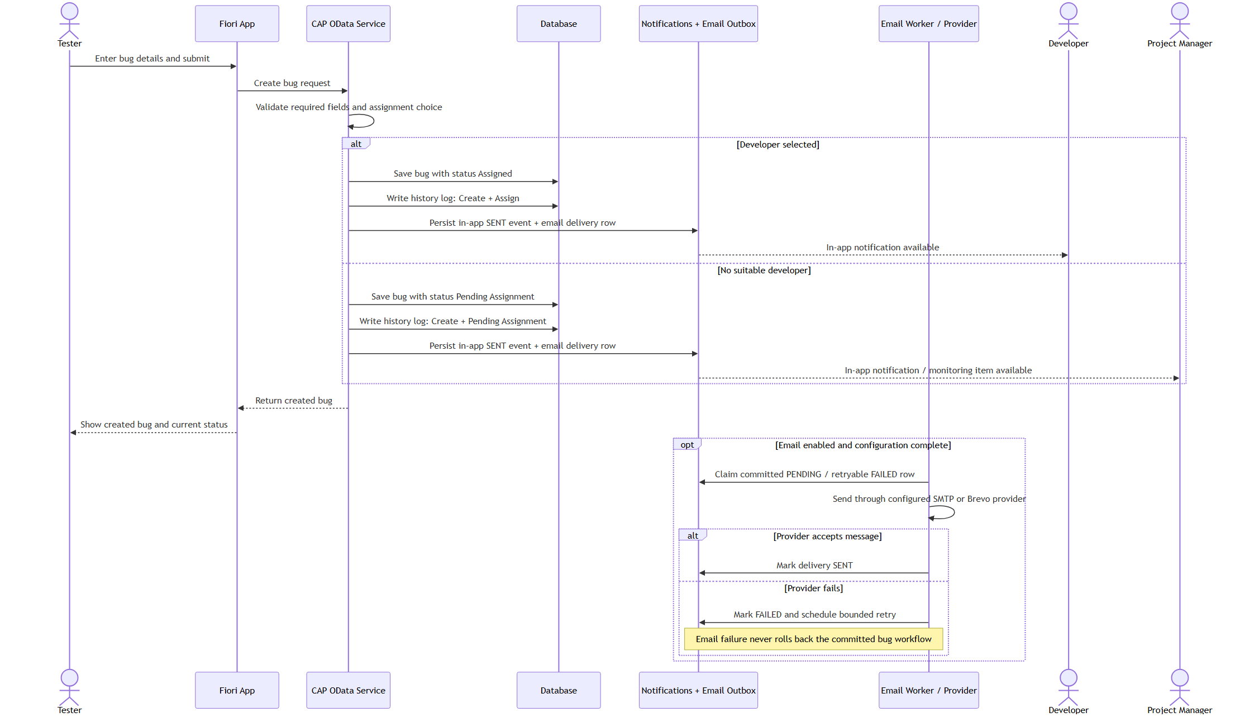
10. Submit Bug and Notification Sequence — Overview
IDTS SAP01 | Source asset: 10-submit-notification.png | Slide 25
Notes:
Mentor review summary: 10. Submit Bug and Notification Sequence — Overview. Use this diagram to explain the actors/components, the direction of the flow, the CAP/backend control boundary, and the observable data or side effect. Canonical source asset: 10-submit-notification.png; editable source and manifest are kept in docs/diagrams/rendered.

Slide 26
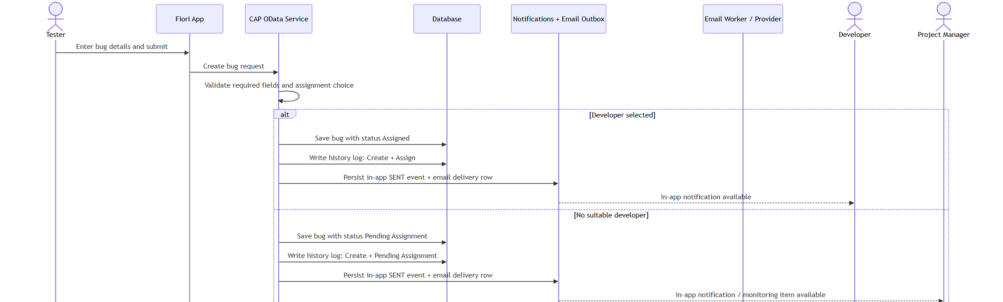
10. Submit Bug and Notification Sequence — Detail 1/2
IDTS SAP01 | Source asset: 10-submit-notification.png | Slide 26
Notes:
Mentor review summary: 10. Submit Bug and Notification Sequence — Detail 1/2. Use this diagram to explain the actors/components, the direction of the flow, the CAP/backend control boundary, and the observable data or side effect. Canonical source asset: 10-submit-notification.png; editable source and manifest are kept in docs/diagrams/rendered.

Slide 27
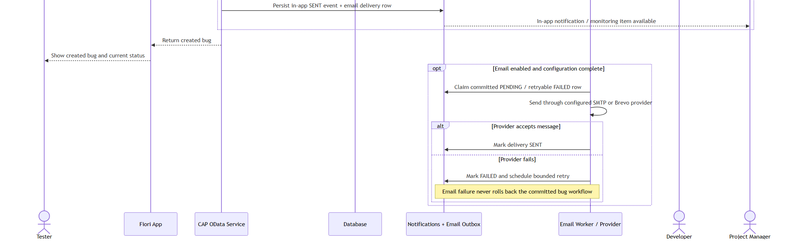
10. Submit Bug and Notification Sequence — Detail 2/2
IDTS SAP01 | Source asset: 10-submit-notification.png | Slide 27
Notes:
Mentor review summary: 10. Submit Bug and Notification Sequence — Detail 2/2. Use this diagram to explain the actors/components, the direction of the flow, the CAP/backend control boundary, and the observable data or side effect. Canonical source asset: 10-submit-notification.png; editable source and manifest are kept in docs/diagrams/rendered.

Slide 28
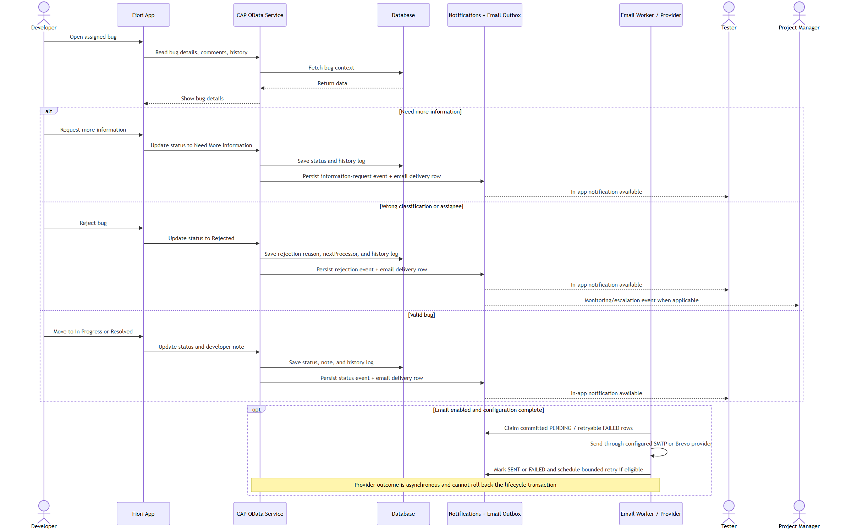
11. Developer Review Notification Sequence — Overview
IDTS SAP01 | Source asset: 11-developer-review-notification.png | Slide 28
Notes:
Mentor review summary: 11. Developer Review Notification Sequence — Overview. Use this diagram to explain the actors/components, the direction of the flow, the CAP/backend control boundary, and the observable data or side effect. Canonical source asset: 11-developer-review-notification.png; editable source and manifest are kept in docs/diagrams/rendered.

Slide 29
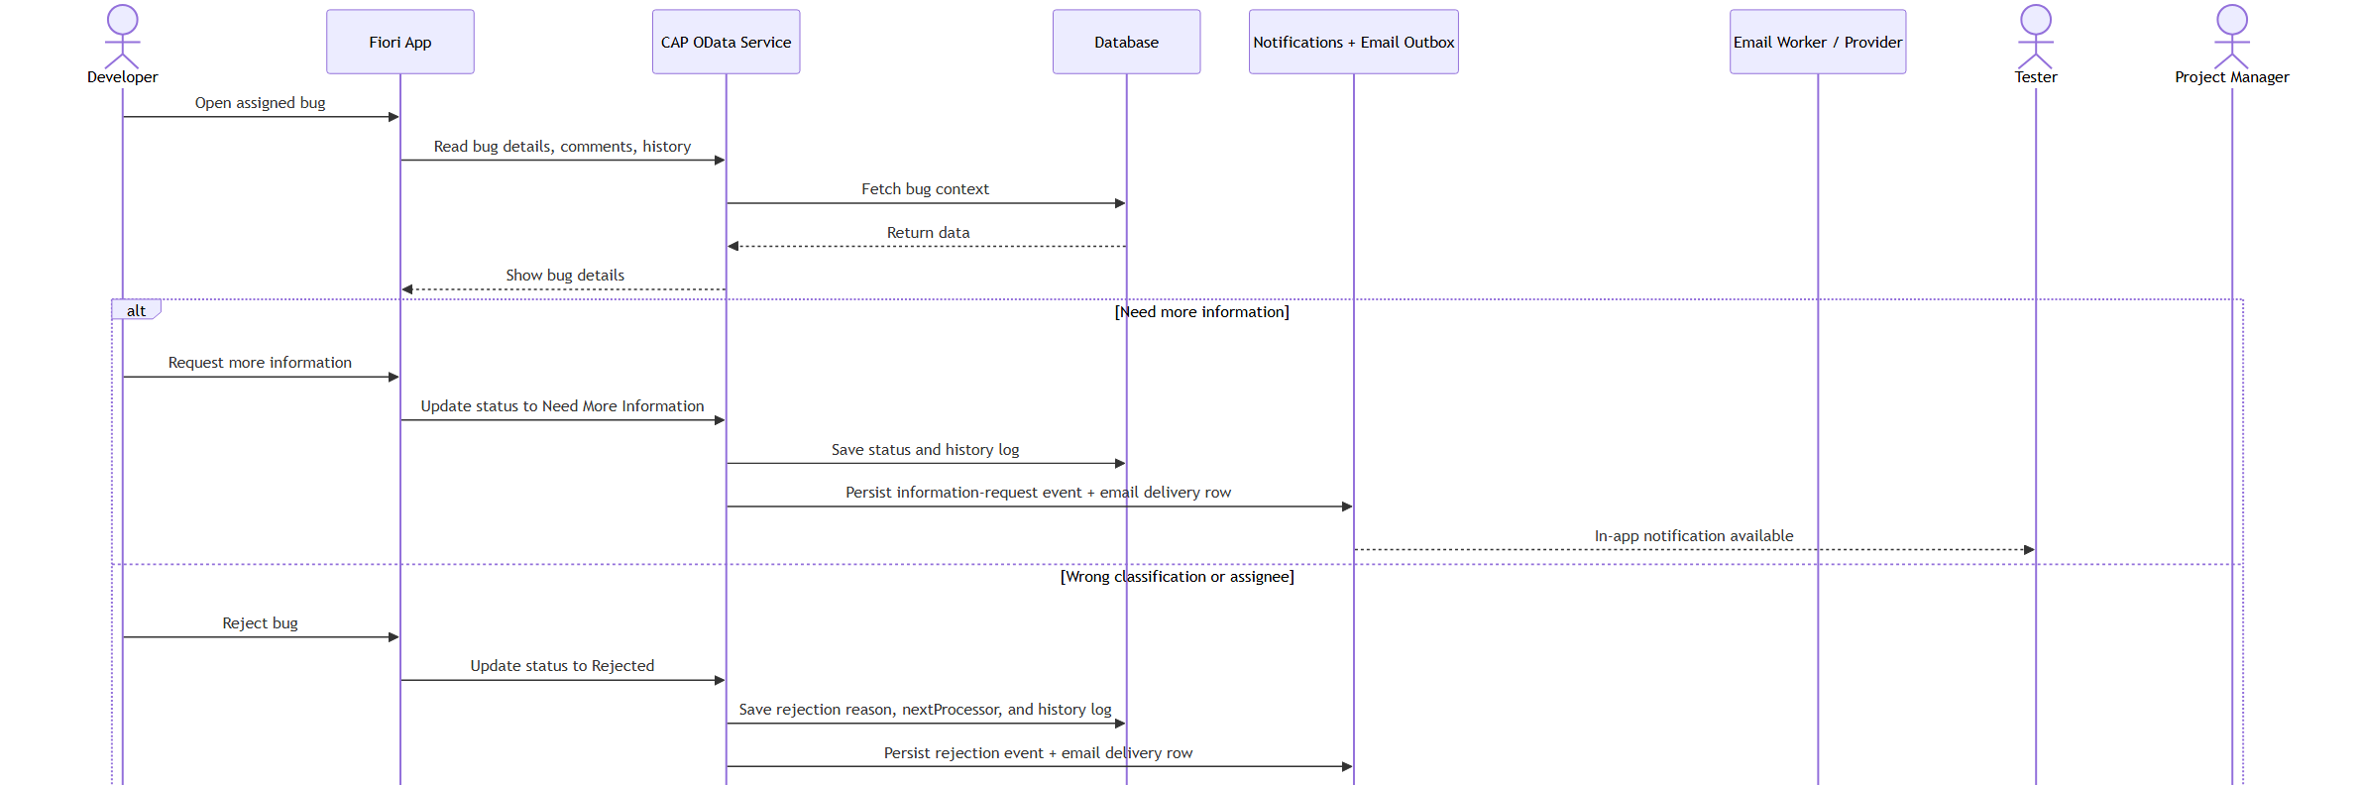
11. Developer Review Notification Sequence — Detail 1/2
IDTS SAP01 | Source asset: 11-developer-review-notification.png | Slide 29
Notes:
Mentor review summary: 11. Developer Review Notification Sequence — Detail 1/2. Use this diagram to explain the actors/components, the direction of the flow, the CAP/backend control boundary, and the observable data or side effect. Canonical source asset: 11-developer-review-notification.png; editable source and manifest are kept in docs/diagrams/rendered.

Slide 30
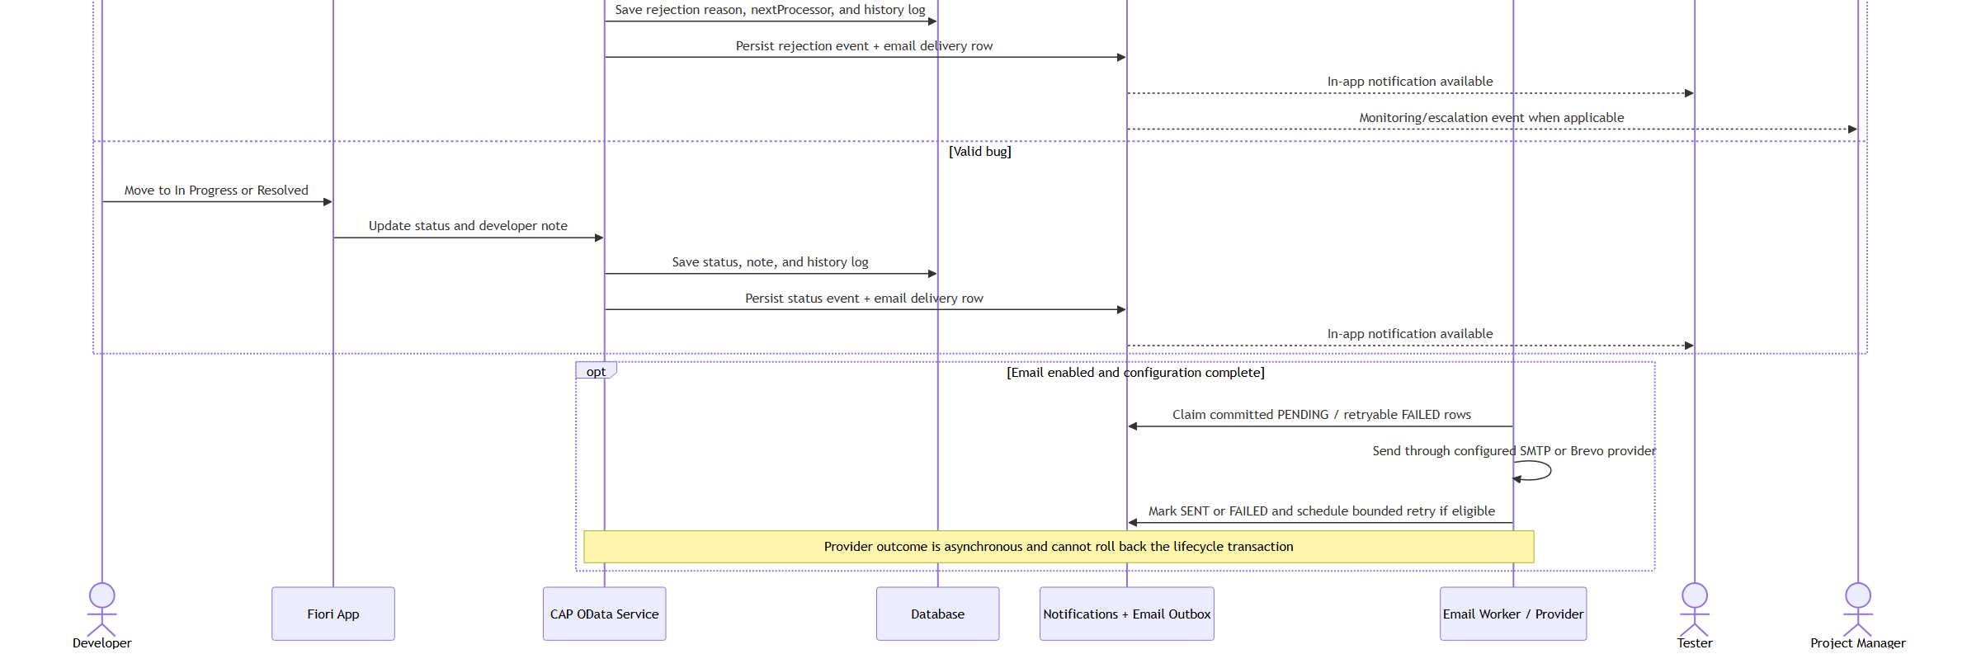
11. Developer Review Notification Sequence — Detail 2/2
IDTS SAP01 | Source asset: 11-developer-review-notification.png | Slide 30
Notes:
Mentor review summary: 11. Developer Review Notification Sequence — Detail 2/2. Use this diagram to explain the actors/components, the direction of the flow, the CAP/backend control boundary, and the observable data or side effect. Canonical source asset: 11-developer-review-notification.png; editable source and manifest are kept in docs/diagrams/rendered.

Slide 31
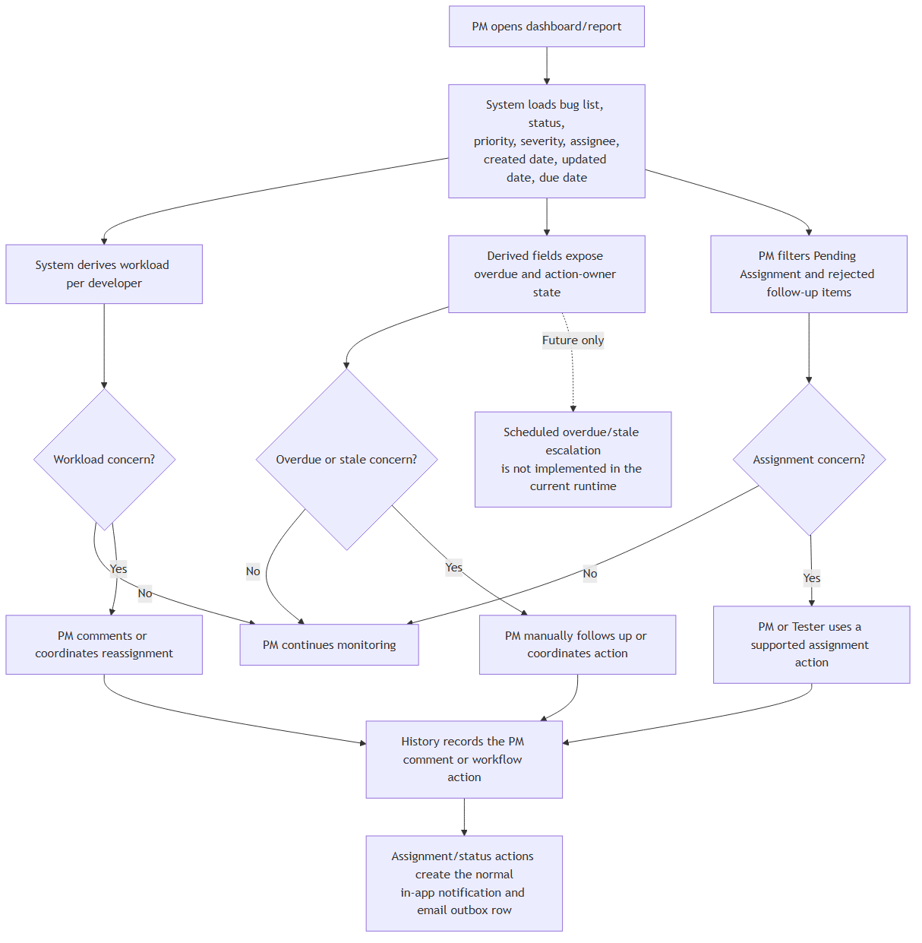
12. PM Monitoring and Escalation Flow — Overview
IDTS SAP01 | Source asset: 12-pm-monitoring.png | Slide 31
Notes:
Mentor review summary: 12. PM Monitoring and Escalation Flow — Overview. Use this diagram to explain the actors/components, the direction of the flow, the CAP/backend control boundary, and the observable data or side effect. Canonical source asset: 12-pm-monitoring.png; editable source and manifest are kept in docs/diagrams/rendered.

Slide 32
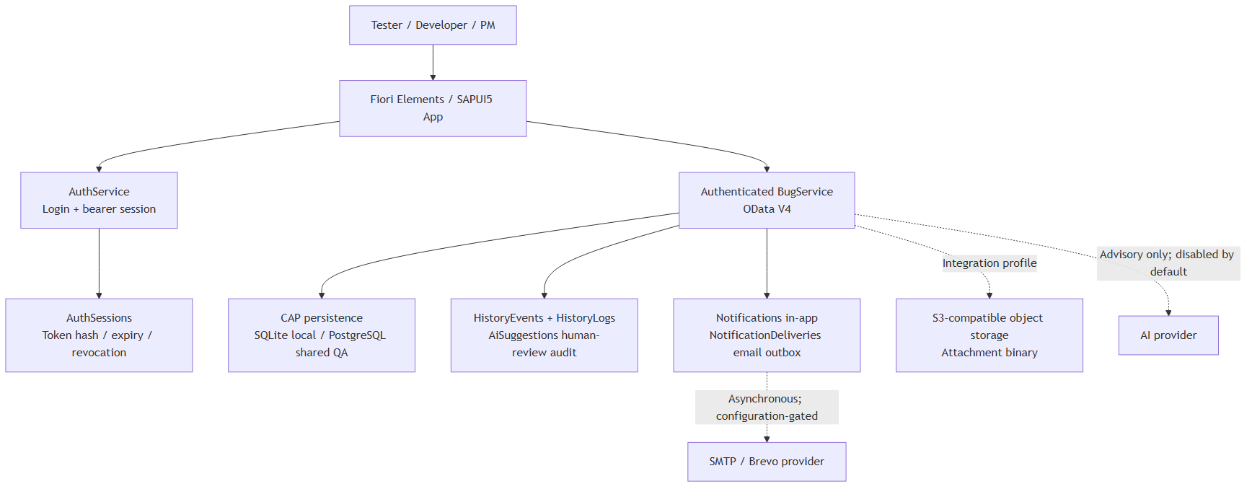
13. SRS System Context — Overview
IDTS SAP01 | Source asset: 13-srs-system-context.png | Slide 32
Notes:
Mentor review summary: 13. SRS System Context — Overview. Use this diagram to explain the actors/components, the direction of the flow, the CAP/backend control boundary, and the observable data or side effect. Canonical source asset: 13-srs-system-context.png; editable source and manifest are kept in docs/diagrams/rendered.

Slide 33
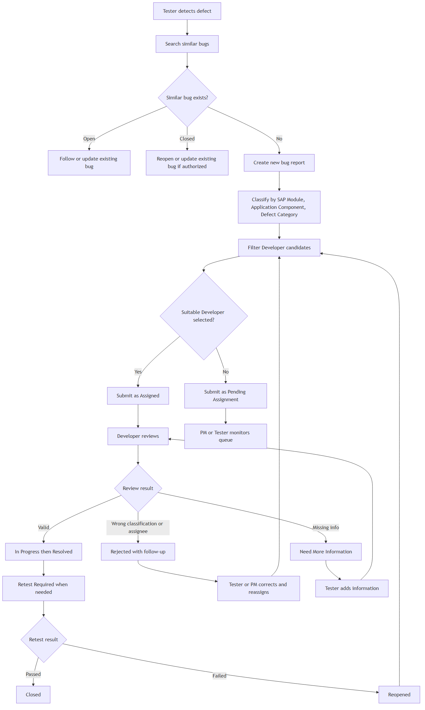
14. Main Defect Tracking Flow — Overview
IDTS SAP01 | Source asset: 14-frs-main-defect-flow.png | Slide 33
Notes:
Mentor review summary: 14. Main Defect Tracking Flow — Overview. Use this diagram to explain the actors/components, the direction of the flow, the CAP/backend control boundary, and the observable data or side effect. Canonical source asset: 14-frs-main-defect-flow.png; editable source and manifest are kept in docs/diagrams/rendered.

Slide 34
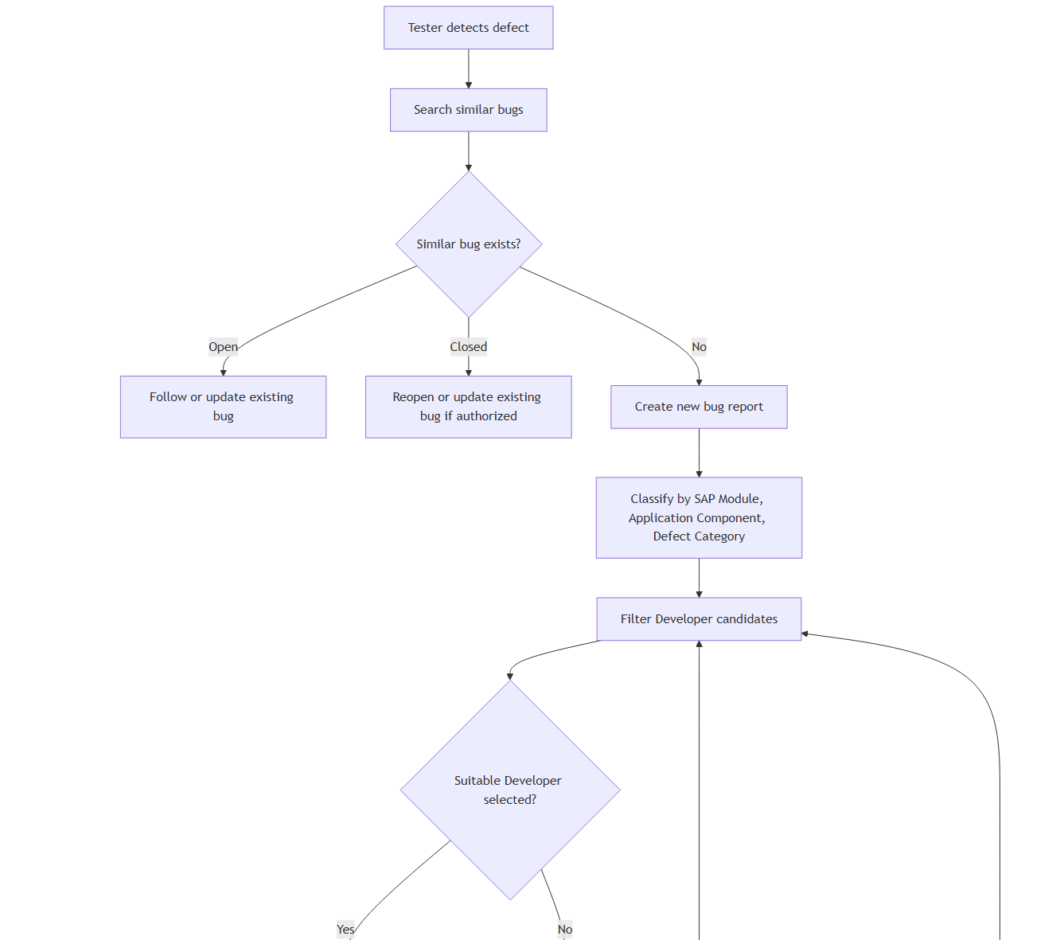
14. Main Defect Tracking Flow — Detail 1/2
IDTS SAP01 | Source asset: 14-frs-main-defect-flow.png | Slide 34
Notes:
Mentor review summary: 14. Main Defect Tracking Flow — Detail 1/2. Use this diagram to explain the actors/components, the direction of the flow, the CAP/backend control boundary, and the observable data or side effect. Canonical source asset: 14-frs-main-defect-flow.png; editable source and manifest are kept in docs/diagrams/rendered.

Slide 35
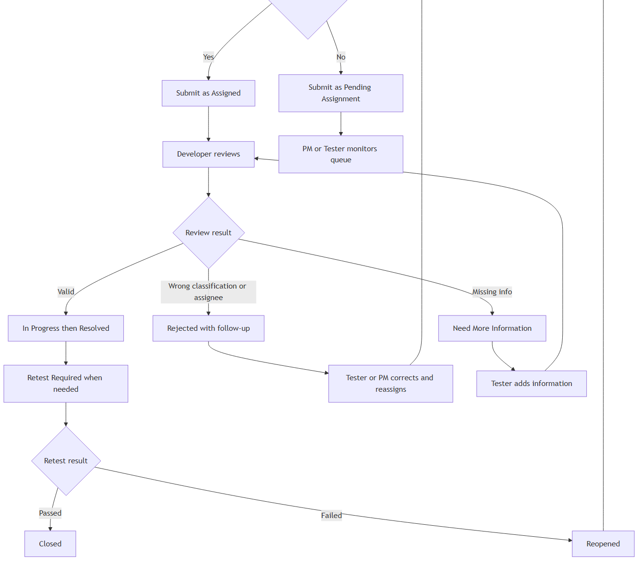
14. Main Defect Tracking Flow — Detail 2/2
IDTS SAP01 | Source asset: 14-frs-main-defect-flow.png | Slide 35
Notes:
Mentor review summary: 14. Main Defect Tracking Flow — Detail 2/2. Use this diagram to explain the actors/components, the direction of the flow, the CAP/backend control boundary, and the observable data or side effect. Canonical source asset: 14-frs-main-defect-flow.png; editable source and manifest are kept in docs/diagrams/rendered.

Slide 36
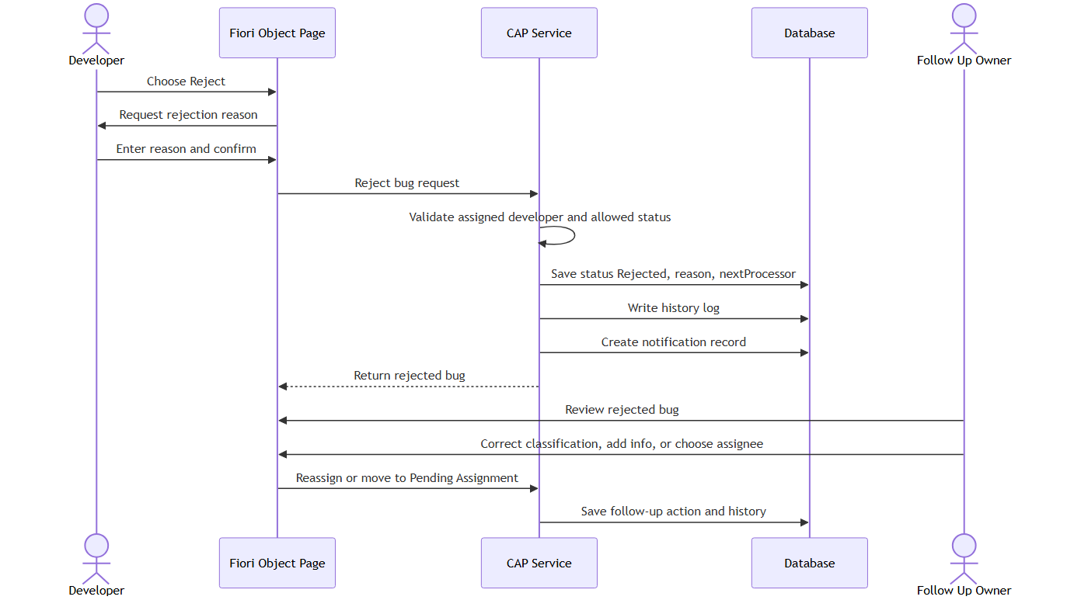
15. Rejected Follow-up Flow — Overview
IDTS SAP01 | Source asset: 15-frs-rejected-follow-up.png | Slide 36
Notes:
Mentor review summary: 15. Rejected Follow-up Flow — Overview. Use this diagram to explain the actors/components, the direction of the flow, the CAP/backend control boundary, and the observable data or side effect. Canonical source asset: 15-frs-rejected-follow-up.png; editable source and manifest are kept in docs/diagrams/rendered.

Slide 37
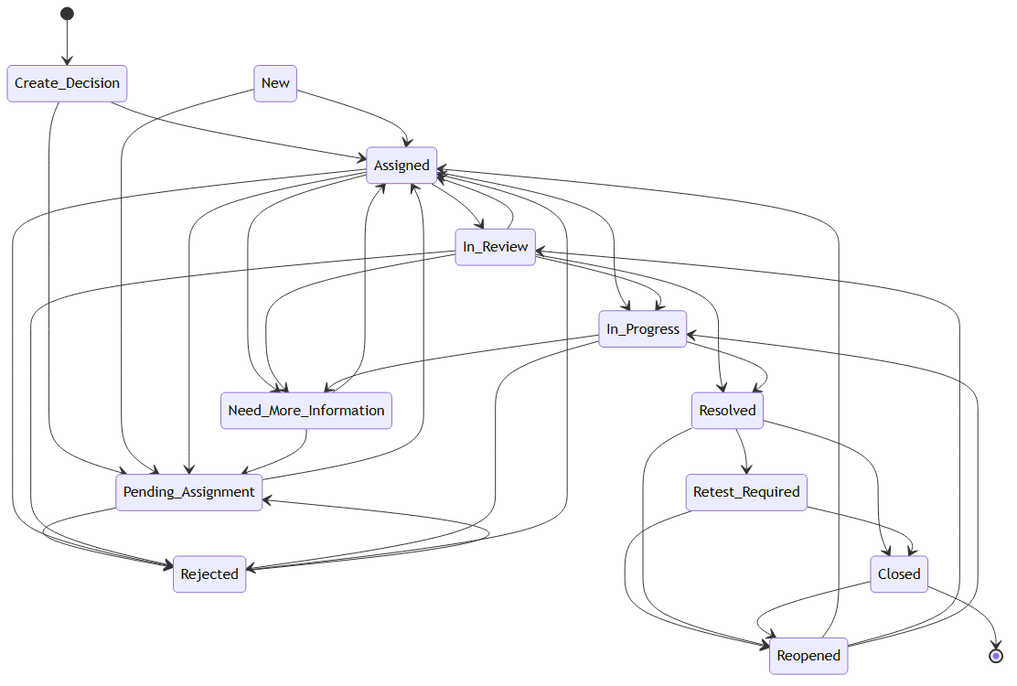
16. Status Lifecycle — Overview
IDTS SAP01 | Source asset: 16-frs-status-lifecycle.png | Slide 37
Notes:
Mentor review summary: 16. Status Lifecycle — Overview. Use this diagram to explain the actors/components, the direction of the flow, the CAP/backend control boundary, and the observable data or side effect. Canonical source asset: 16-frs-status-lifecycle.png; editable source and manifest are kept in docs/diagrams/rendered.

Slide 38
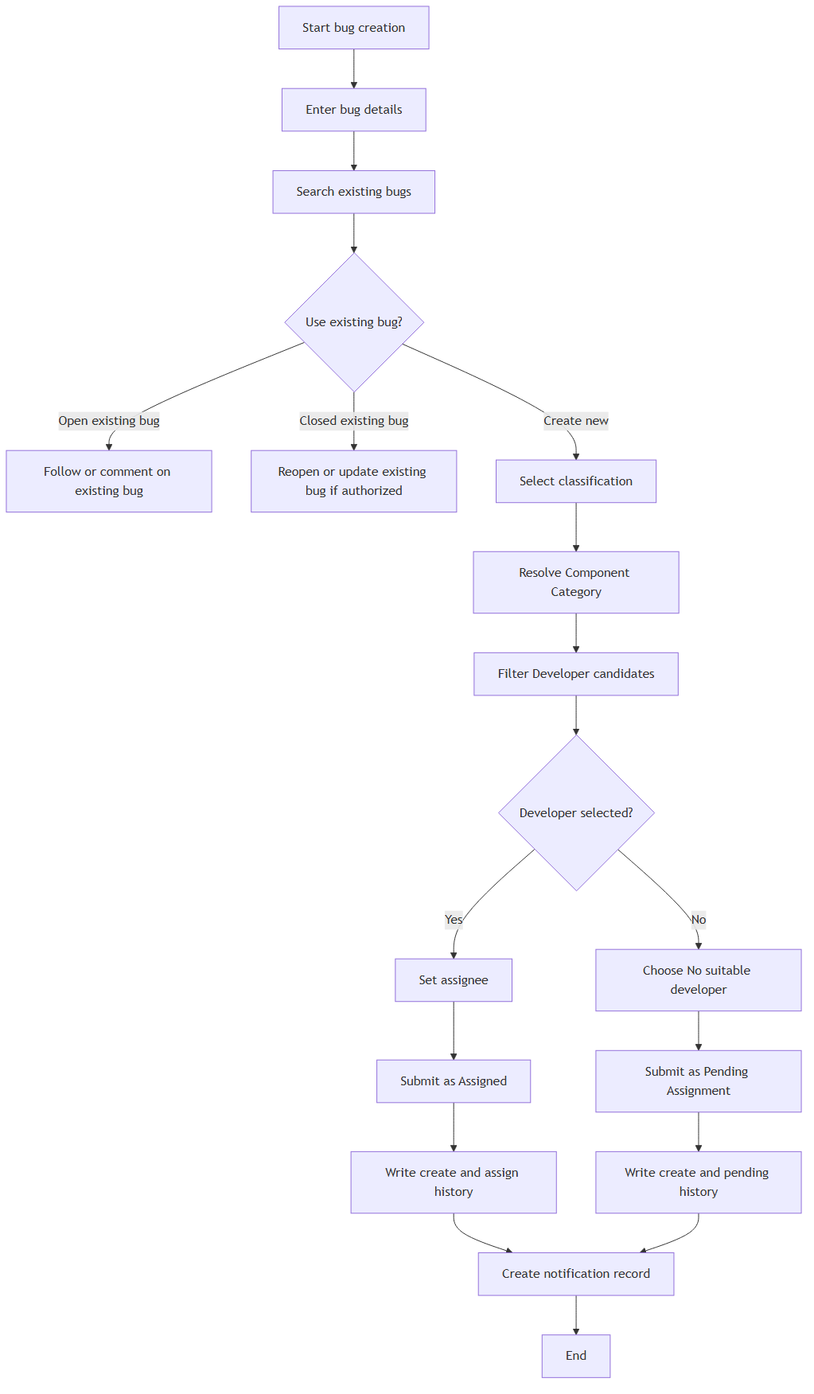
17. Bug Creation and Assignment Activity Flow — Overview
IDTS SAP01 | Source asset: 17-frs-create-assignment.png | Slide 38
Notes:
Mentor review summary: 17. Bug Creation and Assignment Activity Flow — Overview. Use this diagram to explain the actors/components, the direction of the flow, the CAP/backend control boundary, and the observable data or side effect. Canonical source asset: 17-frs-create-assignment.png; editable source and manifest are kept in docs/diagrams/rendered.

Slide 39
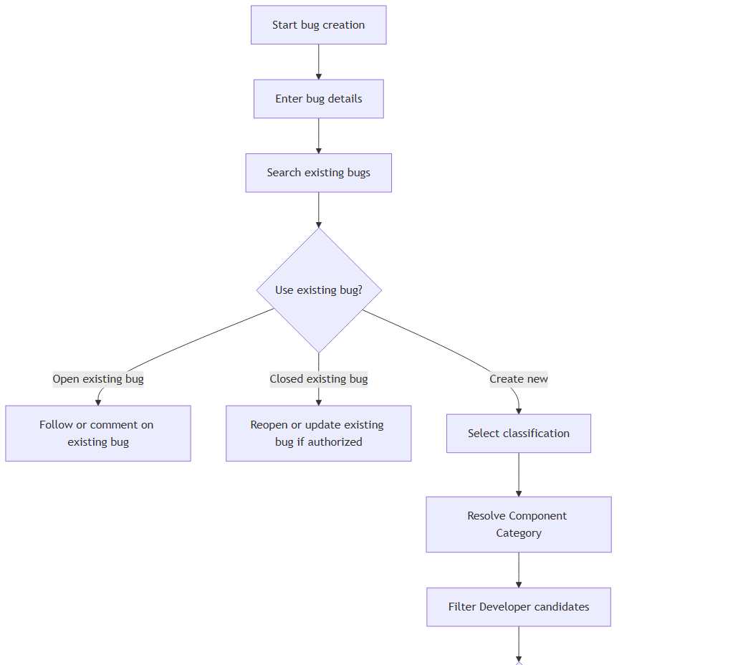
17. Bug Creation and Assignment Activity Flow — Detail 1/2
IDTS SAP01 | Source asset: 17-frs-create-assignment.png | Slide 39
Notes:
Mentor review summary: 17. Bug Creation and Assignment Activity Flow — Detail 1/2. Use this diagram to explain the actors/components, the direction of the flow, the CAP/backend control boundary, and the observable data or side effect. Canonical source asset: 17-frs-create-assignment.png; editable source and manifest are kept in docs/diagrams/rendered.

Slide 40
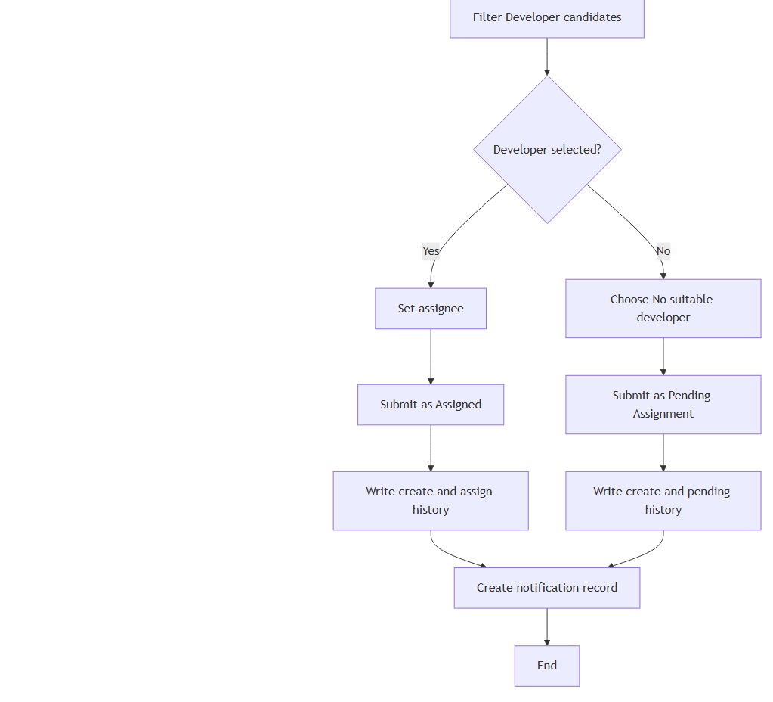
17. Bug Creation and Assignment Activity Flow — Detail 2/2
IDTS SAP01 | Source asset: 17-frs-create-assignment.png | Slide 40
Notes:
Mentor review summary: 17. Bug Creation and Assignment Activity Flow — Detail 2/2. Use this diagram to explain the actors/components, the direction of the flow, the CAP/backend control boundary, and the observable data or side effect. Canonical source asset: 17-frs-create-assignment.png; editable source and manifest are kept in docs/diagrams/rendered.

Slide 41
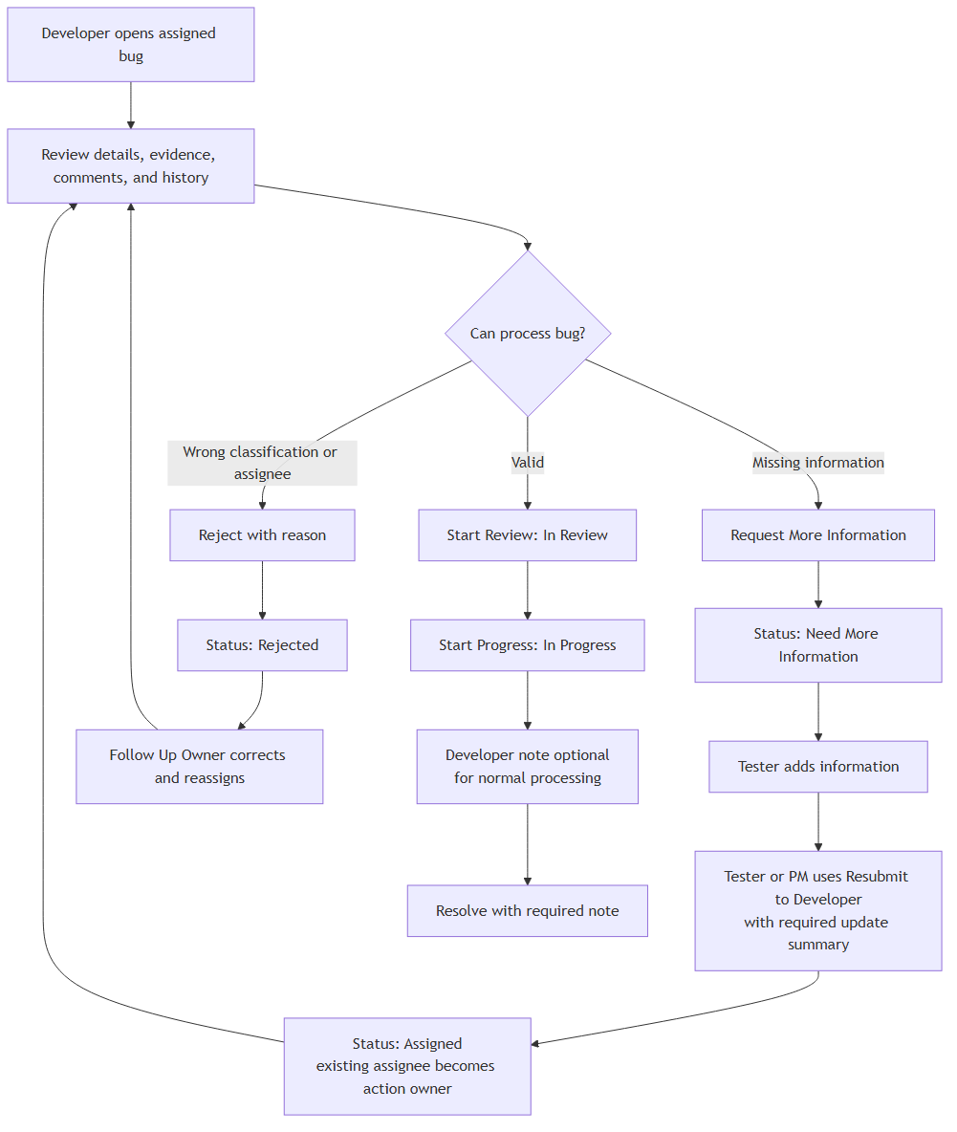
18. Developer Review Decision Flow — Overview
IDTS SAP01 | Source asset: 18-frs-developer-review.png | Slide 41
Notes:
Mentor review summary: 18. Developer Review Decision Flow — Overview. Use this diagram to explain the actors/components, the direction of the flow, the CAP/backend control boundary, and the observable data or side effect. Canonical source asset: 18-frs-developer-review.png; editable source and manifest are kept in docs/diagrams/rendered.

Slide 42
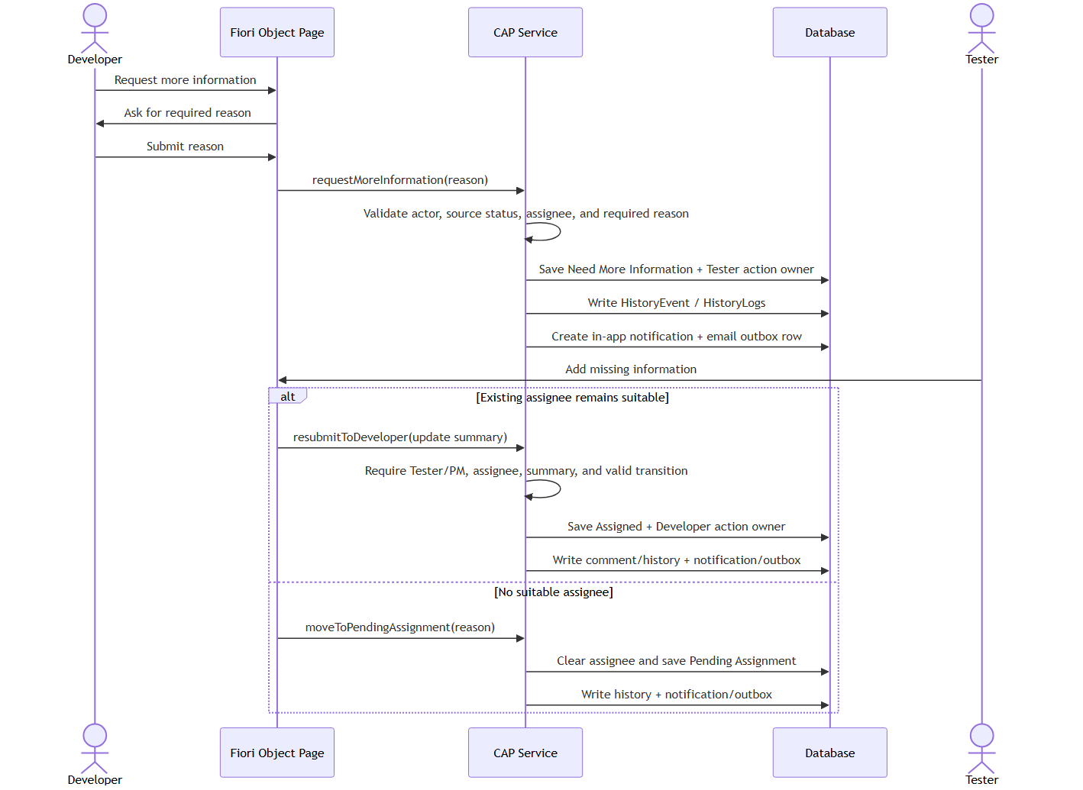
19. Request More Information Flow — Overview
IDTS SAP01 | Source asset: 19-frs-request-more-information.png | Slide 42
Notes:
Mentor review summary: 19. Request More Information Flow — Overview. Use this diagram to explain the actors/components, the direction of the flow, the CAP/backend control boundary, and the observable data or side effect. Canonical source asset: 19-frs-request-more-information.png; editable source and manifest are kept in docs/diagrams/rendered.

Slide 43
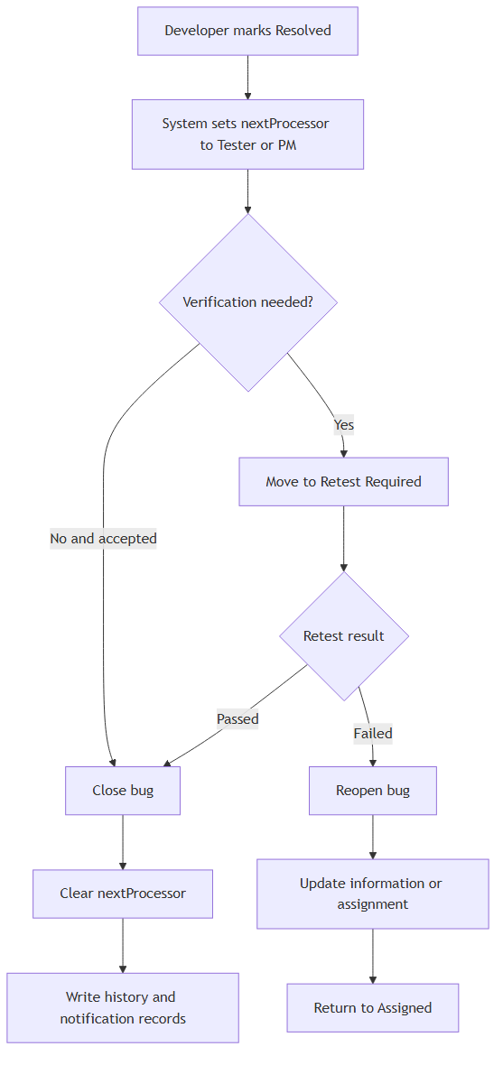
20. Resolve, Retest, Close, and Reopen Flow — Overview
IDTS SAP01 | Source asset: 20-frs-resolve-retest-close-reopen.png | Slide 43
Notes:
Mentor review summary: 20. Resolve, Retest, Close, and Reopen Flow — Overview. Use this diagram to explain the actors/components, the direction of the flow, the CAP/backend control boundary, and the observable data or side effect. Canonical source asset: 20-frs-resolve-retest-close-reopen.png; editable source and manifest are kept in docs/diagrams/rendered.

Slide 44
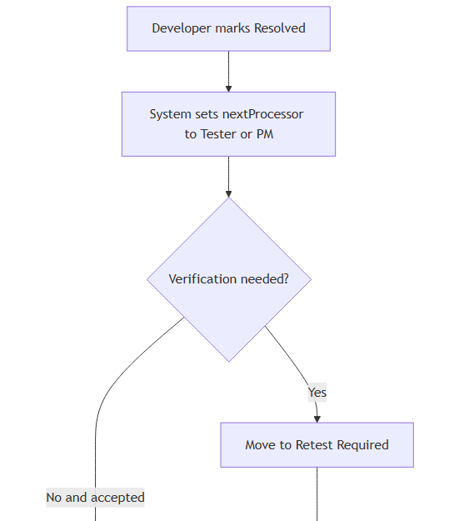
20. Resolve, Retest, Close, and Reopen Flow — Detail 1/2
IDTS SAP01 | Source asset: 20-frs-resolve-retest-close-reopen.png | Slide 44
Notes:
Mentor review summary: 20. Resolve, Retest, Close, and Reopen Flow — Detail 1/2. Use this diagram to explain the actors/components, the direction of the flow, the CAP/backend control boundary, and the observable data or side effect. Canonical source asset: 20-frs-resolve-retest-close-reopen.png; editable source and manifest are kept in docs/diagrams/rendered.

Slide 45
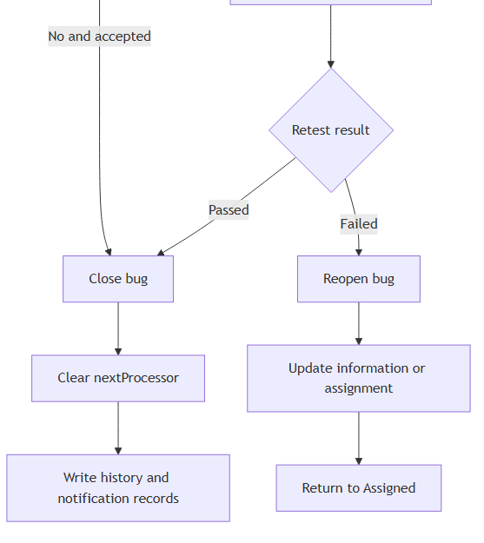
20. Resolve, Retest, Close, and Reopen Flow — Detail 2/2
IDTS SAP01 | Source asset: 20-frs-resolve-retest-close-reopen.png | Slide 45
Notes:
Mentor review summary: 20. Resolve, Retest, Close, and Reopen Flow — Detail 2/2. Use this diagram to explain the actors/components, the direction of the flow, the CAP/backend control boundary, and the observable data or side effect. Canonical source asset: 20-frs-resolve-retest-close-reopen.png; editable source and manifest are kept in docs/diagrams/rendered.

Slide 46
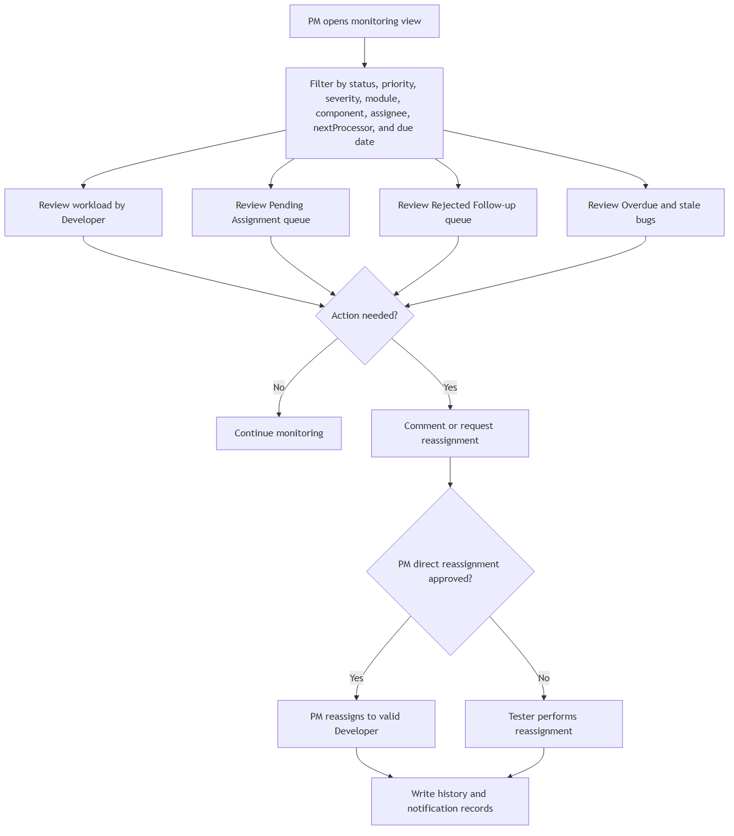
21. PM Monitoring and Escalation Flow — Overview
IDTS SAP01 | Source asset: 21-frs-pm-monitoring.png | Slide 46
Notes:
Mentor review summary: 21. PM Monitoring and Escalation Flow — Overview. Use this diagram to explain the actors/components, the direction of the flow, the CAP/backend control boundary, and the observable data or side effect. Canonical source asset: 21-frs-pm-monitoring.png; editable source and manifest are kept in docs/diagrams/rendered.

