Slide 1
Video Delivery of This Deck for Talk Track:
Use Presenter Mode for Unpacking The Visual MicroStory of Each Slide

Slide 2
Agent Registration for DevOps or Any CD Push to K8s
mygroup-top-group
Group Var abstracts K8s Namespace for Group Hierarchy: KUBE_NAMESPACE=$CI_PROJECT_NAME-$CI_PROJECT_ID KUBE_CONTEXT=<agent_context>
KUBE_INGRESS_BASE_DOMAIN=<ingress_load_balancer>
cluster-management
3
Registered for use with ‘mygroup’
Agent Registration W/ Config = mygroup
cert-manager
5
Managed Apps Install
1
Agent Install Cmd
Ingress
Managed apps Config: ingress & cert-manager
2
Agent Install
4
GL Agent
config managed apps manifests
Kubernetes Cluster

Slide 3
Using Agent got Auto DevOps or Any CD Push to K8s
mygroup-top-group
Group Var abstracts K8s Namespace for Group Hierarchy: KUBE_NAMESPACE=$CI_PROJECT_NAME-$CI_PROJECT_ID KUBE_CONTEXT=<agent_context>
KUBE_INGRESS_BASE_DOMAIN=<ingress_load_balancer>
cert-manager
Ingress
GL Agent
3
Proxy via KAS
AppA
4
AppA Install
AutoDevOps Managed
Runner
Kubernetes Cluster
1
Configure AutoDevOps
2
Runner Execution

Slide 4
Agent Registration for for GitOps CD Pull
mygroup-app-env-group
Group Var abstracts K8s Namespace for App Only: KUBE_NAMESPACE=$CI_PROJECT_NAME-$CI_PROJECT_ID KUBE_CONTEXT=<agent_context>
KUBE_INGRESS_BASE_DOMAIN=<ingress_load_balancer>
cluster-management
3
Registered for use with ‘mygroup’
Agent Registration W/ Config = mygroup
cert-manager
5
Managed Apps Install
1
Agent Install Cmd
Ingress
4
Managed apps Config: ingress & cert-manager
2
Agent Install
config managed apps manifests
GL Agent
Cert-manager is only for classroom convenience. Prod cluster registration probably per-app, not an entire cluster for an entire group hierarchy
Kubernetes Cluster

Slide 5
Deploy for GitOps CD Pull
mygroup-app-env-group
Group Var abstracts K8s Namespace for App Only: KUBE_NAMESPACE=$CI_PROJECT_NAME-$CI_PROJECT_ID KUBE_CONTEXT=<agent_context>
KUBE_INGRESS_BASE_DOMAIN=<ingress_load_balancer>
cert-manager
Ingress
5
GL Agent
GitOps Pull Deployment
AppA ADO (App Build)
Env Deploy Project
6
4
AppA Install
3
Proxy via KAS
GitOps Pull Deployment
AppA GitOps (Env Deploy)
7
AppA Install
App Build Project
Runner
Kubernetes Cluster
1
Configure AutoDevOps
2
Runner Execution

Slide 6
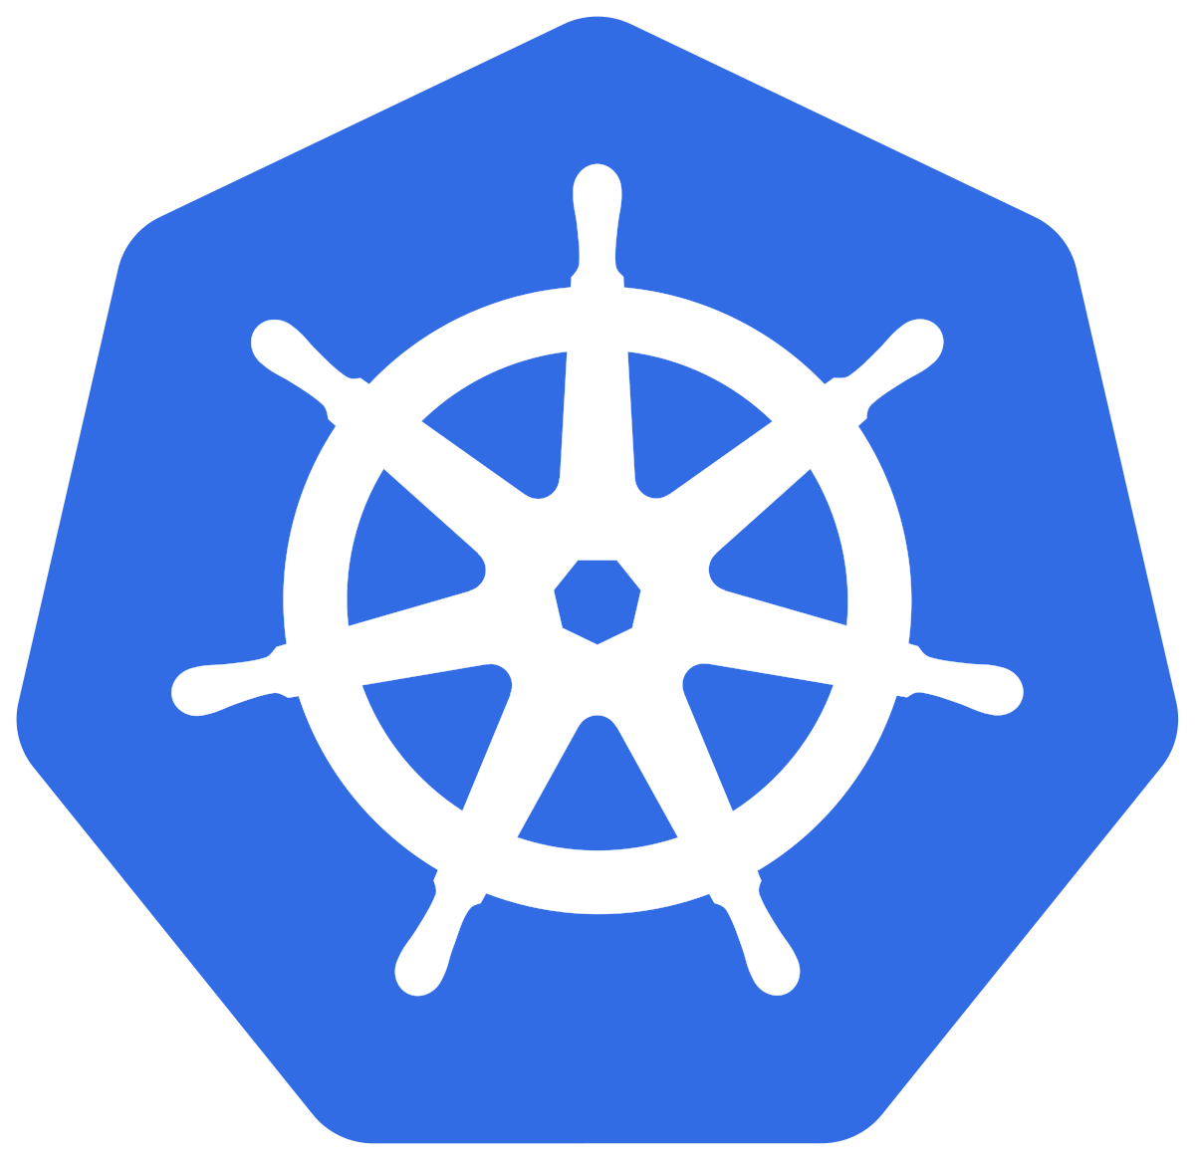
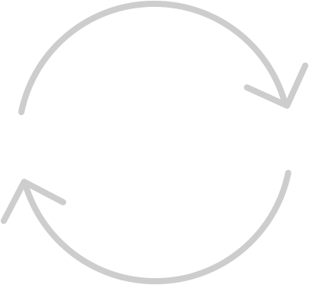

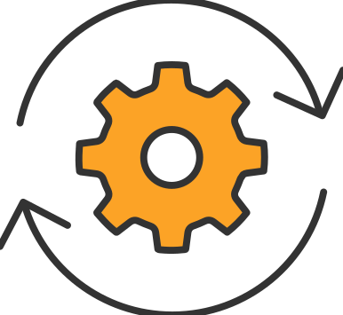

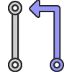

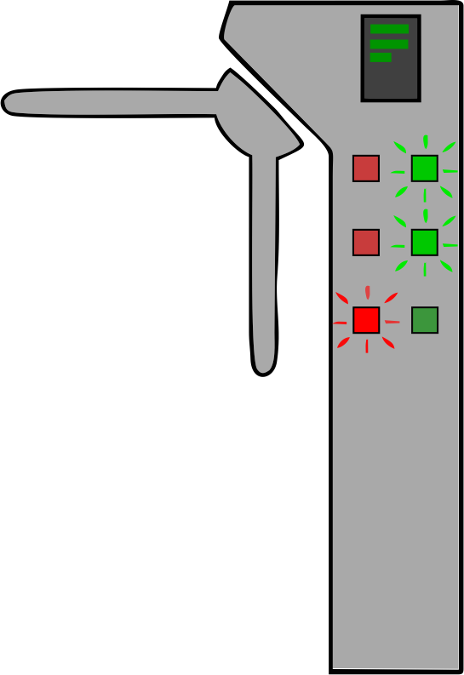


Auto DevOps: Continuous Delivery OR Deployment Using Trunk Based Dev
Auto Deploy / Teardown Review Environment Per Branch For Automated Tests (Dynamic Review Environments)
GitLab Auto DevOps Works This Way
CI
CD
CI TEST
Feature Branch
Main
CI Test Code & Artifacts
CI Test Running Environment
CD Test Validate Environment
CI Build
CD Staging
CD Approve To Prod
Release For Prod
Deploy Prod
Stage
Continuous Deployment to production eliminates these.
Prod
Build Artifacts for Deploy (zip, package, container)
Released Artifacts

Slide 7
Multi-Production Environment Configurations
Some of these models will have a high number of “listening” Environment Deployment repositories for each artifact producing repository.
Multi-tenancy - one production per customer
Geographical Tenancy for Data Sovereignty - Data must reside in a specific country
Multi-Cloud Tenancy - Avoid lock in, meet customer requirements
Multi-GEO Tenancy - global performance
Gov and Commercial - Extreme separation of security and duties
Customer Extensible Software - some has customer extensions that have to be tested in a customer’s staging environment
Customer Owned Deployment Environments - the customer owns and hosts the deployment environment while consuming container artifacts from a different company who makes the software

Slide 8
GitOps Part 1: App Project Produces Quality Tested Artifacts
Auto Deploy / Teardown Review Environment Per Branch For Automated Tests (Dynamic Review Environments)
CI
CD
CI TEST
One codebase tracked in revision control, many deploys “12 Factor APP I. Codebase”
Feature Branch
Main
CI Test Code & Artifacts
CI Test Running Environment
CI Build
CD Staging
CD Approve To Prod
Release For Prod
Stage
Continuous Deployment to production eliminates these.
Build Artifacts for Deploy (zip, package, container)
Released Artifacts

Slide 9
GitOps Part 2: One or More Environment Deployment Only Repositories
#1
Auto Deploy / Teardown Review Environment Per Branch For Automated Tests (Dynamic Review Environments)
Operator Trigger
With Env Test
Artifact Ver Update
CI
CD
CI TEST
App Config Is Stored in Environment Project “12 Factor APP III. Config”
Update Released Artifact Ver Variable
Main (Config Only)
#2
CI Test Running Environment
CD Test Validate Environment
Operator Trigger
CD Staging
CD Approve To Prod
Deploy Prod
Update Released Artifact Ver Variable and Run PIpeline
Scheduled
- pipeline Monitored - pipeline
- variable Called
#3
Auto-Update Released Artifact Ver Variable and Run PIpeline
Optional if able to trust an upstream testing
Pipeline Trigger
Stage
Prod
Released Artifacts
Notes:
Deployment Pipeline Triggers:
New container version (CI Job Workaround)
New package version (CI Job Workaround)
New GitLab Release (CI job workaround)
Update Group Variable (CI job workaround)

Slide 10
Least Configuration & Least Privilege: Group Structure and Data Cascade For Group Hierarchy Using Single Cluster for GitLab Agent for Both CD Push (incl Auto DevOps) and GitOps
PROJECT: Cluster-Management (Agent Registration, Ingress, Cert-Manager)
Supports multiples at every level - including building multiple containers in a single APP project or consuming multiple containers in a single ENV project.
Parent Group To All App, Env & CD Projects All config flows to all subgroup projects.
GL K8s Agent Reg
Ingress / Cert Manager
PROJECT: CD Push: Auto DevOps (CI & CD Push)
Provides Item
Uses Item
KUBE_CONTEXT
PROJECT: App Build Project: hello-world (CI for Build, no CD)
KUBE_INGRESS_BASE_DOMAIN
Project
JOB
IMAGE: hello-world-service
Container image
KUBE_NAMESPACE
03a2b
3.1.2
latest-prod
version=3.1.2
tag
label
Any Groups Hierarchy Allowable
REG_READ_TOKEN
GitLab Variable
PROJECT: Environment Deploy: world-greetings-env-1 (GitOps Pull Deployment)
GitLab Group
CI Push / Auto DevOps Supported with no “per-project” configuration.
GitLab Agent Ops
PRJ_COMMIT_TOKEN
KUBE_NAMESPACE

Slide 11
Auto Detecting New Versions Using Existing Metadata
PROJECT: App Build Project
KEY
IMAGE: hello-world-service
JOB: Container build job 1. Read latest-prod tag 2. Extract version from version label 3. Increment version 4. Create new latest container with incremented version
Project
JOB
Container image
03a2b
3.1.2
latest-prod
tag
label
version=3.1.2
create Image with incremented version
PROJECT: Environment Deploy & Configure
Option #2
Option #1
read-from-variable: NEXTVERSIONTOUSE=1.9.1
read-from-registry
JOB: Version Check 1. Read latest-prod tag 2. Extract version from version label 3. Check version against K8s manifest 4. Update manifests if version is different
Version tag and version label work together, pipeline schedules or subscriptions required
Option #3
read-from-file: NEXTVERSIONTOUSE 2.6.3

Slide 12
NOT USED

Slide 13
Group Var abstracts K8s Namespace for Hierarchy: KUBE_NAMESPACE=$CI_PROJECT_NAME-$CI_PROJECT_ID KUBE_CONTEXT=<agent_context>
KUBE_INGRESS_BASE_DOMAIN=<ingress_load_balancer>
mygroup
cluster-management
3
Registered for use with ‘mygroup’
Agent Registration W/ Config = mygroup
cert-manager
5
Managed Apps Install
1
Agent Install Cmd
Ingress
2
Agent Install
GL Agent
4
config managed apps manifests
Managed apps Config: ingress & cert-manager
8
Proxy via KAS
AppA
9
AppA Install
AutoDevOps Managed AppA
Runner
Kubernetes Cluster
7
Runner Execution
6
Configure AutoDevOps

