Slide 1
auto_cst
5 nm peak error, 99.94% absorption
Autonomous NIR perfect-absorber design via a three-stage agent pipeline
Stage 1 Literature review Stage 2 CST geometry build Stage 3 LLM-in-loop fine-tune
Target: 1550 nm absorber · TM polarization · CST Studio Suite + OpenAI gpt-4o
github.com/DaryLu0v0/auto_cst

Slide 2
The problem
Designing a NIR perfect absorber at 1550 nm
(telecom C-band, 193.41 THz) traditionally requires expert manual iteration in a full-wave EM solver — tweaking geometric parameters until the simulated reflection peak lines up with the target wavelength.
Each candidate design takes 5–15 minutes to simulate. A typical convergence path is 10–50 iterations. Across multiple shape hypotheses, this is hours-to-days of expert time per target.
PER SIMULATION
5–15 min
PER DESIGN
10–50 iters
PER WAVELENGTH
3–10 designs
Goal — automate the loop end-to-end. From a one-line target spec to a converged CST project, no human in the loop.
2 / 12

Slide 3
Three-stage agent pipeline
Each stage is an autonomous LLM-driven module that hands off via a JSON contract.
STAGE 1
STAGE 2
STAGE 3
Literature review
CST geometry build
LLM-in-loop optimizer
(upstream, prior work)
(this work)
(this work)
INPUT Target spec
OUTPUT hypothesis.json — ranked papers + λ-scaled designs
VLM figure extraction · LLM ranking · automated PDF acquisition
INPUT hypothesis.json + chosen rank
OUTPUT per-hypothesis CST project (working_X.cst)
VBA injection harness · constraint validation · materials/geometry/ports
INPUT working CST project + score function
OUTPUT converged design + iteration history
OpenAI gpt-4o · keep/revert loop · mode-hop detection · constraint retry
This deck covers stages 2 and 3. Stage 1 output is treated as an input contract.
3 / 12

Slide 4
Stage 1 input — top-3 ranked hypotheses
Upstream lit-review agent screened 54 papers; ranked 6; handed off the top 3.
Rank | DOI | Geometry (lit review) | Score | Dimensions extracted?
1 | 10.1364/oe.415960 | Elliptical disk supercell (4 ellipses) | 0.467 | Shape only — dimensions all null
2 | 10.1039/d2ra05617h | Metallic disk MIM on Au/SiO₂/Ag stack | 0.442 | Yes — λ-scaled by 1.32× to 1550 nm
3 | 10.1021/acsphotonics.8b00872 | Lithography-free planar absorber | 0.383 | No shape, no dimensions
Insight Only rank 2 was simulation-ready. Ranks 1 and 3 had figures but no extracted dimensions — for those, stage 2 had to invent reasonable starting geometry. This made convergence harder and produced a real result we couldn't have predicted from the lit review alone.
TARGET Peak: 1550 nm (193.41 THz) FWHM: 200 nm Polarization: TM Score: |f − target| + 0.2 · max(0, 0.90 − abs)
4 / 12

Slide 5
Stage 2 — building the unit cell from VBA
Three hypothesis-specific runners share one MIM stack and one VBA-injection pattern.
Ag resonator (h)
VBA injection (one history step per item):
1. Delete default PEC box
2. StoreDoubleParameter "r", 580 (et al.)
3. Units: nm / THz / fs
4. Frequency range 100–300 THz
5. Boundary: X/Y unit cell, Z expanded open
6. Background: vacuum
7. Materials: Au_lossy, Ag_lossy, SiO2
8. Geometry: ground brick + spacer brick + resonator
9. Floquet ports (Zmax + Zmin, 2 modes each)
10. Solver type + mesh
SiO₂ spacer (d)
Au ground (t_ground)
← unit cell, period p (square lattice) →
Three resonator shapes, one stack:
● A circular Ag disk (r)
● B rectangular Ag patch (lx, ly)
● C uniform thin Ag film (no patterning)
Solver / mesh decision rule
● Patterned absorbers (A, B): HF Time Domain + PBA hex
● Uniform planar (C): HF Frequency Domain + Tetrahedral
TD with periodic Floquet boundaries does NOT excite an absorbing mode in a fully-uniform stack.
5 / 12

Slide 6
Stage 3 — the LLM-in-loop optimizer
ChatGPT proposes parameter changes with reasoning. The runner evaluates. Score decides keep or revert.
Read history
ChatGPT proposes
Validate constraints
Run CST
Score
Keep / revert
loop until score < threshold or 5 consecutive no-improve
SCORE FORMULA
PER-ITERATION DETAIL
score = |f_peak − f_target| + 0.2 · max(0, 0.90 − peak_abs)
ChatGPT input: system prompt with hypothesis-specific physics; user message with target + last 12 results + last 5 reverts
ChatGPT output: JSON {changes: {...}, reasoning: "..."}
Constraint retry: up to 2 retries with the violation message in the prompt
Subprocess CST: isolated runner.py — a CST crash never kills the agent
First term: Hz of frequency error (dominant when peak is off-target).
Second term: penalty if peak amplitude < 0.90 (kicks in for weak resonances).
Lower is better. Convergence threshold: 0.5 THz (≈ 4 nm wavelength accuracy at 1550 nm).
6 / 12

Slide 7
HYPOTHESIS A · Disk MIM · CONVERGED
Disk MIM — peak landed 5 nm from target
FINAL
FINAL DESIGN (nm)
1554.94 nm
param | baseline | converged | Δ
p (period) | 993.59 | 1300 | +306
r (disk radius) | 457.05 | 580 | +123
h (disk thickness) | 105.98 | 105.98 | 0
d (SiO₂ spacer) | 112.61 | 100 | −12.6
t_ground (Au) | 100 | 100 | 0
5 nm error (0.32 % of λ)
99.94 % peak absorption
8 iterations (4 keeps, 4 reverts) · ~14 min total wall time
Convergence story: iters 2–5 wasted ~6 min on a mode hop — the LLM proposed shrinking r to lower the frequency, but the peak jumped 75 THz upward instead, because a higher-order LSPR took over near the period boundary. After expanding p from 1200 to 1300 nm at iter 6 (giving the disk room), the score collapsed:
5.21 → 0.61 → 0.19 in three iterations. This case directly motivated the mode-hop detector added in retrospective improvements (slide 11).
7 / 12

Slide 8
HYPOTHESIS B · Rectangular-patch MIM · PARTIAL CONVERGENCE
Rect-patch MIM — landed 7 % off, learned polarization axis
PEAK
FINAL DESIGN (nm)
1662 nm
p | 1400
lx (initial long axis) | 500
ly (now long axis) | 1100
h | 100
d (SiO₂ spacer) | 200
t_ground | 100
112 nm error (7.2 % of λ)
79.0 % peak absorption
10 iterations (5 keeps, capped without convergence)
What the LLM figured out empirically: the agent started with lx = 1100 nm as the LONG axis — but the dominant peak in the measured S₁₁ responded to ly. By the end of the run the agent had swapped the role of the two axes, growing ly to 1100 nm and shrinking lx to 500 nm. This is genuine empirical inference — not just executing prompted physics.
Note Originally specced as elliptical disk per the rank-1 paper figure; pivoted to rect-patch after both ExtrudeCurve+Translate and Cylinder+Transform.Scale VBA paths failed (CST ActiveX 10091).
8 / 12

Slide 9
HYPOTHESIS C · Planar Au/SiO₂/Ag stack · DID NOT CONVERGE
Planar Fabry-Perot — a real materials limit, not a bug
WHAT HAPPENED
WHY (the physics)
● Time Domain solver: absorptance identically zero across 100–300 THz (|S11|² = 1.0). TD with periodic Floquet boundaries on a fully-uniform structure does not excite an absorbing mode.
● Frequency Domain solver: tiny absorption (< 5 %) pegged to spectrum edge. Real signal but no resonant peak.
● Agent loop: 8 attempts varying d ∈ {267, 300, 450, 600 nm} and t_top ∈ {8, 12 nm}. Score plateaued at 106.76 (the noise-floor score) for all of them.
The lithography-free planar absorber relies on impedance matching between a thin top metal film and free space at cavity resonance.
At 1550 nm, Au has ε ≈ −95 + 11i (Johnson & Christy fit) — strongly Drude-dispersive.
Our materials use a constant-σ model (DC values + CST's high-frequency surface-impedance approximation). This is fine for patterned LSPR-driven absorbers (A and B work because the LC mode is dominant) — but for the impedance-matching cavity, the ratio of real to imaginary ε is wrong by an order of magnitude.
Result: high reflection across the band. A real physical/materials limitation, not a code bug.
The unblock: load CST's built-in dispersive Au / Ag from the material library. nir/probe_drude_vba.py automatically tries 9 candidate VBA syntaxes — likely takes one minute to find the right one in any given CST install.
9 / 12

Slide 10
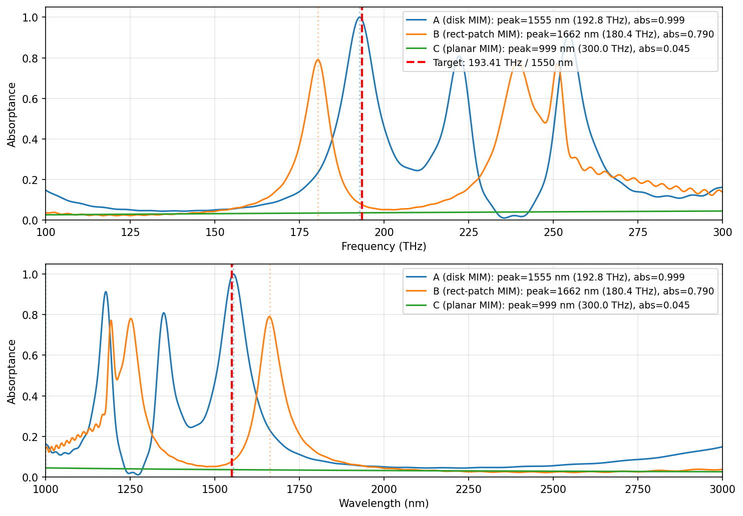
All three designs — final spectra side by side
Vertical red dashed = target 1550 nm / 193.41 THz · vertical dotted = each design's measured peak.
10 / 12

Slide 11
Building robust CST automation
Five failure modes hit during the run, and the defensive code that now catches each one.
01
cst.results.ProjectFile silently breaks with relative paths
Result lookup raises “does not exist for run id=N” even though the data is in the file.
FIX Wrapper open_results() always passes Path(...).resolve()
02
Parameter injection invalidates run_id=0; API default is run_id=0
Real data lives at run_id=1+. Default get_result_item silently returns nothing.
FIX Wrapper queries get_all_run_ids(), requests highest first
03
Solver/mesh combo matters — wrong combo gives zero absorption with no error
TD+PBA hex for patterned absorbers; FD+Tetrahedral for uniform planar.
FIX Hypothesis-specific solver/mesh dispatch in runner.py
04
Constant-σ Au/Ag wrong for impedance-matching designs
OK for plasmonic-resonance designs (A, B). Catastrophic for thin-film cavity (C).
FIX probe_drude_vba.py auto-tries 9 dispersive-material syntaxes
05
LLM extrapolates trends across mode hops
Iters 2–5 of hypothesis A wasted on a higher-order LSPR masquerading as the fundamental.
FIX Mode-hop detector auto-warns the LLM in the user message
11 / 12

Slide 12
CONCLUSIONS
5 nm peak error in ~14 minutes
of CST + LLM time, fully autonomous from a one-line target spec.
Hypothesis matters
LLM can do empirical inference
Defensive wrappers pay off
Patterned absorbers worked (A converged, B partial). The lithography-free planar fell out — the materials model couldn't capture impedance matching. A genuinely different problem class.
Hypothesis B's agent swapped the roles of lx and ly mid-run after seeing how the spectrum responded — not just executing prompted physics.
Every silent CST footgun (relative-path indexing, run_id=0, solver/mesh combos) cost real wall-time the first time. Once wrapped, they're free for everyone after.
FUTURE WORK
● Run probe_drude_vba.py to fix dispersive Au/Ag and unblock hypothesis C
● Add multi-resonator topology (Salisbury overlay or dual-disk supercell) to broaden the 105 nm FWHM toward the 200 nm target
● Generalize to UV / mid-IR / GHz bands with per-band solver/mesh recipes
github.com/DaryLu0v0/auto_cst · runs/FINAL_REPORT.md · nir/VBA_COOKBOOK.md

