Slide 1
SMART INDIA HACKATHON 2026
NetSentinel
PROBLEM STATEMENT ID
«PS ID»
Catching kill chains that ride trusted services.
PROBLEM STATEMENT TITLE
«PS TITLE»
THEME
A passive, agentless AI intrusion-detection layer for unidirectional networks behind data diodes — nuclear, defence and SCADA. No DPI. No signatures. No payload ever written to disk.
«THEME — e.g. Blockchain & Cybersecurity»
PS CATEGORY
Software
TEAM ID
0.992
96.9%
13.7×
«TEAM ID»
Sentry–Inspector agreement (AUC),
real enterprise traffic, 3 seeds
of the Inspector's flags recovered
at a 5% escalation budget
smaller student model —
205,546 → 14,992 parameters
TEAM NAME
«TEAM NAME»
INSTITUTION
Measured on LANL cyber1 — 612 hosts × 13 days × 749 real red-team events. Regenerated from result files, never typed by hand.
«INSTITUTION NAME»
Mentor: «MENTOR NAME», «DEPARTMENT»
Yellow «angle-bracket» text is a placeholder — replace before submitting.
Notes:
Fill every «placeholder» before submission. The one-line hook is: modern intrusions do not use malware domains, they use GitHub, Telegram and Google Drive. We detect the ORDER those services are used in, not the services themselves.

Slide 2
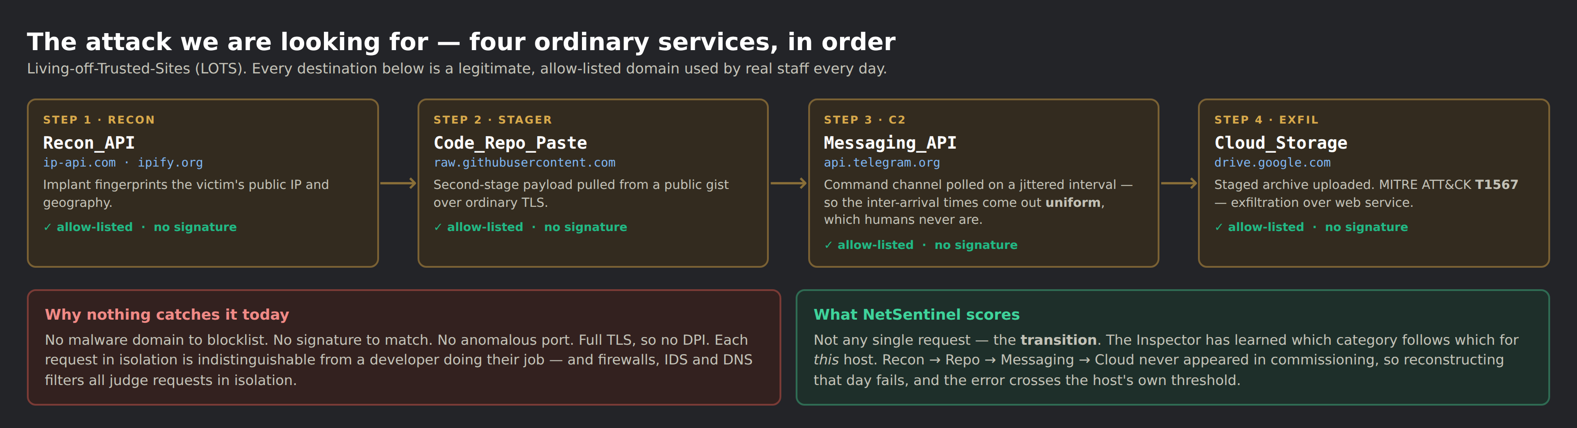
SLIDE 02 · PROBLEM UNDERSTANDING
The attacker no longer brings infrastructure. They borrow yours.
Restated in our words: detect intrusions on networks where you cannot install an agent, cannot decrypt traffic, and cannot see the return channel.
WHO IS AFFECTED
Air-gapped and diode-protected networks: nuclear plants, defence installations, power grid and water SCADA. Plus every IoT, OT and BYOD endpoint that cannot run an agent.
WHY TODAY'S TOOLS MISS IT
Signature IDS needs a known bad. DNS/domain filters need a bad domain. DPI needs plaintext. EDR needs an agent on the host. A LOTS chain defeats all four at once.
Living-off-Trusted-Sites kill chain. Every hop is a legitimate, allow-listed domain.
The gap, precisely
61%
A 91-study review of graph-based NIDS found no published system that models cross-service category TRANSITIONS as the detection signal.
Behind a data diode the return channel is invisible by design — every request-response detector is structurally blind there.
Of 124 surveyed public datasets, none contains multi-day egress traffic with multi-stage campaign labels. The evaluation data does not exist.
of encrypted web traffic on our own measured capture is QUIC. Most sensors treat that as unreadable. We derive the RFC 9001 Initial keys and read the hostname — 16/16 published test vectors pass.
Notes:
The 61% is ours, measured on our own capture — say 'we measured'. If asked how we read QUIC: Initial packets are protected with a salt published in RFC 9001 section 5.2 plus the client's own connection ID, which is in cleartext in the same packet. Reading the handshake is the documented design, not an attack and not TLS interception. We get the hostname and nothing else. netsentinel_v2/quic.py, verified by test_quic.py against the RFC's own vectors.

Slide 3
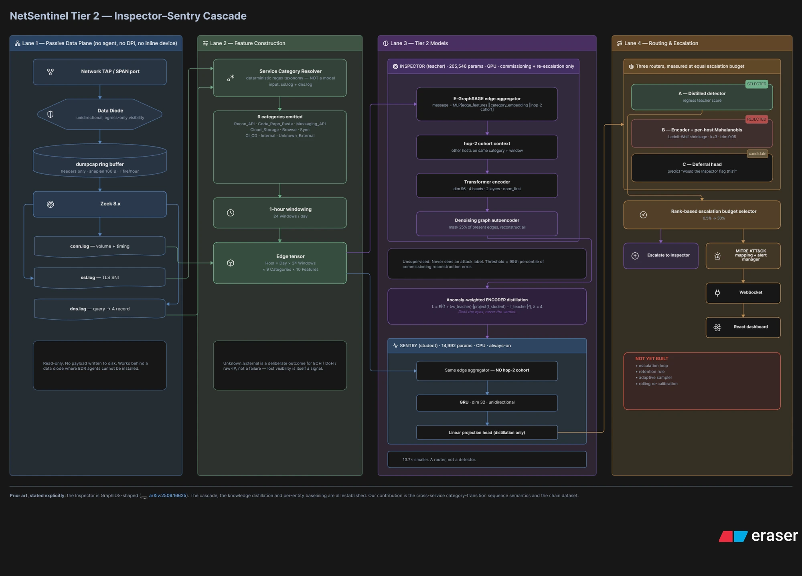
SLIDE 03 · PROPOSED SOLUTION
Expensive eyes at commissioning. Cheap eyes always on.
NetSentinel scores WHICH service categories a host combines and the machine-like shape of that traffic — not the domains, not the payload.
HOW IT SOLVES THE PROBLEM
The Inspector learns each host's own normal, unsupervised, during a commissioning window. It never needs an attack example, so it does not need a signature, a bad domain, decryption, or an agent.
THE KEY DIFFERENTIATOR
The Sentry is not a detector — it is a ROUTER. It answers "would the Inspector want to look at this?", not "is this an attack?". That reframing is what makes a graph neural network affordable on CPU-only OT hardware.
AND IT ESCALATES BACK
Flagged host-days return to the Inspector, which re-runs on those only and emits one alert carrying the four timestamped chain steps — not four disconnected alerts.
In one line: we detect the COMBINATION and the SHAPE, not the destination. Four allow-listed services touched together, with machine timing, is a signal no signature, blocklist, DPI or agent sees.
Notes:
One line if asked to compress: 'We detect the combination and the shape, not the destination.'
This used to say 'the SEQUENCE'. We changed it because we ran the experiment (ablation_order.py) and the claim did not survive: permuting the hours of a day changes the model's score by 0.000 AUC, and an order-free baseline scores 1.000 against our 0.998. If a judge asks whether order matters, the honest answer is 'we tested it, it does not, here is the table' — that is a stronger position than a claim that dies to one line of numpy.

Slide 4
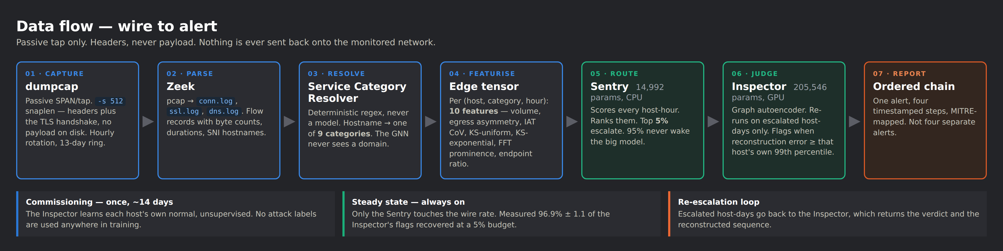
SLIDE 04 · TECHNICAL ARCHITECTURE
Input → process → output, end to end.
CAPTURE & PARSE
MODELS
SERVING & UI
DATA & EVAL
dumpcap (whole packets) · Zeek 6 · Npcap · RFC 9001 QUIC Initial parser · scheduled task with ring-buffer pruning
PyTorch · E-GraphSAGE edge aggregator + Transformer (Inspector) · GRU student (Sentry) · ONNX Runtime for the 6 Tier-1 experts
FastAPI · WebSocket alert hub · React + TypeScript dashboard · force-directed threat graph
NumPy / scikit-learn · LANL cyber1 (real red team) · our own running capture · ablation + multi-seed temporal protocol
No inline device, no agent, no decryption, no payload retention — the whole system is a passive consumer of headers.

Slide 5
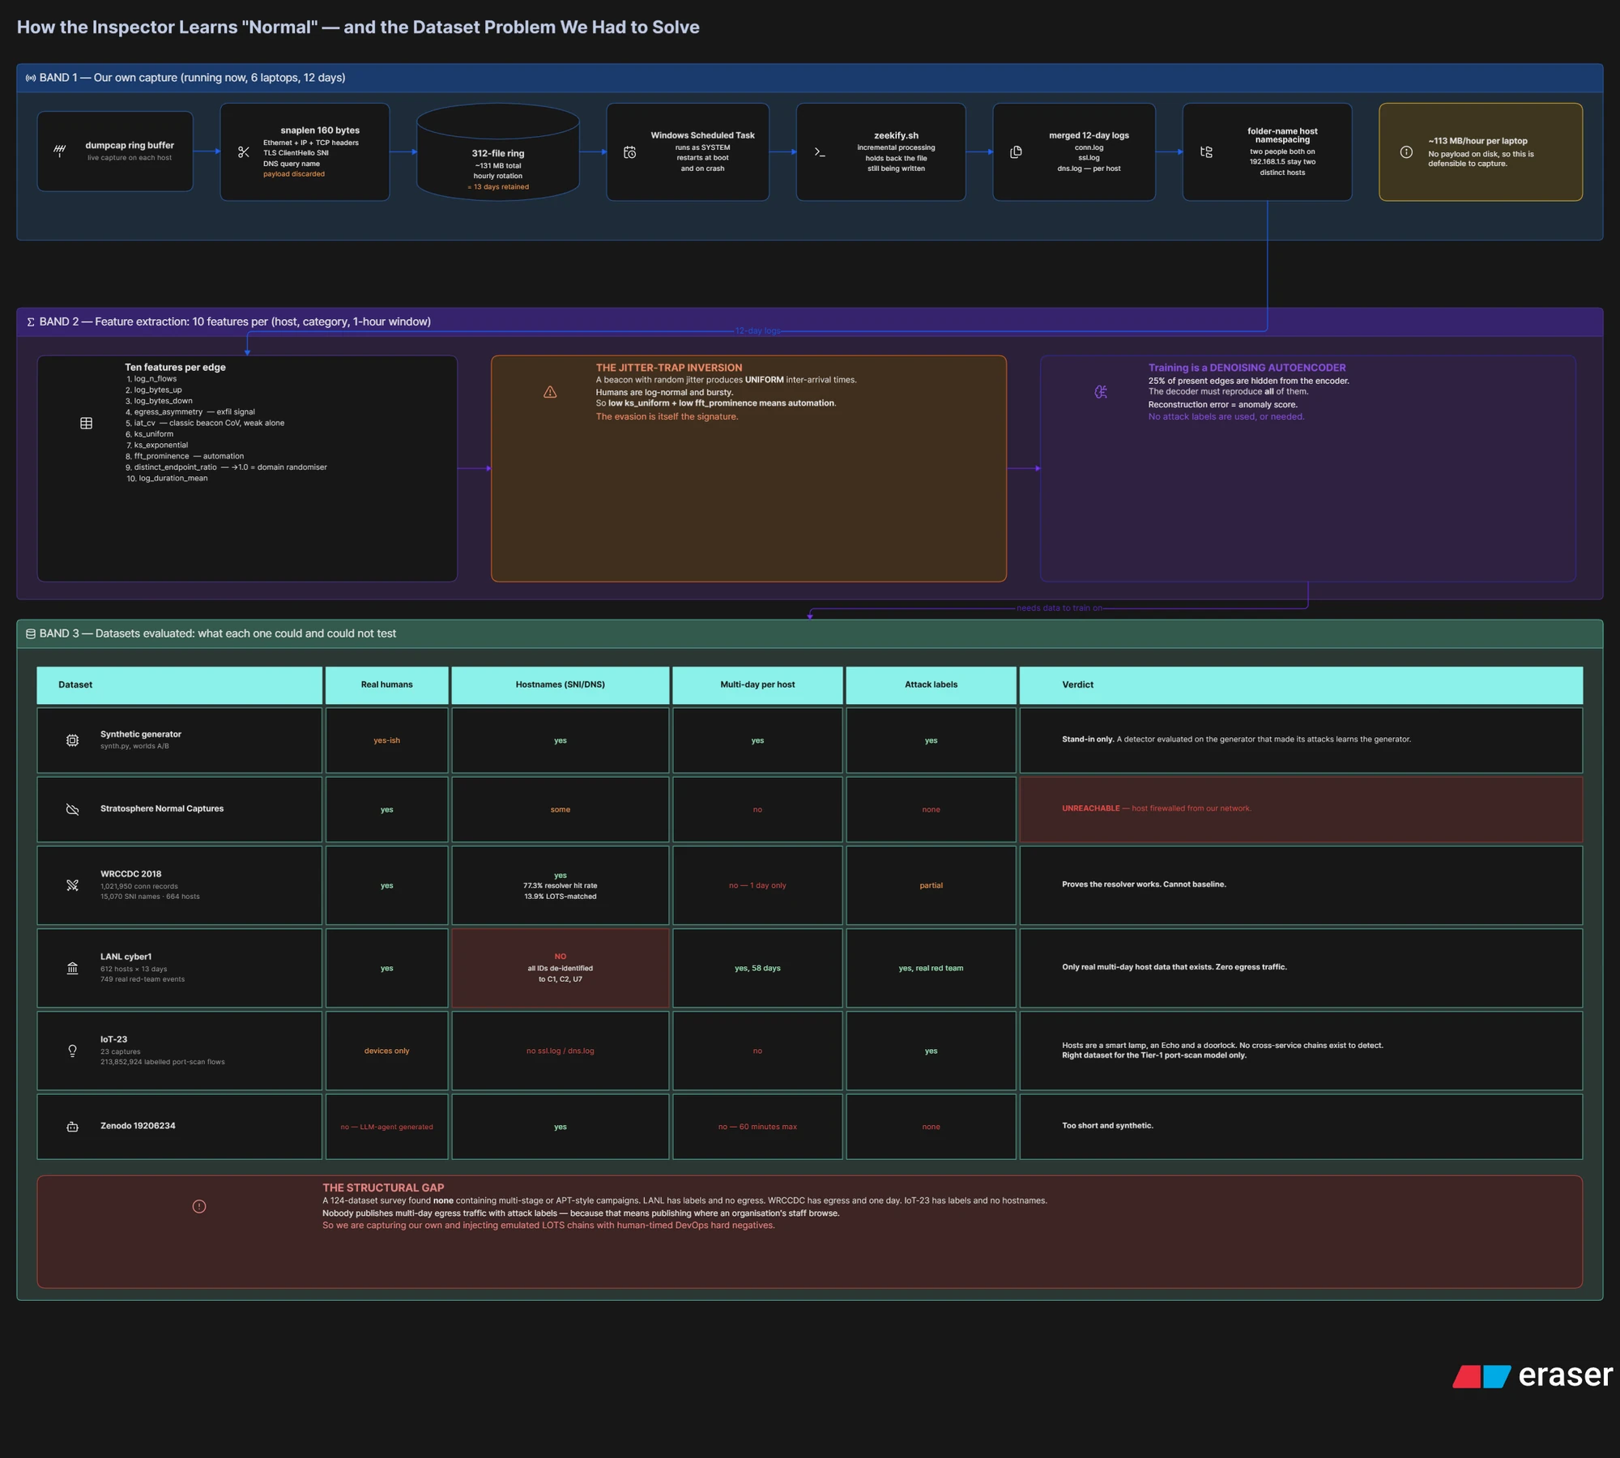
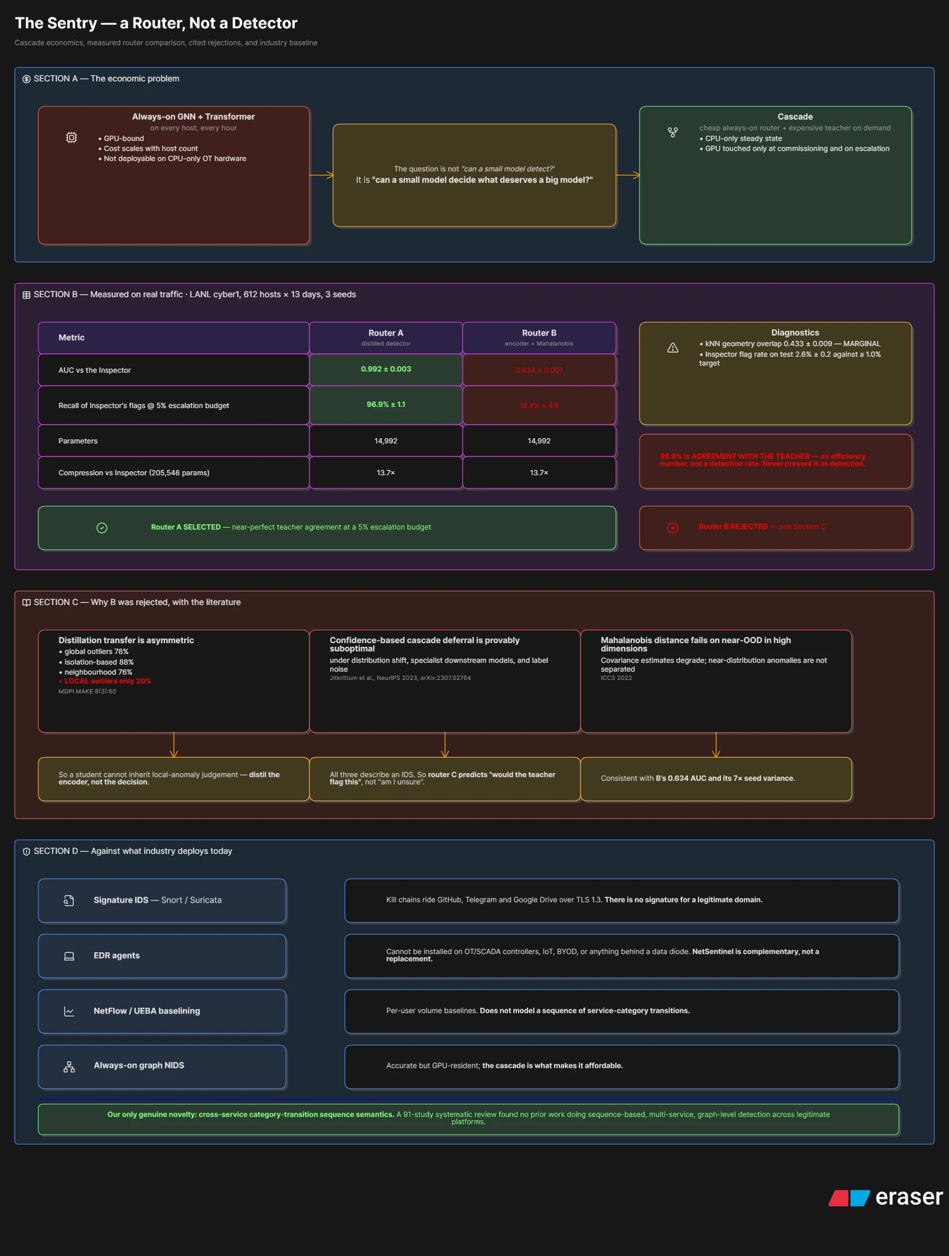
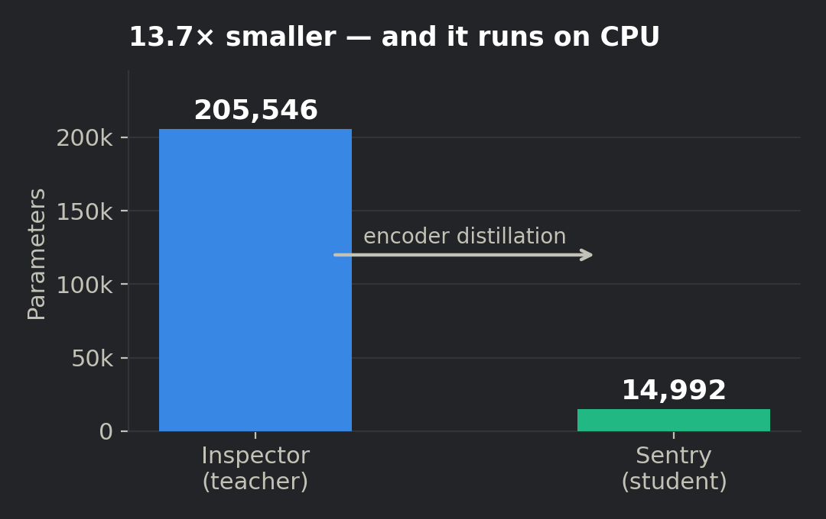
SLIDE 05 · INNOVATION & NOVELTY
One genuine novelty, stated precisely — and the prior art named.
We are explicit about what is ours and what is not. Overclaiming is the fastest way to lose a technical panel.
WHAT IS OURS
Cross-service category semantics: scoring WHICH allow-listed service categories a host combines, per host, as the detection signal. A 91-study review of graph-based NIDS found no published system doing this. Plus the chain dataset — and the ablation that tells us which half of the hypothesis is actually carrying it.
Inspector architecture — GraphIDS (arXiv:2509.16625). Prior art, not ours.
Anomaly-weighted ENCODER distillation, λ=4 — we distil the teacher's representation, never its verdict. Motivated by MDPI MAKE 8(3):60: local outliers transfer at only 20%.
Router predicts "would the teacher flag this", not "am I uncertain" — confidence-based deferral is provably suboptimal (Jitkrittum et al., NeurIPS 2023, arXiv:2307.02764).
Jitter-Trap inversion: a jittered beacon yields UNIFORM inter-arrival times; humans are log-normal. The evasion is the signature.
Notes:
If a judge asks 'what is actually new here' — the answer is the cross-service framing and the dataset. Everything else is honest engineering on published components, and saying so buys credibility.
If they push on ORDER specifically: we tested it and order is not what is carrying the detection. Permuting the hours of a day moves our AUC by 0.000. We kept the cross-service claim, which the same experiment supports, and dropped the ordering claim, which it does not. ablation_order.py, three seeds.

Slide 6
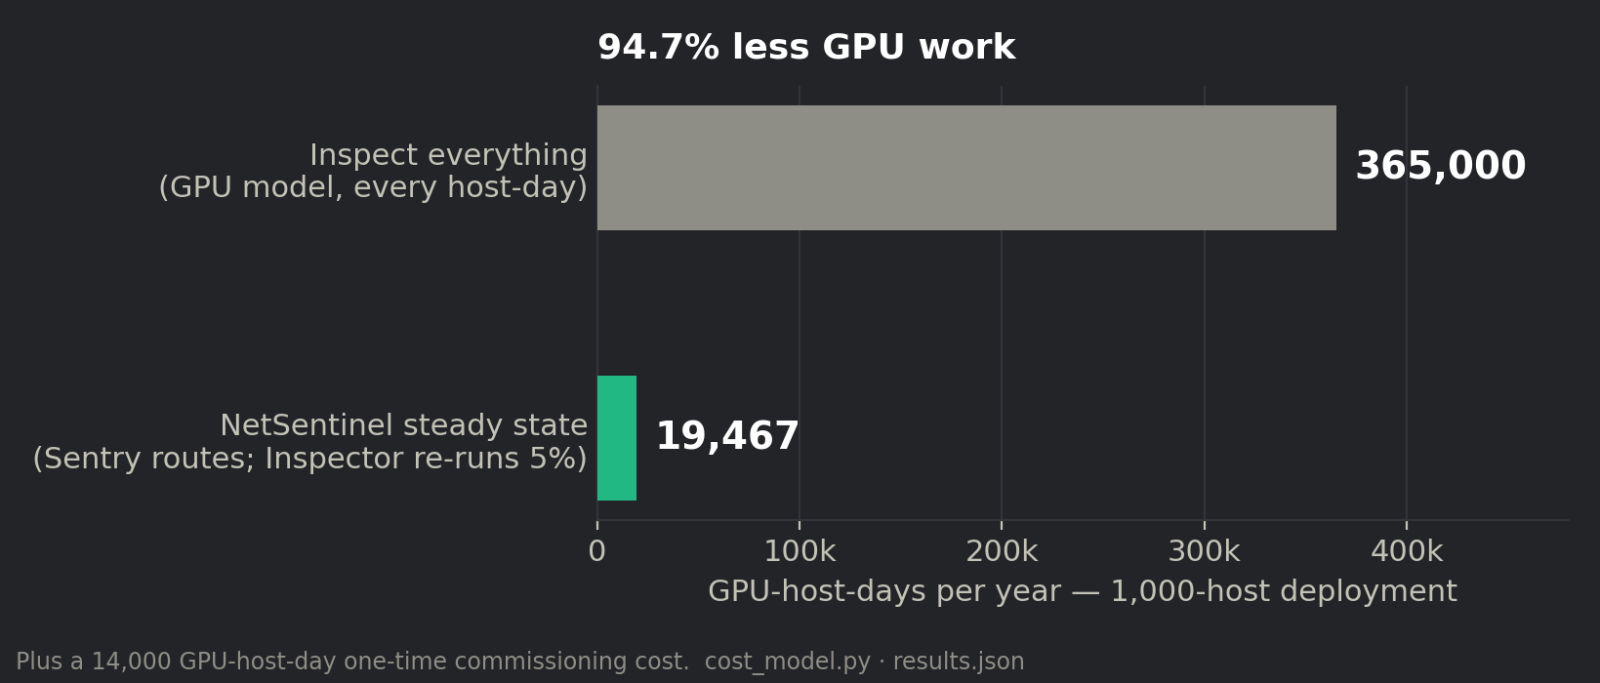
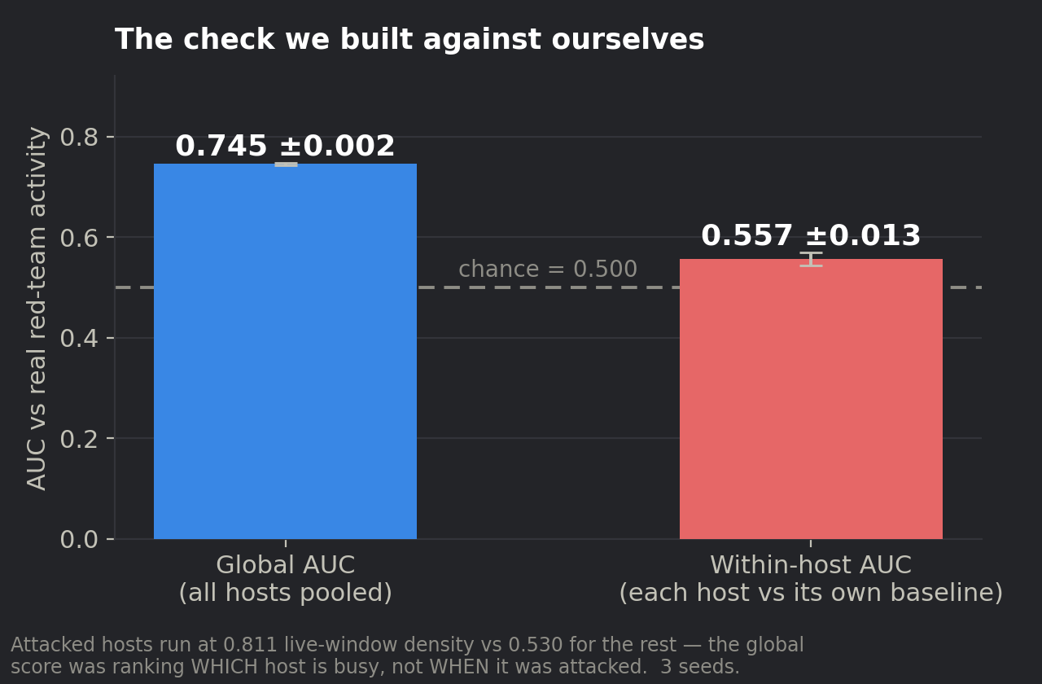
SLIDE 06 · FEASIBILITY & VIABILITY
Built and measured — plus the risk that argues against us.
Can it be built in 36 hours? The cascade is already built and measured on real traffic. The 36 hours are for the escalation loop, re-calibration and the evidence UI.
RESOURCES — ALL FREE / OPEN
SCALES TO 1000× ?
Zeek, Wireshark/Npcap, PyTorch, ONNX Runtime, FastAPI, React — all open source. No paid API. Commissioning ran on CPU; a single consumer GPU is optional, not required.
Cost is linear in host-days and the Sentry is the only always-on component: 14,992 parameters, ~250,000 windows/second on one CPU core. At 1,000 hosts that is 94.7% less GPU work than inspecting everything.
Two risks we found ourselves, stated first. Against the LANL red team our within-host AUC is 0.557 ± 0.013 — chance; attacked hosts were simply busier (0.811 vs 0.530 density).
And we ran an order-shuffle ablation against our own headline claim: permuting the hours of a day changes our AUC by 0.000, so the signal is cross-service combination and traffic shape, not sequence. We changed the claim rather than the experiment.
Checked and clear: a sensor behind a true one-way tap cannot compute log_bytes_down or egress_asymmetry. Dropping both costs 0.002 AUC — the diode deployment story and the feature list agree.
Notes:
Lead with the weakness on this slide. A panel that finds a flaw you hid stops believing the rest; a panel you hand the flaw to starts trusting you.
Both risks here are ones we generated ourselves with experiments designed to fail. If asked 'what would change your mind about the project' — the order ablation already did, and we changed the claim on slide 3 because of it.
The green line is the good news and it is worth saying out loud: the obvious attack on a diode pitch is 'your features need return traffic'. We measured it. They do not.

Slide 7
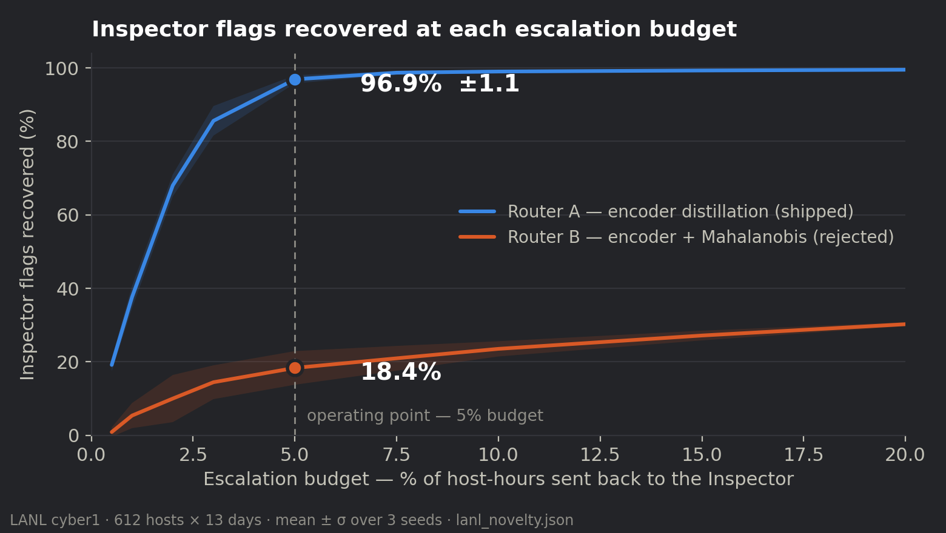
SLIDE 07 · IMPACT & BENEFITS
Measured efficiency today; detection claimed only when earned.
Every number on this slide is regenerated from a result file by script. None is typed by hand.
96.9%
13.7×
of the expensive model's flags recovered at a 5% escalation budget (±1.1, 3 seeds)
smaller student model — 205,546 → 14,992 parameters, CPU-only
94.7%
0.992
less GPU work in steady state at a 1,000-host deployment
Sentry–Inspector agreement, AUC, on real enterprise traffic (±0.003)
WHO BENEFITS
SDG ALIGNMENT
Operators of diode-protected networks (nuclear, defence, grid, water) who today have no behavioural egress detection at all — and any estate with IoT/OT/BYOD endpoints that cannot take an agent.
SDG 9 — resilient infrastructure and industrial innovation.
SDG 11 — safe, resilient critical services.
Supports NCIIPC's Critical Information Infrastructure mandate.
SAID PRECISELY
96.9% is AGREEMENT WITH THE TEACHER — an efficiency figure. It is not a detection rate and we never present it as one. The detection claim is pending our own capture.

Slide 8
SLIDE 08 · PROTOTYPE & DEMO
Working today — and reproducible in front of you.
Tier 1 (6 ONNX experts) processes real PCAP end to end. Tier 2 (the cascade) is measured and re-runnable on stage.
WHAT ALREADY RUNS
6/6 ONNX experts load. 8.8 GB Friday-WorkingHours.pcap → 32,266 alerts across all six classes, 42.5 flows/s, 23 ms latency, 280 MB RSS. Full path: PCAP → extract → infer → alert → WebSocket → dashboard.
PASTE SCREENSHOT: live dashboard / landing page
Recommended: the React threat dashboard mid-replay, or saharasaathi-style landing page.
Delete this yellow box after pasting.
REPRODUCIBLE ON STAGE, ~45 s
demo_scenario.py builds a synthetic organisation, commissions the Inspector, distils the Sentry, escalates the top 5% back, and prints the reconstructed chain — every stage trained live, not replayed.
PASTE SCREENSHOT: demo_scenario.py kill-chain reconstruction
The terminal block showing chain steps 1/4 → 4/4 with ESCALATED markers.
Delete this yellow box after pasting.
RESULT SLOT — fill from inject_demo.py, 19 Sep
Real captured background + injected kill chain + benign-surge CONTROL.
Paste condition A / B / C flag counts here once condition B comes back clean.
Notes:
Do not fill the result slot with anything you have not run. If inject_demo.py has not passed its benign-surge control by submission, delete the box and say the experiment is pending — that is a defensible position and an invented number is not.

Slide 9
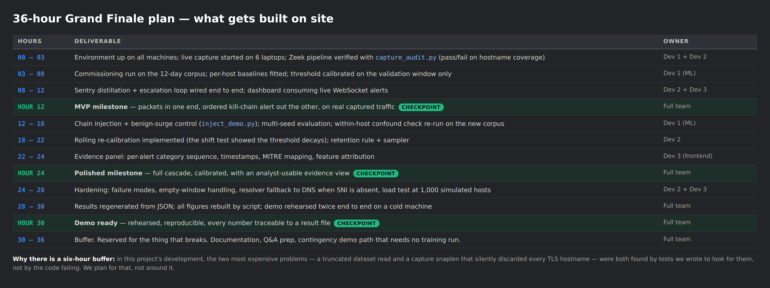
SLIDE 09 · 36-HOUR PLAN
What gets built at the Grand Finale, and who builds it.
Roles: Dev 1 — models and evaluation. Dev 2 — capture, pipeline, backend. Dev 3 — frontend, evidence panel, demo. Replace with real names on slide 10.

Slide 10
SLIDE 10 · TEAM & REFERENCES
Who built it, and what we built it on.
«MEMBER 1»
«MEMBER 2»
«MEMBER 3»
«Dept»
«Dept»
«Dept»
ML / evaluation — Inspector, distillation, multi-seed protocol
Capture & data pipeline — Zeek, resolver, tensor builder
Backend — FastAPI, WebSocket hub, ONNX serving
«MEMBER 4»
«MEMBER 5»
«MEMBER 6»
«Dept»
«Dept»
«Dept»
Frontend — React dashboard, evidence panel, threat graph
Security research — LOTS taxonomy, MITRE mapping, threat model
Testing & documentation — fixtures, audit tooling, runbooks
Mentor: «MENTOR NAME» — «Department / Organisation»
REFERENCES
GraphIDS: self-supervised graph IDS with edge aggregation — arXiv:2509.16625 (the Inspector's architecture; prior art, not ours)
Jitkrittum et al., "When does confidence-based cascade deferral suffice?" NeurIPS 2023 — arXiv:2307.02764 (why the router predicts the teacher's flag, not its own uncertainty)
"Knowledge distillation for anomaly detection" — MDPI Machine Learning & Knowledge Extraction 8(3):60 (transfer asymmetry: local outliers move at only 20%)
Kent, A. D., "Comprehensive, Multi-Source Cyber-Security Events" — Los Alamos National Laboratory, 2015 (LANL cyber1: 612 hosts, 13 days, 749 real red-team events)
MITRE ATT&CK T1567 — Exfiltration Over Web Service; T1102 — Web Service (C2)
The LOTS Project — living-off-trusted-sites domain taxonomy · Zeek Network Security Monitor documentation
All measured figures regenerate from v2/lanl_novelty.json, v2/results.json and v2/capture_audit.json.

