Slide 1
SMART INDIA HACKATHON 2026
TITLE PAGE
Problem Statement ID –
«PS ID»
NetSentinel
Problem Statement Title –
«PS TITLE»
Catching kill chains that ride trusted services.
Theme –
«THEME»
A passive, agentless AI intrusion-detection layer for unidirectional networks behind data diodes. No DPI, no signatures, no payload on disk.
PS Category –
Software
Team ID –
«TEAM ID»
0.992
Sentry–Inspector AUC
96.9%
flags recovered @ 5%
Team Name –
«TEAM NAME»
13.7×
smaller student model
Mentor: «MENTOR NAME», «DEPARTMENT» · Institution: «INSTITUTION NAME»
Underlined amber «angle-bracket» text is a placeholder — replace before submitting.

Slide 2
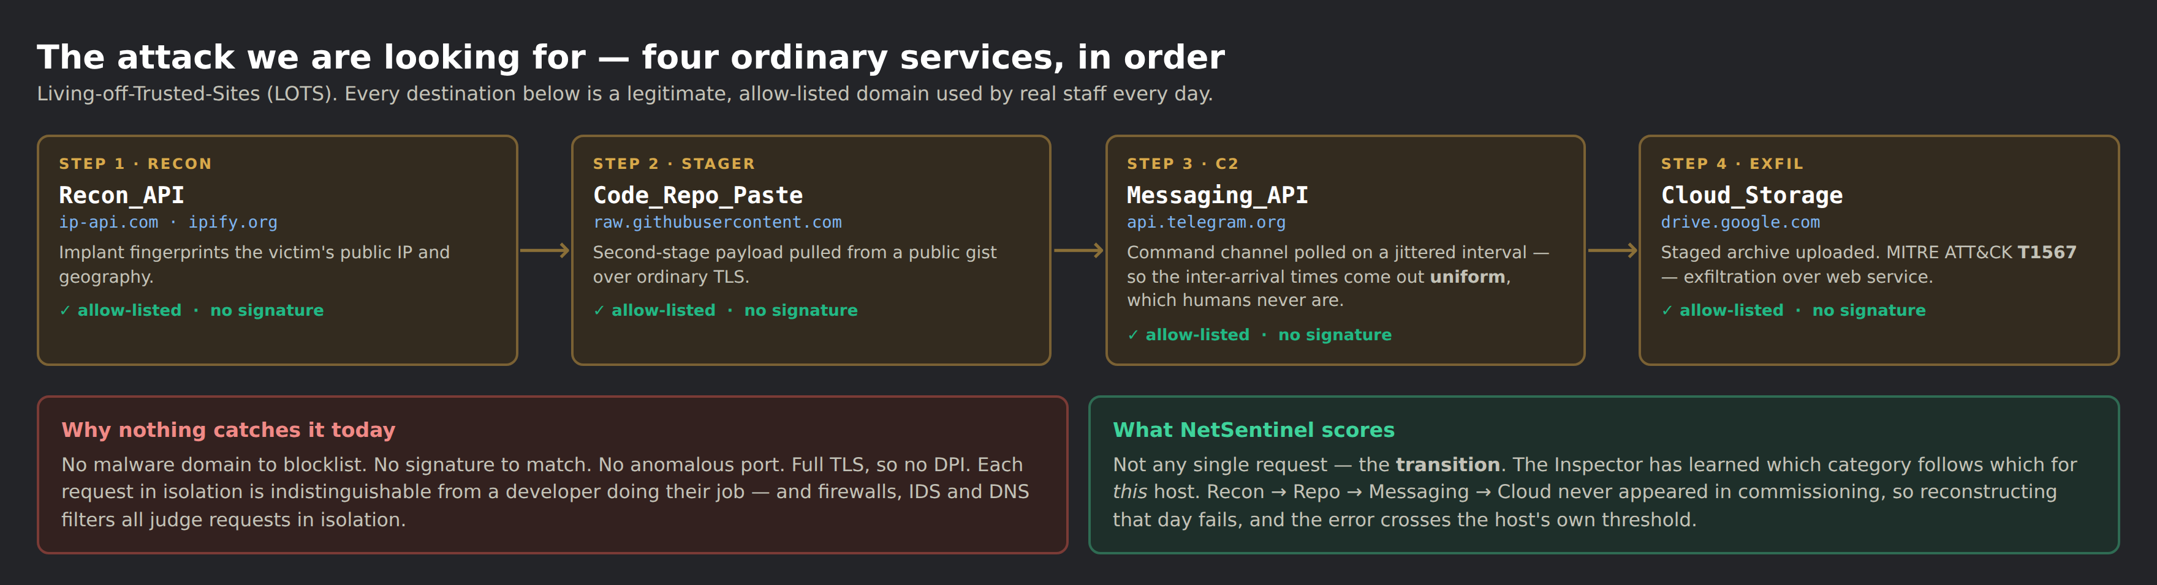
PROPOSED SOLUTION
Detect WHICH service categories a host combines, and the machine-like shape of that traffic — not the domains, not the payload.
THE IDEA
A two-model cascade. The Inspector — a graph autoencoder — learns each host's own normal, unsupervised, during commissioning. The Sentry, 13.7× smaller, runs always-on and decides what deserves the Inspector.
HOW IT ADDRESSES THE PROBLEM
No signature, no bad domain, no decryption, no agent. It works behind a data diode where the return channel is invisible, and on IoT/OT/BYOD that cannot run an agent.
WHY NOTHING CATCHES IT TODAY
AND IT ESCALATES BACK
Signature IDS needs a known bad. Domain and DNS filters need a bad domain. DPI needs plaintext — and 61% of our own measured traffic is QUIC, which we read via RFC 9001. EDR needs an agent on the host. A Living-off-Trusted-Sites chain defeats all four at once, because every hop is a legitimate allow-listed service and each request in isolation is indistinguishable from a developer doing their job.
Host-days the Sentry ranks in the top 5% return to the Inspector, which re-runs on those only and emits ONE alert carrying the four timestamped chain steps — not four disconnected alerts an analyst has to correlate by hand.
Measured: 96.9% ± 1.1 of the Inspector's flags recovered at that 5% budget, over 3 seeds.
INNOVATION & UNIQUENESS
Cross-service category semantics: WHICH allow-listed categories a host combines, scored per host, as the detection signal. A 91-study review of graph-based NIDS found no published system doing this. The Inspector architecture itself is prior art (GraphIDS, arXiv:2509.16625) and we say so.

Slide 3
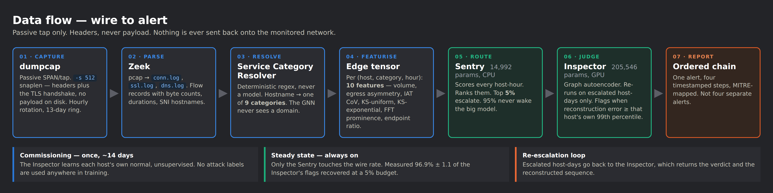
TECHNICAL APPROACH
Methodology and process flow — input → process → output. Passive tap only; headers, never payload.
CAPTURE & PARSE
MODELS
SERVING & UI
DATA & EVALUATION
dumpcap (whole packets) · Zeek 6 · Npcap · RFC 9001 QUIC Initial parser · scheduled task with a hostname-coverage audit
PyTorch · E-GraphSAGE edge aggregator + Transformer (Inspector, 205,546 params) · GRU student (Sentry, 14,992) · ONNX Runtime
FastAPI · WebSocket alert hub · React + TypeScript dashboard · force-directed threat graph · MITRE ATT&CK mapping
LANL cyber1 (612 hosts, 13 days, 749 real red-team events) · our own running capture · ablation + strictly temporal multi-seed protocol
No inline device, no agent, no decryption, no payload retention — the whole system is a passive consumer of packet headers.

Slide 4
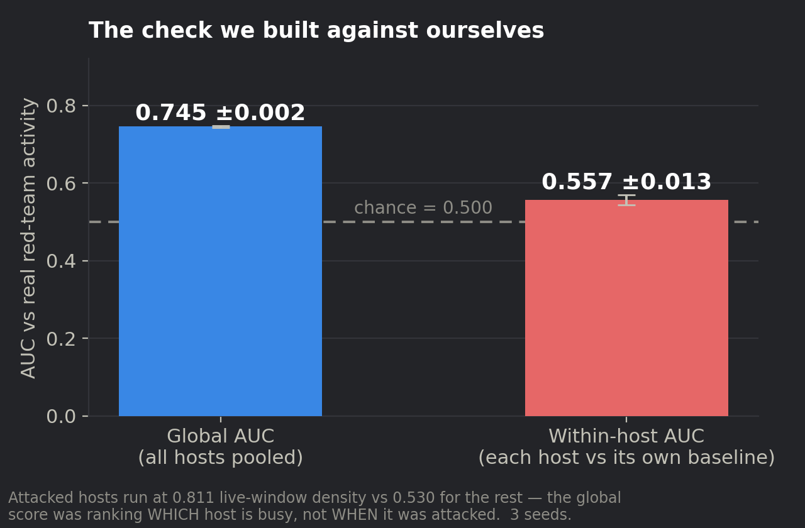
FEASIBILITY AND VIABILITY
Feasibility analysis, the risks we actually found, and how we are handling each one.
IS IT FEASIBLE? — ALREADY BUILT AND MEASURED
Tier 1 (6 ONNX experts) runs end to end: 8.8 GB PCAP → 32,266 alerts, 42.5 flows/s, 23 ms latency, 280 MB RSS. Tier 2 (the cascade) is measured over 3 seeds on real enterprise traffic. All tooling is open source — Zeek, PyTorch, ONNX Runtime, FastAPI, React. No paid API. Commissioning ran on CPU.
SCALABILITY
WHAT THE 36 HOURS ARE FOR
Cost is linear in host-days, and the Sentry is the only always-on component: 14,992 parameters, ~250,000 windows/second on one CPU core. At 1,000 hosts that is 94.7% less GPU work than inspecting everything.
Not the cascade — that exists. The escalation loop, rolling re-calibration, the retention rule and the analyst evidence panel, plus the injection experiment on our own capture.
RISK Our own ablation refuted the ordering half of our hypothesis. → Permuting the hours of a day changes our AUC by 0.000, and an order-free baseline matches us (1.000 vs 0.998). The signal is cross-service combination and traffic shape, not sequence. We changed the claim, not the experiment.
RISK Within-host AUC 0.557 ± 0.013 against the LANL red team — chance. → Attacked hosts were simply busier (0.811 vs 0.530 activity density). LANL has zero external traffic, so the cross-service hypothesis cannot fire there at all. We are capturing our own egress corpus to test it properly.
RISK The alert threshold decays — across networks and over time. → Our shift test showed the mechanism transfers (AUC −3.3%) but the 99th-percentile threshold does not: it flags 6.3% in a second organisation and 6.8% in its own later test period. Every deployment needs its own calibration window plus rolling re-calibration.
RISK No public dataset can evaluate this. → Of 124 surveyed datasets, none has multi-day egress traffic with multi-stage campaign labels. We are building the corpus, and we audit our own capture: capture_probe.py measures truncation, hostname coverage and QUIC readability before we trust a byte of it.

Slide 5
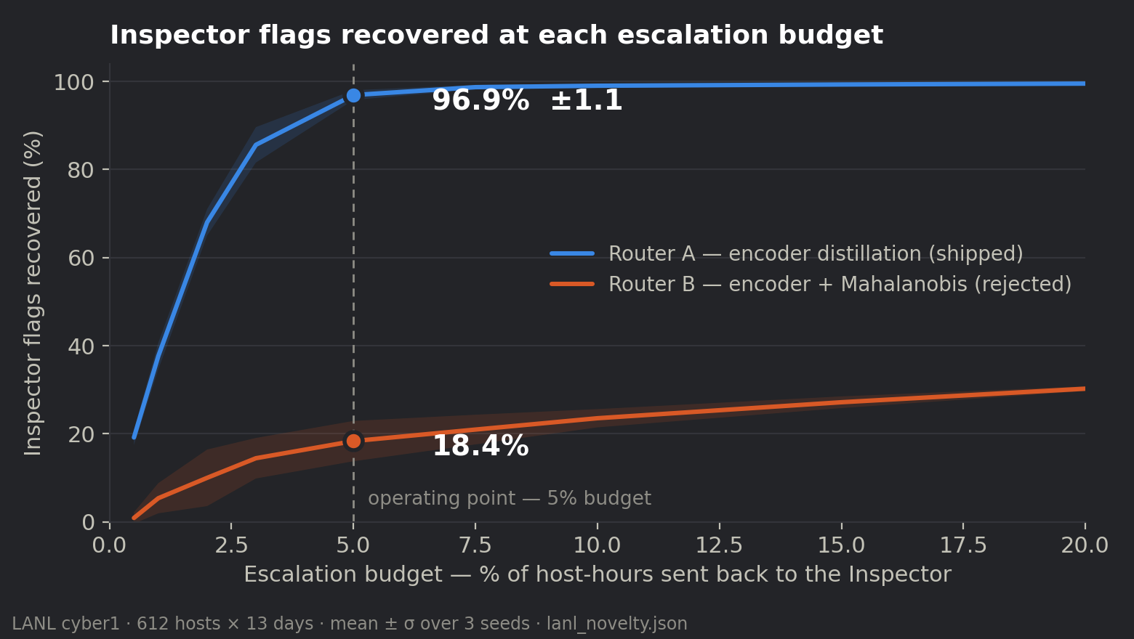
IMPACT AND BENEFITS
Every figure below regenerates from a result file by script. None is typed by hand.
96.9%
13.7×
of the expensive model's flags recovered at a 5% escalation budget (±1.1, 3 seeds)
smaller student model — 205,546 → 14,992 parameters, CPU-only
94.7%
0.992
less GPU work in steady state at a 1,000-host deployment
Sentry–Inspector agreement (AUC) on real enterprise traffic (±0.003)
SOCIAL & STRATEGIC
ECONOMIC
SAID PRECISELY
Behavioural egress detection for diode-protected national infrastructure — nuclear, defence, power grid, water SCADA — which today has none. Directly supports NCIIPC's Critical Information Infrastructure mandate. SDG 9 and SDG 11.
94.7% less GPU work than inspecting every host-day, so the detection layer runs on CPU-only hardware an OT site already owns. One alert carrying four timestamped chain steps instead of four disconnected alerts also cuts analyst triage time.
96.9% is AGREEMENT WITH THE TEACHER — an efficiency figure, not a detection rate, and we never present it as one. Our best honest detection result against a real red team is within-host AUC 0.557 ± 0.013, and the detection claim stays open until our own capture can test it.

Slide 6
RESEARCH AND REFERENCES
Prior art we build on, stated explicitly, and the sources behind every design decision.
Inspector architecture — prior art, not ours
GraphIDS: self-supervised graph intrusion detection with edge aggregation — arXiv:2509.16625
The Inspector is GraphIDS-shaped. We say this on stage. The cascade, the distillation and per-entity baselining are all established technique.
Why the router predicts the teacher's flag, not its own uncertainty
Jitkrittum, Gupta, Menon, Narasimhan, Rawat, Kumar — "When does confidence-based cascade deferral suffice?" NeurIPS 2023, arXiv:2307.02764
Confidence-based deferral is provably suboptimal. Our router is trained to answer "would the Inspector flag this".
Why we distil the encoder and never the verdict
"Knowledge distillation for anomaly detection" — MDPI Machine Learning & Knowledge Extraction 8(3):60
Distillation transfer is asymmetric: global outliers 78%, isolation 88%, neighbourhood 76%, local outliers only 20%. A LOTS chain is a local outlier.
Real red-team evaluation data
Kent, A. D. — "Comprehensive, Multi-Source Cyber-Security Events", Los Alamos National Laboratory, 2015
612 hosts × 13 days × 749 real red-team events. Also the source of our honest negative result: within-host AUC 0.557.
Threat model and taxonomy
MITRE ATT&CK T1567 (Exfiltration Over Web Service), T1102 (Web Service C2) · The LOTS Project living-off-trusted-sites domain taxonomy
The nine service categories in our resolver extend the LOTS taxonomy. The resolver is a deterministic lookup, never a model.
Tooling
Zeek Network Security Monitor · Wireshark/dumpcap · PyTorch · ONNX Runtime · FastAPI · React
All open source. Reproduction instructions and every result file are in the project repository.
All measured figures in this deck regenerate from v2/lanl_novelty.json, v2/results.json, v2/shift_results.json and v2/capture_audit.json. Nothing is typed by hand.

