Slide 1
Frameworks and Stores

Slide 2
PS: GraphQL
https://developer.github.com/v4/

Slide 3
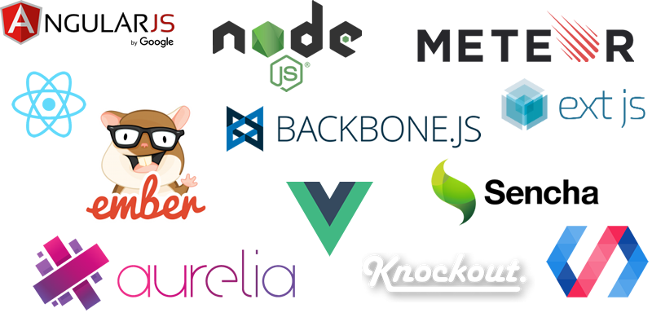

Slide 4




Slide 5

Monolith
As seen by Reddit
A simpler React

Slide 6
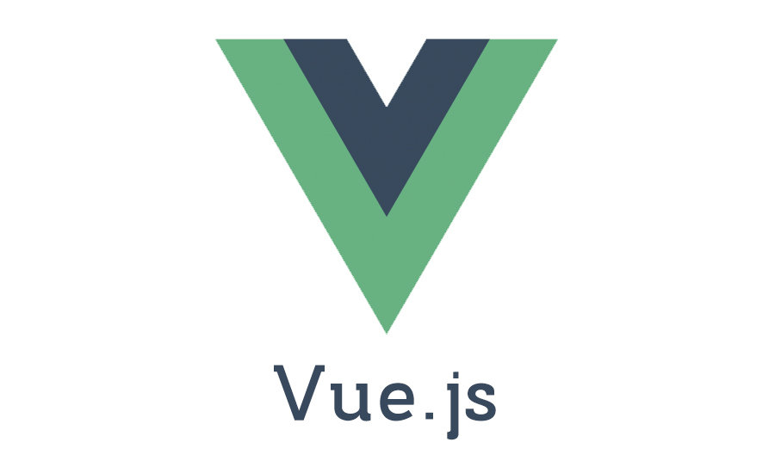
Pros
Cons
Modular
Progressive
Use as much of Vue as you want
Easy to integrate with existing sites
Officially supported tools
Vue Router
Vuex (state management)
Vue CLI
Webpack config
Hot reload, etc
Test Automation
Karma + Mocha
Nightwatch
Excellent Documentation
Easy to learn
Smaller and faster than React
At the moment
Newer than React, still gaining mainstream adoption
3rd party tools are still catching up
Community is smaller than Reacts

Slide 7
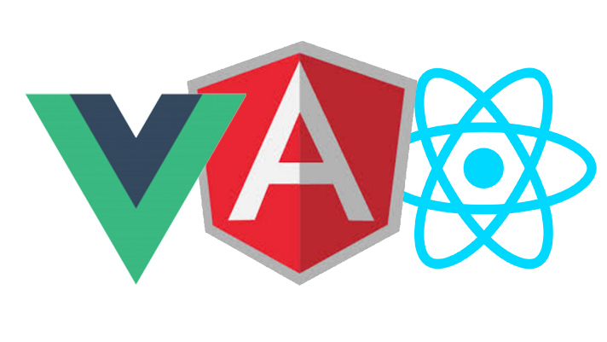
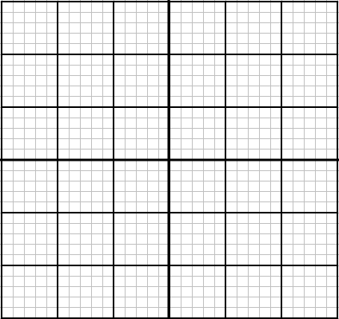
Many
Number of employees interested in the technology
Recruitment
Few
Many
Number of employers using the technology

Slide 8
Many
Number of employees interested in the technology
Recruitment
Few
Many
Number of employers using the technology

Slide 9
Many
Number of employees interested in the technology
Recruitment
Few
Many
Number of employers using the technology

Slide 10
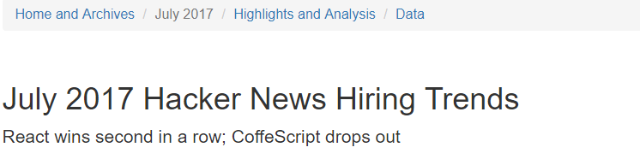
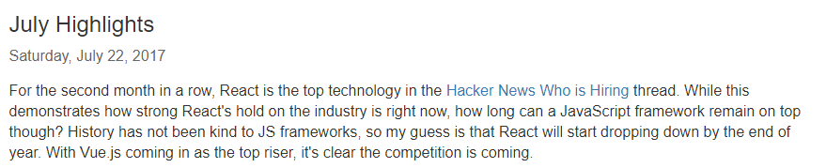
Recruitment
https://www.hntrends.com/2017/july.html
https://news.ycombinator.com/item?id=14688684

Slide 11
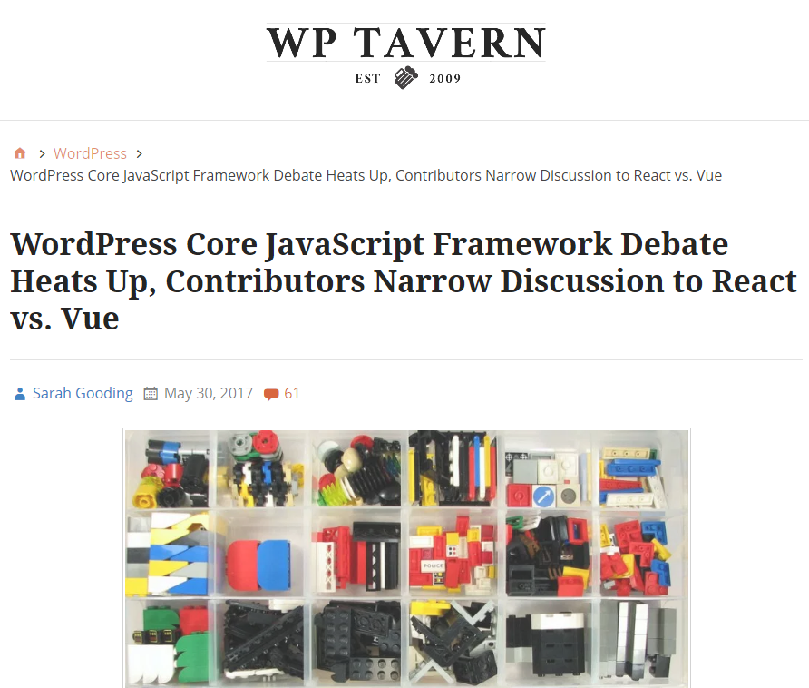
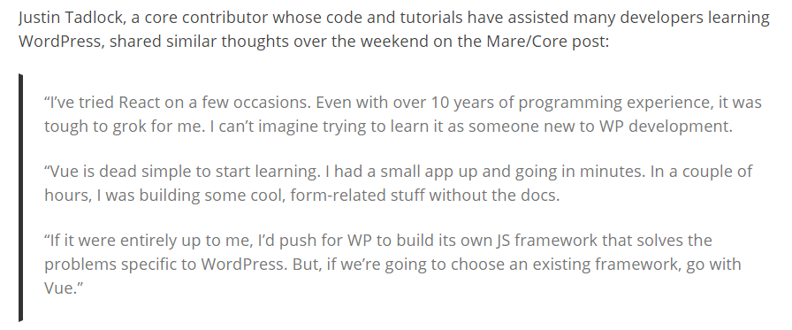

Slide 12

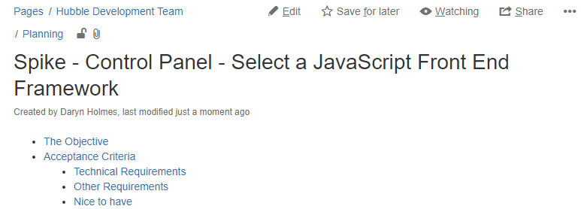
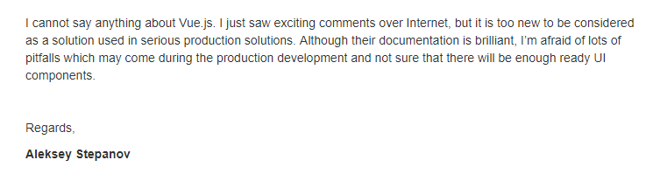

Slide 13
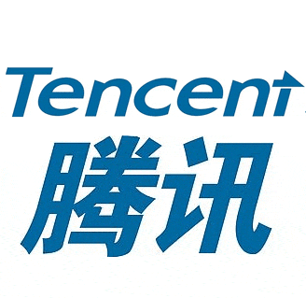



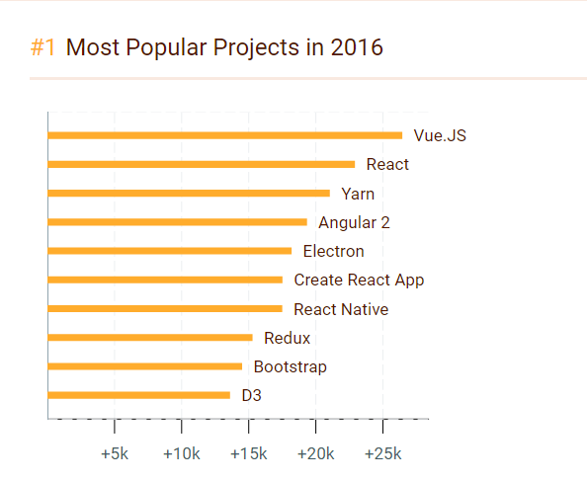


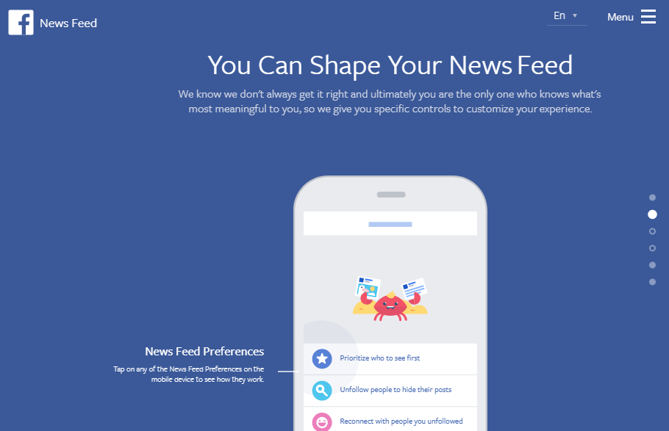

JS Frameworks

Slide 14
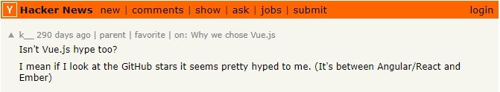
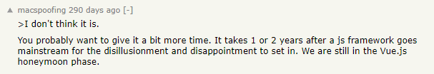

Slide 15
Simple
Safe

Slide 16
Simpler
Safer

Slide 17
Simpler
Safer

Slide 19
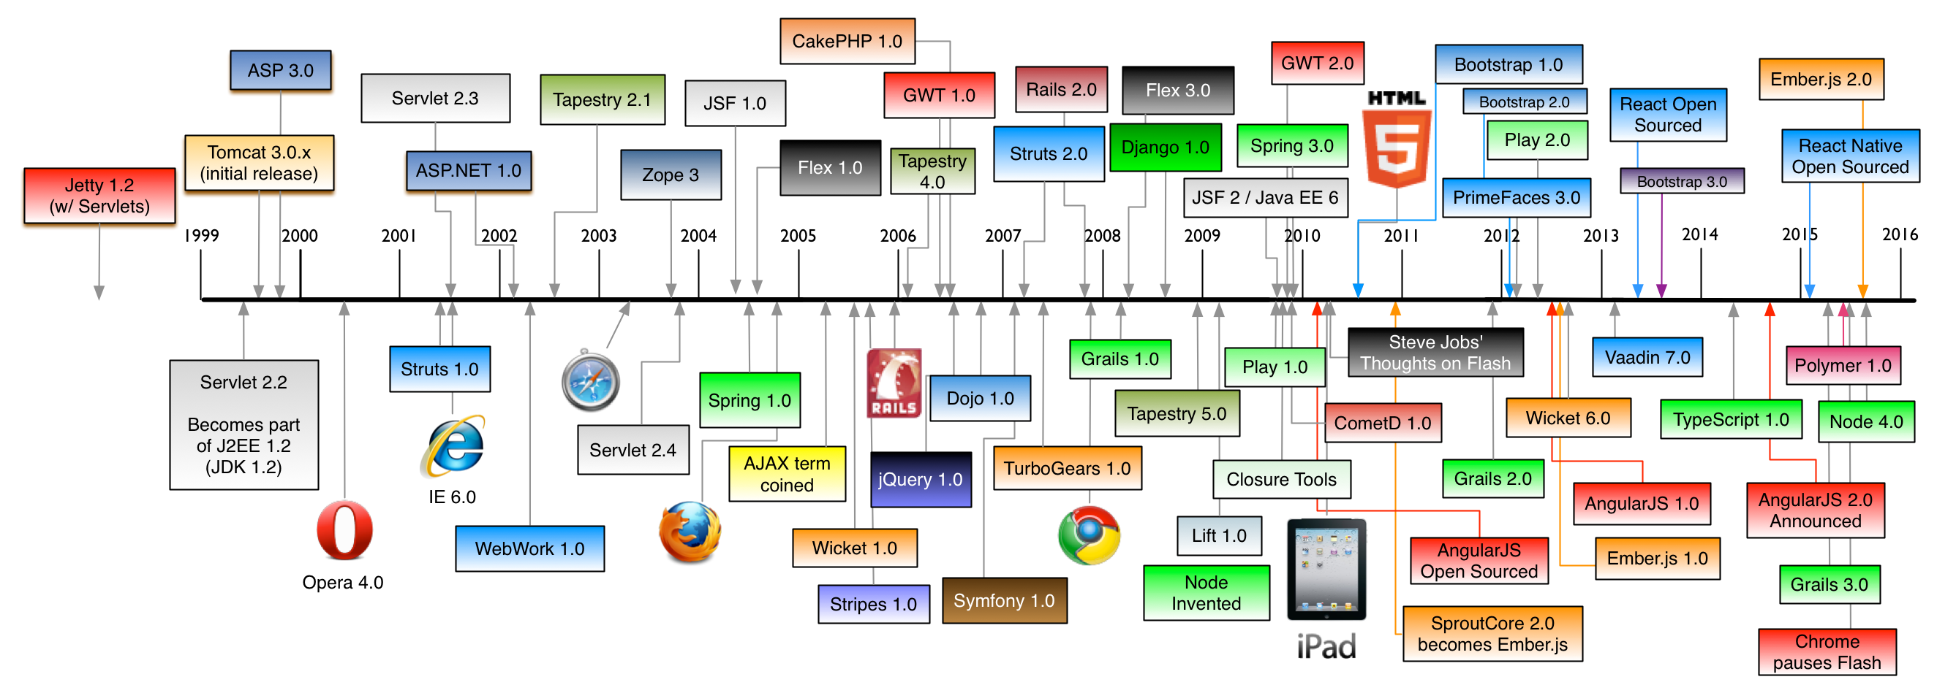

Slide 20
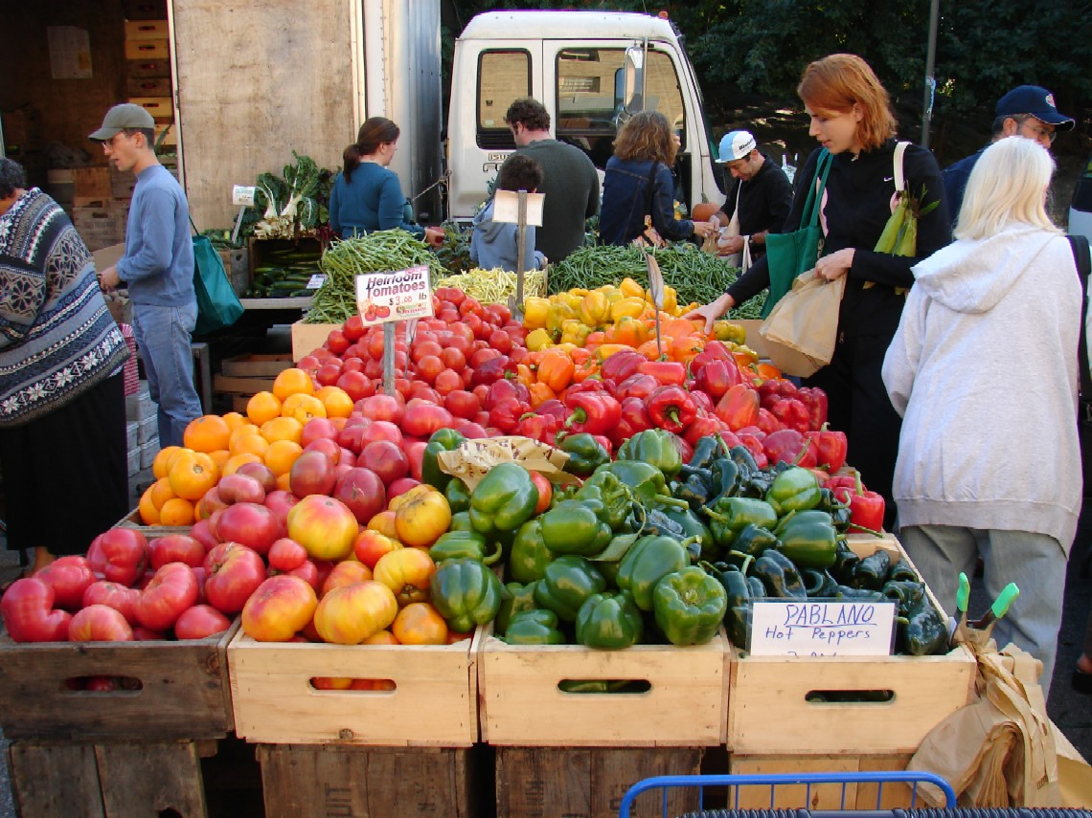

The Store
Flux Architecture

Slide 21
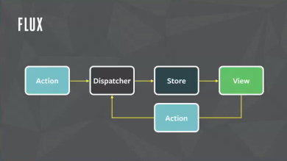
Flux
Flux is an application architecture that Facebook uses for building client-side web applications

Slide 22
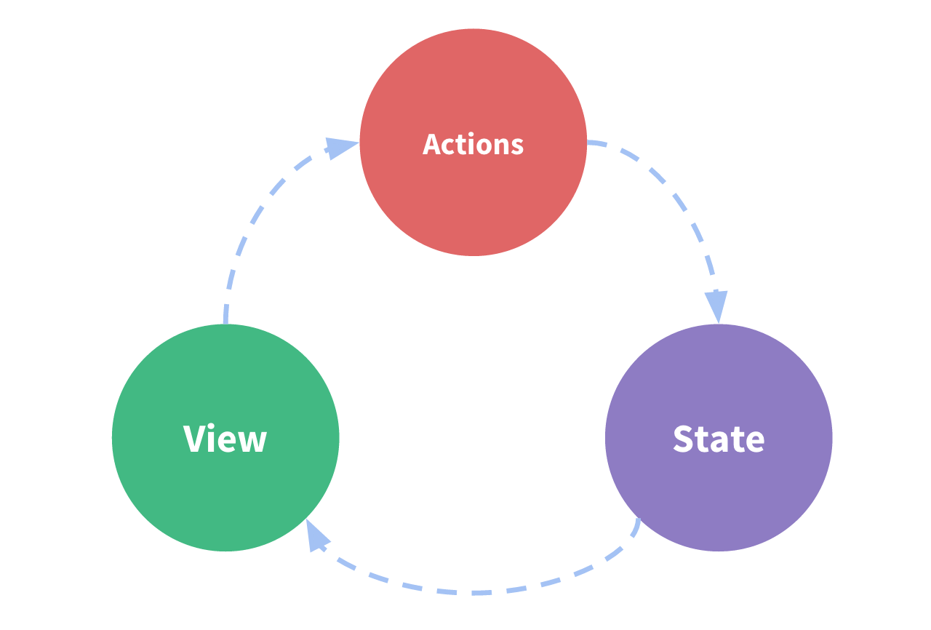
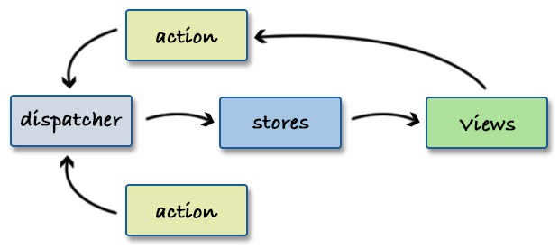

Slide 23
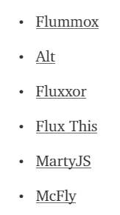
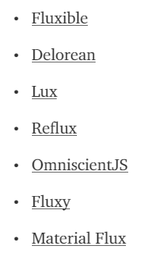
Flux Implementations

Slide 24




MobX

Slide 25
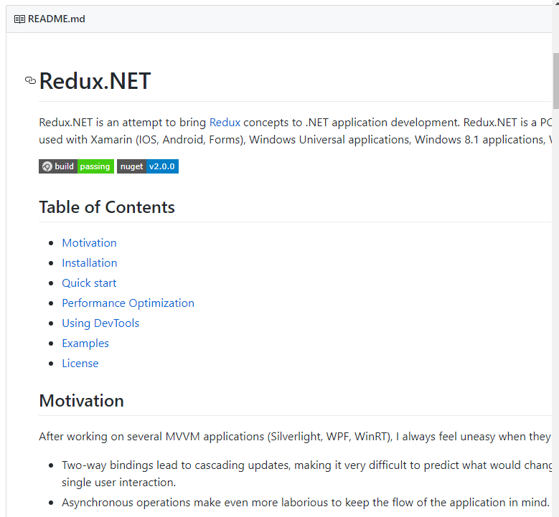

Slide 26
Interacting with the Store
Setters – “change” the state
Getters – fetch or connect to properties of the state

Slide 27
Interacting with the Store
Setters – “change” the state
Getters – fetch or connect to properties of the state
Subscribe – get notifications of changes

Slide 28
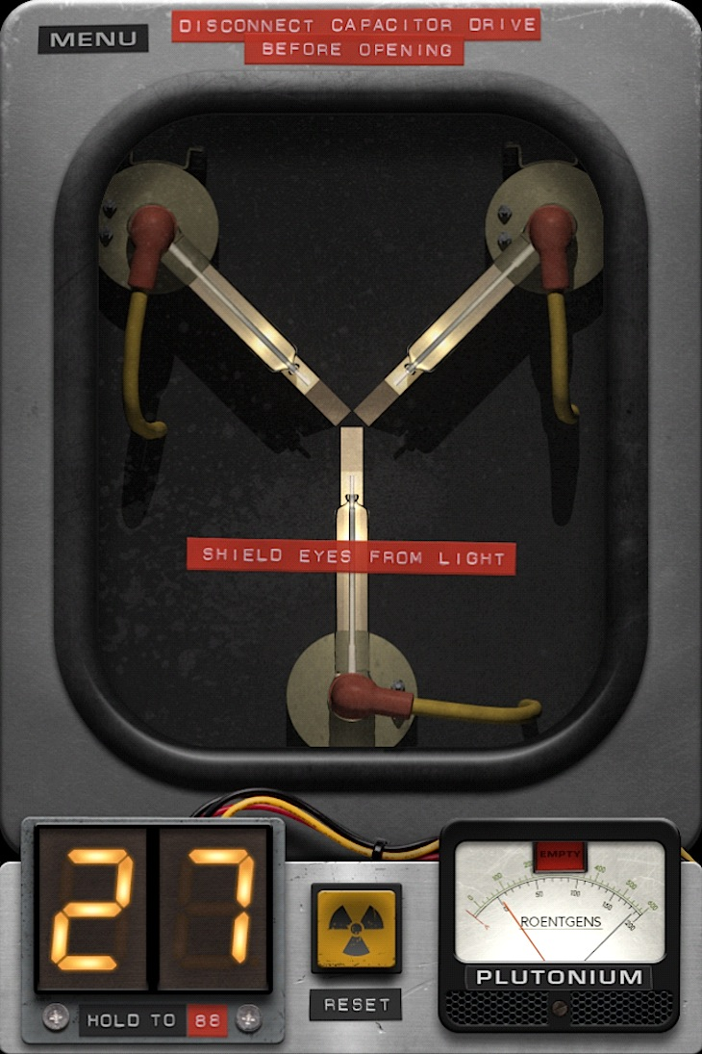
Demo
Basic usage
Interacting with plain JS
Vue tools
store.subscribe((mutation, state) => { console.log(mutation.type) console.log(mutation.payload)
})

Slide 29

Why do we need the Flux Architecture?

Slide 30
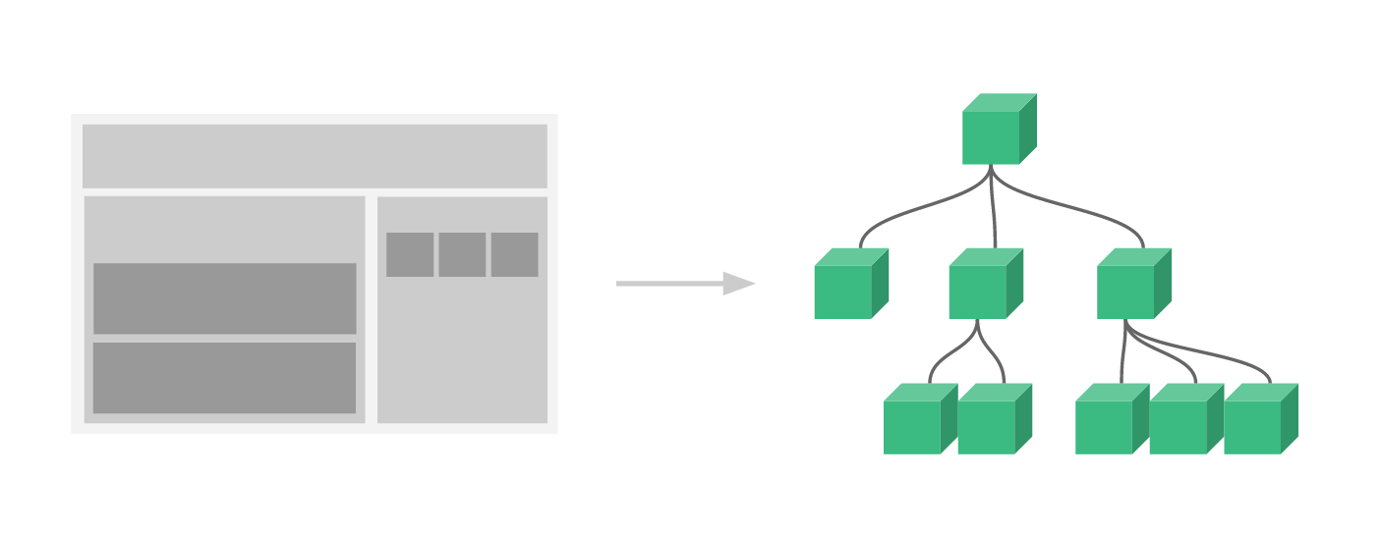

Slide 34
Store

Slide 35
Store

Slide 36
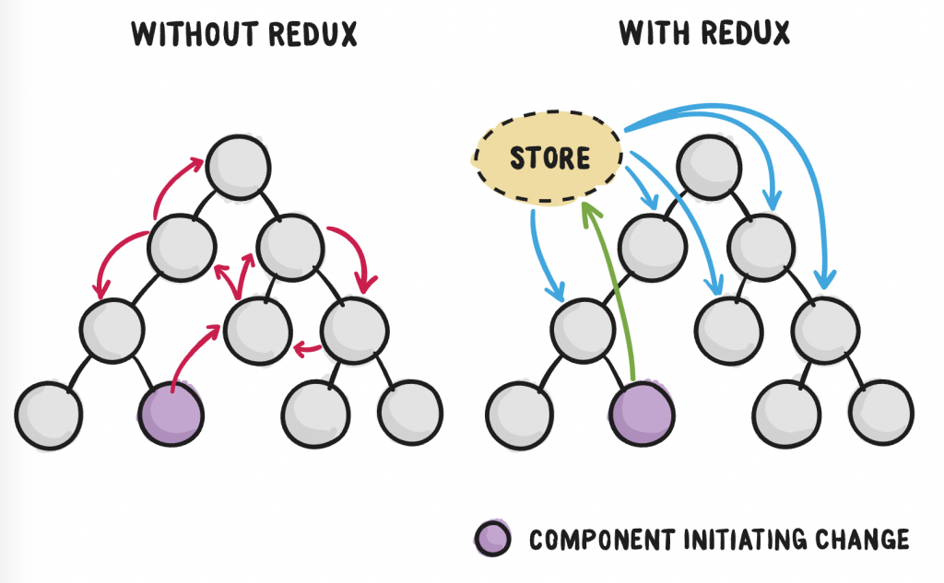

Slide 37
Store

Slide 38
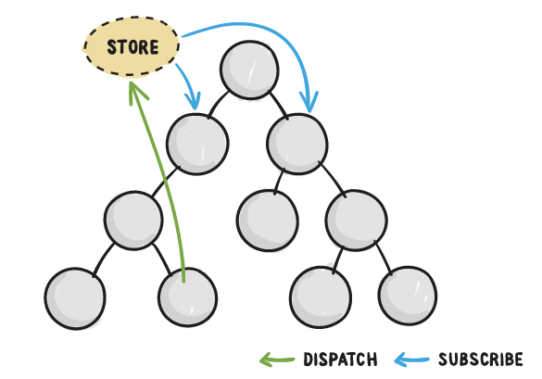

Slide 39
Demo 1

Slide 40
Demo 1
Show todos in action
Show exporting the store

Slide 41
Initial State
Add Todo
Add Todo
Toggle Done
Todos
Todos
Todos
Todos
Desc: Get Milk
Done: false
Desc: Get Milk
Done: false
Desc: Get Milk
Done: false
Desc: Swim
Done: false
Desc: Swim
Done: true

Slide 42
Initial State
Add Todo
Add Todo
Toggle Done
Todos
Todos
Todos
Todos
Desc: Get Milk
Done: false
Desc: Get Milk
Done: false
Desc: Get Milk
Done: false
Desc: Swim
Done: false
Desc: Swim
Done: true

Slide 43
Initial State
Add Todo
Add Todo
Toggle Done
Todos
Todos
Todos
Todos
Desc: Get Milk
Done: false
Desc: Get Milk
Done: false
Desc: Get Milk
Done: false
Desc: Swim
Done: false
Desc: Swim
Done: true

Slide 44
Initial State
Add Todo
Add Todo
Toggle Done
Todos
Todos
Todos
Todos
Desc: Get Milk
Done: false
Desc: Get Milk
Done: false
Desc: Get Milk
Done: false
Desc: Swim
Done: false
Desc: Swim
Done: true

Slide 45
Demo
Vue tools
time travel

Slide 46
Initial State
Add Todo
Add Todo
Toggle Done
Todos
Todos
Todos
Todos
Desc: Get Milk
Done: false
Desc: Get Milk
Done: false
Desc: Get Milk
Done: false
Desc: Swim
Done: false
Desc: Swim
Done: true

Slide 47
Initial State
Add Todo
Add Todo
Toggle Done
Todos
Todos
Todos
Todos
Desc: Get Milk
Done: false
Desc: Get Milk
Done: false
Desc: Get Milk
Done: false
Desc: Swim
Done: false
Desc: Swim
Done: true

Slide 48
Demo 2

Slide 49
Demo 2
Show Vue devtools

Slide 50
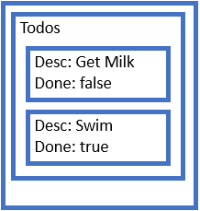
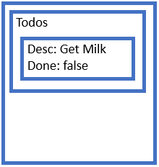
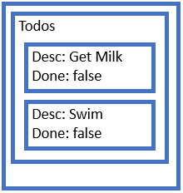
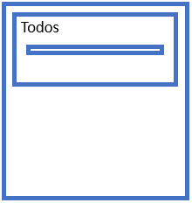
Past
addTodo(state, todo) {
state.past.push(_.cloneDeep(state.present));
state.present.todos.push(todo);
state.future = [];
}
undo(state) {
const previous = state.past.pop();
state.future.push(state.present);
state.present = previous;
}
redo(state) {
const next = state.future.pop();
state.past.push(state.present);
state.present = next;
}
Present
Future

Slide 51
Past
addTodo(state, todo) {
state.past.push(_.cloneDeep(state.present));
state.present.todos.push(todo);
state.future = [];
}
undo(state) {
const previous = state.past.pop();
state.future.push(state.present);
state.present = previous;
}
redo(state) {
const next = state.future.pop();
state.past.push(state.present);
state.present = next;
}
Present
Future

Slide 52
Past
addTodo(state, todo) {
state.past.push(_.cloneDeep(state.present));
state.present.todos.push(todo);
state.future = [];
}
undo(state) {
const previous = state.past.pop();
state.future.push(state.present);
state.present = previous;
}
redo(state) {
const next = state.future.pop();
state.past.push(state.present);
state.present = next;
}
Present
Future

Slide 53
Past
State 0
Present
State 1
Future
State 3
State 2

Slide 54
Past
Present
State 0
Future

Slide 55
Past
State 0
Present
State 1
Future

Slide 56
Past
State 0
State 1
Present
State 2
Future

Slide 57
Past
State 0
State 1
State 2
Present
State 3
Future

Slide 58
Past
State 0
State 1
Present
State 2
Future
State 3

Slide 59
Past
State 0
Present
State 1
Future
State 3
State 2

Slide 60
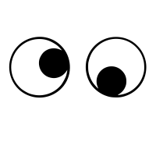

Slide 61
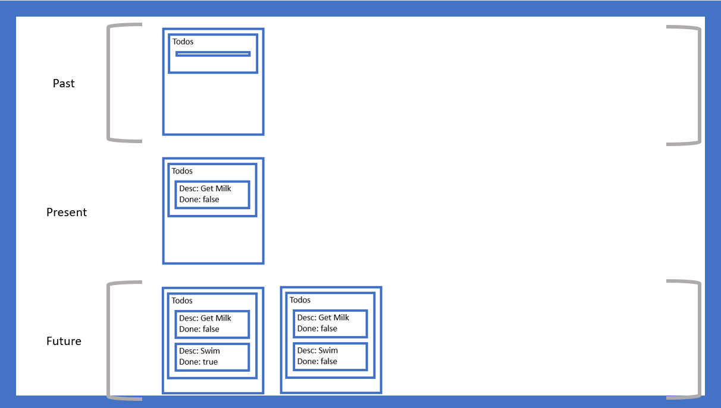
Demo
Vue tools
Import
Undo, Redo

Slide 62
State 3
State 2
State 1
Past
Present
State 0
Future

Slide 63
Demo 3

Slide 64
Demo 3
Show undo, redo
Show exporting, importing

Slide 65

To-do…
Is there value in this?
Generalise the approach?
Make the approach more specific?
Figure out how to get customers to share the state?
The devil is in the details

Slide 66
Thanks

