Slide 1
Decisions and Dreams
PS: GraphQL

Slide 2
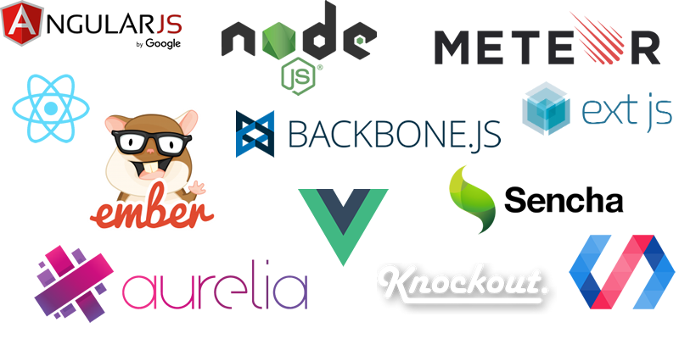

Slide 3




Slide 4

Difficult to integrate into existing sites
A simpler React

Slide 5
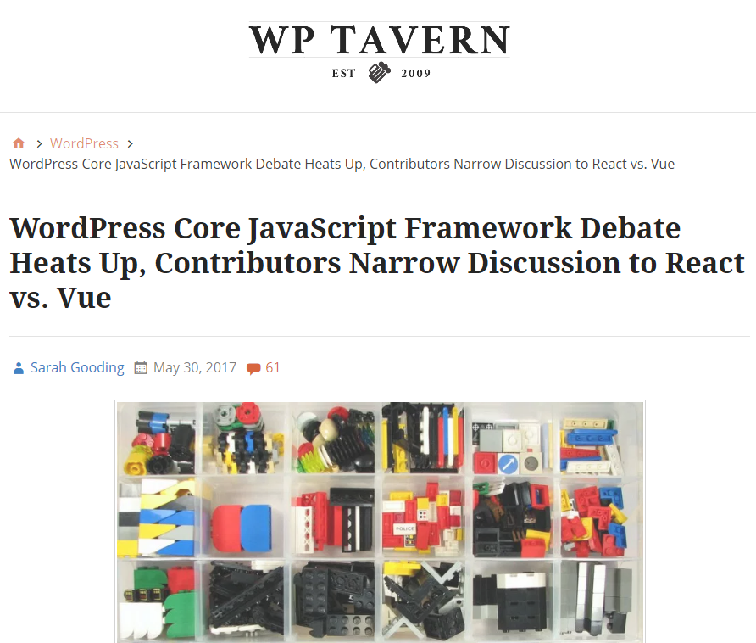
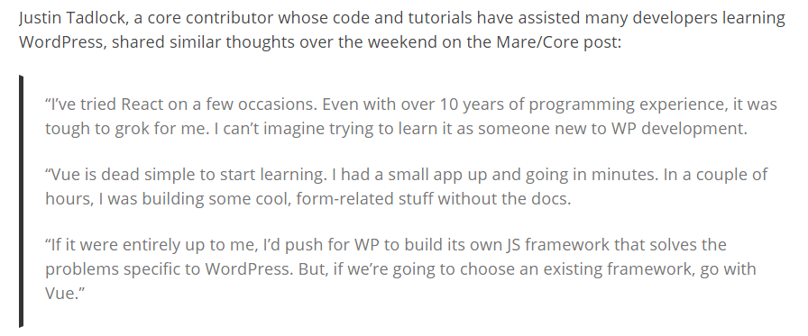

Slide 6

Pros
Cons
Modular
Easy to integrate with existing sites
Officially supported tools
Vue Router
Vuex (state management)
Vue CLI
Webpack config
Hot reload, etc
Test Automation
Mocha
Nightwatch
Excellent Documentation
Easy to learn
Smaller and faster than React
At the moment
Newer than React, still gaining mainstream adoption
3rd party tools are still catching up
Community is smaller than Reacts

Slide 7

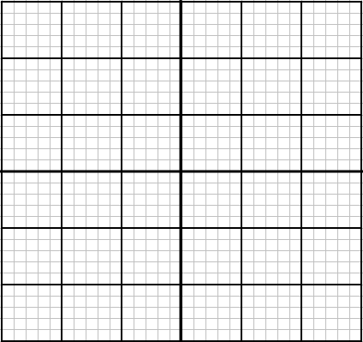

Many
Number of developers interested in the technology
Recruitment
Few
Many
Number of employers using the technology

Slide 8
Many
Number of developers interested in the technology
Recruitment
Few
Many
Number of employers using the technology

Slide 9
Many
Number of developers interested in the technology
Recruitment
Few
Many
Number of employers using the technology

Slide 10
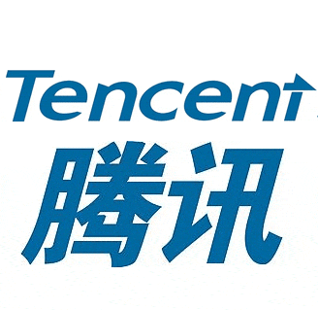



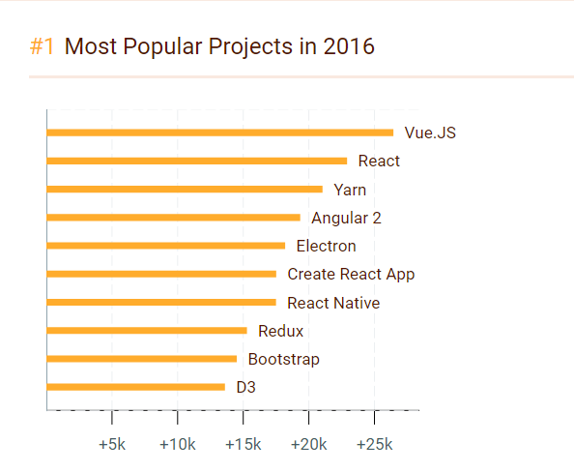




JS Frameworks

Slide 12
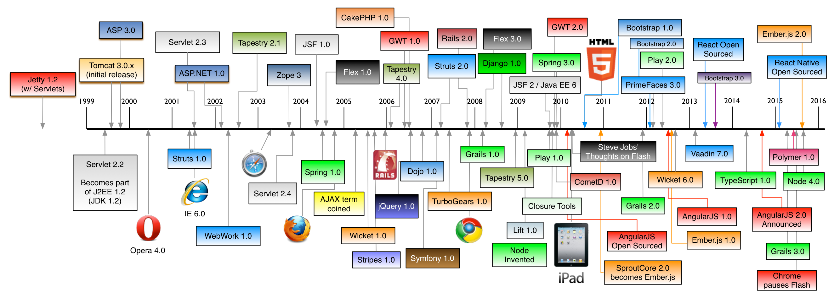

Slide 13
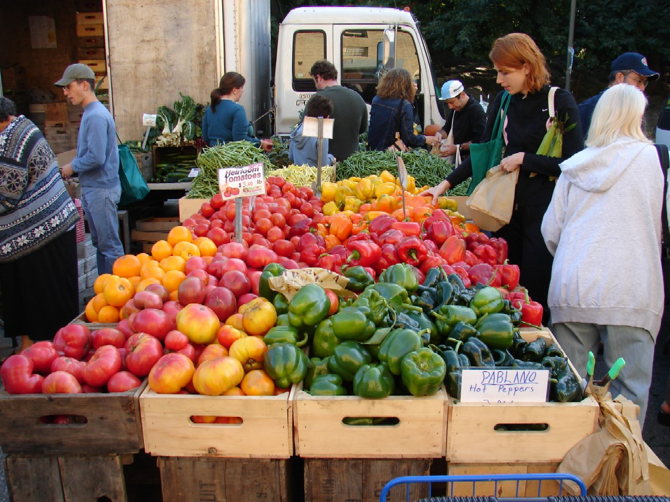

The Store
Flux Architecture

Slide 14
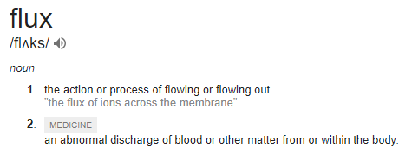
Flux
Flux is an application architecture that Facebook uses for building client-side web applications

Slide 15
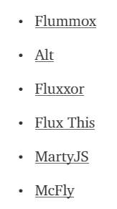
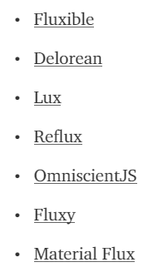
Flux Implementations

Slide 16




MobX

Slide 17
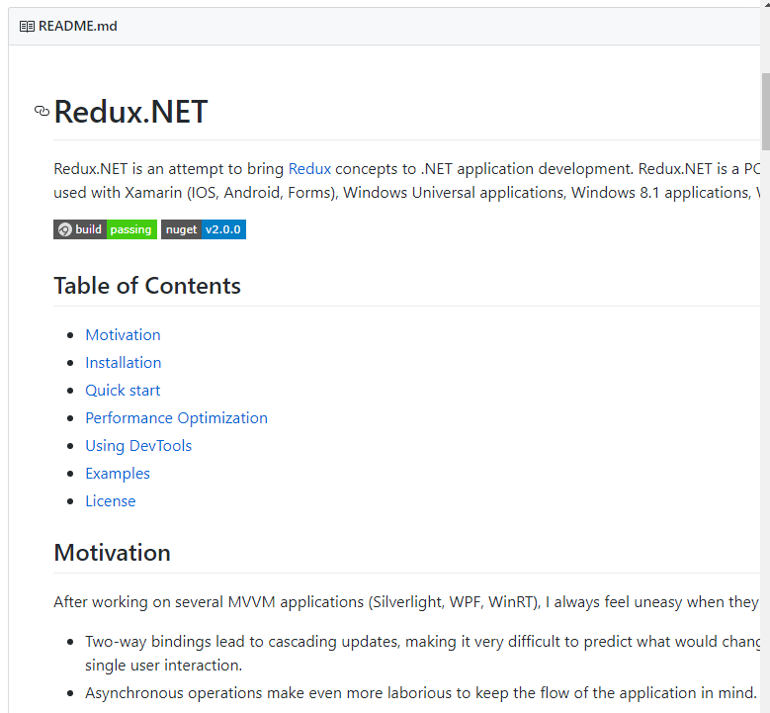

Slide 18
Interacting with the Store
Setters – “change” the state
Getters – fetch or connect to properties of the state

Slide 19
Interacting with the Store
Setters – “change” the state
Getters – fetch or connect to properties of the state
Subscribe – get notifications of changes

Slide 20

Demo
Basic usage
Subscribing
Vue tools
store.subscribe((mutation, state) => { console.log(mutation.type) console.log(mutation.payload)
})

Slide 21

Why do we need Flux?

Slide 22
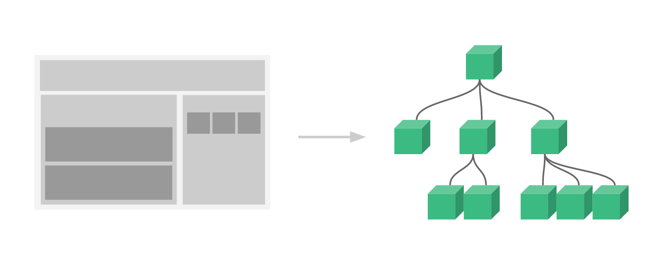

Slide 26
Store

Slide 27
Store

Slide 28
Store

Slide 29
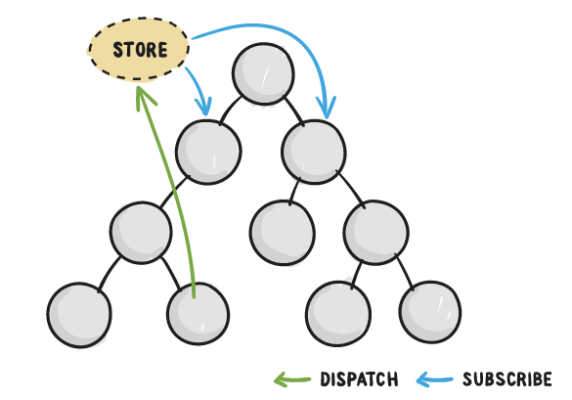

Slide 30
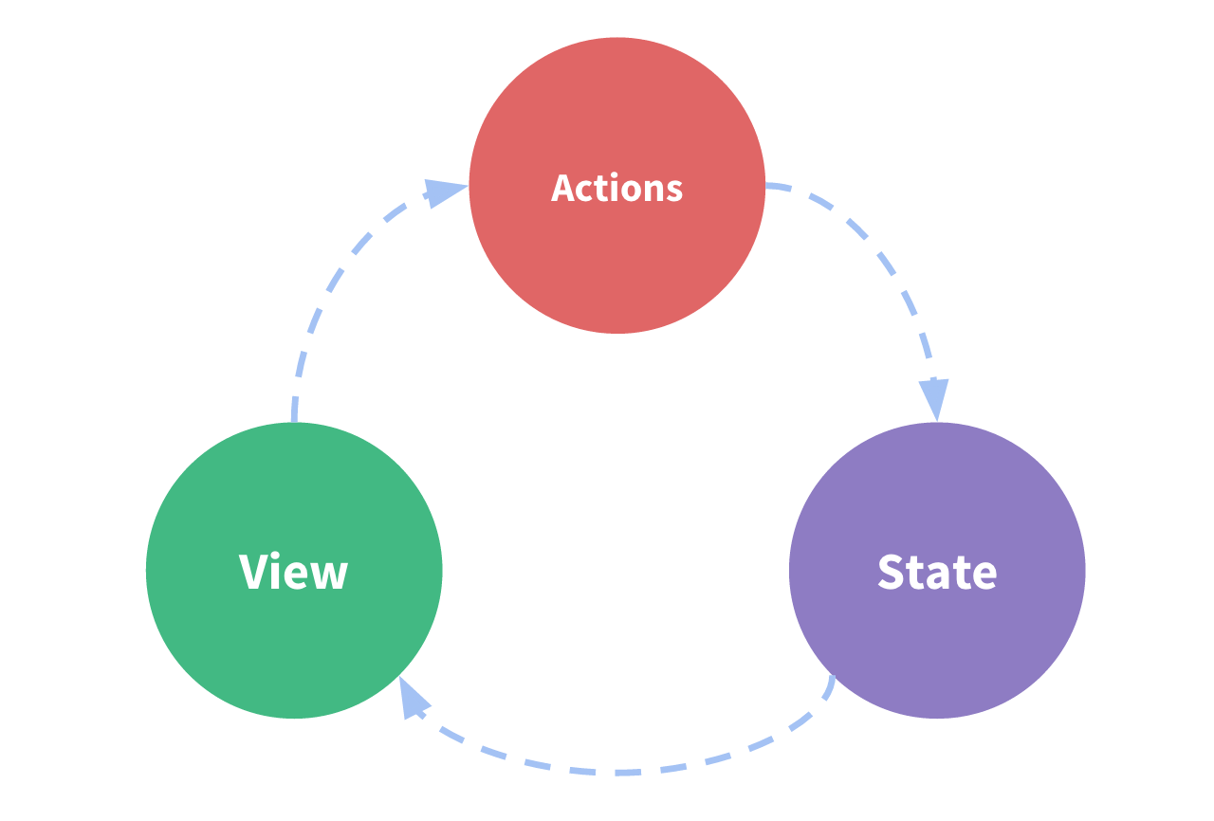
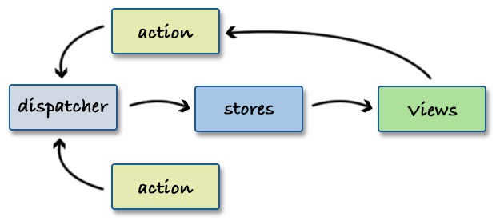

Slide 31
Demo 1

Slide 32
Demo 1
Show todos in action
Show exporting the store

Slide 33
Initial State
Add Todo
Add Todo
Toggle Done
Todos
Todos
Todos
Todos
Desc: Get Milk
Done: false
Desc: Get Milk
Done: false
Desc: Get Milk
Done: false
Desc: Swim
Done: false
Desc: Swim
Done: true

Slide 34
Initial State
Add Todo
Add Todo
Toggle Done
Todos
Todos
Todos
Todos
Desc: Get Milk
Done: false
Desc: Get Milk
Done: false
Desc: Get Milk
Done: false
Desc: Swim
Done: false
Desc: Swim
Done: true

Slide 35
Initial State
Add Todo
Add Todo
Toggle Done
Todos
Todos
Todos
Todos
Desc: Get Milk
Done: false
Desc: Get Milk
Done: false
Desc: Get Milk
Done: false
Desc: Swim
Done: false
Desc: Swim
Done: true

Slide 36
Initial State
Add Todo
Add Todo
Toggle Done
Todos
Todos
Todos
Todos
Desc: Get Milk
Done: false
Desc: Get Milk
Done: false
Desc: Get Milk
Done: false
Desc: Swim
Done: false
Desc: Swim
Done: true

Slide 37
Demo
Vue tools
time travel

Slide 38
Initial State
Add Todo
Add Todo
Toggle Done
Todos
Todos
Todos
Todos
Desc: Get Milk
Done: false
Desc: Get Milk
Done: false
Desc: Get Milk
Done: false
Desc: Swim
Done: false
Desc: Swim
Done: true

Slide 39
Initial State
Add Todo
Add Todo
Toggle Done
Todos
Todos
Todos
Todos
Desc: Get Milk
Done: false
Desc: Get Milk
Done: false
Desc: Get Milk
Done: false
Desc: Swim
Done: false
Desc: Swim
Done: true

Slide 40
Demo 2

Slide 41
Demo 2
Show Vue devtools

Slide 42
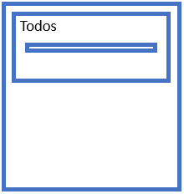
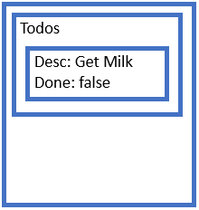
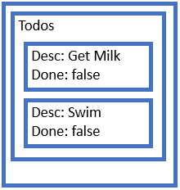
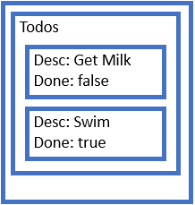
Past
Future

Slide 43
Past
Present
Future

Slide 44
Past
Present
Future

Slide 45
Past
State 0
Present
State 1
Future
State 3
State 2

Slide 46
Past
Present
State 0
Future

Slide 47
Past
State 0
Present
State 1
Future

Slide 48
Past
State 0
State 1
Present
State 2
Future

Slide 49
Past
State 0
State 1
State 2
Present
State 3
Future

Slide 50
Past
State 0
State 1
Present
State 2
Future
State 3

Slide 51
Past
State 0
Present
State 1
Future
State 3
State 2

Slide 52


Slide 53
Demo
Vue tools
Import
Undo, Redo

Slide 54
State 3
State 2
State 1
Past
Present
State 0
Future

Slide 55
Demo 3

Slide 56
Demo 3
Show undo, redo
Show exporting, importing

Slide 57

To-do…
Is there value in this?
Generalise the approach?
Make the approach more specific?
Figure out how to get customers to share the state?
The devil is in the details

Slide 58
Thanks

