Slide 1
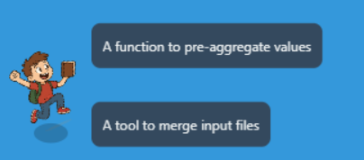
Flappy MMD Game
An interactive way to study Mining Massive Data

Slide 2
Game Inspiration
- Inspired by the classic Flappy Bird game
- Based on MMD lectures by Assoz. Prof. Dr.techn. Sebastian Tschiatschek
- Created as a learning tool and a fun seminar project

Slide 3
Game Purpose
To make learning the Mining Massive Data (MMD) lecture material more engaging.
Includes two levels based on the first two lectures.

Slide 4
Gameplay
- Control a floating student with mouse clicks
- Answer MCQs by flying into answer options
- Avoid hitting the ground
- Skipping reduces XP
- Speed modes: 🐢 Slow, 🚲 Moderate, ⚡ God Mode
- Game can be paused

Slide 5
Scoring
- Score = Questions answered
- XP = Score × 10 − Skipped × 15
- Highest XP is saved and displayed

Slide 6
Character Design
- Character generated using AI tools
- Sound effects from open-source repositories

Slide 7
Why It’s a Serious Game
- Promotes active recall through MCQs
- Enhances memory via interaction and repetition
- Makes learning more enjoyable and less stressful
- Encourages consistent engagement with lecture material

Slide 8
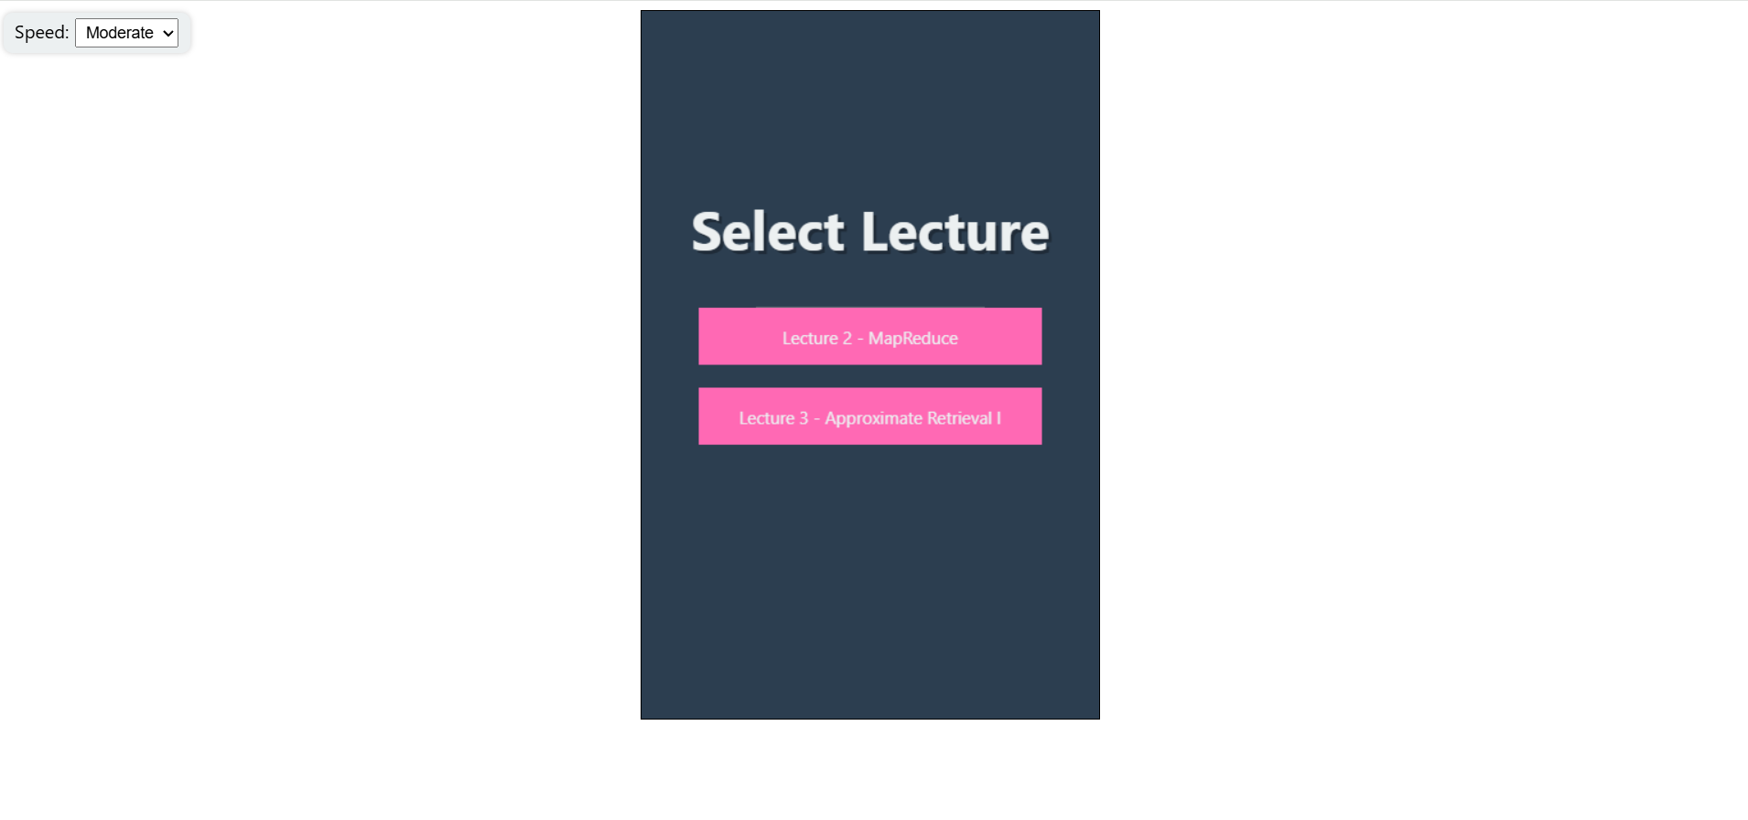

Slide 9
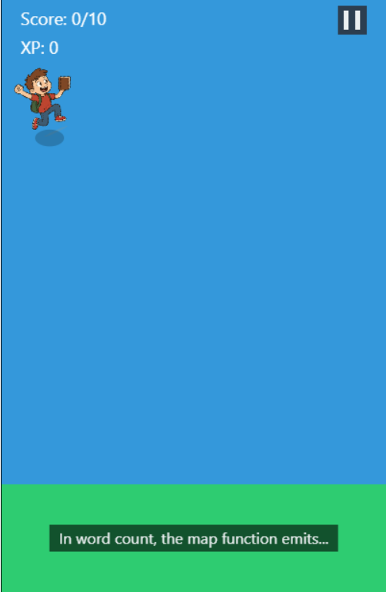

Slide 10
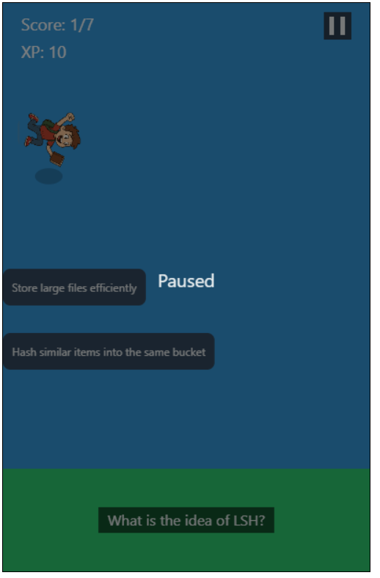

Slide 11
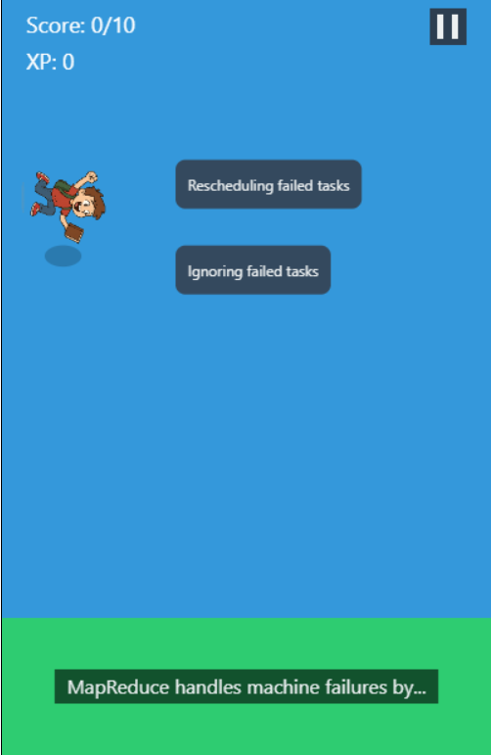

Slide 12
