Slide 1
Corona Detection using deep learning
InfoWeb
Major Project 7th Semester
Abhishek Das
Ashirbad Dipak Das
Anishka Shukla
Megha Kumari
Under Guidance of Prof. N Biraja Isaac

Slide 2
 | CONTENTS
1 | Introduction
2 | Literature Survey
3 | Flowchart
4 | Critical Analysis
5 | Data Sets
6 | References

Slide 3
Introduction:
World has seen 165.9 Million cases of coronavirus till now with 26.02 Million cases alone in India with total of 3.4 million deaths so far. This is biggest modern era pandemic so far and has affected entire world in every possible way.
Detection and testing take a lot of man power and time, which often leads to more community spreading. So there is an urgent need for a quick an efficient way to detect and link possible side effects of the illness.
Using our knowledge of Deep Learning, neural networks, and Data Science we can analyse the data collected from various sources and provide an efficient and accurate method of COVID-19 analysis using X-Rays.

Slide 4
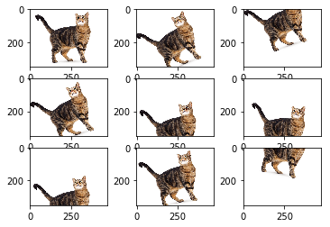
Methodology
Image Augmentation: Deep networks need large amount of training data to achieve good performance. To build a powerful image classifier using very little training data, image augmentation is usually required to boost the performance of deep networks. Image augmentation artificially creates training images through different ways of processing or combination of multiple processing, such as random rotation, shifts, shear and flips, etc.

Slide 5
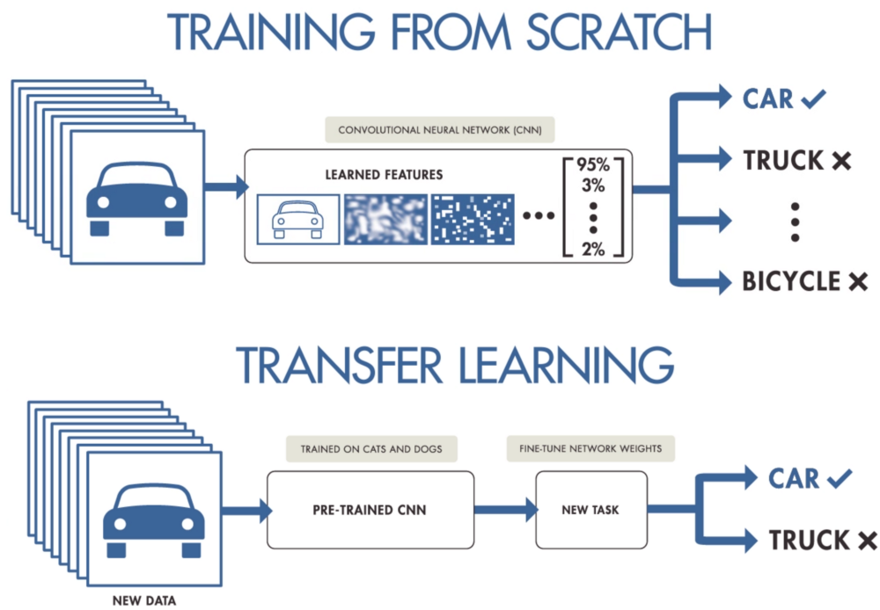
Methodology
Transfer Learning: Transfer learning is a method where we will use a model that has been trained on large scale data for our problem. Therefore, we only train them by fine-tuning the model. The benefit that we will get is the model will train in a short time.

Slide 6
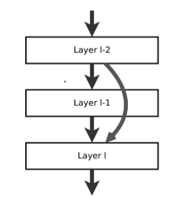
Methodology
RESNET50: ResNet-50 is a pre-trained Deep Learning model for image classification of the Convolutional Neural Network(CNN, or ConvNet), which is a class of deep neural networks, most commonly applied to analysing visual imagery. ResNet-50 is 50 layers deep and is trained on a million images of 1000 categories from the ImageNet database. Furthermore the model has over 23 million trainable parameters, which indicates a deep architecture that makes it better for image recognition.

Slide 7
Methodology Steps:
Our project will be to take images of X-Rays of lungs of people having and not having coronavirus.
Image augmentation will be applied before training to increase dataset size and add biasness to dataset.
Once we get all images we will use ResNet-50 deep learning methods any apply method of transfer learning to get a model which will predict on seeing a new image if person is having virus or not.
Accuracy of model will surely depend on size of image dataset and its quality and models used so we will try to apply different models on same dataset and compare results also.
After that we will take model weights and json file and use it to deploy the model as a webapp using flask for backend server and html, css, javascript to make frontend.

Slide 8
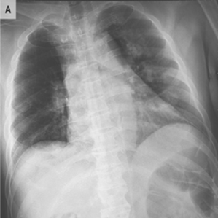
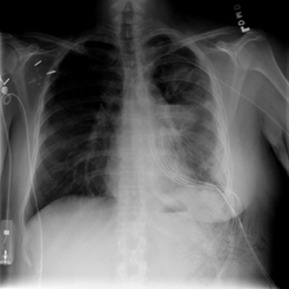
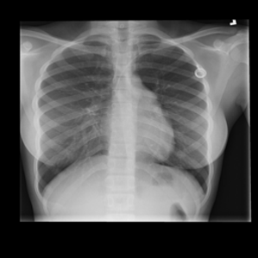
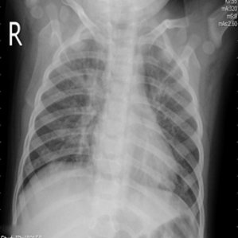
Our Dataset :
Our dataset has 21183 images.
COVID – 3616 images
Viral but not COVID – 6012 images
Normal -10192 images
Pneumonia (not COVID)
– 1345 images

Slide 9
Tools/Packages to be used :
Python – As Language to perform all tasks
TensorFlow/Keras – As deep learning framework to create dl models
Pandas – To analyze datsets in form of DataFrame
Numpy – To perform mathematical operations on data
OpenCV – To process images
MatPlotLib – For visualization
SkLearn – For using Ml models
Flask – To create Backend server for our WebApp
Html, CSS - To create frontend on WebApp
Google Collab – Platform to train models

Slide 10
THANK YOU

