Slide 1
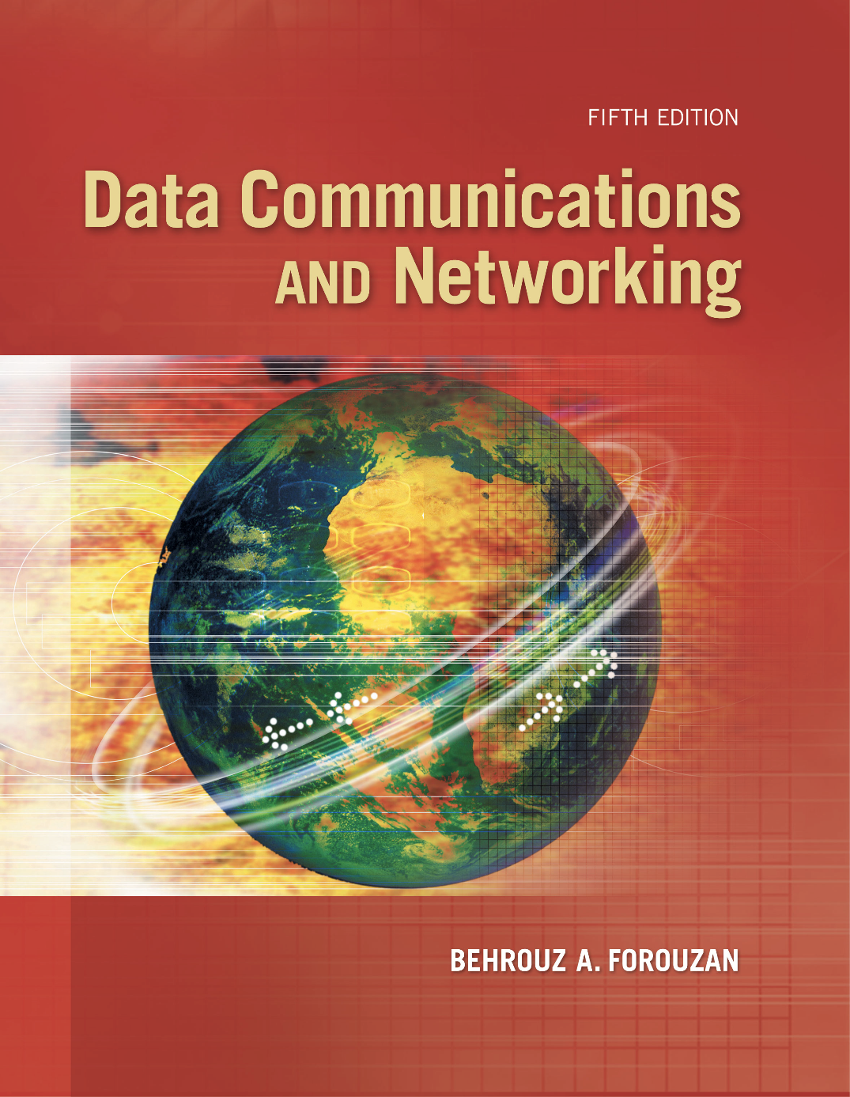
Chapter 5
Analog
Transmission
Copyright © The McGraw-Hill Companies, Inc. Permission required for reproduction or display.
Notes:
‹#›

Slide 2
Chapter 5: Outline
5.1 DIGITAL-TO-ANALOG CONVERSION
5.2 ANALOG-TO-ANALOG CONVERSION
Notes:
5.#

Slide 3
5-1 DIGITAL-TO-ANALOG CONVERSION
Digital-to-analog conversion is the process of changing one of the characteristics of an analog signal based on the information in digital data. Figure 5.1 shows the relationship between the digital information, the digital-to-analog modulating process, and the resultant analog signal.
5.‹#›
Notes:
5.#

Slide 4
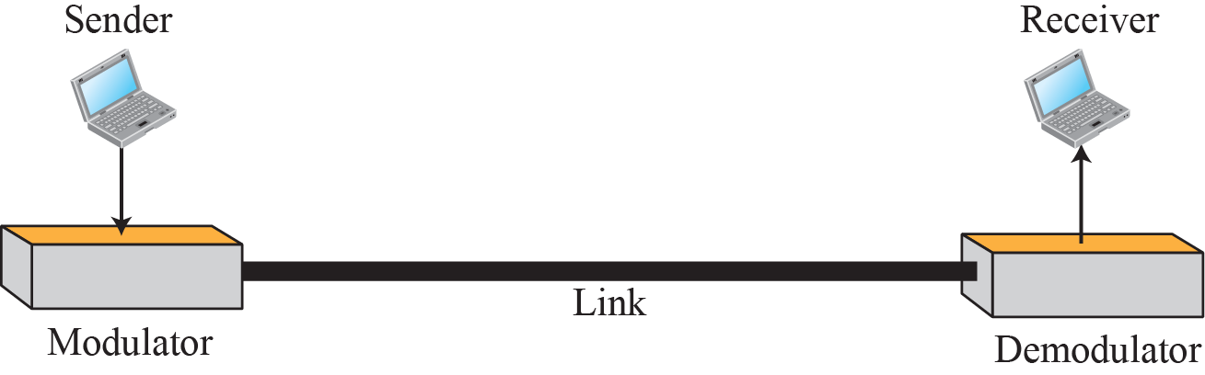
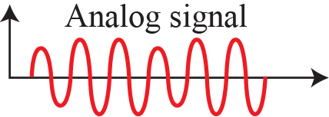
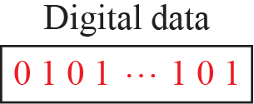
Figure 5.1: Digital-to-analog conversion
5.‹#›
Notes:
5.#

Slide 5
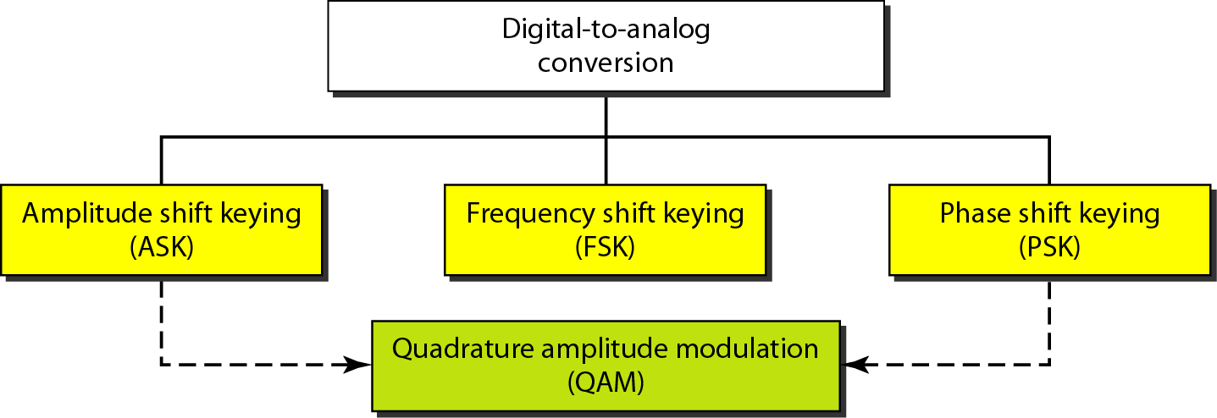
Figure 5.2: Types of digital to analog conversion
5.‹#›
Notes:
5.#

Slide 6
5.5.1 Aspects of Conversion
Before we discuss specific methods of digital-to-analog modulation, two basic issues must be reviewed: bit and baud rates and the carrier signal.
5.‹#›
Notes:
5.#

Slide 7
Example 5.1
An analog signal carries 4 bits per signal element. If 1000 signal elements are sent per second, find the bit rate.
Solution
In this case, r = 4, S = 1000, and N is unknown. We can find the value of N from
5.‹#›
Notes:
‹#›

Slide 8
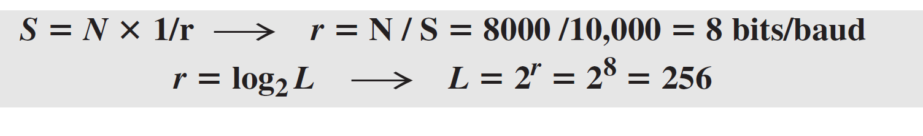
Example 5.2
An analog signal has a bit rate of 8000 bps and a baud rate of 1000 baud. How many data elements are carried by each signal element? How many signal elements do we need?
Solution
In this example, S = 1000, N = 8000, and r and L are unknown. We first find the value of r and then the value of L.
5.‹#›
Notes:
‹#›

Slide 9
5.5.2 Amplitude Shift Keying
In amplitude shift keying, the amplitude of the carrier signal is varied to create signal elements. Both frequency and phase remain constant while the amplitude changes.
5.‹#›
Notes:
5.#

Slide 10
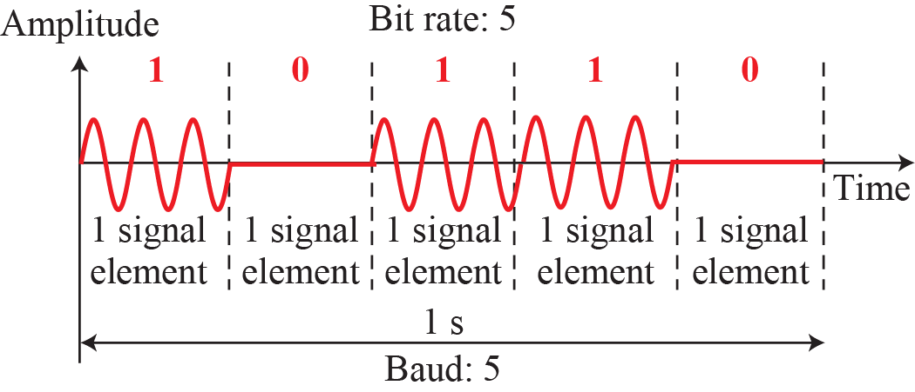
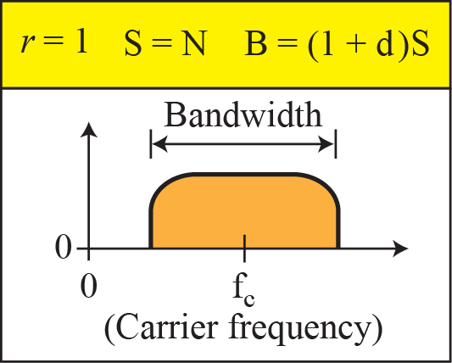
Figure 5.3: Binary amplitude shift keying
5.‹#›
Notes:
5.#

Slide 11
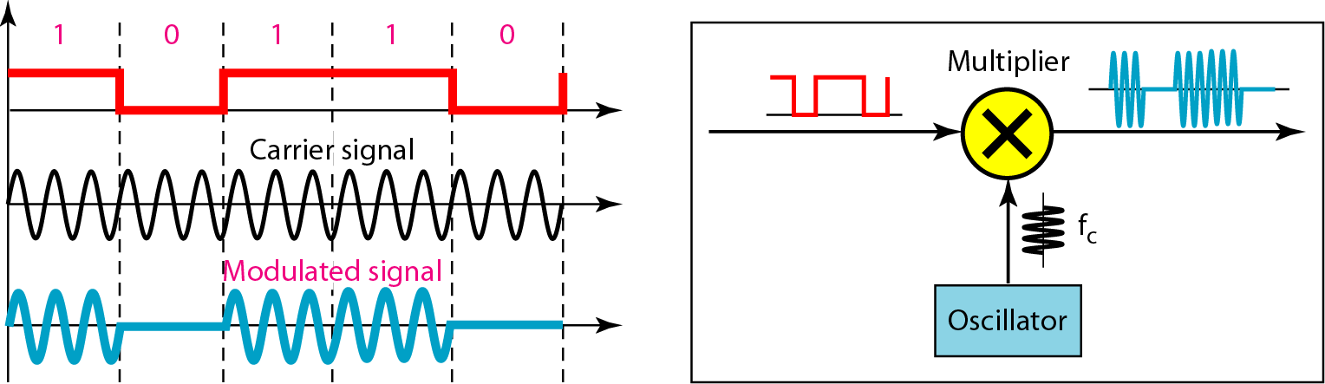
Figure 5.4: Implementation of binary ASK
5.‹#›
Notes:
5.#

Slide 12
Example 5.3
We have an available bandwidth of 100 kHz which spans from 200 to 300 kHz. What are the carrier frequency and the bit rate if we modulated our data by using ASK with d = 1?
Solution
The middle of the bandwidth is located at 250 kHz. This means that our carrier frequency can be at fc = 250 kHz. We can use the formula for bandwidth to find the bit rate (with d = 1 and r = 1).
5.‹#›
Notes:
‹#›

Slide 13
Example 5.4
In data communications, we normally use full-duplex links with communication in both directions. We need to divide the bandwidth into two with two carrier frequencies, as shown in Figure 5.5. The figure shows the positions of two carrier frequencies and the bandwidths. The available bandwidth for each direction is now 50 kHz, which leaves us with a data rate of 25 kbps in each direction.
5.‹#›
Notes:
‹#›

Slide 14
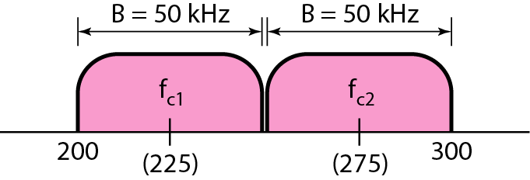
Figure 5.5: Bandwidth of a full-duplex ASK in Example 5.4
5.‹#›
Notes:
5.#

Slide 15
5.5.3 Frequency Shift Keying
In frequency shift keying, the frequency of the carrier signal is varied to represent data. The frequency of the modulated signal is constant for the duration of one signal element, but changes for the next signal element if the data element changes. Both peak amplitude and phase remain constant for all signal elements.
5.‹#›
Notes:
5.#

Slide 16
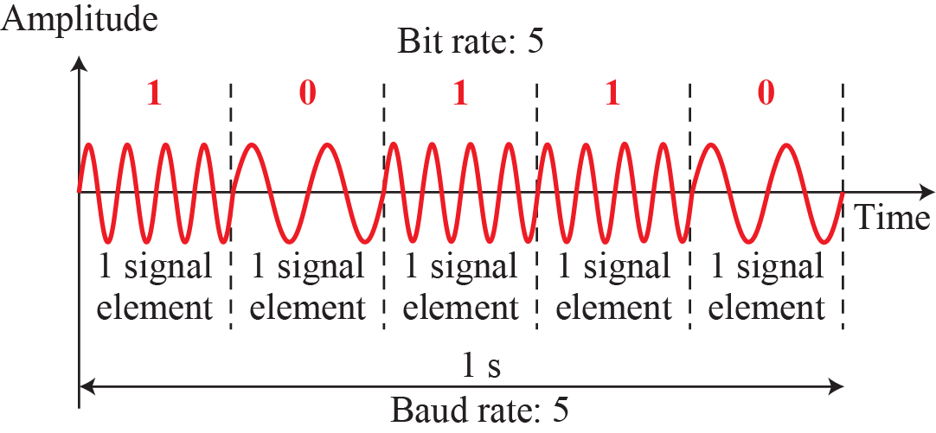
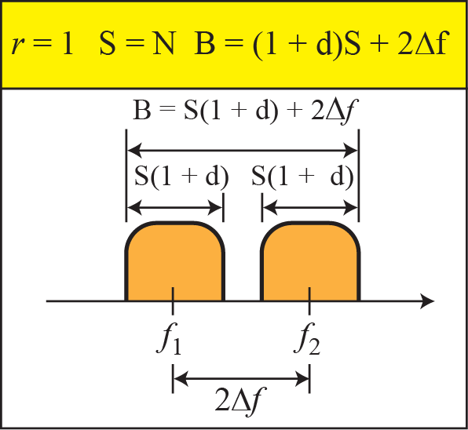
Figure 5.6: Binary frequency shift keying
5.‹#›
Notes:
5.#

Slide 17
Example 5.5
We have an available bandwidth of 100 kHz which spans from 200 to 300 kHz. What should be the carrier frequency and the bit rate if we modulated our data by using FSK with d = 1?
Solution
This problem is similar to Example 5.3, but we are modulating by using FSK. The midpoint of the band is at 250 kHz. We choose 2Δf to be 50 kHz; this means
5.‹#›
Notes:
‹#›

Slide 18
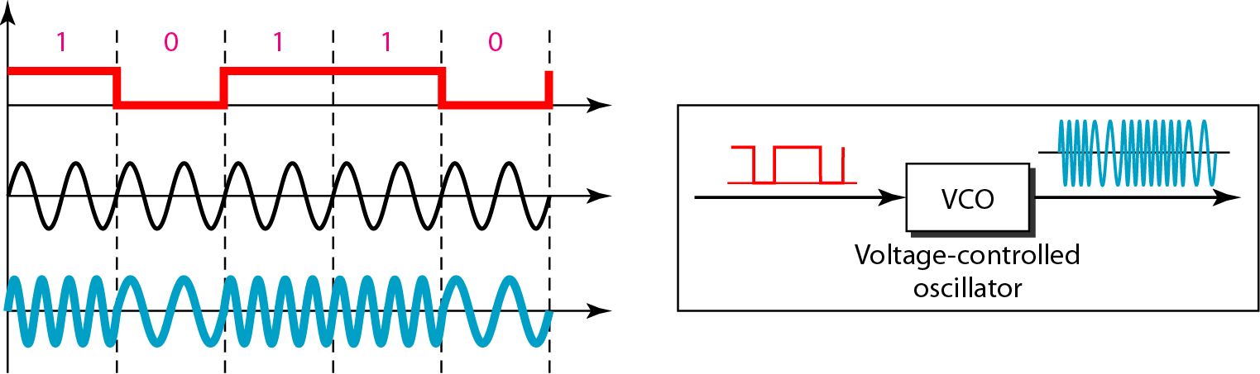
Figure 5.7: Implementation of BFSK
5.‹#›
Notes:
5.#

Slide 19
Example 5.6
We need to send data 3 bits at a time at a bit rate of 3 Mbps. The carrier frequency is 10 MHz. Calculate the number of levels (different frequencies), the baud rate, and the bandwidth.
Solution
We can have L = 2³ = 8. The baud rate is S = 3 MHz/3 = 1 Mbaud. This means that the carrier frequencies must be 1 MHz apart (2Δf = 1 MHz). The bandwidth is B = 8 × 1 = 8 MHz. Figure 5.8 shows the allocation of frequencies and bandwidth.
5.‹#›
Notes:
‹#›

Slide 20
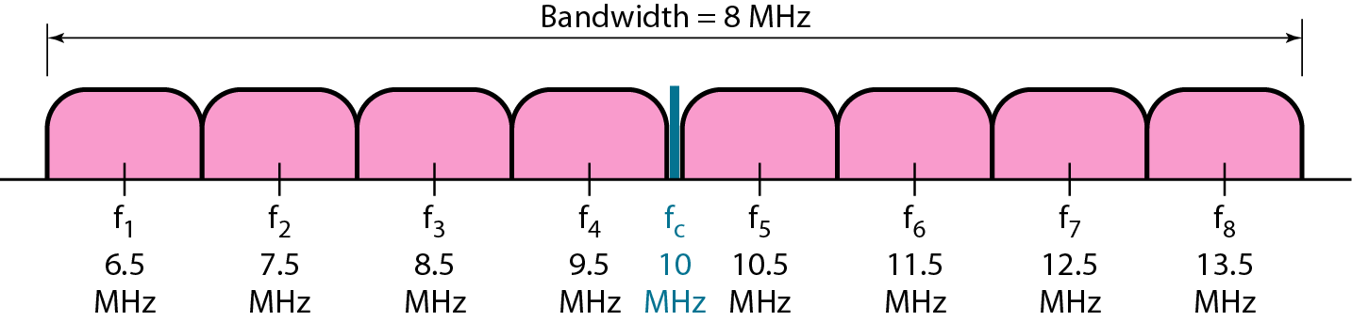
Figure 5.8: Bandwidth of MFSK used in Example 5.6
5.‹#›
Notes:
5.#

Slide 21
5.5.4 Phase Shift Keying
In phase shift keying, the phase of the carrier is varied to represent two or more different signal elements. Both peak amplitude and frequency remain constant as the phase changes. Today, PSK is more common than ASK or FSK. However, we will see shortly that QAM, which combines ASK and PSK, is the dominant method of digital-to-analog modulation.
5.‹#›
Notes:
5.#

Slide 22
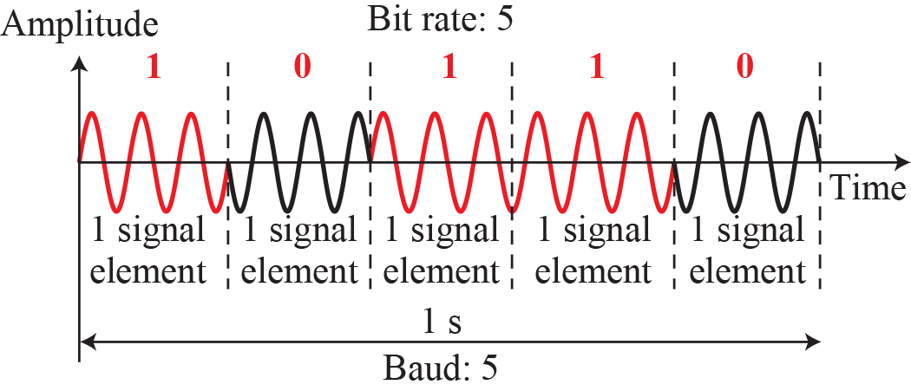
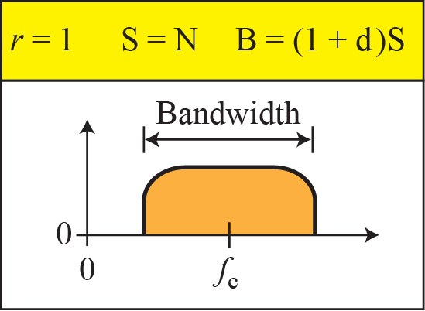
Figure 5.9: Binary phase shift keying
5.‹#›
Notes:
5.#

Slide 23
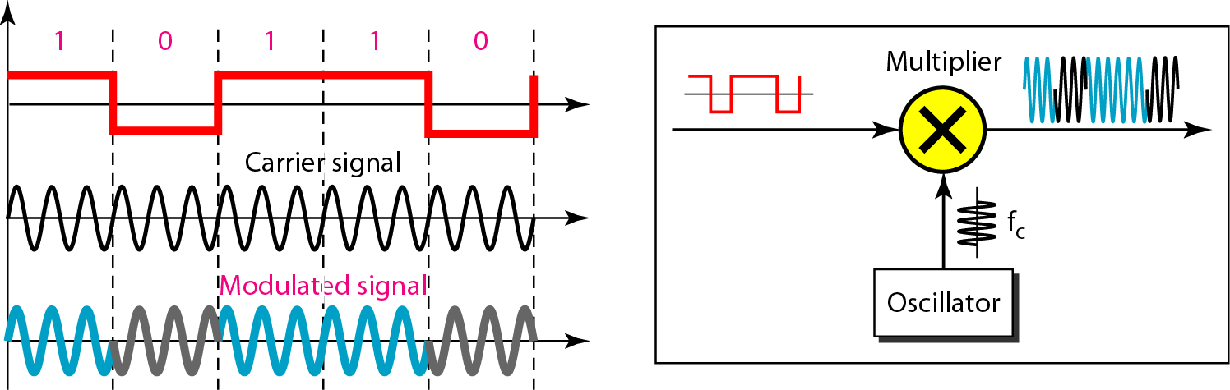
Figure 5.10: Implementation of BPSK
5.‹#›
Notes:
5.#

Slide 24
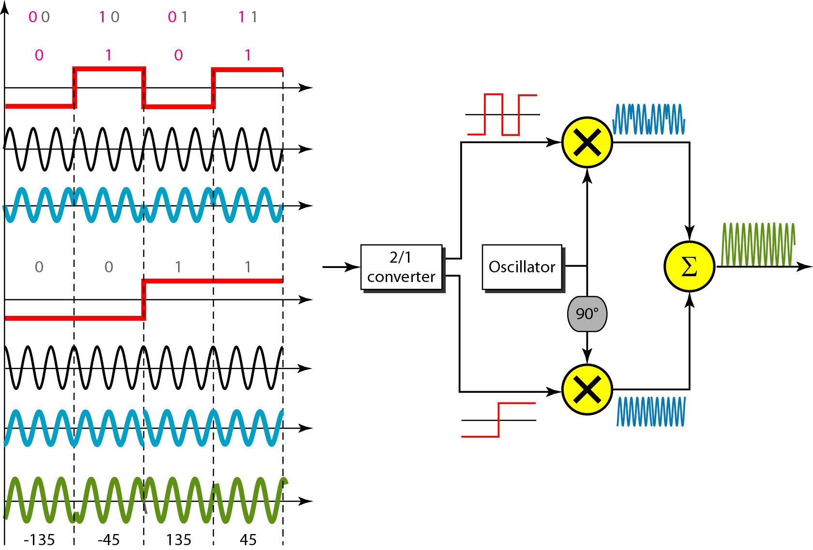
Figure 5.11: QPSK and its implementation
5.‹#›
Notes:
5.#

Slide 25
Example 5.7
Find the bandwidth for a signal transmitting at 12 Mbps for QPSK. The value of d = 0.
Solution
For QPSK, 2 bits are carried by one signal element. This means that r = 2. So the signal rate (baud rate) is S = N × (1/r) = 6 Mbaud. With a value of d = 0, we have B = S = 6 MHz.
5.‹#›
Notes:
‹#›

Slide 26
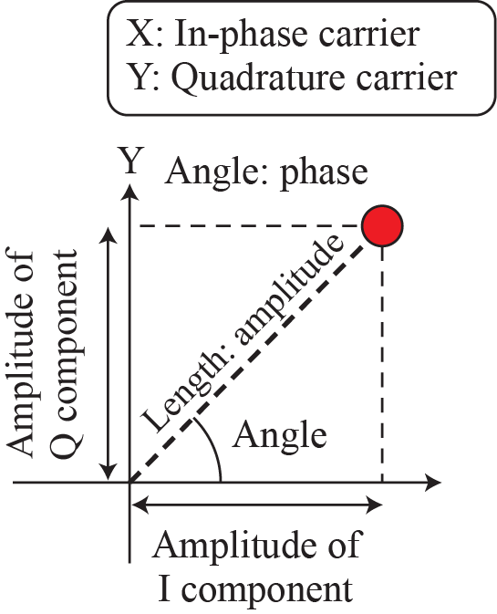
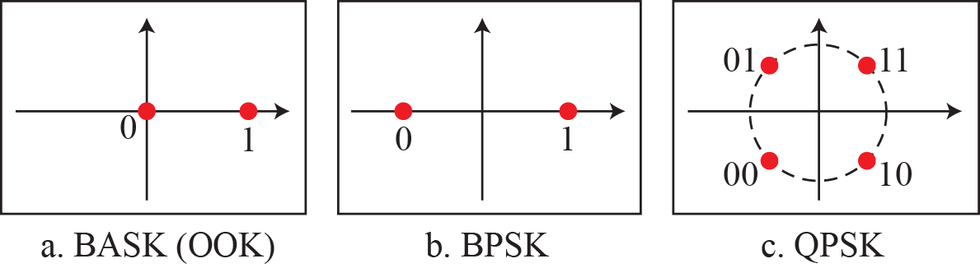
Figure 5.12: Concept of a constellation diagram
5.‹#›
Notes:
5.#

Slide 27
Example 5.8
Show the constellation diagrams for ASK (OOK), BPSK, and QPSK signals.
Solution
Figure 5.13 shows the three constellation diagrams. Let us analyze each case separately:
5.‹#›
Notes:
‹#›

Slide 28
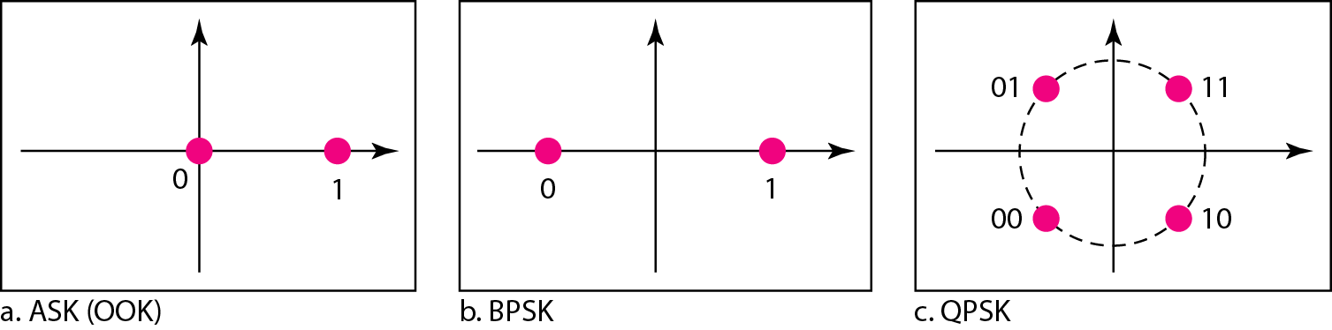
Figure 5.13: Three constellation diagrams
5.‹#›
Notes:
5.#

Slide 29
5.5.5 Quadrature Amplitude Modulation
PSK is limited by the ability of the equipment to distinguish small differences in phase. This factor limits its potential bit rate. So far, we have been altering only one of the three characteristics of a sine wave at a time; but what if we alter two? Why not combine ASK and PSK? The idea of using two carriers, one in-phase and the other quadrature, with different amplitude levels for each carrier is the concept behind quadrature amplitude modulation (QAM).
5.‹#›
Notes:
5.#

Slide 30
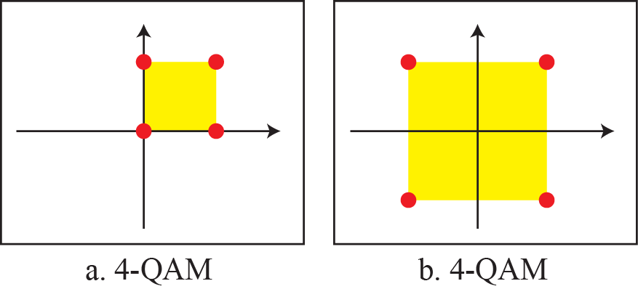
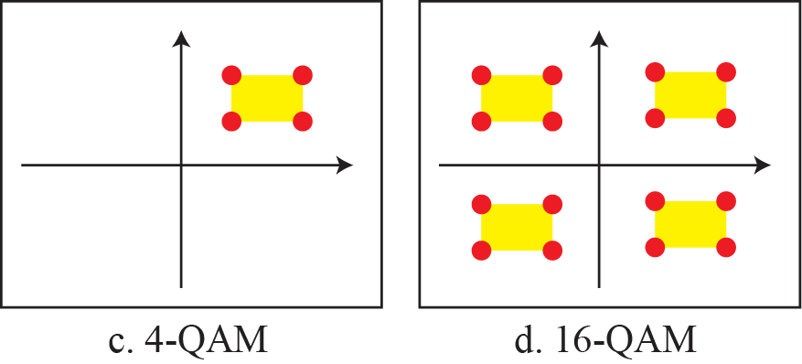
Figure 5.14: Constellation diagrams for some QAMs
5.‹#›
Notes:
5.#

Slide 31
5-2 ANALOG-TO-ANALOG CONVERSION
Analog-to-analog conversion, or analog modulation, is the representation of analog information by an analog signal. One may ask why we need to modulate an analog signal; it is already analog. Modulation is needed if the medium is bandpass in nature or if only a bandpass channel is available to us. Analog-to-analog conversion can be accomplished in three ways: AM FM and PM.
5.‹#›
Notes:
5.#

Slide 32
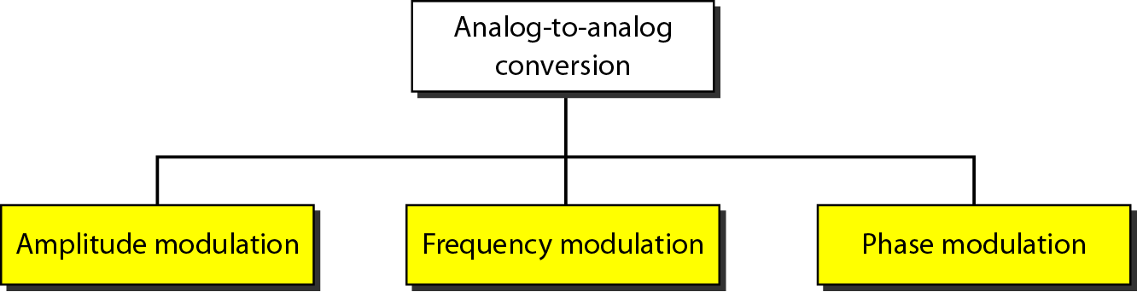
Figure 5.15: Types of analog-to-analog modulation
5.‹#›
Notes:
5.#

Slide 33
5.2.1 Amplitude Modulation (AM)
In AM transmission, the carrier signal is modulated so that its amplitude varies with the changing amplitudes of the modulating signal. The frequency and phase of the carrier remain the same; only the amplitude changes to follow variations in the information. Figure 5.16 shows how this concept works. The modulating signal is the envelope of the carrier. As Figure 5.16 shows, AM is normally implemented by using a simple multiplier because the amplitude of the carrier signal needs to be changed according to the amplitude of the modulating signal.
5.‹#›
Notes:
5.#

Slide 34
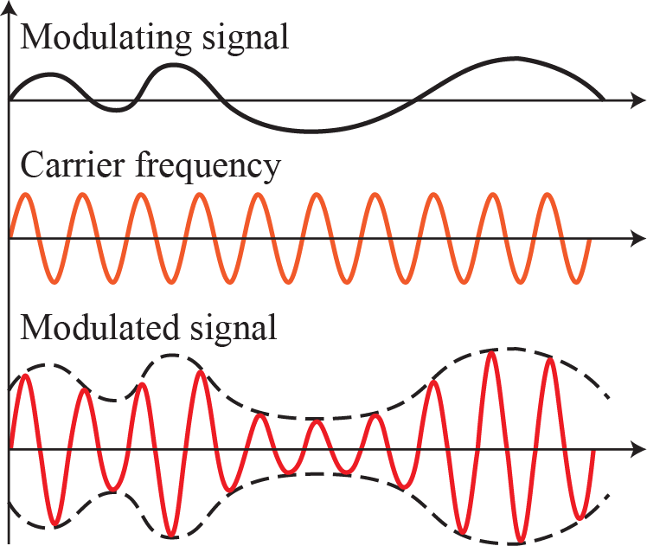
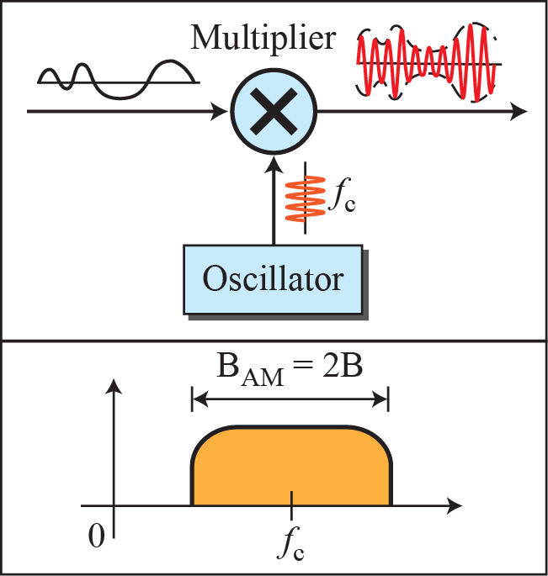
Figure 5.16: Amplitude modulation
5.‹#›
Notes:
5.#

Slide 35
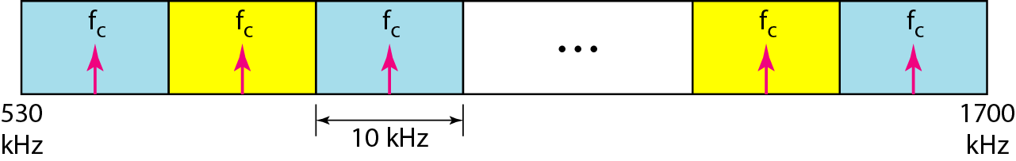
Figure 5.17: AM band allocation
5.‹#›
Notes:
5.#

Slide 36
5.2.2 Frequency Modulation (FM)
In FM transmission, the frequency of the carrier signal is modulated to follow the changing voltage level (amplitude) of the modulating signal. The peak amplitude and phase of the carrier signal remain constant, but as the amplitude of the information signal changes, the frequency of the carrier changes correspondingly. Figure 5.18 shows the relationships of the modulating signal, the carrier signal, and the resultant FM signal.
5.‹#›
Notes:
5.#

Slide 37
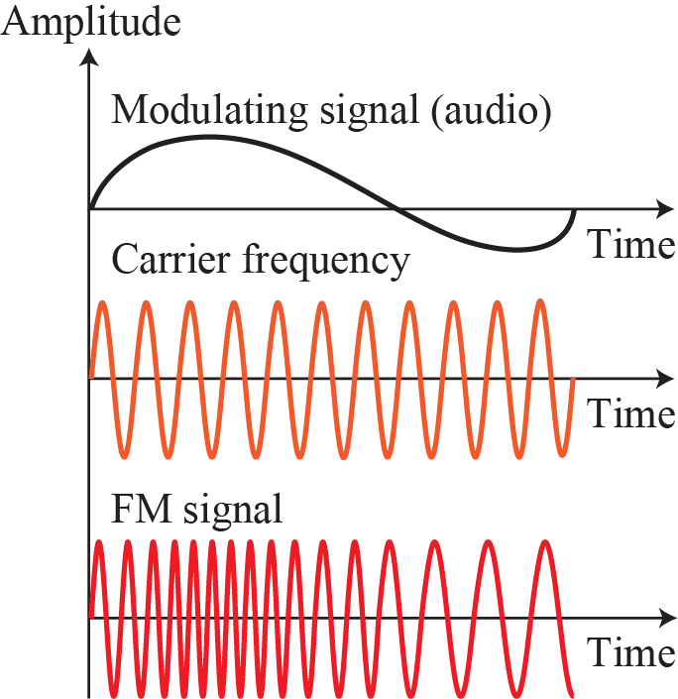
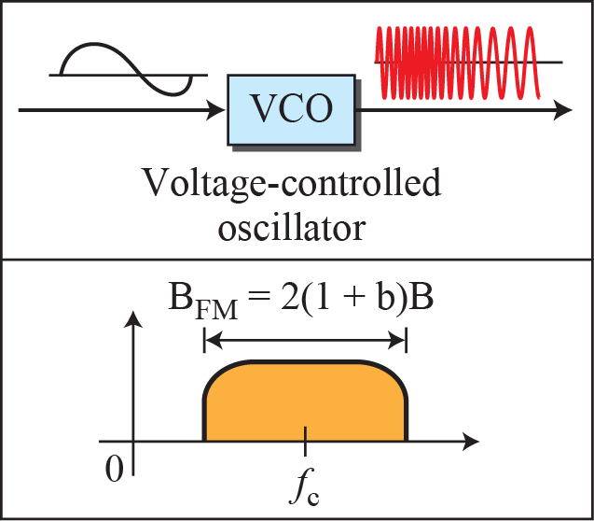
Figure 5.18: Frequency modulation
5.‹#›
Notes:
5.#

Slide 38
Figure 5.19: FM band allocation
5.‹#›
Notes:
5.#

Slide 39
5.2.3 Phase Modulation (PM)
In PM transmission, the phase of the carrier signal is modulated to follow the changing voltage level (amplitude) of the modulating signal. The peak amplitude and frequency of the carrier signal remain constant, but as the amplitude of the information signal changes, the phase of the carrier changes correspondingly.
5.‹#›
Notes:
5.#

Slide 40
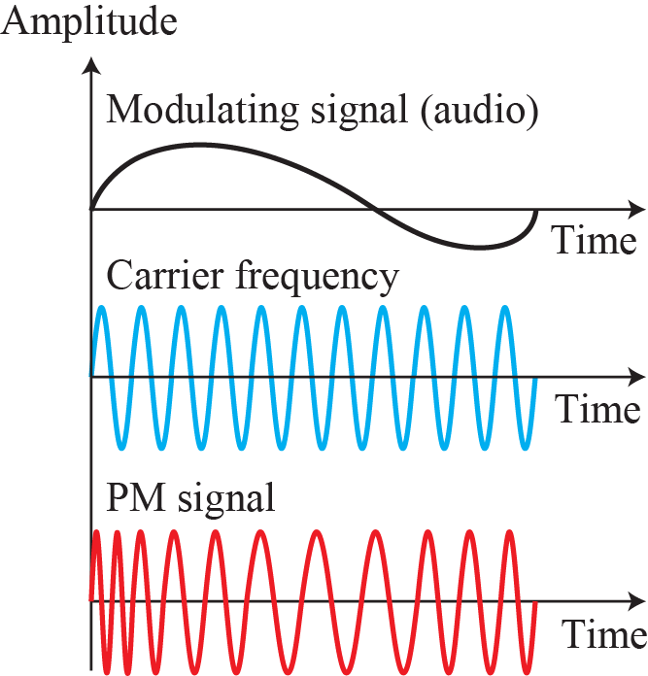
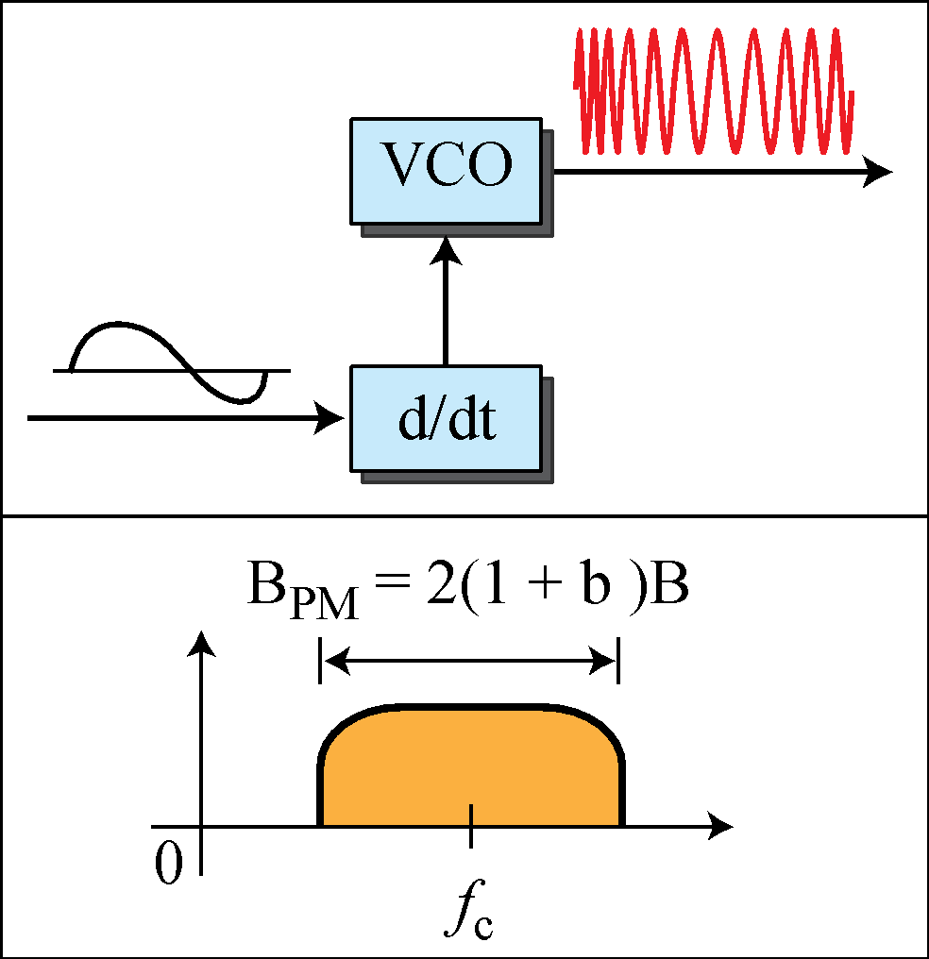
Figure 5.20: Phase modulation
5.‹#›
Notes:
5.#

