Slide 1
1. Software and Software Engineering

Slide 2
Discussion Topics
Appreciate Software Engineering
Nature of Software Engineering
Software Applications
Legacy of Software Engineering
Software Quality
Software Quality and Stakeholders
A Layered Technology
Software Process
Software Myths
2

Slide 3
What is Software?
Software is a collection of programs and associated components that make a computer operate and perform specific tasks. It includes:
Instructions (computer programs) that when executed provide desired features, function, and performance;
Data structures that enable the programs to
organize and manage data so that programs can process and manipulate information effectively.
Documentation explaining how the software works, how to use it, and how to maintain it.
3

Slide 4
What is Software?
Think about WhatsApp on your phone.
Software Component | Real-Time Example
Instructions (Programs) | The code that sends a message, makes a call, or uploads a photo.
Data Structures | The way your chat messages, contacts, and media files are stored and managed inside the app.
Documentation | Help pages, user guides, FAQs, or developer documents that explain how to use or build features.
4

Slide 5
Characteristics/Nature of Software
Software is developed or engineered,
manufactured in the classical sense.
Software is intangible(unable to touch)
Software is easy to reproduce
Software is easy to modify
it is not
5

Slide 6
Characteristics/Nature of Software
Functionality
The functionality of software refers to its ability to perform and function according to design specifications.
Usability (User-friendly)
The user-friendliness of the software is characterized by its ease of use. In other words, learning how to use the software should require less effort or time.
Efficiency
It refers to the software’s ability to utilize human and system resources such as time, effort, CPU, memory, computation power, network bandwidth, files, databases, etc., as effectively and efficiently as possible.
6

Slide 7
Characteristics/Nature of Software
Flexibility
Software Flexibility refers to the ability of the software solution to adapt to potential or future changes in its requirements.
Reliability
The reliability of a software product describes the likelihood it will operate without failure over a specified period of time under certain conditions.
Maintainability
Maintainability refers to how easily you can repair, improve and comprehend software code.
7

Slide 8
Characteristics/Nature of Software
Portability
Software portability is a critical factor that cannot be ignored. Portability refers to the ability to use software in different environments.
Integrity
There are multiple interpretations of software integrity. Some people tend to associate integrity with security, believing it is resistant to hacks and privacy violations.
8

Slide 9
Characteristics/Nature of Software
Conclusions
Much software has poor design and is getting worse
We have to learn to ‘engineer’ software
9

Slide 10
Software Applications
System Software :
Operating system, drivers, networking software, telecommunications
processors, Compilers.
Application Software:
Microsoft Office, Excel and Outlook, Google Chrome, Mozilla Firefox and Skype. Games and mobile applications such as "Clash of Clans," SoundCloud, Spotify and Uber, are also considered application software. Other specific examples include Steam, "Minecraft," Adobe Reader and Photoshop.
Engineering/scientific software:
Computer-aided Design and Computer-aided Manufacturing Software, Civil Engineering and Architectural Software , Electrical Engineering software, Geographic Information Systems Software, Simulation software, Interactive Software.
Embedded Software :
key pad control for a microwave oven, fuel control, dashboard displays, and braking systems, control and monitoring system.
7

Slide 11
Software Applications (Cont..)
Product-line software/Data Processing System:
Inventory control products, word processing, spreadsheets, computer graphics, multimedia, entertainment, database management, and personal and business financial applications
WebApps (Web applications)
Integrated with corporate databases and business applications: Booking application, Chatting application, Upload, E-Business, E- Commerce application.
AI software
Include robotics, expert systems, pattern recognition (image and voice), artificial neural networks, theorem, proving, and game playing.
Gaming Software
Mobile Device Software
8

Slide 12
Legacy Software
Legacy implies that the software is out of date or in need of replacement, however it may be in good working order so the business or individual owner does not want to upgrade or update the software.
Legacy software refers to older computer programs or systems that are still in use even though:
they may be outdated,
they may no longer be supported by vendors,
newer and better versions exist.
However, they are still kept because they work well and fulfill business needs, and changing them may be costly, risky, or unnecessary.

Slide 13
Legacy Software
Why must it change?
software must be adapted to meet the needs of new computing environments or technology.
software must be enhanced to implement new business requirements.
software must be extended to make it interoperable with other more modern systems or databases.
software must be re-architected to make it viable within a network environment.

Slide 14
Software Engineering
The IEEE definition:
Software Engineering:
The application of a systematic, disciplined, quantifiable approach to the development, operation, and maintenance of software; that is, the application of engineering to software.
The study of approaches as in (1).

Slide 15
Software Engineering (Cont..)
The process of solving customers’ problems by the systematic development and evolution of large, high-quality software systems within cost, time and other constraints

Slide 16
Software Engineering (Cont..)
Solving customers’ problems
The goal
Sometimes the solution is to buy, not build
Adding unnecessary features often makes software worse
Software engineers must communicate effectively
to identify and understand the problem

Slide 17
Software Engineering (Cont..)
Systematic development and evolution
An engineering process involves applying well understood techniques in a organized and disciplined way
Many well-accepted practices have been formally standardized
e.g. by the IEEE or ISO
Most development work is evolution

Slide 18
Software Engineering (Cont..)
Large, high quality software systems
Software engineering techniques are needed because large systems cannot be completely understood by one person
Teamwork and co-ordination are required
Key challenge: Dividing up the work and ensuring that the parts of the system work properly together
The end-product must be of sufficient quality

Slide 19
Software Engineering (Cont..)
Cost, time and other constraints
Finite resources
The benefit must outweigh the cost
Others are competing to do the job cheaper and faster
Inaccurate estimates of cost and time have caused many project failures

Slide 20
Software Quality
Usability
Users can learn it and fast and get their job done easily
Efficiency
It doesn't’t waste resources such as CPU time and memory
Reliability
It does what it is required to do without failing
Maintainability
It can be easily changed
Reusability
Its parts can be used in other projects, so reprogramming is not needed
20

Slide 21
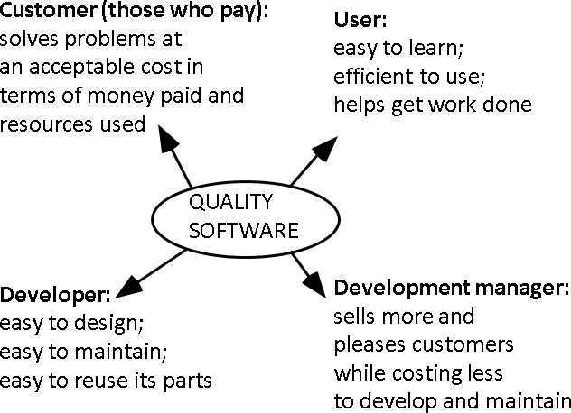
Software Quality and Stakeholders
21

Slide 22

A Layered Technology
22
Fig: Software engineering layers

Slide 23
Software Process
A process is a collection of activities, actions, and tasks that are performed when some work product is to be created.
An activity strives to achieve a broad objective (e.g., communication with stakeholders) and is applied regardless of the application domain, size of the project, complexity of the effort, or degree of rigor with which software engineering is to be applied.
An action (e.g., architectural design) encompasses a set of tasks that produce a major work product (e.g., an architectural design model).
A task focuses on a small, but well-defined objective (e.g., conducting a unit test) that produces a tangible outcome.
23

Slide 24
The Essence of Practice
George Polya outlined The essence of software
engineering practice:
Understand the problem (communication and analysis).
Plan a solution (modeling and software design).
Carry out the plan (code generation).
Examine the result for accuracy (testing and quality assurance).
24

Slide 25
Hooker’s General Principles
1: The Reason It All Exists
2: Keep It Simple, Stupid! (KISS Principle)
3: Maintain the Vision
4: What You Produce, Others Will Consume
5: Be Open to the Future
6: Plan Ahead for Reuse
7: Think!

Slide 26
Hooker’s General Principles
1: The Reason It All Exists
2: Keep It Simple, Stupid! (KISS Principle)
3: Maintain the Vision
4: What You Produce, Others Will Consume
5: Be Open to the Future
6: Plan Ahead for Reuse
7: Think!

Slide 27
References:
Software Engineering by Ian Sommerville,
9th edition, Addison-Wesley, 2011
Software Engineering A practitioner’s Approach by Roger S. Pressman, 7th edition, McGraw Hill, 2010.

