Slide 1
Cloud assessment

Slide 2
Table of contents
1
Our assessment and planning approach
7
Candidates
2
What we did for your assessment
8
Financial comparison
3
What we found at a high level
9
Next steps discussion
4
Metrics by group
5
IaaS cloud readiness
6
Platform-as-a-Services (PaaS) fit

Slide 3
Our assessment and planning approach
Understand your environment and needs
Plan requirements and create your roadmap
Identify cost savings and best-fit products
Create your migration plan and cloud architecture
Our proven assessment and planning approach shown below was employed for your engagement and integrated the data collection, analytics, and brokerage capabilities of the StratoZone® platform.
A critical component of any cloud assessment or planning service is to collect and rely on accurate and timely data. As the first step of your assessment, the StratoProbe® data collection application is deployed to retrieve and analyze data from your environments.
Once discovery is completed, the StratoZone® platform is used to analyze data relating to your IT assets that are deemed to be in scope. This analysis is a combination of proprietary technical methodologies combined with robust industry benchmark data, and real-time pricing from the cloud-providers you selected for your assessment.
The findings, analysis, and recommendations are made available to you within your StratoZone® portal and summarized in this report.

Slide 4
What we did for your assessment
1
2
Your engagement included a basic assessment. The basic assessment is a starting point for any customer embarking on the journey to public or hybrid cloud.
One or more data collectors were deployed in your environment and your data was automatically aggregated, analyzed, and staged for additional planning functions. The phases and tasks of the basic assessment are shown below:
Phase 1
Discovery, Inventory Analysis, and Cloud Readiness
The objective of this phase is to collect data from the target workloads and complete inventory analysis including basic cloud readiness. The StratoProbe® discovery engine gathered workload, application and network information and processed the following analytics:
Phase 2
Basic Cloud Fit and Financial Analysis
The objective of this phase is to further analyze your data to provide insights into cloud readiness, potential savings from cloud, consumption strategies including IaaS and PaaS alternatives, and to review your projected spend in the selected cloud providers. The expected output from this phase includes:
Inventory Analysis
Asset performance analysis
Network dependency mapping
Cloud-readiness scoring
Application inventory analysis
Best-fit vendor catalog-product match (IaaS)
PaaS-fit analysis
IaaS-fit analysis
Cloud-spend estimates (by vendor catalog)
TCO and ROI against benchmark baselines

Slide 5
What we looked at
 | Location | Type | Start date | End date | Total assets
1 | DRC | Automatic Asset Discovery | 08-Jun-2021 | 15-Jun-2021 | 40
2 | DRC2 | Automatic Asset Discovery | 10-Jun-2021 | 18-Jun-2021 | 1
3 | DRC3 | Automatic Asset Discovery | 16-Jun-2021 | 30-Jun-2021 | 611
This assessment is intended to analyze specific areas within your computing environment as designated by you or your personnel. It is important to note that this engagement may not have been a comprehensive assessment of your entire environment.
All locations that we analyzed along with the count of assets in each location are shown below.

Slide 6
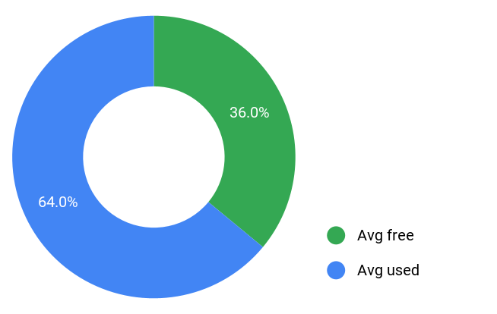
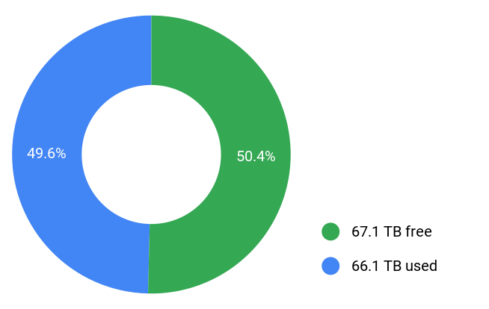
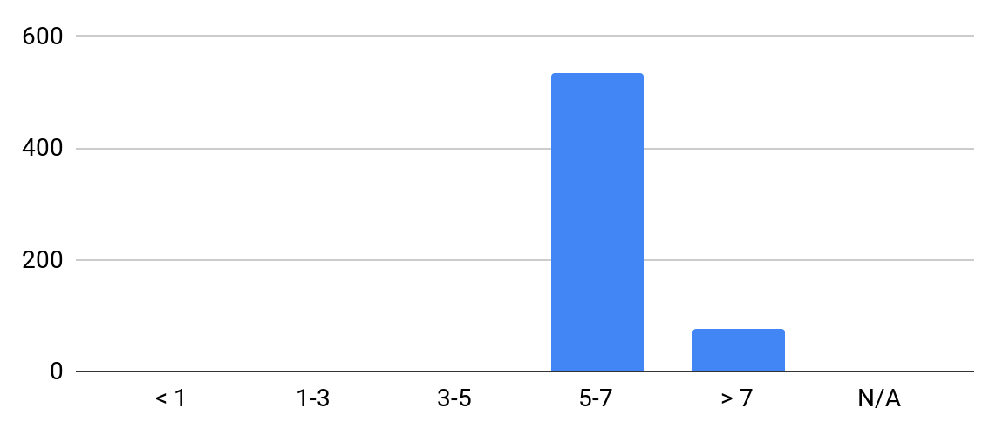
High level findings
This section represents the high-level findings we summarized from across your in-scope environments. You may access additional information and analytics by logging into your HCLVertex® portal account.
Memory utilization
Storage utilization
Assets age distribution
Number of assets
Years
Assets
Total | Windows | Linux
611 | 357 | 254
Strato Fit Score
High | Medium | Low
338 | 273 | 0
CPU Cores
2,162 Cores
Installed Software
1,620 Apps
Total Memory
9 TBs
Total Storage
133.2 TBs

Slide 7
What we found at a high level

Slide 8
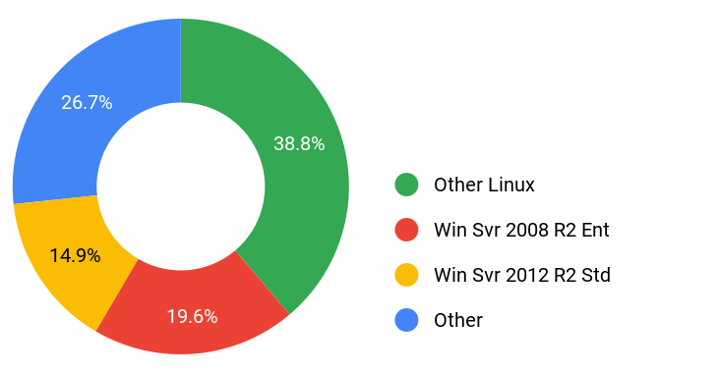
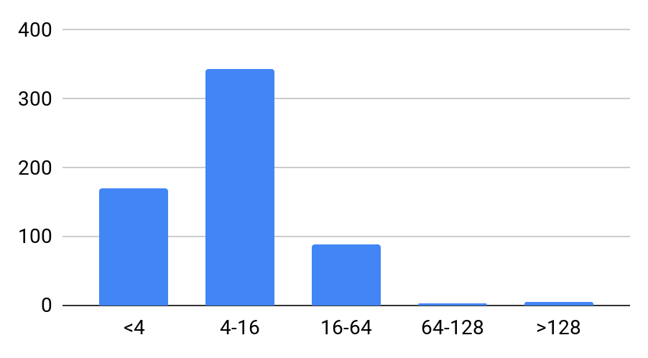

Findings for DRC3
Assets age distribution
Operating Systems
Memory Distribution
Assets count
Assets count
Years
Gigabytes of RAM
Asset Statistics
Total Assets: | 611
Total Storage: | 133.2 TB
Average Asset Age: | 5.9
Average Memory: | 15 GB
Asset Performance
Total Used Storage: | 66.1 TB
Average Used Memory: | 58%
Average Peak Memory: | 58%
Average CPU Usage: | 6%
Average Peak CPU Usage: | 7%

Slide 9
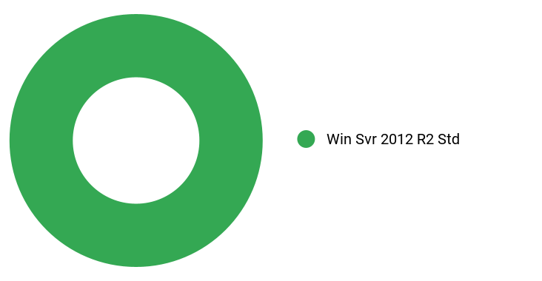
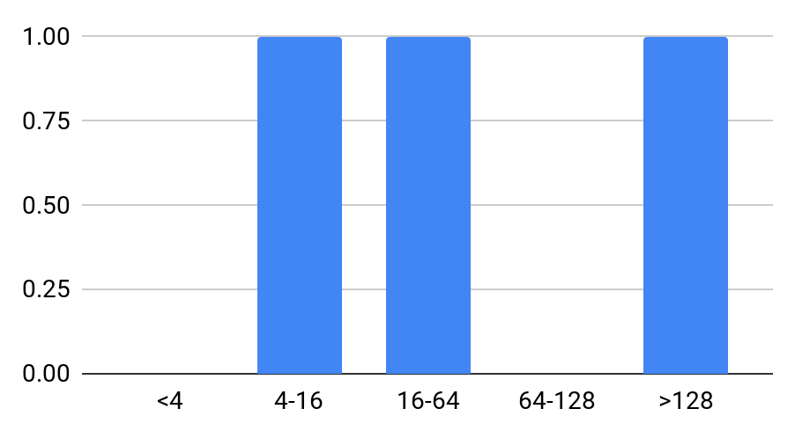
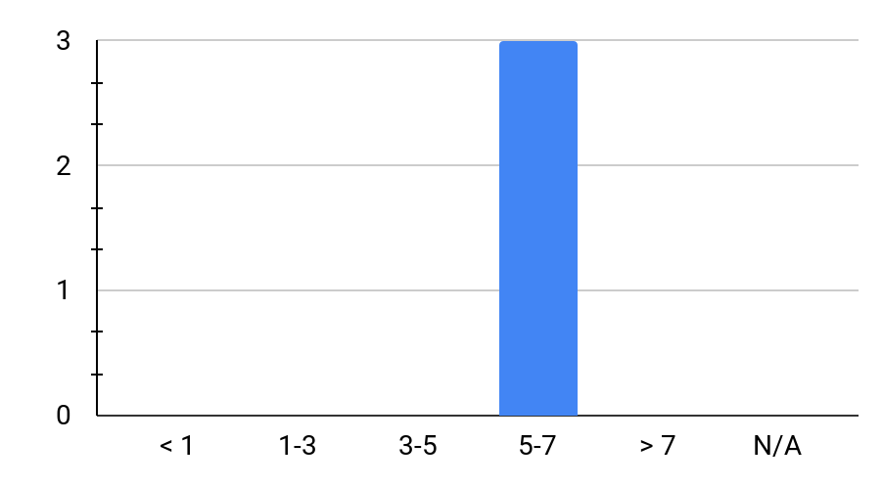
Findings for .NET Core
Assets age distribution
Operating Systems
Memory Distribution
Assets count
Assets count
Years
Gigabytes of RAM
Asset Statistics
Total Assets: | 3
Total Storage: | 2.0 TB
Average Asset Age: | 5.8
Average Memory: | 101 GB
Asset Performance
Total Used Storage: | 935.4 GB
Average Used Memory: | 46%
Average Peak Memory: | 47%
Average CPU Usage: | 6%
Average Peak CPU Usage: | 7%

Slide 10
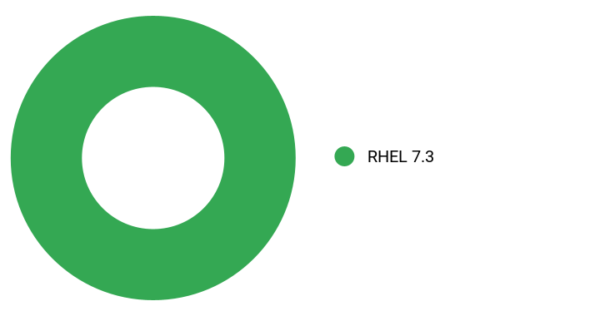
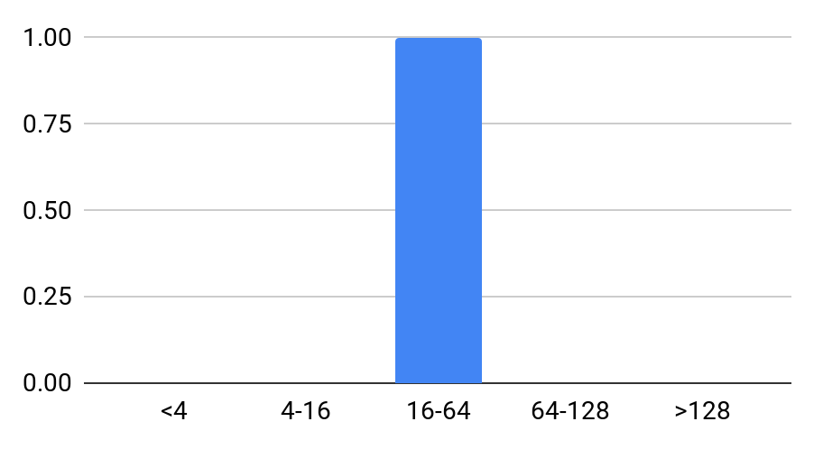

Findings for Apache
Assets age distribution
Operating Systems
Memory Distribution
Assets count
Assets count
Years
Gigabytes of RAM
Asset Statistics
Total Assets: | 1
Total Storage: | 354.3 GB
Average Asset Age: | 5.8
Average Memory: | 23 GB
Asset Performance
Total Used Storage: | 213.1 GB
Average Used Memory: | 98%
Average Peak Memory: | 98%
Average CPU Usage: | 6%
Average Peak CPU Usage: | 6%

Slide 11
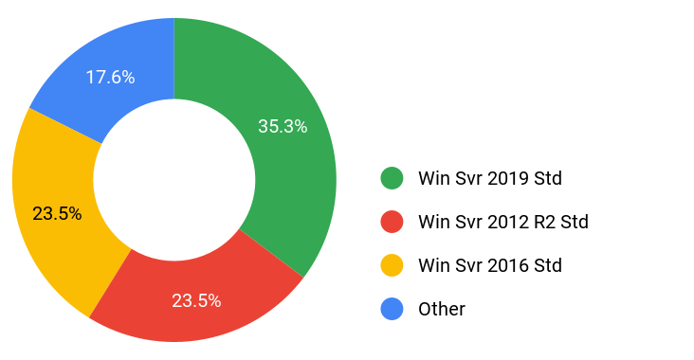
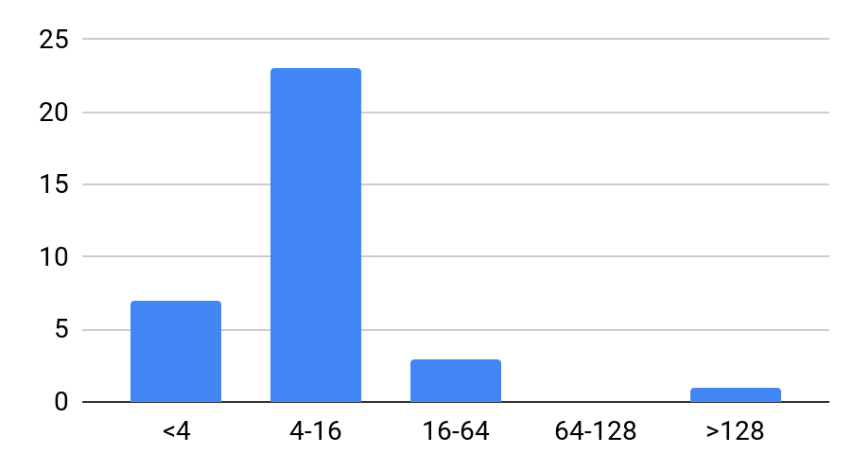
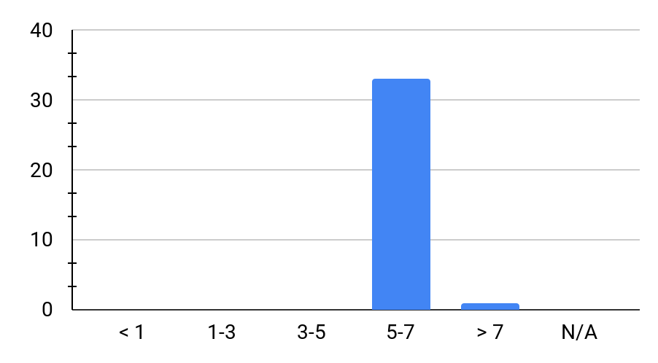
Findings for Microsoft IIS
Assets age distribution
Operating Systems
Memory Distribution
Assets count
Assets count
Years
Gigabytes of RAM
Asset Statistics
Total Assets: | 34
Total Storage: | 7.0 TB
Average Asset Age: | 5.8
Average Memory: | 17 GB
Asset Performance
Total Used Storage: | 4.6 TB
Average Used Memory: | 43%
Average Peak Memory: | 43%
Average CPU Usage: | 6%
Average Peak CPU Usage: | 7%

Slide 12
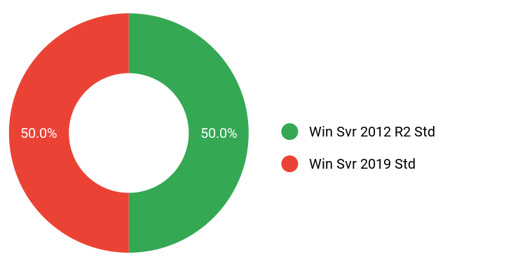
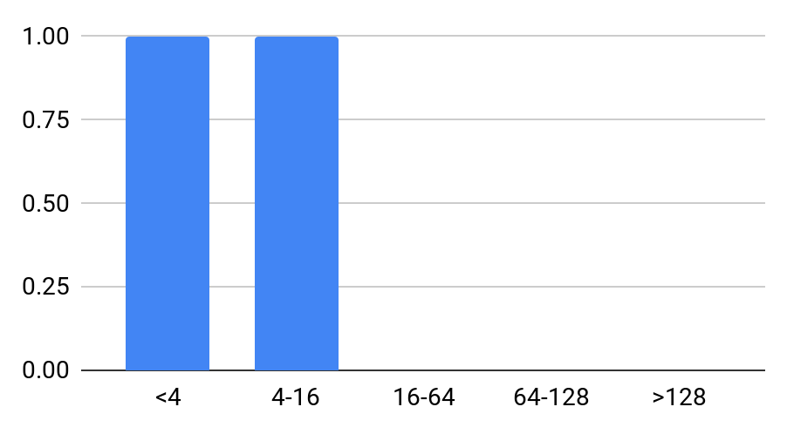

Findings for Microsoft MQ
Assets age distribution
Operating Systems
Memory Distribution
Assets count
Assets count
Years
Gigabytes of RAM
Asset Statistics
Total Assets: | 2
Total Storage: | 874.4 GB
Average Asset Age: | 5.8
Average Memory: | 10 GB
Asset Performance
Total Used Storage: | 423.1 GB
Average Used Memory: | 61%
Average Peak Memory: | 64%
Average CPU Usage: | 8%
Average Peak CPU Usage: | 12%

Slide 13
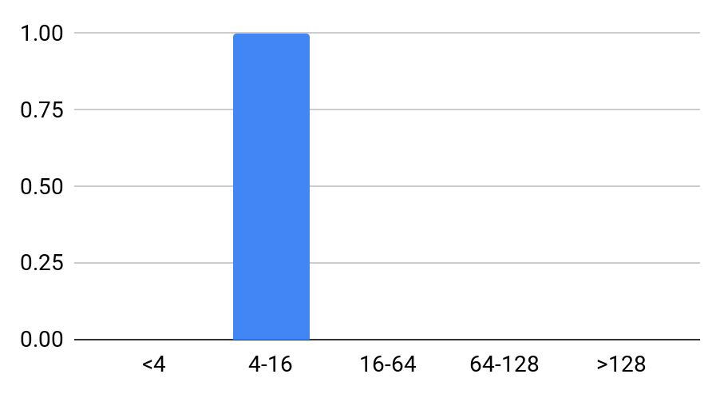
Findings for MySQL
Assets age distribution
Operating Systems
Memory Distribution
Assets count
Assets count
Years
Gigabytes of RAM
Asset Statistics
Total Assets: | 1
Total Storage: | 429.7 GB
Average Asset Age: | 5.8
Average Memory: | 16 GB
Asset Performance
Total Used Storage: | 297.1 GB
Average Used Memory: | 45%
Average Peak Memory: | 47%
Average CPU Usage: | 6%
Average Peak CPU Usage: | 9%

Slide 14
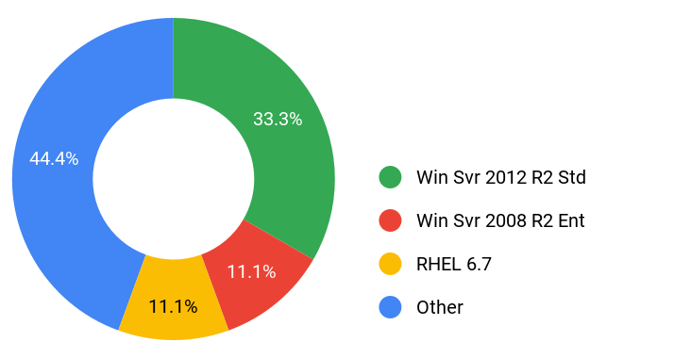
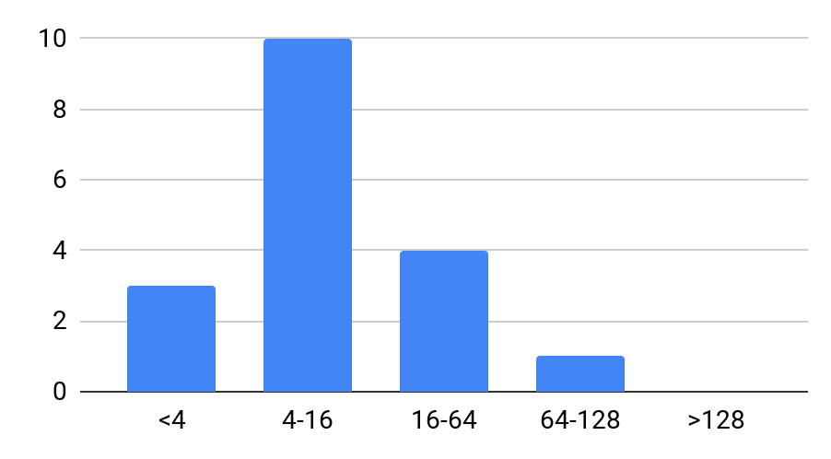
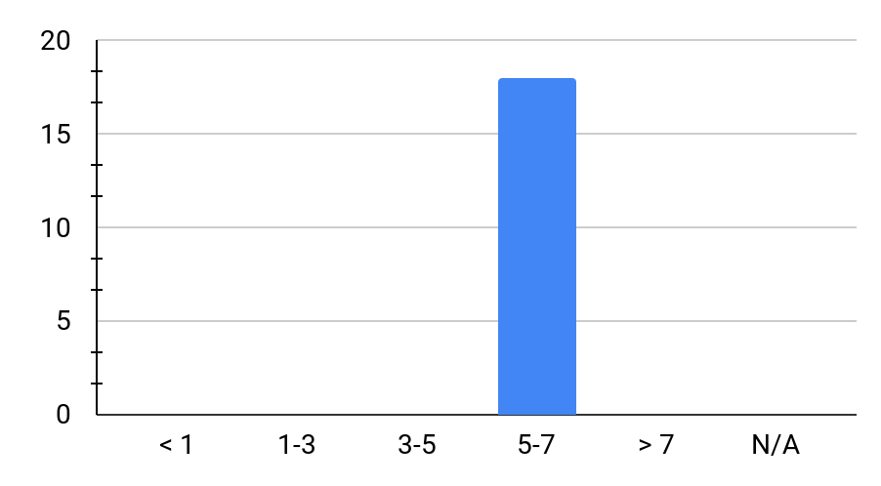
Findings for Oracle
Assets age distribution
Operating Systems
Memory Distribution
Assets count
Assets count
Years
Gigabytes of RAM
Asset Statistics
Total Assets: | 18
Total Storage: | 14.2 TB
Average Asset Age: | 5.8
Average Memory: | 18 GB
Asset Performance
Total Used Storage: | 10.7 TB
Average Used Memory: | 83%
Average Peak Memory: | 85%
Average CPU Usage: | 17%
Average Peak CPU Usage: | 28%

Slide 15
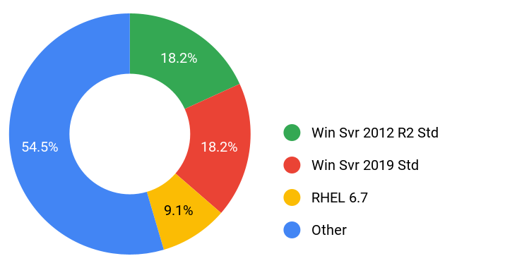
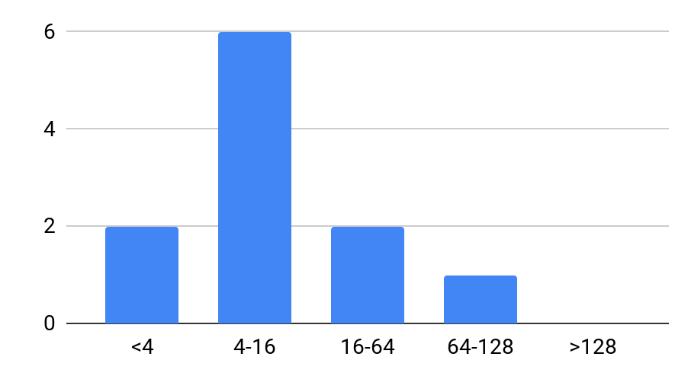
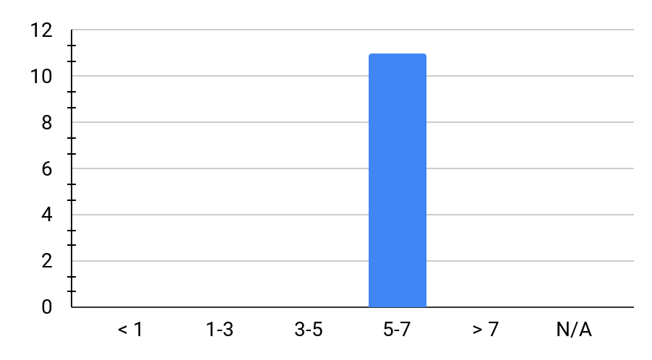
Findings for Postgres
Assets age distribution
Operating Systems
Memory Distribution
Assets count
Assets count
Years
Gigabytes of RAM
Asset Statistics
Total Assets: | 11
Total Storage: | 8.8 TB
Average Asset Age: | 5.8
Average Memory: | 27 GB
Asset Performance
Total Used Storage: | 6.1 TB
Average Used Memory: | 70%
Average Peak Memory: | 72%
Average CPU Usage: | 19%
Average Peak CPU Usage: | 23%

Slide 16

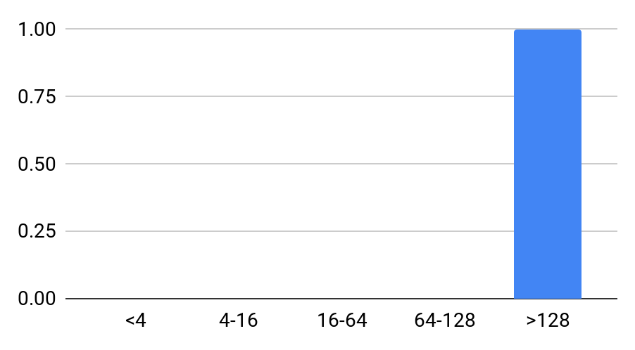
Findings for SAP
Assets age distribution
Operating Systems
Memory Distribution
Assets count
Assets count
Years
Gigabytes of RAM
Asset Statistics
Total Assets: | 1
Total Storage: | 3.2 TB
Average Asset Age: | 5.8
Average Memory: | 757 GB
Asset Performance
Total Used Storage: | 2.0 TB
Average Used Memory: | 74%
Average Peak Memory: | 74%
Average CPU Usage: | 1%
Average Peak CPU Usage: | 1%

Slide 17
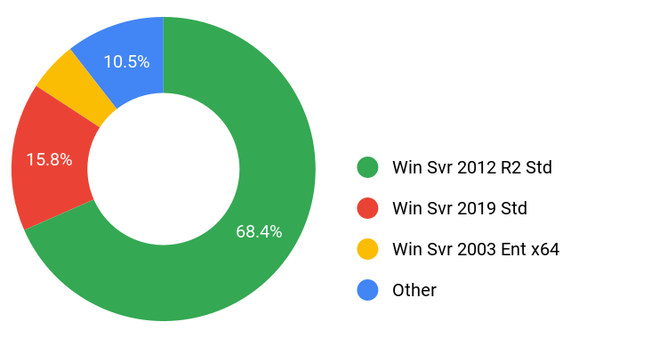
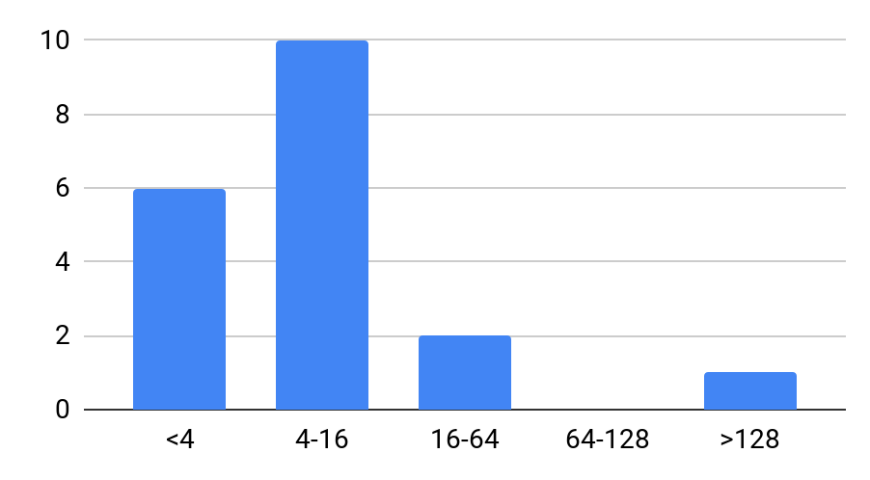
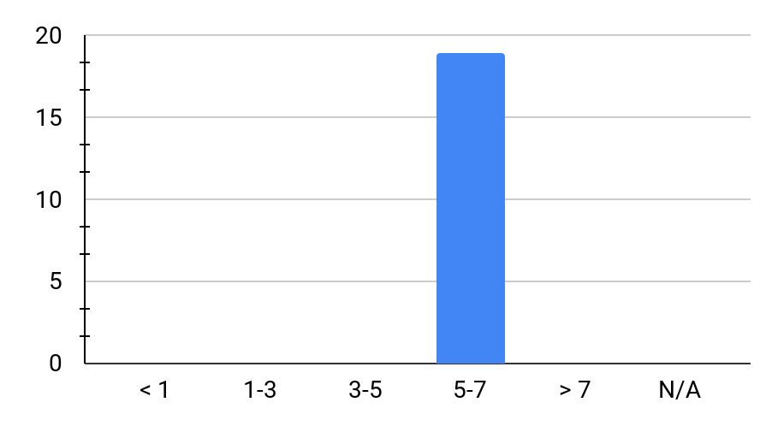
Findings for SQL Server
Assets age distribution
Operating Systems
Memory Distribution
Assets count
Assets count
Years
Gigabytes of RAM
Asset Statistics
Total Assets: | 19
Total Storage: | 6.9 TB
Average Asset Age: | 5.8
Average Memory: | 23 GB
Asset Performance
Total Used Storage: | 4.2 TB
Average Used Memory: | 65%
Average Peak Memory: | 67%
Average CPU Usage: | 12%
Average Peak CPU Usage: | 23%

Slide 18
Cloud Readiness
Cloud readiness

Slide 19
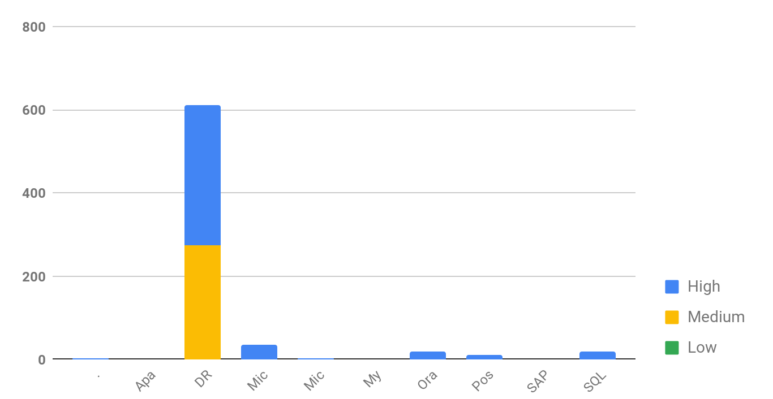
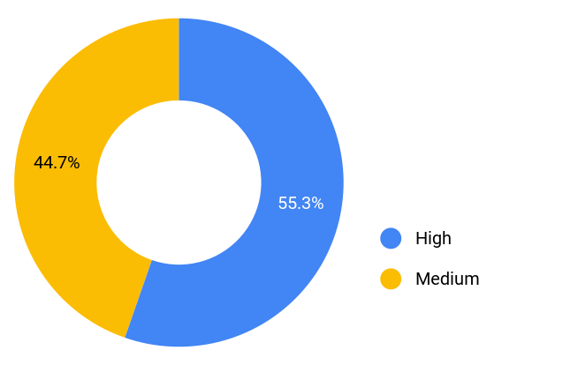
Cloud readiness findings
We conducted a cloud readiness analysis on each of the assets within your assessment scope. The resulting cloud readiness score is intended to capture the asset's fit in public cloud, based on specific infrastructure characteristics. These characteristics include capacity, performance, age, operating systems, and other machine-based attributes.
Overall, this score describes the level of remediation your assets might require for a successful migration to public cloud (under a re-host migration). This score may impact the total cost of migrating certain assets to public cloud. The cloud readiness score for all your selected build groups is shown below.
Cloud readiness score distribution
Cloud readiness score distribution
Assets count

Slide 20
Cloud readiness preferences
The cloud readiness score is impacted by your response to questions in the StratoZone® portal. The table below shows the parameters that are taken into consideration for the basic cloud
readiness scoring along with your indicated preference for each
parameter. If you did not modify these, the defaults are used.
The StratoZone® pricing engine can be used to further analyze the impact of effort and cost, as well as a services engagement with StratoZone® or your delivery partner.
Cloud Readiness Characteristic | Your Indicated Importance
Your preference regarding high-performance assets | Maybe
Your ability to exit a selected public cloud provider | Somewhat
Your preference regarding older assets | Somewhat
Your preference to migrate certain higher-risk roles (ex: DB Server) | Maybe
Your desire to move assets with high network dependency | Yes
Your preference regarding remediating unsupported OS’s | Yes

Slide 21
Google Cloud Platform Solutions - Top 10
This assessment identified assets that qualify for direct migration to Google Cloud Platform Solutions. The detailed breakdown of workloads is shown in your StratoZone® portal. Further analysis is necessary to determine the associated cost, risk, and effort level required to migrate these assets to specific GCP Solutions
 | Identified Solution | Assets found | vCPU | Memory (GB) | Storage (TB) | GCP Recommended Solution
1 | Microsoft IIS | 34 | 112 | 326.8 | 6.9 | Google App Engine
2 | SQL Server | 19 | 24 | 189.8 | 6.4 | Cloud SQL for SQL Server
3 | Oracle | 18 | 31 | 373.5 | 16.0 | Oracle Bare Metal Solution
4 | Postgres | 11 | 29 | 338.0 | 9.2 | Cloud SQL for PostgreSQL
5 | .NET Core | 3 | 4 | 69.5 | 1.4 | Google Kubernetes Engine (GKE)
6 | Microsoft MQ | 2 | 2 | 12.8 | 0.6 | GCP Pub/Sub
7 | SAP | 1 | 1 | 702.8 | 3.0 | GCP SAP Certified Shapes
8 | Apache | 1 | 1 | 29.0 | 0.3 | Google App Engine
9 | MySQL | 1 | 1 | 9.3 | 0.4 | Cloud SQL for MySQL
* Solution breakdown in detailed inventory reports

Slide 22
Financial comparison
We conducted a basic financial comparison for each of your assets within the designated groups. This comparison is conducted at the infrastructure-level, using the process shown below:
1
2
2
Step 1
Performance-based right-sizing
We optimize each asset’s capacity for a public-cloud metered model. Asset capacity includes CPU, memory, bandwidth, up-time, OS licensing, and storage performance.
Step 2
Selection of best-fit public cloud product
We select the best-fit cloud products from each of your designated vendor catalogs, based on capacity, performance, and price.
Step 3
Compare to benchmark environment
We compare your assets to the best-match benchmark t-shirt sizes and selected the closest match from your cloud providers for each as-is asset.
The financial comparison results, with associated assumptions, are shown on the following page(s). At this stage, the financial comparison does not account for all cost-of-ownership components. Excluded items typically relate to third-party products (such as DR or monitoring) that are sometimes required to operate assets in public cloud. Additionally, this analysis does not take into
consideration application modernization, platform-as-a-service migrations, or other cloud–native enhancements that may be available to your asset inventory. Using the StratoZone® pricing engine, or by engaging your delivery partner, we can conduct additional analysis to determine total cost of ownership and return on investment, on a multi-year basis.

Slide 23
Locations: DRC3
611 Assets
Cost Component (Monthly) | Private Data Center | GCE (3 Year Commit) | GCE (1 Year Commit) | GCE (On-demand)
Hosting Location: | Europe | Frankfurt (europe-west3) | Frankfurt (europe-west3) | Frankfurt (europe-west3)
Compute: | $122,361.50 | $36,039.40 | $50,798.91 | $72,829.16
Operating System: | $2,106.34 | $32,740.50 | $32,740.50 | $32,606.18
Storage: | $15,363.30 | $4,959.43 | $4,959.43 | $4,959.43
Egress: | $0.00 | $2,448.85 | $2,448.85 | $2,448.85
Other Costs: | $0.00 | $0.00 | $0.00 | $0.00
Total Monthly Cost: | $139,831.15 | $76,188.19 | $90,947.69 | $112,843.62
Monthly Savings: |  | $63,642.96 45.5% | $48,883.46 35.0% | $26,987.53 19.3%
* Detailed assumptions on the following slide

Slide 24
Locations: DRC3
Financial Assumptions, based on Moderate-level optimization
Sizing and Requirements
Machines were sized based on the following performance metrics based on average performance data:
CPU utilization target of 50% (cloud assets would utilize up to 50% of CPU based on detected utilization)
RAM utilization target of 80% (cloud assets would utilize up to 80% of RAM based on detected utilization)
Target drive type (e.g. SSD vs. Standard) determined based on a detected IOPS threshold of 500 IOPS
Storage amount based on used storage with a 50% uplift
Estimated outbound bandwidth incurring egress charges based on 10% of total outbound detected network traffic
Target cloud provider CPU performance will meet at least 100% of the detected CPU benchmark of the machine
Catalogs
Google On-Demand catalogs include Sustained Use Discounts based on runtime, where applicable
The following categories of machines were excluded for comparison:
Machine Uptime
All machines assumed to be running full time (730 hours, on average, per month)
Operating System Licensing Strategy
Current on-premise operating system licenses to be brought to cloud, where possible
Private Data Center | GCE (3 Year Commit) | GCE (1 Year Commit) | GCE (On-demand)
None | • E2 Preemptible • E2 Shared-core • N1 Preemptible • N1 Shared-core • N2 Preemptible • N2D Preemptible | • E2 Preemptible • E2 Shared-core • N1 Preemptible • N1 Shared-core • N2 Preemptible • N2D Preemptible | • E2 Preemptible • E2 Shared-core • N1 Preemptible • N1 Shared-core • N2 Preemptible • N2D Preemptible

Slide 25
Solution Groups: .NET Core
3 Assets
Cost Component (Monthly) | Private Data Center | GCE (3 Year Commit) | GCE (1 Year Commit) | GCE (On-demand)
Hosting Location: | Europe | Frankfurt (europe-west3) | Frankfurt (europe-west3) | Frankfurt (europe-west3)
Compute: | $661.82 | $355.66 | $397.83 | $415.91
Operating System: | $23.58 | $134.32 | $134.32 | $134.32
Storage: | $210.45 | $67.34 | $67.34 | $67.34
Egress: | $0.00 | $2.55 | $2.55 | $2.55
Other Costs: | $0.00 | $0.00 | $0.00 | $0.00
Total Monthly Cost: | $895.85 | $559.87 | $602.04 | $620.12
Monthly Savings: |  | $335.97 37.5% | $293.81 32.8% | $275.72 30.8%
* Detailed assumptions on the following slide

Slide 26
Solution Groups: .NET Core
Financial Assumptions, based on Moderate-level optimization
Sizing and Requirements
Machines were sized based on the following performance metrics based on average performance data:
CPU utilization target of 50% (cloud assets would utilize up to 50% of CPU based on detected utilization)
RAM utilization target of 80% (cloud assets would utilize up to 80% of RAM based on detected utilization)
Target drive type (e.g. SSD vs. Standard) determined based on a detected IOPS threshold of 500 IOPS
Storage amount based on used storage with a 50% uplift
Estimated outbound bandwidth incurring egress charges based on 10% of total outbound detected network traffic
Target cloud provider CPU performance will meet at least 100% of the detected CPU benchmark of the machine
Catalogs
Google On-Demand catalogs include Sustained Use Discounts based on runtime, where applicable
The following categories of machines were excluded for comparison:
Machine Uptime
All machines assumed to be running full time (730 hours, on average, per month)
Operating System Licensing Strategy
Current on-premise operating system licenses to be brought to cloud, where possible
Private Data Center | GCE (3 Year Commit) | GCE (1 Year Commit) | GCE (On-demand)
None | • E2 Preemptible • E2 Shared-core • N1 Preemptible • N1 Shared-core • N2 Preemptible • N2D Preemptible | • E2 Preemptible • E2 Shared-core • N1 Preemptible • N1 Shared-core • N2 Preemptible • N2D Preemptible | • E2 Preemptible • E2 Shared-core • N1 Preemptible • N1 Shared-core • N2 Preemptible • N2D Preemptible

Slide 27
Solution Groups: Apache
1 Asset
Cost Component (Monthly) | Private Data Center | GCE (3 Year Commit) | GCE (1 Year Commit) | GCE (On-demand)
Hosting Location: | Europe | Frankfurt (europe-west3) | Frankfurt (europe-west3) | Frankfurt (europe-west3)
Compute: | $198.05 | $72.79 | $101.91 | $161.79
Operating System: | $0.00 | $0.00 | $0.00 | $0.00
Storage: | $48.00 | $15.36 | $15.36 | $15.36
Egress: | $0.00 | $7.65 | $7.65 | $7.65
Other Costs: | $0.00 | $0.00 | $0.00 | $0.00
Total Monthly Cost: | $246.05 | $95.80 | $124.92 | $184.80
Monthly Savings: |  | $150.25 61.1% | $121.13 49.2% | $61.25 24.9%
* Detailed assumptions on the following slide

Slide 28
Solution Groups: Apache
Financial Assumptions, based on Moderate-level optimization
Sizing and Requirements
Machines were sized based on the following performance metrics based on average performance data:
CPU utilization target of 50% (cloud assets would utilize up to 50% of CPU based on detected utilization)
RAM utilization target of 80% (cloud assets would utilize up to 80% of RAM based on detected utilization)
Target drive type (e.g. SSD vs. Standard) determined based on a detected IOPS threshold of 500 IOPS
Storage amount based on used storage with a 50% uplift
Estimated outbound bandwidth incurring egress charges based on 10% of total outbound detected network traffic
Target cloud provider CPU performance will meet at least 100% of the detected CPU benchmark of the machine
Catalogs
Google On-Demand catalogs include Sustained Use Discounts based on runtime, where applicable
The following categories of machines were excluded for comparison:
Machine Uptime
All machines assumed to be running full time (730 hours, on average, per month)
Operating System Licensing Strategy
Current on-premise operating system licenses to be brought to cloud, where possible
Private Data Center | GCE (3 Year Commit) | GCE (1 Year Commit) | GCE (On-demand)
None | • E2 Preemptible • E2 Shared-core • N1 Preemptible • N1 Shared-core • N2 Preemptible • N2D Preemptible | • E2 Preemptible • E2 Shared-core • N1 Preemptible • N1 Shared-core • N2 Preemptible • N2D Preemptible | • E2 Preemptible • E2 Shared-core • N1 Preemptible • N1 Shared-core • N2 Preemptible • N2D Preemptible

Slide 29
Solution Groups: Microsoft IIS
34 Assets
Cost Component (Monthly) | Private Data Center | GCE (3 Year Commit) | GCE (1 Year Commit) | GCE (On-demand)
Hosting Location: | Europe | Frankfurt (europe-west3) | Frankfurt (europe-west3) | Frankfurt (europe-west3)
Compute: | $6,583.36 | $1,535.36 | $2,117.75 | $3,246.66
Operating System: | $194.98 | $3,760.96 | $3,760.96 | $3,760.96
Storage: | $1,060.05 | $339.22 | $339.22 | $339.22
Egress: | $0.00 | $35.70 | $35.70 | $35.70
Other Costs: | $0.00 | $0.00 | $0.00 | $0.00
Total Monthly Cost: | $7,838.39 | $5,671.23 | $6,253.63 | $7,382.53
Monthly Savings: |  | $2,167.16 27.6% | $1,584.77 20.2% | $455.86 5.8%
* Detailed assumptions on the following slide

Slide 30
Solution Groups: Microsoft IIS
Financial Assumptions, based on Moderate-level optimization
Sizing and Requirements
Machines were sized based on the following performance metrics based on average performance data:
CPU utilization target of 50% (cloud assets would utilize up to 50% of CPU based on detected utilization)
RAM utilization target of 80% (cloud assets would utilize up to 80% of RAM based on detected utilization)
Target drive type (e.g. SSD vs. Standard) determined based on a detected IOPS threshold of 500 IOPS
Storage amount based on used storage with a 50% uplift
Estimated outbound bandwidth incurring egress charges based on 10% of total outbound detected network traffic
Target cloud provider CPU performance will meet at least 100% of the detected CPU benchmark of the machine
Catalogs
Google On-Demand catalogs include Sustained Use Discounts based on runtime, where applicable
The following categories of machines were excluded for comparison:
Machine Uptime
All machines assumed to be running full time (730 hours, on average, per month)
Operating System Licensing Strategy
Current on-premise operating system licenses to be brought to cloud, where possible
Private Data Center | GCE (3 Year Commit) | GCE (1 Year Commit) | GCE (On-demand)
None | • E2 Preemptible • E2 Shared-core • N1 Preemptible • N1 Shared-core • N2 Preemptible • N2D Preemptible | • E2 Preemptible • E2 Shared-core • N1 Preemptible • N1 Shared-core • N2 Preemptible • N2D Preemptible | • E2 Preemptible • E2 Shared-core • N1 Preemptible • N1 Shared-core • N2 Preemptible • N2D Preemptible

Slide 31
Solution Groups: Microsoft MQ
2 Assets
Cost Component (Monthly) | Private Data Center | GCE (3 Year Commit) | GCE (1 Year Commit) | GCE (On-demand)
Hosting Location: | Europe | Frankfurt (europe-west3) | Frankfurt (europe-west3) | Frankfurt (europe-west3)
Compute: | $368.58 | $57.96 | $76.35 | $83.51
Operating System: | $6.72 | $67.16 | $67.16 | $67.16
Storage: | $95.25 | $30.48 | $30.48 | $30.48
Egress: | $0.00 | $11.05 | $11.05 | $11.05
Other Costs: | $0.00 | $0.00 | $0.00 | $0.00
Total Monthly Cost: | $470.54 | $166.65 | $185.04 | $192.20
Monthly Savings: |  | $303.89 64.6% | $285.50 60.7% | $278.34 59.2%
* Detailed assumptions on the following slide

Slide 32
Solution Groups: Microsoft MQ
Financial Assumptions, based on Moderate-level optimization
Sizing and Requirements
Machines were sized based on the following performance metrics based on average performance data:
CPU utilization target of 50% (cloud assets would utilize up to 50% of CPU based on detected utilization)
RAM utilization target of 80% (cloud assets would utilize up to 80% of RAM based on detected utilization)
Target drive type (e.g. SSD vs. Standard) determined based on a detected IOPS threshold of 500 IOPS
Storage amount based on used storage with a 50% uplift
Estimated outbound bandwidth incurring egress charges based on 10% of total outbound detected network traffic
Target cloud provider CPU performance will meet at least 100% of the detected CPU benchmark of the machine
Catalogs
Google On-Demand catalogs include Sustained Use Discounts based on runtime, where applicable
The following categories of machines were excluded for comparison:
Machine Uptime
All machines assumed to be running full time (730 hours, on average, per month)
Operating System Licensing Strategy
Current on-premise operating system licenses to be brought to cloud, where possible
Private Data Center | GCE (3 Year Commit) | GCE (1 Year Commit) | GCE (On-demand)
None | • E2 Preemptible • E2 Shared-core • N1 Preemptible • N1 Shared-core • N2 Preemptible • N2D Preemptible | • E2 Preemptible • E2 Shared-core • N1 Preemptible • N1 Shared-core • N2 Preemptible • N2D Preemptible | • E2 Preemptible • E2 Shared-core • N1 Preemptible • N1 Shared-core • N2 Preemptible • N2D Preemptible

Slide 33
Solution Groups: MySQL
1 Asset
Cost Component (Monthly) | Private Data Center | GCE (3 Year Commit) | GCE (1 Year Commit) | GCE (On-demand)
Hosting Location: | Europe | Frankfurt (europe-west3) | Frankfurt (europe-west3) | Frankfurt (europe-west3)
Compute: | $185.86 | $41.47 | $51.47 | $55.36
Operating System: | $3.36 | $33.58 | $33.58 | $33.58
Storage: | $66.90 | $21.41 | $21.41 | $21.41
Egress: | $0.00 | $0.85 | $0.85 | $0.85
Other Costs: | $0.00 | $0.00 | $0.00 | $0.00
Total Monthly Cost: | $256.12 | $97.30 | $107.31 | $111.20
Monthly Savings: |  | $158.81 62.0% | $148.81 58.1% | $144.92 56.6%
* Detailed assumptions on the following slide

Slide 34
Solution Groups: MySQL
Financial Assumptions, based on Moderate-level optimization
Sizing and Requirements
Machines were sized based on the following performance metrics based on average performance data:
CPU utilization target of 50% (cloud assets would utilize up to 50% of CPU based on detected utilization)
RAM utilization target of 80% (cloud assets would utilize up to 80% of RAM based on detected utilization)
Target drive type (e.g. SSD vs. Standard) determined based on a detected IOPS threshold of 500 IOPS
Storage amount based on used storage with a 50% uplift
Estimated outbound bandwidth incurring egress charges based on 10% of total outbound detected network traffic
Target cloud provider CPU performance will meet at least 100% of the detected CPU benchmark of the machine
Catalogs
Google On-Demand catalogs include Sustained Use Discounts based on runtime, where applicable
The following categories of machines were excluded for comparison:
Machine Uptime
All machines assumed to be running full time (730 hours, on average, per month)
Operating System Licensing Strategy
Current on-premise operating system licenses to be brought to cloud, where possible
Private Data Center | GCE (3 Year Commit) | GCE (1 Year Commit) | GCE (On-demand)
None | • E2 Preemptible • E2 Shared-core • N1 Preemptible • N1 Shared-core • N2 Preemptible • N2D Preemptible | • E2 Preemptible • E2 Shared-core • N1 Preemptible • N1 Shared-core • N2 Preemptible • N2D Preemptible | • E2 Preemptible • E2 Shared-core • N1 Preemptible • N1 Shared-core • N2 Preemptible • N2D Preemptible

Slide 35
Solution Groups: Oracle
18 Assets
Cost Component (Monthly) | Private Data Center | GCE (3 Year Commit) | GCE (1 Year Commit) | GCE (On-demand)
Hosting Location: | Europe | Frankfurt (europe-west3) | Frankfurt (europe-west3) | Frankfurt (europe-west3)
Compute: | $3,710.88 | $1,542.88 | $1,880.02 | $2,300.20
Operating System: | $40.30 | $436.54 | $436.54 | $436.54
Storage: | $2,558.10 | $861.77 | $861.77 | $861.77
Egress: | $0.00 | $201.45 | $201.45 | $201.45
Other Costs: | $0.00 | $0.00 | $0.00 | $0.00
Total Monthly Cost: | $6,309.28 | $3,042.64 | $3,379.78 | $3,799.96
Monthly Savings: |  | $3,266.64 51.8% | $2,929.50 46.4% | $2,509.32 39.8%
* Detailed assumptions on the following slide

Slide 36
Solution Groups: Oracle
Financial Assumptions, based on Moderate-level optimization
Sizing and Requirements
Machines were sized based on the following performance metrics based on average performance data:
CPU utilization target of 50% (cloud assets would utilize up to 50% of CPU based on detected utilization)
RAM utilization target of 80% (cloud assets would utilize up to 80% of RAM based on detected utilization)
Target drive type (e.g. SSD vs. Standard) determined based on a detected IOPS threshold of 500 IOPS
Storage amount based on used storage with a 50% uplift
Estimated outbound bandwidth incurring egress charges based on 10% of total outbound detected network traffic
Target cloud provider CPU performance will meet at least 100% of the detected CPU benchmark of the machine
Catalogs
Google On-Demand catalogs include Sustained Use Discounts based on runtime, where applicable
The following categories of machines were excluded for comparison:
Machine Uptime
All machines assumed to be running full time (730 hours, on average, per month)
Operating System Licensing Strategy
Current on-premise operating system licenses to be brought to cloud, where possible
Private Data Center | GCE (3 Year Commit) | GCE (1 Year Commit) | GCE (On-demand)
None | • E2 Preemptible • E2 Shared-core • N1 Preemptible • N1 Shared-core • N2 Preemptible • N2D Preemptible | • E2 Preemptible • E2 Shared-core • N1 Preemptible • N1 Shared-core • N2 Preemptible • N2D Preemptible | • E2 Preemptible • E2 Shared-core • N1 Preemptible • N1 Shared-core • N2 Preemptible • N2D Preemptible

Slide 37
Solution Groups: Postgres
11 Assets
Cost Component (Monthly) | Private Data Center | GCE (3 Year Commit) | GCE (1 Year Commit) | GCE (On-demand)
Hosting Location: | Europe | Frankfurt (europe-west3) | Frankfurt (europe-west3) | Frankfurt (europe-west3)
Compute: | $2,455.28 | $1,354.53 | $1,651.65 | $2,121.57
Operating System: | $20.15 | $369.38 | $369.38 | $369.38
Storage: | $1,413.75 | $452.40 | $452.40 | $452.40
Egress: | $0.00 | $106.25 | $106.25 | $106.25
Other Costs: | $0.00 | $0.00 | $0.00 | $0.00
Total Monthly Cost: | $3,889.18 | $2,282.56 | $2,579.68 | $3,049.60
Monthly Savings: |  | $1,606.62 41.3% | $1,309.50 33.7% | $839.58 21.6%
* Detailed assumptions on the following slide

Slide 38
Solution Groups: Postgres
Financial Assumptions, based on Moderate-level optimization
Sizing and Requirements
Machines were sized based on the following performance metrics based on average performance data:
CPU utilization target of 50% (cloud assets would utilize up to 50% of CPU based on detected utilization)
RAM utilization target of 80% (cloud assets would utilize up to 80% of RAM based on detected utilization)
Target drive type (e.g. SSD vs. Standard) determined based on a detected IOPS threshold of 500 IOPS
Storage amount based on used storage with a 50% uplift
Estimated outbound bandwidth incurring egress charges based on 10% of total outbound detected network traffic
Target cloud provider CPU performance will meet at least 100% of the detected CPU benchmark of the machine
Catalogs
Google On-Demand catalogs include Sustained Use Discounts based on runtime, where applicable
The following categories of machines were excluded for comparison:
Machine Uptime
All machines assumed to be running full time (730 hours, on average, per month)
Operating System Licensing Strategy
Current on-premise operating system licenses to be brought to cloud, where possible
Private Data Center | GCE (3 Year Commit) | GCE (1 Year Commit) | GCE (On-demand)
None | • E2 Preemptible • E2 Shared-core • N1 Preemptible • N1 Shared-core • N2 Preemptible • N2D Preemptible | • E2 Preemptible • E2 Shared-core • N1 Preemptible • N1 Shared-core • N2 Preemptible • N2D Preemptible | • E2 Preemptible • E2 Shared-core • N1 Preemptible • N1 Shared-core • N2 Preemptible • N2D Preemptible

Slide 39
Solution Groups: SAP
1 Asset
Cost Component (Monthly) | Private Data Center | GCE (3 Year Commit) | GCE (1 Year Commit) | GCE (On-demand)
Hosting Location: | Europe | Frankfurt (europe-west3) | Frankfurt (europe-west3) | Frankfurt (europe-west3)
Compute: | $878.19 | $1,693.22 | $3,331.79 | $3,952.81
Operating System: | $0.00 | $0.00 | $0.00 | $0.00
Storage: | $467.70 | $149.66 | $149.66 | $149.66
Egress: | $0.00 | $0.00 | $0.00 | $0.00
Other Costs: | $0.00 | $0.00 | $0.00 | $0.00
Total Monthly Cost: | $1,345.89 | $1,842.88 | $3,481.46 | $4,102.47
Monthly Savings: |  | -$496.99 -36.9% | -$2,135.57 -158.7% | -$2,756.58 -204.8%
* Detailed assumptions on the following slide

Slide 40
Solution Groups: SAP
Financial Assumptions, based on Moderate-level optimization
Sizing and Requirements
Machines were sized based on the following performance metrics based on average performance data:
CPU utilization target of 50% (cloud assets would utilize up to 50% of CPU based on detected utilization)
RAM utilization target of 80% (cloud assets would utilize up to 80% of RAM based on detected utilization)
Target drive type (e.g. SSD vs. Standard) determined based on a detected IOPS threshold of 500 IOPS
Storage amount based on used storage with a 50% uplift
Estimated outbound bandwidth incurring egress charges based on 10% of total outbound detected network traffic
Target cloud provider CPU performance will meet at least 100% of the detected CPU benchmark of the machine
Catalogs
Google On-Demand catalogs include Sustained Use Discounts based on runtime, where applicable
The following categories of machines were excluded for comparison:
Machine Uptime
All machines assumed to be running full time (730 hours, on average, per month)
Operating System Licensing Strategy
Current on-premise operating system licenses to be brought to cloud, where possible
Private Data Center | GCE (3 Year Commit) | GCE (1 Year Commit) | GCE (On-demand)
None | • E2 Preemptible • E2 Shared-core • N1 Preemptible • N1 Shared-core • N2 Preemptible • N2D Preemptible | • E2 Preemptible • E2 Shared-core • N1 Preemptible • N1 Shared-core • N2 Preemptible • N2D Preemptible | • E2 Preemptible • E2 Shared-core • N1 Preemptible • N1 Shared-core • N2 Preemptible • N2D Preemptible

Slide 41
Solution Groups: SQL Server
19 Assets
Cost Component (Monthly) | Private Data Center | GCE (3 Year Commit) | GCE (1 Year Commit) | GCE (On-demand)
Hosting Location: | Europe | Frankfurt (europe-west3) | Frankfurt (europe-west3) | Frankfurt (europe-west3)
Compute: | $3,698.18 | $952.23 | $1,155.81 | $1,268.55
Operating System: | $90.81 | $805.92 | $805.92 | $805.92
Storage: | $1,029.15 | $365.62 | $365.62 | $365.62
Egress: | $0.00 | $88.40 | $88.40 | $88.40
Other Costs: | $0.00 | $0.00 | $0.00 | $0.00
Total Monthly Cost: | $4,818.14 | $2,212.16 | $2,415.74 | $2,528.49
Monthly Savings: |  | $2,605.98 54.1% | $2,402.40 49.9% | $2,289.66 47.5%
* Detailed assumptions on the following slide

Slide 42
Solution Groups: SQL Server
Financial Assumptions, based on Moderate-level optimization
Sizing and Requirements
Machines were sized based on the following performance metrics based on average performance data:
CPU utilization target of 50% (cloud assets would utilize up to 50% of CPU based on detected utilization)
RAM utilization target of 80% (cloud assets would utilize up to 80% of RAM based on detected utilization)
Target drive type (e.g. SSD vs. Standard) determined based on a detected IOPS threshold of 500 IOPS
Storage amount based on used storage with a 50% uplift
Estimated outbound bandwidth incurring egress charges based on 10% of total outbound detected network traffic
Target cloud provider CPU performance will meet at least 100% of the detected CPU benchmark of the machine
Catalogs
Google On-Demand catalogs include Sustained Use Discounts based on runtime, where applicable
The following categories of machines were excluded for comparison:
Machine Uptime
All machines assumed to be running full time (730 hours, on average, per month)
Operating System Licensing Strategy
Current on-premise operating system licenses to be brought to cloud, where possible
Private Data Center | GCE (3 Year Commit) | GCE (1 Year Commit) | GCE (On-demand)
None | • E2 Preemptible • E2 Shared-core • N1 Preemptible • N1 Shared-core • N2 Preemptible • N2D Preemptible | • E2 Preemptible • E2 Shared-core • N1 Preemptible • N1 Shared-core • N2 Preemptible • N2D Preemptible | • E2 Preemptible • E2 Shared-core • N1 Preemptible • N1 Shared-core • N2 Preemptible • N2D Preemptible

Slide 43
Next Steps

Slide 44
Next Steps
To continue the journey towards making public cloud an integral part of your IT infrastructure, we recommend the following next steps.
1
2
3
4
Architecture
Establishing Your Network, Security, and Identity Management
Architects your network, security, and identity management frameworks that will allow you to most efficiently consume public cloud.
Migration Planning
Establishing and Validating Your Migration Plan
Establishes and tests your migration plan to ensure that your assets can be migrated to your target cloud environment with minimal disruption to your business.
Migration
Migrate Your Assets to the Cloud
Migrates your assets to your target cloud environment using the established and approved migration plan and schedule.
Application Services
Application Modernization
Analyzes key applications for possible cloud-native optimization and modernization.

