Slide 1
CodeMender
AI that finds, verifies and fixes vulnerabilities in your code
Gemini Enterprise Agent Platform · A2A-connected security analysis agent
Live demo: Defect-Fix Agent → CodeMender Analysis Agent
Notes:
Open with the one-line story: we already have a defect-fix agent; CodeMender adds security analysis through A2A.

Slide 2
Finding bugs is no longer the bottleneck
Fixing them safely is
Scanner noise
Slow remediation
Risky fixes
SAST tools flood teams with findings, many false positives.
Triage consumes the time meant for fixing.
Patches need context, tests and review.
Critical flaws sit in backlogs for weeks.
A bad patch breaks functionality or adds new bugs.
Teams hesitate to change working code.
CodeMender closes the loop: it reasons about the codebase, proves a flaw is real, and proposes a tested patch for human approval.
CodeMender · Code security agent
2

Slide 3
What is CodeMender?
An autonomous AI code-security agent from Google (preview on Gemini Enterprise Agent Platform)
1 FIND
›
2 VERIFY
›
3 FIX
Scans for vulnerabilities static and model-only scanners miss, using repo context.
Builds and runs proof-of-concept exploits in an isolated sandbox to confirm the flaw is real.
Generates a secure patch, validates build/tests, an LLM judge checks behaviour is preserved.
• Reactive: patches newly found flaws. • Proactive: hardens code to remove whole vulnerability classes.
• Developers approve every patch before commit. • Fits CI/CD, CLI, VS Code and Antigravity.
CodeMender · Code security agent
3

Slide 4
How it works
Local CLI keeps your code on your machine; the cloud agent reasons over targeted snippets
Your environment
Gemini Enterprise Agent Platform
Outputs
`cm` CLI: reads files, builds, runs PoCs and tests in your sandbox
CodeMender agent: plans scans, writes PoCs and patches, LLM-as-judge review
Findings by severity/type, verification plan + tested exploits, code diffs for approval
⇄
→
Tooling behind the agent: static + dynamic analysis, fuzzing, symbolic reasoning, differential testing.
Governance: VPC routing, data isolation and encryption, zero retention of source code, model choice for cost vs depth.
CodeMender · Code security agent
4
Notes:
Source: Google Cloud blog (Jul 2026) and CodeMender docs. Capabilities may change during preview.

Slide 5
Coverage
Languages and vulnerability classes
Languages
Vulnerability classes
C/C++ · Go · Java · Python
Ruby · Rust · TypeScript
Memory corruption · Injection
Web security issues · Cryptographic flaws
Insecure data handling
Proven direction (Google DeepMind research)
72 security fixes upstreamed to open source (reported Oct 2025), incl. libwebp hardening with -fbounds-safety.
All upstream patches were human-reviewed before submission.
CodeMender · Code security agent
5

Slide 6
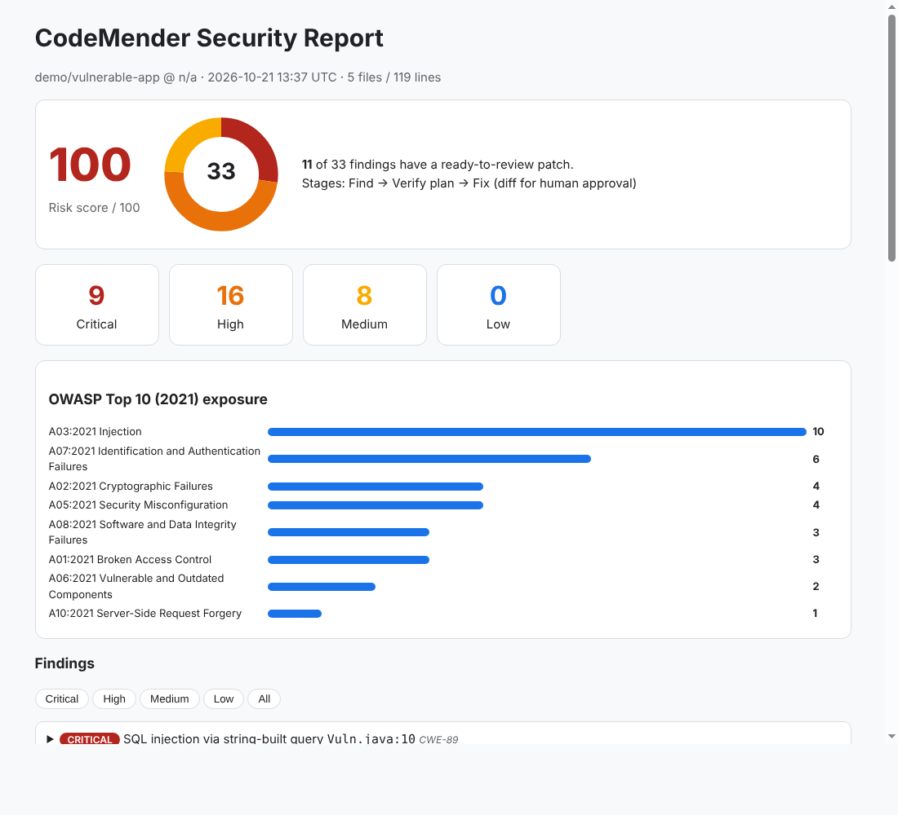
Reports and outputs
Everything the analysis agent produces for a repository
Interactive HTML dashboard
risk score, severity donut, OWASP exposure, filterable findings
Markdown executive summary
paste into tickets / chat
SARIF 2.1.0
GitHub code scanning, IDEs, DevSecOps pipelines
JSON + CSV
dashboards, audit evidence, import to other tools
Patch set (unified diff)
reviewable fixes, hand-off to the Defect-Fix agent
Per-finding detail
CWE, OWASP, why it matters, fix, verification plan
CodeMender · Code security agent
6

Slide 7
Demo architecture: agents working together via A2A
Gemini Enterprise
Defect-Fix Agent
CodeMender Analysis Agent
Git repository
→
→
→
User asks:
“Analyse and fix this repo”
ADK · Agent Engine
Orchestrates the fix
ADK · Agent Engine (A2A)
Find · Verify plan · Fix
Cloned read-only,
scanned, discarded
A2A over Vertex AI Agent Engine · IAM-authenticated · both agents registered in Gemini Enterprise
1. Defect-Fix agent delegates repo analysis to CodeMender over A2A.
2. CodeMender returns severity, CWE/OWASP, patches and report links.
3. Defect-Fix agent applies approved fixes and re-runs analysis to confirm.
CodeMender · Code security agent
7

Slide 8
Live demo: results on the sample repository
5 files · 119 lines · Python, JavaScript, Java, C, Kubernetes YAML
9
16
8
0
100/100
Critical
High
Medium
Low
Risk score
Top weakness classes
Remediation readiness
CWE-798 ×4
CWE-502 ×3
CWE-89 ×2
CWE-78 ×2
CWE-120 ×2
33 findings, 11 with a ready-to-review diff
Every finding: CWE, OWASP category, fix guidance, verification plan
Patches are suggestions; humans approve
CodeMender · Code security agent
8

Slide 9
Business value
Faster remediation
Less noise
From finding to reviewed patch in one flow
Exploit verification reduces false positives
Safer changes
Audit-ready
Build/test validation and LLM-judge before approval
SARIF/JSON/CSV evidence, OWASP & CWE mapping
CodeMender · Code security agent
9

Slide 10
Next steps
1. Enable CodeMender preview on the Gemini Enterprise Agent Platform project
2. Install the `cm` CLI on build/dev hosts; connect to the analysis agent
3. Wire the analysis agent into CI and the Defect-Fix agent via A2A
4. Pilot on 2–3 priority repositories; track time-to-fix and false-positive rate
5. Expand: scheduled scans, SARIF into code scanning, Wiz / AI Threat Defense integration
Sources: Google Cloud blog “Now in preview: Find and fix software vulnerabilities with CodeMender” (Jul 2026); Google DeepMind announcement (Oct 2025).
CodeMender · Code security agent
10

