Slide 1
Direct Regression of Distortion Field from a Single Fingerprint Image
Xiongjun Guan, Yongjie Duan, Jianjiang Feng, and Jie Zhou
Department of Automation, BNRist, Tsinghua University, China
Notes:
Hello everyone, this is XiongJun Guan from Tsinghua University.
It’s my honor to introduce our study: Direct Regression of Distortion Field from a Single Fingerprint Image.

Slide 2
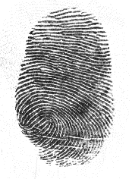
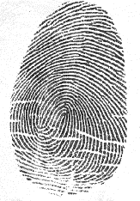
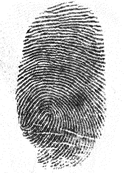
Introduction
Fingerprint 1
(distorted)
Fingerprint 2
(normal)
Fingerprint 1
(rectified)
Skin distortion increases intra-class variation and reduces the matching performance
Distortion field of the same finger is different under different pressing poses and strengths
a long standing challenge !
match score: 96
match score: 236
Direct Regression of Distortion Field from a Single Fingerprint Image
Notes:
Fingerprint is one of the most important and widely used biometric traits due to its easy collection process, persistence and uniqueness.
However, since the finger pulp is curved and soft, fingerprint will deform when it is in contact with acquisition equipment, and the distortion field becomes obvious when it is subjected to lateral force or torque.
This distortion changes the ridge orientation, ridge frequency, and relative positions of minutiae, which increases intra-class variations among fingerprints from the same finger and thus reduces the matching performance.
In addition, the distortion field of the same finger is different under different pressing poses and strengths, which makes the recognition of distorted fingerprints more challenging.

Slide 3
Introduction
Previous methods
Contactless 3D imaging [1] - not widely used
Distortion detection [2] - usually requires additional sensors
Distortion-tolerant matching [3] - inevitably increases the false match rate
Elastic registraition [4] - time-consuming
Distortion rectification [5]
more universal and efficient !
A. Kumar. Contactless 3D Fingerprint Identification. Springer International Publishing, 2018.
C. Dorai, N. Ratha, and R. Bolle. Dynamic behavior analysis in compressed fingerprint videos. IEEE Transactions on Circuits and Systems for Video Technology, 14(1):58–73, Jan. 2004.
X. Chen, J. Tian, and X. Yang. A new algorithm for dis_x0002_torted fingerprints matching based on normalized fuzzy similarity measure. IEEE Transactions on Image Processing, 15(3):767–776, 2006.
Z. Cui, J. Feng, and J. Zhou. Dense registration and mosaicking of fingerprints by training an end-to-end network. IEEE Transactions on Information Forensics and Security, 16:627–642, 2021.
A. Dabouei, H. Kazemi, S. M. Iranmanesh, J. Dawson, and N. M. Nasrabadi. Fingerprint distortion rectification using deep convolutional neural networks. In International Conference on Biometrics (ICB), pages 1–8, 2018
Direct Regression of Distortion Field from a Single Fingerprint Image
Notes:
Researchers have proposed several methods to overcome the negative effects introduced by contact fingerprint distortion, which can be classified as contactless 3D imaging, distortion detection,distortion-tolerant matching, elastic registraition, and distortion rectification.
Although contactless 3D fingerprints can avoid skin distortion, this technology has not been widely used.
Distortion detection usually requires additional sensors in the fingerprint acquisition stage, which is expensive and cannot be applied to existing fingerprint databases.
Distortion-tolerant matching inevitably increases the false match rate while allowing large distortion.
Elastic registration needs to be performed on every matching pair which is time-consuming for identification systems.
While given a single distorted fingerprint, distortion rectification algorithms can rectify it to remove distortion component before matching stage.
There is no need to change the existing acquisition and matching modules and only need to be performed once after acquisition, which is more universal and efficient.

Slide 4
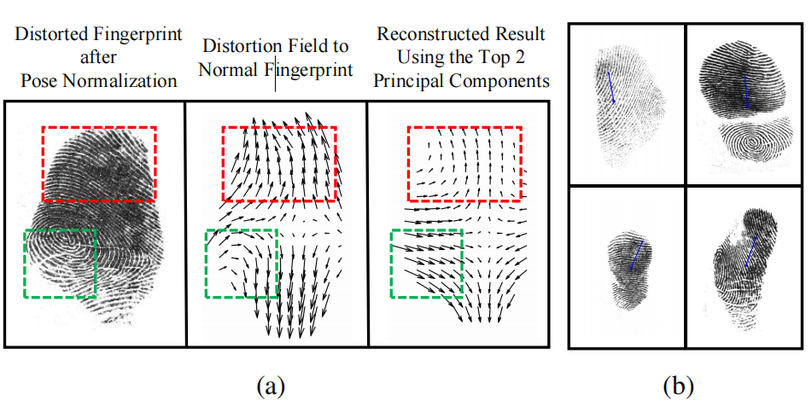
Introduction
Conventional rectification algorithms are based on PCA, which are limited
S. Gu, J. Feng, J. Lu, and J. Zhou. Efficient rectification of distorted fingerprints. IEEE Transactions on Information Forensics and Security, 13(1):156–169, 2017.
A. Dabouei, H. Kazemi, S. M. Iranmanesh, J. Dawson, and N. M. Nasrabadi. Fingerprint distortion rectification using deep convolutional neural networks. In International Conference on Biometrics (ICB), pages 1–8, 2018
Direct Regression of Distortion Field from a Single Fingerprint Image
Notes:
Conventional rectification algorithms estimate the distortion field represented by Principal Component Analysis, whose performance is highly dependent on the performance of pose normalization, and is limited by the accuracy of principle components.
Figure (a) shows a failure case where local details are lost even if pose normalization is accurate, and the error of PCA reconstruction will be larger when the finegr pose is misestimated such as examples in (b).

Slide 5
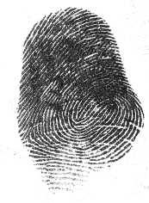
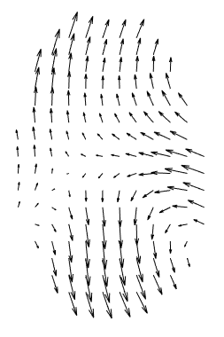
Motivation
Directly regress the dense distortion field
Dense estimation: finely estimate detailed distortion patterns, instead of its low dimensional representation
Directly estimation: the dependence on finger pose is avoided
Estimated Distortion Field
Distorted Fingerprint
Rectified Fingerprint
Direct Regression of Distortion Field from a Single Fingerprint Image
Notes:
Therefore, we propose a dense rectification method, which directly estimates the distortion field from a single distorted fingerprint image.
Correlation between local and global distortion patterns is captured so as to finely estimate detailed distortion patterns, rather than a linear superposition of principle components as previous studies, which can only restore a rough distortion field.
Meanwhile, the dependence on finger pose is avoided because we directly regress the distortion field through convolution neural network, which is translation invariant.

Slide 6
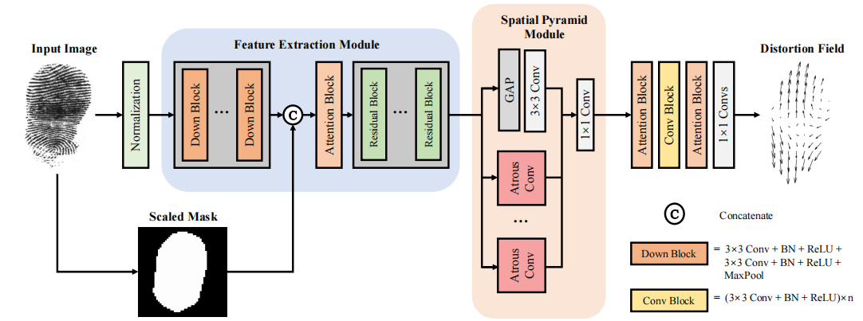
Network architecture
Direct Regression of Distortion Field from a Single Fingerprint Image
Notes:
We aim to predict a dense distortion field ditectly from a single fingerprint by utilizing multi-scale feature information. The proposed network structure is shown in Figure.
It takes the distorted fingerprint and scaled mask as input, and outputs the two-dimensional distortion field to the rectification target. The rectified fingerprint is obtained by shifting the input image pixel by pixel according to the prediction result of the network.
It is noted that the input mask is needed because a mask-related constraints used when generating ground truth. We add the mask after downsampling blocks instead of before, because it is used to constrain the estimation of the distortion and not helpful for analyzing the regional features.
To better focus on the information of multiple channels, a coordinate-sensitive channel attention block is adopted. After assigning weights to channels, several residual blocks are concatenated to better extract and integrate feature information.
Since fingers have a continuous irregular elastic surface, the distortion field of the distorted fingerprint is usually relatively uniform in a large area, and it is locally different at the same time. In order to capture those contextual information at multiple scales, global average pooling and atrous convolution blocks with different dilation rates are parallelized in the spatial pyramid module.
In the last part, attention blocks and convolution blocks are used to regress the distortion field.

Slide 7
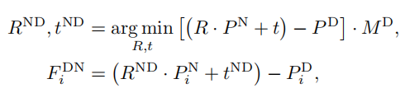
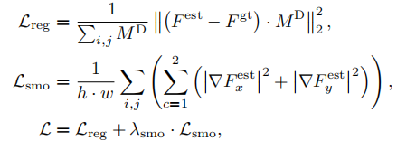
Loss function
Distortion field defination
Loss function
N : normal fingerprint
D : distorted fingerprint
P : coordinates set
F : distorted field
Direct Regression of Distortion Field from a Single Fingerprint Image
Notes:
We take the initial frame as the normal fingerprint and the end frame as the distorted fingerprint, and obtain the displacement between them by pairing minutiae points in adjacent frames and performing thin-plate spline interpolation. Instead of simply computing difference as existing methods, given a distorted fingerprint D and its corresponding normal fingerprint N, we first align the fingerprint pairs rigidly and then extract non Direct Current components in distortion.
With the strong constraint proposed above, the situation of multiple solutions due to rigid transformations is avoided, and unnecessary DC component caused by finger translation or rotation during acquisition will not be introduced.
The training loss consists of two parts: the regression loss between the estimated distortion field and the ground truth, and the smoothing loss according to the gradient of distorted field.

Slide 8
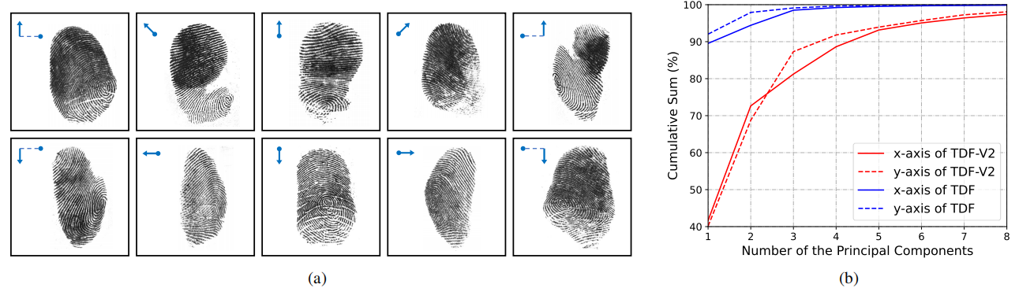
Distorted fingerprints database
Tsinghua Distorted Fingerprint (TDF) database (320)
Additional Distorted Fingerprint Videos (480)
TDF-V2
Direct Regression of Distortion Field from a Single Fingerprint Image
Notes:
To take full advantage of the learning capability of neural networks, a large amount of distorted fingerprint data needs to be provided. However, most of the distorted fingerprints in public Tsinghua Distorted Fingerprint database are of front pose, high quality, and have simple distortion patterns, which are relatively easy to rectify. Therefore, we collected more abundant distorted fingerprints.
TDF has 320 distorted fingerprints. In the collection process of this database, fingers were first pressed in the front pose, and then deformed by horizontal or vertical force or torque.
Considering that the common fingerprint distortion in pracice is usually caused by unidirectional force and may occur with various poses, we collected additional 480 distorted fingerprint videos generated by one-way rubbing in different directions on the front or side finger pose, instead of torque and two-stage force types in TDF.
Examples of 10 distortion fingerprint types and the principal component distribution of all data are shown in Figure. It takes about 6-8 principal components to represent the distortion field well, instead of 2 for TDF, which proves that with different initial poses and pressing directions, different distortion patterns will be produced.
We merged the above two distorted fingerprint databases, and named the new database as TDF-V2 for convenience. 640 videos in TDF-V2 are used for training and the remaining 160 for testing.

Slide 9
Experiments
Database
160 fingerprints in TDF-V2 (TDF-V2_T)
Hard subset of TDF-V2_T
Three types of evaluation
Distortion estimation accuracy
Matching performance
Model complexity and efficiency
Direct Regression of Distortion Field from a Single Fingerprint Image
Notes:
We selected 160 distorted fingerprints as the test set and matched them with multiple corresponding normal fingerprints. We also select the part with relatively lowr matching score as the hard subset.
We evaluate our method in three types of evaluation.

Slide 10
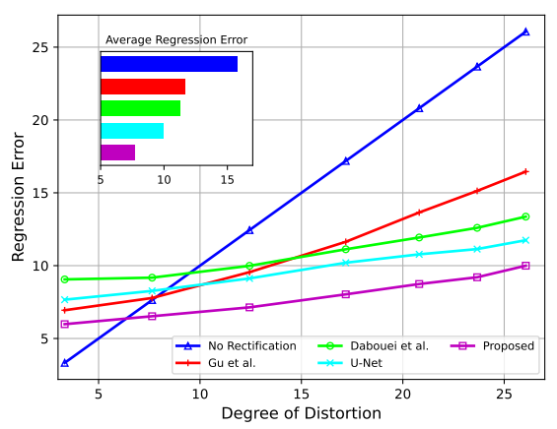

Distortion estimation accuracy
Regression error respectively of different distortion field estimation algorithms on TDF-V2_T
Direct Regression of Distortion Field from a Single Fingerprint Image
Notes:
We regard amplitude of each point in the distortion field (without rectification) as its degree of distortion, and divide the complete mask into different sub regions pixel by pixel according to it.
Regression error of each region is calculated separately, so as to specifically observe the estimation accuracy under different degrees of distortion.
As shown in Figure, dense estimation methods perform better than PCA based methods on large distoriton regions, which proves that directly regressing the distortion field is more refined.
Proposed method significantly outperforms other methods in both regions with large and small distortions. Even for regions with slight distortion, our network still performs appropriate rectification.

Slide 11
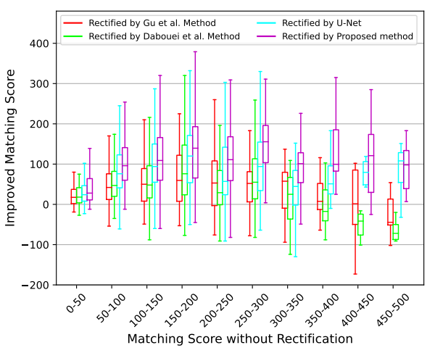
Matching performance
Boxplot of VeriFinger matching score improvements after rectification on TDF-V2_T
Only the pairs with original matching score (without rectification) lower than 500 are shown in Figure 6, since matching scores over 500 are sufficiently high for genuine match.
Direct Regression of Distortion Field from a Single Fingerprint Image
Notes:
To quantitatively evaluate the performance of these distortion rectification methods in a complete fingerprint recognition system, we further evaluated the matching performance using fingerprints after distortion rectification. Matching scores are computed by a commercial software VeriFinger.
We first compare the matching score improvement of different rectification methods.
Genuine match scores are calculated for each distorted fingerprint and its corresponding normal fingerprints.
From the distribution we can see that the proposed method leads prominently in each segment. PCA based methods do not work well in cases where the original matching scores are high which means the fingerprint distortion is slight, because it is a global distortion and may incorrectly rectify some local areas.

Slide 12
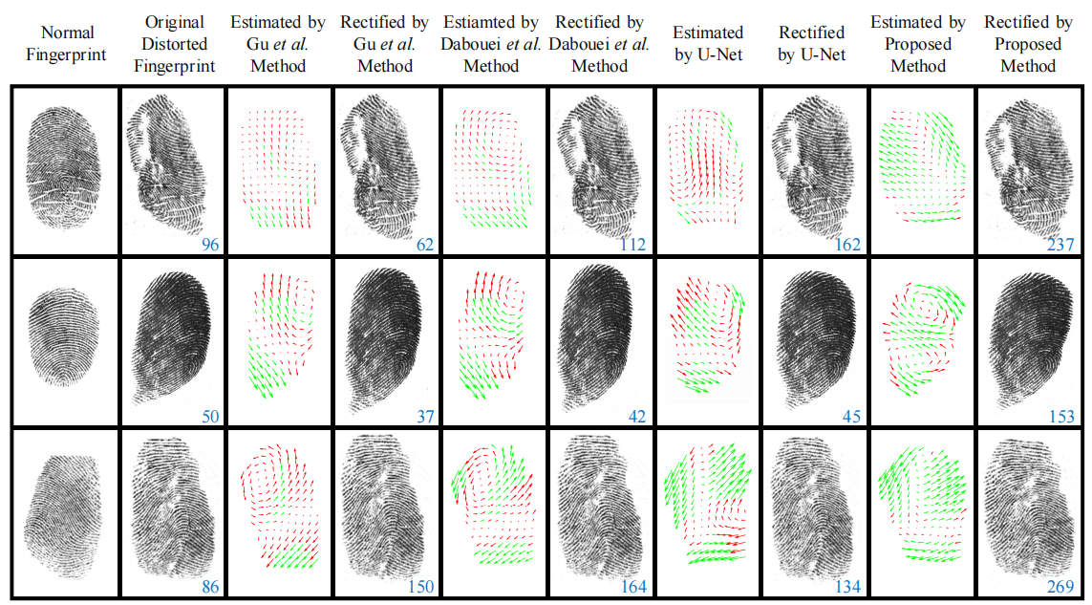
Matching performance
Direct Regression of Distortion Field from a Single Fingerprint Image
Notes:
Three examples are given in Figure to compare the rectified results. The blue numbers are matching scores between the normal fingerprint and the distorted one calculated by VeriFinger. The green vectors in the estimated distortion field indicate the correctly estimated distortion elements, while the red vectors for wrong.
Existing methods expose the following problems: (1) hard to deal with fingerprints whose pose cannot be accurrately normalized like line 1; (2) only significant distortion in one direction is concerned and transverse distortion is ignored in line 2; (3) cannot understand complex distortion like line 3. while our method works well in these cases.

Slide 13
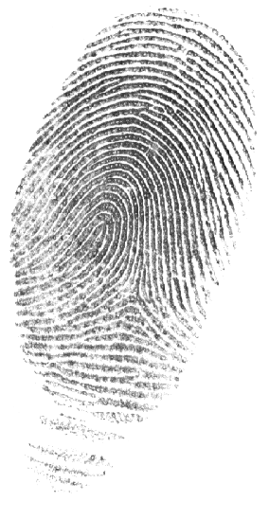
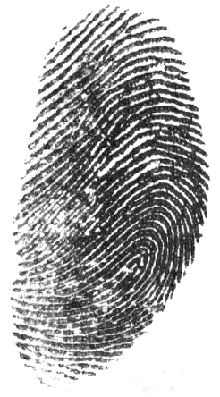
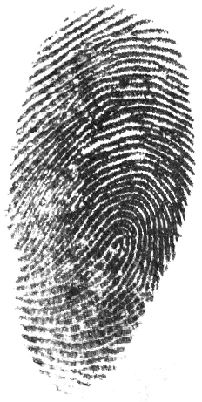
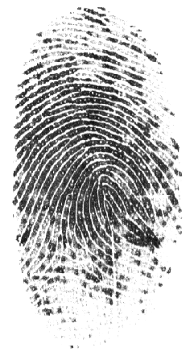
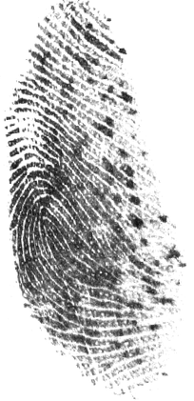
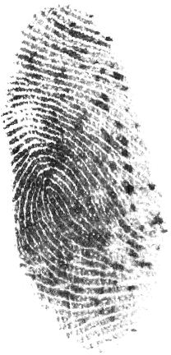
Matching performance
Fingerprint 1
(normal)
Fingerprint 2
(distorted)
Fingerprint 2
(rectified)
Fingerprint 1
(normal)
Fingerprint 2
(distorted)
Fingerprint 2
(rectified)
86
104
269
257
Direct Regression of Distortion Field from a Single Fingerprint Image
Notes:
Here are two other examples, which show how our method improve the matching score by rectifying the distortion field.

Slide 14
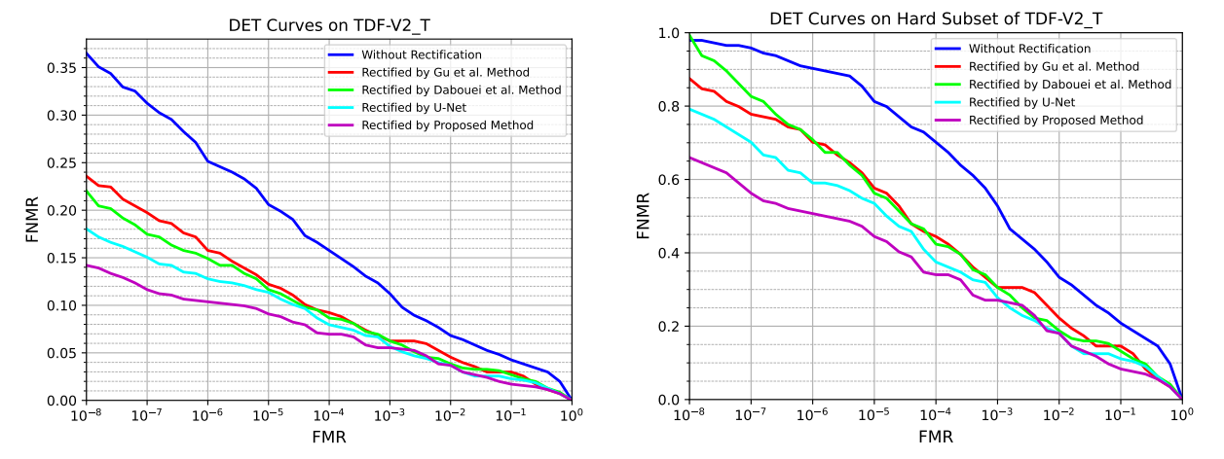
Matching performance
Direct Regression of Distortion Field from a Single Fingerprint Image
Notes:
To further evaluate the rectification performance in recognition task, Detection Error Tradeoff curves are depicted in Figure. Same as previous experimental settings, we only use genuine match scores because the match score of VeriFinger has been designed to map the false match rate.
This allows us to measure the false non-match rates at lower FMRs despite the limited number of imposter matches.
It can be observed from these curves that our method exceeds other rectification methods on matching performance.

Slide 15
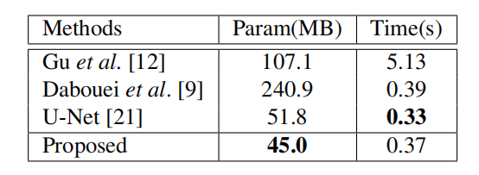
Model complexity and efficiency
All rectification algorithms are implemented in Python on a computer with a NVIDIA GeForce RTX 2080 Ti GPU and a 1.2 GHz CPU.
[1]
[2]
[3]
S. Gu, J. Feng, J. Lu, and J. Zhou. Efficient rectification of distorted fingerprints. IEEE Transactions on Information Forensics and Security, 13(1):156–169, 2017.
A. Dabouei, H. Kazemi, S. M. Iranmanesh, J. Dawson, and N. M. Nasrabadi. Fingerprint distortion rectification using deep convolutional neural networks. In International Conference on Biometrics (ICB), pages 1–8, 2018
O. Ronneberger, P. Fischer, and T. Brox. U-net: Convolutional networks for biomedical image segmentation. In In_x0002_ternational Conference on Medical Image Computing and Computer-Assisted Intervention, pages 234–241, 2015.
Direct Regression of Distortion Field from a Single Fingerprint Image
Notes:
This table shows the model size and efficiency of different rectification algorithms. Parameters of Gu and Dabouei contain the principal distortion patterns extracted by PCA.
Time in this table is the average time from inputting a 512 × 512 distorted fingerprint to outputting its rectified result.
It can be seen that our method has the smallest number of parameters and there is little difference in time cost.

Slide 16
Conclusion
An end-to-end network to directly estimate a dense distortion field:
Dense estimation: finely estimate detailed distortion patterns, instead of its low dimensional representation
Directly estimation: the dependence on finger pose is avoided
Experimental results on distorted fingerprint database demonstrates the superior performance
Direct Regression of Distortion Field from a Single Fingerprint Image
Notes:
In summary, we propose a fingerprint distortion rectification algorithm where the distortion field of a single fingerprint is directly regressed.
Self-reference relationship is constructed in the proposed network to finely estimate the detailed distortion patterns, instead of a sparse combination of principle components.
Moreover, the performance of our proposed method does not depend on pose normalization, which is unreliable for fingerprints with several distortion and non-frontal poses.
The experiments on distorted fingerprints demonstrates the superior performance of our method compared with other state-of-the-art approaches.

Slide 17
Notes:
Thank you for watching!
Please refer our paper for more details!

