Slide 1
Pose-Specific 3D Fingerprint Unfolding
Xiongjun Guan, Jianjiang Feng, and Jie Zhou
Department of Automation, Tsinghua University
Notes:
Hello everyone, this is Xiongjun Guan from Tsinghua University.
It’s my honor to introduce our study: pose-specific 3D fingerprint unfolding.

Slide 2
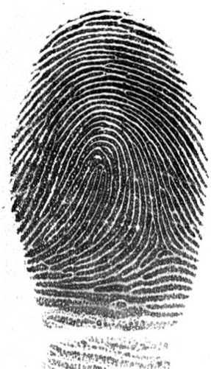
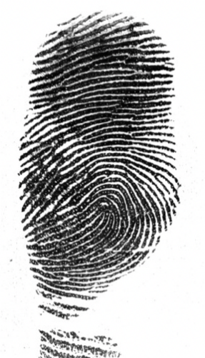
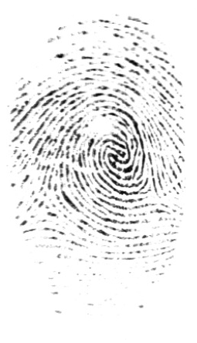
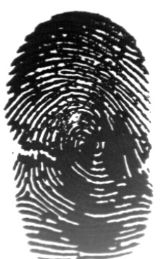
Introduction
The quality of 2D fingerprint image is disturbed by many factors
Skin deformation
Skin humidity
...
Fingerprint distortion
Dry fingerprint
Wet fingerprint
3D fingerprints are not affected by such factors!
Pose-Specific 3D Fingerprint Unfolding
Notes:
Fingerprint is one of the most widely used biometric traits beacause it is very stable, easy to collect and highly distinctive.
Up to now, 2D fingerprint images obtained by contact-based sensors are the dominating fingerprint image type.
However, the quality of 2D fingerprint images is affected by factors such as skin deformation and humidity.
Compared with 2D fingerprints, 3D fingerprints are not deformed, less affected by dry or wet fingers, and hygienic, since they are acquired in a non-contact manner.
Due to this advantage, a number of 3D fingerprint sensing technologies have been proposed .

Slide 3
Introduction
Existing fingerprint databases contain mainly 2D fingerprints
2D fingerprint sensors are very popular
3D fingerprint sensors are expensive and large
A compatible application scenario
3D for enrollment
2D for recognition
Pose-Specific 3D Fingerprint Unfolding
Notes:
Since existing fingerprint databases contain mainly 2D fingerprints and 2D sensors are very popular, new 3D fingerprint sensors need to be compatible with them.
Considering that 3D fingerprint sensors are expensive and large, a common application scenario is using 3D for enrollment and 2D for recognition.
For compatibility, 3D fingerprints are usually unfolded into 2D rolled fingerprints, which are then matched to query flat fingerprints by traditional 2D recognition technology.

Slide 4
Related Work
3D fingerprint unfolding methods
Parametric method
Non-parametric method
Unfolding in different postures will cause additional deformation
Fingerprint distortion
No explicit consideration of 3D finger shape
Pose-Specific 3D Fingerprint Unfolding
Notes:
Generally, there are two types of 3D fingerprint unfolding methods. Parametric method uses a hypothetical geometric model to approximate the 3D shape of the finger. However, since the finger is irregular, these models do not fully conform to the shape of fingers.
The non-parametric method does not assume the shape of the finger. But because of special shape of finger, it cannot be spread out on a plane without tearing.
In addition, the deformation of the fingerprint is related to its pressing pose, and the pose of the query fingerprint is not known in advance. Therefore, there is large deformation between the unfolded 3D fingerprint and the query fingerprint. This will result in false non-matches.
In order to deal with the skin deformation problem, researchers have proposed various deformable registration and matching algorithms, which are however designed for 2D fingerprints.
Since there is no explicit consideration of 3D finger shape during registration or matching, non-mated fingerprints may appear similar after unreasonable deformable registration, which may result in false matches.

Slide 5
Motivation
A pose-specific 3D fingerprint unfolding algorithm
A compatible application of 2D and 3D fingerprints
Unfold the 3D fingerprint using the same pose as the flat fingerprint
Explicit consideration of 3D finger shape
Reduce deformation caused by pose
Pose-Specific 3D Fingerprint Unfolding
Notes:
Therefore, with the aim of reducing deformation between unfolded and flat fingerprints we propose a pose-specific 3D fingerprint unfolding algorithm to unfold the 3D fingerprint using the same pose as the flat fingerprint.

Slide 6
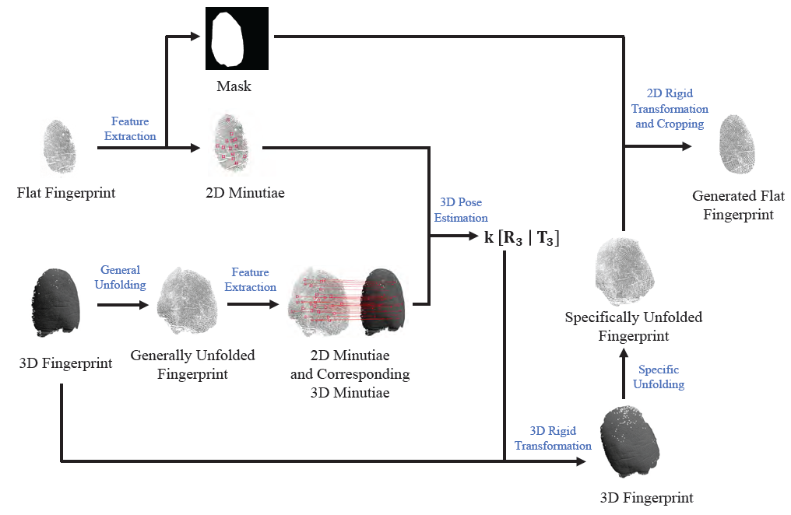
Algorithm flowchart
Pose-Specific 3D Fingerprint Unfolding
Notes:
Here is the complete process of our algorithm.
First we unfold the 3D fingerprint using the normal pose, next estimate the specific pose of the query flat, then unfold the 3D fingerprint using the estimated pose, and finally apply a 2D fingerprint registration method.
In the following we will describe the unfolding and 3D pose estimation steps.

Slide 7
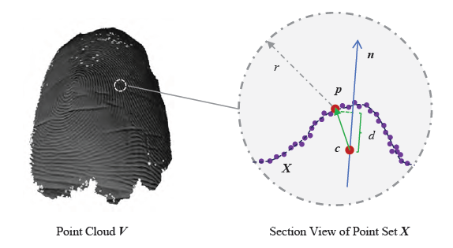


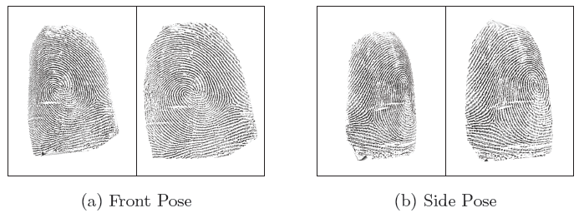
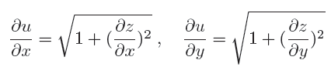

Unfolding
Point cloud Visualization
Unfolding
$$\left(x,y,z\right)→(u,v,0)$$
Pose-Specific 3D Fingerprint Unfolding
Notes:
There are two parts in unfolding: First, visualize the point cloud and then unfold it.
The visualization method takes the neighborhood around each point in the point cloud as the partial surface, and calculates the depth of the point relative to the surface. We use the normalized surface depth as the value and project it to the image plane.
During unfolding, we use the arc length between two points in the point cloud as the coordinates of the unfolded fingerprint.
The figure at the bottom right shows two comparisons of the visualization results before and after unfolding. The area with a large tilt relative to the observation plane is effectively flattened.

Slide 8
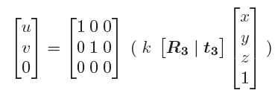
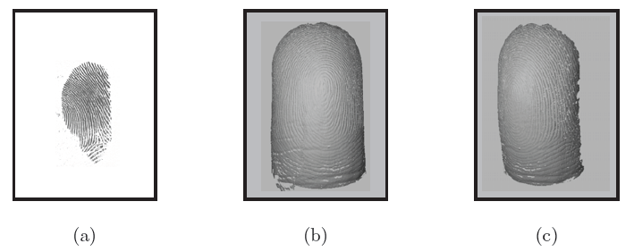
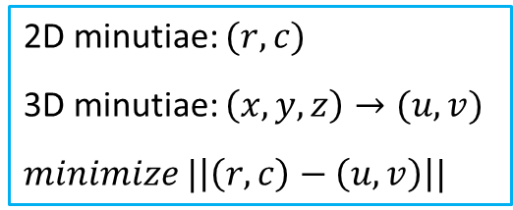
3D Pose Estimation
Global rigid transformation
2D minutiae: $(r,c)$
3D minutiae: $\left(x,y,z\right)→(u,v)$
$minimize |\left|\left(r,c\right)−\left(u,v\right)\right||$
Projection relationship
3D Pose estimation example
Pose-Specific 3D Fingerprint Unfolding
Notes:
The 3D pose estimation step conducts global rigid transformation between the 3D fingerprint and the flat fingerprint.
We use mated 3D/2D minutiae pairs to estimate a 3D rigid transformation to minimize the average distance under orthogonal projection.
The following figure shows an example of transformed 3D fingerprint using 3D pose estimation results. Figure (a) is a real flat fingerprint. (b) is the corresponding finger point cloud in the original pose. (c) is the point cloud in the same pose as the flat fingerprint.

Slide 9
Exepriments
Database
150 fingers’ 3D point clouds
1200 corresponding flat fingerprints (8 images per finger)
People aged 20 to 30
10 fingers were collected for each person
Pose-Specific 3D Fingerprint Unfolding
Notes:
Due to the lack of databases containing high quality finger point clouds and corresponding flat fingerprints, we collected a database for this study.
The finger point clouds were captured by using a commercial structured light 3D scanner, while the corresponding 2D flat fingerprints at multiple poses were captured with a Frustrated Total Internal Reflection (FTIR) fingerprint sensor.
3D point clouds of 150 fingers and 1200 corresponding flat fingerprints were used in our experiments. Finger data were collected from people aged 20 to 30. Ten fingers were collected for each person.

Slide 10
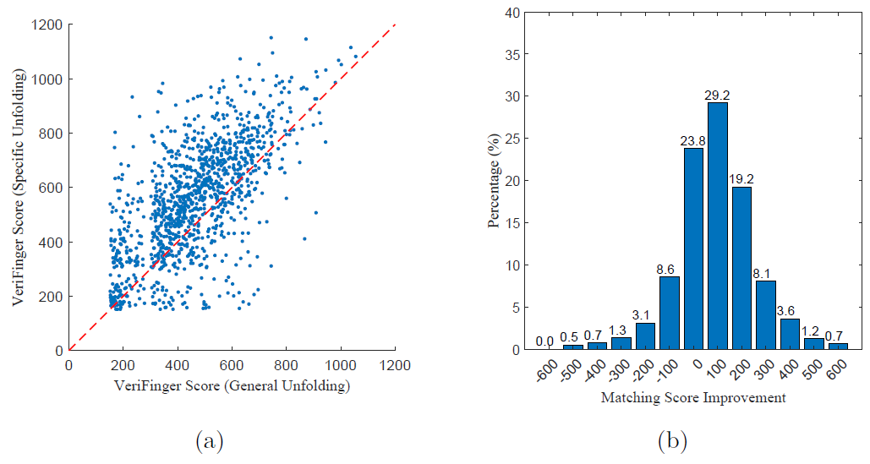
Matching Score
VeriFinger is used to calculate the matching score
Pose-Specific 3D Fingerprint Unfolding
Notes:
The purpose of unfolding is to improve the compatibility of 3D fingerprints and flat fingerprints, that is, to improve the matching score between them.
We match the results of general unfolding and our specific unfolding algorithm with the same flat fingerprint.
Due to high quality in the database, genuine match scores are much higher than impostor match scores, which makes them totally separable.
Therefore, we use the improvement of genuine matching score as an indicator of unfolding quality.
According to the figure, we can see that most of the matching performance are improved after pose-specific unfolding.
We analyzed the cases where pose-specific unfolding failed and found that in these cases, 3D pose estimation is inaccurate due to very small number of matching minutiae between 3D fingerprint and flat fingerprint.

Slide 11
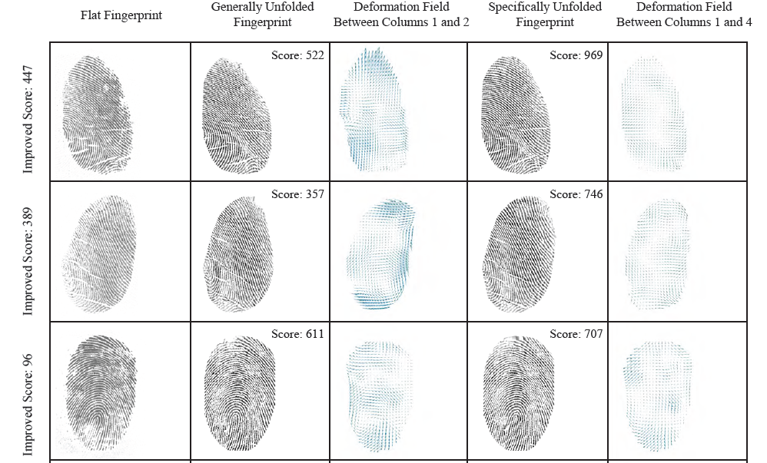
Deformation Field
Pose-Specific 3D Fingerprint Unfolding
Notes:
We estimate the deformation field between flat and unfolded fingerprints with general pose and specific pose to directly measure the performance of our unfolding algorithm.
Examples show that the improvement of the matching score is closely related to reduction of fingerprint distortion:
when fingerprint distortion is greatly reduced, the matching score improves very much.
The comparison also proves that our pose-specific unfolding does greatly reduce fingerprint deformation caused by different finger poses.

Slide 12
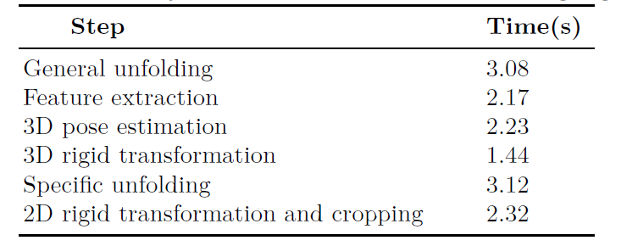
Efficiency
Speed of major steps of the proposed unfolding algorithm
Pose-Specific 3D Fingerprint Unfolding
Notes:
The average times of major steps of the proposed unfolding algorithm are reported in the following table.
Compared with general unfolding, our method requires additional steps for 3D pose estimation, 3D rigid transformation and specific unfolding.

Slide 13
Conclusion
A pose-specific 3D fingerprint unfolding algorithm
Explicit consideration of 3D finger shape
Reduce deformation caused by pose
Experiments show that pose difference is a very important cause for fingerprint deformation and genuine matching score can be greatly improved by pose-specific unfolding.
Pose-Specific 3D Fingerprint Unfolding
Notes:
In summary, we propose a novel pose-specific 3D fingerprint unfolding algorithm to unfold the 3D fingerprint using the same pose as the flat fingerprint.
We collected a database of mated 2D and 3D fingerprints.
Experiments on it show that our unfolding algorithm improves the compatibility between 3D fingerprint and flat fingerprint and thus leads to higher genuine matching scores.

Slide 14
Notes:
Thank you for watching!
Please refer our paper for more details!

Slide 15
References
Chen, Y., Parziale, G., Diaz-Santana, E., Jain, A.K.: 3D touchless fingerprints:Compatibility with legacy rolled images. In: Biometrics Symposium: Special Session on Research at the Biometric Consortium Conference, IEEE (2006) 1–6
Zhao, Q., Jain, A., Abramovich, G.: 3D to 2D fingerprints: Unrolling and distortion correction. In: International Joint Conference on Biometrics (IJCB), IEEE (2011) 1–8
Labati, R.D., Genovese, A., Piuri, V., Scotti, F.: Quality measurement of unwrapped three-dimensional fingerprints: a neural networks approach. In: International Joint Conference on Neural Networks (IJCNN), IEEE (2012) 1–8
Wang, Y., Lau, D.L., Hassebrook, L.G.: Fit-sphere unwrapping and performance analysis of 3D fingerprints. Applied Optics 49(4) (2010) 592–600
Anitha, R., Sesireka, N.: Performance improvisation on 3D converted 2D unraveled fingerprint. IOSR Journal of Computer Engineering (IOSR-JCE) 16(6) (2014) 50–56
Wang, Y., Hassebrook, L.G., Lau, D.L.: Data acquisition and processing of 3-D fingerprints. IEEE Transactions on Information Forensics and Security 5(4) (2010) 750–760
Labati, R.D., Genovese, A., Piuri, V., Scotti, F.: Fast 3-D fingertip reconstruction using a single two-view structured light acquisition. In: IEEE Workshop on Biometric Measurements and Systems for Security and Medical Applications (BIOMS), IEEE (2011) 1–8
Dighade, R.R.: Approach to unwrap a 3D fingerprint to a 2D equivalent. University of Maryland, Master Thesis (2012)
Pose-Specific 3D Fingerprint Unfolding

Slide 16
References
Fatehpuria, A., Lau, D.L., Hassebrook, L.G.: Acquiring a 2D rolled equivalent fingerprint image from a non-contact 3D finger scan. In: Biometric Technology for Human Identification III. Volume 6202., International Society for Optics and Photonics (2006) 62020C
Shafaei, S., Inanc, T., Hassebrook, L.G.: A new approach to unwrap a 3-D fingerprint to a 2-D rolled equivalent fingerprint. In: IEEE 3rd International Conference on Biometrics: Theory, Applications, and Systems (BTAS), IEEE (2009) 1–5
Bazen, A.M., Gerez, S.H.: Fingerprint matching by thin-plate spline modelling of elastic deformations. Pattern Recognition 36(8) (2003) 1859–1867
Ross, A., Shah, S., Shah, J.: Image versus feature mosaicing: A case study in fingerprints. In: Biometric Technology for Human Identification III. Volume 6202., International Society for Optics and Photonics (2006) 620208
Cheng, X., Tulyakov, S., Govindaraju, V.: Minutiae-based matching state model for combinations in fingerprint matching system. In: CVPR Workshop on Biometrics. (2013) 92–97
Si, X., Feng, J., Yuan, B., Zhou, J.: Dense registration of fingerprints. Pattern Recognition 63 (2017) 87–101
Cui, Z., Feng, J., Li, S., Lu, J., Zhou, J.: 2-D phase demodulation for deformable fingerprint registration. IEEE Transactions on Information Forensics and Security 13(12) (2018) 3153–3165
Pose-Specific 3D Fingerprint Unfolding

