Slide 1

Roundhouse
Kicking your database up a notch

Slide 2
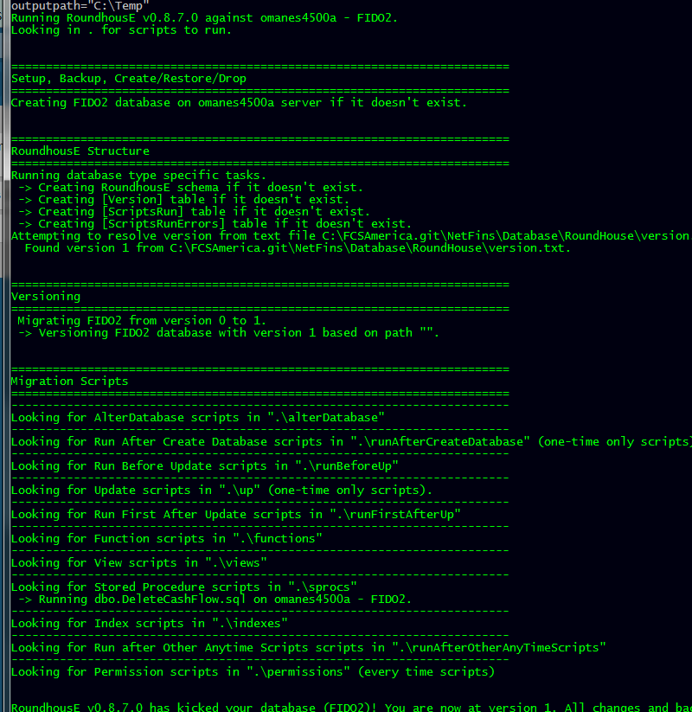
What is RoundhousE
Migrating databases
Open Source
Command line
Written in C#
https://github.com/chucknorris/roundhouse

Slide 3
What does it do?
Versions the database
Runs scripts in a particular order
Keeps track of scripts run
Replaces tokens for different environments

Slide 4
RoundhousE Script Types
One Time Scripts
Scripts that you will run once and only once
Folders: Up, RunAfterCreateDatabase
AnyTime Scripts
Scripts you will run whenever they change
Folders: Sprocs, Functions, Indexes
Everytime Scripts
Scripts you will run every time roundhouse runs, even if the script hasn’t changed
Folders: permissions
Also runs any script file with EVERYTIME in the name.

Slide 5
RoundhousE Script Types
Environment Scripts:
Scripts that should run only in particular environments
Folders: any folder. Just name the file with the environment name and put “.env” in it: SYSTEST.createTestSproc.env.sql
Token Replacement:
Any value in configuration can be tokenized: ALTER DATABASE {{DatabaseName}} will be changed to: ALTER DATABASE foo (if database name is “foo”)

Slide 6
RoundhousE Script Types
Environment Scripts:
Scripts that should run only in particular environments
Folders: any folder. Just name the file with the environment name and put “.env” in it: SYSTEST.createTestSproc.env.sql
Token Replacement:
Any value in configuration can be tokenized: ALTER DATABASE {{DatabaseName}} will be changed to: ALTER DATABASE foo (if database name is “foo”)

Slide 7
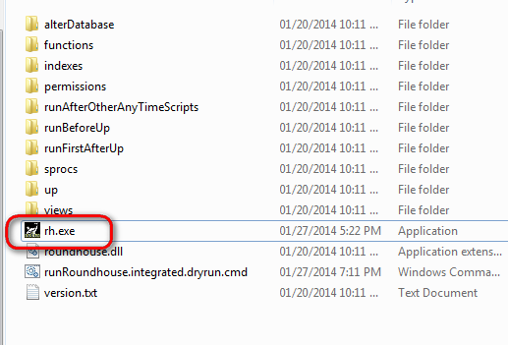
How do you use it?
Add your scripts
Run rh.exe
rh.exe -d FIDO -s omanes2500a -vf version.txt
File w/ db version
In it
Database name
Server

Slide 8
Scenario: Adding a table
This is a one time script
Put it in the up folder

