Slide 1




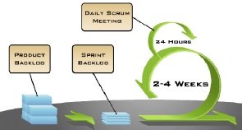






The Agile Scrum Framework
Product
Owner
Scrum
Master
Scrum
Team
Sprint Review
Product Backlog
Potentially shippable
product
Sprint Planning
Sprint Cycle
Retrospective Meeting
Pallavi v
Deepthi K

