Slide 1
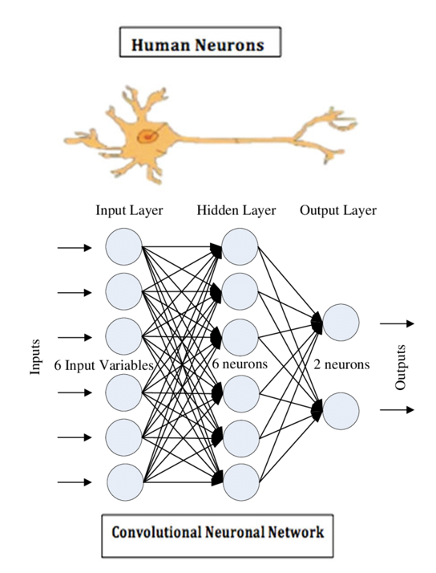
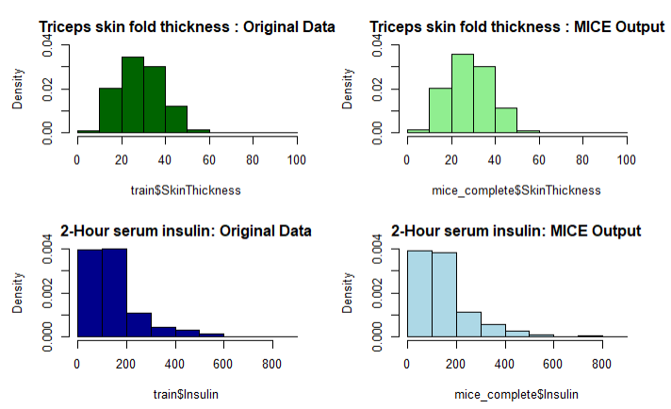
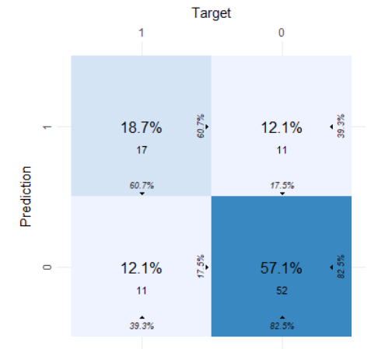
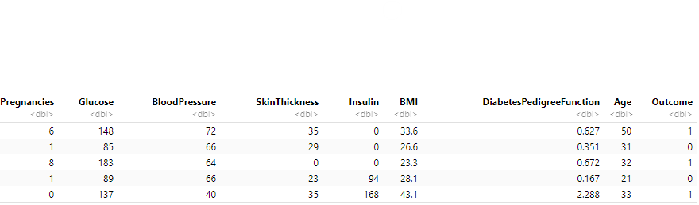
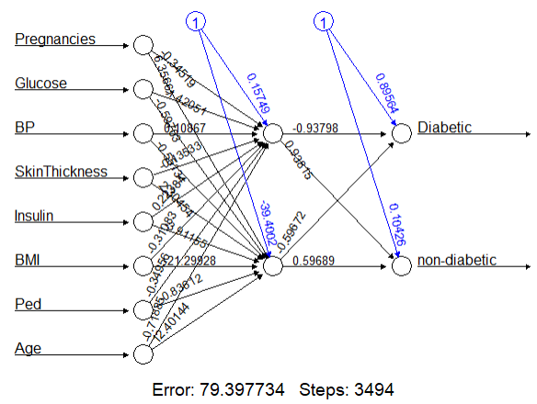
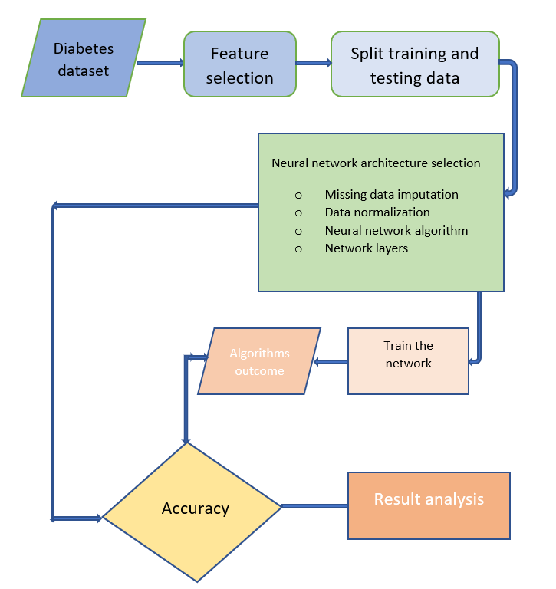
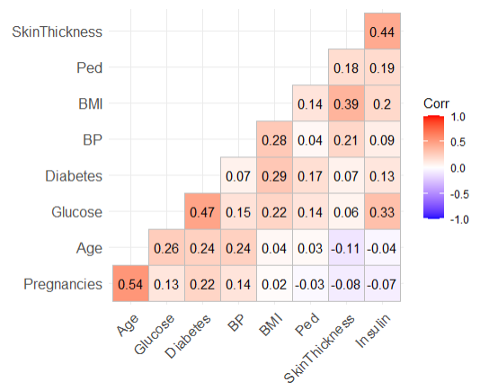
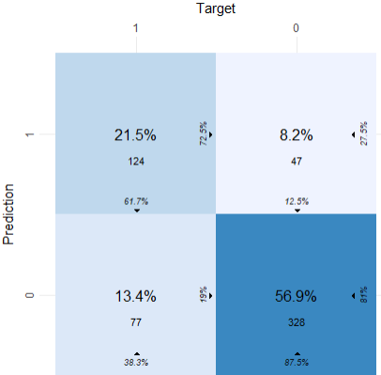
Supervised Machine Learning Application in Medical Research:
Prediction of Pima Indians Diabetes using Neural-Network approach
Sunanda Das, MSSDS, UTSA
Background
General Structure of Neural Network
Data preprocessing
Results
A neural network is a computer system modeled on the human brain.
Split the dataset: 75% for training and 25% for testing
Training dataset:
Missing Data Imputation:
I’ve used median on the small number of missing values and Multiple Imputations on the large number of missing values.
 | Evaluation of parameters
 | Train | Test
Accuracy | 0.7847 | 0.7582
Kappa | 0.5092 | 0.4325
Area under curve | 0.746 | 0.716
According to WHO, about 422 million people worldwide have diabetes, and 1.5 million deaths are directly attributed to diabetes each year. The Pima Indians of Arizona have the highest reported prevalence of obesity and non-insulin-dependent diabetes mellitus (NIDDM).
Early detection of diabetes is very important to maintain a healthy life and enhance life expectancy.
Confusion matrix for test data:
Objectives of the study
to create a machine learning tool to use medical data
analyze the relation between medical indexes and diabetes
Data source
originally from the National Institute of Diabetes and Digestive and Kidney Diseases
Kaggle website
Compared with the original distributions, the two complete distributions above for tsk thickness and serum are not significantly changed.
Data Normalization
Conclusion
Data overview
Model training and performance
Using a Neural network (NN), a pragmatic framework has been proposed to predict the diagnosis of diabetes. The model is evaluated based on different parameters- accuracy, kappa and AUC. The proposed NN framework is effective and efficient, with a 76% accuracy for Pima Indian dataset. In summary, NN is functionally beneficial for successfully predicting the diagnosis of diabetes with suitable disease input features and a corresponding set of instances.
Neural network on training data:
The proposed framework
Response variable
Diabetes: 0 (negative test representing diabetes) or
1 (positive test representing diabetes)
Features:
Future work
it would be interesting to test other supervised machine learning methods with other diabetes datasets or other types of datasets and compare the results.
Confusion Matrix:
References
Who-Diabetes . https://www.who.int/health-topics/diabetes#tab=tab_1
Muhammad Mazhar Bukhari et al. An Improved Artificial Neural Network Model for Effective Diabetes Prediction. https://doi.org/10.1155/2021/5525271
L. Mamykinaa et al., Personal discovery in diabetes self-management: discovering cause and effect using self-monitoring data, J. Biomed. Informat. 76 (2017) 1–8.
M.W. Libbrecht, W.S. Noble, Machine learning applications in genetics and genomics, Nat. Rev. Genet. 16 (6) (2015) 321–332.
No strong correlation was observed between variables (highest 0.47). So, no need to drop any of them for analysis.

