Slide 1
TRANSISTOR
Pandapotan Siagian, ST, M.Eng

Slide 2
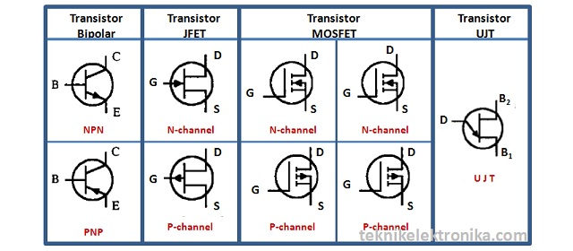
Jenis-Jenis Transistor

Slide 3
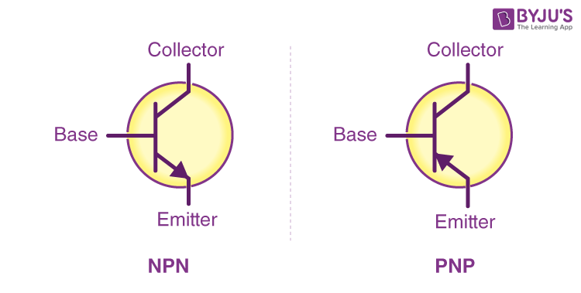
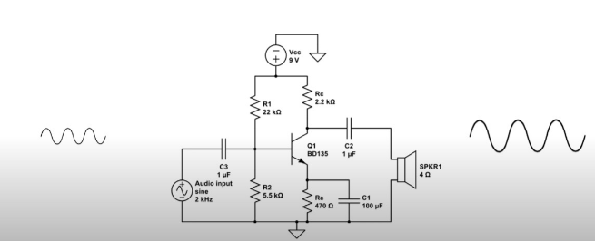
1. Transistor Bipolar (BJT)

Slide 4
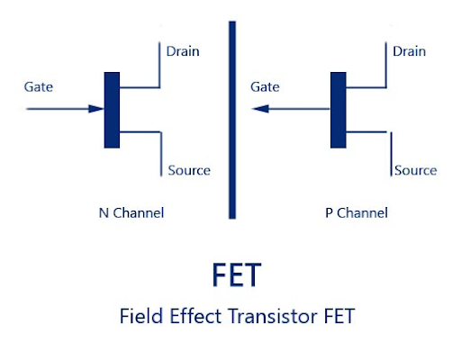
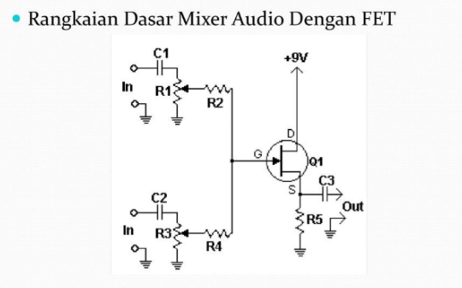
2. FET (Field Effect Transistor)

Slide 5
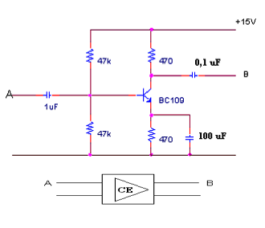
Common Emitter (CE) Amplifier (kiri):

Slide 6
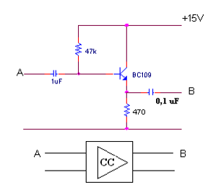
Common Collector (CC) Amplifier atau Emitter Follower (tengah):

Slide 7
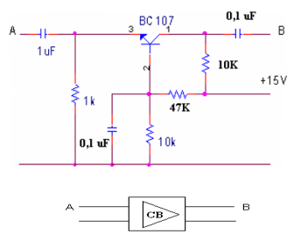
Common Base (CB) Amplifier (kanan):

Slide 8
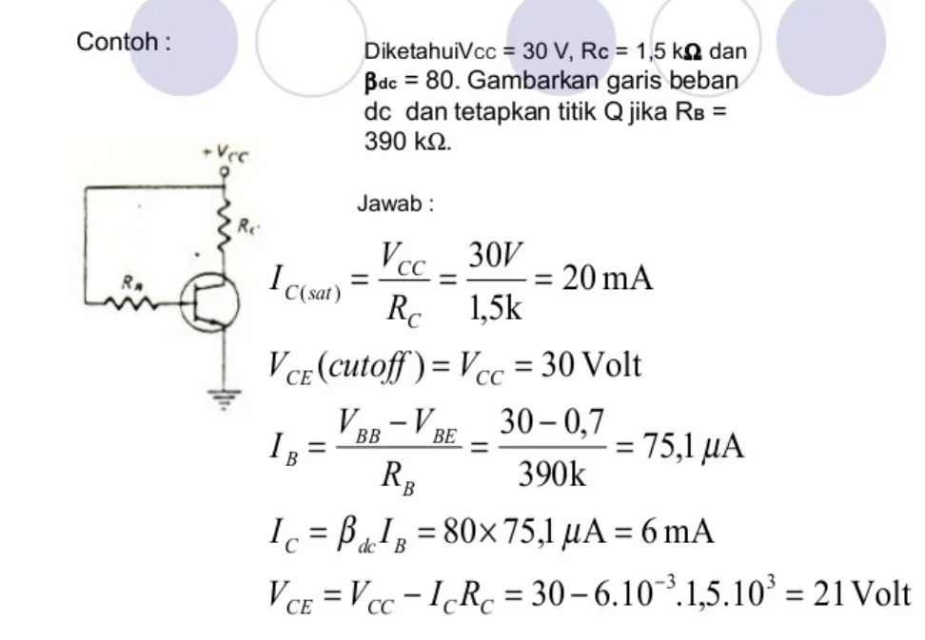
Contoh Soal:

Slide 9
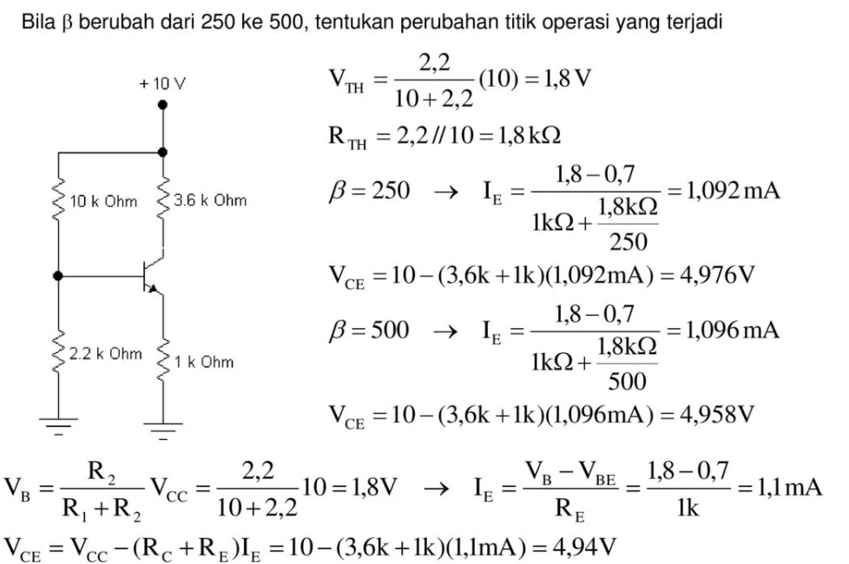
Contoh Soal:

Slide 10
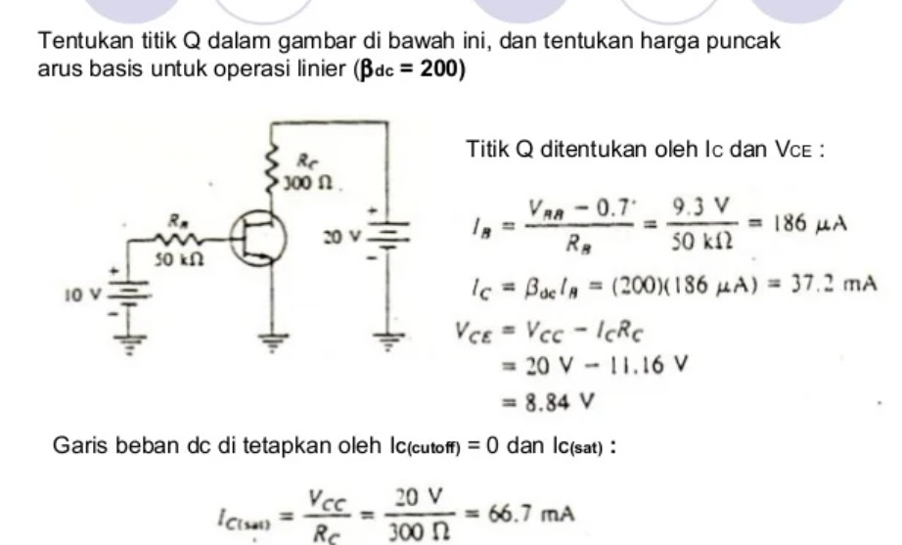
Contoh Soal:

Slide 11
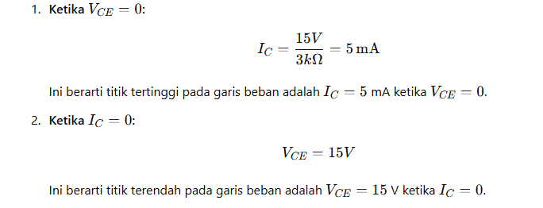
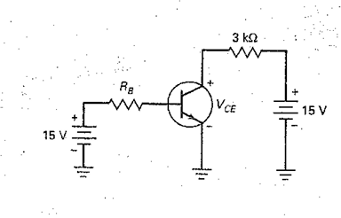
Contoh Soal:

Slide 12
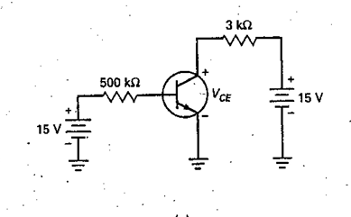
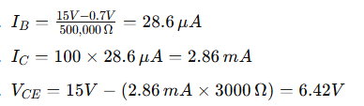
Contoh Soal:

Slide 13
Terima kasih

