Slide 1

19CSE305 Machine Learning Project Review - 1
Airline Passenger Satisfaction

Slide 2

TEAM MEMBERS
Datta Sai Kumar - CB.EN.U4CSE20406
Harsha - CB.EN.U4CSE20414
Gouthami - CB.EN.U4CSE20415
Balaji R - CB.EN.U4CSE20451
Subhash Gupta - CB.EN.U4CSE20466

Slide 3

Outline
Objective(s)
Introduction
Background
Dataset Description
Data Visualization
Baseline Models
Conclusion
References

Slide 4
1. Introduction
Obtained about 130k of flight satisfaction surveys from Kaggle.
Data is taken from passengers from a US airline.
Goal: Identify critical factors that ensure satisfaction.
Focus on Precision of our machine learning model.

Slide 5
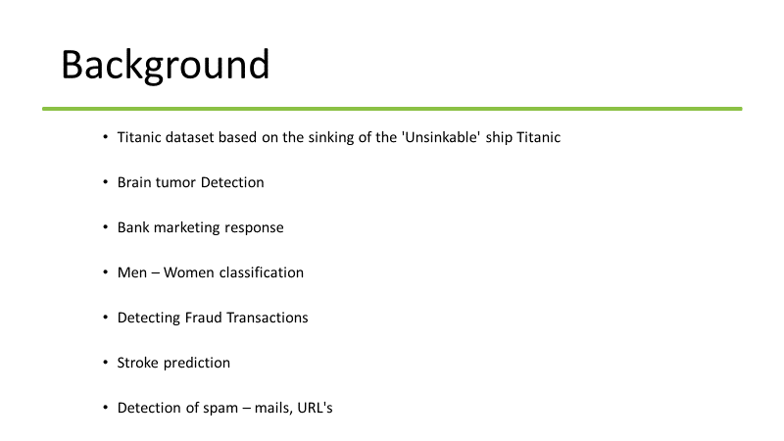

Slide 6
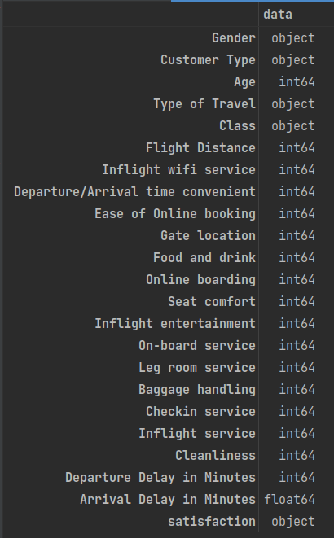
Dataset Description
The dataset contains the survey of airline passenger satisfaction
[103904 rows × 24 columns]
Gender - Gender of the passengers [Female, Male]
Customer Type - Type of Customer [Loyal customer, disloyal customer]
Age - Passenger's Age
Type of Travel - Purpose of the travel [Personal Travel, Business Travel]
Class - Travel class in the plane [Business, Eco, Eco Plus]
Flight distance - The flight distance of this journey
Inflight Wi-Fi service - Satisfaction level of the inflight Wi-Fi service [0:Not Applicable;1-5]
Departure/Arrival time convenient - Satisfaction level of Departure/Arrival time convenient

Slide 7
Ease of Online booking - Satisfaction level of online booking
Gate location - Satisfaction level of Gate location
Food and drink - Satisfaction level of Food and drink
Online boarding - Satisfaction level of online boarding
Seat comfort - Satisfaction level of Seat comfort
Inflight entertainment - Satisfaction level of inflight entertainment
On-board service - Satisfaction level of On-board service
Leg room service - Satisfaction level of Leg room service
Baggage handling - Satisfaction level of baggage handling
Check-in service - Satisfaction level of Check-in service
Inflight service - Satisfaction level of inflight service
Cleanliness - Satisfaction level of Cleanliness
Departure Delay in Minutes - Minutes delayed when departure
Arrival Delay in Minutes - Minutes delayed when Arrival
Satisfaction - Airline satisfaction level [Satisfaction, neutral or dissatisfaction]

Slide 8
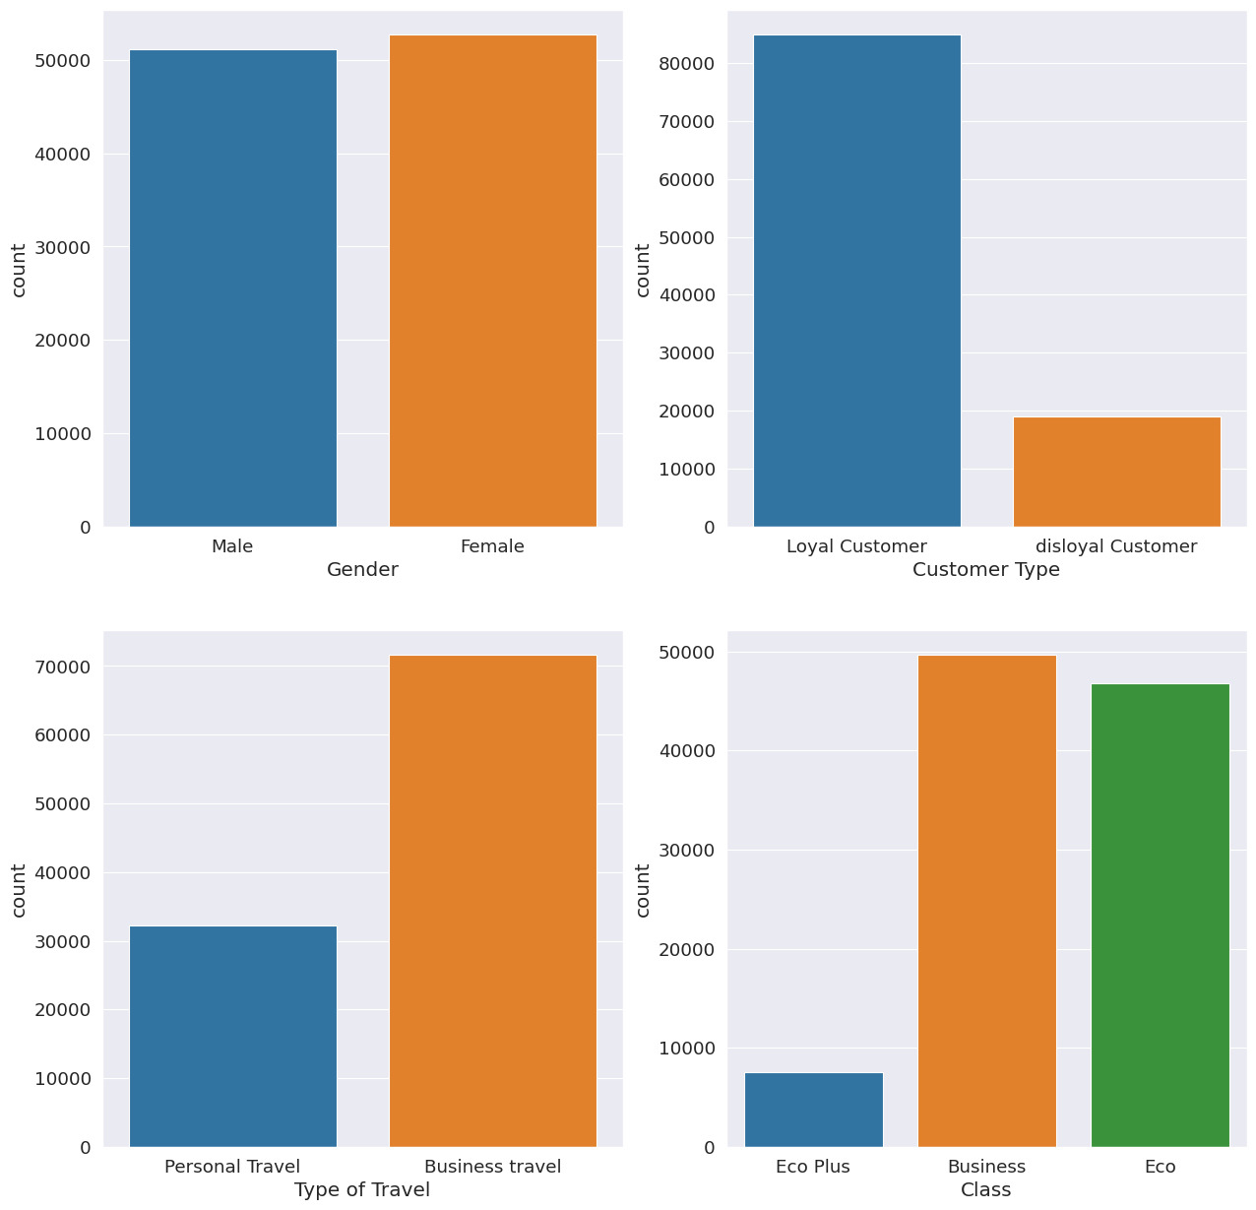
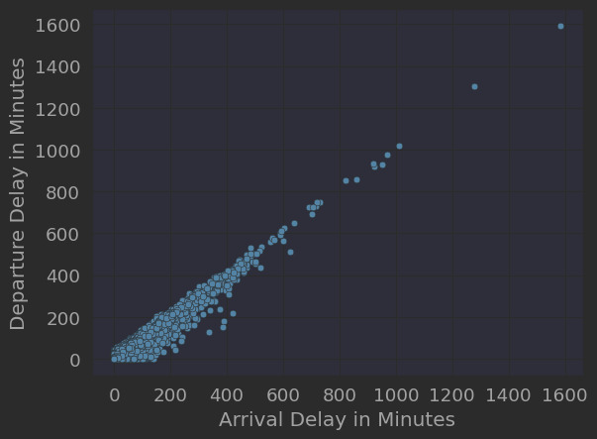
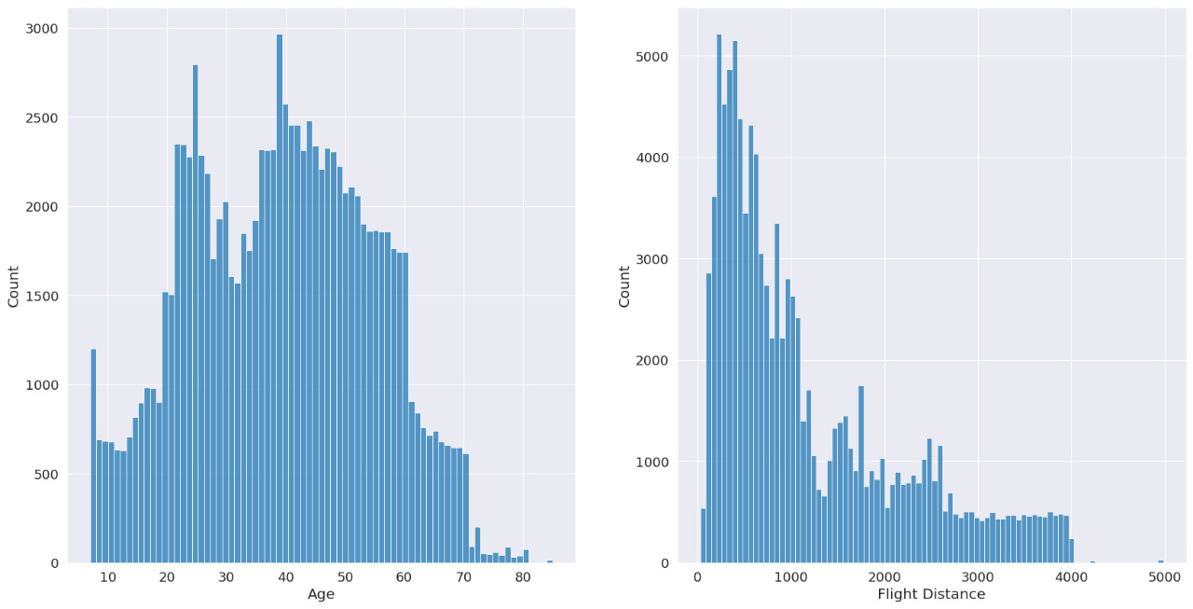
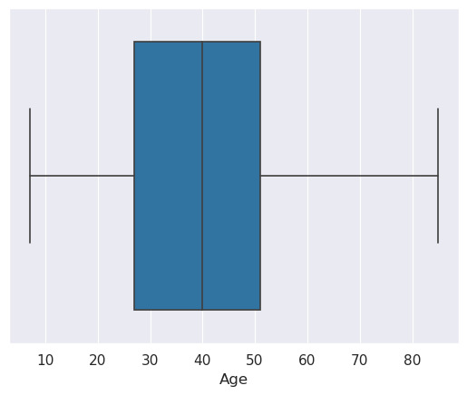
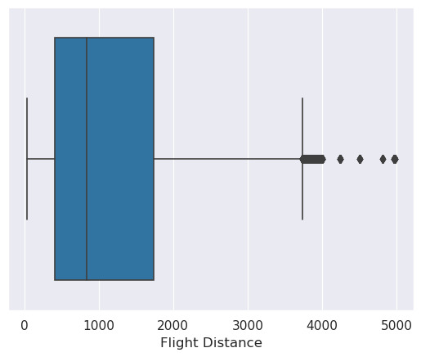
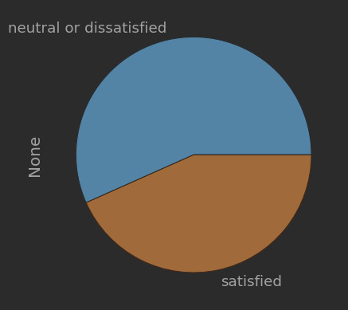
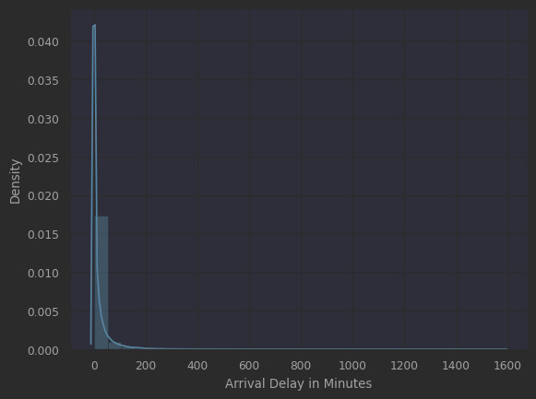
Data Visualization
Count plot
Scatter Plot
Histogram
Box plots
Pie Chart
Distribution Plot

Slide 9
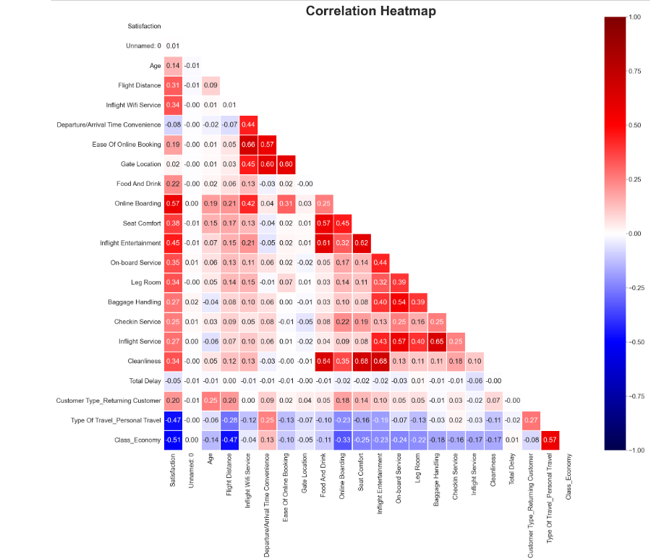
Heatmap

