Slide 1
CMAC
Cryptography and Network Security
By
Dasari Jayanth
2019 BCS 016

Slide 2
What is MAC ?
MAC - Message Authentication Code
A Symmetric key cryptographic technique used to provide message authentication and detect falsification of the original message.(To provide data integrity)
MAC is generated using the key that is shared between both sender and receiver only.
Condenses a variable length message to a fixed size authenticator using secret key.

Slide 3
MAC based on block cipher
Data Authentication Algorithm (DAA)
Cipher based Message Authentication Code (CMAC).
Both DAA and CMAC uses cipher block chaining concepts(CBC).
Block Cipher :
Process of encrypting data in blocks( dividing message into n blocks and encrypting them separately) to produce ciphertext using cryptographic key and algorithm.

Slide 4
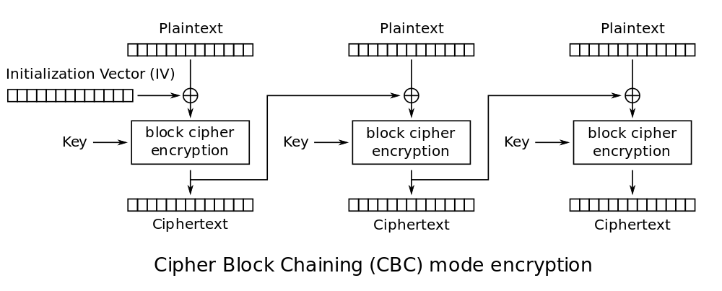
Cipher Block Chaining (CBC)
This method Ensures that there are no data patterns after the encryption is done. Before the plaintext is fed into the encryption algorithm, it is XORed with the ciphertext of the previous block. This ensures that each ciphertext block depends on all the plaintext blocks processed up to that point, and diffusion is achieved.

Slide 5
DAA
The data to be authenticated are grouped into contiguous 64-bit blocks. If necessary, final block is padded with zeros on right to form full 64 bit-block. Using DES encryption algorithm, a secret key(k), a data authentication code(DAC) is calculated.
This method is only secure for fixed length of blocks, since we are only using one key receiver can not figure where the message is ending so any intruder can add extra blocks at end by xoring it.

Slide 6
What is CMAC ?
CMAC- Cipher based message authentication code.
Creates message authentication codes (MACs) using a block cipher and a secret key.
CMAC is a simple variant of the CBC MAC (Cipher Block Chaining Message Authentication Code, also known as DAA).
It is designed to overcome the deficiencies of DAA(Data Authentication Algorithm) by using 3 keys generated from the single encryption key. One original key and two n-bit keys formed from this original k-bit encryption key.

Slide 7
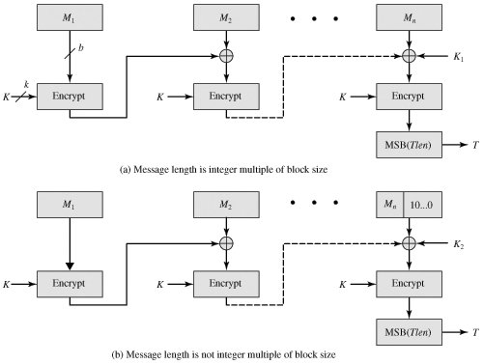
CMAC

Slide 8
CMAC
=> Block ciphers that are used in CMAC can be either AES or triple DES.
=> Given Message is divided into b- bit size blocks M1, M2,...,Mn.
If cipher used is AES then message is divided into 128 bits size blocks and for triple DES cipher it is divided into 64 bit size blocks.
For triple DES, key size k can be of 2 sizes 112 bit or 168 bit and for AES key can be of 128 bit or 192 bit or 256 bit sizes.
=> If the message length is not an integer multiple of block size then we should add the 1 followed by 0’s (padding) on right side of last block till it matches the block size and k2 is used instead of k1 at the final stage.

Slide 9

Sub Keys Generation
where multiplication ( . ) is done in the finite field GF(2n) and x and x2 are first- and second-order polynomials that are elements of GF(2n).
To generate K1 and K2, the block cipher is applied to the block that consists entirely of 0 bits.
The first subkey is derived from the resulting ciphertext by a left shift of one bit and, conditionally, by XORing a constant that depends on the block size.
The second subkey is derived in the same manner from the first subkey.

Slide 10
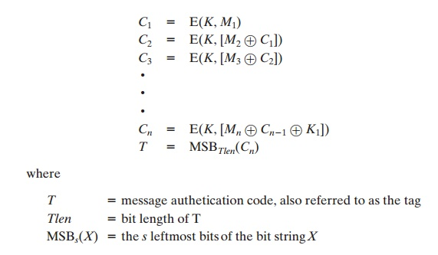
CMAC
Message is divided into b- bit size blocks M1, M2,...,Mn.
k- shared encryption key size; k1 and k2 are b-bit size keys generated from shared key by applying the block cipher to the block that consists entirely of 0 bits.

Slide 11
CMAC
The output of above algorithm is the required MAC.
The key is added to final stage to prevent from appending extra blocks by any intruder, for maintaining data integrity.
Messages can be of variable length.
CMAC provides both integrity and authenticity of the message.
CMAC is slower than HMAC, may work faster if embedded with hardware acceleration required for block ciphers.

Slide 12
Thank you

