Slide 1


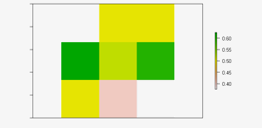
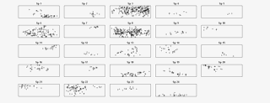
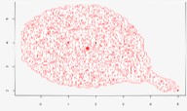
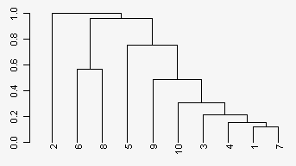
Biodiversity Assessment Tools :: Cheat Sheet
Using BAT
Hypervolume
Raster
Biodiversity Assessment Tools (BAT) assesses biodiversity data and provides analysis tools from species, phylogeny and convex-hulls or kernel density hypervolumes depicting the species relationship.
Building and analyzing the n-dimensional hypervolumes
Observe based on a raster data from diversity samples
Assessments
Convex-Hull hypervolume
Raster
gdm(comm, tree, area, time)
compares common supported models for the GDM
iaor(comm)
compares common support models for the IAOR
sar(comm, tree, area)
Compares some of most supported models for the SAR
sad(comm, …)
compares sites with different total abundances with possible rarefactions
hill(comm, …)
obtains hill numbers with possible rarefaction from multiple sites
Pedro Cardoso
hull.build(comm, trait, …)
builds convex hull hypervolume for each community and trait data
hull.alpha(comm)
functional richness of one or multiple sites
hull.beta(comm, func = “jaccard”)
pairwise decomposition beta diversity hull.contribution(comm)
contribution of each species or individual to the total volume of a convex hull hypervolume
raster.alpha(layers, tree)
maps the alpha diversity using rasters of species distribution
raster.beta(layers, tree, func = “jaccard”, …)
maps beta diversity using rasters of species distribution
#Installation
install.packages(“BAT”)
library(BAT)
Data
Community, comm, sites x species
indices or abundance data about the species
Trait, trait, species x trait
trait values in each species in the community
Tree, tree
hierarchical cluster object based on a trait
Kernel hypervolume
uniqueness(comm, tree, distance, …)
dissimilarity between each species and the closest
dispersion(comm, tree, distance, …)
average dissimilarity between any two species or individuals randomly chosen
originality(comm, tree, distance, …)
average dissimilarity between a species or individual and all others
evenness(comm, tree, distance, …)
regularity of abundance and distances between species
contribution(comm, tree, …)
contribution of each species or individuals to total phylogenic or functional diversity
coverage(comm, tree)
checks completeness of the data set
fill(trait, method = “regression”, …)
estimates the missing trait values NA based on different methods
tree.build(trait, …)
builds a functional tree from trait data
kernel.build(comm, trait, method = “gaussian”, …)
builds kernel density hypervolume based on given trait data
kernel.alpha(comm)
functional richness of one or multiple sites
kernel.beta(comm, func = “jaccard”)
pairwise decomposition beta diversity
kernel.beta.evenness(comm)
simple differences between pair of sites
kernel.evenness(comm, func = “jaccard”)
functional eveness of the community
kernel.evenness.contribution(comm, func = “jaccard”)
contribution of each species or individual to the total volume of a kernel density hypervolume
kernel.dispersion(comm, func = “dissimilarity”)
calculates average distance to centroid or dissimilarities
kernel.originality(comm,…)
dissimilarity between a species or individuals
kernel.similarity(comm)
similarity indices between species and communities
kernel.contribution(comm, func = “jaccard”)
contribution of each species or individual to the total volume of a kernel density hypervolume
kernel.hotspots(comm)
identify hotspots of one or more communities based on minimum volume needed
raster.dispersion(layers, tree, distance, …)
maps averages dissimilarity between any two species or individuals
raster.evenness(layers, tree, distance, …)
maps the phylogenic/functional evenness of species or individuals
Trait
Simulation
Alpha Diversity
Builds and simulates diversity based on artificial communities
alpha(comm, tree, func = “nonparametric”)
observe richness of the of the multiple sites
alpha.accum(comm, tree, func = “nonparametric”)
estimates accumulated alpha diversity of a single site
alpha.estimate(comm, tree, func = “nonparametric”)
estimates accumulated alpha diversity of a single site
optim.alpha(comm, tree, methods, base, …)
optimizes alpha diversity with different methods
optim.alpha.stat(comm, tree, methods, samples, …)
average alpha diversity observed for efficient statistics
Simulate
sim.plot(comm, …)
plots simulated species spatial distributions
Beta Diversity
sim.sad(n, s, sad = “lognormal”, …)
creates artificial communities following given SADs
sim.sample(comm, …)
simulates a sampling process from artificial communities
sim.spatial(n, s, sad = “lognormal”, sd = 1, …)
simulates species spatial distributions
sim.tree(s, m = 100)
simulates a phylogenetic or functional tree
cwd(comm, trait, …)
calculates standard deviation values of each of a series of traits in multiple communities
cwe(comm, trait, func = “camargo”, …)
calculates evenness of each of a series of traits in multiple communities
cwm(comm, trait, …)
averages value of each of a series of traits in multiple communities
aic(comm, trait, …)
calculates AIC of any model
gower(comm, trait, …)
Calculates Gower distances
rao(comm, trait, …)
calculates Rao quadratic entropy
beta(comm, tree, func = “jaccard”)
observe the beta diversity of multiple sites
beta.accum(comm1, comm2, tree, func = “jaccard”)
estimates accumulated beta diversity of a single site
beta.evenesss(comm, tree, distance, func = “camargo”)
checks differences of evenness between pair of sites
beta.multi(comm, tree, func=“jaccard”)
observe with average of all pairwise values
optim.beta(comm, tree, methods, base, …)
optimizes beta diversity with different methods
optim.beta.stat(comm, tree, methods, …)
average absolute difference between sample and real beta diversity
RStudio® is a trademark of RStudio, Inc. • CC BY SA Daseurim Kim • Daseurim.Kim001@umb.edu • 617-337-7417 • Learn more about BAT • package version 2.7.1 • Updated: 2021-10

