Slide 1
IMDB Movie Ratings Analysis
Presented by: Dawit Ashenafi Getachew
Course: CS*2704 – Data Analytics using Python
Instructor: Dr. Jong-Kyou Kim

Slide 2
Introduction
Movies captivate global audiences, but does money really buy critical acclaim?
Hypothesis: Higher budgets lead to higher IMDB ratings.
Additional Questions:
- Which genres earn top scores?
- How have ratings changed over time?

Slide 3
Dataset Overview
Source: Kaggle’s IMDB Movie Dataset
Number of Movies: ~838
Key Data Points:
- Title, Year, Genre, Rating
- Budget (Millions), Revenue (Millions)
- Director, Actors

Slide 4
Data Cleaning & Processing
Steps:
- Removed rows with missing values (Budget, Rating)
- Retained essential columns: Title, Year, Genre, Budget, Rating, Revenue
- Converted Budget/Revenue to numeric format

Slide 5
Exploratory Data Analysis (EDA)
Key Insights:
- Sci-Fi, Drama, and Thriller have the highest ratings
- Comedies and Action films show broader variability
- Older films (pre-2000) tend to have stable high ratings

Slide 6
Genre-Based Ratings
Highest Rated Genres:
- Sci-Fi
- Drama
- Thriller
Bar chart analysis reveals these genres consistently receive strong ratings.

Slide 7
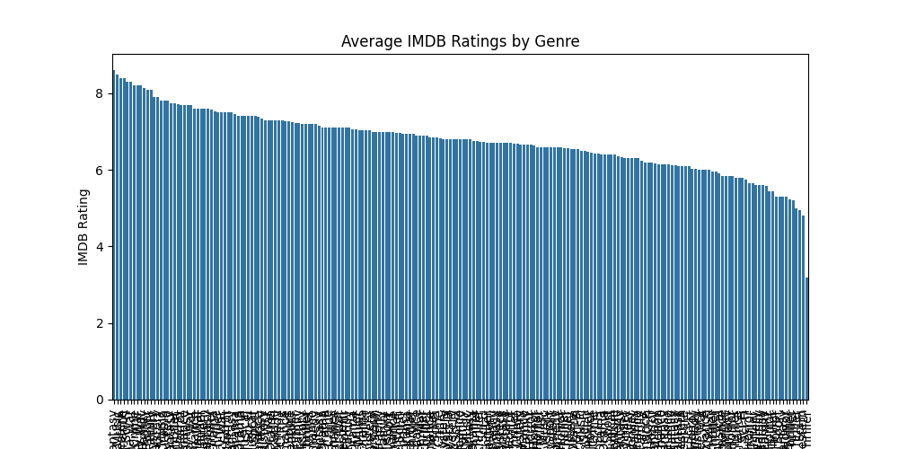

Slide 8
Trends in Ratings Over Time
Findings:
- Pre-2000 films retain strong IMDB scores
- Post-2010 films exhibit broader rating distributions
- Shifting audience preferences and digital streaming expansion likely factors

Slide 9
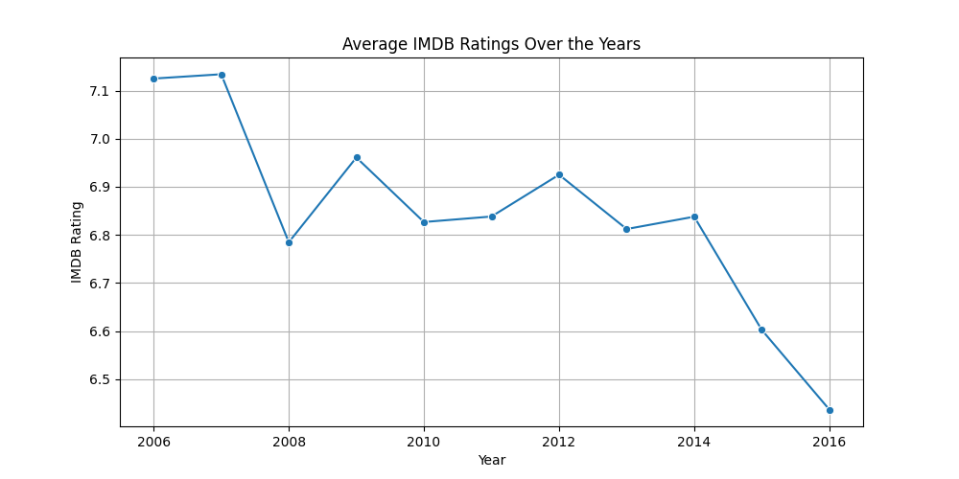

Slide 10
Hypothesis Testing (Budget vs. Ratings)
Statistical Methods Used:
- Correlation Analysis (~0.15, weak but significant)
- Two-Sample T-test (High vs. Low Budget)
Findings:
- High-budget films: ~6.8 avg. rating
- Low-budget films: ~6.5 avg. rating
- P-value < 0.05 (statistically significant, but minor effect)

Slide 11
T-test Interpretation
Since p-value < 0.05, we reject the null hypothesis (budget does impact rating).
However, a ~0.3 rating difference on a 10-point scale is modest.
Other factors (storytelling, acting, marketing) likely play key roles.

Slide 12
Revenue vs. Ratings
Additional Finding:
- Weak relationship between revenue and IMDB ratings
- Some cult classics earned little but rated high
- Some big-budget blockbusters had low viewer scores

Slide 13
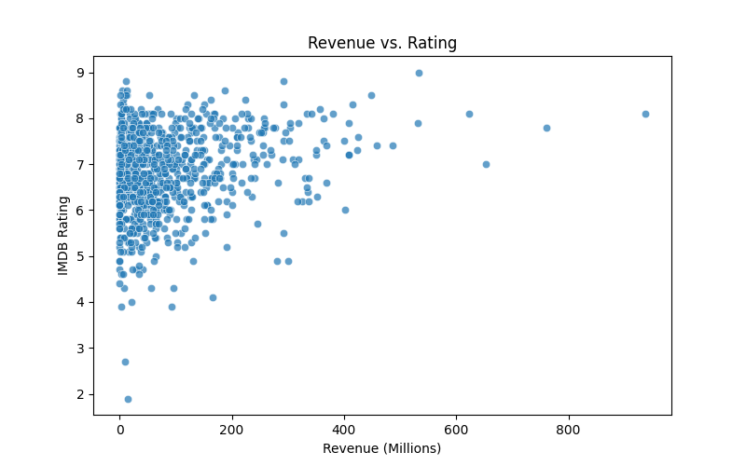

Slide 14
Conclusion & Future Work
Key Takeaways:
- Higher budgets show a slight increase in IMDB ratings, but not significantly
- Sci-Fi, Drama, and Thriller dominate in high ratings
- Older films often hold better long-term ratings
Future Work:
- Regression models incorporating director, cast, and awards
- ANOVA testing for refined budget brackets
- Integrating streaming/award data for deeper insights

Slide 15
Thank You!
Questions?

