Slide 1
RS485

Slide 2
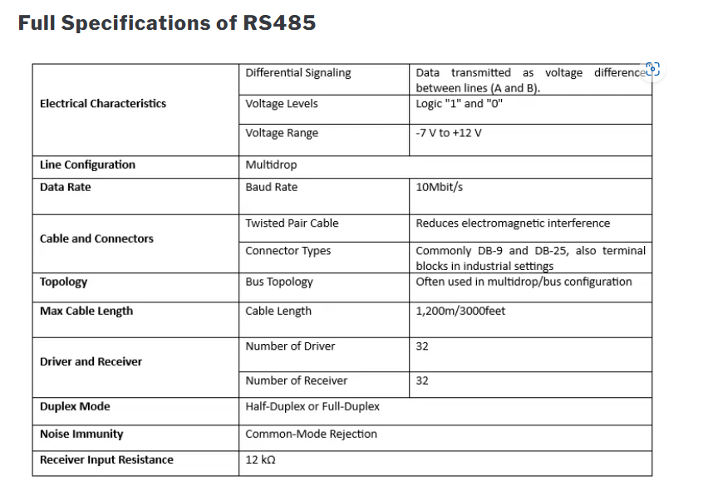

Slide 3
