Slide 1
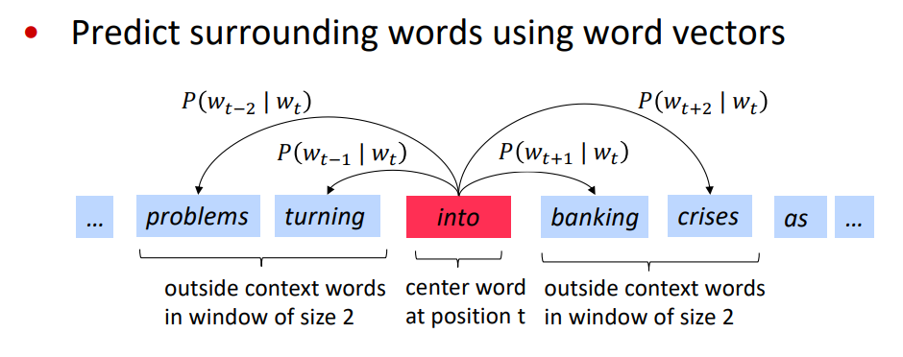
Word2Vec SkipGram model

Slide 2
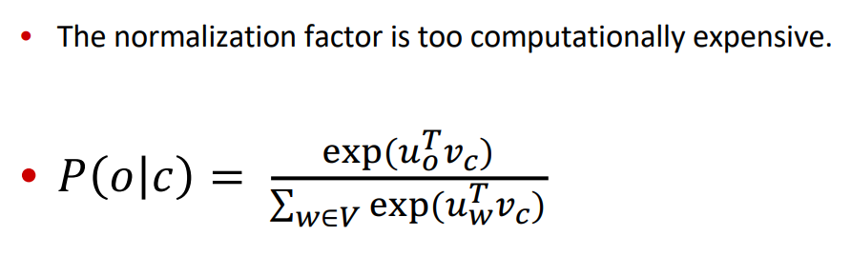
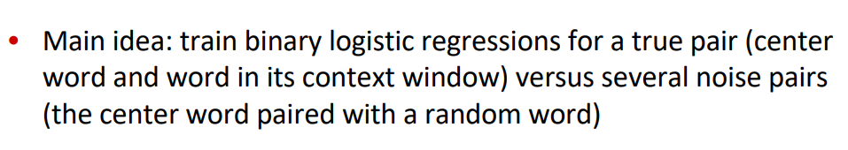
Negative Sampling
From paper: “Distributed Representations of Words and Phrases and their Compositionality” (Mikolov et al. 2013)

Slide 3
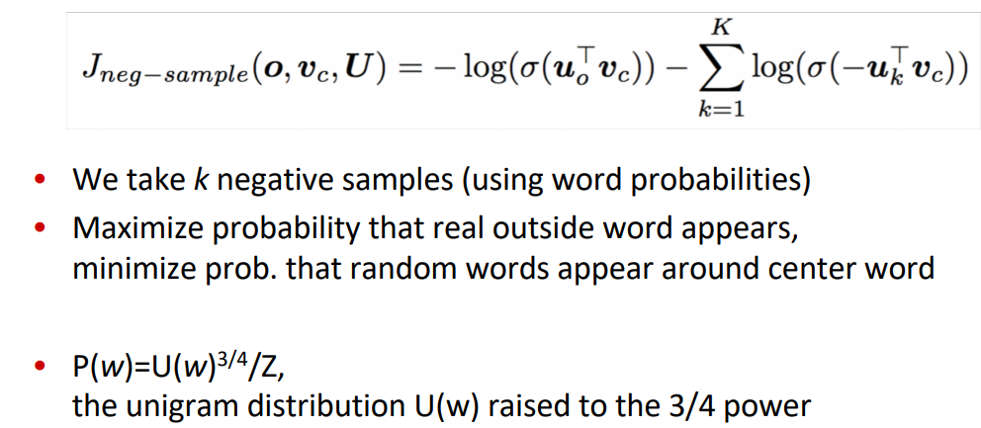

Slide 4
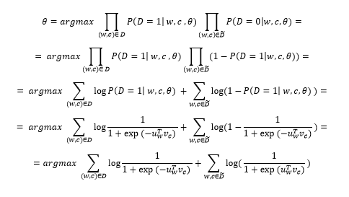
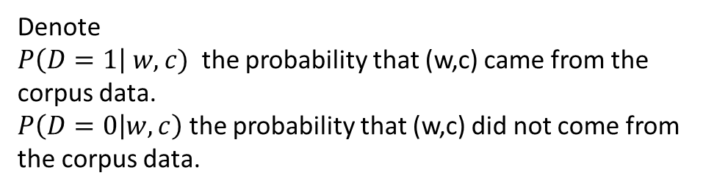
Denote
$P\left(D=1\right| w,c)$ the probability that (w,c) came from the corpus data.
$P\left(D=0 | w,c\right)$ the probability that (w,c) did not come from the corpus data.

Slide 5
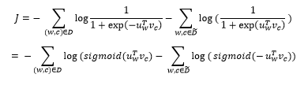
Loss function to minimize:

