Slide 1

Data Exploration of Motor Vehicle Crashes
In Texas 2013

Slide 2
Road accidents are a major issue in our societies all over the world. In 2010, the World Health Organization (WHO) estimated that 1.25 million people died as a result of road traffic injuries. More than 3,500 people were killed in motor vehicle accidents in Texas in 2013. Can data exploration help us understand the causes and factors that influence the severity of car accidents?
In this presentation, we will conduct exploratory data analysis on a dataset of motor vehicle crashes in Texas.

Slide 3
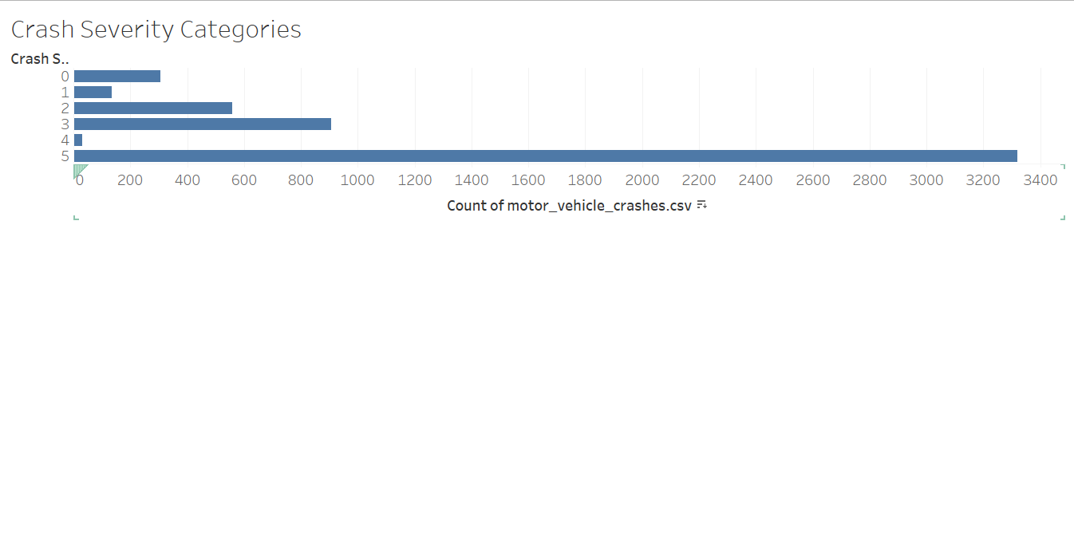
According to Tx Police, the total number of serious injuries in car accidents in Texas is 16,782. According to this graph, most of the crashes result in injuries.

Slide 4
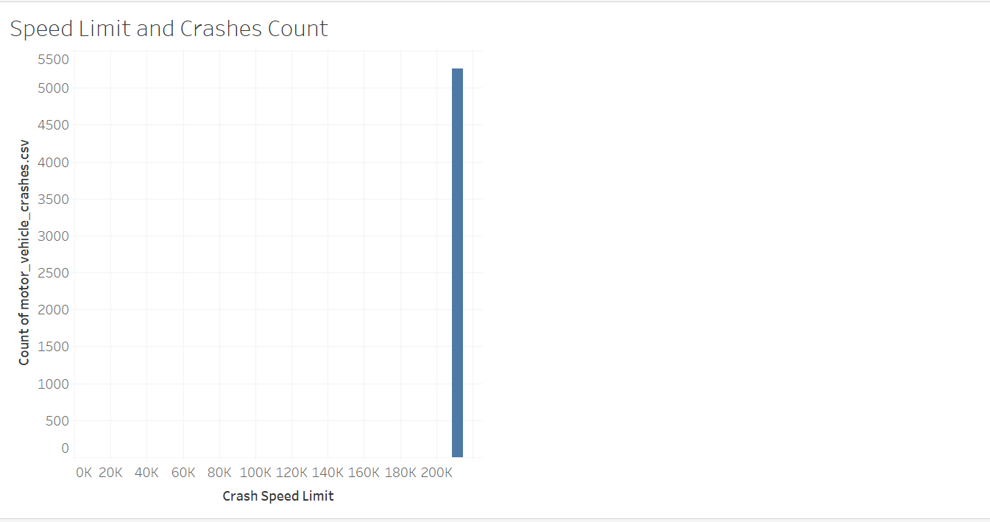
Let us examine the relationship between the speed limit and the total number of crashes. According to this bar chart in Texas, speed is a major cause of vehicle crashes.

Slide 5
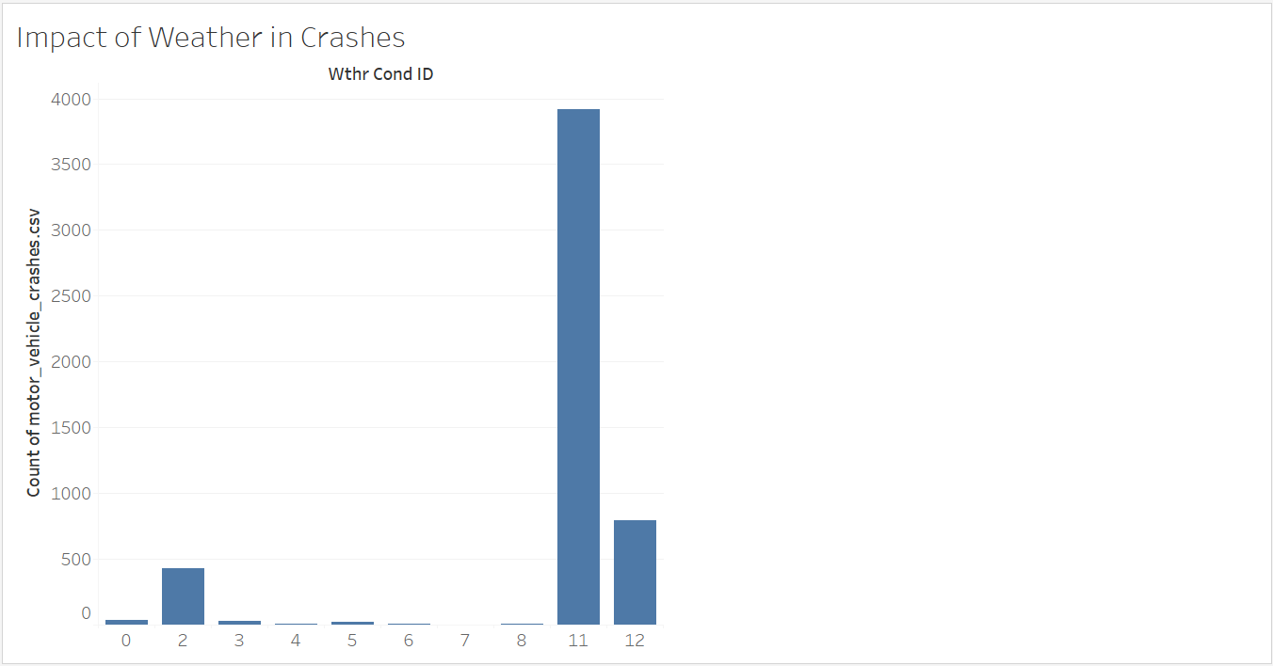
This diagram shows that the weather has an impact in motor crashes as well.

Slide 6
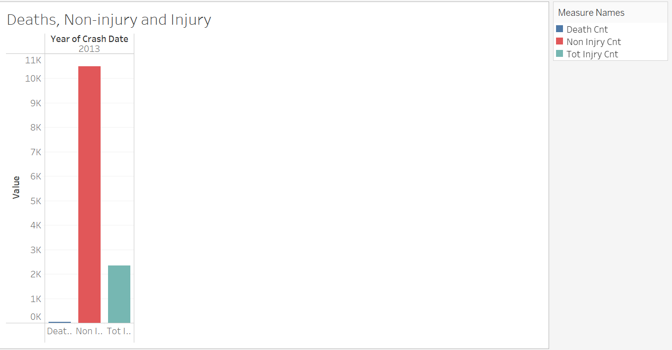
According to this graph, most vehicle crashes result in no injuries than deaths.

