Slide 1
Customer Sentiment & Text Analytics of Indian Banking and Fintech Mobile Applications
A text mining and sentiment analysis project: 12,000 reviews across 6 apps
HDFC Bank · ICICI iMobile · YONO SBI · Paytm · PhonePe · Groww

Slide 2
Objective & Business Questions
Executive summary
How satisfied are users of each app, and how does text sentiment compare with the star ratings they already leave?
Which themes (login, payments, customer support, performance, UI/UX) drive positive vs negative experiences?
Which app needs the most urgent product / operations attention, and what should be prioritised?
12,000
6
user reviews
apps analysed
3 + 3
5
banks + fintechs
pipeline stages
2

Slide 3
Pipeline & Environment Setup
Section 1: libraries and end-to-end workflow
Load & explore
Clean & tokenize
Stem & stopwords
BoW / TF-IDF
Sentiment scoring
Compare & recommend
Preprocessing: NLTK (tokenizers, stopwords, stemmers, WordNet), pyspellchecker
Sentiment: TextBlob, VADER (core); AFINN, SentiWordNet, NRCLex (extra credit)
Features & visuals: scikit-learn, pandas, seaborn, matplotlib, WordCloud
3

Slide 4
Dataset Overview
Section 2: data dictionary and quality checks
(12000, 10)
0
Column | Meaning
app / group | Reviewed app; Bank or Fintech
rating | 1–5 stars given by the user
review | Free-text review
thumbs_up | Helpful votes
date, app_version | When and on which version
company_replied | Whether the company replied
rows × columns
missing review texts
508
2,000
missing app_version
reviews per app
4

Slide 5
Exploratory Data Analysis
Section 2: star ratings by segment and per app
Ratings are bimodal (7,108 one-star vs 2,273 five-star). HDFC (1.41★) and ICICI (1.93★) rate lowest; Groww and PhonePe highest, an early sign fintechs outperform banks.
5

Slide 6
Tokenization
Section 3.1: four tokenizers compared on one sample review
Tokenizer | Behaviour on noisy reviews
word_tokenize (standard) | Splits words and punctuation; keeps "%" and "."
wordpunct_tokenize | Almost identical to the standard tokenizer
Treebank tokenizer | Follows Penn Treebank conventions
Regexp (\w+) alphanumeric | Strictest: only clean word tokens, no punctuation
Decision: alphanumeric tokens for the cleaning pipeline
Goal is a clean vocabulary for frequency and vector-space analysis, not punctuation-level analysis.
6

Slide 7
Cleaning, Stemming & Lemmatization
Section 3.2: three stemmers and a lemmatizer compared
Lowercase, collapse elongated letters (helllooo → hello), strip punctuation and digits.
Porter and Snowball agree; Lancaster is too aggressive (registration → reg).
WordNet lemmas stay readable but are slower.
Snowball stemmer adopted for modelling.
Word | Porter | Snowball | Lancaster | Lemma
running | run | run | run | run
registration | registr | registr | reg | registration
complaints | complaint | complaint | complaint | complaints
fraudulent | fraudul | fraudul | fraud | fraudulent
crashed | crash | crash | crash | crash
verification | verif | verif | ver | verification
7

Slide 8
Stopword Removal & Word Frequency
Section 3.3: 12,000 reviews processed in 4.6 seconds
Top words 1–10 | Count
app | 13,557
time | 2,660
account | 2,326
issue | 2,287
use | 2,283
even | 2,103
please | 2,043
customer | 1,979
bank | 1,952
update | 1,748
Top words 11–20 | Count
login | 1,686
one | 1,564
good | 1,522
worst | 1,507
working | 1,499
dont | 1,486
payment | 1,430
banking | 1,417
open | 1,403
money | 1,397
301,316
total word tokens
13,487
unique vocabulary
"app" dominates; complaint words (issue, worst, login, update) fill the top 20, an early sign of negative skew.
8

Slide 9
Spelling Normalization (with a Caveat)
Section 3.4: automated correction tested on a noisy sample
Original | Corrected
appp | happy (wrong)
verry | very
crashinng | crashing
transction | transition (wrong)
Generic spell-checkers use general English word frequency, with no banking vocabulary.
"transction" becomes "transition": a real but wrong word.
Decision: correction is not applied across the corpus; it would need a custom domain dictionary.
9

Slide 10
Feature Engineering: BoW & TF-IDF
Section 4: turning text into vector-space features
12,000 × 2,410
12,000 × 2,410
Top TF-IDF term | Weight
app | 604.9
use | 291.9
time | 248.9
bank | 244.2
work | 230.7
updat | 217.8
issu | 216.3
Bag-of-Words (min_df=5, max_df=0.9)
TF-IDF (L2 norm, smooth IDF)
Bigram TF-IDF (1–2 words) expands vocabulary to 10,937 terms.
Surfaces phrases such as "credit card", "custom care", "custom support".
Top weighted terms: app, use, time, bank, work, updat, issu, account, payment.
10

Slide 11
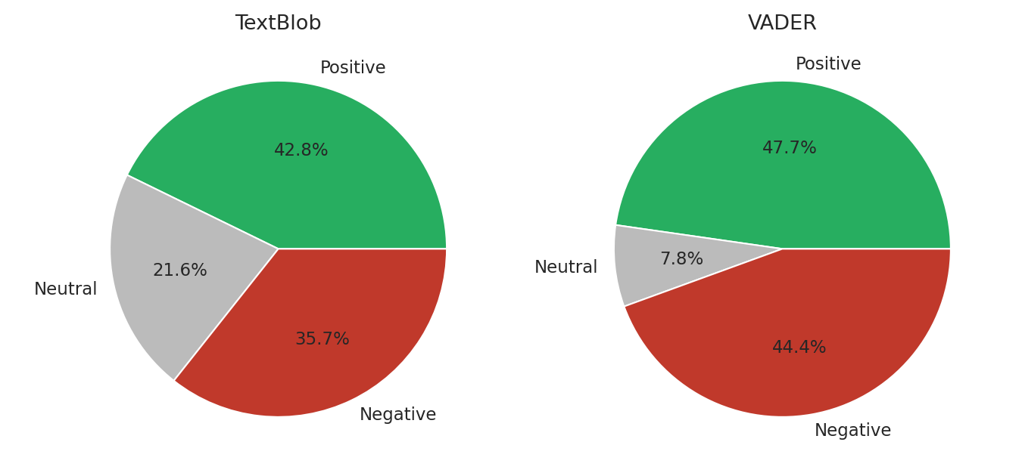
Sentiment Distribution: TextBlob vs VADER
Section 5: polarity scores split into Positive / Neutral / Negative (±0.05)
TextBlob: 42.8% positive, 35.6% negative, 21.6% neutral.
VADER: 47.7% positive, 44.4% negative, only 7.8% neutral.
VADER is more decisive; both show a large negative share.
TextBlob returns polarity and subjectivity; VADER returns a compound score built for short, informal text.
11

Slide 12
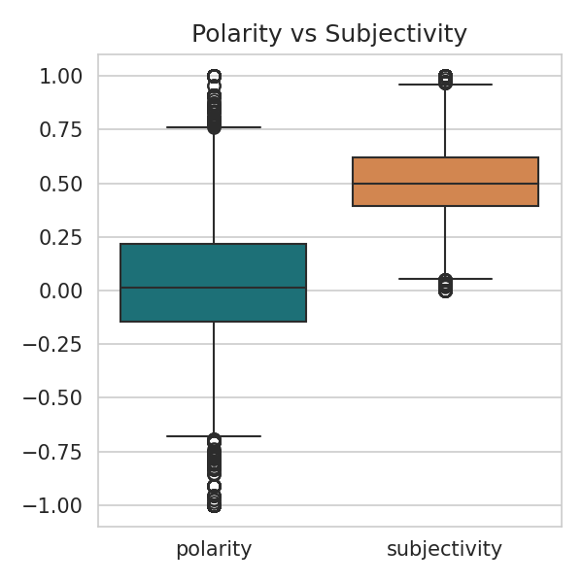
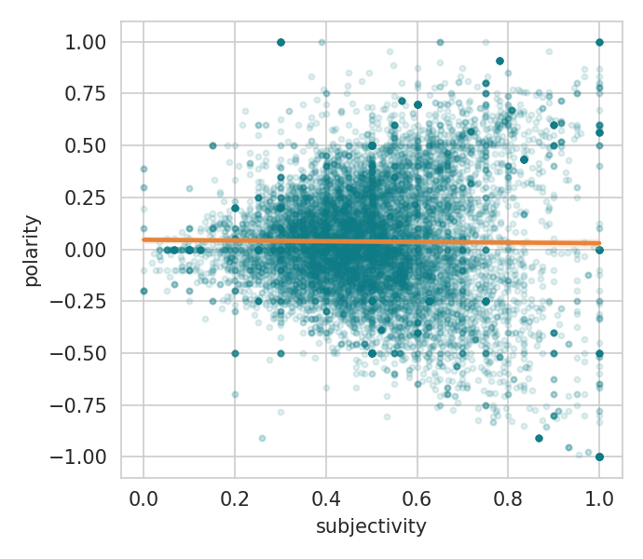
Polarity vs Subjectivity
Section 5: box plot, scatter plot and correlation
-0.01
correlation (polarity, subjectivity)
Effectively zero: how opinionated a review is says nothing about whether it is positive or negative. Factual reviews cluster near neutral polarity.
Based on 11,483 reviews with non-zero scores.
12

Slide 13
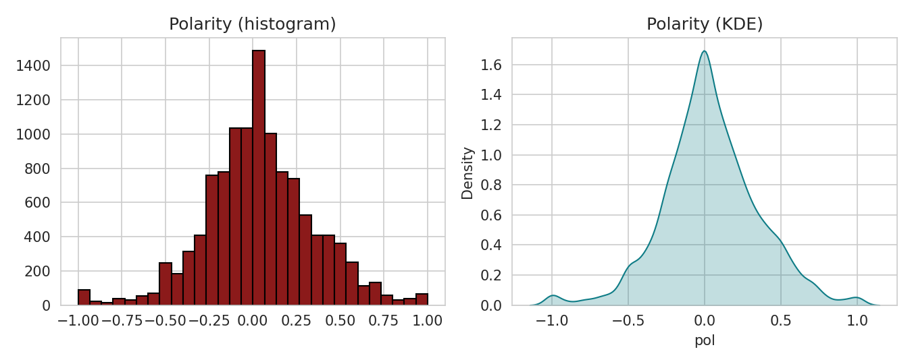
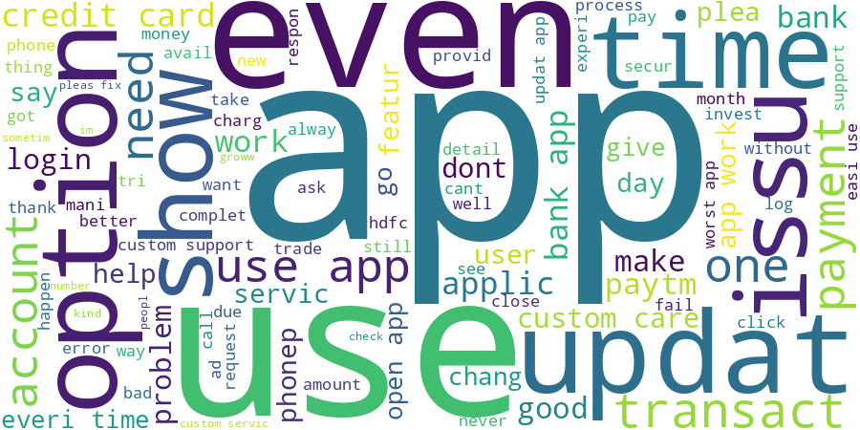
Polarity Distribution & Overall Word Cloud
Section 5: histogram, KDE and word cloud of all reviews
A secondary hump in negative territory: two populations, satisfied and frustrated users.
Word cloud is led by app, bank, account, issue, update, customer, login: functional and support language, not casual commentary.
13

Slide 14
Validation Against Star Ratings
Section 5: how well do the engines match true ratings?
0.57
0.51
Star label \ VADER | Negative | Neutral | Positive | All
Negative | 4,741 | 675 | 2,669 | 8,085
Neutral | 265 | 94 | 478 | 837
Positive | 326 | 171 | 2,581 | 3,078
All | 5,332 | 940 | 5,728 | 12,000
TextBlob r with stars
VADER r with stars
55.5%
61.8%
TextBlob agreement
VADER agreement
VADER wins on this corpus, yet about 40% disagreement remains (e.g. 2,669 low-star reviews scored positive), which motivates the extra-credit analysis.
14

Slide 15
Extended Lexicons & Ensemble Score
EXTRA CREDIT
Section 6.1–6.4: AFINN, SentiWordNet, NRC emotions, ensemble
Averaging four engines gives r = 0.60, above the best single engine (0.57).
NRC emotions: trust and positive lead; banks show more negative and anger language than fintechs.
Complaints read as frustration, not hostility.
15

Slide 16
Aspect-Based Sentiment Mining
EXTRA CREDIT
Section 6.5: sentiment around theme keywords
Customer Support is the most negative aspect (1,290 reviews).
Login and performance are mildly negative.
Payments is mentioned most (3,834 reviews) but near neutral.
UI / UX is the most positive.
16

Slide 17
Comparative Analysis Across Apps
Section 7: star rating vs ensemble sentiment
App | Avg stars | Ensemble | Negative emotion | Trust
Groww | 2.72 | 0.089 | 0.102 | 0.177
PhonePe | 2.70 | 0.096 | 0.144 | 0.187
Paytm | 2.24 | 0.003 | 0.177 | 0.150
YONO SBI | 2.08 | -0.009 | 0.134 | 0.196
ICICI iMobile | 1.93 | -0.033 | 0.143 | 0.170
HDFC Bank | 1.41 | -0.048 | 0.154 | 0.189
Text-only ranking matches star ranking (only top two swap): strong validation.
Top bigrams: use app (834), credit card (795), bank app (753), custom care (620), worst app (440).
Groww and PhonePe lead, Paytm and YONO SBI sit in the middle, ICICI iMobile and HDFC Bank trail.
17

Slide 18
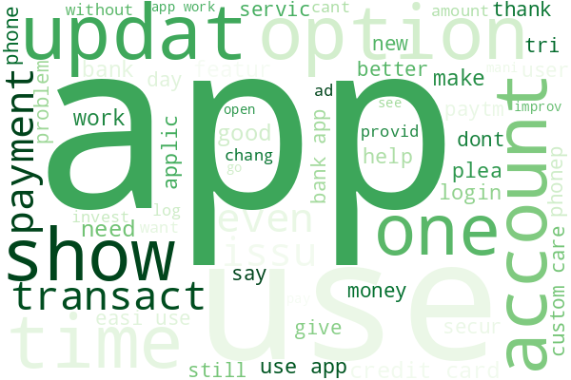
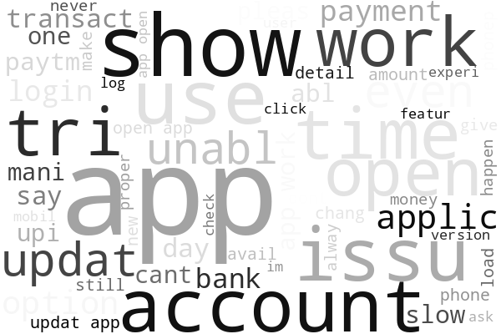
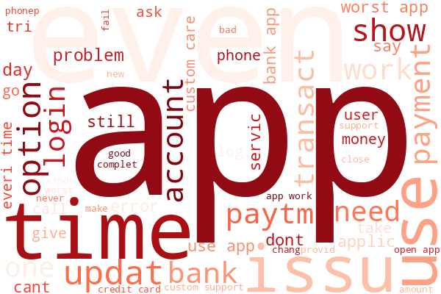
Word Clouds by Sentiment
Section 7: VADER positive vs neutral vs negative reviews
Positive reviews
Neutral reviews
Negative reviews
Positive: generic praise (good, easy, nice, best, love). Negative: specific, actionable complaints (worst, issue, problem, fix, fraud), consistent with the aspect findings.
18

Slide 19
Key Findings & Recommendations
Sections 8–10
Findings
Recommendations
HDFC Bank and ICICI iMobile are weakest on every method.
Customer support and login are the top pain points.
VADER (61.8%) beats TextBlob (55.5%); the ensemble beats both.
Complaints skew to frustration and disappointment.
Audit customer support at HDFC Bank and ICICI iMobile.
Invest in login / OTP / registration reliability.
Promote UI/UX as a strength.
Use the ensemble score and a live aspect dashboard for monitoring.
19

