Slide 1
Employee Data Analysis using Excel
STUDENT NAME:S.DASHVANDINI
REGISTER NO: 312209246
DEPARTMENT: B.COM BANK MANAGEMENT
COLLEGE: ANNA ADARSH COLLEGE FOR WOMEN
ANNA NAGAR, CHENNAI-40

Slide 2
PROJECT TITLE
Employee Performance Analysis using Excel

Slide 3


AGENDA
Problem Statement
Project Overview
End Users
Our Solution and Proposition
Dataset Description
Modelling Approach
Results and Discussion
Conclusion
3/21/2024 Annual Review

Slide 4

PROBLEM STATEMENT
To analyze the employee dataset to gain insights into the workforce. The dataset contains information about 3000 employees including employee id, name , gender, performance rating.
To fine the average performance rating by business unit

Slide 5

PROJECT OVERVIEW
Scope of the project:
1.Analysing the employee dataset using Excel
2.Creating a comprehensive dashboard with charts
3.Identifying the correlation in the data
4.Providing the recommendations based on the insights gained
Resources:
Employee dataset provided in an Excel file
Excel Software

Slide 6

WHO ARE THE END USERS?
HR managers
Department heads
Business leaders
Compensation and benefits Team
Talent management team
Organization Development team

Slide 7

OUR SOLUTION AND ITS VALUE PROPOSITION
1.Identify the top performers: clearly distinguish between high and low performers and recognize the talent early
2. Develop targeted training: pin point skill gaps and create personalized development plans to enhance employee growth.
3.Enhance employee engagement: Provide transparent and regular feedback, fostering a culture of continuous improvement and growth.
4.Inform strategic decisions: Use data driven insights to inform talent management, succession planning and business strategy

Slide 8
Dataset Description
Description: Employee dataset-Kaggle 9features,
This dataset contains information on employee performance rating including demographic, job related, and performance metrics.
Data types: Categorical : Department, job title, gender, performance rating, business unit
Numerical: Employee id, DOB
Text: name

Slide 9

THE "WOW" IN OUR SOLUTION
Opportunity spotlight:
Highlighting high potential employees and recommending development opportunities to accelerate their growth
3/21/2024 Annual Review
9

Slide 10
MODELLING
1.Collecting the data from kaggle.it contains about 3000 data
2.Analysing the employee dataset using Excel, beginning with data filtering
3.Creating a comprehensive dashboard with charts
3.Identifying the correlation in the data
4.Providing the recommendations based on the insights gained
10

Slide 11
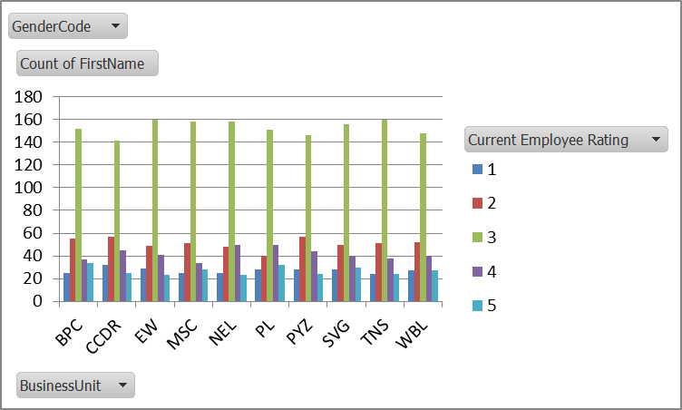
RESULTS
11

Slide 12
conclusion
With using data analytics using excel, we analysed that BPC Business unit has highest employee rating.
Most employees have employee rating of 3.

