Slide 1

Medicine Management Made Easy

Slide 2




Team
Herve Aniglo,
Business Analyst
Kareem DaSilva,
Project Manager
Pamodou Jawneh,
Software Developer

Slide 3
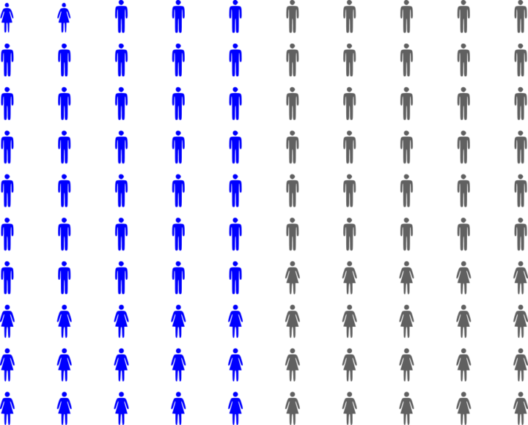
Proper medication
Approximately 50% of patients do not take their medications as prescribed
prescription of complex drug regimens,
communication barriers,
ineffective communication of information about adverse effect
provision of care by multiple physician

Slide 4
As a result
This cost healthcare system nearly $300,000,000,000 a year in additional doctor visits, emergency department visits and hospitalizations
Notes:
costs the healthcare system nearly $300 billion a year in additional doctor visits, emergency department visits and hospitalizations.

Slide 5

Introducing
Pillar is a mobile application that delivers native instructions on how to take prescribed drugs

Slide 6
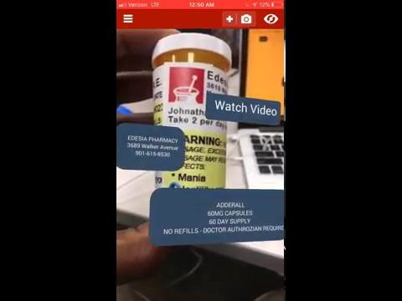
Demo

Slide 7
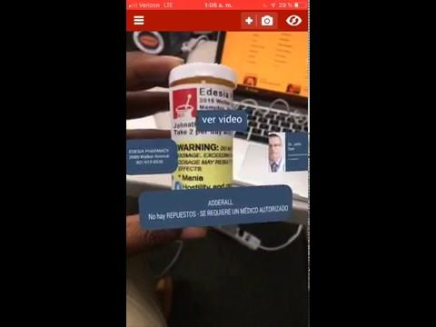
Language Support
English
Spanish
German*
Russian*
Korean*
French*
Arabic*
Vietnamese*
Japanese*
Chinese*
* Not available yet

Slide 8
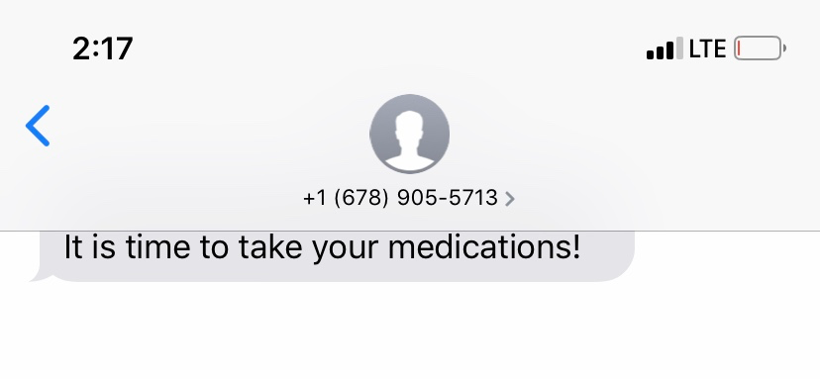
Medicine Reminders w/ Twilio
Get SMS, Calls, and Push Notifications on when to take your medicine

Slide 9



Technology
Image Detection
QR Code
Augmented Reality
ARKit
ARCore
Unity
Vuforia

Slide 10
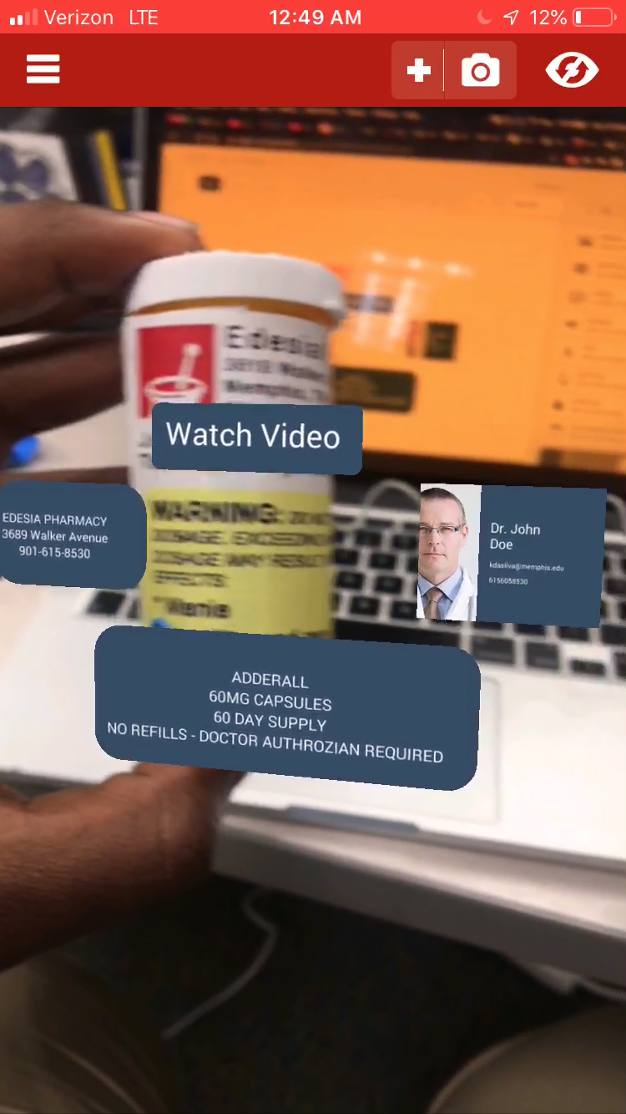
Q & A

