Slide 1
Qyntara AI: Comprehensive Overview
End-to-End Asset Assurance Pipeline
Feature Breakdown & Demo Plan

Slide 2
What Qyntara AI Covers
The tool is designed as an end-to-end Asset Assurance Pipeline for game development (Unreal/Unity).
It covers the entire lifecycle:
1. Validation (Health Check)
2. Auto-Fix (Repair)
3. Baking (Virtual Studio)
4. UVs (Optimization)
5. Export (Game Ready)

Slide 3
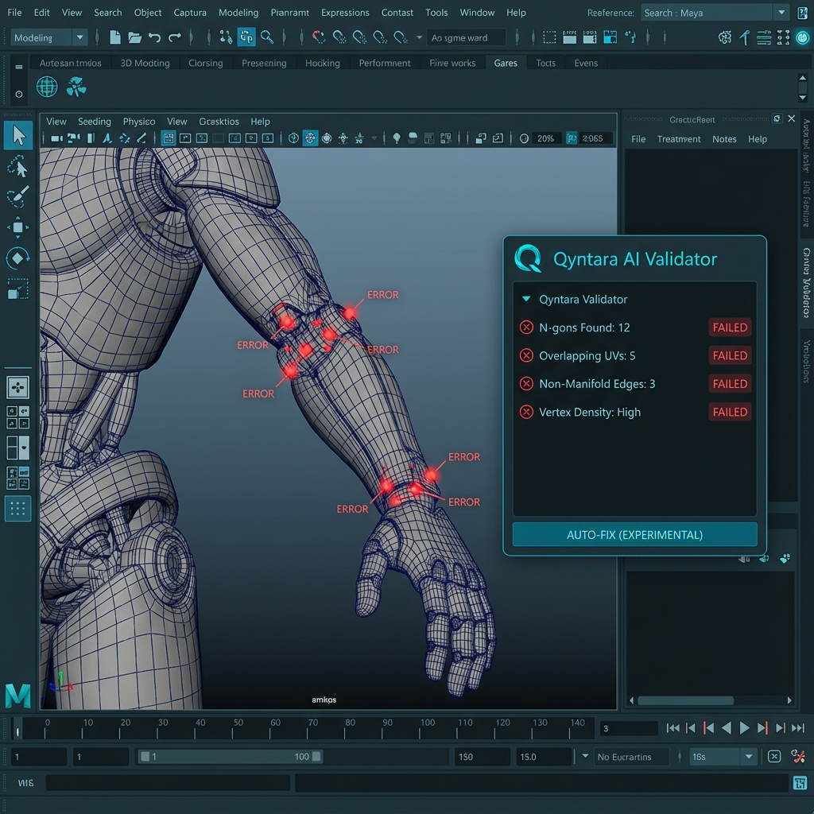
1. Core Validation (The Health Check)
Pipeline Profiles: Auto-switch rules for Game, VR, VFX, Web.
Geometry: Checks N-gons, Open Edges, Non-Manifold.
Transforms: Validates Freeze, Pivot Zero, Scale.
UVs: Detects Overlaps, Bounds issues.
Visualizer: Viewport HUD highlights errors (Red markers).
Reporting: Generates Summary HTML.

Slide 4
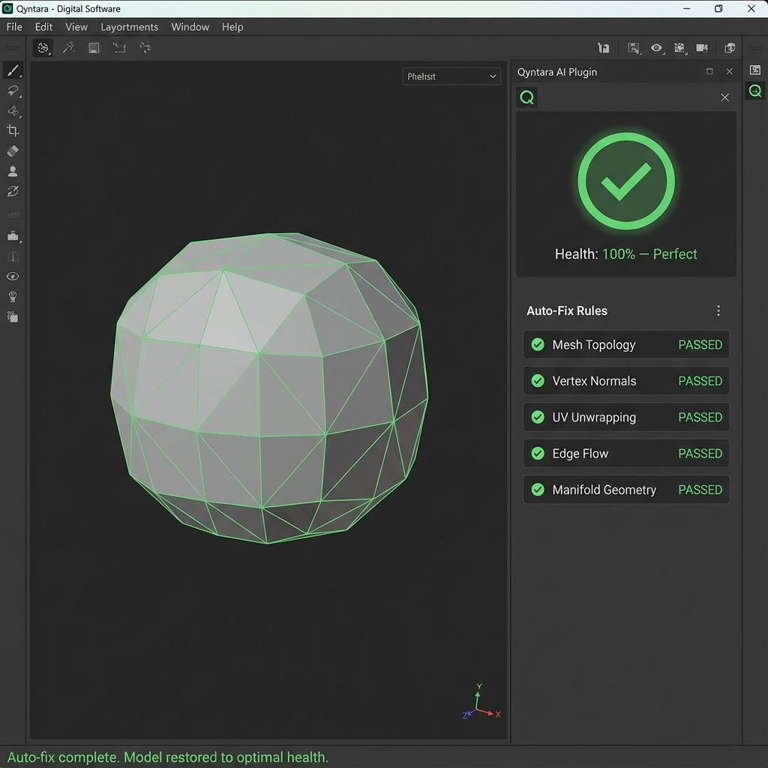
2. Smart Auto-Fix (One-Click)
Automated Cleanup: Deterministic repairs.
Scope: Fixes History, Transforms, Unlocks Normals, Triangulates N-gons.
Safety: Wrapped in Undo Chunks (Non-destructive).
Result: Instantly turns a 'Red' asset to 'Green'.

Slide 5
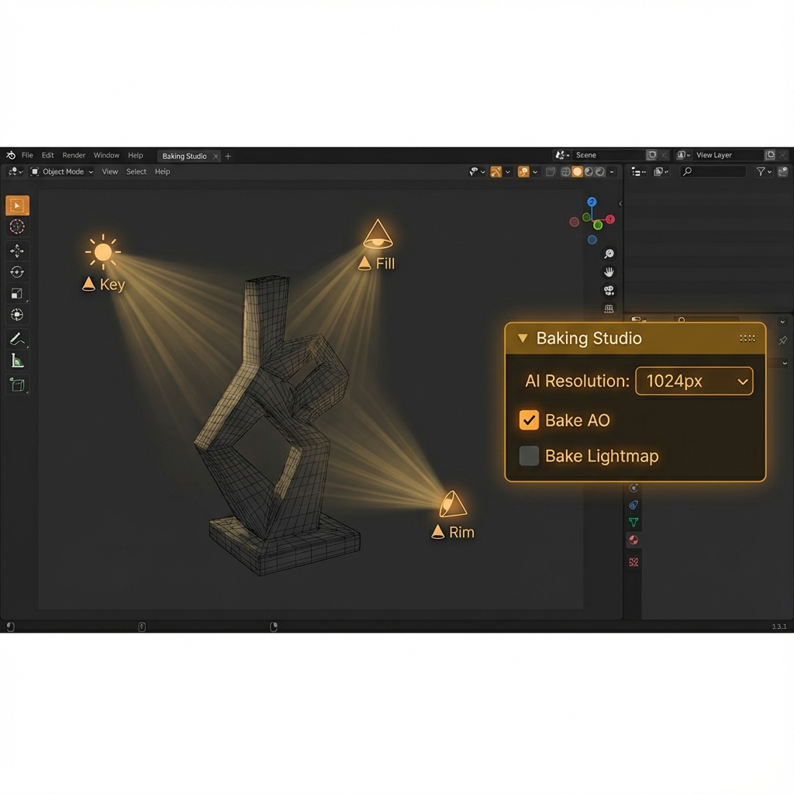
3. Virtual Studio (Baking)
Virtual Rig: Procedural 3-Point Lighting (Key/Fill/Rim).
AI Resolution: Suggests map size based on object scale.
Production Bake: AO & Lightmaps via Arnold (GPU/CPU).
Packing: Heuristic & Tetris algorithms for Lightmap UVs.

Slide 6
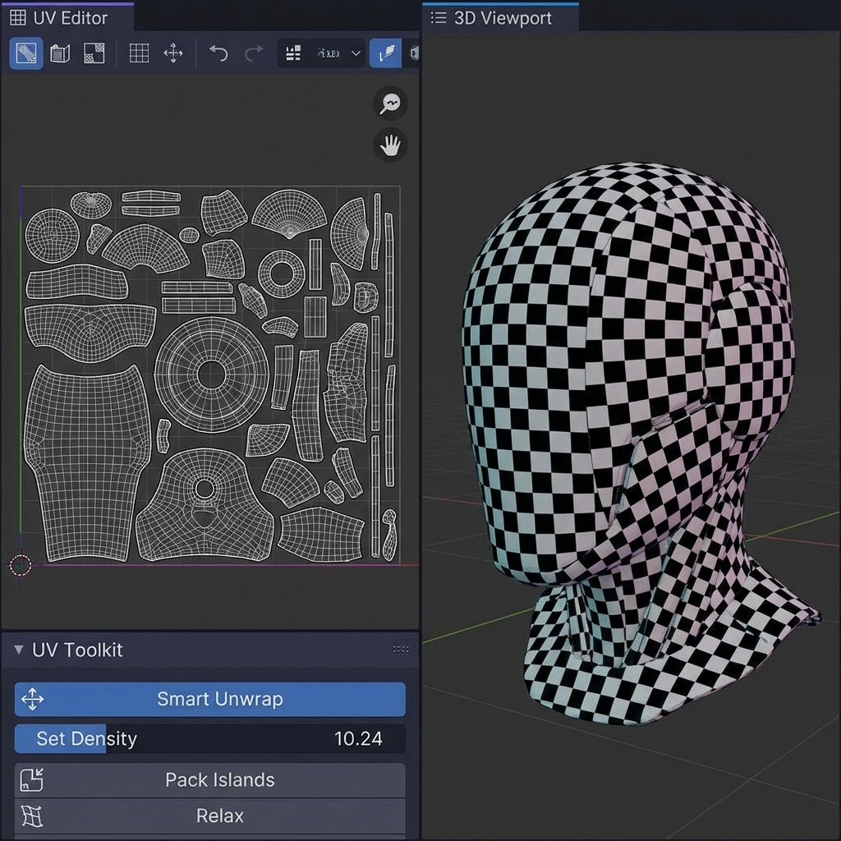
4. UV Toolkit
Texel Density: Standardize to 10.24 px/cm.
Smart Unwrap: AI-assisted unwrap (Angle vs Projection).
Utilities: Quick Checker Map, Reset Materials.
Optimization: Ensures consistent texture quality.

Slide 7

5. Alignment & AI (Experimental)
Smart Snapping: Closes gaps between modular assets.
MeshAnomalyNet: Deep Learning for subjective topology analysis.
Dataset Gen: Procedural training data creation.
Innovation: Goes beyond simple math rules.

Slide 8
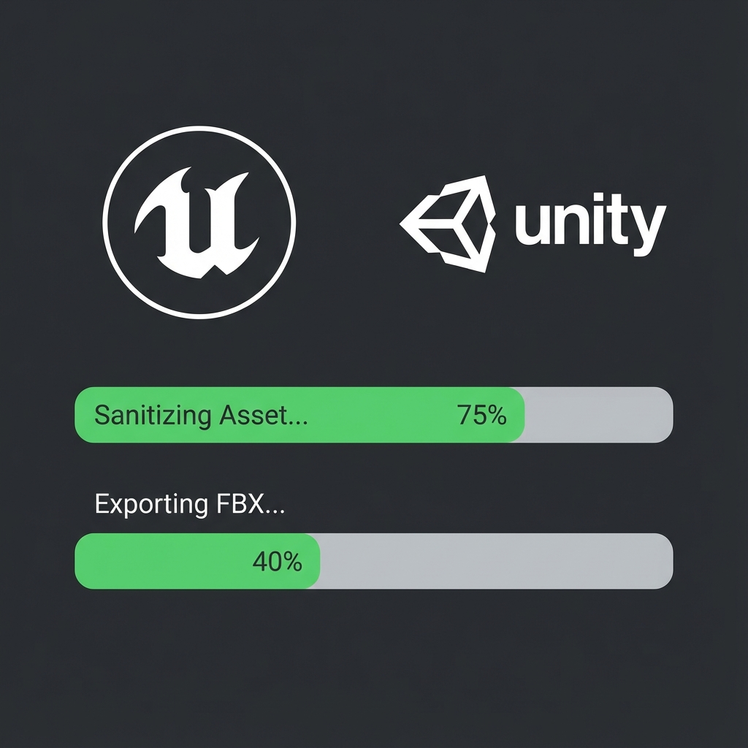
6. Game Export
Engine Presets: Unreal (Z-Up) / Unity (Y-Up).
Safe Export: Auto-Sanitizes before writing file.
Format: Standard FBX compliant with engine importers.
Workflow: 'Green Check' required before export.

Slide 9
Suggested Demo Workflow
Step 1: Import 'Bad' Asset -> Show Low Health Score.
Step 2: Validate -> Highlight Red Errors in Viewport.
Step 3: Auto-Fix -> Watch it turn Green (100%).
Step 4: Baking Tab -> 'Create Studio Rig' + 'AI Resolution'.
Step 5: Export Tab -> 'Unreal Engine' -> Safe Export.

