Slide 1
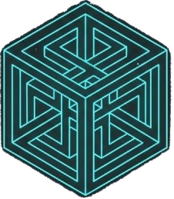
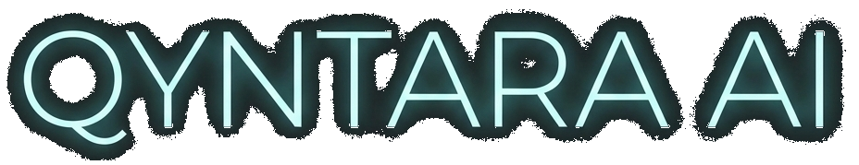
QYNTARA AI
The Future of 3D Asset Assurance

Slide 2
The Challenge: Quality Bottleneck
• Manual validation is slow, subjective, and prone to error.
• Incorrect assets break game builds and delay releases.
• Fixing technical debt late in production costs 10x more.
• Outsource consistency is hard to maintain.

Slide 3
The Solution: Qyntara AI
• Automated Plugin: Runs directly in Autodesk Maya.
• Rule-Based Engine: 40+ deterministic checks (N-gons, UVs).
• AI Analysis: Deep Learning for subjective quality assessment.
• One-Click Auto-Fix: Resolves 80% of topology errors instantly.

Slide 4
Modern Hybrid Architecture
ARTIST
(Maya Client)
QYNTARA CLOUD
(Validator Farm)
Secure HTTPS / API
Hybrid Integration: Instant feedback locally, massive scalability remotely.

Slide 5
Full Technology Stack
• Core: Autodesk Maya 2022-2025, Python 3.9, PySide2/6.
• Backend: FastAPI (Rest API), Redis Queue, Docker.
• Geometry: OpenMaya (C++ Wrapper), NumPy, Trimesh.
• AI Engine: PyTorch (MeshAnomalyNet Point Cloud Model).

Slide 6
Return on Investment (ROI)
• Speed: Validation time from 2 hours -> 5 seconds.
• Confidence: 100% technical compliance guaranteed.
• Scalability: Cloud backend handles unlimited bulk processing.
• Workflow: Artists stay compatible with Unity/Unreal automatically.

Slide 7
Future Roadmap
• Q3 2025: Multi-DCC Support (Blender, 3ds Max).
• Q4 2025: CI/CD Pipeline Integration.
• Q2 2026: Generative Geometry Repair (Auto-Retopology).

